Slide 1

Things to Come!
Daniel 2:29
This presentation uses Airstrike Condensed font:
https://www.dafont.com/airstrike.font
Notes:
Backround image = FREE = Image by <a href="https://pixabay.com/users/geralt-9301/?utm_source=link-attribution&amp;utm_medium=referral&amp;utm_campaign=image&amp;utm_content=2709662">Gerd Altmann</a> from <a href="https://pixabay.com/?utm_source=link-attribution&amp;utm_medium=referral&amp;utm_campaign=image&amp;utm_content=2709662">Pixabay</a>
Copyright © 2006−2021. All rights reserved. Bible Point is a registered trademark of Dennis Henderson. All other trademarks acknowledged.
Bible Point contains graphics from Bible Point artists. These illustrations belong to Bible Point and the respective artists. You may use the designs and illustrations for graphical illustration of lessons free and without special permission, provided they are not used in any way that maligns the Christian faith. Furthermore, republication or production of any illustration by any other graphic service whether it be in book, in a machine-readable form, or in any other design resource is strictly prohibited. Furthermore, they cannot be duplicated or resold as any other form of publishing, clip art, or graphic resource.
So What does it mean? (A simple translations of the legal jargon)
So, if you don’t own the presentation(s), graphic(s), and text(s) how can you legally use them? The purchase of the license allows you to use all the images in the product. However, the actual ownership and copyright of the presentation(s), graphic(s), and text(s) remain the property of Bible Point and its licensors. If you had plans on using this product in your “for sale” work—think again!
License Agreement
Article 1: License Grant
All the graphics and text in Bible Point presentations (excluding quotes from the Bible and stated sources) are the intellectual and real property of Bible Point and its licensors, and is protected by law, including United States copyright laws and international treaties. Bible Point grants to you a license:
1. To use the presentation in a single church, single school, or single office of a Christian organization.
2. To make a single archival back-up copy of the program.
3. To modify the presentation(s) and merge with other presentations in a single church, school, or Christian organization.
4. To transfer to another party if that party agrees to accept the terms and conditions of this agreement, and you do not retain any copies of the presentation, whether printed, machine readable, modified, or merged form.
Article 2: Terms
This license is effective until terminated. You may terminate the license at any time by destroying the presentation(s), graphic(s), or text(s) together with all copies, modifications and merged portions in any form. Bible Point may terminate your license if you fail to comply with this Agreement. You agree, upon such termination, for any reason, to destroy the presentation(s), graphics, and text(s) with all copies, modifications, and merged portions in any form.
Article 3: Disclaimers
1. Bible Point presentations, graphics, and texts are licensed to you As Is. You, the consumer, bear the entire risk relating to the quality and performance of the presentation(s), graphic(s), or text(s). In no event will Bible Point be liable for damages resulting from any defect.
2. Thirty-day limited warrantee on disks. Bible Point warrants the disks to be free of defects in material and workmanship under normal use for 30 days after purchase. During the 30-day period you may return a defective presentation, graphic, or text with proof of purchase and it will be replaced without charge, unless the presentation is damaged by misuse.
Article 4: General
1. You may not sub-license, assign, or transfer the license of the presentation(s), graphic(s), or text(s) except as provided by this Agreement.
2. This Agreement will be governed by the laws of the State of Michigan.
So What does it mean? (A simple translations of the legal jargon)
May I let someone borrow or copy my licensed Bible Point presentation (even after I modified it)? As long as it is within your local church, or single school, or the immediate office of a Christian organization you may. Otherwise, please refer the person interested in borrowing to: http://www.biblepoint.com or E-mail: dennis@DrDH.net with any related questions.

Slide 2
Things to Come!
Daniel 2:29
Notes:
Backround image = FREE = Image by <a href="https://pixabay.com/users/geralt-9301/?utm_source=link-attribution&amp;utm_medium=referral&amp;utm_campaign=image&amp;utm_content=2709662">Gerd Altmann</a> from <a href="https://pixabay.com/?utm_source=link-attribution&amp;utm_medium=referral&amp;utm_campaign=image&amp;utm_content=2709662">Pixabay</a>
Copyright © 2006−2021. All rights reserved. Bible Point is a registered trademark of Dennis Henderson. All other trademarks acknowledged.
Bible Point contains graphics from Bible Point artists. These illustrations belong to Bible Point and the respective artists. You may use the designs and illustrations for graphical illustration of lessons free and without special permission, provided they are not used in any way that maligns the Christian faith. Furthermore, republication or production of any illustration by any other graphic service whether it be in book, in a machine-readable form, or in any other design resource is strictly prohibited. Furthermore, they cannot be duplicated or resold as any other form of publishing, clip art, or graphic resource.
So What does it mean? (A simple translations of the legal jargon)
So, if you don’t own the presentation(s), graphic(s), and text(s) how can you legally use them? The purchase of the license allows you to use all the images in the product. However, the actual ownership and copyright of the presentation(s), graphic(s), and text(s) remain the property of Bible Point and its licensors. If you had plans on using this product in your “for sale” work—think again!
License Agreement
Article 1: License Grant
All the graphics and text in Bible Point presentations (excluding quotes from the Bible and stated sources) are the intellectual and real property of Bible Point and its licensors, and is protected by law, including United States copyright laws and international treaties. Bible Point grants to you a license:
1. To use the presentation in a single church, single school, or single office of a Christian organization.
2. To make a single archival back-up copy of the program.
3. To modify the presentation(s) and merge with other presentations in a single church, school, or Christian organization.
4. To transfer to another party if that party agrees to accept the terms and conditions of this agreement, and you do not retain any copies of the presentation, whether printed, machine readable, modified, or merged form.
Article 2: Terms
This license is effective until terminated. You may terminate the license at any time by destroying the presentation(s), graphic(s), or text(s) together with all copies, modifications and merged portions in any form. Bible Point may terminate your license if you fail to comply with this Agreement. You agree, upon such termination, for any reason, to destroy the presentation(s), graphics, and text(s) with all copies, modifications, and merged portions in any form.
Article 3: Disclaimers
1. Bible Point presentations, graphics, and texts are licensed to you As Is. You, the consumer, bear the entire risk relating to the quality and performance of the presentation(s), graphic(s), or text(s). In no event will Bible Point be liable for damages resulting from any defect.
2. Thirty-day limited warrantee on disks. Bible Point warrants the disks to be free of defects in material and workmanship under normal use for 30 days after purchase. During the 30-day period you may return a defective presentation, graphic, or text with proof of purchase and it will be replaced without charge, unless the presentation is damaged by misuse.
Article 4: General
1. You may not sub-license, assign, or transfer the license of the presentation(s), graphic(s), or text(s) except as provided by this Agreement.
2. This Agreement will be governed by the laws of the State of Michigan.
So What does it mean? (A simple translations of the legal jargon)
May I let someone borrow or copy my licensed Bible Point presentation (even after I modified it)? As long as it is within your local church, or single school, or the immediate office of a Christian organization you may. Otherwise, please refer the person interested in borrowing to: http://www.biblepoint.com or E-mail: dennis@DrDH.net with any related questions.

Slide 3
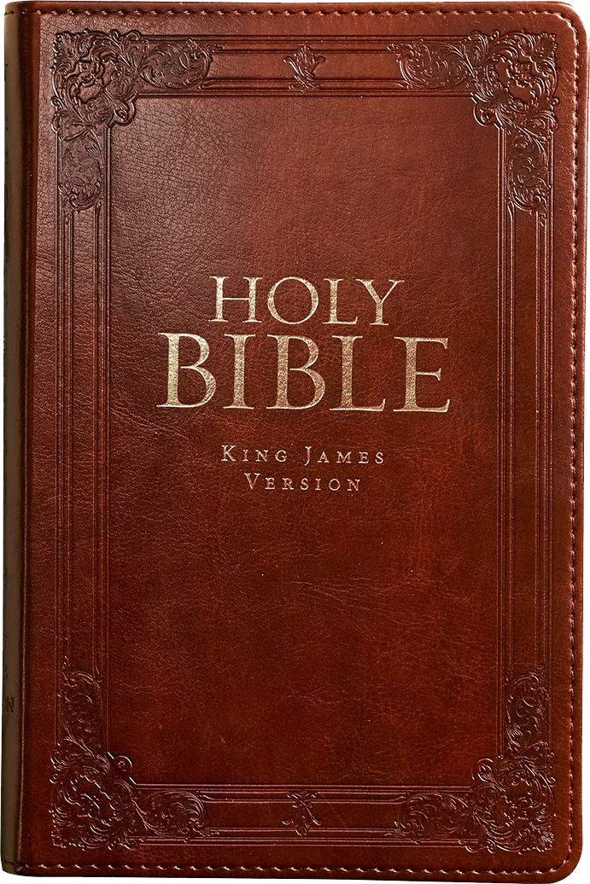


Predictive prophecy
50%
25%

Slide 4
The End of the Tribulation

Slide 5
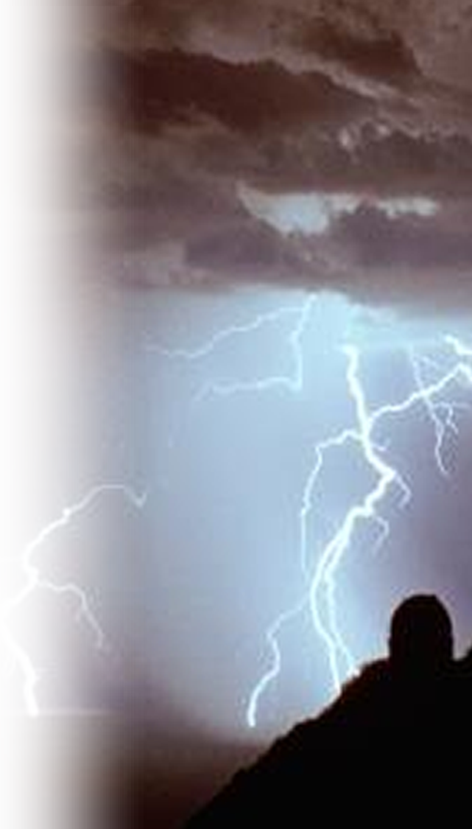

Review of the Tribulation
^{Mat 24:27} For as lightning that comes from the east is visible even in the west, so will be the coming of the Son of Man.
Deception
War
Famine
Martyrdom
Apostasy
Cold-Hearted
Awakening
Abomination
Urgent Flight
Dreadfulness
Severity
Imposters
Antichrist
2nd Coming
MATTHEW 24: 1-14
MATTHEW 24: 15-28

Slide 6
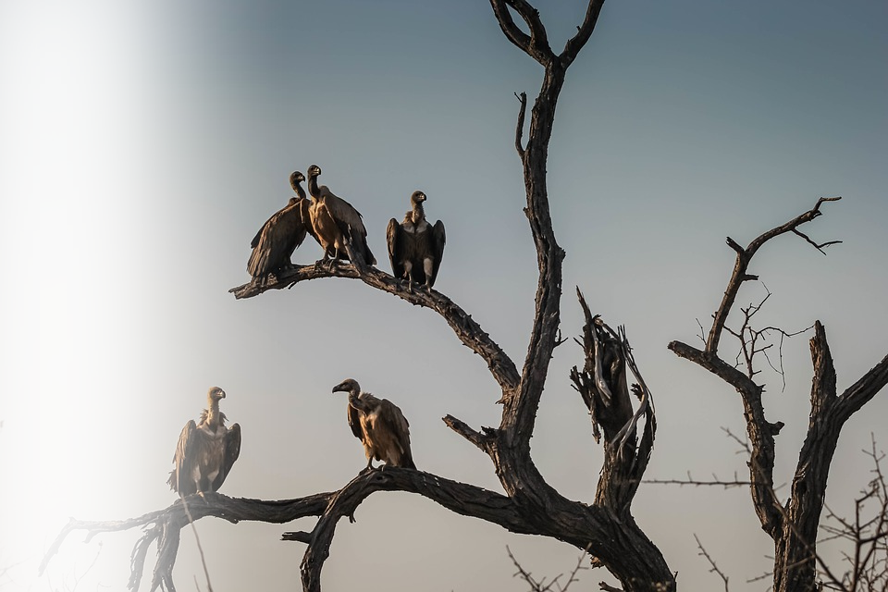
Heads up: War is coming!
²⁸ Wherever there is a carcass, there the vultures will gather.
Deception
War
Famine
Martyrdom
Apostasy
Cold-Hearted
Awakening
Abomination
Urgent Flight
Dreadfulness
Severity
Imposters
Antichrist
2nd Coming
MATTHEW 24: 1-14
MATTHEW 24: 15-28
Notes:
https://www.maxpixel.net/static/photo/1x/Vultures-Outdoors-Sunset-Highway-Watching-Wildlife-1081751.jpg

Slide 7
Immediately After Tribulation
tribulation
²⁹ "Immediately after the distress of those days" 'the sun will be darkened, and the moon will not give its light; the stars will fall from the sky, and
the heavenly bodies will be shaken.’
Deception
War
Famine
Martyrdom
Apostasy
Cold-Hearted
Awakening
Abomination
Urgent Flight
Dreadfulness
Severity
Imposters
Antichrist
2nd Coming

Slide 8
Immediately After Tribulation
tribulation
²⁹ "Immediately after the distress of those days" 'the sun will be darkened, and the moon will not give its light; the stars will fall from the sky, and
the heavenly bodies will be shaken.’
Deception
War
Famine
Martyrdom
Apostasy
Cold-Hearted
Awakening
Abomination
Urgent Flight
Dreadfulness
Severity
Imposters
Antichrist
2nd Coming

Slide 9
1. Cosmic Disturbances
tribulation
²⁹ "Immediately after the distress of those days" 'the sun will be darkened, and the moon will not give its light; the stars will fall from the sky, and
the heavenly bodies will be shaken.’
Deception
War
Famine
Martyrdom
Apostasy
Cold-Hearted
Awakening
Abomination
Urgent Flight
Dreadfulness
Severity
Imposters
Antichrist
2nd Coming

Slide 10
1. Cosmic Disturbances
tribulation
²⁹ "Immediately after the distress of those days" 'the sun will be darkened, and the moon will not give its light; the stars will fall from the sky, and
the heavenly bodies will be shaken.’
Deception
War
Famine
Martyrdom
Apostasy
Cold-Hearted
Awakening
Abomination
Urgent Flight
Dreadfulness
Severity
Imposters
Antichrist
2nd Coming

Slide 11
1. Cosmic Disturbances
tribulation
²⁹ "Immediately after the distress of those days" 'the sun will be darkened, and the moon will not give its light; the stars will fall from the sky, and
the heavenly bodies will be shaken.’
Deception
War
Famine
Martyrdom
Apostasy
Cold-Hearted
Awakening
Abomination
Urgent Flight
Dreadfulness
Severity
Imposters
Antichrist
2nd Coming

Slide 12
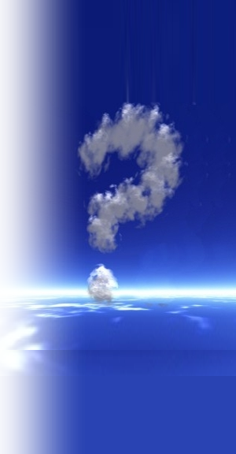
1. Cosmic Disturbances
tribulation
²⁹ "Immediately after the distress of those days"
... ³⁰ "At that time the sign of the Son of Man
will appear in the sky, and all the nations
of the earth will mourn.
Deception
War
Famine
Martyrdom
Apostasy
Cold-Hearted
Awakening
Abomination
Urgent Flight
Dreadfulness
Severity
Imposters
Antichrist
2nd Coming

Slide 13
1. Cosmic Disturbances
tribulation
²⁹ "Immediately after the distress of those days"
... ³⁰ "At that time the sign of the Son of Man
will appear in the sky, and all the nations
of the earth will mourn.
Deception
War
Famine
Martyrdom
Apostasy
Cold-Hearted
Awakening
Abomination
Urgent Flight
Dreadfulness
Severity
Imposters
Antichrist
2nd Coming
WHY?

Slide 14
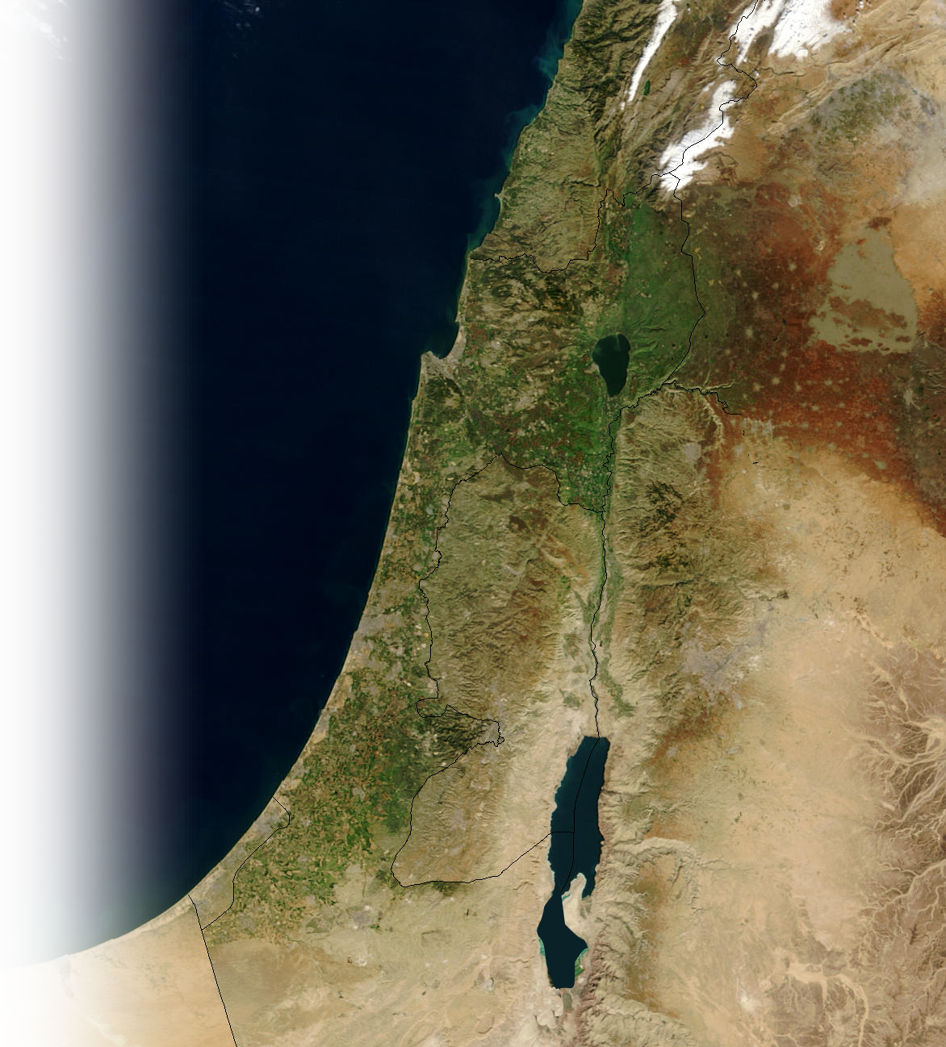
2. Battle of Armageddon
Rev 16:16 Then they gathered the kings together to the place that in Hebrew is called Armageddon.
City
MEGIDDO
Plain
Har-Megiddo
Mount-Place of Troops
JERUSALEM
Notes:
The Plain of Megiddo (before the Mount where the city is) is where the armies will stage for the final assault on Jerusalem.

Slide 15
2. Battle of Armageddon
Zechariah 14:2 I will gather all the nations to Jerusalem to fight against it; the city will be captured, the houses ransacked, and the women raped. Half of the city will go into exile, but the rest of the people will not be taken from the city.
City
MEGIDDO
Plain
JERUSALEM

Slide 16
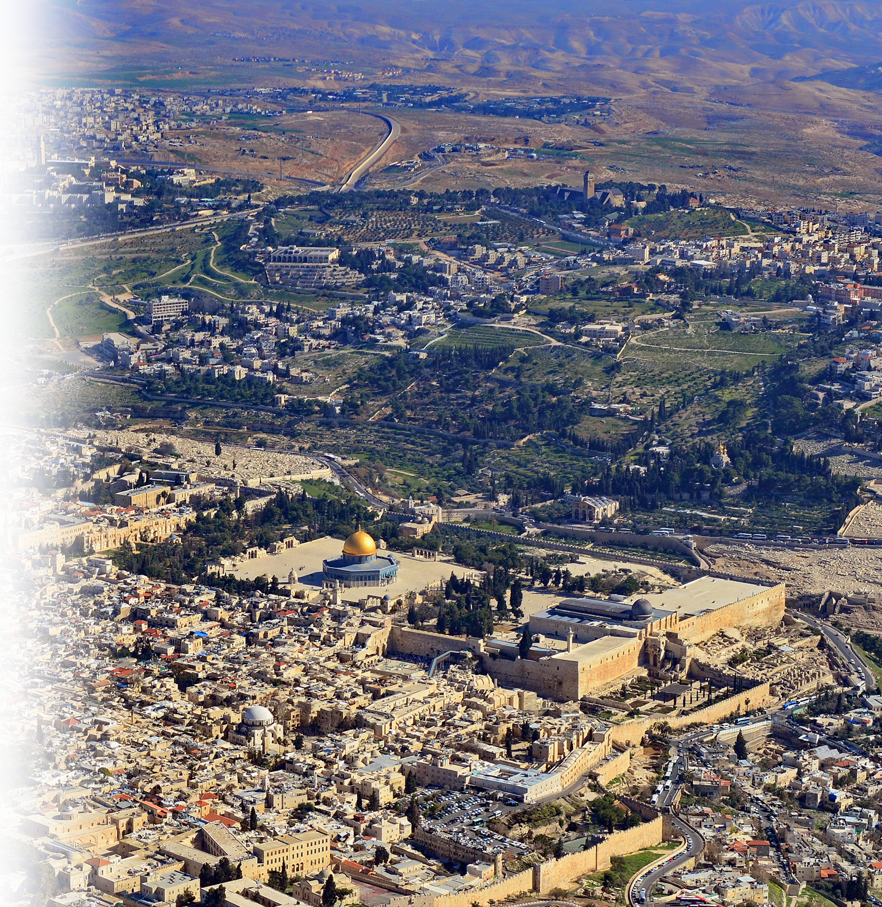
3. Christ’s Return
³ Then the LORD will go out and fight against those nations, as he fights in the day of battle. ⁴ On that day his feet will stand on the Mount of Olives, east of Jeru-salem, and the Mount of Olives will be split in two from east to west, forming a great valley, with half of the mountain moving north and half moving south.
Notes:
https://upload.wikimedia.org/wikipedia/commons/4/43/THE_OLD_CITY_JERUSALEM.JPG

Slide 17
3. Christ’s Return
⁵ You will flee by my mountain valley, for it will extend to Azel. You will flee as you fled from the earthquake in the days of Uzziah king of Judah. Then the LORD my God will come, and all the holy ones with him.

Slide 18
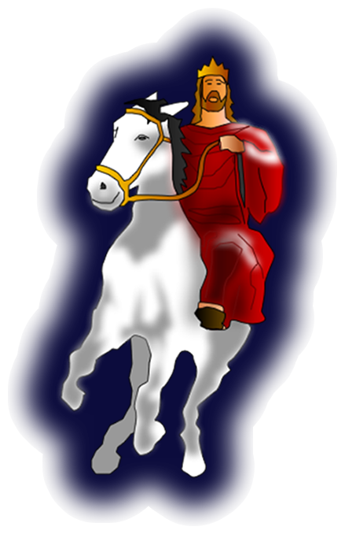

3. Christ’s Return
Rev. 19:11 I saw heaven standing open and there before me was a white horse, whose rider is called Faithful and True. With justice he judges and makes war. ¹² His eyes are like blazing fire, and on his head are many crowns. He has a name written on him that no one knows but he himself. ¹³ He is dressed in a robe dipped in blood, and his name is the Word of God.

Slide 19
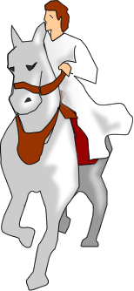
3. Christ’s Return
¹⁴ The armies of heaven were following him, riding on white horses and dressed in fine linen, white and clean. ¹⁵ Out of his mouth comes a sharp sword with which to strike down the nations. "He will rule them with an iron scepter." He treads the winepress of the fury of the wrath of God Almighty.

Slide 20
3. Christ’s Return
¹⁶ On his robe and on his thigh he has this name written:
KING OF KINGS AND
LORD OF LORDS.

Slide 21
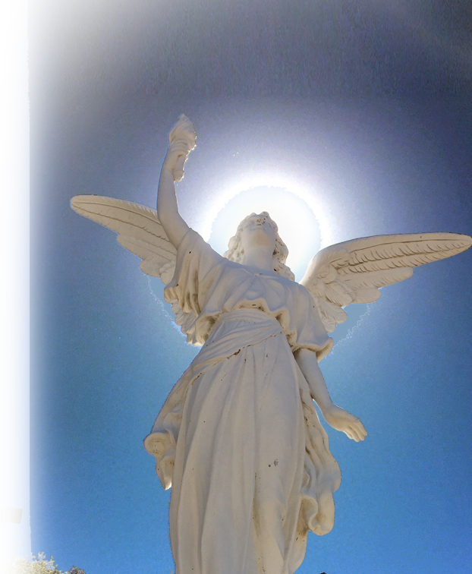

4. The Lord’s victory
¹⁷ And I saw an angel standing in the sun, who cried in a loud voice to all the birds flying in midair, "Come, gather together for the great supper of God, ¹⁸ so that you may eat the flesh of kings, generals, and mighty men, of horses and their riders, and the flesh of all people, free and slave, small and great.“
.
Notes:
https://get.pxhere.com/photo/light-sky-monument-statue-love-symbol-peace-religion-church-freedom-sculpture-religious-christ-memorial-angel-art-inspiration-jesus-prayer-holy-glory-spirit-god-heavenly-spirituality-salvation-belief-angelic-forgiveness-christian-symbols-618767.jpg

Slide 22

4. The Lord’s victory
¹⁹ Then I saw the beast and the kings of the earth and their armies gathered together to make war against the rider on the horse and his army.
Notes:
https://pixabay.com/photos/weapon-cannon-fire-shot-war-3d-3570438/

Slide 23

4. The Lord's victory
²⁰ But the beast was captured, and with him the false prophet who had performed the miraculous signs on his behalf.
Notes:
https://upload.wikimedia.org/wikipedia/commons/thumb/a/a9/An_Airman%27s_hands_are_secured_behind_his_back_with_handcuffs_during_a_riot_control_procedures_drill_DF-ST-87-11855.jpg/2048px-An_Airman%27s_hands_are_secured_behind_his_back_with_handcuffs_during_a_riot_control_procedures_drill_DF-ST-87-11855.jpg

Slide 24
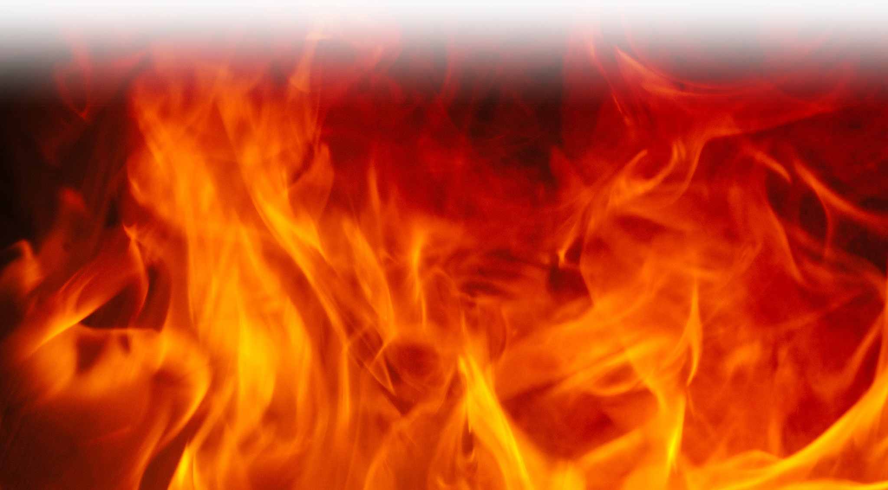
4. The Lord's victory
With these signs he had deluded those who had received the mark of the beast and worshiped his image. The two of them were thrown alive into the fiery lake of burning sulfur.
6
6
6

Slide 25
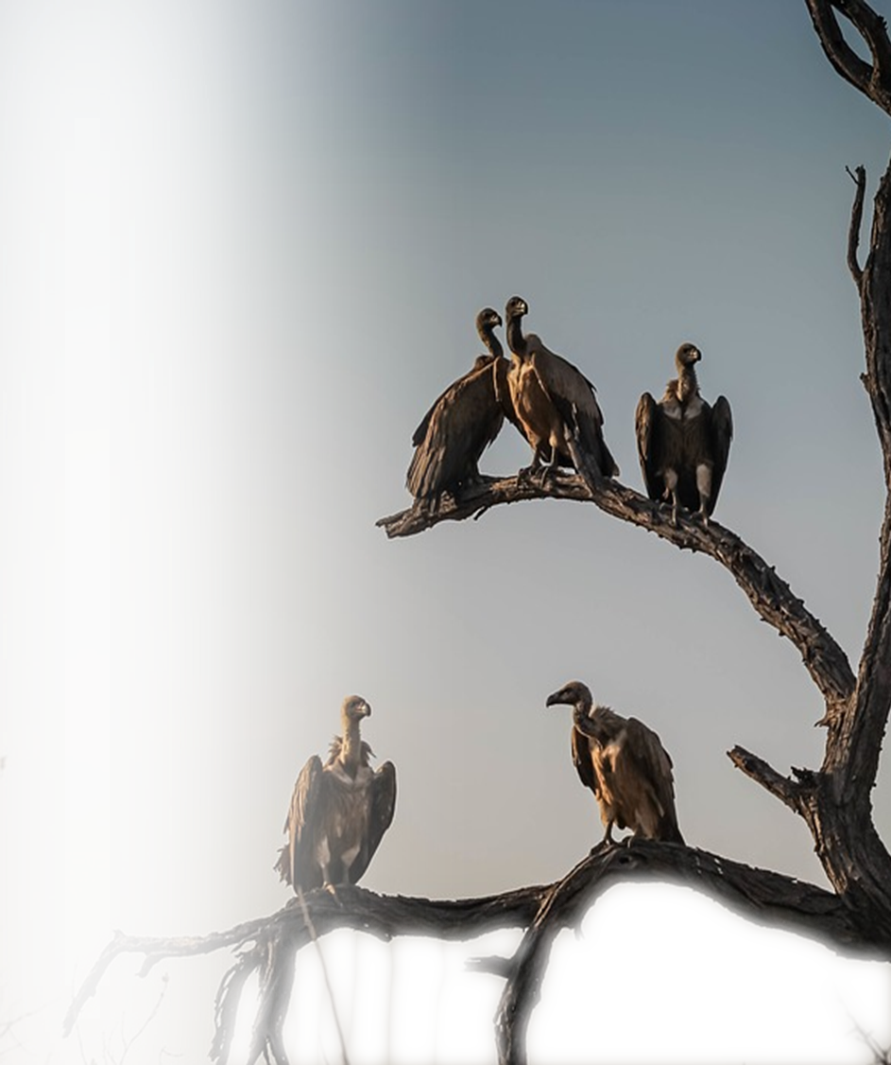
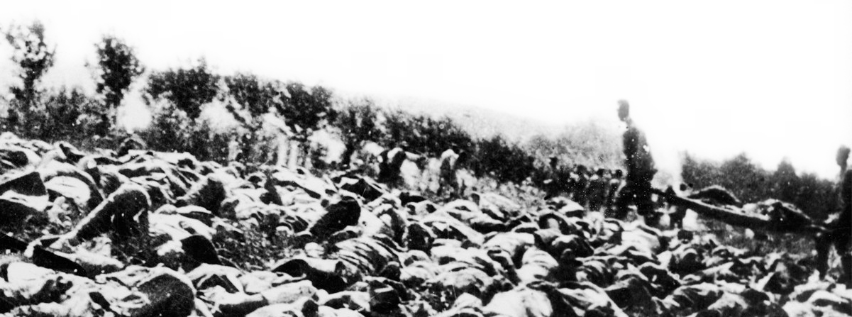
4. The Lord's victory
²¹ The rest of them were killed with the sword that came out of the mouth of the rider on the horse, and all the birds gorged themselves on their flesh.

Slide 26
5. Lessons to be Learned

Slide 27
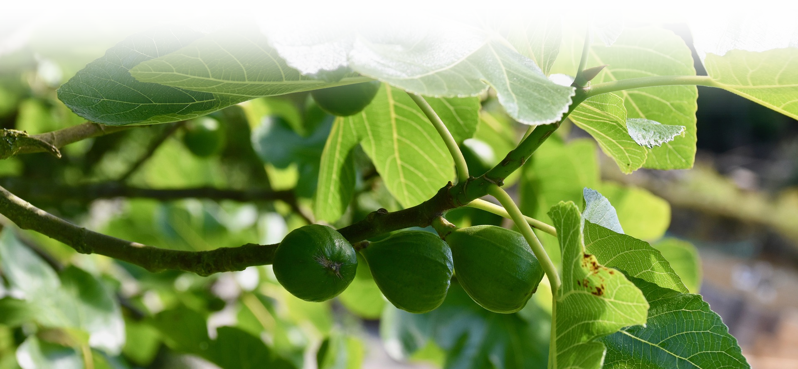
Learn the FIG Tree Lesson
You can know the “Season” when it will occur

Slide 28
Learn the FIG Tree Lesson
³² "Now learn this lesson from the fig tree: As soon as its twigs get tender and its leaves come out, you know that summer is near. ³³ Even so, when you see all these things, you know that it is near, right at the door.
³⁴ I tell you the truth, this generation will certainly not pass away until all these things have happened.

Slide 29
Learn the FIG Tree Lesson
³⁵ Heaven and earth will pass away, but my words will never pass away. ³⁶ "No one knows about that day or hour, not even the angels in heaven, nor the Son, but only the Father.

Slide 30
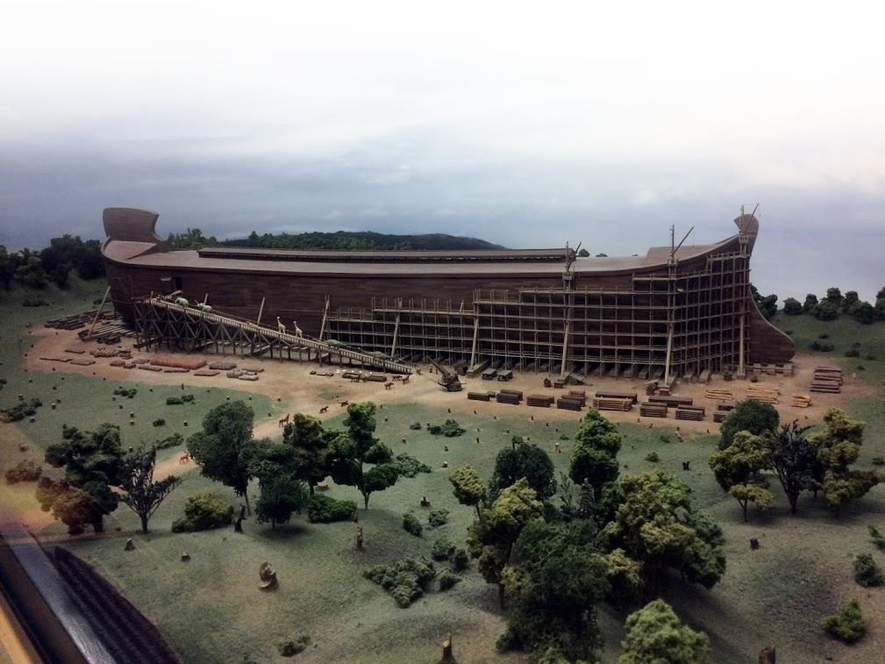
Learn the “NOAH” lesson
You cannot know the “Day” of Judgment

Slide 31
Learn the “NOAH” lesson
³⁷ As it was in the days of Noah, so it will be at the coming of the Son of Man. ³⁸ For in the days before the flood, people were eating and drinking, marrying and giving in marriage, up to the day Noah entered the ark;

Slide 32
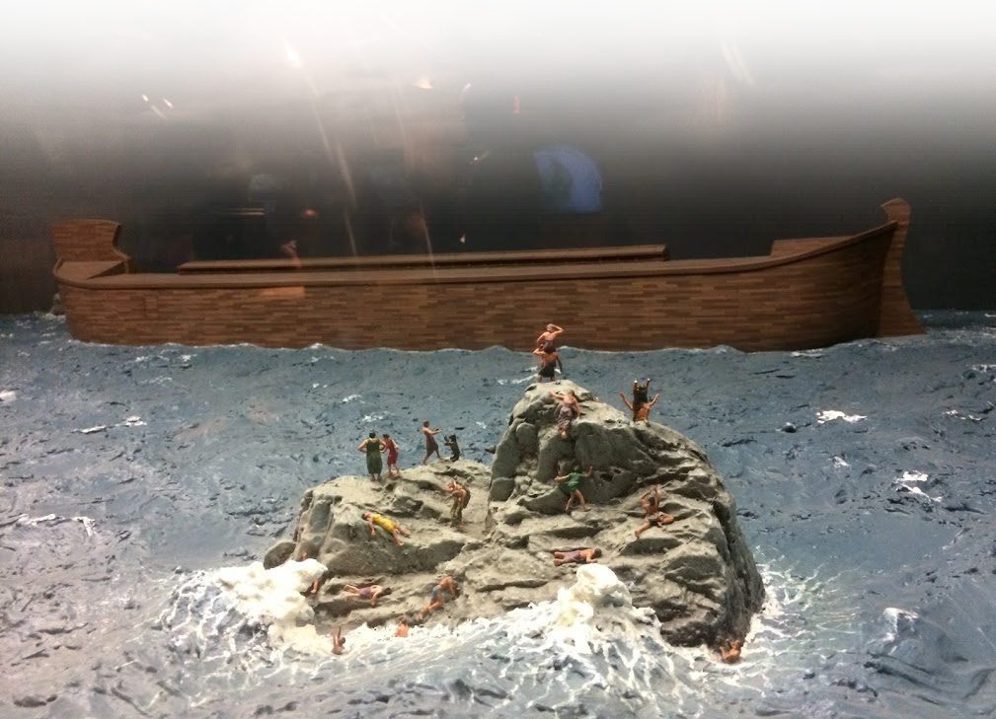
Learn the “NOAH” lesson
³⁹ and they knew nothing about what would happen until the flood came and took them all away. That is how it will be at the coming of the Son of Man.

Slide 33
Learn the “NOAH” lesson
⁴⁰ Two men will be in the field; one will be taken
and the other left.
IN JUDGMENT

Slide 34
Learn the “NOAH” lesson
⁴⁰ Two men will be in the field; one will be taken
and the other left.
⁴¹ Two women will be grinding
with a hand mill; one will be taken
and the other left.
IN JUDGMENT

Slide 35
Learn the “NOAH” lesson
⁴² "Therefore keep watch, because you do not know on what day your Lord will come.

Slide 36

Learn the “Thief” lesson
You do not know the “hour” of disaster.

Slide 37

Learn the “Thief” lesson
⁴³ But understand this: If the owner of the house had known at what time of night the thief was coming, he would have kept watch and would not have let his house be broken into.

Slide 38
Learn the “Thief” lesson
⁴⁴ So you also must be ready, because the Son of Man will come at an hour when you do not expect him.

Slide 39
Learn the “Stewardship” Lesson
They did not know the “Proper Time”

Slide 40
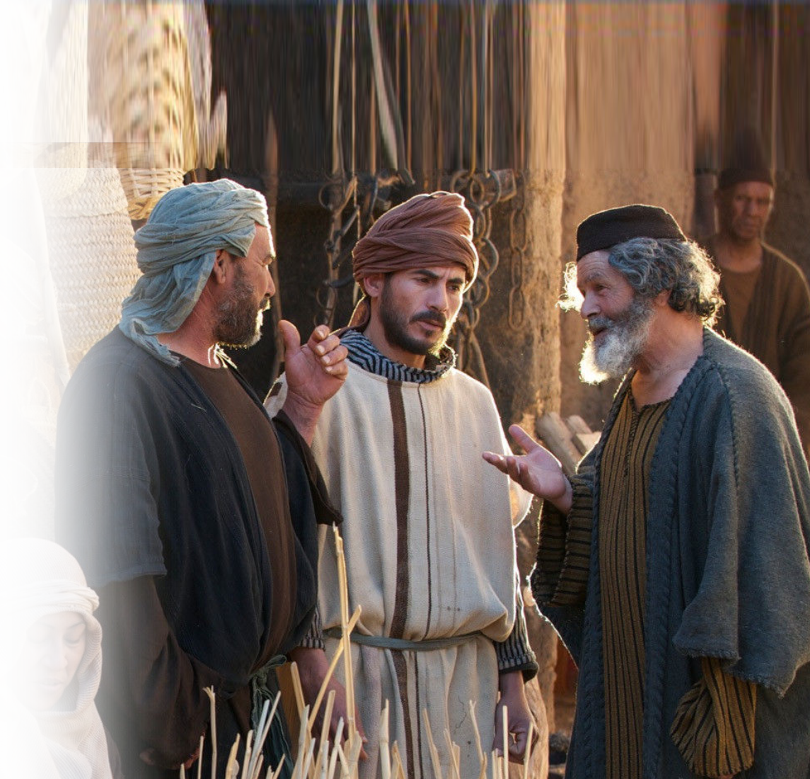
Learn the “Stewardship” Lesson
⁴⁵ "Who then is the faithful and wise servant, whom the master has put in charge of the servants in his household to give them their food at the proper time?

Slide 41
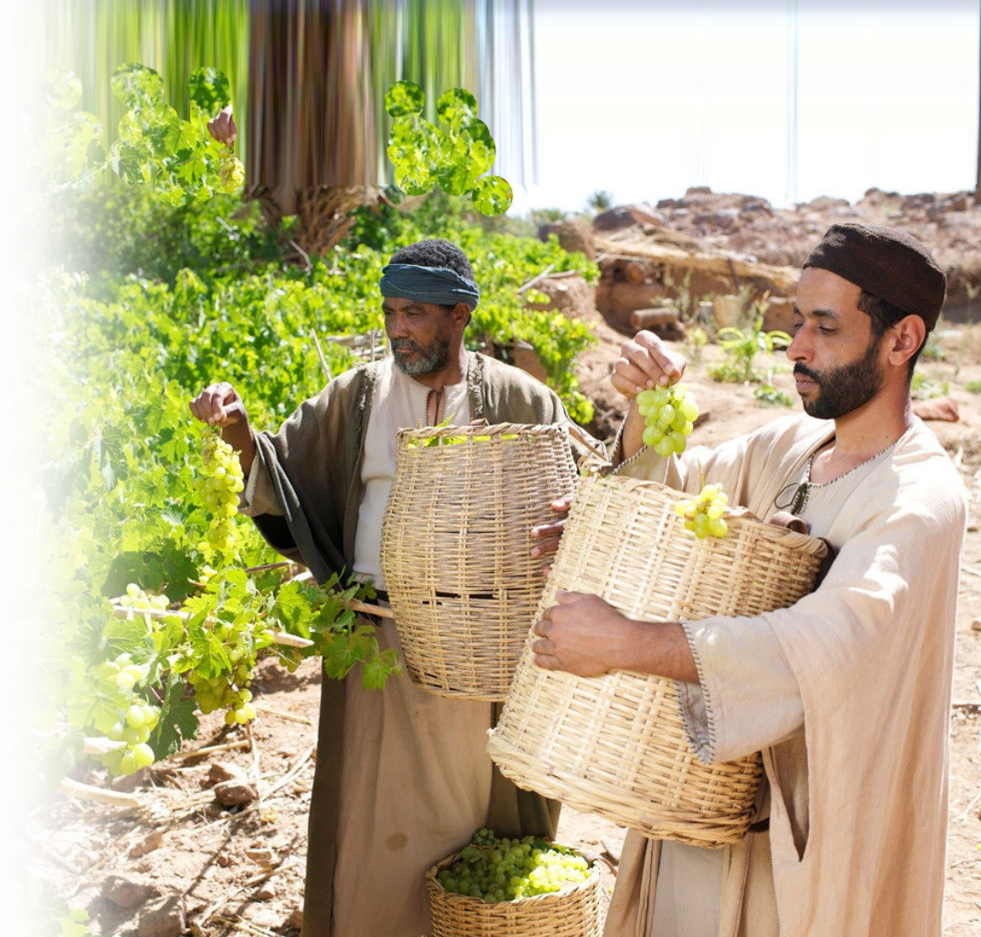
Learn the “Stewardship” Lesson
⁴⁶ It will be good for that servant whose master finds him doing so when he returns. ⁴⁷ I tell you the truth, he will put him
in charge of all his possessions.

Slide 42
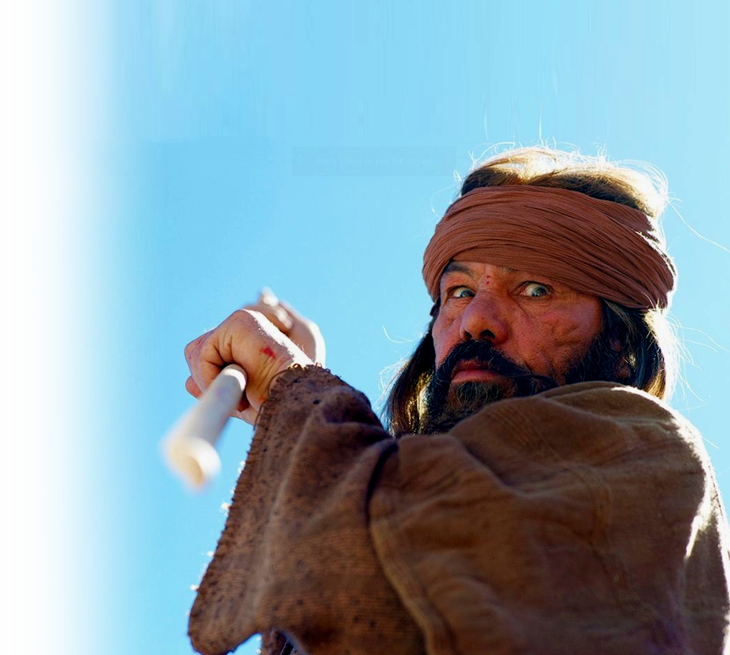
Learn the “Stewardship” Lesson
⁴⁸ But suppose that servant is wicked and says to himself, 'My master is staying away a long time,’ ⁴⁹ and he then begins to beat his fellow servants and
to eat and drink with
drunkards.

Slide 43
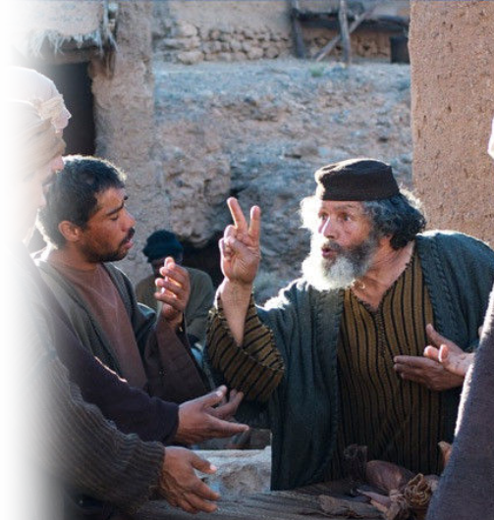
Learn the “Stewardship” Lesson
⁵⁰ The master of that servant will come on a day when he does not expect him and at an hour he is not aware of.

Slide 44
Learn the “Stewardship” Lesson
⁵¹ He will cut him to pieces and assign him a place with the hypocrites, where there will be weeping and gnashing of teeth.

Slide 45
Finally, Be Alert!
Learn from the budding fig –
“Be knowledgeable” of the SEASON of His return.
Learn from the days of Noah –
”Keep watch” for the DAY of His return.
Learn from the thief—
”Be prepared” for the HOUR of His return.
Learn from the steward—
“Be faithful” until the TIME of His return.

Slide 46
… the Son of Man will come at an hour
when you do not expect him.

Slide 47
Let’s Pray

