Slide 1

Things to Come!
Daniel 2:29
This presentation uses Airstrike Condensed font:
https://www.dafont.com/airstrike.font
Notes:
Backround image = FREE = Image by <a href="https://pixabay.com/users/geralt-9301/?utm_source=link-attribution&amp;utm_medium=referral&amp;utm_campaign=image&amp;utm_content=2709662">Gerd Altmann</a> from <a href="https://pixabay.com/?utm_source=link-attribution&amp;utm_medium=referral&amp;utm_campaign=image&amp;utm_content=2709662">Pixabay</a>
Copyright © 2006−2021. All rights reserved. Bible Point is a registered trademark of Dennis Henderson. All other trademarks acknowledged.
Bible Point contains graphics from Bible Point artists. These illustrations belong to Bible Point and the respective artists. You may use the designs and illustrations for graphical illustration of lessons free and without special permission, provided they are not used in any way that maligns the Christian faith. Furthermore, republication or production of any illustration by any other graphic service whether it be in book, in a machine-readable form, or in any other design resource is strictly prohibited. Furthermore, they cannot be duplicated or resold as any other form of publishing, clip art, or graphic resource.
So What does it mean? (A simple translations of the legal jargon)
So, if you don’t own the presentation(s), graphic(s), and text(s) how can you legally use them? The purchase of the license allows you to use all the images in the product. However, the actual ownership and copyright of the presentation(s), graphic(s), and text(s) remain the property of Bible Point and its licensors. If you had plans on using this product in your “for sale” work—think again!
License Agreement
Article 1: License Grant
All the graphics and text in Bible Point presentations (excluding quotes from the Bible and stated sources) are the intellectual and real property of Bible Point and its licensors, and is protected by law, including United States copyright laws and international treaties. Bible Point grants to you a license:
1. To use the presentation in a single church, single school, or single office of a Christian organization.
2. To make a single archival back-up copy of the program.
3. To modify the presentation(s) and merge with other presentations in a single church, school, or Christian organization.
4. To transfer to another party if that party agrees to accept the terms and conditions of this agreement, and you do not retain any copies of the presentation, whether printed, machine readable, modified, or merged form.
Article 2: Terms
This license is effective until terminated. You may terminate the license at any time by destroying the presentation(s), graphic(s), or text(s) together with all copies, modifications and merged portions in any form. Bible Point may terminate your license if you fail to comply with this Agreement. You agree, upon such termination, for any reason, to destroy the presentation(s), graphics, and text(s) with all copies, modifications, and merged portions in any form.
Article 3: Disclaimers
1. Bible Point presentations, graphics, and texts are licensed to you As Is. You, the consumer, bear the entire risk relating to the quality and performance of the presentation(s), graphic(s), or text(s). In no event will Bible Point be liable for damages resulting from any defect.
2. Thirty-day limited warrantee on disks. Bible Point warrants the disks to be free of defects in material and workmanship under normal use for 30 days after purchase. During the 30-day period you may return a defective presentation, graphic, or text with proof of purchase and it will be replaced without charge, unless the presentation is damaged by misuse.
Article 4: General
1. You may not sub-license, assign, or transfer the license of the presentation(s), graphic(s), or text(s) except as provided by this Agreement.
2. This Agreement will be governed by the laws of the State of Michigan.
So What does it mean? (A simple translations of the legal jargon)
May I let someone borrow or copy my licensed Bible Point presentation (even after I modified it)? As long as it is within your local church, or single school, or the immediate office of a Christian organization you may. Otherwise, please refer the person interested in borrowing to: http://www.biblepoint.com or E-mail: dennis@DrDH.net with any related questions.

Slide 2
Things to Come!
Matthew 24:15-22
Notes:
Backround image = FREE = Image by <a href="https://pixabay.com/users/geralt-9301/?utm_source=link-attribution&amp;utm_medium=referral&amp;utm_campaign=image&amp;utm_content=2709662">Gerd Altmann</a> from <a href="https://pixabay.com/?utm_source=link-attribution&amp;utm_medium=referral&amp;utm_campaign=image&amp;utm_content=2709662">Pixabay</a>
Copyright © 2006−2021. All rights reserved. Bible Point is a registered trademark of Dennis Henderson. All other trademarks acknowledged.
Bible Point contains graphics from Bible Point artists. These illustrations belong to Bible Point and the respective artists. You may use the designs and illustrations for graphical illustration of lessons free and without special permission, provided they are not used in any way that maligns the Christian faith. Furthermore, republication or production of any illustration by any other graphic service whether it be in book, in a machine-readable form, or in any other design resource is strictly prohibited. Furthermore, they cannot be duplicated or resold as any other form of publishing, clip art, or graphic resource.
So What does it mean? (A simple translations of the legal jargon)
So, if you don’t own the presentation(s), graphic(s), and text(s) how can you legally use them? The purchase of the license allows you to use all the images in the product. However, the actual ownership and copyright of the presentation(s), graphic(s), and text(s) remain the property of Bible Point and its licensors. If you had plans on using this product in your “for sale” work—think again!
License Agreement
Article 1: License Grant
All the graphics and text in Bible Point presentations (excluding quotes from the Bible and stated sources) are the intellectual and real property of Bible Point and its licensors, and is protected by law, including United States copyright laws and international treaties. Bible Point grants to you a license:
1. To use the presentation in a single church, single school, or single office of a Christian organization.
2. To make a single archival back-up copy of the program.
3. To modify the presentation(s) and merge with other presentations in a single church, school, or Christian organization.
4. To transfer to another party if that party agrees to accept the terms and conditions of this agreement, and you do not retain any copies of the presentation, whether printed, machine readable, modified, or merged form.
Article 2: Terms
This license is effective until terminated. You may terminate the license at any time by destroying the presentation(s), graphic(s), or text(s) together with all copies, modifications and merged portions in any form. Bible Point may terminate your license if you fail to comply with this Agreement. You agree, upon such termination, for any reason, to destroy the presentation(s), graphics, and text(s) with all copies, modifications, and merged portions in any form.
Article 3: Disclaimers
1. Bible Point presentations, graphics, and texts are licensed to you As Is. You, the consumer, bear the entire risk relating to the quality and performance of the presentation(s), graphic(s), or text(s). In no event will Bible Point be liable for damages resulting from any defect.
2. Thirty-day limited warrantee on disks. Bible Point warrants the disks to be free of defects in material and workmanship under normal use for 30 days after purchase. During the 30-day period you may return a defective presentation, graphic, or text with proof of purchase and it will be replaced without charge, unless the presentation is damaged by misuse.
Article 4: General
1. You may not sub-license, assign, or transfer the license of the presentation(s), graphic(s), or text(s) except as provided by this Agreement.
2. This Agreement will be governed by the laws of the State of Michigan.
So What does it mean? (A simple translations of the legal jargon)
May I let someone borrow or copy my licensed Bible Point presentation (even after I modified it)? As long as it is within your local church, or single school, or the immediate office of a Christian organization you may. Otherwise, please refer the person interested in borrowing to: http://www.biblepoint.com or E-mail: dennis@DrDH.net with any related questions.

Slide 3
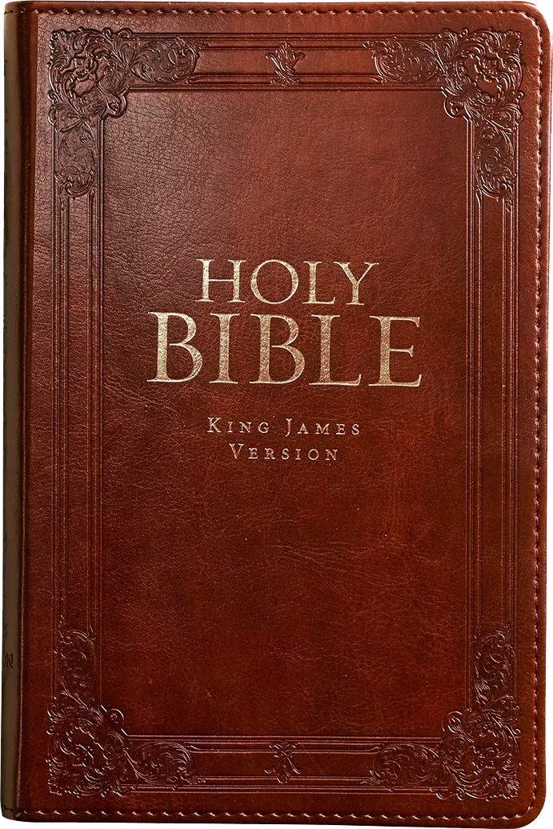
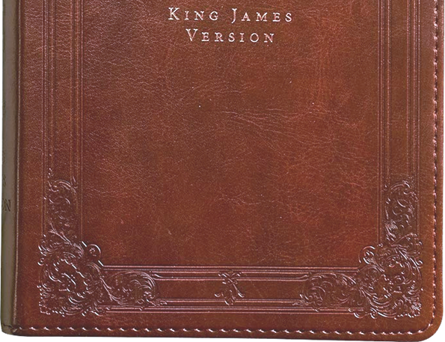

Predictive prophecy
50%
25%

Slide 4
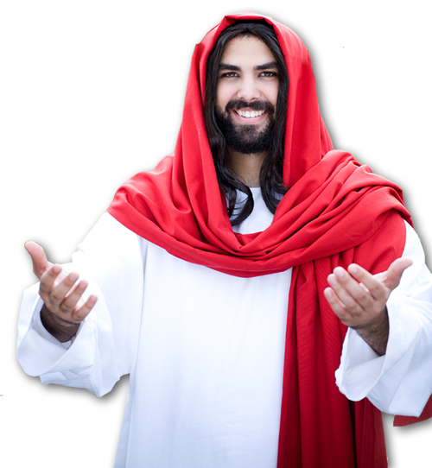

A Little Review ...
Jesus predicted the Church
“I will build my church”
OT

Slide 5

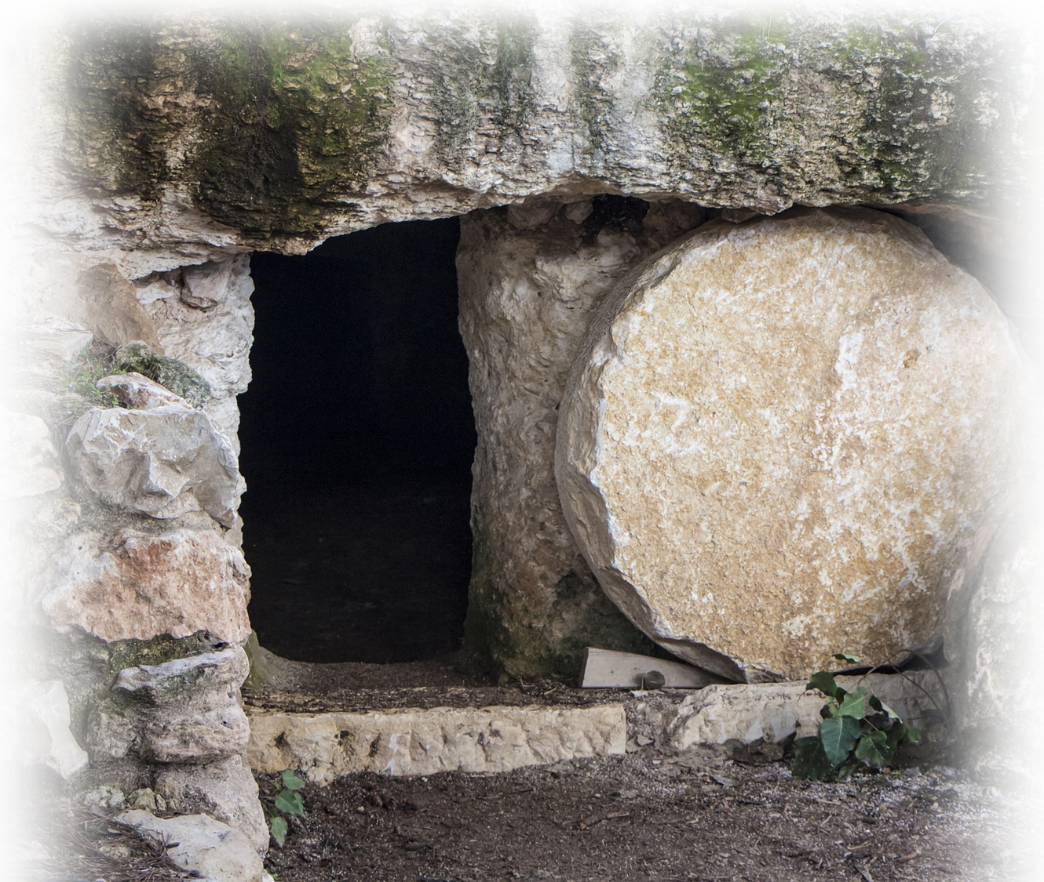
A Little Review ...
Christ died for our sins ...
He was buried .....
He was raised on the third day (1Cor 15)
OT

Slide 6
A Little Review ...
Jesus’ Prediction was fulfilled in Acts 2
OT

Slide 7
A Little Review ...
Jesus had predicted the Rapture
if I go and prepare a place for
you, I will come back and take
you to be with me (John 14:3)
OT
NT

Slide 8
A Little Review ...
Jesus had predicted the Rapture
if I go and prepare a place for
you, I will come back and take
you to be with me (John 14:3)
OT
NT

Slide 9

A Little Review ...
Jesus had predicted the Rapture
if I go and prepare a place for
you, I will come back and take
you to be with me (John 14:3)
OT
NT

Slide 10

A Little Review ...
After the Rapture ... “we must all appear before the judgment seat of Christ ...”
(2Co 5:10 NIV)
OT
OT

Slide 11
A Little Review ...
After the Rapture
“the day of the Lord will come like a thief in the night.” (1Thes 5:2)
OT
Tribulation -- Kingdom

Slide 12
Deception
War
Famine
Martyrdom
Apostasy
Cold-Hearted
Awakening

Slide 13
The Middle of the Tribulation
Deception
War
Famine
Martyrdom
Apostasy
Cold-Hearted
Awakening

Slide 14
Jesus Continues ...
^{Mat 24:15} "So when you see standing in the
holy place 'the abomination that causes desolation,' spoken of through the
prophet Daniel--let the reader understand--
WHAT IS THIS?
Notes:
Jesus says it is still future. Therefore Antiochus Euphonies was just a foreshadowing of this future event.

Slide 15
Daniel 9:24-27

Slide 16
Seventy ‘Sevens’
490
years
Daniel 9:24-27
²⁴ "Seventy 'sevens' are decreed for
your people and your holy city
to finish transgression,
to put an end to sin,
to atone for wickedness,
to bring in everlasting righteousness,
to seal up vision and prophecy and
to anoint the most holy.
1st COMING
2ND COMING
Notes:
1 & 2 “It is Finished”
² He is the atoning sacrifice for our sins, (1Jo 2:2 NIV)
4 = Millennial Kingdom
5 = Fulfillment of Kingdom Prophecies
6 = Consecrate the Millennial Temple

Slide 17
Seventy ‘Sevens’
²⁵ "Know and understand this: From the issuing of the decree to restore and rebuild Jerusalem until the Anointed One, the ruler, comes, there will be seven 'sevens,' and sixty-two 'sevens.' It will be rebuilt with streets and a trench, but in times of trouble.
445
B.C.

Slide 18
Seventy ‘Sevens’
²⁵ "Know and understand this: From the issuing of the decree to restore and rebuild Jerusalem until the Anointed One, the ruler, comes, there will be seven 'sevens,' and sixty-two 'sevens.' It will be rebuilt with streets and a trench, but in times of trouble.
445
B.C.
Anointed
Christ
Messiah

Slide 19
Seventy ‘Sevens’
²⁵ "Know and understand this: From the issuing of the decree to restore and rebuild Jerusalem until the Anointed One, the ruler, comes, there will be seven 'sevens,' and sixty-two 'sevens.' It will be rebuilt with streets and a trench, but in times of trouble.
7
62
445
B.C.
Anointed
Christ
Messiah
490
years
49
434
+7 years =
49 + 434 = 483

Slide 20
Seventy ‘Sevens’
²⁵ "Know and understand this: From the issuing of the decree to restore and rebuild Jerusalem until the Anointed One, the ruler, comes, there will be seven 'sevens,' and sixty-two 'sevens.' It will be rebuilt with streets and a trench, but in times of trouble.
7
62
445
B.C.
Anointed
Christ
Messiah
49
434
49 + 434 = 483

Slide 21
Seventy ‘Sevens’
²⁶ After the sixty-two 'sevens,' the Anointed One will be cut off and will have nothing. The people of the ruler who will come will destroy the city and the sanctuary. The end will come like a flood: War will continue until the end, and desolations have been decreed.
7
62
445
B.C.
Anointed
Christ
Messiah
49
434
69 X 7 = 483

Slide 22
Seventy ‘Sevens’
²⁶ After the sixty-two 'sevens,' the Anointed One will be cut off and will have nothing. The people of the ruler who will come will destroy the city and the sanctuary. The end will come like a flood: War will continue until the end, and desolations have been decreed.
7
62
445
B.C.
Anointed
Christ
Messiah
49
434
69 X 7 = 483

Slide 23
Seventy ‘Sevens’
²⁶ After the sixty-two 'sevens,' the Anointed One will be cut off and will have nothing. The people of the ruler who will come will destroy the city and the sanctuary. The end will come like a flood: War will continue until the end, and desolations have been decreed.
7
62
445
B.C.
Anointed
Christ
Messiah
49
434
69 X 7 = 483
32
70
ROMANS

Slide 24
Seventy ‘Sevens’
²⁶ After the sixty-two 'sevens,' the Anointed One will be cut off and will have nothing. The people of the ruler who will come will destroy the city and the sanctuary. The end will come like a flood: War will continue until the end, and desolations have been decreed.
7
62
445
B.C.
Anointed
Christ
Messiah
49
434
69 X 7 = 483
32
70
ROMANS

Slide 25
Seventy ‘Sevens’
²⁶ After the sixty-two 'sevens,' the Anointed One will be cut off and will have nothing. The people of the ruler who will come will destroy the city and the sanctuary. The end will come like a flood: War will continue until the end, and desolations have been decreed.
7
62
445
B.C.
Anointed
Christ
Messiah
49
434
69 X 7 = 483
ROMANS
Notes:
Titus campaigned and destroyed in 70 AD. Totally clearing the temple mount so it was a total desolation/destruction.

Slide 26
Seventy ‘Sevens’
²⁷ He will confirm a covenant with many for one 'seven.' In the middle of the 'seven' he will put an end to sacrifice and offering. And on a wing of the temple he will set up an abomination that causes desolation, until the end that is decreed is poured out on him. "
7
62
445
B.C.
Anointed
Christ
Messiah
49
434
69 X 7 = 483
1 X 7 =7
ROMANS

Slide 27
Seventy ‘Sevens’
²⁷ He will confirm a covenant with many for one 'seven.' In the middle of the 'seven' he will put an end to sacrifice and offering. And on a wing of the temple he will set up an abomination that causes desolation, until the end that is decreed is poured out on him. "
7
62
445
B.C.
Anointed
Christ
Messiah
49
434
7 Year
Treaty
69 X 7 = 483
1 X 7 =7
ROMANS

Slide 28
Seventy ‘Sevens’
²⁷ He will confirm a covenant with many for one 'seven.' In the middle of the 'seven' he will put an end to sacrifice and offering. And on a wing of the temple he will set up an abomination that causes desolation, until the end that is decreed is poured out on him. "
... the ruler who will come ... (9:26)
7
62
445
B.C.
Anointed
Christ
Messiah
49
434
7 Year
Treaty
69 X 7 = 483
1 X 7 =7
ROMANS

Slide 29
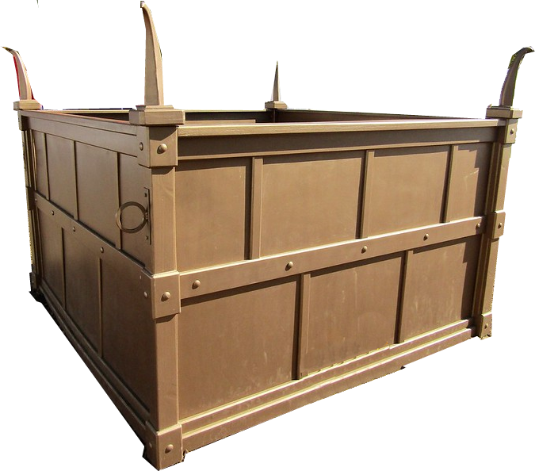
Seventy ‘Sevens’
²⁷ He will confirm a covenant with many for one 'seven.' In the middle of the 'seven' he will put an end to sacrifice and offering. And on a wing of the temple he will set up an abomination that causes desolation, until the end that is decreed is poured out on him. "
7
62
445
B.C.
Anointed
Christ
Messiah
49
434
7 Year
Treaty
69 X 7 = 483
1 X7 =7
ROMANS
Notes:
This implies there is a Tribulation temple.
It implies that sacrifices have resumed.

Slide 30
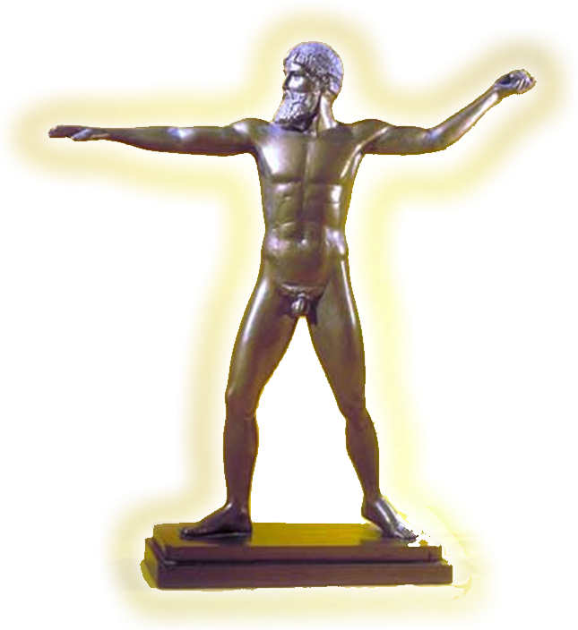
Seventy ‘Sevens’
²⁷ He will confirm a covenant with many for one 'seven.' In the middle of the 'seven' he will put an end to sacrifice and offering. And on a wing of the temple he will set up an abomination that causes desolation, until the end that is decreed is poured out on him. "
7
62
445
B.C.
Anointed
Christ
Messiah
49
434
7 Year
Treaty
69 X 7 = 483
1 X7 =7
ROMANS

Slide 31
Seventy ‘Sevens’
²⁷ He will confirm a covenant with many for one 'seven.' In the middle of the 'seven' he will put an end to sacrifice and offering. And on a wing of the temple he will set up an abomination that causes desolation, until the end that is decreed is poured out on him."
END
7
62
445
B.C.
Anointed
Christ
Messiah
49
434
7 Year
Treaty
69 X 7 = 483
1 X7 =7
ROMANS

Slide 32
The Middle of the Tribulation:
¹¹ "From the time that the daily sacrifice is abolished and the abomination that causes desolation is set up, there will be 1,290 days. (Daniel 12:11)
Will Be Marked by ...

Slide 33
1- Marked by The Abomination
¹⁵ "So when you see standing in the
holy place 'the abomination that causes desolation,' spoken of through the
prophet Daniel--let the reader understand--
Notes:
Jesus says it is still future. Therefore Antiochus Euphonies was just a foreshadowing of this future event.

Slide 34
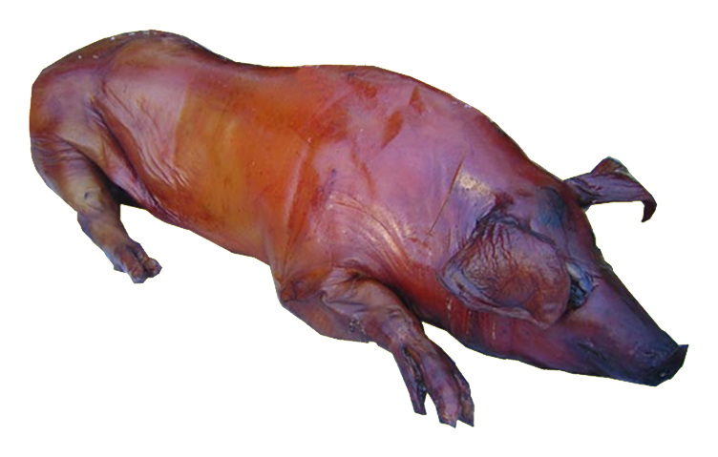
1- Marked by The Abomination
¹⁵ "So when you see standing in the
holy place 'the abomination that causes desolation,' spoken of through the
prophet Daniel--let the reader understand--
Daniel 9: 27 “an abomination that causes desolation”
Notes:
Jesus says it is still future. Therefore Antiochus Euphonies was just a foreshadowing of this future event.

Slide 35
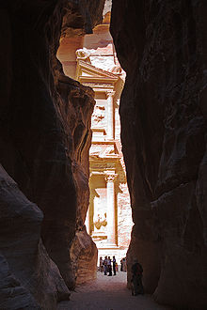
2- Marked by URGENCY of Flight
¹⁵ "So when you see … 'the abomination that causes desolation,' ... ¹⁶ then let those who are in Judea flee to the mountains. ¹⁷ Let no one on the roof of his house go down to take anything out of the house. ¹⁸ Let no one in the field go back to get his cloak.
Notes:
https://upload.wikimedia.org/wikipedia/commons/thumb/6/68/Petra_First_Glimpse.jpg/440px-Petra_First_Glimpse.jpg
Why Flee? The worst is yet to come!
Wars and rumor of wars are now underway! The Gog Magog battle ended, but not the war. After the Northern invasion, there will be a southern invasion, then a westward invasion and an eastern invasion (See Daniel 11).
It culminates with all the nations of the earth waring against Israel.
² I will gather all the nations to Jerusalem to fight against it; the city will be captured, the houses ransacked, and the women raped. Half of the city will go into exile, but the rest of the people will not be taken from the city.
³ Then the LORD will go out and fight against those nations, as he fights in the day of battle.
(Zec 14:2-3 NIV)
God is so gracious to warn. But will they take the warning? They are no different than you and I .
Remember the story of the catholic priest and the Baptist minister who were with big placards that read, “Repent, the end is near.” As car after car drove by to their doom. When the Baptist minister said to the priest, perhaps we should change the signs to read, “Turn around, bridge out ahead.” We must graciously, clearly warn our generation that we will all give an account to God. Repent and believe in the Lord Jesus Christ to avoid devastation ahead.

Slide 36

3- Marked by DREADFUL Days
¹⁹ How dreadful it will be in those days for pregnant women and nursing mothers! ²⁰ Pray that your flight will not take place in winter or on the Sabbath.
Notes:
https://upload.wikimedia.org/wikipedia/commons/thumb/6/68/Petra_First_Glimpse.jpg/440px-Petra_First_Glimpse.jpg
Why Flee? Wars and rumor of wars are now underway! The Gog Magog battle ended, but not the war. After the Northern invasion, there will be a southern invasion, then a westward invasion and an eastern invasion (See Daniel 11).
It culminates with all the nations of the earth waring against Israel.
² I will gather all the nations to Jerusalem to fight against it; the city will be captured, the houses ransacked, and the women raped. Half of the city will go into exile, but the rest of the people will not be taken from the city.
³ Then the LORD will go out and fight against those nations, as he fights in the day of battle.
(Zec 14:2-3 NIV)

Slide 37
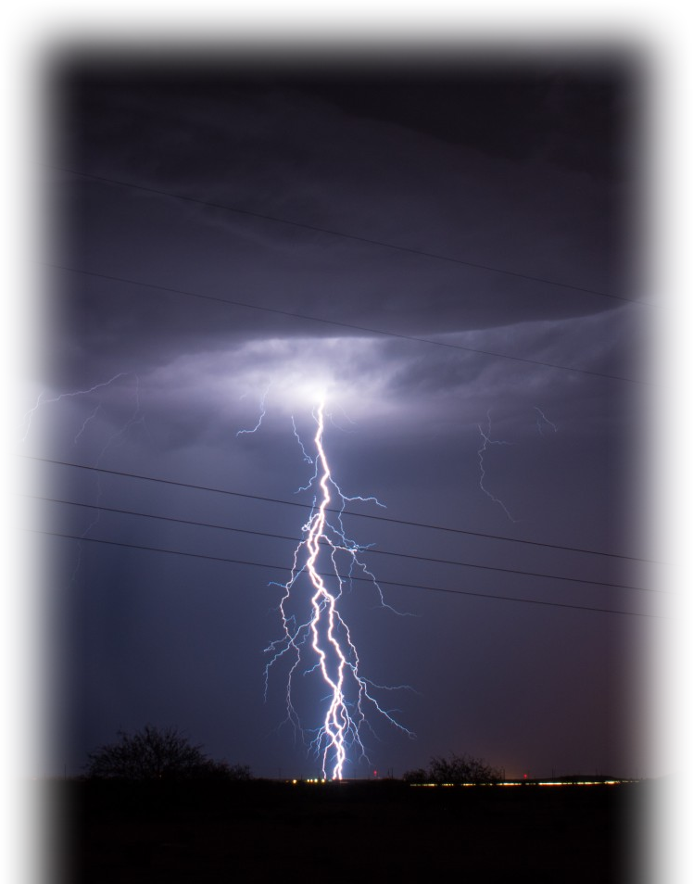
4- Marked by Unequaled Severity
¹⁹ How dreadful it will be ... ²¹ For then
there will be great distress, unequaled
from the beginning of the world until
now--and never to be equaled again.
²² If those days had not been cut short,
no one would survive, but for the sake
of the elect those days will be shortened.
tribulation
Beginning of Pain
Great Tribulation
Notes:
We’re talking about all the wrath of God unloaded on sinners as in the book of Revelation 6-19.
Under the _ seal ¼ of human population dies.
Under the ___ Trumet Judgement 1/3 of the remaining dies = ½ of earths population is dead.

Slide 38
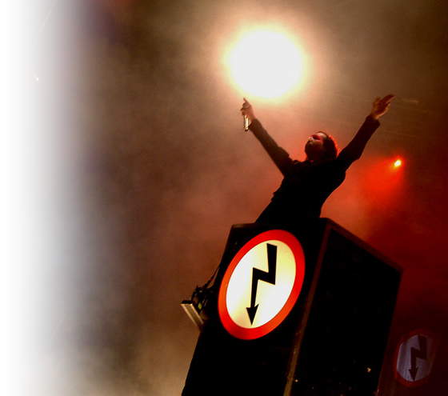
5- Marked by Imposters
²³ At that time if anyone says to you, 'Look, here is the Christ!' or, 'There he is!' do not believe it. ²⁴ For false Christs and false prophets will appear and perform great signs and miracles to deceive even the elect--if that were possible. ²⁵ See, I have told you ahead of time.
Notes:
Don’t be mislead. When they tell you that Christ is here. You see, they will be saying that to get the remnant to reveal themselves—to come out of hiding. Then they will kill them. Do not believe the lie!

Slide 39
6- Marked by the Antichrist
²⁶ "So if anyone tells you,
'There he is, out in the desert,’
do not go out; or, 'Here he is,
in the inner rooms,' do not
believe it.
Notes:
Though there are many antichrists there is one coming who is the ultimate villain and nemesis of Israel. Don’t fall for the false shepherd of Israel.
Rev 13: two beasts 1) Roman Emperor of the Future 2) the Prime Minister of Israel / False Prophet / the Antichrist.
Even today we nee to be careful of those false preachers, making themselves rich at the expense of the truth. ¹⁷ Unlike so many, we do not peddle the word of God for profit. On the contrary, in Christ we speak before God with sincerity, like men sent from God. (2Co 2:17 NIV)
Look out for imposters in the pulpit!

Slide 40
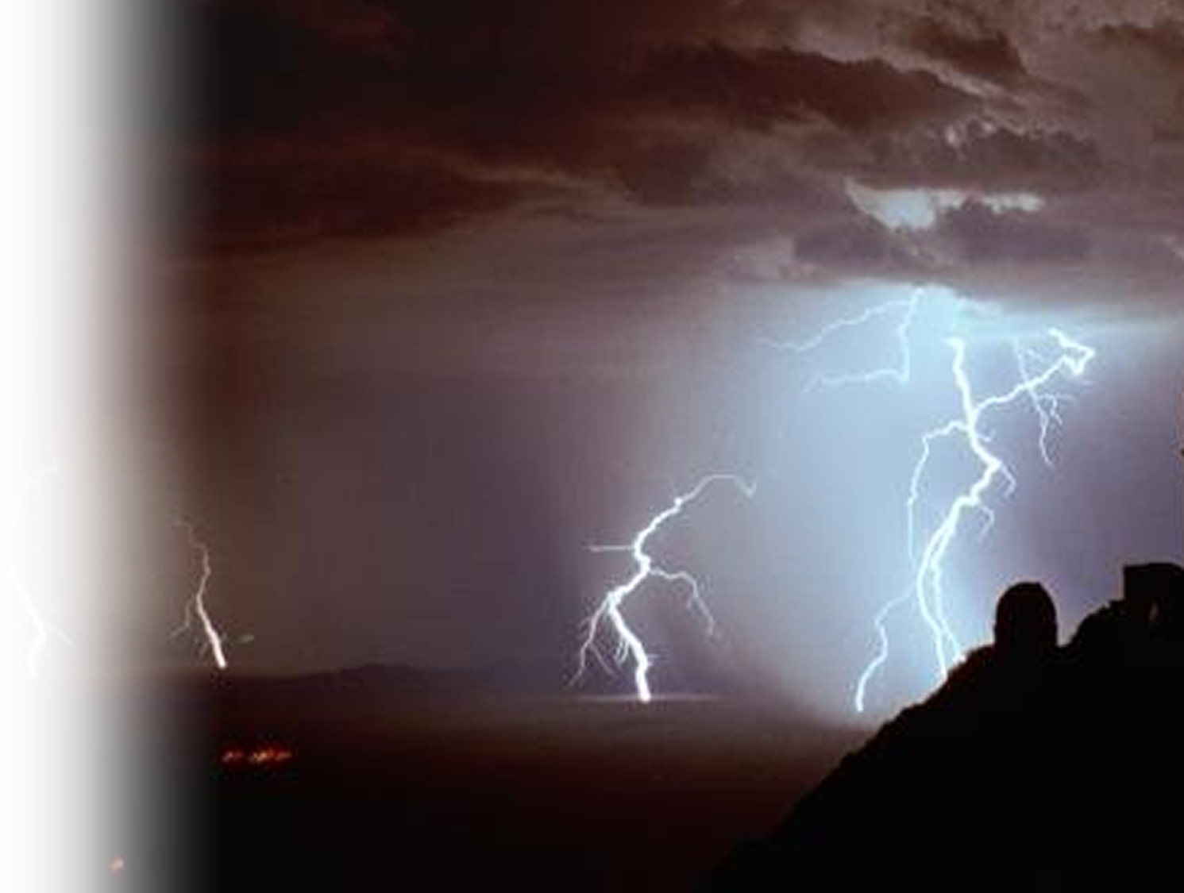
7- Marked by Second coming
²⁷ For as lightning that comes from the east is visible even in the west, so will be the coming of the Son of Man.
²⁸ Wherever there is a carcass, there the vultures will gather.
Notes:
Lightning from NASA http://www.nasaimages.org/luna/servlet/detail/NVA2~4~4~3993~104519:Lightning-on-Earth
Jesus will return to the earth to set up His kingdom at the end of the Great Tribulation . When he does He will come at the speed of light!
The carcasses are the dead bodies from the final battle in the long war.
Jesus returns to end it.
Verse 28 – the battle will end as it is predicted in the Zechariah 14 and Revelation 19.

Slide 41
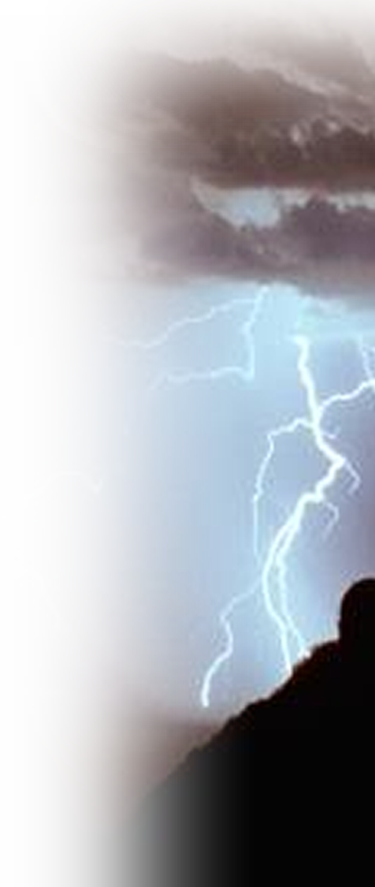
The Middle of the Tribulation
... so will be the coming of the Son of Man.
Deception
War
Famine
Martyrdom
Apostasy
Cold-Hearted
Awakening
Abomination
Urgent Flight
Dreadfulness
Severity
Imposters
Antichrist
2nd Coming

Slide 42
So what Do We Take Away?
Notes:
The Church Age (the age of grace) will one day come to a close and God will intrude in space and time with severe judgment on an unbelieving world.
God has intruded in the past: Floor, Sodom and Gomorrah, Israel’s Captivity, and again in the Tribulation

Slide 43
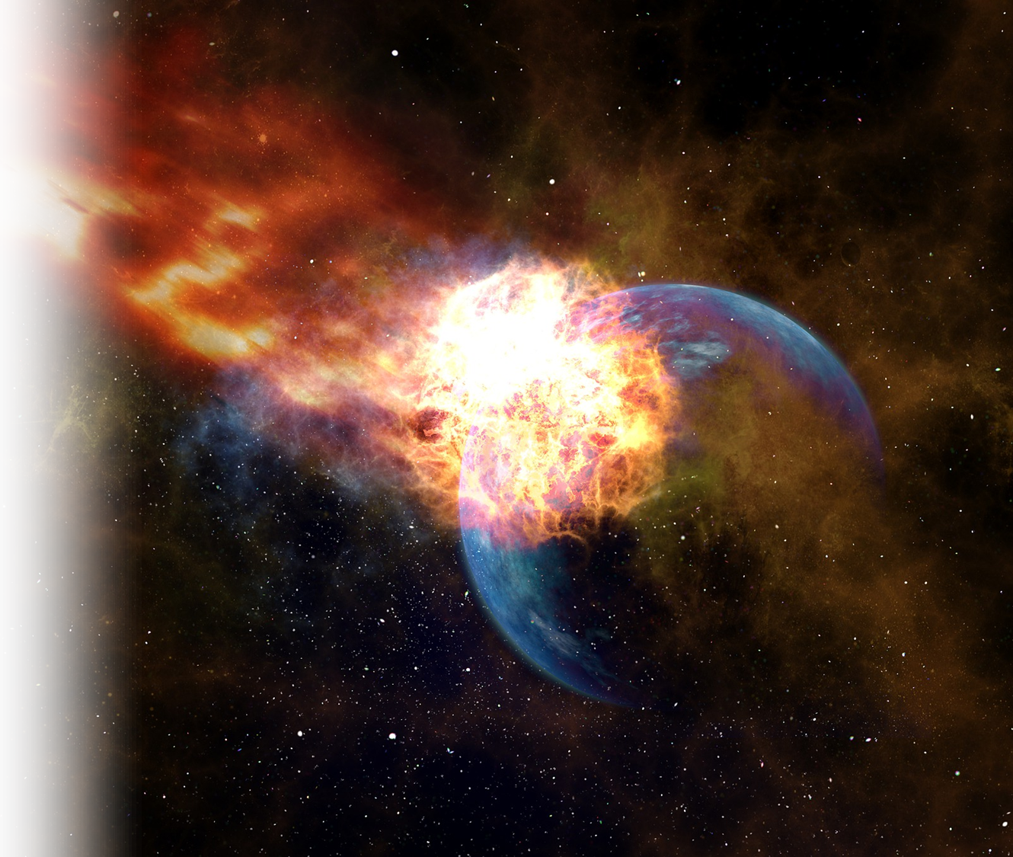
So what Do We Take Away?
God will intrude in time and history with judgment.
Notes:
The Church Age (the age of grace) will one day come to a close and God will intrude in space and time with severe judgment on an unbelieving world.
God has intruded in the past: Floor, Sodom and Gomorrah, Israel’s Captivity, and again in the Tribulation

Slide 44

So what Do We Take Away?
God will intrude in time and history with judgment.
God graciously warns to “Flee the wrath to come!”
Notes:
The Bible is His message to flee the wrath to Come”
He did so with Noah, Lot, through the prophets, and now in Matthew
https://www.publicdomainpictures.net/en/view-image.php?image=80535&picture=u-turn

Slide 45
So what Do We Take Away?
God will intrude in time and history with judgment.
God graciously warns to “Flee the wrath to come!”
Consequence of rejecting the warnings are severe.
Notes:
This is always true—wages of sin is death.

Slide 46
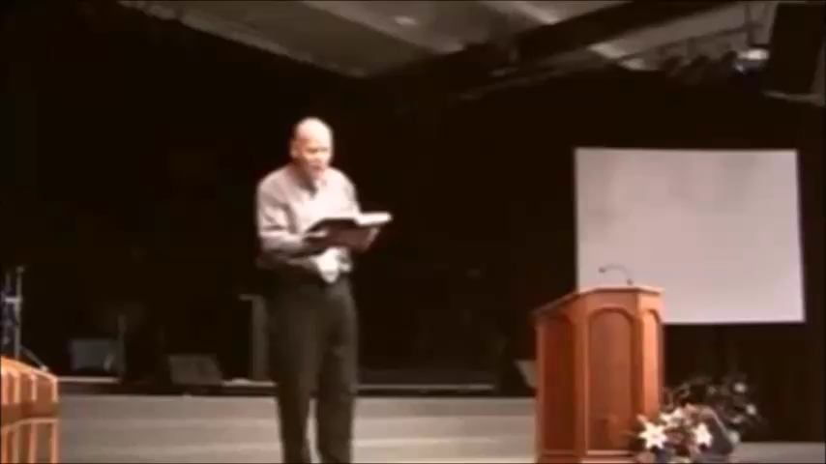
So what Do We Take Away?
God will intrude in time and history with judgment.
God graciously warns to “Flee the wrath to come!”
Consequence of rejecting the warnings are severe.

Slide 47
So what Do We Take Away?
God will intrude in time and history with judgment.
God graciously warns to “Flee the wrath to come!”
Consequence of rejecting the warnings are severe.
Imposters give a false message that you’re OK.
Notes:
Don’t be duped by false teachers with another gospel that is really not another Gal 1

Slide 48
So what Do We Take Away?
God will intrude in time and history with judgment.
God graciously warns to “Flee the wrath to come!”
Consequence of rejecting the warnings are severe.
Imposters give a false message that you’re OK.
Today is the day of salvation.

Slide 49
... now is the time of God's favor,
now is the day of salvation.
(2Corinthians 6:2)

Slide 50
Let’s Pray

