Slide 1

Things to Come!
Daniel 2:29
This presentation uses Airstrike Condensed font:
https://www.dafont.com/airstrike.font
Notes:
Backround image = FREE = Image by <a href="https://pixabay.com/users/geralt-9301/?utm_source=link-attribution&amp;utm_medium=referral&amp;utm_campaign=image&amp;utm_content=2709662">Gerd Altmann</a> from <a href="https://pixabay.com/?utm_source=link-attribution&amp;utm_medium=referral&amp;utm_campaign=image&amp;utm_content=2709662">Pixabay</a>
Copyright © 2006−2021. All rights reserved. Bible Point is a registered trademark of Dennis Henderson. All other trademarks acknowledged.
Bible Point contains graphics from Bible Point artists. These illustrations belong to Bible Point and the respective artists. You may use the designs and illustrations for graphical illustration of lessons free and without special permission, provided they are not used in any way that maligns the Christian faith. Furthermore, republication or production of any illustration by any other graphic service whether it be in book, in a machine-readable form, or in any other design resource is strictly prohibited. Furthermore, they cannot be duplicated or resold as any other form of publishing, clip art, or graphic resource.
So What does it mean? (A simple translations of the legal jargon)
So, if you don’t own the presentation(s), graphic(s), and text(s) how can you legally use them? The purchase of the license allows you to use all the images in the product. However, the actual ownership and copyright of the presentation(s), graphic(s), and text(s) remain the property of Bible Point and its licensors. If you had plans on using this product in your “for sale” work—think again!
License Agreement
Article 1: License Grant
All the graphics and text in Bible Point presentations (excluding quotes from the Bible and stated sources) are the intellectual and real property of Bible Point and its licensors, and is protected by law, including United States copyright laws and international treaties. Bible Point grants to you a license:
1. To use the presentation in a single church, single school, or single office of a Christian organization.
2. To make a single archival back-up copy of the program.
3. To modify the presentation(s) and merge with other presentations in a single church, school, or Christian organization.
4. To transfer to another party if that party agrees to accept the terms and conditions of this agreement, and you do not retain any copies of the presentation, whether printed, machine readable, modified, or merged form.
Article 2: Terms
This license is effective until terminated. You may terminate the license at any time by destroying the presentation(s), graphic(s), or text(s) together with all copies, modifications and merged portions in any form. Bible Point may terminate your license if you fail to comply with this Agreement. You agree, upon such termination, for any reason, to destroy the presentation(s), graphics, and text(s) with all copies, modifications, and merged portions in any form.
Article 3: Disclaimers
1. Bible Point presentations, graphics, and texts are licensed to you As Is. You, the consumer, bear the entire risk relating to the quality and performance of the presentation(s), graphic(s), or text(s). In no event will Bible Point be liable for damages resulting from any defect.
2. Thirty-day limited warrantee on disks. Bible Point warrants the disks to be free of defects in material and workmanship under normal use for 30 days after purchase. During the 30-day period you may return a defective presentation, graphic, or text with proof of purchase and it will be replaced without charge, unless the presentation is damaged by misuse.
Article 4: General
1. You may not sub-license, assign, or transfer the license of the presentation(s), graphic(s), or text(s) except as provided by this Agreement.
2. This Agreement will be governed by the laws of the State of Michigan.
So What does it mean? (A simple translations of the legal jargon)
May I let someone borrow or copy my licensed Bible Point presentation (even after I modified it)? As long as it is within your local church, or single school, or the immediate office of a Christian organization you may. Otherwise, please refer the person interested in borrowing to: http://www.biblepoint.com or E-mail: dennis@DrDH.net with any related questions.

Slide 2
Things to Come!
Matthew 24:1-14
Notes:
Backround image = FREE = Image by <a href="https://pixabay.com/users/geralt-9301/?utm_source=link-attribution&amp;utm_medium=referral&amp;utm_campaign=image&amp;utm_content=2709662">Gerd Altmann</a> from <a href="https://pixabay.com/?utm_source=link-attribution&amp;utm_medium=referral&amp;utm_campaign=image&amp;utm_content=2709662">Pixabay</a>
Copyright © 2006−2021. All rights reserved. Bible Point is a registered trademark of Dennis Henderson. All other trademarks acknowledged.
Bible Point contains graphics from Bible Point artists. These illustrations belong to Bible Point and the respective artists. You may use the designs and illustrations for graphical illustration of lessons free and without special permission, provided they are not used in any way that maligns the Christian faith. Furthermore, republication or production of any illustration by any other graphic service whether it be in book, in a machine-readable form, or in any other design resource is strictly prohibited. Furthermore, they cannot be duplicated or resold as any other form of publishing, clip art, or graphic resource.
So What does it mean? (A simple translations of the legal jargon)
So, if you don’t own the presentation(s), graphic(s), and text(s) how can you legally use them? The purchase of the license allows you to use all the images in the product. However, the actual ownership and copyright of the presentation(s), graphic(s), and text(s) remain the property of Bible Point and its licensors. If you had plans on using this product in your “for sale” work—think again!
License Agreement
Article 1: License Grant
All the graphics and text in Bible Point presentations (excluding quotes from the Bible and stated sources) are the intellectual and real property of Bible Point and its licensors, and is protected by law, including United States copyright laws and international treaties. Bible Point grants to you a license:
1. To use the presentation in a single church, single school, or single office of a Christian organization.
2. To make a single archival back-up copy of the program.
3. To modify the presentation(s) and merge with other presentations in a single church, school, or Christian organization.
4. To transfer to another party if that party agrees to accept the terms and conditions of this agreement, and you do not retain any copies of the presentation, whether printed, machine readable, modified, or merged form.
Article 2: Terms
This license is effective until terminated. You may terminate the license at any time by destroying the presentation(s), graphic(s), or text(s) together with all copies, modifications and merged portions in any form. Bible Point may terminate your license if you fail to comply with this Agreement. You agree, upon such termination, for any reason, to destroy the presentation(s), graphics, and text(s) with all copies, modifications, and merged portions in any form.
Article 3: Disclaimers
1. Bible Point presentations, graphics, and texts are licensed to you As Is. You, the consumer, bear the entire risk relating to the quality and performance of the presentation(s), graphic(s), or text(s). In no event will Bible Point be liable for damages resulting from any defect.
2. Thirty-day limited warrantee on disks. Bible Point warrants the disks to be free of defects in material and workmanship under normal use for 30 days after purchase. During the 30-day period you may return a defective presentation, graphic, or text with proof of purchase and it will be replaced without charge, unless the presentation is damaged by misuse.
Article 4: General
1. You may not sub-license, assign, or transfer the license of the presentation(s), graphic(s), or text(s) except as provided by this Agreement.
2. This Agreement will be governed by the laws of the State of Michigan.
So What does it mean? (A simple translations of the legal jargon)
May I let someone borrow or copy my licensed Bible Point presentation (even after I modified it)? As long as it is within your local church, or single school, or the immediate office of a Christian organization you may. Otherwise, please refer the person interested in borrowing to: http://www.biblepoint.com or E-mail: dennis@DrDH.net with any related questions.

Slide 3
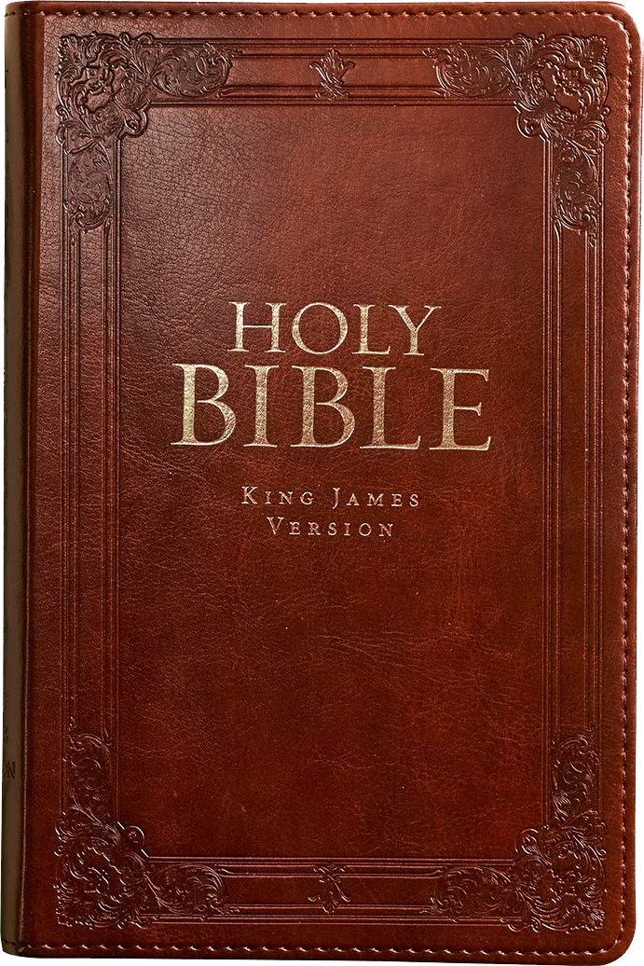


Predictive prophecy
50%
25%

Slide 4
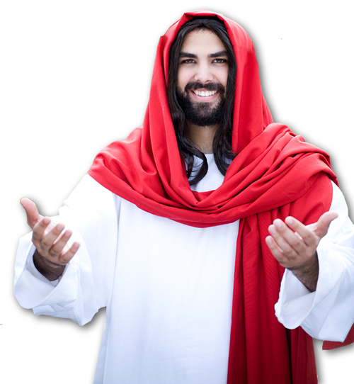
Dark Days Ahead
For then there will be great tribulation, such as has not been from the beginning of the world until now, no, and never will be. (Matthew 24:21 ESV)

Slide 5
The Day of the Lord
The “Day of the Lord” is a time period that includes:
Darkness (judgment) and Light (blessing)
Jesus calls “Tribulation”
Jesus calls “Kingdom”

Slide 6
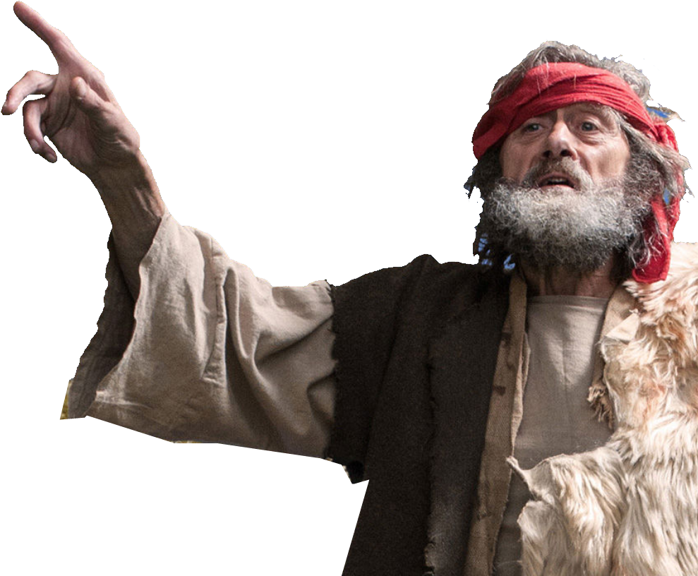
Joel: “the Day of the Lord”
DAY OF DARKNESS
Joel 2¹ Blow the trumpet ... ; sound the alarm .... Let all who live in the land tremble, for the day of the LORD is coming. It is close at hand-- ² a day of darkness and gloom, a day of clouds and black-ness.

Slide 7
Joel: “the Day of the Lord”
DAY OF DREADFULNESS
Joel 2¹¹ The day of the
LORD is great; it is dread-
ful. Who can endure it?

Slide 8
Joel: “the Day of the Lord”
DAY OF JUDGMENT
Joel 3¹⁴ Multitudes,
multitudes in the valley of
decision! For the day of the
LORD is near in the valley of
decision. ¹⁵ The sun and
moon will be darkened, and
the stars no longer shine.

Slide 9
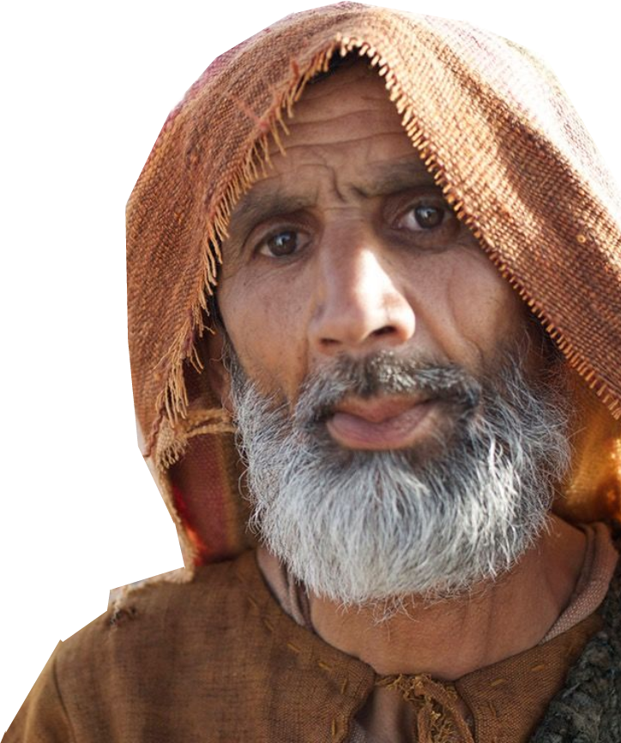
Zechariah: Day of the Lord
DAY OF THE SECOND COMING
³ Then the LORD will go out and fight
against those nations, as he fights in
the day of battle. ⁴ On that day his
feet will stand on the Mount of Olives,
east of Jerusalem, and the Mount of
Olives will be split in two from east to
west, forming a great valley, with half of the mountain moving north and half moving south.

Slide 10
Zechariah: Day of the Lord
DAY OF MILLENIAL REIGN
⁹ The LORD will be king over the whole earth. On that day there will be one LORD, and his name the only name.

Slide 11
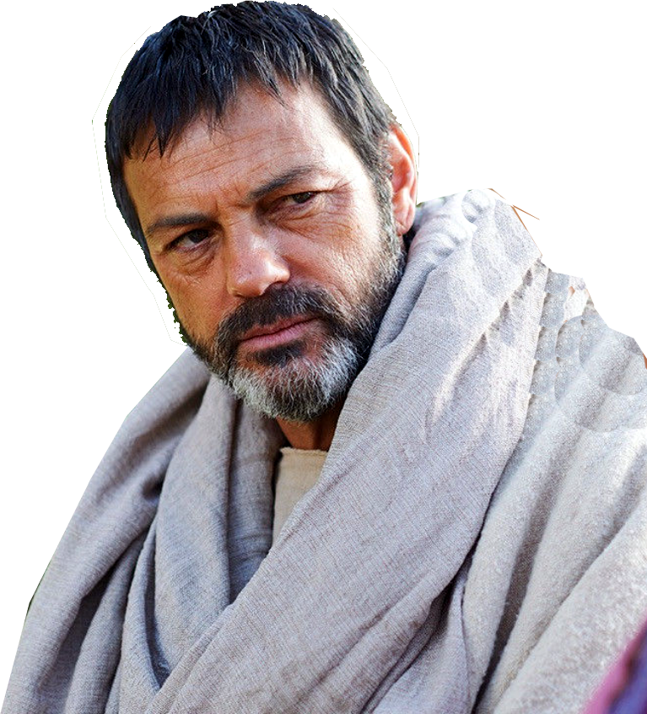
How does the Rapture fit in?
BEFORE THE DAY OF THE LORD
² for you know very well that the day of the Lord will come like a thief in the night. ³ While people are saying, "Peace and safety," destruction will come on them suddenly, (1Thes 5:2-3)

Slide 12
How does the Rapture fit in?
BEFORE THE DAY OF THE LORD
⁹ For God did not appoint us to suffer wrath but to receive salvation through our Lord Jesus Christ. ¹⁰ He died for us so that, whether we are awake or asleep, we may live together with him.
(1Thes 5:9-10)

Slide 13
Think about this ...
Since the Rapture removes the Church from the earth before the Day of the Lord ...
But what about those ...
LEFT BEHIND?
I will come back and take you to be with me. John 14:3

Slide 14
Dark Days are Ahead ...
But, how dark?

Slide 15
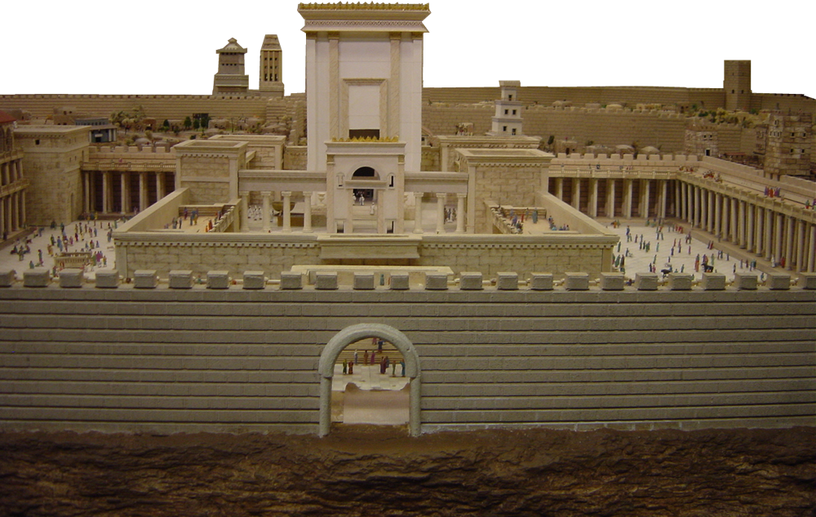
Matthew 24:1-14
¹ Jesus left the temple and was walking away when his disciples came up to him to call his attention to its buildings.

Slide 16
² "Do you see all these things?" he asked. "I tell you
the truth, not one stone here will be left on another; everyone will be thrown down.”

Slide 17
³ As Jesus was sitting on the Mount of Olives, the disciples came to him privately. "Tell us," they said, "when will this happen, and what will be the sign of your coming and of the end of the age?”
1
2
1
Answered in Luke 21:20-24
2
Answered in verses 24:4-44
Notes:
The second question is about a single “sign” that marks both the coming of Messiah who will end the age and inaugurate the next one = millennium.

Slide 18
His Answer Falls into
Three parts about the
“Tribulation”

Slide 19
1. The Beginning of the Tribulation
2. The Middle of the Tribulation
3. The End of the Tribulation

Slide 20
The Beginning of the Tribulation
Matthew 24:4-14
2. The Middle of the Tribulation
3. The End of the Tribulation

Slide 21
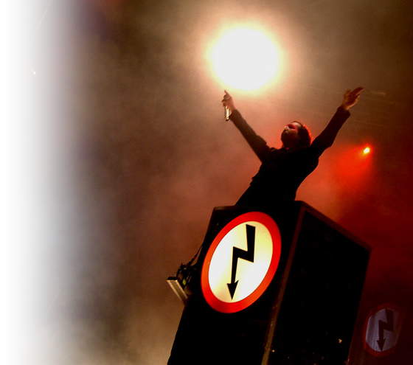
1-Deception—False Christs
⁴ Jesus answered: "Watch out that no one deceives you. ⁵ For many will come in my name, claiming, 'I am the Christ, ' and will deceive many.
Notes:
Deceives claim to be the Christ.
The apostle John calls them “Anti-Christs” = 1 John 2:18, 22; 4:3;2 John 1:7
Part of the deception is that there is “peace and safety” because “sudden destruction is about to follow ...
Anti-Christ Free to reuse:
http://commons.wikimedia.org/wiki/File:Marilyn_Manson_performing_Antichrist_Superstar,_SomewhatDamaged2.jpg

Slide 22
1-Deception—False Christs
Antichrists are many
1 John 2:18
Dear children, this is the last hour; and as you have heard that the antichrist is coming, even now many antichrists have come. This is how we know it is the last hour.
Notes:
Last hour = our age of grace. Kind of like Churchill calling the battle for France the “their finest hour” – figurative speech, not for 60 minutes but for days on end of war.
Deceives claim to be the Christ.
The apostle John calls them “Anti-Christs” = 1 John 2:18, 22; 4:3;2 John 1:7
Part of the deception is that there is “peace and safety” because “sudden destruction is about to follow ...
Anti-Christ Free to reuse:
http://commons.wikimedia.org/wiki/File:Marilyn_Manson_performing_Antichrist_Superstar,_SomewhatDamaged2.jpg

Slide 23
1-Deception—False Christs
Antichrist is a Liar / Denier
1 John 2:22 Who is the liar?
It is the man who denies that Jesus is the Christ. Such a man is the antichrist--he denies the Father and the Son. ²³ No one who denies the Son has the Father; whoever acknowledges the Son has the Father also.
Notes:
Deceives claim to be the Christ.
The apostle John calls them “Anti-Christs” = 1 John 2:18, 22; 4:3;2 John 1:7
Part of the deception is that there is “peace and safety” because “sudden destruction is about to follow ...
Anti-Christ Free to reuse:
http://commons.wikimedia.org/wiki/File:Marilyn_Manson_performing_Antichrist_Superstar,_SomewhatDamaged2.jpg

Slide 24
1-Deception—False Christs
Antichrist rejects Jesus
1 John 4:3
but every spirit that does not acknowledge Jesus is not from God. This is the spirit of the antichrist, which you have heard is coming and even now is already in the world.
Notes:
Deceives claim to be the Christ.
The apostle John calls them “Anti-Christs” = 1 John 2:18, 22; 4:3;2 John 1:7
Part of the deception is that there is “peace and safety” because “sudden destruction is about to follow ...
Anti-Christ Free to reuse:
http://commons.wikimedia.org/wiki/File:Marilyn_Manson_performing_Antichrist_Superstar,_SomewhatDamaged2.jpg

Slide 25
1-Deception—False Christs
Antichrists Reject Christmas
2 John 1:7
Many deceivers, who do not acknowledge Jesus Christ as coming in the flesh, have gone out into the world. Any such person is the deceiver and the antichrist.
Notes:
Deceives claim to be the Christ.
The apostle John calls them “Anti-Christs” = 1 John 2:18, 22; 4:3;2 John 1:7
Part of the deception is that there is “peace and safety” because “sudden destruction is about to follow ...
Anti-Christ Free to reuse:
http://commons.wikimedia.org/wiki/File:Marilyn_Manson_performing_Antichrist_Superstar,_SomewhatDamaged2.jpg

Slide 26
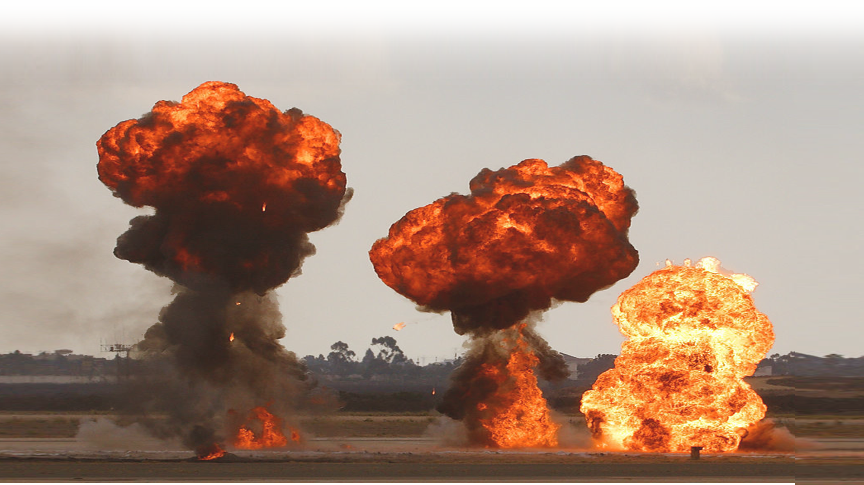
2-Wars
⁶ You will hear of wars and rumors of wars, but see to it that you are not alarmed. Such things must happen, but the end is still to come. ⁷ Nation will rise against nation, and kingdom against kingdom.
Notes:
Explosions in Public domain
Wars and rumors of wars – there have always been wars and rumors of war, but these seem to be in connection with the false claims of Messiahship. They are not the final war—but precursors to the final war. There is a final war coming.
Nations will align themselves against each other.
Ezekiel tells us of a norther collision aligned against Isreal in Ezekiel 38
Daniel tells us of a revived Roman Empire in the West Daniel 2, 7,8, 11-12
Daniel also identifies forces to the South Daniel 11
Armies from the east Rev 16, 9:11 (200 million mounted)
It ends in the final Battle for Jerusalem (Armageddon) The Final Battle for Jerusalem Zech 14

Slide 27
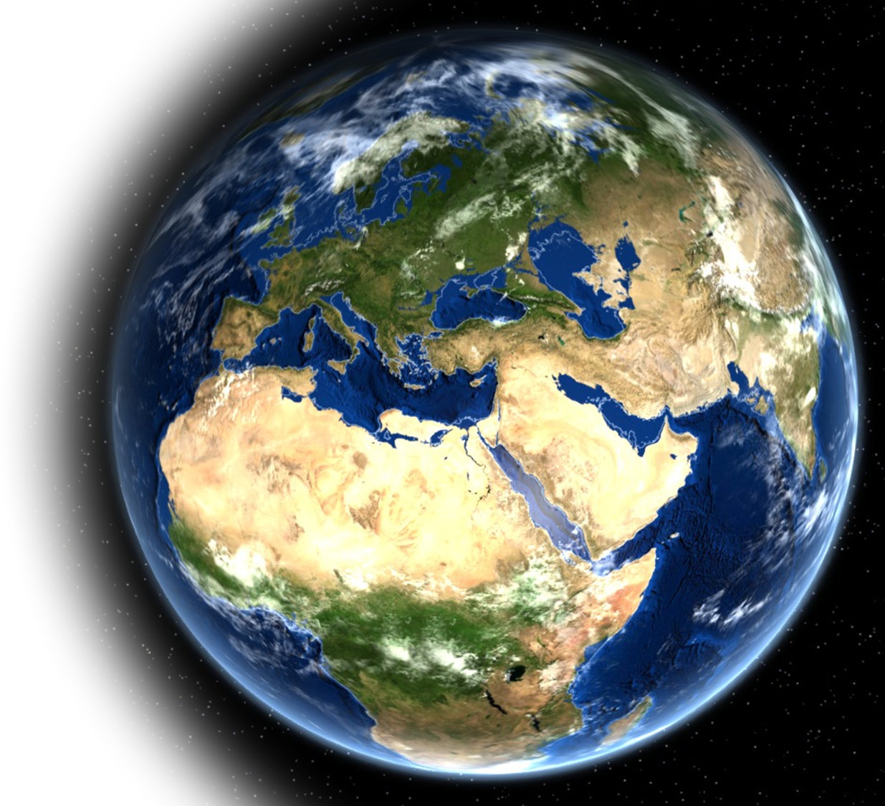
Ezekiel 38
² "Son of man, set your face against Gog, of the land of Magog, the chief prince of Meshech and Tubal; prophesy against him ³ and say: 'This is what the Sovereign LORD says: I am against you, O Gog, chief prince of Meshech and Tubal.

Slide 28
Ezekiel 38
² "Son of man, set your face against Gog, of the land of Magog, the chief prince of Meshech and Tubal; prophesy against him ³ and say: 'This is what the Sovereign LORD says: I am against you, O Gog, chief prince of Meshech and Tubal.
Magog

Slide 29
Ezekiel 38
⁵ Persia, Cush and Put will be with them, all with shields and helmets,
⁶ also Gomer with all
its troops, and Beth Togarmah from the far north with all its troops--the many nations with you.
Magog
Persia

Slide 30
Ezekiel 38
⁵ Persia, Cush and Put will be with them, all with shields and helmets,
⁶ also Gomer with all
its troops, and Beth Togarmah from the far north with all its troops--the many nations with you.
Magog
Persia
Cush

Slide 31
Ezekiel 38
⁵ Persia, Cush and Put will be with them, all with shields and helmets,
⁶ also Gomer with all
its troops, and Beth Togarmah from the far north with all its troops--the many nations with you.
Magog
Persia
Put
Cush

Slide 32
Ezekiel 38
⁵ Persia, Cush and Put will be with them, all with shields and helmets,
⁶ also Gomer with all
its troops, and Beth Togarmah from the far north with all its troops--the many nations with you.
Gomer
Magog
Persia
Put
Cush

Slide 33
Ezekiel 38
⁵ Persia, Cush and Put will be with them, all with shields and helmets,
⁶ also Gomer with all
its troops, and Beth Togarmah from the far north with all its troops--the many nations with you.
Gomer
Magog
Togarmah
Persia
Put
Cush

Slide 34
Ezekiel 38
⁵ Persia, Cush and Put will be with them, all with shields and helmets,
⁶ also Gomer with all
its troops, and Beth Togarmah from the far north with all its troops--the many nations with you.
Gomer
Magog
Togarmah
Persia
Put
Cush

Slide 35
Ezekiel 38
⁸ After many days you will be called to arms. In future years you will invade a land that has recovered from war, whose people were gathered from many nations to the mountains of Israel, which had long been desolate. They had ...
Gomer
Magog
Togarmah
Persia
Put
Cush

Slide 36
Ezekiel 38
been brought out from the nations, and now all of them live in safety.
⁹ You [Gog] and all your troops and the many nations with you will go
up, advancing like a storm; you will be like a cloud covering the land.
Gomer
Magog
Togarmah
Persia
Put
Cush

Slide 37
Ezekiel 38
¹⁵ You will come from your place in the far north, you
and many nations with
you, .... ¹⁶ You will
advance against my
people Israel like a cloud
that covers the land. In
days to come, O Gog, I will bring you against my land, ....
Gomer
Magog
Togarmah
Persia
Put
Cush

Slide 38
Ezekiel 38
¹⁸ This is what will happen in that day .... ¹⁹ In my
zeal and fiery wrath I declare that at that time there shall be a great earthquake in the land of Israel. ²¹ I will summon a sword against Gog on all my mountains, ....
Gomer
Magog
Togarmah
Persia
Put
Cush

Slide 39
Ezekiel 38
Every man's sword will be against his brother. ²² I
will execute judgment upon him with plague
and bloodshed; I will
pour down torrents of
rain, hailstones and burning sulfur on him
and on his troops and on the many nations with him.
Gomer
Magog
Togarmah
Persia
Put
Cush

Slide 40
Ezekiel 38
39:⁴ On the mountains of Israel you will fall, you
and all your troops and
the nations with you. ....
Gomer
Magog
Togarmah
Persia
Put
Cush

Slide 41
Ezekiel 38
39:⁴ On the mountains of Israel you will fall, you
and all your troops and
the nations with you. ....
Gomer
Magog
Togarmah
Persia
Put
Cush

Slide 42
The Rumors of this war
39:⁴ On the mountains of Israel you will fall, you
and all your troops and
the nations with you. ....
⁸ It is coming! It will
surely take place, declares the Sovereign LORD. This is the day I have spoken of.
Gomer
Magog
Togarmah
Persia
Put
Cush

Slide 43
2-Wars
⁶ You will hear of wars and rumors of wars, but see to it that you are not alarmed. Such things must happen, but the end is still to come. ⁷ Nation will rise against nation, and kingdom against kingdom.
Notes:
Explosions in Public domain
Wars and rumors of wars – there have always been wars and rumors of war, but these seem to be in connection with the false claims of Messiahship. They are not the final war—but precursors to the final war. There is a final war coming.
Nations will align themselves against each other.
Ezekiel tells us of a norther collision aligned against Isreal in Ezekiel 38
Daniel tells us of a revived Roman Empire in the West Daniel 2, 7,8, 11-12
Daniel also identifies forces to the South Daniel 11
Armies from the east Rev 16, 9:11 (200 million mounted)
It ends in the final Battle for Jerusalem (Armageddon) The Final Battle for Jerusalem Zech 14

Slide 44
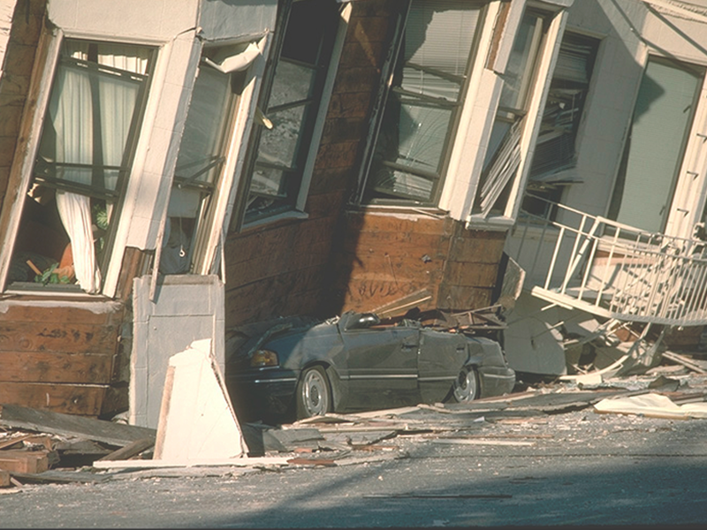
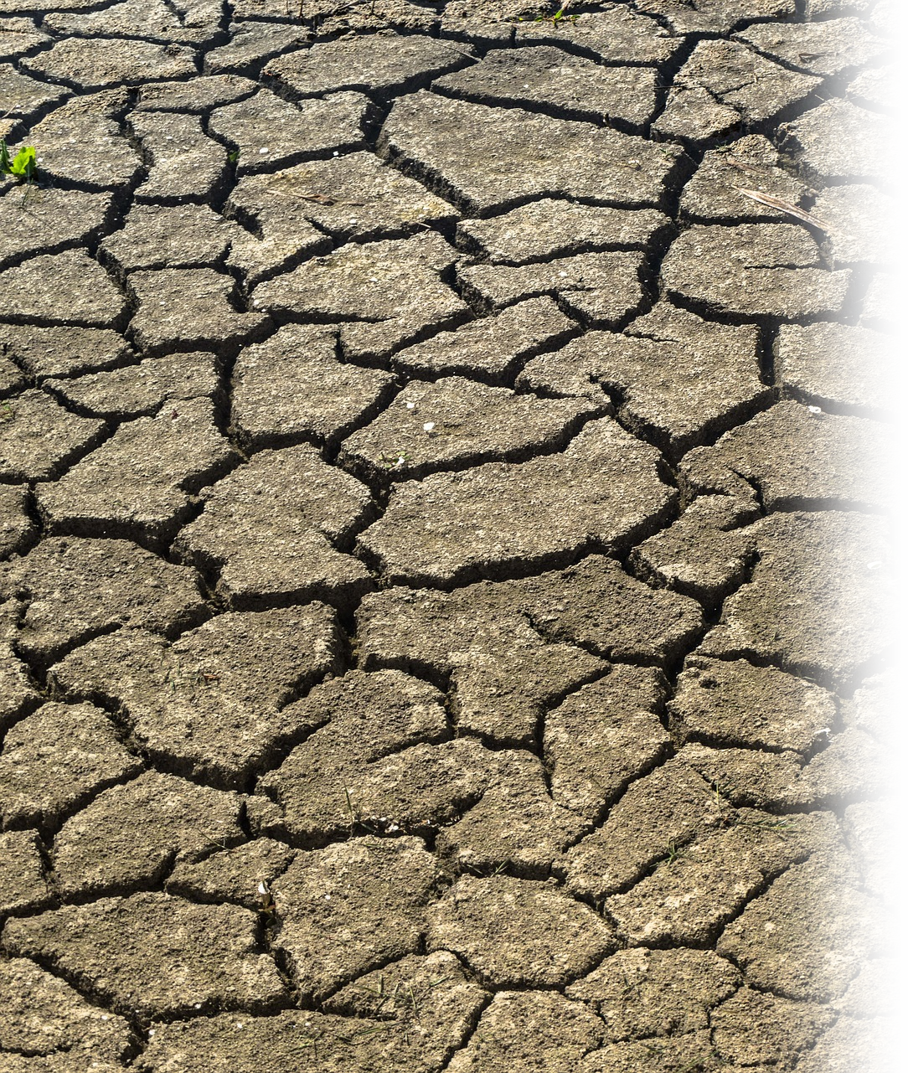
3-Famines and Earthquakes
⁷ … There will be famines and earthquakes in various places.
Notes:
Famine = See Rev 6:8 where ¼ of human population is killed by war, FAMINE, plague, and wild bests
Earthquake = See Rev 6:12 sixth seal = There was a great earthquake 11:13 a sever earthquake 16:18-19 mega earthquake
Reuse permitted earthquake photo:
https://pixabay.com/photos/drought-mud-dry-africa-famine-1745154/ http://www.google.com/imgres?imgurl=http://mix.msfc.nasa.gov/IMAGES/HIGH/0004352.jpg&imgrefurl=http://mix.msfc.nasa.gov/abstracts.php%3Fp%3D755&usg=__yBMdxkYB39L8i6xn4BPxtkcvEH4=&h=2000&w=3000&sz=2208&hl=en&start=52&zoom=1&tbnid=wVSzK6_0ttBqWM:&tbnh=152&tbnw=206&prev=/images%3Fq%3Dearthquake%26um%3D1%26hl%3Den%26client%3Dfirefox-a%26rls%3Dorg.mozilla:en-US:official%26biw%3D1296%26bih%3D672%26as_st%3Dy%26tbs%3Disch:1,iur:f0%2C1592&um=1&itbs=1&iact=rc&dur=398&ei=RWzkTI3TBYH98Abi8aSgDQ&oei=iGrkTNKpKo7vsgaC-fieBA&esq=30&page=4&ndsp=18&ved=1t:429,r:11,s:52&tx=145&ty=32&biw=1296&bih=672

Slide 45
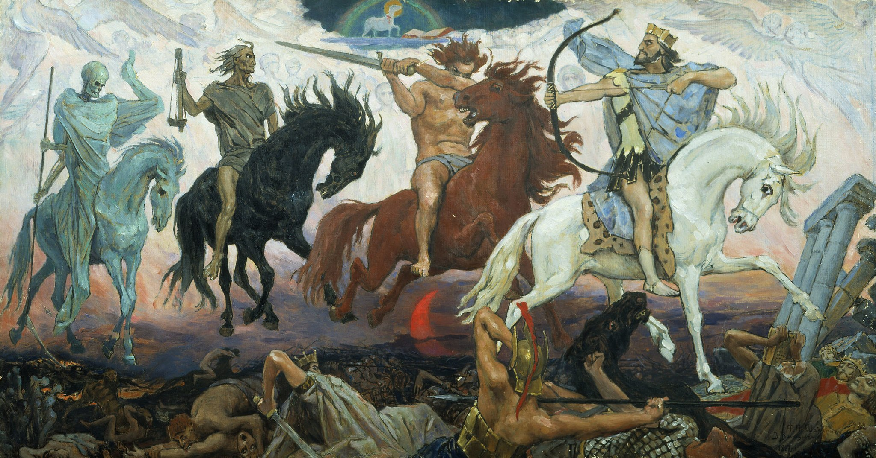

Four Horsemen of Revelation 6
1st
DECEPTION
6:1-2
Notes:
https://commons.wikimedia.org/wiki/File:Apocalypse_vasnetsov.jpg

Slide 46
Four Horsemen of Revelation 6
1st
DECEPTION
6:1-2
2nd
WAR
6:3-4
Notes:
https://commons.wikimedia.org/wiki/File:Apocalypse_vasnetsov.jpg

Slide 47
Four Horsemen of Revelation 6
1st
DECEPTION
6:1-2
2nd
WAR
6:3-4
3rd FAMINE
6:5-6
Notes:
https://commons.wikimedia.org/wiki/File:Apocalypse_vasnetsov.jpg

Slide 48
Four Horsemen of Revelation 6
1st
DECEPTION
6:1-2
2nd
WAR
6:3-4
3rd FAMINE
6:5-6
4th
DEATH
6:5-6
Notes:
https://commons.wikimedia.org/wiki/File:Apocalypse_vasnetsov.jpg

Slide 49
This is just the beginning of the end!
⁸ All these are the beginning of birth pains.

Slide 50
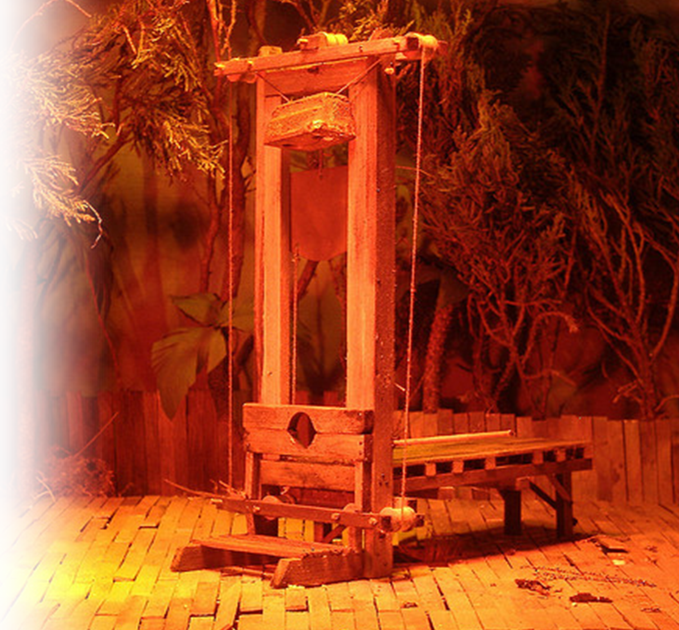
4-Martyrdom (death)
⁹ "Then you will be handed over to be persecuted and put to death, and you will be hated by all nations because of me.
Notes:
// Revelation ⁹ When he opened the fifth seal, I saw under the altar the souls of those who had been slain because of the word of God and the testimony they had maintained (Rev 6:9 NIV)
7:9,11-14
“beheaded” in the great tribulation (Rev 20:4)
Free guillotine: http://www.google.com/imgres?imgurl=http://farm4.static.flickr.com/3276/2610718075_33f6655748_z.jpg&imgrefurl=http://www.flickr.com/photos/rustyboxcars/2610718075/&usg=__2MKWEvY7lzzrL_QeVBpal-Z0XJQ=&h=480&w=640&sz=157&hl=en&start=0&zoom=1&tbnid=KN8BgytOR9lEyM:&tbnh=137&tbnw=178&prev=/images%3Fq%3Dguillotine%26um%3D1%26hl%3Den%26client%3Dfirefox-a%26rls%3Dorg.mozilla:en-US:official%26biw%3D1296%26bih%3D672%26as_st%3Dy%26tbs%3Disch:1,iur:f&um=1&itbs=1&iact=hc&vpx=620&vpy=165&dur=2667&hovh=194&hovw=259&tx=150&ty=160&ei=iWvkTI3BC4OztAapmLCeBA&oei=iWvkTI3BC4OztAapmLCeBA&esq=1&page=1&ndsp=21&ved=1t:429,r:3,s:0

Slide 51
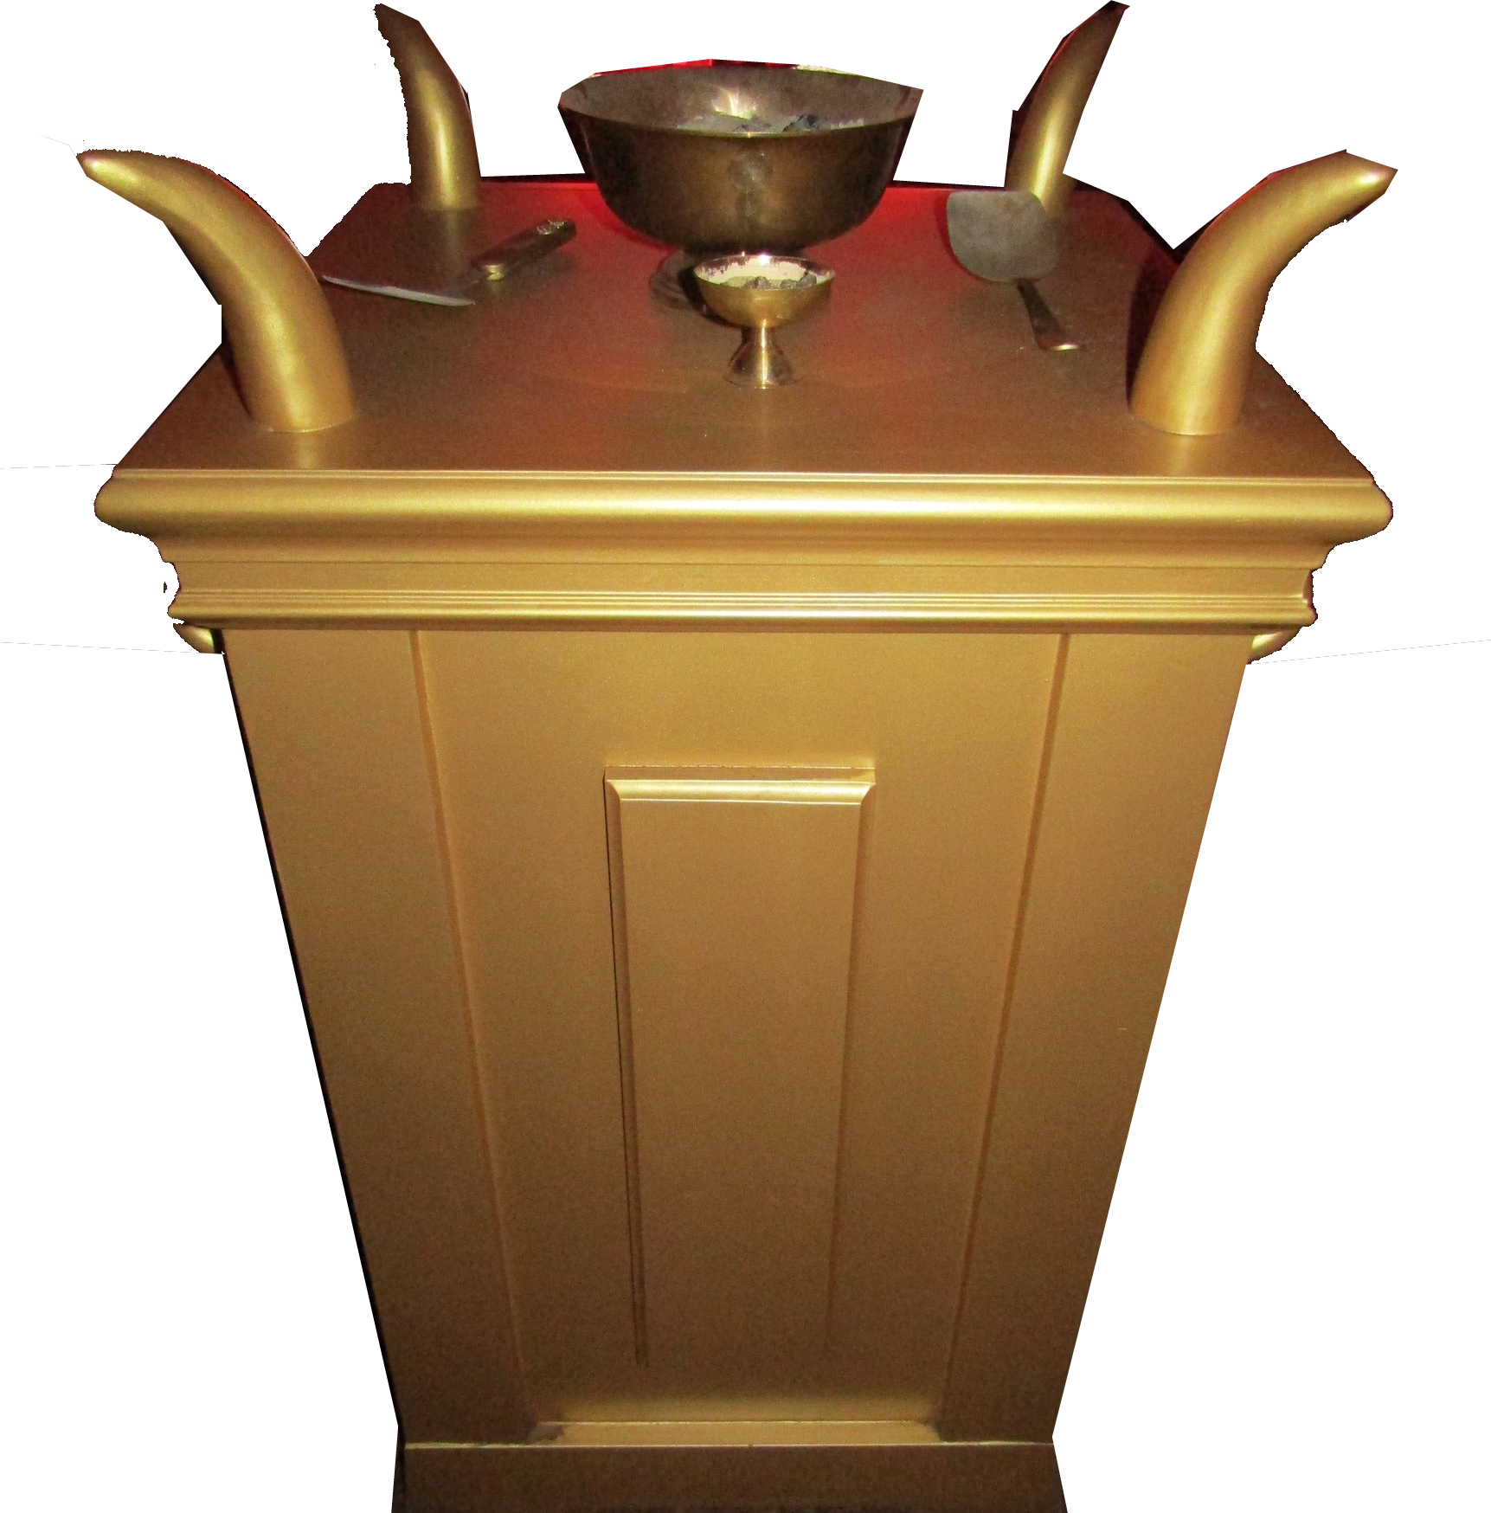
Fifth Seal
5th
⁹ When he opened the fifth seal, I saw under the altar the souls of those who had been slain because of the word of God and the testimony they had maintained.
(Revelation 6:9)
Notes:
https://www.flickr.com/photos/88663091@N04/39825616841
At this point the Revelation does not follow the pattern set by Jesus. There is enough to confirm that the two are about the coming Tribulation.

Slide 52
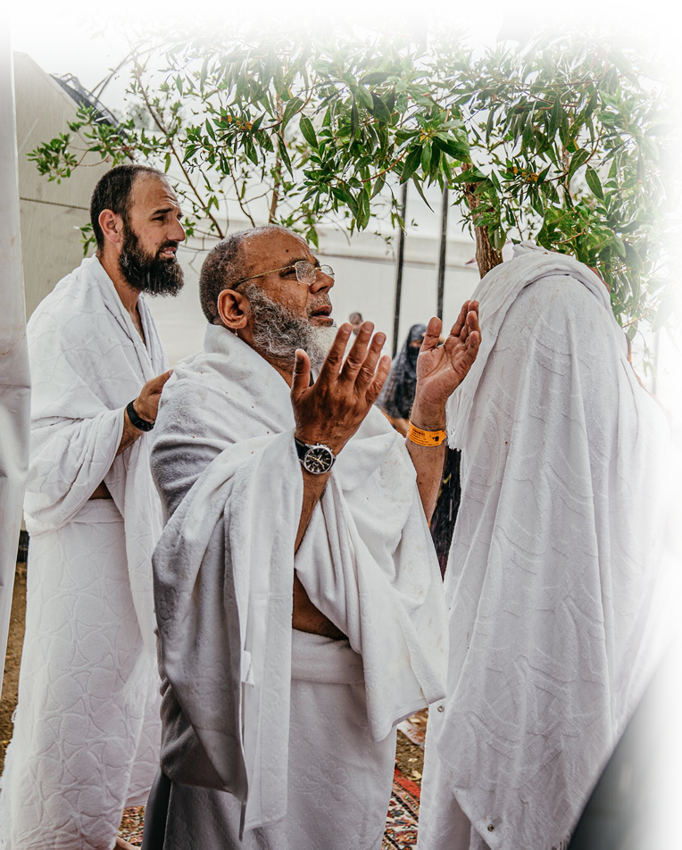
Great Multitude in heaven
Rev 7:9 ... there before me was a great multitude that no one could count, from every nation, tribe, people and language, standing before the throne and in front of the Lamb. They were wearing white robes and were holding palm branches in their hands.
Notes:
https://www.pexels.com/photo/men-in-white-robes-2787826//
At this point the Revelation does not follow the pattern set by Jesus. There is enough to confirm that the two are about the coming Tribulation.

Slide 53
Great Multitude in heaven
¹³ Then one of the elders asked me, "These in white robes--who are they, and where did they come from?"
¹⁴ I answered, "Sir, you know." And he said, "These are they who have come out of the great tribulation; they have washed their robes and made them white in the blood of the Lamb.
Notes:
https://www.pexels.com/photo/men-in-white-robes-2787826/
At this point the Revelation does not follow the pattern set by Jesus. There is enough to confirm that the two are about the coming Tribulation.

Slide 54
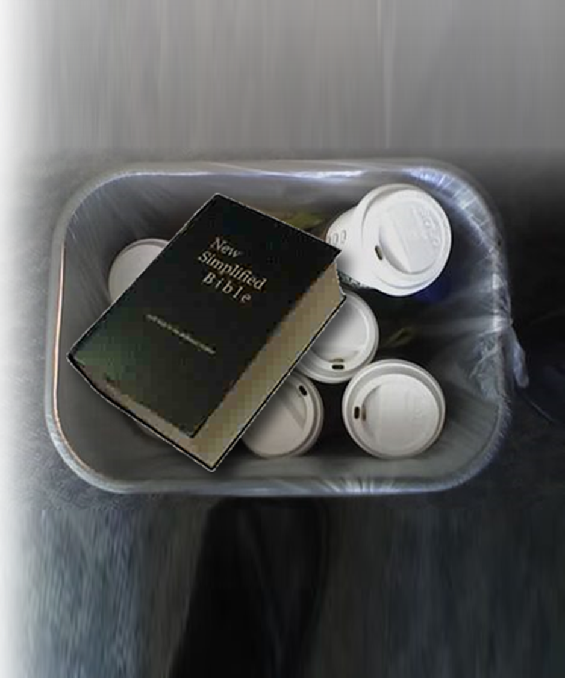
5-Apostasy
¹⁰ At that time many will turn away from the faith and will betray and hate each other, ¹¹ and
many false prophets will
appear and deceive many
people.
Notes:
// 1 Timothy 4:1 The Spirit clearly says that in later times some will abandon the faith and follow deceiving spirits and things taught by demons. (1Ti 4:1 NIV)
The “nones” of our generation are those who turn away to “none of the above.”
Without the Lord in their lives they betray and hate. You see, God is love.
All this is happening because they are deceived by false prophets.
All this is leading to the fact that in the end time an ultimate false Messiah and false Prophet will emerge who 2 Thess says will deceive many and because the refuse to believe the truth God sends them a powerful delusion so that they will believe the lie.
Trash can: http://www.google.com/imgres?imgurl=http://www.rudecactus.com/coffee-thumb.jpg&imgrefurl=http://www.rudecactus.com/2008/03/there_a_slight_chance_i.html&usg=__-d0ZJsNEpBT9QkpYddNFvgePiz0=&h=337&w=450&sz=25&hl=en&start=61&zoom=1&tbnid=4vTRogeeIawUZM:&tbnh=154&tbnw=201&prev=/images%3Fq%3Dtrash%2Bcan%26um%3D1%26hl%3Den%26client%3Dfirefox-a%26sa%3DG%26rls%3Dorg.mozilla:en-US:official%26biw%3D1296%26bih%3D672%26as_st%3Dy%26tbs%3Disch:1,iur:f0%2C1317&um=1&itbs=1&iact=hc&vpx=149&vpy=395&dur=418&hovh=154&hovw=206&tx=140&ty=72&ei=onDkTPWLEcL78AaDkpGfDQ&oei=bnDkTNzrOceFswaE2rifBA&esq=8&page=4&ndsp=18&ved=1t:429,r:0,s:61&biw=1296&bih=672

Slide 55
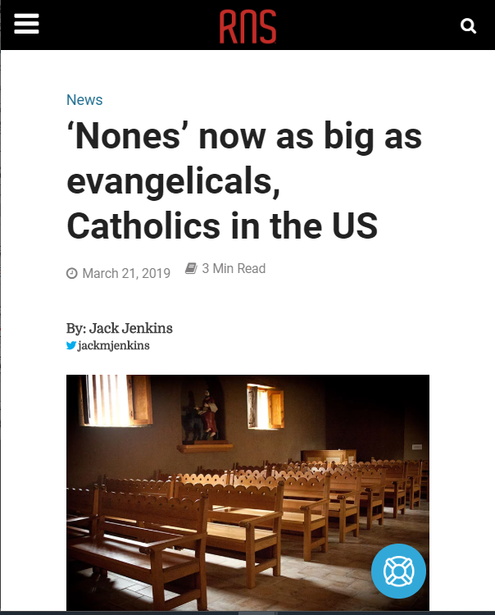
The “Nones”
1 Timothy 4:1
The Spirit clearly says that in later times some will abandon the faith and follow deceiving spirits and things taught by demons.
Notes:
Even at the later times of the Church age “some will abandon the faith.”
Imagine what it will be like in the “Tribulation.”
https://religionnews.com/2019/03/21/nones-now-as-big-as-evangelicals-catholics-in-the-us/

Slide 56

6-cold hearted
¹² Because of the increase of wickedness, the love of most will grow cold,
¹³ but he who stands firm to the end will be saved.
Notes:
https://www.needpix.com/photo/download/1377158/heart-cold-ice-frost-snow-background-wallpaper-blue-illustrationWickedness abound, so people are desensitized to it – the result is they are cold hearted, loveless.
In contrast, those who stand firm in their faith, in the end will be saved.

Slide 57
Heartless ...
2 Timothy 3:1 But mark this: There will be terrible times in the last days. ² People will be lovers of themselves, lovers of money, boastful, proud, abusive, disobedient to their parents, ungrateful, unholy, ³ without love, unforgiving, slanderous, without self-control, brutal, not lovers of the good, ⁴ treacherous, rash, conceited, lovers of pleasure rather than lovers of God-- ⁵ having a form of godliness but denying its power. Have nothing to do with them. (2Timothy 3:1-5)
Notes:
https://www.needpix.com/photo/download/1377158/heart-cold-ice-frost-snow-background-wallpaper-blue-illustration

Slide 58
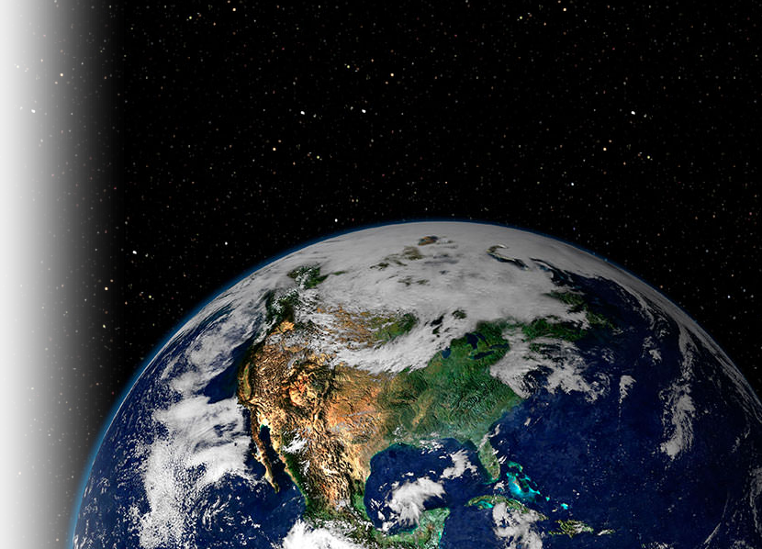

7-Great Awakening
¹⁴ And this gospel of the kingdom will be preached in the whole world as a testimony to all nations, and then the end will come.
Notes:
Rev 7:1
Labeled Reuse: http://www.google.com/imgres?imgurl=http://farm3.static.flickr.com/2454/3631642493_07ff679032_z.jpg&imgrefurl=http://www.flickr.com/photos/gnmcauley/3631642493/&usg=___f79VjVa8RTML3eblha3J2jCNYo=&h=640&w=606&sz=253&hl=en&start=37&zoom=1&tbnid=49qYcm2pdZdilM:&tbnh=162&tbnw=153&prev=/images%3Fq%3Dpreaching%26um%3D1%26hl%3Den%26client%3Dfirefox-a%26rls%3Dorg.mozilla:en-US:official%26biw%3D1296%26bih%3D672%26as_st%3Dy%26tbs%3Disch:1,iur:f0%2C1113&um=1&itbs=1&iact=rc&dur=423&ei=tW3kTNyOA8L48AbE_b3SAQ&oei=gG3kTMG5I4a1tAb42-CeBA&esq=17&page=3&ndsp=18&ved=1t:429,r:9,s:37&tx=97&ty=48&biw=1296&bih=672

Slide 59
7-Great Awakening
¹⁴ And this gospel of the kingdom will be preached in the whole world as a testimony to all nations, and then the end will come.
⁹ For God did not appoint us to suffer wrath but to receive salvation through our Lord Jesus Christ.
Does not mean, “This is the end,”
But “the end is in sight.” (Future tense)
Beginning of … pain 8
Great Tribulation 21
Tribulation
Notes:
Rev 7:1
Labeled Reuse: http://www.google.com/imgres?imgurl=http://farm3.static.flickr.com/2454/3631642493_07ff679032_z.jpg&imgrefurl=http://www.flickr.com/photos/gnmcauley/3631642493/&usg=___f79VjVa8RTML3eblha3J2jCNYo=&h=640&w=606&sz=253&hl=en&start=37&zoom=1&tbnid=49qYcm2pdZdilM:&tbnh=162&tbnw=153&prev=/images%3Fq%3Dpreaching%26um%3D1%26hl%3Den%26client%3Dfirefox-a%26rls%3Dorg.mozilla:en-US:official%26biw%3D1296%26bih%3D672%26as_st%3Dy%26tbs%3Disch:1,iur:f0%2C1113&um=1&itbs=1&iact=rc&dur=423&ei=tW3kTNyOA8L48AbE_b3SAQ&oei=gG3kTMG5I4a1tAb42-CeBA&esq=17&page=3&ndsp=18&ved=1t:429,r:9,s:37&tx=97&ty=48&biw=1296&bih=672

Slide 60
Next Time
2. The Middle of the Tribulation
Beginning of … pain 8
Great Tribulation 21
Tribulation

Slide 61
Take this with you Today ...

Slide 62
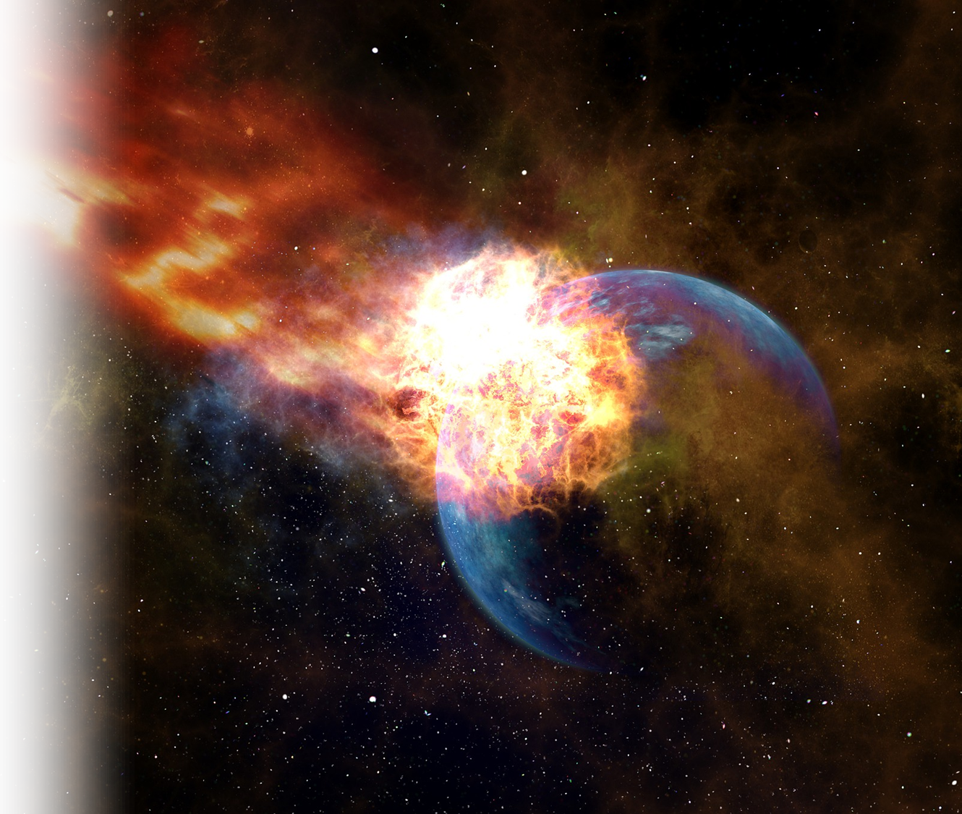
We’re not appointed to Wrath
⁹ For God did not appoint
us to suffer wrath but to receive salvation through
our Lord Jesus Christ
Notes:
https://pixabay.com/photos/meteor-impact-globe-planet-trace-3127290/

Slide 63
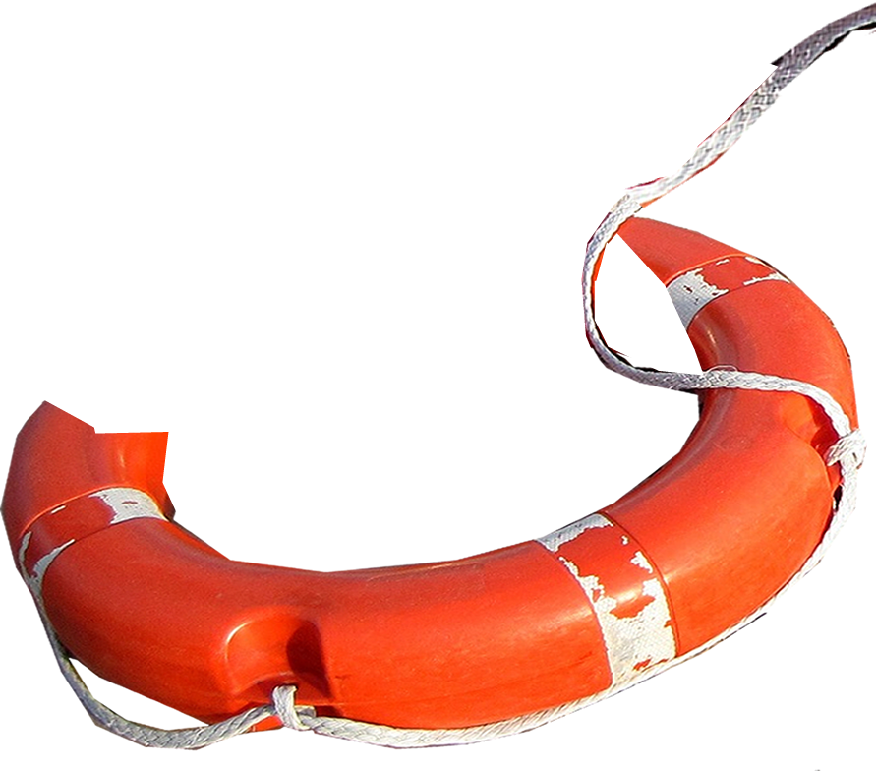
We’re Appoint to Salvation
⁹ For God did not appoint
us to suffer wrath but to receive salvation through
our Lord Jesus Christ.
Notes:
https://libreshot.com/old-stone-cross-at-night/

Slide 64
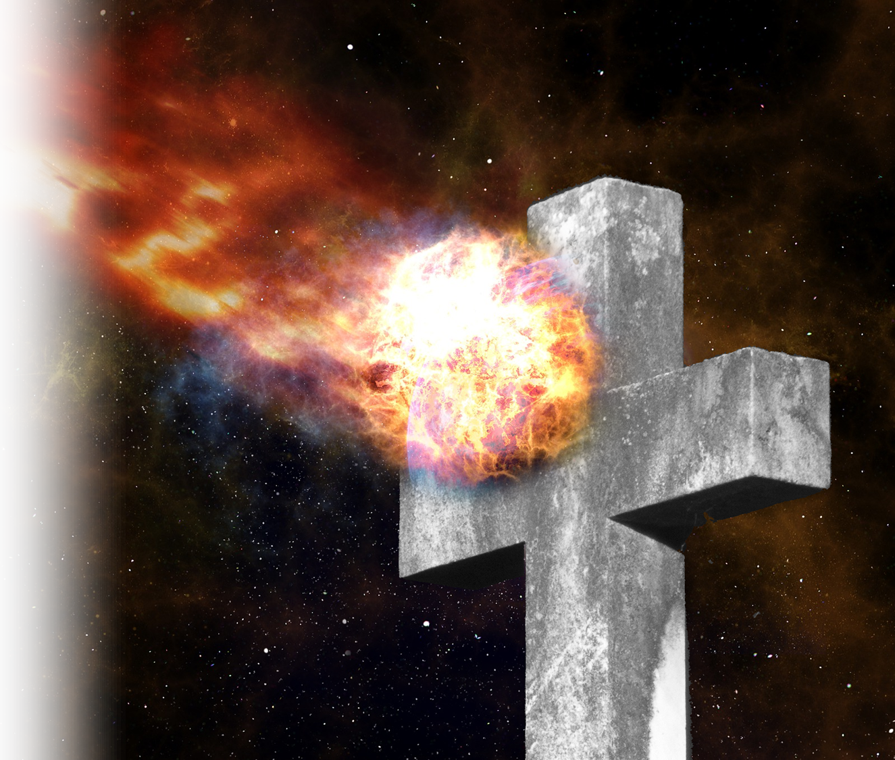
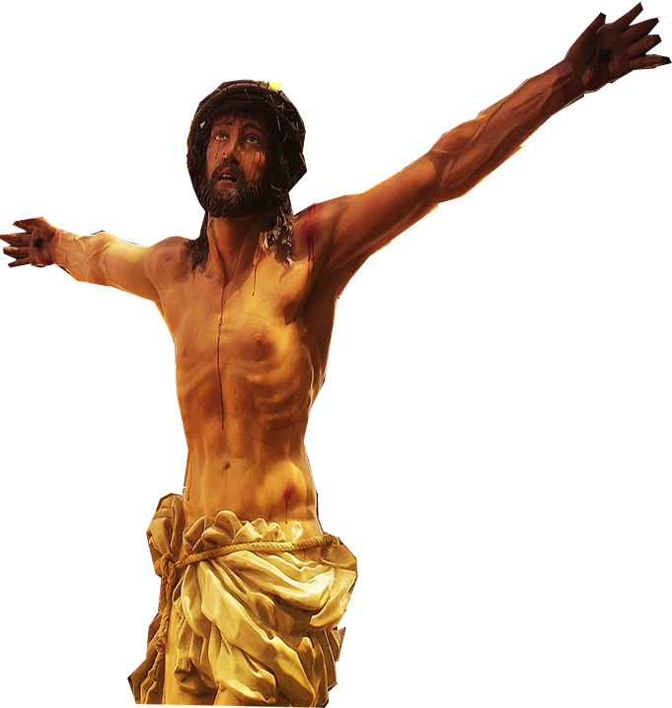
Jesus already took our wrath
¹⁰ He died for us so that,
whether we are awake or
asleep, we may live
together with him.
⁹ Since we have now been
justified by his blood, how much
more shall we be saved from God's wrath through him! (Romans 5:9)
Notes:
https://pixabay.com/photos/christ-cross-faith-jesus-passion-3484141/

Slide 65
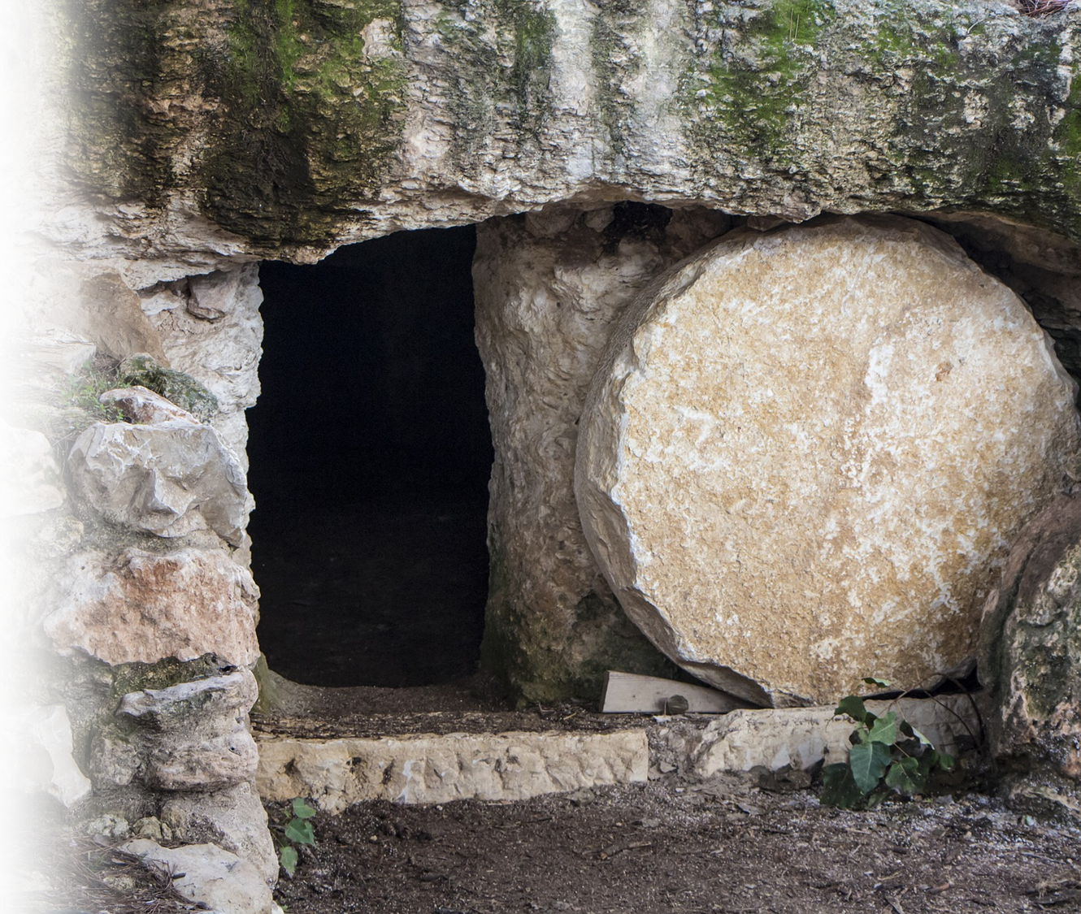
Jesus gives us life!
¹⁰ He died for us so that,
whether we are awake or
asleep, we may live
together with him.
Notes:
https://pixabay.com/photos/empty-tomb-nazareth-israel-3326100/

Slide 66
Jesus gives us life!
"I am the resurrection and the life. He who believes in me will live, even though he dies;
²⁶ and whoever lives and believes in me will never die. Do you believe this?"
(John 11:25-26)
Notes:
https://pixabay.com/photos/empty-tomb-nazareth-israel-3326100/

Slide 67
Let’s Pray!

