Slide 1

Things to Come!
Daniel 2:29
This presentation uses Airstrike Condensed font:
https://www.dafont.com/airstrike.font
Notes:
Backround image = FREE = Image by <a href="https://pixabay.com/users/geralt-9301/?utm_source=link-attribution&amp;utm_medium=referral&amp;utm_campaign=image&amp;utm_content=2709662">Gerd Altmann</a> from <a href="https://pixabay.com/?utm_source=link-attribution&amp;utm_medium=referral&amp;utm_campaign=image&amp;utm_content=2709662">Pixabay</a>
Copyright © 2006−2021. All rights reserved. Bible Point is a registered trademark of Dennis Henderson. All other trademarks acknowledged.
Bible Point contains graphics from Bible Point artists. These illustrations belong to Bible Point and the respective artists. You may use the designs and illustrations for graphical illustration of lessons free and without special permission, provided they are not used in any way that maligns the Christian faith. Furthermore, republication or production of any illustration by any other graphic service whether it be in book, in a machine-readable form, or in any other design resource is strictly prohibited. Furthermore, they cannot be duplicated or resold as any other form of publishing, clip art, or graphic resource.
So What does it mean? (A simple translations of the legal jargon)
So, if you don’t own the presentation(s), graphic(s), and text(s) how can you legally use them? The purchase of the license allows you to use all the images in the product. However, the actual ownership and copyright of the presentation(s), graphic(s), and text(s) remain the property of Bible Point and its licensors. If you had plans on using this product in your “for sale” work—think again!
License Agreement
Article 1: License Grant
All the graphics and text in Bible Point presentations (excluding quotes from the Bible and stated sources) are the intellectual and real property of Bible Point and its licensors, and is protected by law, including United States copyright laws and international treaties. Bible Point grants to you a license:
1. To use the presentation in a single church, single school, or single office of a Christian organization.
2. To make a single archival back-up copy of the program.
3. To modify the presentation(s) and merge with other presentations in a single church, school, or Christian organization.
4. To transfer to another party if that party agrees to accept the terms and conditions of this agreement, and you do not retain any copies of the presentation, whether printed, machine readable, modified, or merged form.
Article 2: Terms
This license is effective until terminated. You may terminate the license at any time by destroying the presentation(s), graphic(s), or text(s) together with all copies, modifications and merged portions in any form. Bible Point may terminate your license if you fail to comply with this Agreement. You agree, upon such termination, for any reason, to destroy the presentation(s), graphics, and text(s) with all copies, modifications, and merged portions in any form.
Article 3: Disclaimers
1. Bible Point presentations, graphics, and texts are licensed to you As Is. You, the consumer, bear the entire risk relating to the quality and performance of the presentation(s), graphic(s), or text(s). In no event will Bible Point be liable for damages resulting from any defect.
2. Thirty-day limited warrantee on disks. Bible Point warrants the disks to be free of defects in material and workmanship under normal use for 30 days after purchase. During the 30-day period you may return a defective presentation, graphic, or text with proof of purchase and it will be replaced without charge, unless the presentation is damaged by misuse.
Article 4: General
1. You may not sub-license, assign, or transfer the license of the presentation(s), graphic(s), or text(s) except as provided by this Agreement.
2. This Agreement will be governed by the laws of the State of Michigan.
So What does it mean? (A simple translations of the legal jargon)
May I let someone borrow or copy my licensed Bible Point presentation (even after I modified it)? As long as it is within your local church, or single school, or the immediate office of a Christian organization you may. Otherwise, please refer the person interested in borrowing to: http://www.biblepoint.com or E-mail: dennis@DrDH.net with any related questions.

Slide 2
Things to Come!
1 Thessalonians 5:1-10
Notes:
Backround image = FREE = Image by <a href="https://pixabay.com/users/geralt-9301/?utm_source=link-attribution&amp;utm_medium=referral&amp;utm_campaign=image&amp;utm_content=2709662">Gerd Altmann</a> from <a href="https://pixabay.com/?utm_source=link-attribution&amp;utm_medium=referral&amp;utm_campaign=image&amp;utm_content=2709662">Pixabay</a>
Copyright © 2006−2021. All rights reserved. Bible Point is a registered trademark of Dennis Henderson. All other trademarks acknowledged.
Bible Point contains graphics from Bible Point artists. These illustrations belong to Bible Point and the respective artists. You may use the designs and illustrations for graphical illustration of lessons free and without special permission, provided they are not used in any way that maligns the Christian faith. Furthermore, republication or production of any illustration by any other graphic service whether it be in book, in a machine-readable form, or in any other design resource is strictly prohibited. Furthermore, they cannot be duplicated or resold as any other form of publishing, clip art, or graphic resource.
So What does it mean? (A simple translations of the legal jargon)
So, if you don’t own the presentation(s), graphic(s), and text(s) how can you legally use them? The purchase of the license allows you to use all the images in the product. However, the actual ownership and copyright of the presentation(s), graphic(s), and text(s) remain the property of Bible Point and its licensors. If you had plans on using this product in your “for sale” work—think again!
License Agreement
Article 1: License Grant
All the graphics and text in Bible Point presentations (excluding quotes from the Bible and stated sources) are the intellectual and real property of Bible Point and its licensors, and is protected by law, including United States copyright laws and international treaties. Bible Point grants to you a license:
1. To use the presentation in a single church, single school, or single office of a Christian organization.
2. To make a single archival back-up copy of the program.
3. To modify the presentation(s) and merge with other presentations in a single church, school, or Christian organization.
4. To transfer to another party if that party agrees to accept the terms and conditions of this agreement, and you do not retain any copies of the presentation, whether printed, machine readable, modified, or merged form.
Article 2: Terms
This license is effective until terminated. You may terminate the license at any time by destroying the presentation(s), graphic(s), or text(s) together with all copies, modifications and merged portions in any form. Bible Point may terminate your license if you fail to comply with this Agreement. You agree, upon such termination, for any reason, to destroy the presentation(s), graphics, and text(s) with all copies, modifications, and merged portions in any form.
Article 3: Disclaimers
1. Bible Point presentations, graphics, and texts are licensed to you As Is. You, the consumer, bear the entire risk relating to the quality and performance of the presentation(s), graphic(s), or text(s). In no event will Bible Point be liable for damages resulting from any defect.
2. Thirty-day limited warrantee on disks. Bible Point warrants the disks to be free of defects in material and workmanship under normal use for 30 days after purchase. During the 30-day period you may return a defective presentation, graphic, or text with proof of purchase and it will be replaced without charge, unless the presentation is damaged by misuse.
Article 4: General
1. You may not sub-license, assign, or transfer the license of the presentation(s), graphic(s), or text(s) except as provided by this Agreement.
2. This Agreement will be governed by the laws of the State of Michigan.
So What does it mean? (A simple translations of the legal jargon)
May I let someone borrow or copy my licensed Bible Point presentation (even after I modified it)? As long as it is within your local church, or single school, or the immediate office of a Christian organization you may. Otherwise, please refer the person interested in borrowing to: http://www.biblepoint.com or E-mail: dennis@DrDH.net with any related questions.

Slide 3



Predictive prophecy
50%
25%

Slide 4
The Day of the Lord
IS COMING!
Question: How is it coming?

Slide 5
What is “The Day of the Lord?”
The Word “Day” can mean ...
Daytime of light = 12 hours
A Solar Day = evening and morning = 24 hours
An extended period of time = an age
The “Day of the Lord” is a time period that includes:
Darkness (judgment) and Light (blessing)

Slide 6
The Day of the Lord
IS COMING!

Slide 7
The Manner of its Coming

Slide 8

1. It’s A Timely coming
^{5:1} Now, brothers, about times and dates we do not need to write to you,
Notes:
https://upload.wikimedia.org/wikipedia/commons/c/ca/5-to-12-icon.svg

Slide 9

2. It’s Definitely Coming!
^{5:1} Now, brothers, about times and dates we do not need to write to you, ² for you know very well that the day of the Lord will come ...
Get Ready...
It’s Coming!
Notes:
https://www.needpix.com/photo/download/863698/eye-look-spy-hole-paper-torn-pupil-iris-view

Slide 10
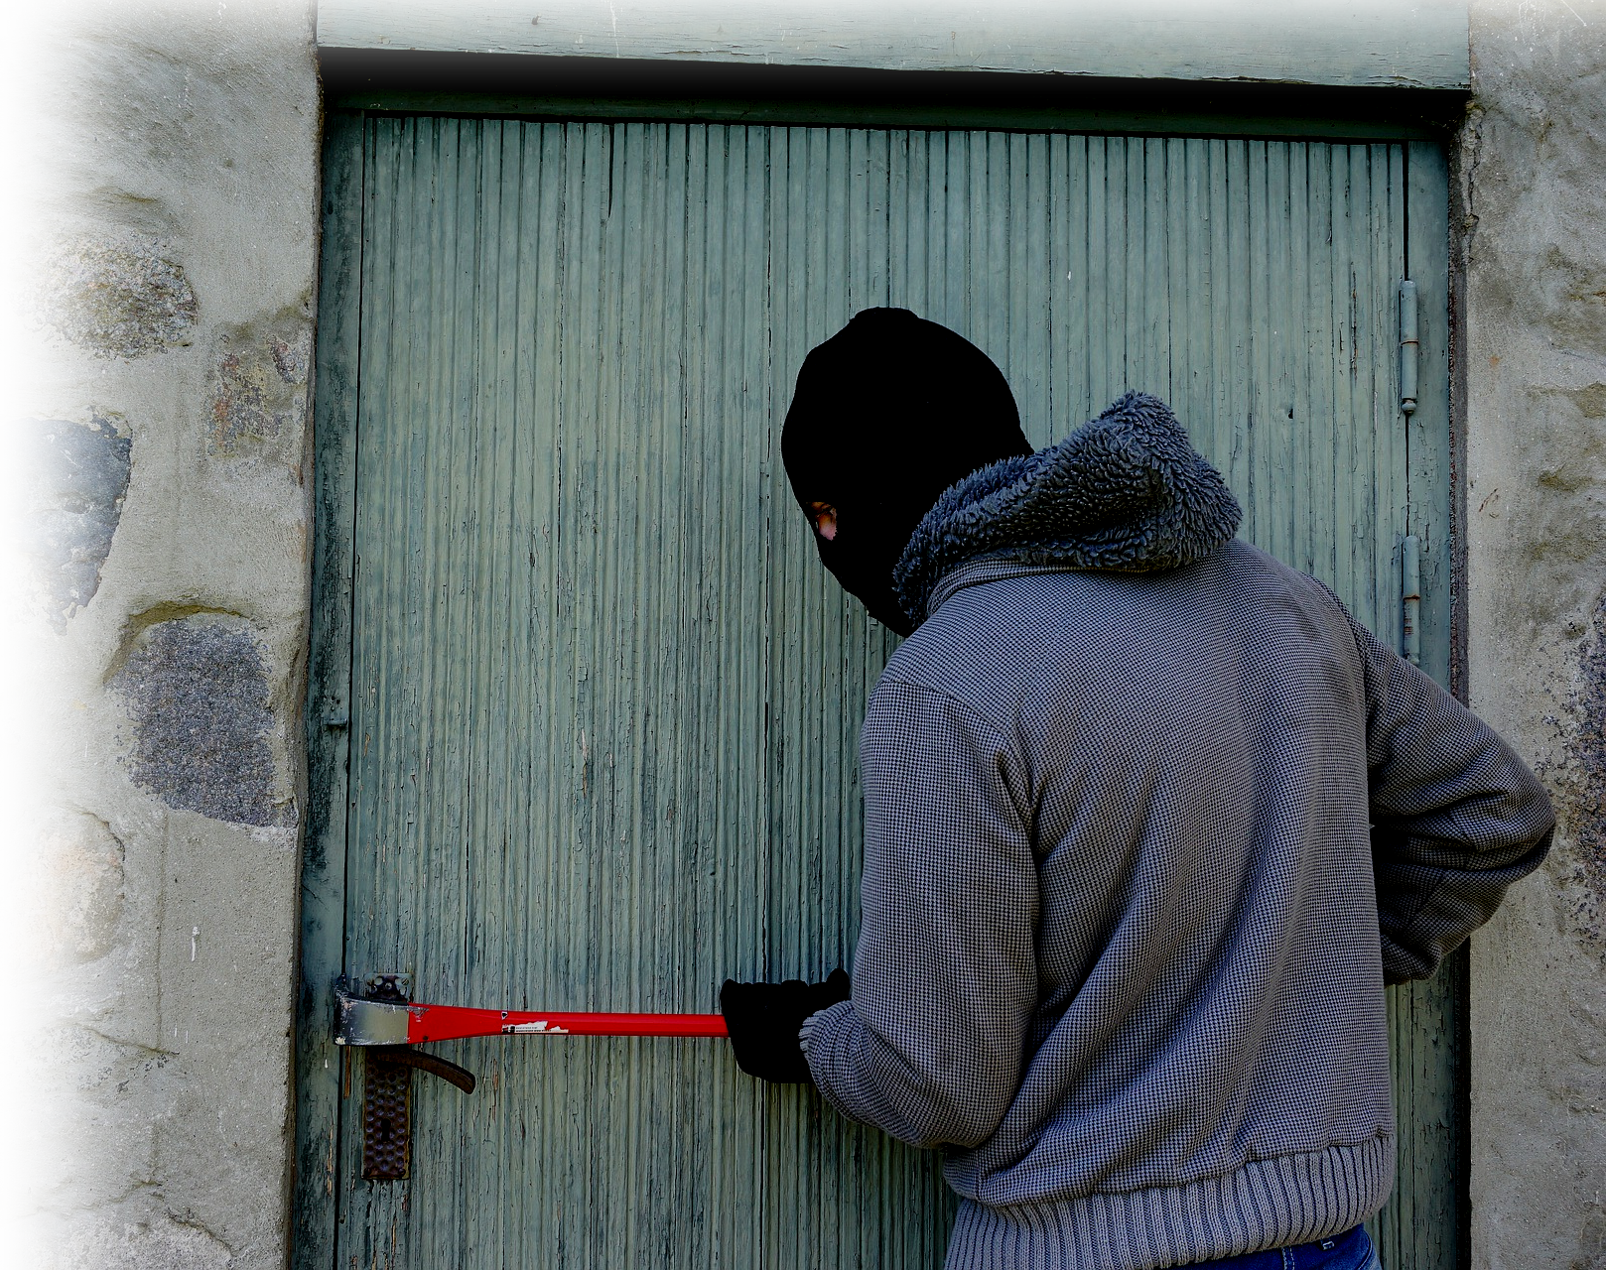
3. It’s An UNEXPECTANT Coming!
^{5:1} Now, brothers, about times and dates we do not need to write to you, ² for you know very well that the day of the Lord will come like a thief in the night.
Notes:
https://pixabay.com/photos/thief-burglary-break-into-balaclava-1562699/

Slide 11


4. It’s A Misundersood Coming!
^{5:3} While people are saying, "Peace and safety," destruction will come
on them ...
Notes:
https://en.wikipedia.org/wiki/United_Nations_Honour_Flag#/media/File:Flag_of_the_United_Nations.svg
https://commons.wikimedia.org/wiki/File:Peace_sign.svg

Slide 12
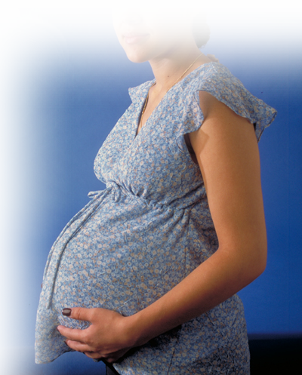
5. It’s A Sudden Coming!
^{5:3} While people are saying, "Peace and safety," destruction will come
on them suddenly, as
labor pains on a pregnant woman, and they will not escape.
Notes:
https://commons.wikimedia.org/wiki/File:Pregnant_woman.jpg

Slide 13

6. It’s An Inescapable Coming!
^{5:3} While people are saying, "Peace and safety," destruction will come
on them suddenly, as
labor pains on a pregnant woman, and they will not escape.

Slide 14
The Description of its coming

Slide 15
Previously Described ...
¹ Now, brothers, about times and dates we do not need to write to you, ² for you know very well ...
HOW DO YOU KNOW?

Slide 16
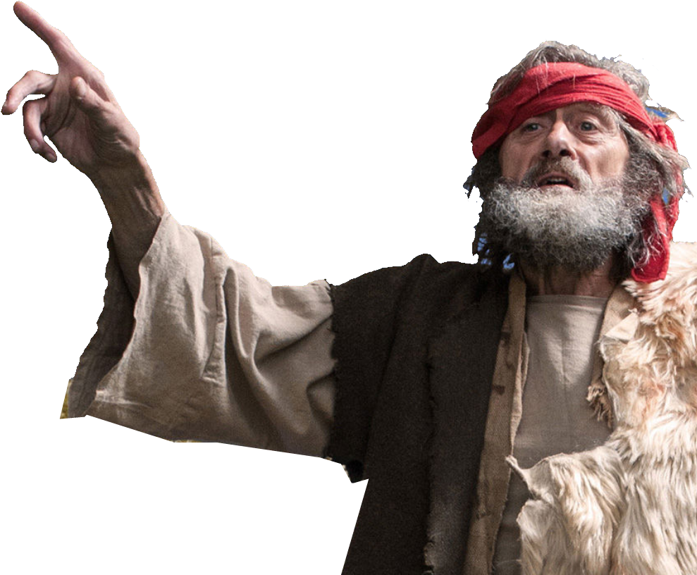
As Previously Described ...
DAY OF DARKNESS
Joel 2¹ Blow the trumpet ... ; sound the alarm .... Let all who live in the land tremble, for the day of the LORD is coming. It is close at hand-- ² a day of darkness and gloom, a day of clouds and black-ness.

Slide 17
Previously Described ...
DAY OF BATTLE
Like dawn spreading
across the mountains a
large and mighty army comes, such as never was of old nor ever will be in ages to come..

Slide 18
Previously Described ...
DAY OF DEVESTATION
³ Before them fire
devours, behind them a flame blazes. Before them the land is like the garden of Eden, behind them, a desert waste-- nothing escapes them.

Slide 19
Previously Described ...
DAY OF DREADFULNESS
Joel 2¹¹ The day of the
LORD is great; it is dread-
ful. Who can endure it?
Joel 2³¹ The sun will be turned
to darkness and the moon to
blood before the coming of
the great and dreadful day of the LORD. ³² And every-one who calls on the name of the LORD will be saved ....

Slide 20
Previously Described ...
DAY OF JUDGMENT
Joel 3¹⁴ Multitudes,
multitudes in the valley of
decision! For the day of the
LORD is near in the valley of
decision. ¹⁵ The sun and
moon will be darkened, and
the stars no longer shine.

Slide 21
Previously Described ...
DAY OF REFUGE
¹⁶ The LORD will roar from Zion and thunder from Jerusalem; the earth and the sky
will tremble. But the LORD will be a
refuge for his people, a strong-
hold for the people of Israel.
¹⁷ "Then you will know that I ...
dwell in Zion, my holy hill. Jerusalem will be holy; never again will foreigners invade her.

Slide 22
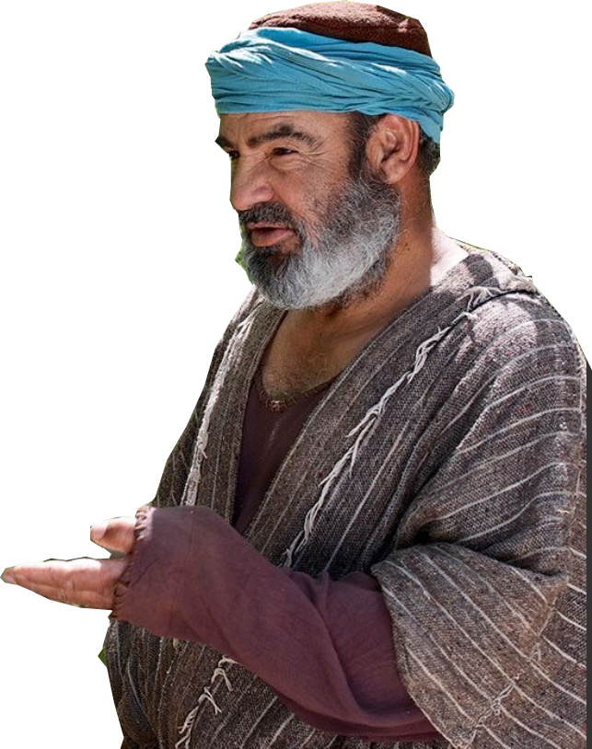
Previously Described ...
DAY OF DARKNESS
Amo 5¹⁸ Woe to you who long for the day of the LORD! Why do you long for the day of the LORD? That day will be darkness, not light. ¹⁹ It will be as though a man fled from a lion only to meet a bear, as though he entered his house and rested his
hand on the wall only to have a
snake bite him.
²⁰ Will not the day of the LORD be darkness, not light-- pitch-dark, without a ray of brightness?

Slide 23
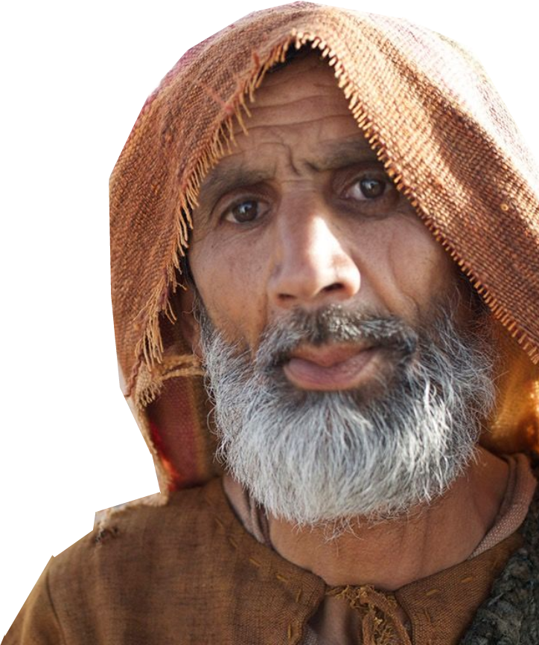
Previously Described ...
DAY OF WAR
Zechariah 14¹ A day of the LORD is coming when ... ² I will gather all the nations to Jerusalem to fight against it; the city will be captured, the houses ransacked, and the women raped. Half of the city will go into exile, but the rest of the people will not be taken from the city.

Slide 24
Previously Described ...
DAY OF SECOND COMING
³ Then the LORD will go out and fight
against those nations, as he fights in
the day of battle. ⁴ On that day his
feet will stand on the Mount of Olives,
east of Jerusalem, and the Mount of
Olives will be split in two from east to
west, forming a great valley, with half of the mountain moving north and half moving south.

Slide 25
Previously Described ...
DAY OF SECOND COMING
⁵ ... Then the LORD my God will come, and all the holy ones with him.
⁶ On that day there will be no light, no cold or frost. ⁷ It will be a unique day, without daytime or nighttime--a day known to the LORD. When evening comes, there will be light.

Slide 26
Previously Described ...
DAY OF MILLENIAL REIGN
⁸ On that day living water will flow out from Jerusalem, half to the eastern sea and half to the western sea, in summer and in winter. ⁹ The LORD will be king over the whole earth. On that day there will be one LORD, and his name the only name.

Slide 27
Paul calls it “Darkness”
1Thes 5⁴ But you, brothers, are not in darkness so that this day should surprise you like a thief. ⁵ You are all sons of the light and sons of the day. We do not belong to the night or to the darkness. ⁶ So then, let us not be like others, who are asleep, but let us be alert and self-controlled. ⁷ For those who sleep, sleep at night, and those who get drunk, get drunk at night.

Slide 28
Paul Speaks of light!
1Thes 5⁴ But you, brothers, are not in darkness so that this day should surprise you like a thief. ⁵ You are all sons of the light and sons of the day. We do not belong to the night or to the darkness. ⁶ So then, let us not be like others, who are asleep, but let us be alert and self-controlled. ⁷ For those who sleep, sleep at night, and those who get drunk, get drunk at night.

Slide 29
The VICTIMS of its coming

Slide 30

Not You, Brothers, We, Us
⁴ But you, brothers, are not in darkness so that this day should surprise you like a thief. ⁵ You are all sons of the light and sons of the day. We do not belong to
the night or to the darkness. ⁶ So
then, let us not be like others, who
are asleep, but let us be alert and
self-controlled. ⁷ For those who
sleep, sleep at night, and those who
get drunk, get drunk at night.

Slide 31

But Those “Others”
⁴ But you, brothers, are not in darkness so that this day should surprise you like a thief. ⁵ You are all sons of the light and sons of the day. We do not belong to the night or to the darkness.
⁶ So then, let us not be
like others, who are
asleep, but let us be alert and
self-controlled. ⁷ For those who
sleep, sleep at night, and those
who get drunk, get drunk at night.
Notes:
https://pixabay.com/photos/hand-finger-pointing-pointing-1923005/

Slide 32

The rescued from its coming

Slide 33
Those who “Put On” ...
Be Self-Controlled
⁸ But since we belong to the day,
let us be self-controlled, putting
on faith and love as a breastplate, and the hope of salvation as a helmet.

Slide 34

Those who “Put On” ...
SOBRIETY – NOT DRUNKENESS
⁸ But since we belong to the day,
let us be self-controlled, putting
on faith and love as a breastplate, and the hope of salvation as a helmet.
----SOBER----

Slide 35
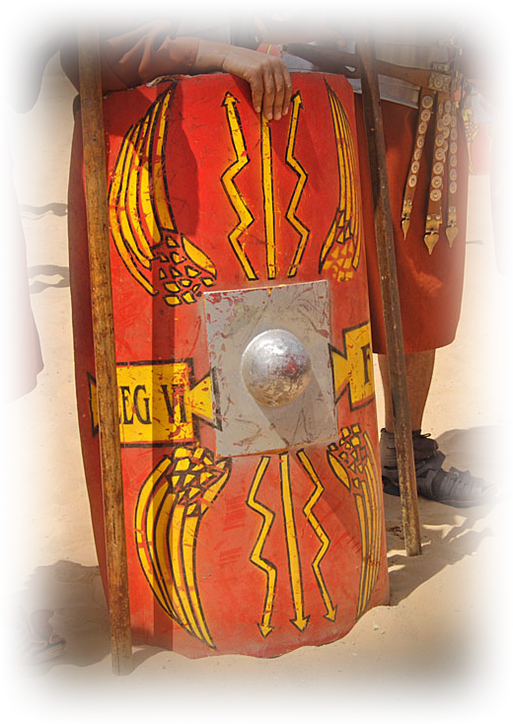
Those who “Put On” ...
FAITH – NOT DOUBT
⁸ But since we belong to the day,
let us be self-controlled, putting
on faith and love as a breastplate,
and the hope of salvation as a
helmet.
Notes:
Beleive in your heart Romans 10:9,10

Slide 36
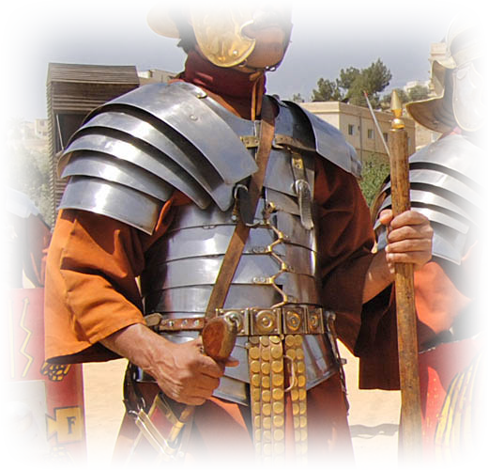
Those who “Put On” ...
LOVE – NOT SELF-CENTEREDNESS
⁸ But since we belong to the day,
let us be self-controlled, putting
on faith and love as a breastplate,
and the hope of salvation as a
helmet.
Notes:
The great commandment = Love the Lord with all your heart.
Self-centered righteousness is “self-righteous.”

Slide 37
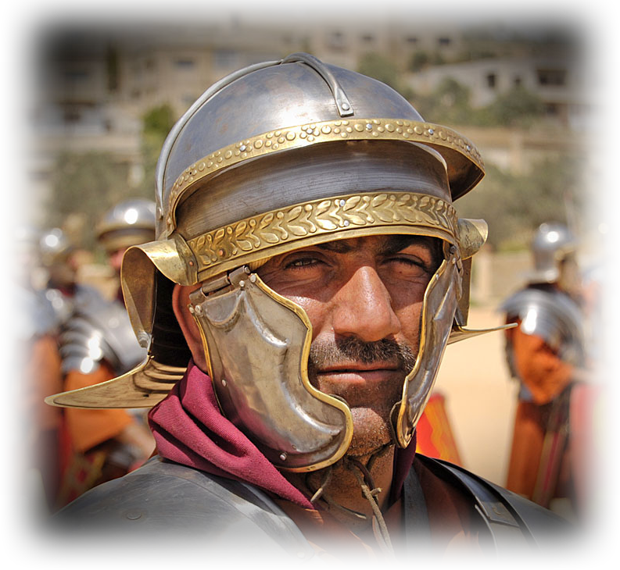
Those who “Put On” ...
HOPE – NOT DESPAIR
⁸ But since we belong to the day,
let us be self-controlled, putting
on faith and love as a breastplate,
and the hope of salvation as a
helmet.

Slide 38
Those who “Put On” ...
SALVATION – NOT TRIBULATION
⁸ But since we belong to the day,
let us be self-controlled, putting
on faith and love as a breastplate,
and the hope of salvation as a
helmet.

Slide 39
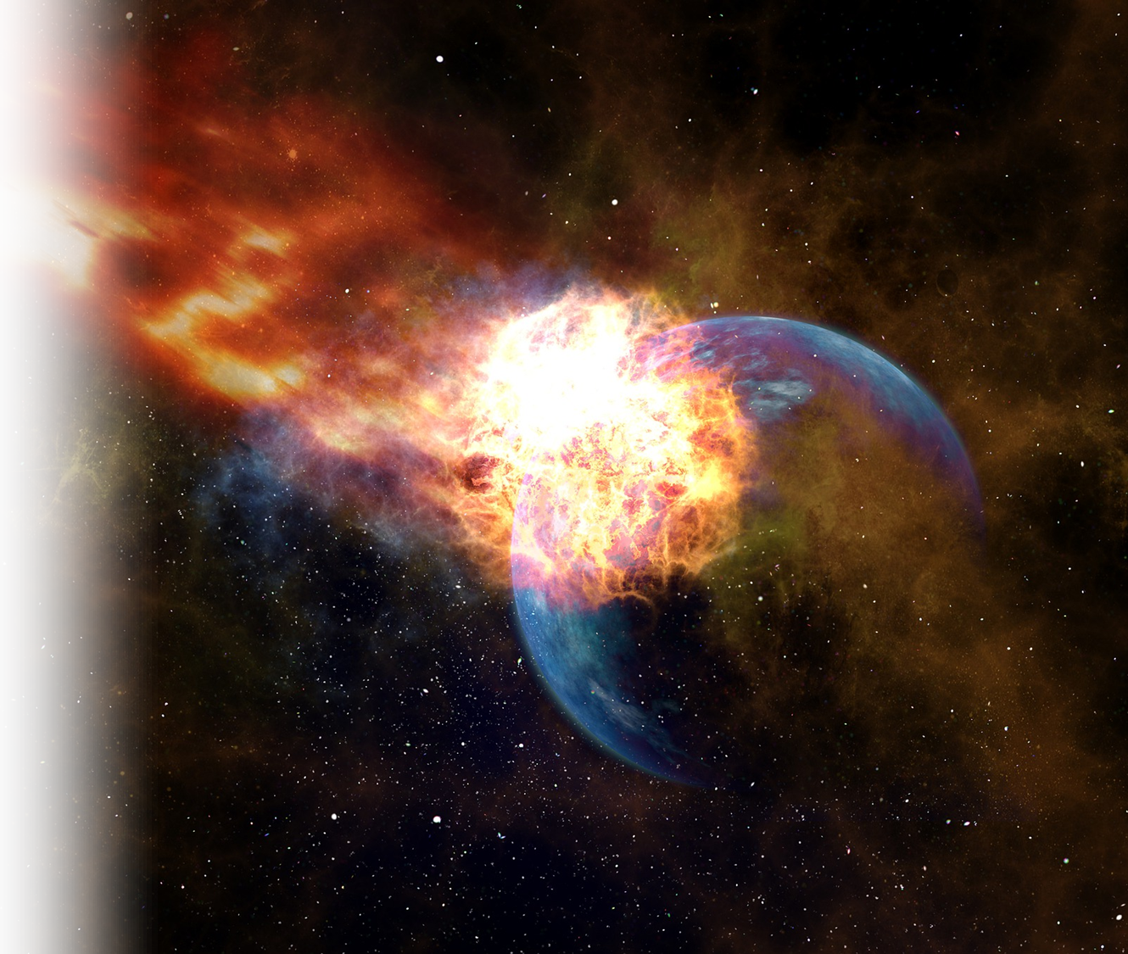
Why are we exempted from it?
1. No WRATH for the saved!
⁹ For God did not appoint
us to suffer wrath but to receive salvation through
our Lord Jesus Christ
Notes:
https://pixabay.com/photos/meteor-impact-globe-planet-trace-3127290/

Slide 40
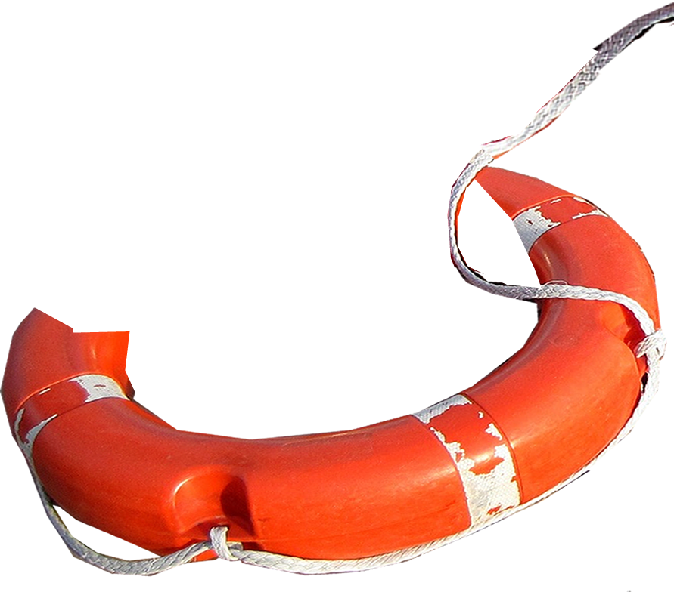
Why are we exempted from it?
1. No WRATH for the saved!
⁹ For God did not appoint
us to suffer wrath but to receive salvation through
our Lord Jesus Christ.
Notes:
https://libreshot.com/old-stone-cross-at-night/

Slide 41
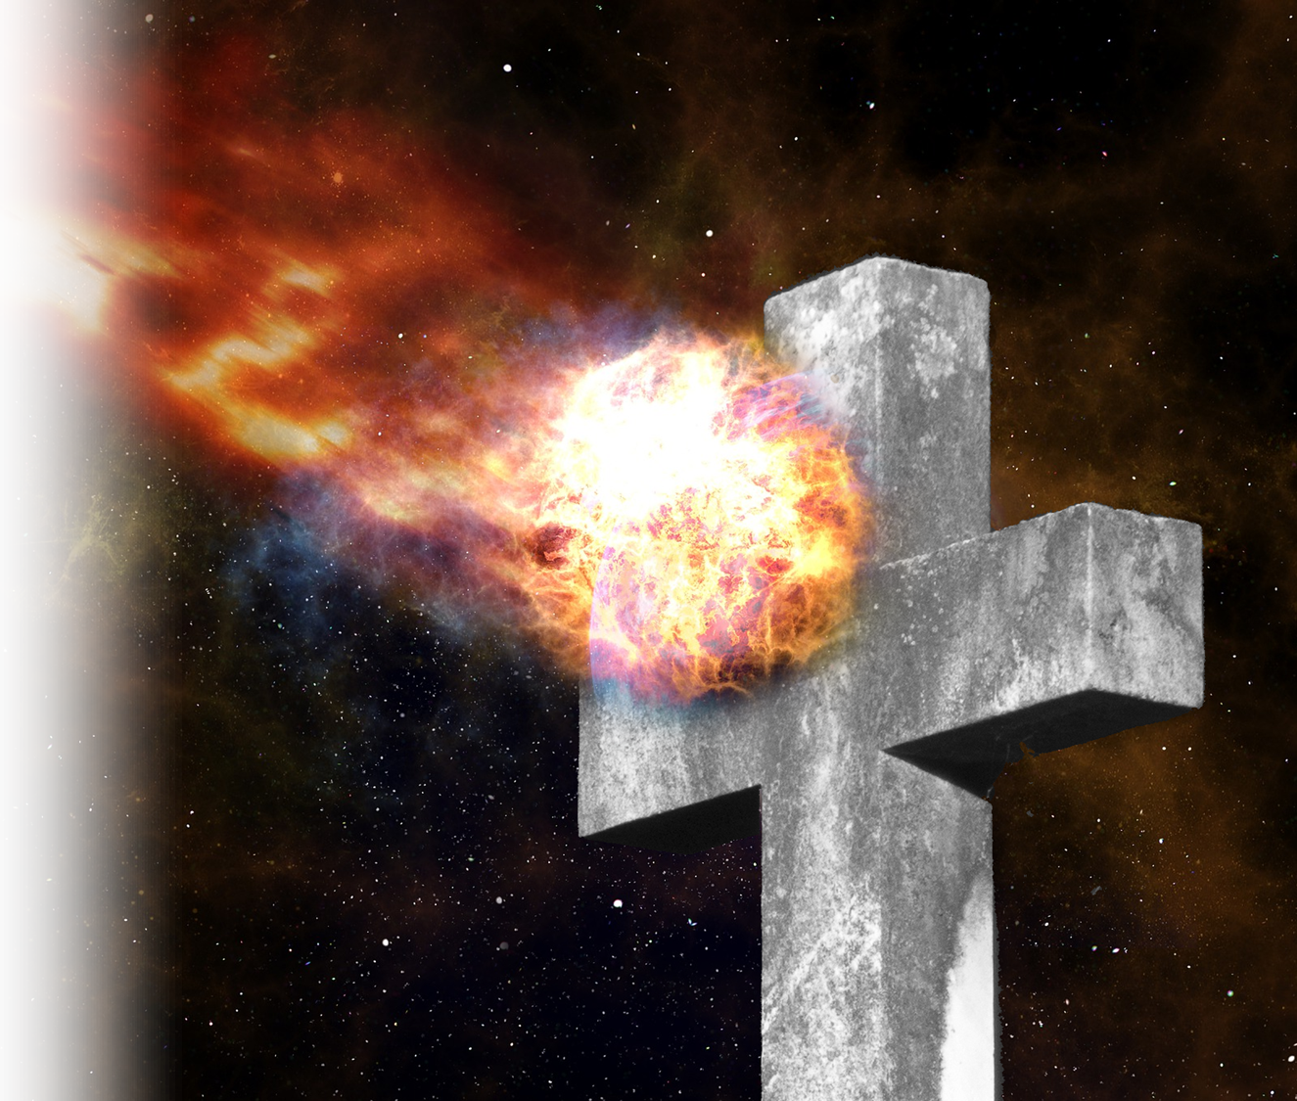
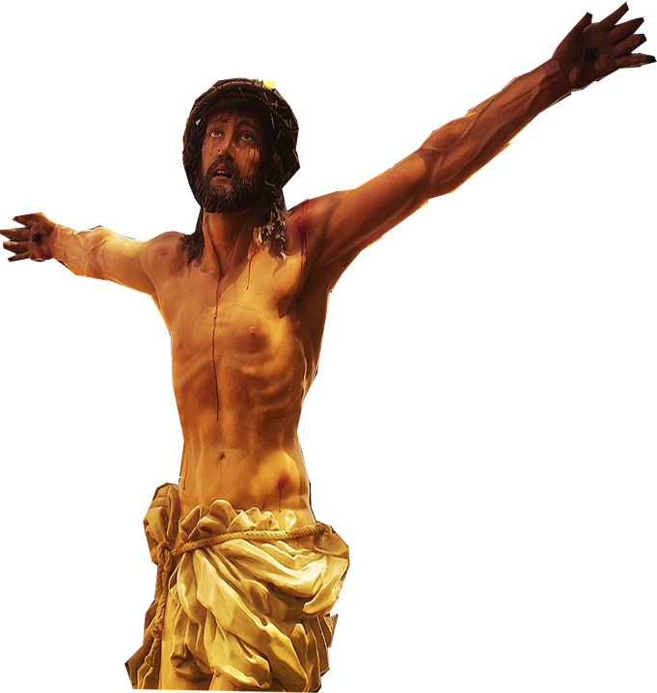
Why are we exempted from it?
2. Jesus took our wrath ... So we might live!
¹⁰ He died for us so that,
whether we are awake or
asleep, we may live
together with him.
⁹ Since we have now been
justified by his blood, how much
more shall we be saved from God's wrath through him! (Romans 5:9)
Notes:
https://pixabay.com/photos/christ-cross-faith-jesus-passion-3484141/

Slide 42
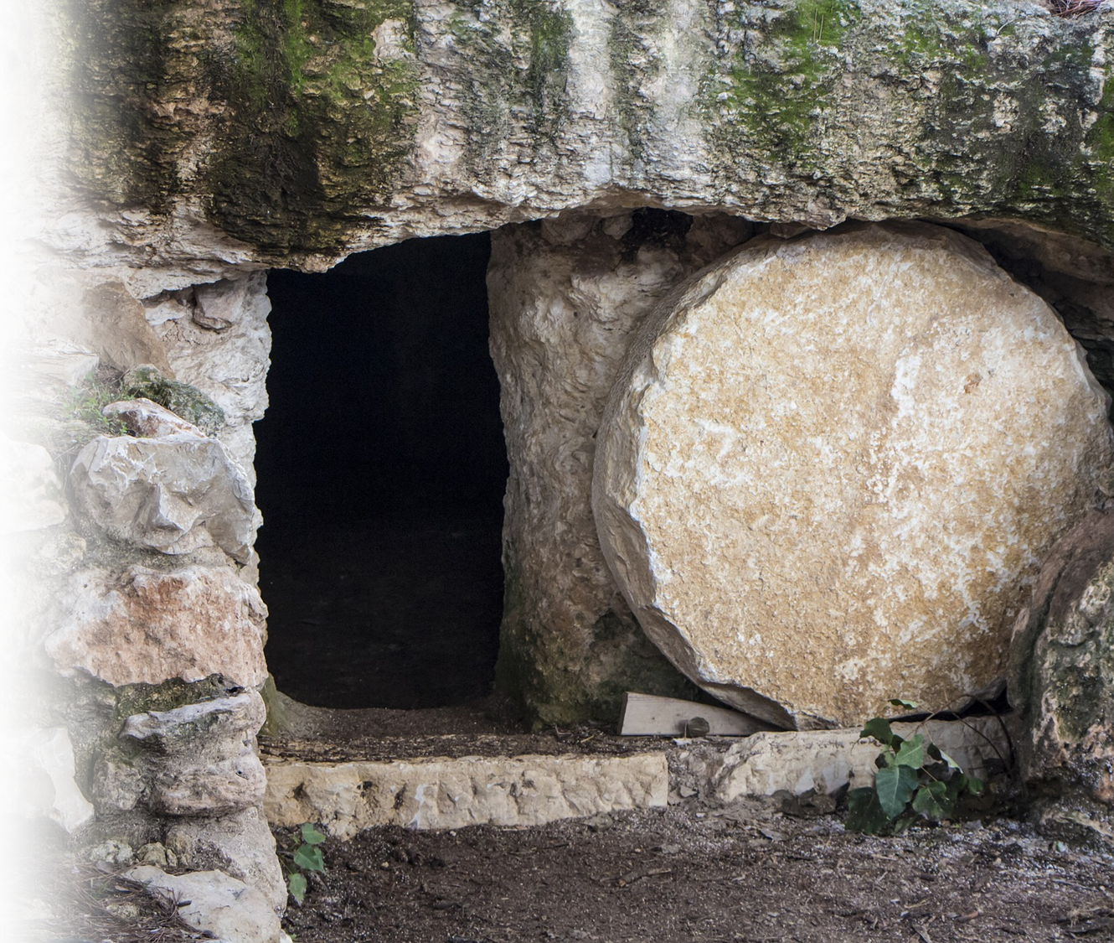
Why are we exempted from it?
2. Jesus took our wrath ... So we might live!
¹⁰ He died for us so that,
whether we are awake or
asleep, we may live
together with him.
Notes:
https://pixabay.com/photos/empty-tomb-nazareth-israel-3326100/

Slide 43

Why are we exempted from it?
3. To Encourage and Build Us Up!
¹¹ Therefore encourage one another and build each other up, just as in fact you are doing.
Notes:
http://www.peakpx.com/253185/human-right-thumbs-up

Slide 44
Here’s the point:
Be Encouraged!
YOU are exempted from wrath ...
If YOU are Saved!

Slide 45
Let’s Pray!

