Slide 1

Things to Come!
Daniel 2:29
This presentation uses Airstrike Condensed font:
https://www.dafont.com/airstrike.font
Notes:
Backround image = FREE = Image by <a href="https://pixabay.com/users/geralt-9301/?utm_source=link-attribution&amp;utm_medium=referral&amp;utm_campaign=image&amp;utm_content=2709662">Gerd Altmann</a> from <a href="https://pixabay.com/?utm_source=link-attribution&amp;utm_medium=referral&amp;utm_campaign=image&amp;utm_content=2709662">Pixabay</a>
Copyright © 2006−2021. All rights reserved. Bible Point is a registered trademark of Dennis Henderson. All other trademarks acknowledged.
Bible Point contains graphics from Bible Point artists. These illustrations belong to Bible Point and the respective artists. You may use the designs and illustrations for graphical illustration of lessons free and without special permission, provided they are not used in any way that maligns the Christian faith. Furthermore, republication or production of any illustration by any other graphic service whether it be in book, in a machine-readable form, or in any other design resource is strictly prohibited. Furthermore, they cannot be duplicated or resold as any other form of publishing, clip art, or graphic resource.
So What does it mean? (A simple translations of the legal jargon)
So, if you don’t own the presentation(s), graphic(s), and text(s) how can you legally use them? The purchase of the license allows you to use all the images in the product. However, the actual ownership and copyright of the presentation(s), graphic(s), and text(s) remain the property of Bible Point and its licensors. If you had plans on using this product in your “for sale” work—think again!
License Agreement
Article 1: License Grant
All the graphics and text in Bible Point presentations (excluding quotes from the Bible and stated sources) are the intellectual and real property of Bible Point and its licensors, and is protected by law, including United States copyright laws and international treaties. Bible Point grants to you a license:
1. To use the presentation in a single church, single school, or single office of a Christian organization.
2. To make a single archival back-up copy of the program.
3. To modify the presentation(s) and merge with other presentations in a single church, school, or Christian organization.
4. To transfer to another party if that party agrees to accept the terms and conditions of this agreement, and you do not retain any copies of the presentation, whether printed, machine readable, modified, or merged form.
Article 2: Terms
This license is effective until terminated. You may terminate the license at any time by destroying the presentation(s), graphic(s), or text(s) together with all copies, modifications and merged portions in any form. Bible Point may terminate your license if you fail to comply with this Agreement. You agree, upon such termination, for any reason, to destroy the presentation(s), graphics, and text(s) with all copies, modifications, and merged portions in any form.
Article 3: Disclaimers
1. Bible Point presentations, graphics, and texts are licensed to you As Is. You, the consumer, bear the entire risk relating to the quality and performance of the presentation(s), graphic(s), or text(s). In no event will Bible Point be liable for damages resulting from any defect.
2. Thirty-day limited warrantee on disks. Bible Point warrants the disks to be free of defects in material and workmanship under normal use for 30 days after purchase. During the 30-day period you may return a defective presentation, graphic, or text with proof of purchase and it will be replaced without charge, unless the presentation is damaged by misuse.
Article 4: General
1. You may not sub-license, assign, or transfer the license of the presentation(s), graphic(s), or text(s) except as provided by this Agreement.
2. This Agreement will be governed by the laws of the State of Michigan.
So What does it mean? (A simple translations of the legal jargon)
May I let someone borrow or copy my licensed Bible Point presentation (even after I modified it)? As long as it is within your local church, or single school, or the immediate office of a Christian organization you may. Otherwise, please refer the person interested in borrowing to: http://www.biblepoint.com or E-mail: dennis@DrDH.net with any related questions.

Slide 2
Things to Come!
2 Thessalonians 5:1-10
Notes:
Backround image = FREE = Image by <a href="https://pixabay.com/users/geralt-9301/?utm_source=link-attribution&amp;utm_medium=referral&amp;utm_campaign=image&amp;utm_content=2709662">Gerd Altmann</a> from <a href="https://pixabay.com/?utm_source=link-attribution&amp;utm_medium=referral&amp;utm_campaign=image&amp;utm_content=2709662">Pixabay</a>
Copyright © 2006−2021. All rights reserved. Bible Point is a registered trademark of Dennis Henderson. All other trademarks acknowledged.
Bible Point contains graphics from Bible Point artists. These illustrations belong to Bible Point and the respective artists. You may use the designs and illustrations for graphical illustration of lessons free and without special permission, provided they are not used in any way that maligns the Christian faith. Furthermore, republication or production of any illustration by any other graphic service whether it be in book, in a machine-readable form, or in any other design resource is strictly prohibited. Furthermore, they cannot be duplicated or resold as any other form of publishing, clip art, or graphic resource.
So What does it mean? (A simple translations of the legal jargon)
So, if you don’t own the presentation(s), graphic(s), and text(s) how can you legally use them? The purchase of the license allows you to use all the images in the product. However, the actual ownership and copyright of the presentation(s), graphic(s), and text(s) remain the property of Bible Point and its licensors. If you had plans on using this product in your “for sale” work—think again!
License Agreement
Article 1: License Grant
All the graphics and text in Bible Point presentations (excluding quotes from the Bible and stated sources) are the intellectual and real property of Bible Point and its licensors, and is protected by law, including United States copyright laws and international treaties. Bible Point grants to you a license:
1. To use the presentation in a single church, single school, or single office of a Christian organization.
2. To make a single archival back-up copy of the program.
3. To modify the presentation(s) and merge with other presentations in a single church, school, or Christian organization.
4. To transfer to another party if that party agrees to accept the terms and conditions of this agreement, and you do not retain any copies of the presentation, whether printed, machine readable, modified, or merged form.
Article 2: Terms
This license is effective until terminated. You may terminate the license at any time by destroying the presentation(s), graphic(s), or text(s) together with all copies, modifications and merged portions in any form. Bible Point may terminate your license if you fail to comply with this Agreement. You agree, upon such termination, for any reason, to destroy the presentation(s), graphics, and text(s) with all copies, modifications, and merged portions in any form.
Article 3: Disclaimers
1. Bible Point presentations, graphics, and texts are licensed to you As Is. You, the consumer, bear the entire risk relating to the quality and performance of the presentation(s), graphic(s), or text(s). In no event will Bible Point be liable for damages resulting from any defect.
2. Thirty-day limited warrantee on disks. Bible Point warrants the disks to be free of defects in material and workmanship under normal use for 30 days after purchase. During the 30-day period you may return a defective presentation, graphic, or text with proof of purchase and it will be replaced without charge, unless the presentation is damaged by misuse.
Article 4: General
1. You may not sub-license, assign, or transfer the license of the presentation(s), graphic(s), or text(s) except as provided by this Agreement.
2. This Agreement will be governed by the laws of the State of Michigan.
So What does it mean? (A simple translations of the legal jargon)
May I let someone borrow or copy my licensed Bible Point presentation (even after I modified it)? As long as it is within your local church, or single school, or the immediate office of a Christian organization you may. Otherwise, please refer the person interested in borrowing to: http://www.biblepoint.com or E-mail: dennis@DrDH.net with any related questions.

Slide 3
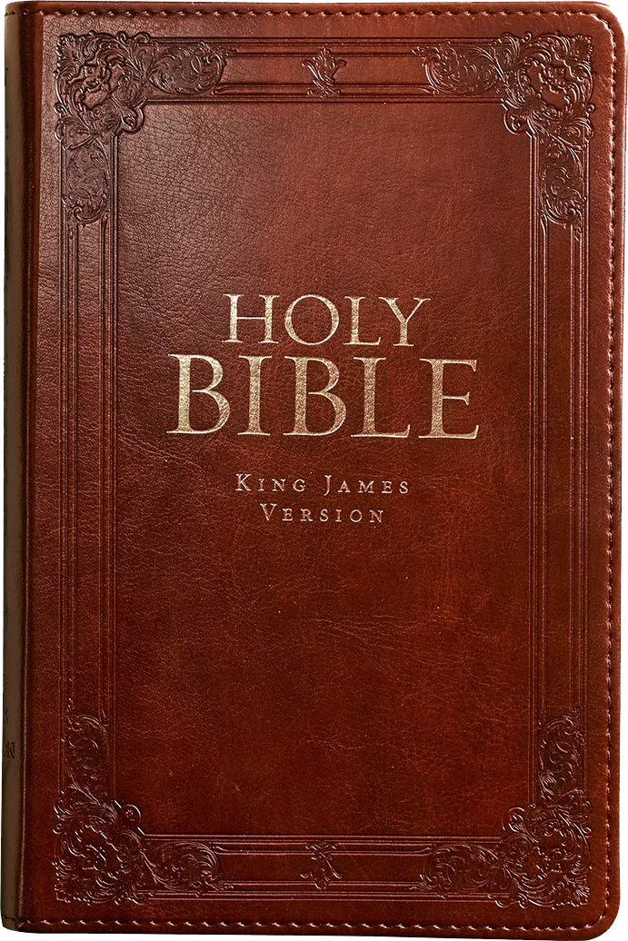
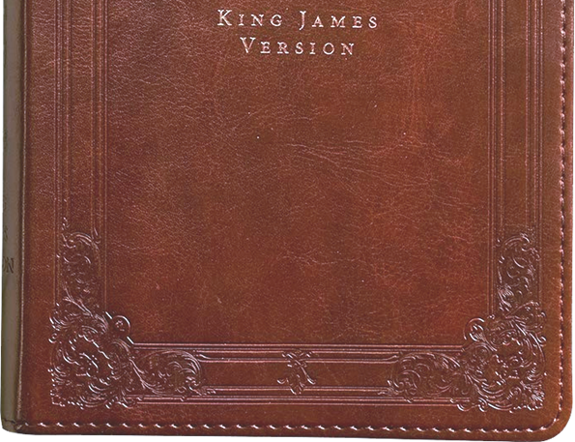

Predictive prophecy
50%
25%

Slide 4
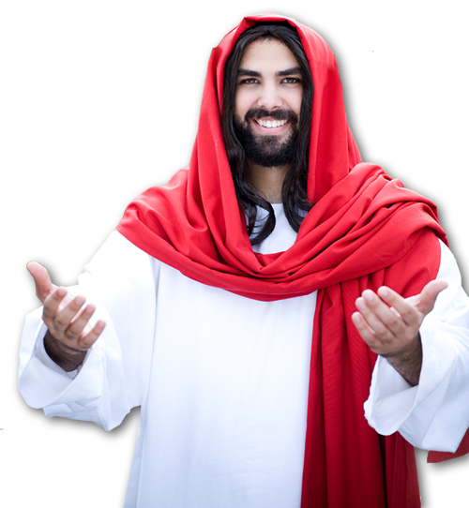
Think about it ...
The next prophetic event for the church
is the Rapture.
I will come back and take you to be with me. John 14:3

Slide 5
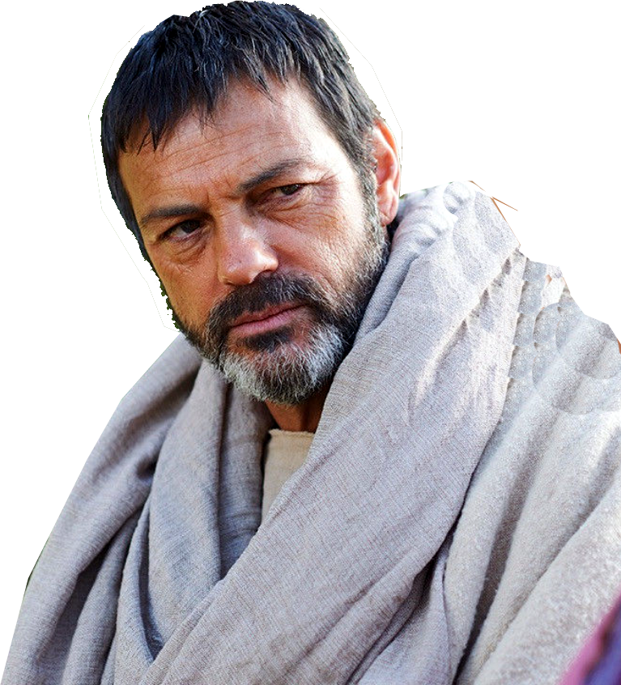
Think about it ...
The next prophetic event for the church
is the Rapture.
¹⁶ ... the dead in Christ will rise first. ¹⁷ After that, we who are still alive and are left will be caught up together with them (1Thes 4:16-17)

Slide 6
After the Rapture,
Then What?

Slide 7
Three Metaphors to help explain The Rapture and What follows ...
(2 Corinthians 5)

Slide 8
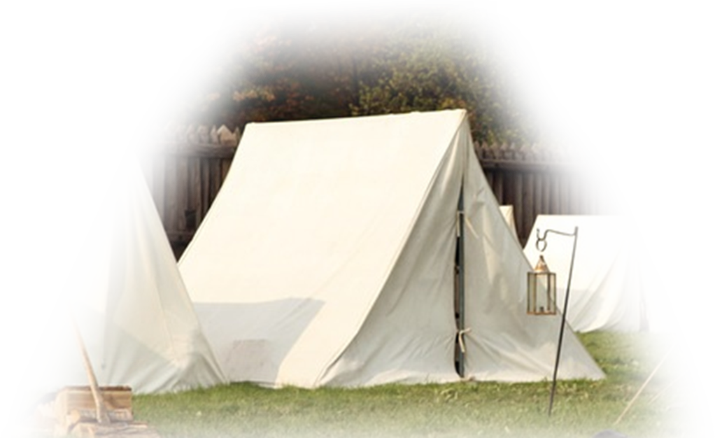
The Tent and the building
^{5:1} Now we know that if the earthly tent we live in is destroyed, we have a building from God, an eternal house in heaven, not built by human hands.

Slide 9

The Tent and the building
^{5:1} Now we know that if the earthly tent we live in is destroyed, we have a building from God, an eternal house in heaven, not built by human hands.

Slide 10
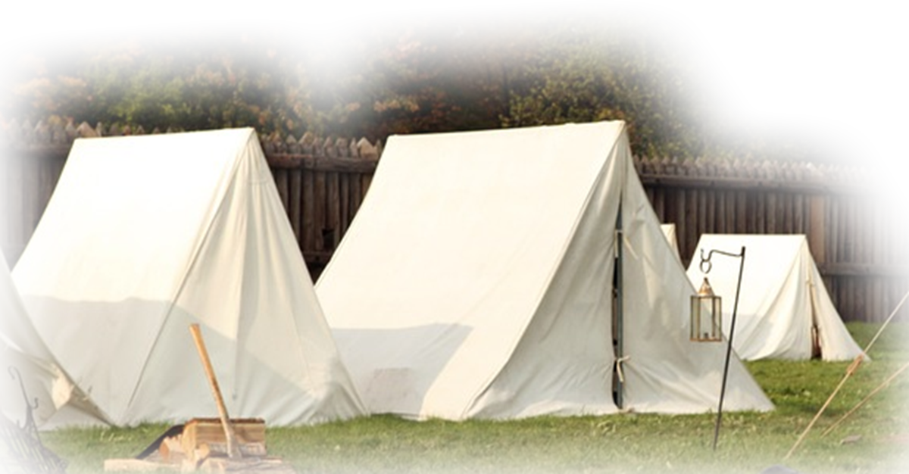
Your current body is a tent
^{5:1} Now we know that if the earthly tent we live in is destroyed, we have a building from God, an eternal house in heaven, not built by human hands.
Notes:
https://www.maxpixel.net/Camp-Civil-Soldier-Memorial-Infantry-Cannon-War-144552

Slide 11
It’s Destructible & Temporary
^{5:1} Now we know that if the earthly tent we live in is destroyed, we have a building from God, an eternal house in heaven, not built by human hands.

Slide 12
It’s Destructible & Temporary
^{5:1} Now we know that if the earthly tent we live in is destroyed, we have a building from God, an eternal house in heaven, not built by human hands.

Slide 13
Your Future Body is a building
^{5:1} Now we know that if the earthly tent we live in is destroyed, we have a building from God, an eternal house in heaven, not built by human hands.

Slide 14
It’s Eternal & indestructible
^{5:1} Now we know that if the earthly tent we live in is destroyed, we have a building from God, an eternal house in heaven, not built by human hands.

Slide 15
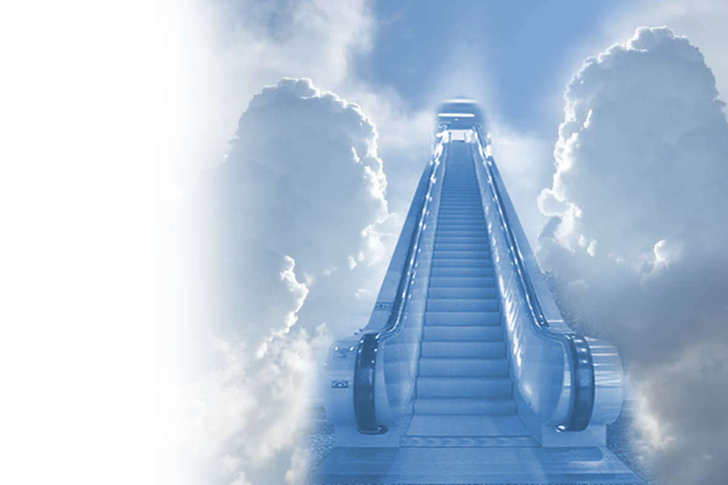
Think about This
²⁰ But our citizenship is in heaven. And we eagerly await a Savior from there, the Lord Jesus Christ, ²¹ who, by the power that enables him to bring everything under his control, will transform our lowly bodies so that they will be like his glorious body. (Phil 3:20-21)

Slide 16
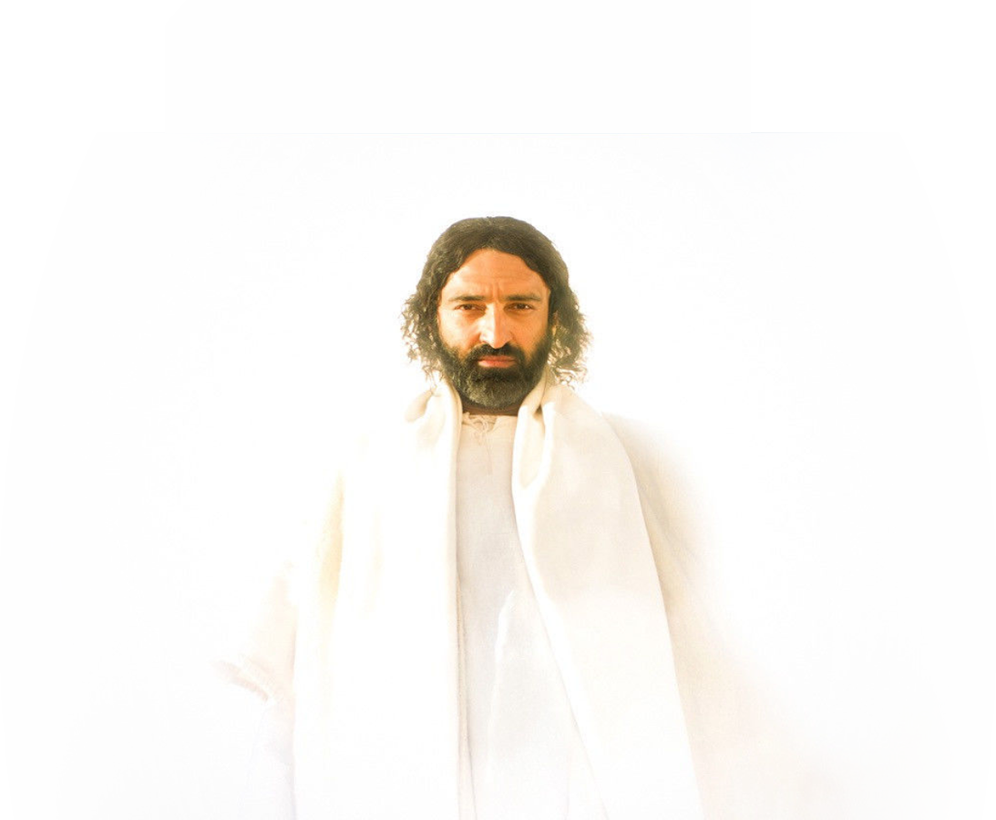
Think about This
²⁰ But our citizenship is in heaven. And we eagerly await a Savior from there, the Lord Jesus Christ, ²¹ who, by the power that enables him to bring everything under his control, will transform our lowly bodies so that they will be like his glorious body. (Phil 3:20-21)

Slide 17
Think about This
² Dear friends, now we are children of God, and what we will be has not yet been made known. But we know that when he appears, we shall be like him, for we shall see him as he is.
(1John 3:2)

Slide 18
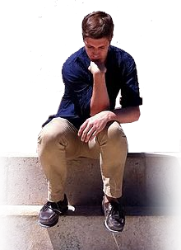
Being Clothed or Unclothed
Notes:
https://upload.wikimedia.org/wikipedia/commons/thumb/6/60/The_thinker_pdd.jpg/672px-The_thinker_pdd.jpg

Slide 19
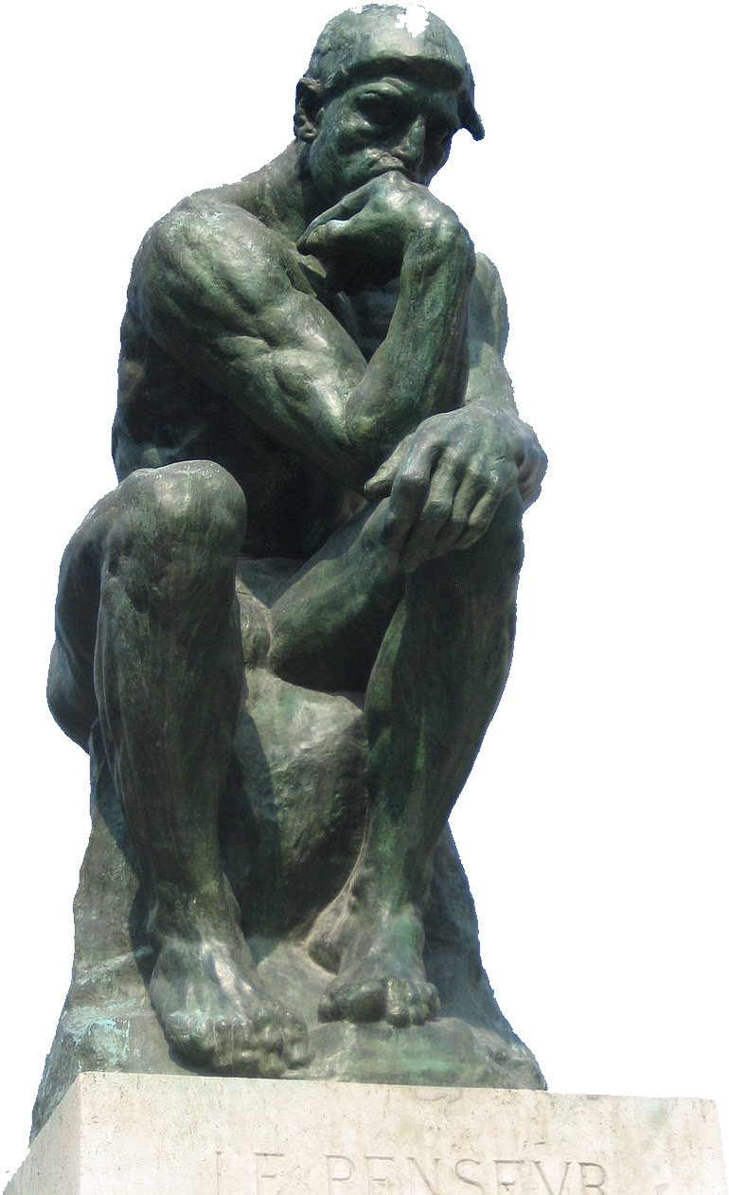
Being Clothed or Unclothed
Notes:
https://commons.wikimedia.org/wiki/File:The_thinker_pdd.jpg

Slide 20



Being Clothed or Unclothed

Slide 21
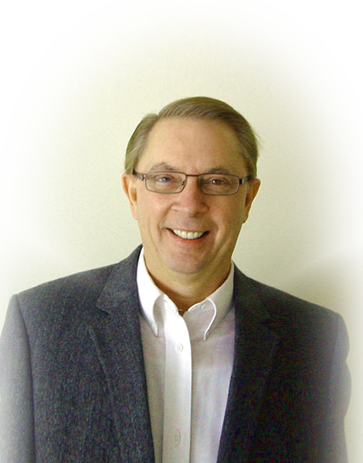
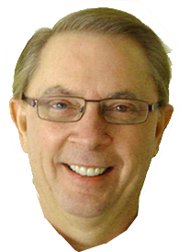
Being Clothed or Unclothed
Expressed:
² Meanwhile we groan, longing to be clothed with our heavenly dwelling

Slide 22
Being Clothed or Unclothed
Explained:
³ because when we are clothed, we will not be found naked.

Slide 23
Being Clothed or Unclothed
Explained:
³ because when we are clothed, we will not be found naked.

Slide 24
Being Clothed or Unclothed
Elaborated:
⁴ For while we are in this tent, we groan and are burdened, because we do not wish to be unclothed but to be clothed with our heavenly dwelling, so that what is mortal may be swallowed up by life.

Slide 25
Being Clothed or Unclothed
Elaborated:
⁴ For while we are in this tent, we groan and are burdened, because we do not wish to be unclothed but to be clothed with our heavenly dwelling, so that what is mortal may be swallowed up by life.
DEATH

Slide 26
Being Clothed or Unclothed
Elaborated:
⁴ For while we are in this tent, we groan and are burdened, because we do not wish to be unclothed but to be clothed with our heavenly dwelling, so that what is mortal may be swallowed up by life.

Slide 27
Being Clothed or Unclothed
Elaborated:
⁴ For while we are in this tent, we groan and are burdened, because we do not wish to be unclothed but to be clothed with our heavenly dwelling, so that what is mortal may be swallowed up by life.
Able to Die

Slide 28
Being Clothed or Unclothed
Elaborated:
⁴ For while we are in this tent, we groan and are burdened, because we do not wish to be unclothed but to be clothed with our heavenly dwelling, so that what is mortal may be swallowed up by life.
LIFE
⁵¹ Listen, I tell you a mystery: We will not all sleep, but we will all be changed-- ⁵² in a flash, in the twinkling of an eye, at the last trumpet. For the trumpet will sound, the dead will be raised imperishable, and we will be changed.
⁵³ For the perishable must clothe itself with the imperishable, and the mortal with immortality. ⁵⁴ When the perishable has been clothed with the imperishable, and the mortal with immortality, then the saying that is written will come true: "Death has been swallowed up in victory." (1Corinthians 15:51-54)

Slide 29
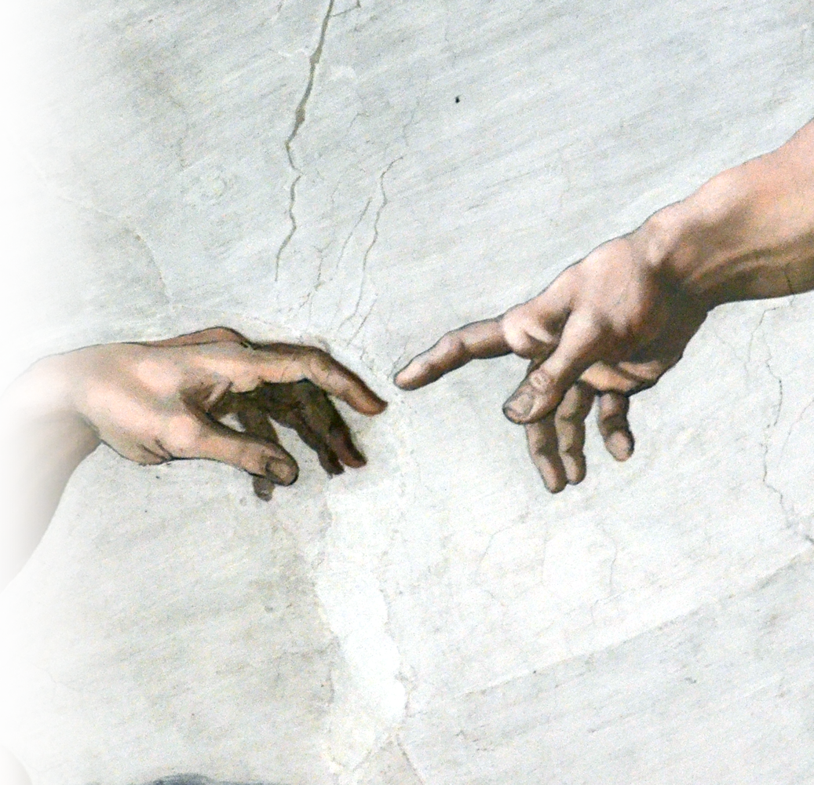
Being Clothed or Unclothed
Expanded:
⁵ Now it is God who has made us for this very purpose and has given us the Spirit as a deposit, guaranteeing what is to come.
Notes:
https://www.flickr.com/photos/yarra64/5642725837

Slide 30

Being Clothed or Unclothed
Expanded:
⁵ Now it is God who has made us for this very purpose and has given us the Spirit as a deposit, guaranteeing what is to come.

Slide 31


Walking and standing
Notes:
https://pixabay.com/photos/walking-feet-gravel-path-shoes-349991/

Slide 32
About Walking And Standing
WHEN:
⁶ Therefore we are always confident and know that as long as we are at home in the body we are away from the Lord. ⁷ We live by faith, not by sight.

Slide 33
About Walking And Standing
WHEN:
⁶ Therefore we are always confident and know that as long as we are at home in the body we are away from the Lord. ⁷ We live by faith, not by sight.

Slide 34
About Walking And Standing
WHEN:
⁶ Therefore we are always confident and know that as long as we are at home in the body we are away from the Lord. ⁷ We live by faith, not by sight.

Slide 35
About Walking And Standing
HOW: BY FAITH
⁶ Therefore we are always confident and know that as long as we are at home in the body we are away from the Lord. ⁷ We live by faith, not by sight.
Notes:
https://pixabay.com/photos/walking-feet-gravel-path-shoes-349991/

Slide 36
About Walking And Standing
HOW: CONFIDENTLY
⁸ We are confident, I say, and would prefer to be away from the body and at home with the Lord.
²³ I am torn between the two: I desire to depart and be with Christ, which is better by far; ²⁴ but it is more necessary for you that I remain in the body. (Phil 1:23-24)

Slide 37

About Walking And Standing
HOW: TOWARD A GOAL
⁹ So we make it our goal to please him, whether we are at home in the body or away from it.

Slide 38
About Walking And Standing
HOW: TOWARD A GOAL
⁹ So we make it our goal to please him, whether we are at home in the body or away from it.
Forgetting what is behind and straining toward what is ahead, ¹⁴ I press on toward the goal to win the prize for which God has called me heavenward in Christ Jesus. (Phil 3:13-14)

Slide 39
About Walking And Standing
HOW: TOWARD A GOAL
⁹ So we make it our goal to please him, whether we are at home in the body or away from it.

Slide 40
Walking And Standing

Slide 41
About Standing
WHERE:
¹⁰ For we must all appear before the judgment seat of Christ, that each one may receive what is due him for the things done while in the body, whether good or bad.

Slide 42

About Standing
WHERE:
¹⁰ For we must all appear before the judgment seat of Christ, that each one may receive what is due him for the things done while in the body, whether good or bad.

Slide 43
About Standing
WHO:
¹⁰ For we must all appear before the judgment seat of Christ, that each one may receive what is due him for the things done while in the body, whether good or bad.

Slide 44
About Standing
¹⁰ For we are God's workmanship, created in Christ Jesus to do good works, which God prepared in advance for us to do. (Eph 2:10)
WHY:
¹⁰ For we must all appear before the judgment seat of Christ, that each one may receive what is due him for the things done while in the body, whether good or bad.

Slide 45



About Standing
HOW: 1 Corinthians 3
¹² If any man builds on this foundation [Jesus Christ] using gold, silver, costly stones, wood, hay or straw,

Slide 46
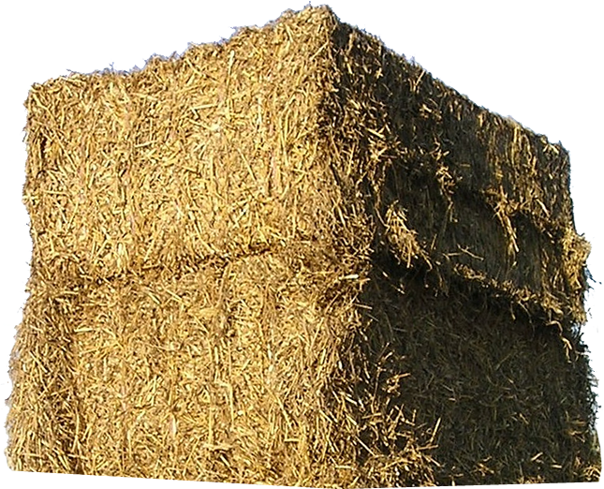
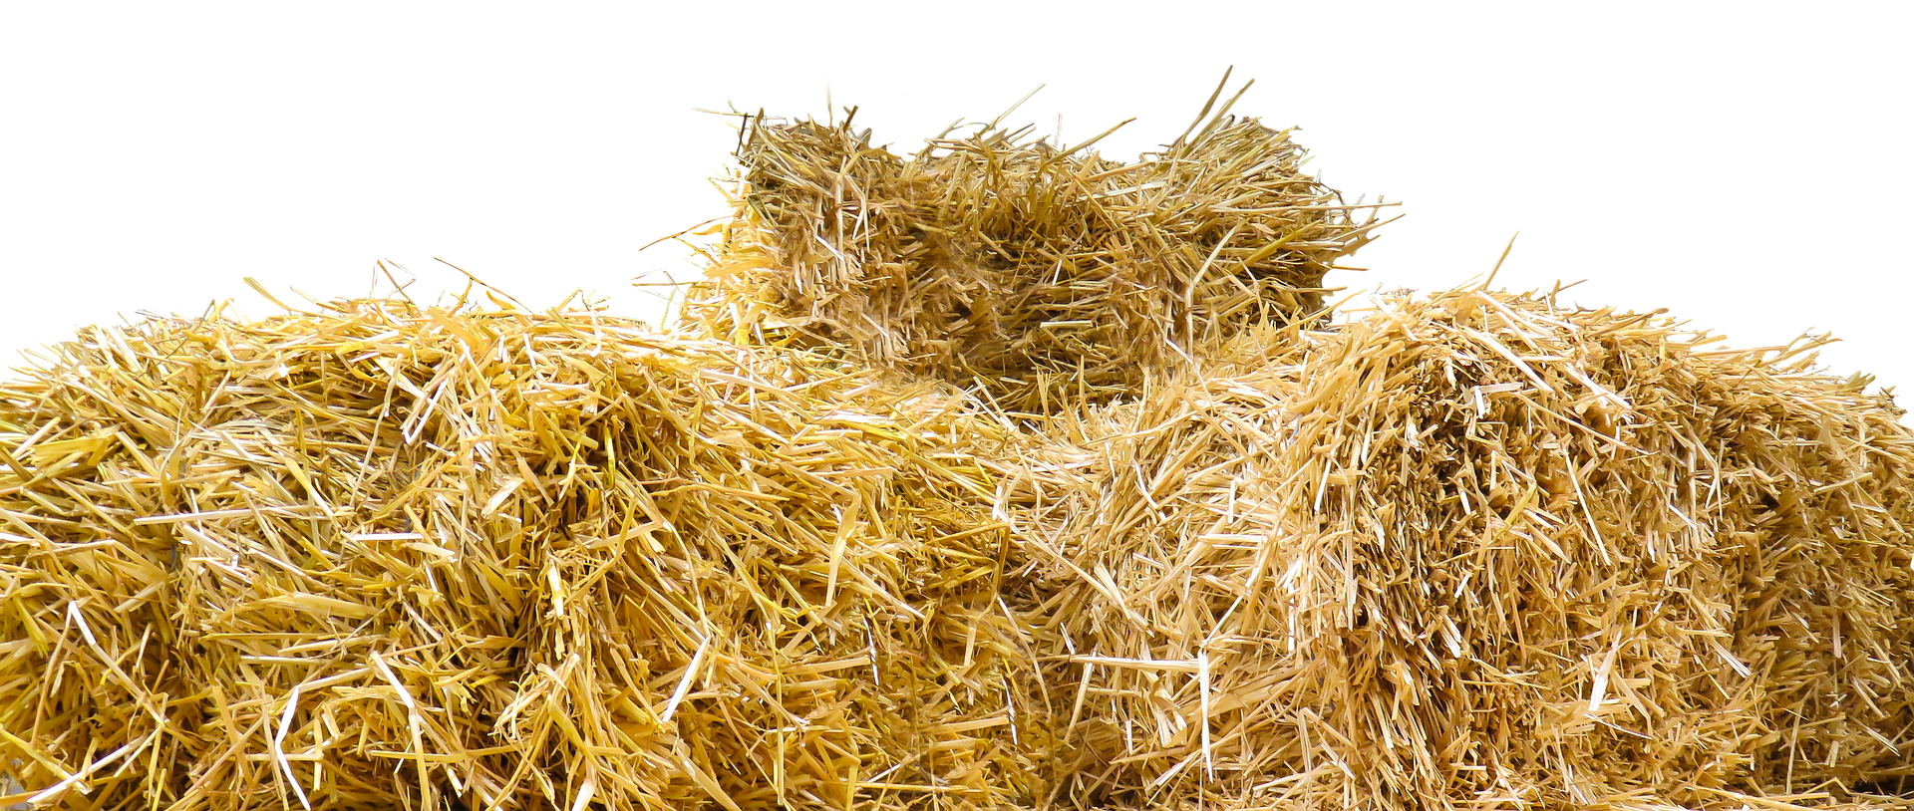
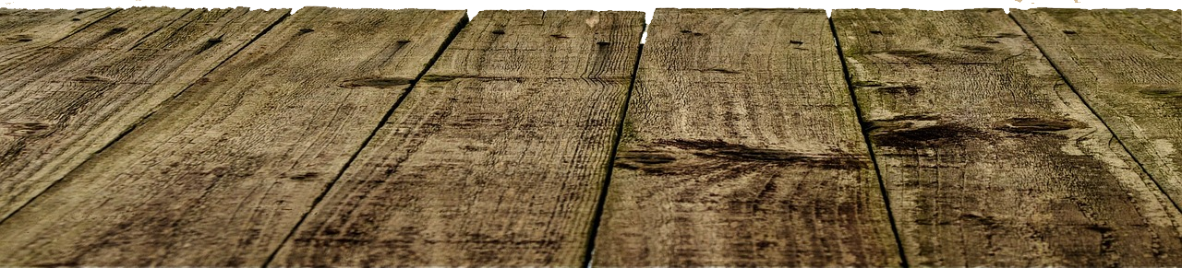
About Standing
HOW: 1 Corinthians 3
¹² If any man builds on this foundation [Jesus Christ] using gold, silver, costly stones, wood, hay or straw,
¹³ his work will be shown for what it is ...

Slide 47
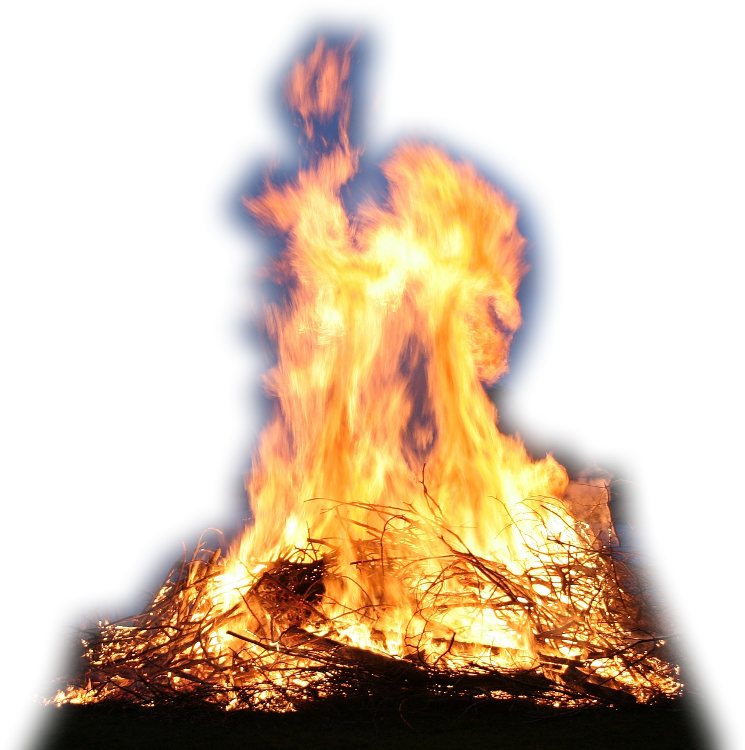
About Standing
HOW:
because the Day will bring it to light. It will be revealed with fire, and the fire will test the quality of each man's work.

Slide 48
About Standing
HOW:
¹⁴ If what he has built survives, he will receive his reward.
¹⁵ If it is burned up, he will suffer loss; he himself will be saved,
but only as one escaping through the flames.

Slide 49
The Point ... After the Rapture
“Well done good and faithful servant!”
¹⁰ For we must all appear before the judgment seat of Christ, that each one may receive what is due him for the things done while in the body, whether good or bad.

Slide 50

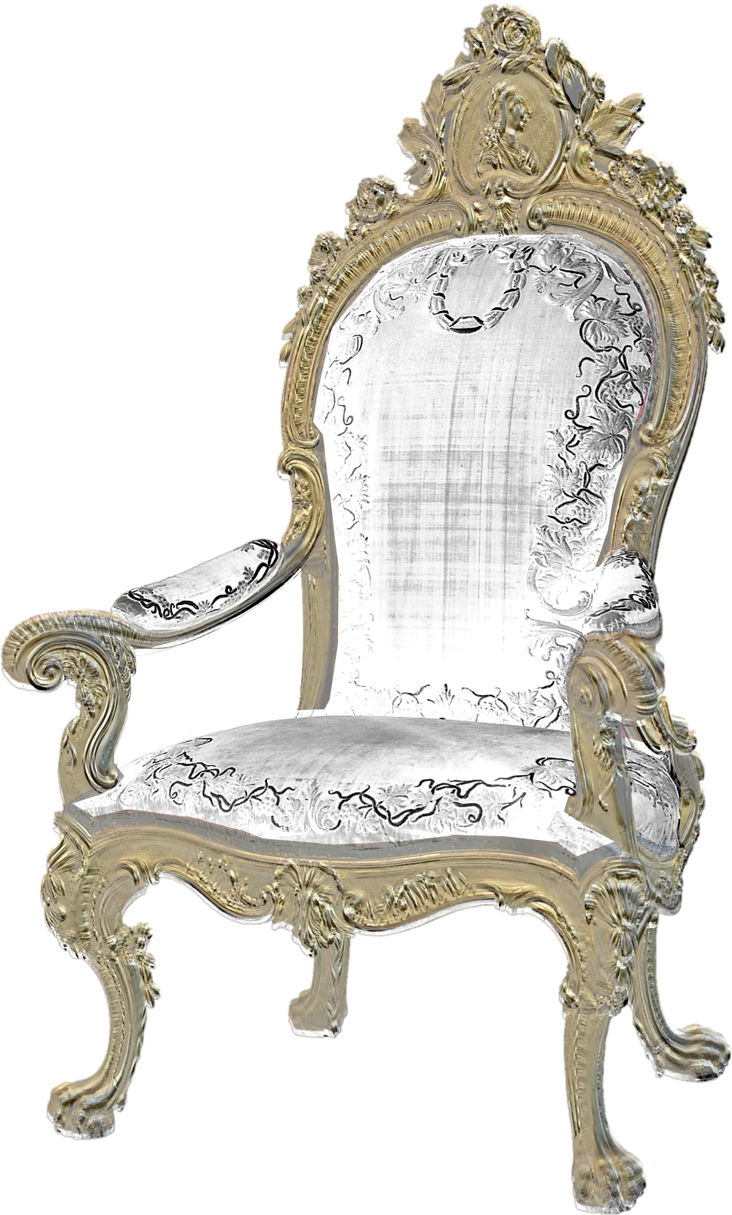
Think about it ...
The Dot and the Line
What you “BELIEVE” in the dot
determines “WHERE” you spend eternity
REWARD
Believe = HEAVEN
at the BEMA
Unbelief = LAKE OF FIRE
RETRIBUTION
at the GWT
What you “DO” in the dot
determines “HOW” you spend eternity

Slide 51
Think about it ...
The only thing that really makes sense is to ...
place your faith in Christ and then live for Him.

Slide 52
You Can do so now-- as we Pray!

