Slide 1

Things to Come!
Daniel 2:29
This presentation uses Airstrike Condensed font:
https://www.dafont.com/airstrike.font
Notes:
Backround image = FREE = Image by <a href="https://pixabay.com/users/geralt-9301/?utm_source=link-attribution&amp;utm_medium=referral&amp;utm_campaign=image&amp;utm_content=2709662">Gerd Altmann</a> from <a href="https://pixabay.com/?utm_source=link-attribution&amp;utm_medium=referral&amp;utm_campaign=image&amp;utm_content=2709662">Pixabay</a>
Copyright © 2006−2021. All rights reserved. Bible Point is a registered trademark of Dennis Henderson. All other trademarks acknowledged.
Bible Point contains graphics from Bible Point artists. These illustrations belong to Bible Point and the respective artists. You may use the designs and illustrations for graphical illustration of lessons free and without special permission, provided they are not used in any way that maligns the Christian faith. Furthermore, republication or production of any illustration by any other graphic service whether it be in book, in a machine-readable form, or in any other design resource is strictly prohibited. Furthermore, they cannot be duplicated or resold as any other form of publishing, clip art, or graphic resource.
So What does it mean? (A simple translations of the legal jargon)
So, if you don’t own the presentation(s), graphic(s), and text(s) how can you legally use them? The purchase of the license allows you to use all the images in the product. However, the actual ownership and copyright of the presentation(s), graphic(s), and text(s) remain the property of Bible Point and its licensors. If you had plans on using this product in your “for sale” work—think again!
License Agreement
Article 1: License Grant
All the graphics and text in Bible Point presentations (excluding quotes from the Bible and stated sources) are the intellectual and real property of Bible Point and its licensors, and is protected by law, including United States copyright laws and international treaties. Bible Point grants to you a license:
1. To use the presentation in a single church, single school, or single office of a Christian organization.
2. To make a single archival back-up copy of the program.
3. To modify the presentation(s) and merge with other presentations in a single church, school, or Christian organization.
4. To transfer to another party if that party agrees to accept the terms and conditions of this agreement, and you do not retain any copies of the presentation, whether printed, machine readable, modified, or merged form.
Article 2: Terms
This license is effective until terminated. You may terminate the license at any time by destroying the presentation(s), graphic(s), or text(s) together with all copies, modifications and merged portions in any form. Bible Point may terminate your license if you fail to comply with this Agreement. You agree, upon such termination, for any reason, to destroy the presentation(s), graphics, and text(s) with all copies, modifications, and merged portions in any form.
Article 3: Disclaimers
1. Bible Point presentations, graphics, and texts are licensed to you As Is. You, the consumer, bear the entire risk relating to the quality and performance of the presentation(s), graphic(s), or text(s). In no event will Bible Point be liable for damages resulting from any defect.
2. Thirty-day limited warrantee on disks. Bible Point warrants the disks to be free of defects in material and workmanship under normal use for 30 days after purchase. During the 30-day period you may return a defective presentation, graphic, or text with proof of purchase and it will be replaced without charge, unless the presentation is damaged by misuse.
Article 4: General
1. You may not sub-license, assign, or transfer the license of the presentation(s), graphic(s), or text(s) except as provided by this Agreement.
2. This Agreement will be governed by the laws of the State of Michigan.
So What does it mean? (A simple translations of the legal jargon)
May I let someone borrow or copy my licensed Bible Point presentation (even after I modified it)? As long as it is within your local church, or single school, or the immediate office of a Christian organization you may. Otherwise, please refer the person interested in borrowing to: http://www.biblepoint.com or E-mail: dennis@DrDH.net with any related questions.

Slide 2
Things to Come!
1 Thessalonians 4:13-18
Notes:
Backround image = FREE = Image by <a href="https://pixabay.com/users/geralt-9301/?utm_source=link-attribution&amp;utm_medium=referral&amp;utm_campaign=image&amp;utm_content=2709662">Gerd Altmann</a> from <a href="https://pixabay.com/?utm_source=link-attribution&amp;utm_medium=referral&amp;utm_campaign=image&amp;utm_content=2709662">Pixabay</a>
Copyright © 2006−2021. All rights reserved. Bible Point is a registered trademark of Dennis Henderson. All other trademarks acknowledged.
Bible Point contains graphics from Bible Point artists. These illustrations belong to Bible Point and the respective artists. You may use the designs and illustrations for graphical illustration of lessons free and without special permission, provided they are not used in any way that maligns the Christian faith. Furthermore, republication or production of any illustration by any other graphic service whether it be in book, in a machine-readable form, or in any other design resource is strictly prohibited. Furthermore, they cannot be duplicated or resold as any other form of publishing, clip art, or graphic resource.
So What does it mean? (A simple translations of the legal jargon)
So, if you don’t own the presentation(s), graphic(s), and text(s) how can you legally use them? The purchase of the license allows you to use all the images in the product. However, the actual ownership and copyright of the presentation(s), graphic(s), and text(s) remain the property of Bible Point and its licensors. If you had plans on using this product in your “for sale” work—think again!
License Agreement
Article 1: License Grant
All the graphics and text in Bible Point presentations (excluding quotes from the Bible and stated sources) are the intellectual and real property of Bible Point and its licensors, and is protected by law, including United States copyright laws and international treaties. Bible Point grants to you a license:
1. To use the presentation in a single church, single school, or single office of a Christian organization.
2. To make a single archival back-up copy of the program.
3. To modify the presentation(s) and merge with other presentations in a single church, school, or Christian organization.
4. To transfer to another party if that party agrees to accept the terms and conditions of this agreement, and you do not retain any copies of the presentation, whether printed, machine readable, modified, or merged form.
Article 2: Terms
This license is effective until terminated. You may terminate the license at any time by destroying the presentation(s), graphic(s), or text(s) together with all copies, modifications and merged portions in any form. Bible Point may terminate your license if you fail to comply with this Agreement. You agree, upon such termination, for any reason, to destroy the presentation(s), graphics, and text(s) with all copies, modifications, and merged portions in any form.
Article 3: Disclaimers
1. Bible Point presentations, graphics, and texts are licensed to you As Is. You, the consumer, bear the entire risk relating to the quality and performance of the presentation(s), graphic(s), or text(s). In no event will Bible Point be liable for damages resulting from any defect.
2. Thirty-day limited warrantee on disks. Bible Point warrants the disks to be free of defects in material and workmanship under normal use for 30 days after purchase. During the 30-day period you may return a defective presentation, graphic, or text with proof of purchase and it will be replaced without charge, unless the presentation is damaged by misuse.
Article 4: General
1. You may not sub-license, assign, or transfer the license of the presentation(s), graphic(s), or text(s) except as provided by this Agreement.
2. This Agreement will be governed by the laws of the State of Michigan.
So What does it mean? (A simple translations of the legal jargon)
May I let someone borrow or copy my licensed Bible Point presentation (even after I modified it)? As long as it is within your local church, or single school, or the immediate office of a Christian organization you may. Otherwise, please refer the person interested in borrowing to: http://www.biblepoint.com or E-mail: dennis@DrDH.net with any related questions.

Slide 3
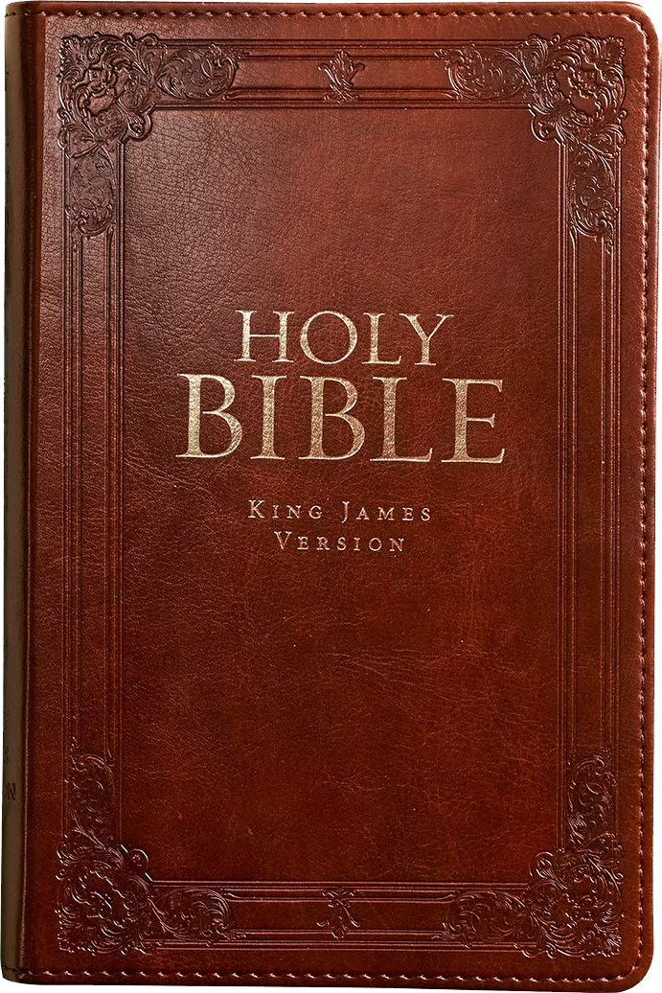
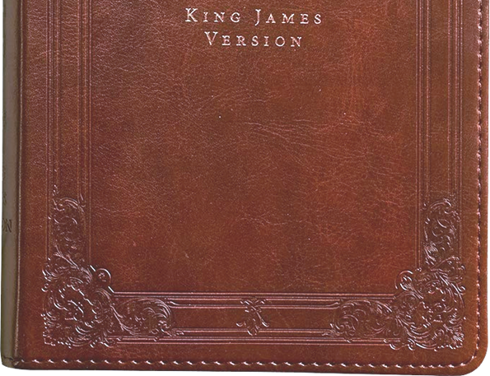

Predictive prophecy
50%
25%

Slide 4
The RAPTURE

Slide 5
Rapture not Revealed in OT
Notes:
Life saver = https://www.needpix.com/photo/18804/lifesaver-life-ring-life-preserver-flotation-device-lifeguard-rescue-at-sea

Slide 6


Rapture not Revealed in OT
The Old Testament speaks of a Messiah who will come to:
1- Suffer and die:
as Savior.
2- Rule and reign:
as King:
Could there be two Messiahs? No! Two comings!
Notes:
Life saver = https://www.needpix.com/photo/18804/lifesaver-life-ring-life-preserver-flotation-device-lifeguard-rescue-at-sea

Slide 7
Rapture not Revealed in OT
The Old Testament speaks of a Messiah who will come to:
1- Suffer and die:
as Savior.
2- Rule and reign:
as King:
Could there be two Messiahs? No! Two comings!
Notes:
Life saver = https://www.needpix.com/photo/18804/lifesaver-life-ring-life-preserver-flotation-device-lifeguard-rescue-at-sea

Slide 8
Rapture not Revealed in OT
The Old Testament speaks of a Messiah who will come to:
1- Suffer and die:
as Savior.
2- Rule and reign:
as King:
Could there be two Messiahs? No! Two comings!
Notes:
Life saver = https://www.needpix.com/photo/18804/lifesaver-life-ring-life-preserver-flotation-device-lifeguard-rescue-at-sea

Slide 9
Rapture not Revealed in OT
The Old Testament speaks of a Messiah who will come to:
1- Suffer and die:
as Savior.
2- Rule and reign:
as King:
Sometimes the two are run together, as in ...
Notes:
Life saver = https://www.needpix.com/photo/18804/lifesaver-life-ring-life-preserver-flotation-device-lifeguard-rescue-at-sea

Slide 10
¹ The Spirit of the Sovereign LORD is on me, because the LORD has anointed me to preach good news to the poor. He has sent me to bind up the brokenhearted, to proclaim freedom for the captives and release from darkness for the prisoners, ² to proclaim the year of the LORD's favor and the day of vengeance of our God, to comfort all who mourn, ³ and provide for those who grieve in Zion-- to bestow on them a crown of beauty instead of ashes, the oil of gladness instead of mourning, and a garment of praise instead of a spirit of despair. They will be called oaks of righteousness, a planting of the LORD for the display of his splendor. (Isaiah 61:1-3)

Slide 11
¹ The Spirit of the Sovereign LORD is on me, because the LORD has anointed me to preach good news to the poor. He has sent me to bind up the brokenhearted, to proclaim freedom for the captives and release from darkness for the prisoners, ² to proclaim the year of the LORD's favor and the day of vengeance of our God, to comfort all who mourn, ³ and provide for those who grieve in Zion-- to bestow on them a crown of beauty instead of ashes, the oil of gladness instead of mourning, and a garment of praise instead of a spirit of despair. They will be called oaks of righteousness, a planting of the LORD for the display of his splendor. (Isa 61:1-3 NIV)

Slide 12
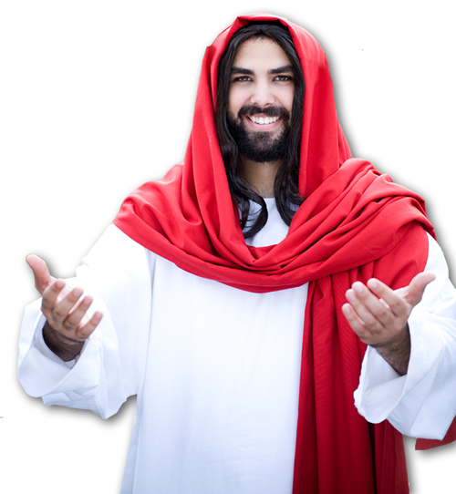
^{Luke 4:17} The scroll of the prophet Isaiah was handed to him. Unrolling it, he found the place where it is written:
¹⁸ "The Spirit of the Lord is on me,
because he has anointed me to
preach good news to the poor. He
has sent me to proclaim freedom
for the prisoners and recovery of
sight for the blind, to release the
oppressed, ¹⁹ to proclaim the year
of the Lord's favor."

Slide 13
²⁰ Then he rolled up the scroll, gave it back to the attendant and sat down. The eyes of everyone in the synagogue were fastened on him,
²¹ and he began by saying to them,
"Today this scripture is fulfilled
in your hearing."
(Luke 4:17-21)

Slide 14
¹ The Spirit of the Sovereign LORD is on me, because the LORD has anointed me to preach good news to the poor. He has sent me to bind up the brokenhearted, to proclaim freedom for the captives and release from darkness for the prisoners, ² to proclaim the year of the LORD's favor and the day of vengeance of our God, to comfort all who mourn, ³ and provide for those who grieve in Zion-- to bestow on them a crown of beauty instead of ashes, the oil of gladness instead of mourning, and a garment of praise instead of a spirit of despair. They will be called oaks of righteousness, a planting of the LORD for the display of his splendor. (Isaiah 61:1-3)

Slide 15
Jesus Reveals the Rapture

Slide 16
Jesus Reveals the Rapture
² In my Father's house are many rooms; if it were not so, I would have told you. I am going there to prepare a place for you. ³ And if I go and prepare a place for you, I will come back and take you to be with me that you also may be where I am. John 14:2-3

Slide 17
Jesus Reveals the Rapture
While the Old Testament speaks of TWO COMINGS ...
1- Suffer and die:
as Savior.
2- Rule and reign:
as King:
Jesus promise another BETWEEN THE TWO COMINGS!
Notes:
Life saver = https://www.needpix.com/photo/18804/lifesaver-life-ring-life-preserver-flotation-device-lifeguard-rescue-at-sea

Slide 18
Jesus Reveals the Rapture
² In my Father's house are many rooms; if it were not so, I would have told you. I am going there to prepare a place for you. ³ And if I go and prepare a place for you, I will come back and take you to be with me that you also may be where I am. John 14:2-3

Slide 19
Until Then God wants us …

Slide 20
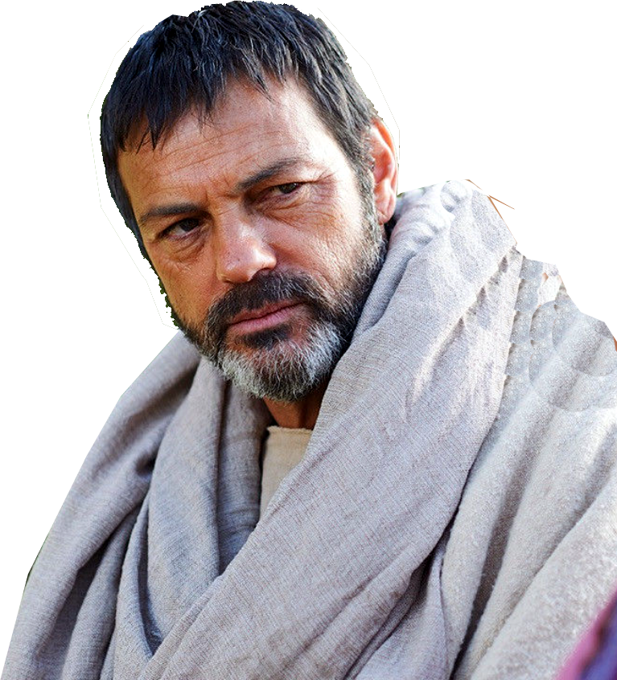

1. To Be INFORMed of His Return
^{1Thess 4:13} Brothers, we do not want you to be ignorant about those who fall asleep, or to grieve like the rest of men, who have no hope.

Slide 21
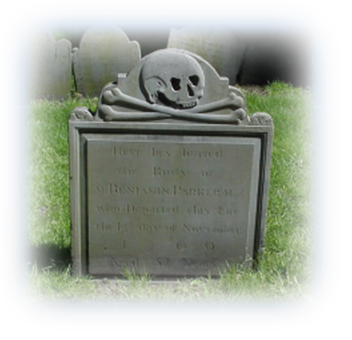
1. to Be Informed of His Return
^{1Thess 4:13} Brothers, we do not want you to be ignorant about those who fall asleep, or to grieve like the rest of men, who have no hope.

Slide 22
Anticipating QUESTIONS regarding His Return
?
What happens to those who die before
Jesus returns?
Will they go to heaven or have they missed it?

Slide 23
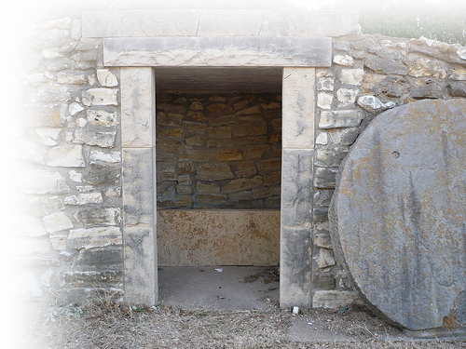
2. To HAVE Faith in His Return
¹⁴ We believe that Jesus died and rose again and so we believe that God will bring with Jesus those who have fallen
asleep in him.
Notes:
Free Photo = empty tomb = http://www.google.com/imgres?imgurl=http://farm3.static.flickr.com/2293/2265865802_d2d9c91534.jpg%3Fv%3D0&imgrefurl=http://flickr.com/photos/kodi_tanner/2265865802/&usg=__0meLMTk7Y1mV--00DMDkiY4GhOY=&h=375&w=500&sz=168&hl=en&start=0&zoom=1&tbnid=_ek9UNL3SA9bQM:&tbnh=120&tbnw=151&prev=/images%3Fq%3Dempty%2Btomb%26um%3D1%26hl%3Den%26client%3Dfirefox-a%26hs%3Dk3c%26sa%3DG%26rls%3Dorg.mozilla:en-US:official%26biw%3D1440%26bih%3D747%26as_st%3Dy%26tbs%3Disch:1,iur:f&um=1&itbs=1&iact=hc&vpx=111&vpy=478&dur=1407&hovh=194&hovw=259&tx=128&ty=153&ei=zwXbTJaMK8T38AbLke34CQ&oei=xAXbTMLGBcOpcfbu6cIG&esq=5&page=1&ndsp=32&ved=1t:429,r:24,s:0

Slide 24



2. To Have Faith in His Return
¹⁴ We believe that Jesus died and rose again and so we believe that God will bring with Jesus those who have fallen
asleep in him.
Notes:
Free Photo = empty tomb = http://www.google.com/imgres?imgurl=http://farm3.static.flickr.com/2293/2265865802_d2d9c91534.jpg%3Fv%3D0&imgrefurl=http://flickr.com/photos/kodi_tanner/2265865802/&usg=__0meLMTk7Y1mV--00DMDkiY4GhOY=&h=375&w=500&sz=168&hl=en&start=0&zoom=1&tbnid=_ek9UNL3SA9bQM:&tbnh=120&tbnw=151&prev=/images%3Fq%3Dempty%2Btomb%26um%3D1%26hl%3Den%26client%3Dfirefox-a%26hs%3Dk3c%26sa%3DG%26rls%3Dorg.mozilla:en-US:official%26biw%3D1440%26bih%3D747%26as_st%3Dy%26tbs%3Disch:1,iur:f&um=1&itbs=1&iact=hc&vpx=111&vpy=478&dur=1407&hovh=194&hovw=259&tx=128&ty=153&ei=zwXbTJaMK8T38AbLke34CQ&oei=xAXbTMLGBcOpcfbu6cIG&esq=5&page=1&ndsp=32&ved=1t:429,r:24,s:0

Slide 25
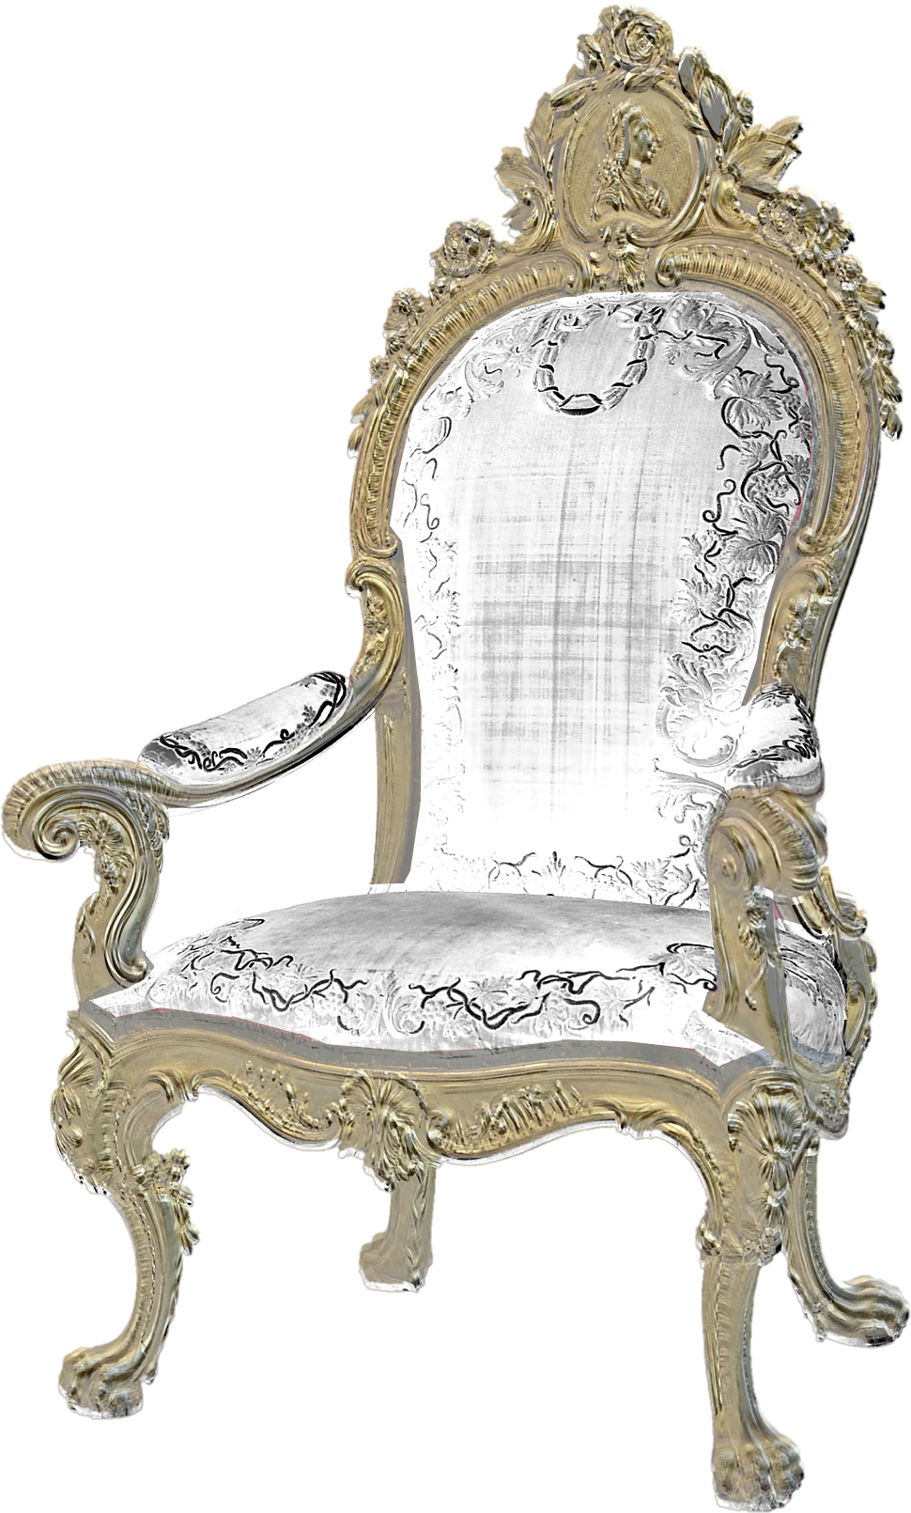
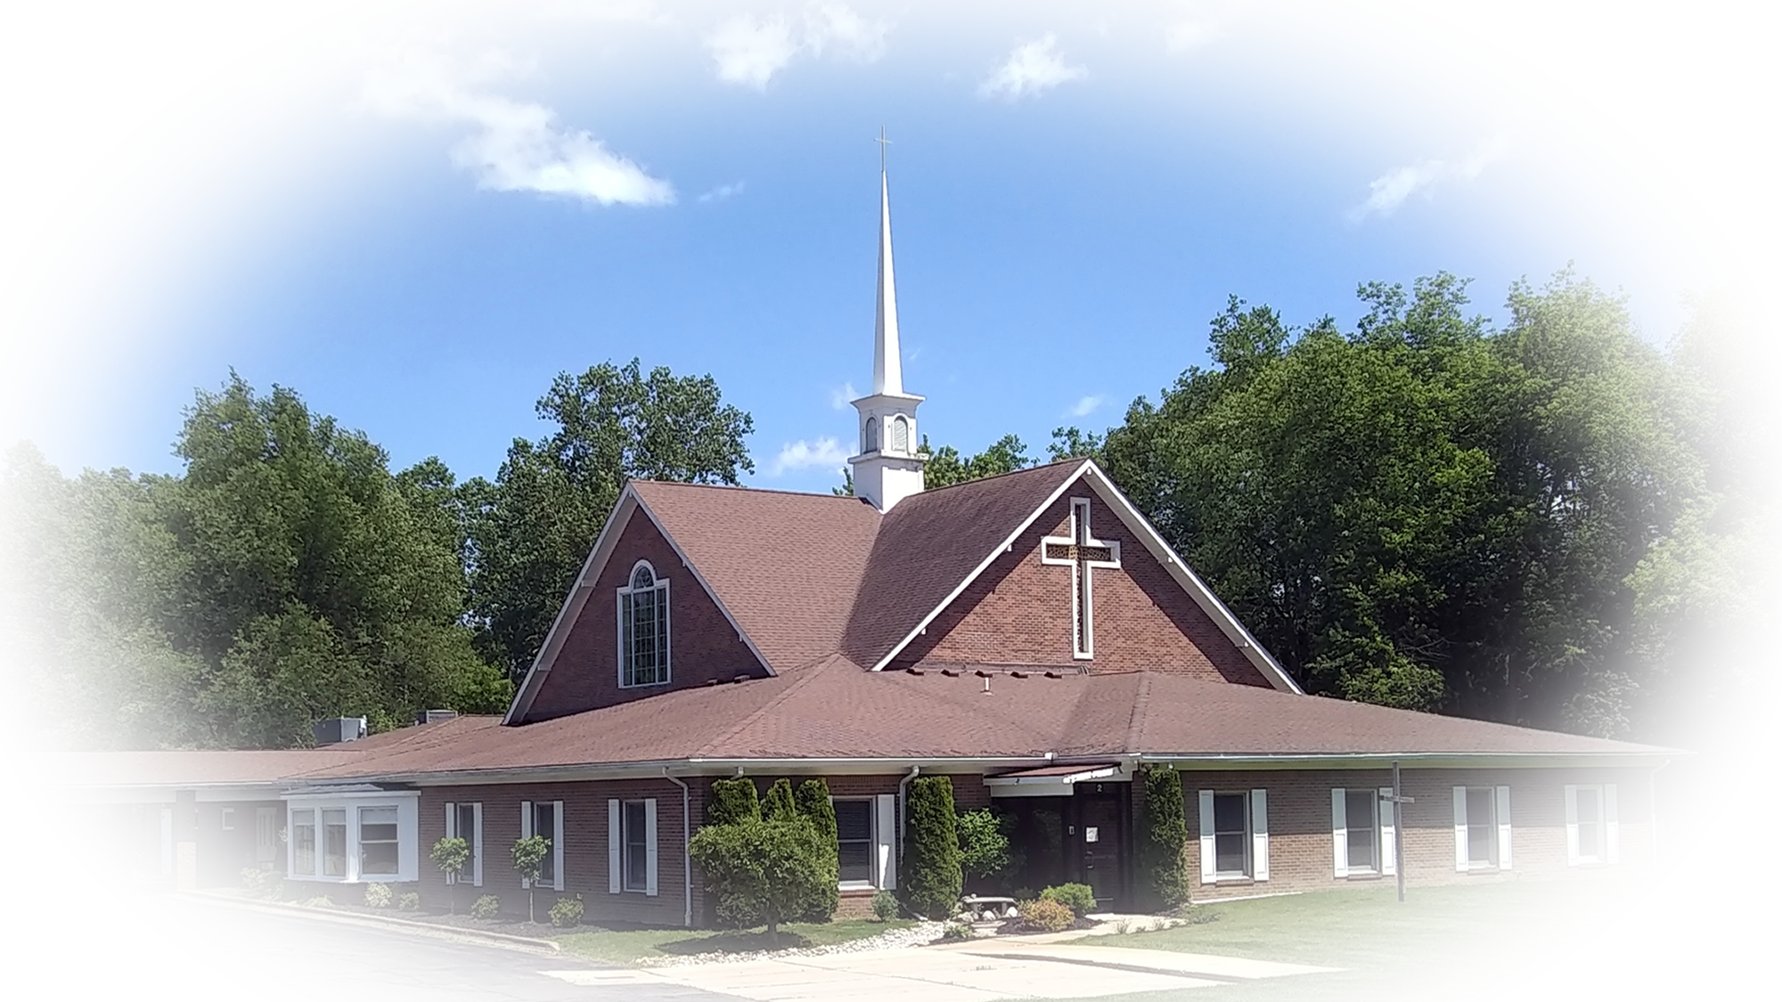
There are two resurrections:
“there will be a resurrection of both the righteous and the wicked.” (Act 24:15)
Stages of the Righteous Resurrections
The Wicked
Christ
OT
Saints
Church
All “The Dead” stand before… (Rev 20:12)
1 Cor 15:23
firstfruits
1 Thes 4:16
rapture
Rev 20:4
revelation

Slide 26
There are two resurrections:
“there will be a resurrection of both the righteous and the wicked.” (Act 24:15)
Stages of the Righteous Resurrections
The Wicked
Church
What will the resurrection/rapture be like?
1 Thes 4:16
rapture

Slide 27
3. To Be Assured of His Return
¹⁵ According to the Lord's own word, we tell you that we who are still alive, who are left till the coming of the Lord, will certainly not precede those who have fallen asleep.
³ ... I will come back and take you to be with me that you also may be where I am. John 14:2-3

Slide 28
4. To Know the details
¹⁵ According to the Lord's own word, we tell you that we who are still alive, who are left till the coming of the Lord, will certainly not precede those who have fallen asleep.
There is an order:

Slide 29

4. To Know the details
1
¹⁶ For the Lord himself will come down from heaven, with a loud command, with the voice of the archangel and with the trumpet call of God, and the dead in Christ will rise first.

Slide 30
4. To Know the details
Church, come forth!
¹⁶ For the Lord himself will come down from heaven, with a loud command, with the voice of the archangel and with the trumpet call of God, and the dead in Christ will rise first.
2

Slide 31
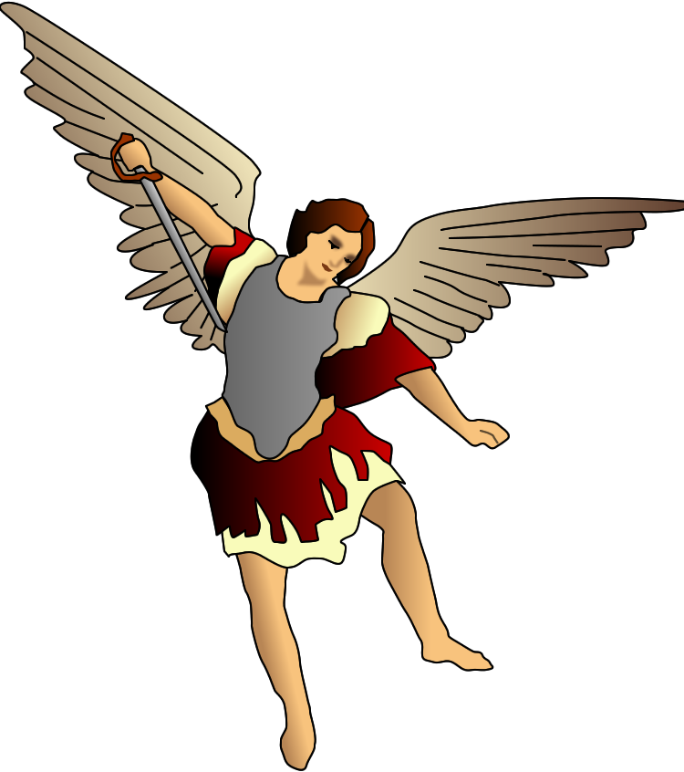
4. To Know the details
Church, come forth!
¹⁶ For the Lord himself will come down from heaven, with a loud command, with the voice of the archangel and with the trumpet call of God, and the dead in Christ will rise first.
3

Slide 32

4. To Know the details
Church, come forth!
¹⁶ For the Lord himself will come down from heaven, with a loud command, with the voice of the archangel and with the trumpet call of God, and the dead in Christ will rise first.
4

Slide 33


4. To Know the details
¹⁶ For the Lord himself will come down from heaven, with a loud command, with the voice of the archangel and with the trumpet call of God, and the dead in Christ will rise first.
5

Slide 34
4. To Know the details
6
¹⁷ After that, we who are still alive and are left will be caught up together with them in the clouds to meet the Lord in the air. And so we will be with the Lord forever.

Slide 35
4. To Know the details
⁵¹ Listen, I tell you a mystery: We will not all sleep, but we will all be changed-- ⁵² in a flash, in the twinkling of an eye, at the last trumpet. For the trumpet will sound, the dead will be raised imperishable, and we will be changed.
⁵³ For the perishable must clothe itself with the imperishable, and the mortal with immortality. ⁵⁴ When the perishable has been clothed with the imperishable, and the mortal with immortality, then the saying that is written will come true: "Death has been swallowed up in victory." (1Corinthians 15:51-54)
¹⁷ After that, we who are still alive and are left will be caught up together with them in the clouds to meet the Lord in the air. And so we will be with the Lord forever.
7

Slide 36
4. To Know the details
¹⁷ After that, we who are still alive and are left will be caught up together with them in the clouds to meet the Lord in the air. And so we will be with the Lord forever.
7
“Caught up" = αρπαγησομεθα
harpagasometha
“robbed”
(KJV – Phil 2:8)

Slide 37
4. To Know the details
¹⁷ After that, we who are still alive and are left will be caught up together with them in the clouds to meet the Lord in the air. And so we will be with the Lord forever.
7
“Caught up" = "rapture”
From the Latin word "rapiemur“ which means “will be caught up.”

Slide 38
4. To Know the details
¹⁷ After that, we who are still alive and are left will be caught up together with them in the clouds to meet the Lord in the air. And so we will be with the Lord forever.
7
1-Snatch away speedily Acts 8:39

Slide 39
4. To Know the details
¹⁷ After that, we who are still alive and are left will be caught up together with them in the clouds to meet the Lord in the air. And so we will be with the Lord forever.
7
1-Snatch away speedily Acts 8:39
2-Seize and carry-off by force
John 6:15

Slide 40
4. To Know the details
¹⁷ After that, we who are still alive and are left will be caught up together with them in the clouds to meet the Lord in the air. And so we will be with the Lord forever.
7
1-Snatch away speedily Acts 8:39
2-Seize and carry-off by force
John 6:15
3-Rescue from danger/destruction
Acts 23:10

Slide 41
4. To Know the details
¹⁷ After that, we who are still alive and are left will be caught up together with them in the clouds to meet the Lord in the air. And so we will be with the Lord forever.
7
1-Snatch away speedily Acts 8:39
2-Seize and carry-off by force
John 6:15
3-Rescue from danger/destruction
Acts 23:10
4-Move to a new place 2 Cor 12:1-4

Slide 42
4. To Know the details
¹⁷ After that, we who are still alive and are left will be caught up together with them in the clouds to meet the Lord in the air. And so we will be with the Lord forever.
8

Slide 43
4. To Know the details
¹⁷ After that, we who are still alive and are left will be caught up together with them in the clouds to meet the Lord in the air. And so we will be with the Lord forever.
9

Slide 44
5. To Be Encouraged
¹⁸ Therefore encourage each other with these words.

Slide 45
Encouraged from His Promise
¹ "Do not let your hearts be troubled. ... I will come back and take you to be with me that you also may be where I am.” (John 14:1, 3)

Slide 46

Encouraged from The Hope
¹³ ... we wait for the blessed hope--the glorious appearing of our great God and Savior, Jesus Christ,
¹⁴ who gave himself for us to redeem us from all wickedness and to purify for himself a people that are his very own, (Titus 2:13-14)
Notes:
https://media.defense.gov/2018/Jun/28/2001937132/-1/-1/0/180625-F-SR919-0001.JPG

Slide 47
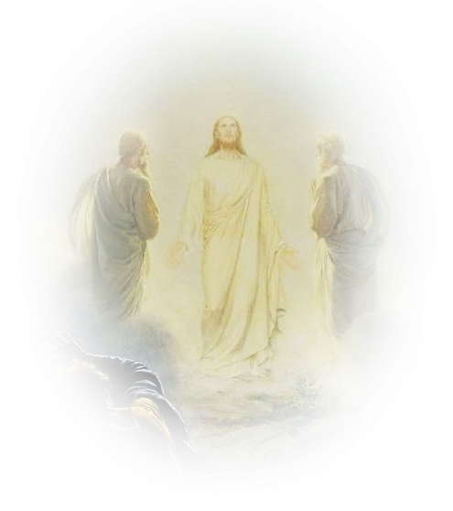
Encouraged from Glorification
²⁰ But our citizenship is in heaven. And we eagerly await a Savior from there, the Lord Jesus Christ,
²¹ who, by the power that enables him to bring everything under his control, will transform our lowly bodies so that they will be like his glorious body. (Phil 3:20-1)

Slide 48
Encouraged from Glorification
... we know that when he appears, we shall be like him, for we shall see him as he is. ³ Everyone who has this hope in him purifies himself, just as he is pure.
(1John 3:2-3)

Slide 49
Encouraged from Glorification
¹⁸ I consider that our present sufferings are not worth comparing with the glory that will be revealed in us. (Romans 8:18)

Slide 50
Let’s Pray!
Notes:
Backround image = FREE = Image by <a href="https://pixabay.com/users/geralt-9301/?utm_source=link-attribution&amp;utm_medium=referral&amp;utm_campaign=image&amp;utm_content=2709662">Gerd Altmann</a> from <a href="https://pixabay.com/?utm_source=link-attribution&amp;utm_medium=referral&amp;utm_campaign=image&amp;utm_content=2709662">Pixabay</a>

