Slide 1

Things to Come!
Daniel 2:29
This presentation uses Airstrike Condensed font:
https://www.dafont.com/airstrike.font
Notes:
Backround image = FREE = Image by <a href="https://pixabay.com/users/geralt-9301/?utm_source=link-attribution&amp;utm_medium=referral&amp;utm_campaign=image&amp;utm_content=2709662">Gerd Altmann</a> from <a href="https://pixabay.com/?utm_source=link-attribution&amp;utm_medium=referral&amp;utm_campaign=image&amp;utm_content=2709662">Pixabay</a>
Copyright © 2006−2021. All rights reserved. Bible Point is a registered trademark of Dennis Henderson. All other trademarks acknowledged.
Bible Point contains graphics from Bible Point artists. These illustrations belong to Bible Point and the respective artists. You may use the designs and illustrations for graphical illustration of lessons free and without special permission, provided they are not used in any way that maligns the Christian faith. Furthermore, republication or production of any illustration by any other graphic service whether it be in book, in a machine-readable form, or in any other design resource is strictly prohibited. Furthermore, they cannot be duplicated or resold as any other form of publishing, clip art, or graphic resource.
So What does it mean? (A simple translations of the legal jargon)
So, if you don’t own the presentation(s), graphic(s), and text(s) how can you legally use them? The purchase of the license allows you to use all the images in the product. However, the actual ownership and copyright of the presentation(s), graphic(s), and text(s) remain the property of Bible Point and its licensors. If you had plans on using this product in your “for sale” work—think again!
License Agreement
Article 1: License Grant
All the graphics and text in Bible Point presentations (excluding quotes from the Bible and stated sources) are the intellectual and real property of Bible Point and its licensors, and is protected by law, including United States copyright laws and international treaties. Bible Point grants to you a license:
1. To use the presentation in a single church, single school, or single office of a Christian organization.
2. To make a single archival back-up copy of the program.
3. To modify the presentation(s) and merge with other presentations in a single church, school, or Christian organization.
4. To transfer to another party if that party agrees to accept the terms and conditions of this agreement, and you do not retain any copies of the presentation, whether printed, machine readable, modified, or merged form.
Article 2: Terms
This license is effective until terminated. You may terminate the license at any time by destroying the presentation(s), graphic(s), or text(s) together with all copies, modifications and merged portions in any form. Bible Point may terminate your license if you fail to comply with this Agreement. You agree, upon such termination, for any reason, to destroy the presentation(s), graphics, and text(s) with all copies, modifications, and merged portions in any form.
Article 3: Disclaimers
1. Bible Point presentations, graphics, and texts are licensed to you As Is. You, the consumer, bear the entire risk relating to the quality and performance of the presentation(s), graphic(s), or text(s). In no event will Bible Point be liable for damages resulting from any defect.
2. Thirty-day limited warrantee on disks. Bible Point warrants the disks to be free of defects in material and workmanship under normal use for 30 days after purchase. During the 30-day period you may return a defective presentation, graphic, or text with proof of purchase and it will be replaced without charge, unless the presentation is damaged by misuse.
Article 4: General
1. You may not sub-license, assign, or transfer the license of the presentation(s), graphic(s), or text(s) except as provided by this Agreement.
2. This Agreement will be governed by the laws of the State of Michigan.
So What does it mean? (A simple translations of the legal jargon)
May I let someone borrow or copy my licensed Bible Point presentation (even after I modified it)? As long as it is within your local church, or single school, or the immediate office of a Christian organization you may. Otherwise, please refer the person interested in borrowing to: http://www.biblepoint.com or E-mail: dennis@DrDH.net with any related questions.

Slide 2
Things to Come!
Daniel 2:29
Notes:
Backround image = FREE = Image by <a href="https://pixabay.com/users/geralt-9301/?utm_source=link-attribution&amp;utm_medium=referral&amp;utm_campaign=image&amp;utm_content=2709662">Gerd Altmann</a> from <a href="https://pixabay.com/?utm_source=link-attribution&amp;utm_medium=referral&amp;utm_campaign=image&amp;utm_content=2709662">Pixabay</a>
Copyright © 2006−2021. All rights reserved. Bible Point is a registered trademark of Dennis Henderson. All other trademarks acknowledged.
Bible Point contains graphics from Bible Point artists. These illustrations belong to Bible Point and the respective artists. You may use the designs and illustrations for graphical illustration of lessons free and without special permission, provided they are not used in any way that maligns the Christian faith. Furthermore, republication or production of any illustration by any other graphic service whether it be in book, in a machine-readable form, or in any other design resource is strictly prohibited. Furthermore, they cannot be duplicated or resold as any other form of publishing, clip art, or graphic resource.
So What does it mean? (A simple translations of the legal jargon)
So, if you don’t own the presentation(s), graphic(s), and text(s) how can you legally use them? The purchase of the license allows you to use all the images in the product. However, the actual ownership and copyright of the presentation(s), graphic(s), and text(s) remain the property of Bible Point and its licensors. If you had plans on using this product in your “for sale” work—think again!
License Agreement
Article 1: License Grant
All the graphics and text in Bible Point presentations (excluding quotes from the Bible and stated sources) are the intellectual and real property of Bible Point and its licensors, and is protected by law, including United States copyright laws and international treaties. Bible Point grants to you a license:
1. To use the presentation in a single church, single school, or single office of a Christian organization.
2. To make a single archival back-up copy of the program.
3. To modify the presentation(s) and merge with other presentations in a single church, school, or Christian organization.
4. To transfer to another party if that party agrees to accept the terms and conditions of this agreement, and you do not retain any copies of the presentation, whether printed, machine readable, modified, or merged form.
Article 2: Terms
This license is effective until terminated. You may terminate the license at any time by destroying the presentation(s), graphic(s), or text(s) together with all copies, modifications and merged portions in any form. Bible Point may terminate your license if you fail to comply with this Agreement. You agree, upon such termination, for any reason, to destroy the presentation(s), graphics, and text(s) with all copies, modifications, and merged portions in any form.
Article 3: Disclaimers
1. Bible Point presentations, graphics, and texts are licensed to you As Is. You, the consumer, bear the entire risk relating to the quality and performance of the presentation(s), graphic(s), or text(s). In no event will Bible Point be liable for damages resulting from any defect.
2. Thirty-day limited warrantee on disks. Bible Point warrants the disks to be free of defects in material and workmanship under normal use for 30 days after purchase. During the 30-day period you may return a defective presentation, graphic, or text with proof of purchase and it will be replaced without charge, unless the presentation is damaged by misuse.
Article 4: General
1. You may not sub-license, assign, or transfer the license of the presentation(s), graphic(s), or text(s) except as provided by this Agreement.
2. This Agreement will be governed by the laws of the State of Michigan.
So What does it mean? (A simple translations of the legal jargon)
May I let someone borrow or copy my licensed Bible Point presentation (even after I modified it)? As long as it is within your local church, or single school, or the immediate office of a Christian organization you may. Otherwise, please refer the person interested in borrowing to: http://www.biblepoint.com or E-mail: dennis@DrDH.net with any related questions.

Slide 3



Predictive prophecy
50%
25%

Slide 4
Our focus ...

Slide 5
The Prediction of the Church

Slide 6
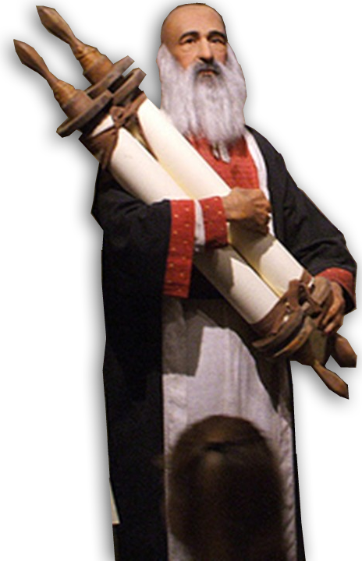
The Prediction of the Church
1. The church is neither mentioned nor
predicted in the Old Testament

Slide 7
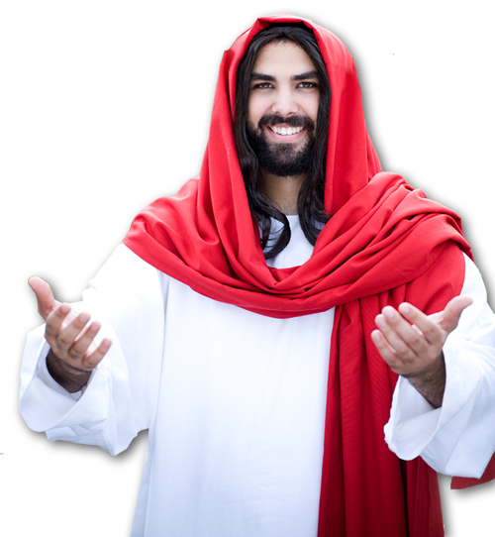
The Prediction of the Church
1. The church is neither mentioned nor
predicted in the Old Testament
2. The first reference/prediction
is by Jesus Christ

Slide 8
The Prediction of the Church
"Who do people say the Son of Man is?“

Slide 9
The Prediction of the Church
¹⁴ They replied,
"Some say John the Baptist; others say Elijah; and still others, Jeremiah or one of the prophets."

Slide 10
The Prediction of the Church
¹⁵ "But what about you?" he asked. "Who do you say I am?"

Slide 11
The Prediction of the Church
¹⁶ Simon Peter answered,
"You are the Christ, the Son of the living God."

Slide 12
The Prediction of the Church
¹⁷ Jesus replied,
"Blessed are you, Simon son of Jonah, for this was not revealed to you by man, but by my Father in heaven.

Slide 13
The Prediction of the Church
¹⁸ And I tell you that you are Peter, and on this rock I will build my church, and the gates of Hades will not overcome it. (Mat 16:18)

Slide 14
The Prediction of the Church
Future Tense Prediction
¹⁸ And I tell you that you are Peter, and on this rock I will build my church, and the gates of Hades will not overcome it. (Mat 16:18)

Slide 15
The Prediction of the Church
Prediction of a New Entity
¹⁸ And I tell you that you are Peter, and on this rock I will build my church, and the gates of Hades will not overcome it. (Mat 16:18)

Slide 16
The Prediction of the Church
Predicted Victory
¹⁸ And I tell you that you are Peter, and on this rock I will build my church, and the gates of Hades will not overcome it. (Mat 16:18)

Slide 17
The Purpose of the Church

Slide 18

The Purpose of the Church
Predicted to be a Spiritual Entity (Acts 1:8)
⁸ But you will receive power when the Holy Spirit comes on you; and you will be my witnesses in Jerusalem, and in all
Judea and Samaria, and to the ends of the earth."

Slide 19
The Purpose of the Church
Predicted to be Witnesses (Acts 1:8)
⁸ But you will receive power when the Holy Spirit comes on you; and you will be my witnesses in Jerusalem, and in all
Judea and Samaria, and to the ends of the earth."

Slide 20
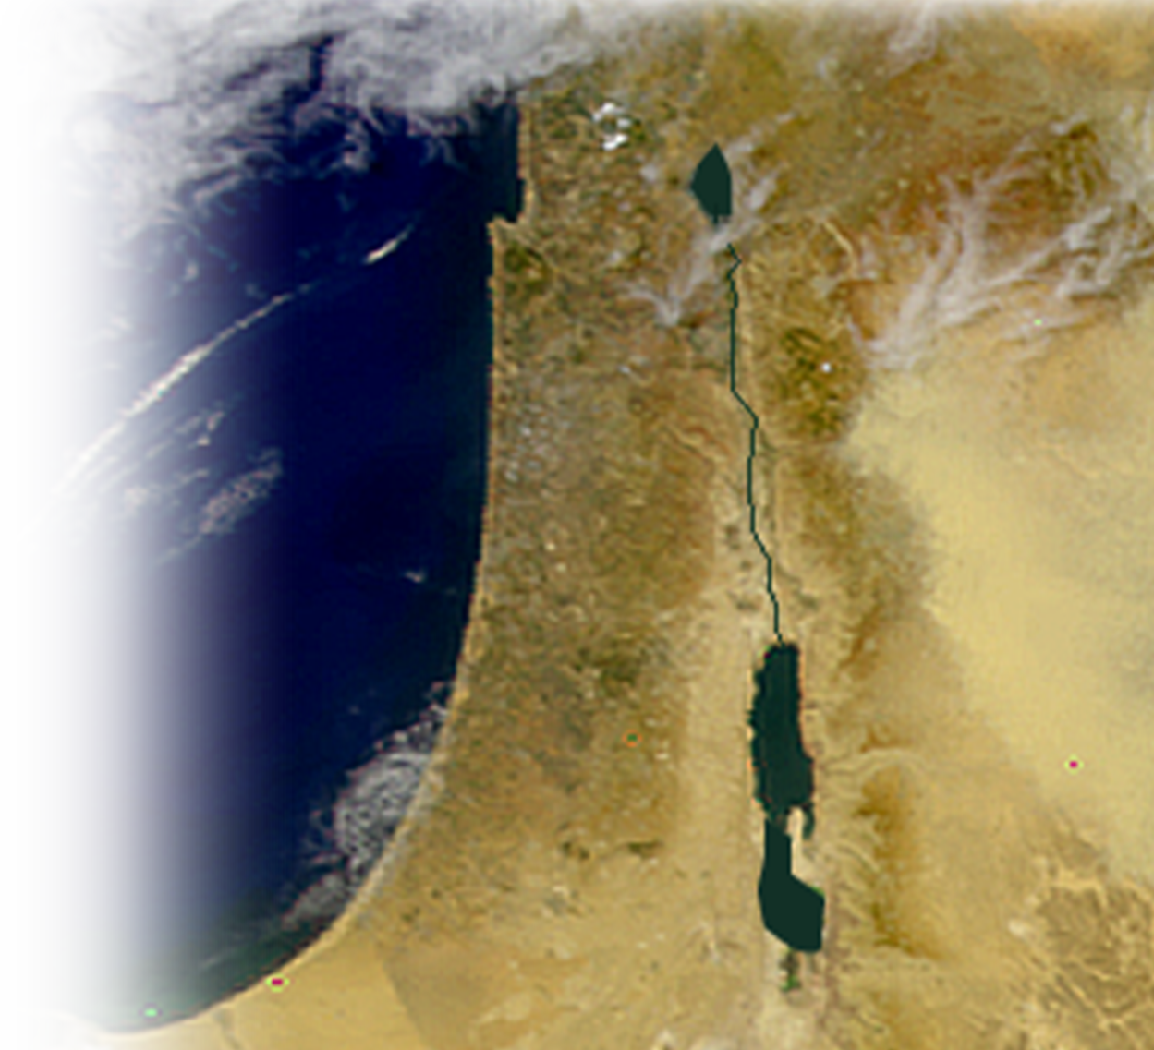
The Purpose of the Church
Predicted to be Witnesses (Acts 1:8)
⁸ But you will receive power when the Holy Spirit comes on you; and you will be my witnesses in Jerusalem, and in all
Judea and Samaria, and to the ends of the earth."

Slide 21
The Purpose of the Church
Predicted to be Witnesses (Acts 1:8)
⁸ But you will receive power when the Holy Spirit comes on you; and you will be my witnesses in Jerusalem, and in all
Judea and Samaria, and to the ends of the earth."

Slide 22

The Purpose of the Church
Predicted to be Witnesses (Acts 1:8)
⁸ But you will receive power when the Holy Spirit comes on you; and you will be my witnesses in Jerusalem, and in all
Judea and Samaria, and to the ends of the earth."

Slide 23
The Beginning of the Church

Slide 24
The Beginning of the Church
"Do not leave Jerusalem, but wait for the gift my Father promised, which you have heard me speak about. ⁵ For John baptized with water, but in a few days you will be baptized with the Holy Spirit." (Acts 1:4-5)

Slide 25

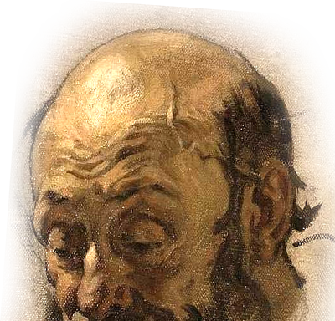
The Beginning of the Church
Acts 2¹ When the day of Pentecost came, they
were all together in one place. ² Suddenly
a sound like the blowing of a violent wind
came from heaven and filled the whole
house where they were sitting. ³ They
saw what seemed to be tongues of fire
that separated and came to rest on each
of them. ⁴ All of them were filled with
the Holy Spirit ....

Slide 26


The Beginning of the Church
Acts 11:15 "As I began to speak, the Holy Spirit came on them as he had come on us at the beginning. ¹⁶ Then I remembered what the Lord had
said: 'John baptized with water,
but you will be baptized with
the Holy Spirit.' ¹⁷ So if God
gave them the same gift as he
gave us, who believed in the
Lord Jesus Christ, who was I to
think that I could oppose God?“

Slide 27
The Beginning of the Church
Acts 11:15 "As I began to speak, the Holy Spirit came on them as he had come on us at the beginning. ¹⁶ Then I remembered what the Lord had
said: 'John baptized with water,
but you will be baptized with
the Holy Spirit.' ¹⁷ So if God
gave them the same gift as he
gave us, who believed in the
Lord Jesus Christ, who was I to
think that I could oppose God?“

Slide 28
The Beginning of the Church
Acts 11:15 "As I began to speak, the Holy Spirit came on them as he had come on us at the beginning. ¹⁶ Then I remembered what the Lord had
said: 'John baptized with water,
but you will be baptized with
the Holy Spirit.' ¹⁷ So if God
gave them the same gift as he
gave us, who believed in the
Lord Jesus Christ, who was I to
think that I could oppose God?“

Slide 29
The Propagation of the Church

Slide 30
The Propagation of the Church
... about three thousand were added to their number (Acts 2:41)
And the Lord added to their number daily those who were being saved. (Acts 2:47)
... more ... believed in the Lord and were added to their number. (Acts 5:14)
Now in those days, the number of disciples was multiplying, (Act 6:1 NKJ)
The number of disciples in Jerusalem increased rapidly, (Acts 6:7)
⁴ Those who had been scattered preached the word wherever they went. (Acts 8:4)

Slide 31
The Propagation of the Church
the church increased in numbers. (Acts 9:31 NET)
But the word of God continued to increase and spread. (Act 12:24)
So the churches were strengthened in the faith and grew daily in numbers. (Act 16:5 NIV)
In this way the word of the Lord spread widely and grew in power. (Acts 19:20)
All over the world this gospel is bearing fruit and growing, just as it has been doing among you since the day you heard it and understood God's grace in all its truth. (Col 1:6 NIV)

Slide 32
The Continuation of the Church

Slide 33
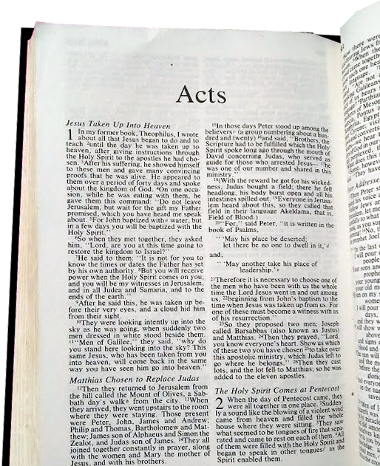
The Continuation of the Church
Acts 28³⁰ For two whole years Paul stayed there in his own rented house and welcomed all who came to see him. ³¹ Boldly and without hindrance he preached the kingdom of God and taught about the Lord Jesus Christ.
No “The End.”

Slide 34
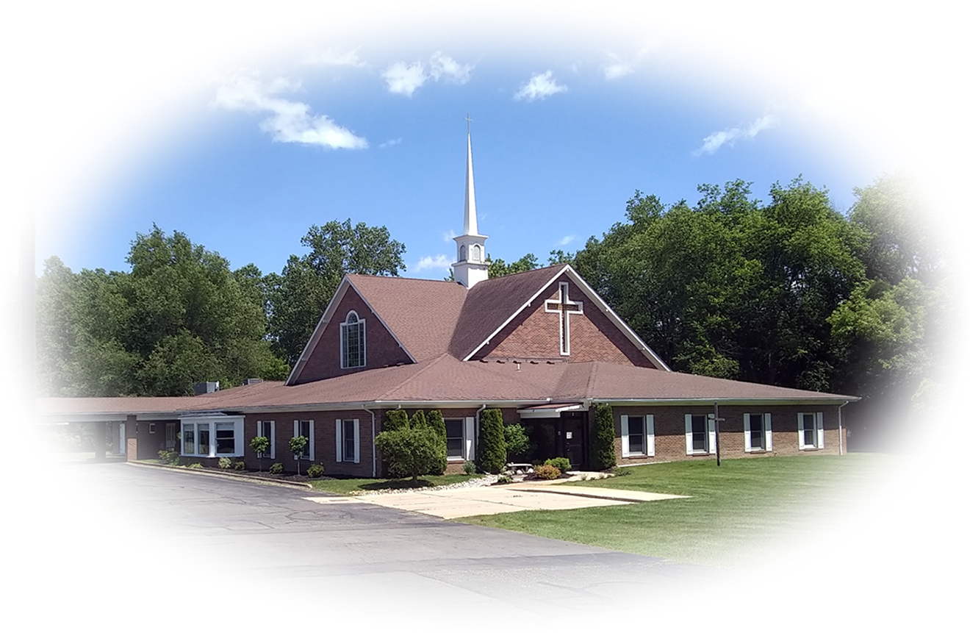

The Continuation of the Church
End of Acts
Nearly 2000 Years
To Come
PENTECOST
NOW

Slide 35
The Culmination of the Church

Slide 36
The Culmination of the Church
² In my Father's house are many rooms; if it were not so, I would have told you. I am going there to prepare a place for you. ³ And if I go and prepare a place for you,
I will come back and take you to be with me that you also may be where I am. John 14:2-3

Slide 37
The Culmination of the Church
End of Acts
Nearly 2000 Years
To Come
PENTECOST
NOW
RAPTURE

Slide 38
The Reward of the Church

Slide 39

The Reward of the Church
¹⁰ For we must all appear before the judgment seat of Christ, that each one may receive what is due him for the things done while in the body, whether good or bad. (2Cor 5:10)
Nearly 2000 Years
To Come
PENTECOST
NOW
RAPTURE

Slide 40
Here’s the Point

Slide 41
Here’s the Point
The Church ...
Was Predicted—by Jesus.

Slide 42
Here’s the Point
The Church ...
Was Predicted—by Jesus.
Has a Purpose—to witness.

Slide 43
Here’s the Point
The Church ...
Was Predicted—by Jesus.
Has a Purpose—to witness.
Had a Beginning—Pentecost.

Slide 44
Here’s the Point
The Church ...
Was Predicted—by Jesus.
Has a Purpose—to witness.
Had a Beginning—Pentecost.
Will Continue — Persevere,
Nearly 2000 Years
To Come

Slide 45
Here’s the Point
The Church ...
Was Predicted—by Jesus.
Has a Purpose—to witness.
Had a Beginning—Pentecost.
Will Continue — Persevere,
Until Jesus Comes—at the Rapture.
Nearly 2000 Years
To Come

Slide 46
Here’s the Point
The Church ...
Was Predicted—by Jesus.
Has a Purpose—to witness.
Had a Beginning—Pentecost.
Will Continue — Persevere,
Until Jesus Comes—at the Rapture.
And will be Rewarded—at the Judgment Seat.
Nearly 2000 Years
To Come

Slide 47
This Gives Us Hope!

Slide 48

This Gives Us Hope!
... we wait for the blessed hope --the glorious appearing of our great God and Savior, Jesus Christ, ¹⁴ who gave himself for us to redeem us from all wickedness and to purify for himself a people that are his very own, eager to do what is good. (Titus 2:13-14)

Slide 49
Let’s Pray!
Notes:
Backround image = FREE = Image by <a href="https://pixabay.com/users/geralt-9301/?utm_source=link-attribution&amp;utm_medium=referral&amp;utm_campaign=image&amp;utm_content=2709662">Gerd Altmann</a> from <a href="https://pixabay.com/?utm_source=link-attribution&amp;utm_medium=referral&amp;utm_campaign=image&amp;utm_content=2709662">Pixabay</a>

