Slide 1
The Love of God
Notes:
Copyright © 2006−2021. All rights reserved. Bible Point is a registered trademark of Dennis Henderson. All other trademarks acknowledged.
Bible Point contains graphics from Bible Point artists. These illustrations belong to Bible Point and the respective artists. You may use the designs and illustrations for graphical illustration of lessons free and without special permission, provided they are not used in any way that maligns the Christian faith. Furthermore, republication or production of any illustration by any other graphic service whether it be in book, in a machine-readable form, or in any other design resource is strictly prohibited. Furthermore, they cannot be duplicated or resold as any other form of publishing, clip art, or graphic resource.
So What does it mean? (A simple translations of the legal jargon)
So, if you don’t own the presentation(s), graphic(s), and text(s) how can you legally use them? The purchase of the license allows you to use all the images in the product. However, the actual ownership and copyright of the presentation(s), graphic(s), and text(s) remain the property of Bible Point and its licensors. If you had plans on using this product in your “for sale” work—think again!
License Agreement
Article 1: License Grant
All the graphics and text in Bible Point presentations (excluding quotes from the Bible and stated sources) are the intellectual and real property of Bible Point and its licensors, and is protected by law, including United States copyright laws and international treaties. Bible Point grants to you a license:
1. To use the presentation in a single church, single school, or single office of a Christian organization.
2. To make a single archival back-up copy of the program.
3. To modify the presentation(s) and merge with other presentations in a single church, school, or Christian organization.
4. To transfer to another party if that party agrees to accept the terms and conditions of this agreement, and you do not retain any copies of the presentation, whether printed, machine readable, modified, or merged form.
Article 2: Terms
This license is effective until terminated. You may terminate the license at any time by destroying the presentation(s), graphic(s), or text(s) together with all copies, modifications and merged portions in any form. Bible Point may terminate your license if you fail to comply with this Agreement. You agree, upon such termination, for any reason, to destroy the presentation(s), graphics, and text(s) with all copies, modifications, and merged portions in any form.
Article 3: Disclaimers
1. Bible Point presentations, graphics, and texts are licensed to you As Is. You, the consumer, bear the entire risk relating to the quality and performance of the presentation(s), graphic(s), or text(s). In no event will Bible Point be liable for damages resulting from any defect.
2. Thirty-day limited warrantee on disks. Bible Point warrants the disks to be free of defects in material and workmanship under normal use for 30 days after purchase. During the 30-day period you may return a defective presentation, graphic, or text with proof of purchase and it will be replaced without charge, unless the presentation is damaged by misuse.
Article 4: General
1. You may not sub-license, assign, or transfer the license of the presentation(s), graphic(s), or text(s) except as provided by this Agreement.
2. This Agreement will be governed by the laws of the State of Michigan.
So What does it mean? (A simple translations of the legal jargon)
May I let someone borrow or copy my licensed Bible Point presentation (even after I modified it)? As long as it is within your local church, or single school, or the immediate office of a Christian organization you may. Otherwise, please refer the person interested in borrowing to: http://www.biblepoint.com or E-mail: dennis@DrDH.net with any related questions.

Slide 2
The Love of God
Notes:
Copyright © 2006−2021. All rights reserved. Bible Point is a registered trademark of Dennis Henderson. All other trademarks acknowledged.
Bible Point contains graphics from Bible Point artists. These illustrations belong to Bible Point and the respective artists. You may use the designs and illustrations for graphical illustration of lessons free and without special permission, provided they are not used in any way that maligns the Christian faith. Furthermore, republication or production of any illustration by any other graphic service whether it be in book, in a machine-readable form, or in any other design resource is strictly prohibited. Furthermore, they cannot be duplicated or resold as any other form of publishing, clip art, or graphic resource.
So What does it mean? (A simple translations of the legal jargon)
So, if you don’t own the presentation(s), graphic(s), and text(s) how can you legally use them? The purchase of the license allows you to use all the images in the product. However, the actual ownership and copyright of the presentation(s), graphic(s), and text(s) remain the property of Bible Point and its licensors. If you had plans on using this product in your “for sale” work—think again!
License Agreement
Article 1: License Grant
All the graphics and text in Bible Point presentations (excluding quotes from the Bible and stated sources) are the intellectual and real property of Bible Point and its licensors, and is protected by law, including United States copyright laws and international treaties. Bible Point grants to you a license:
1. To use the presentation in a single church, single school, or single office of a Christian organization.
2. To make a single archival back-up copy of the program.
3. To modify the presentation(s) and merge with other presentations in a single church, school, or Christian organization.
4. To transfer to another party if that party agrees to accept the terms and conditions of this agreement, and you do not retain any copies of the presentation, whether printed, machine readable, modified, or merged form.
Article 2: Terms
This license is effective until terminated. You may terminate the license at any time by destroying the presentation(s), graphic(s), or text(s) together with all copies, modifications and merged portions in any form. Bible Point may terminate your license if you fail to comply with this Agreement. You agree, upon such termination, for any reason, to destroy the presentation(s), graphics, and text(s) with all copies, modifications, and merged portions in any form.
Article 3: Disclaimers
1. Bible Point presentations, graphics, and texts are licensed to you As Is. You, the consumer, bear the entire risk relating to the quality and performance of the presentation(s), graphic(s), or text(s). In no event will Bible Point be liable for damages resulting from any defect.
2. Thirty-day limited warrantee on disks. Bible Point warrants the disks to be free of defects in material and workmanship under normal use for 30 days after purchase. During the 30-day period you may return a defective presentation, graphic, or text with proof of purchase and it will be replaced without charge, unless the presentation is damaged by misuse.
Article 4: General
1. You may not sub-license, assign, or transfer the license of the presentation(s), graphic(s), or text(s) except as provided by this Agreement.
2. This Agreement will be governed by the laws of the State of Michigan.
So What does it mean? (A simple translations of the legal jargon)
May I let someone borrow or copy my licensed Bible Point presentation (even after I modified it)? As long as it is within your local church, or single school, or the immediate office of a Christian organization you may. Otherwise, please refer the person interested in borrowing to: http://www.biblepoint.com or E-mail: dennis@DrDH.net with any related questions.

Slide 3
The phrase “Love of God ” appears six times in my NIV Bible
Other translations have the expression more frequently …
but we will focus only on these six.

Slide 4
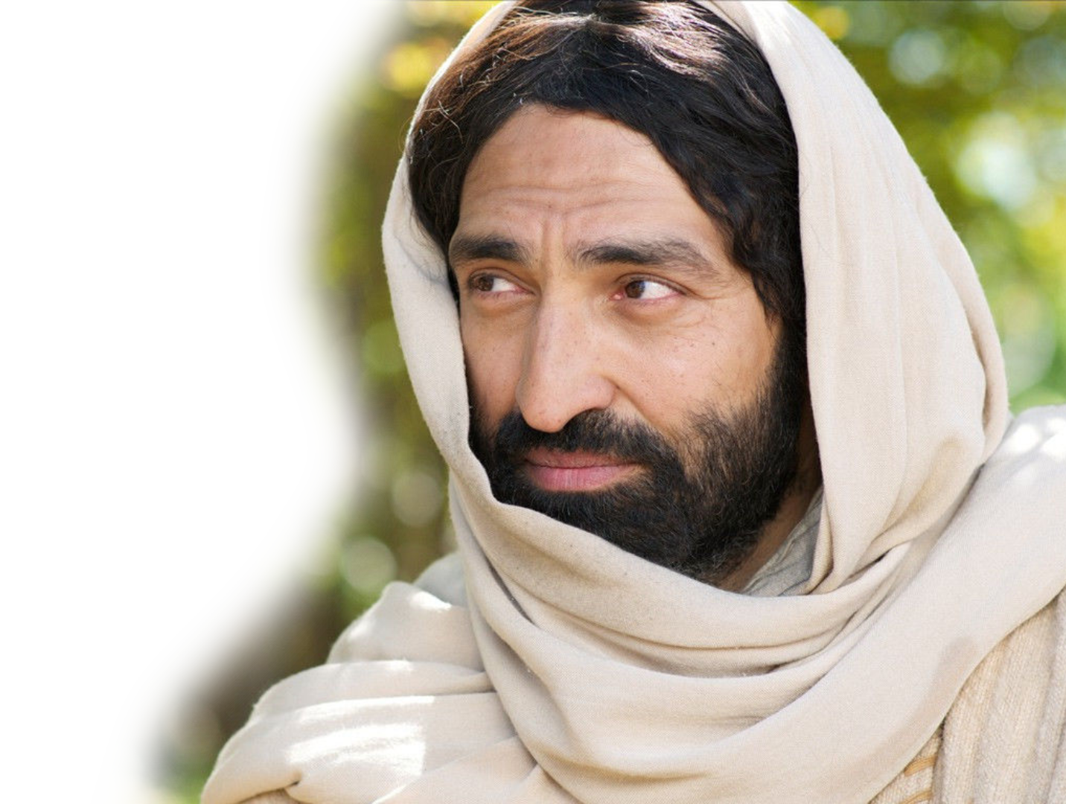
1-The Missed “Love of God ”
^{John 5:39} You diligently study the Scriptures because you think that by them you possess eternal life. These are the Scriptures that testify about me, ⁴⁰ yet you refuse to come to me to have life. ⁴¹ "I do not accept praise from men, ⁴² but I know you. I know that you do not have the love of God in your hearts.”
Notes:
Unbelievers in the Word of God do not have the love of God in their hearts.
Those who profess to be Christians and do not accept the authority of the Scriptures are only fooling themselves.
They missed it by twelve inches – it was a head thing
Not a heart thing
They fake they have the love of God
They fake they have eternal life

Slide 5
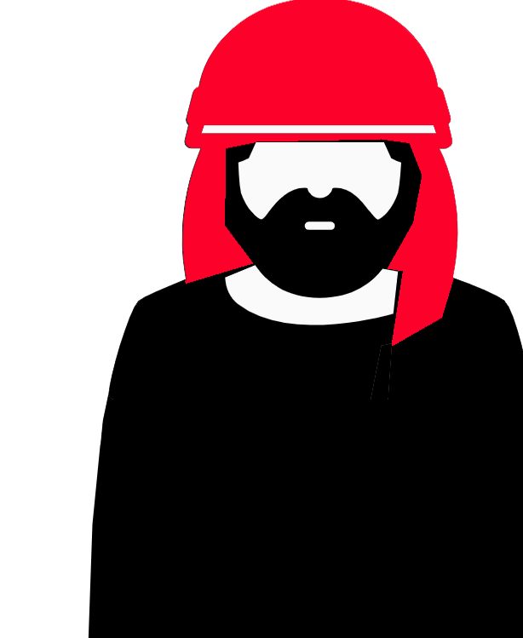
They Missed it by 12 inches
^{John 5:39} You diligently study the Scriptures because you think that by them you possess eternal life. These are the Scriptures that testify about me, ⁴⁰ yet you refuse to come to me to have life.
HEAD KNOWLEDGE
Notes:
https://thenounproject.com/term/arabic-man/1050455/
Unbelievers in the Word of God do not have the love of God in their hearts.
Those who profess to be Christians and do not accept the authority of the Scriptures are only fooling themselves.
They missed it by twelve inches – it was a head thing
Not a heart thing
They fake they have the love of God
They fake they have eternal life

Slide 6
They Missed it by 12 inches
⁴¹ "I do not accept praise from men, ⁴² but I know you. I know that you do not have the love of God in your hearts.”
HEART FAITH
Notes:
Unbelievers in the Word of God do not have the love of God in their hearts.
Those who profess to be Christians and do not accept the authority of the Scriptures are only fooling themselves.
They missed it by twelve inches – it was a head thing
Not a heart thing
They fake they have the love of God
They fake they have eternal life

Slide 7
2-The Neglected “Love of God ”
^{Luke 11:42} "Woe to you Pharisees, because you give God a tenth of your mint, rue and all other kinds of garden herbs, but you neglect justice and the love of God. You should have practiced the latter without leaving the former undone.
Notes:
This is the pick what I want to do Christian. I do only what is convenient for me.

Slide 8

Neglect from Half-Heartedness
^{Luke 11:42} "Woe to you Pharisees, because you give God a tenth of your mint, rue and all other kinds of garden herbs, but you neglect justice and the love of God. You should have practiced the latter without leaving the former undone.
Notes:
https://pixabay.com/photos/jesus-christ-god-holy-spirit-4499718/
This is the pick what I want to do Christian. I do only what is convenient for me.

Slide 9

Neglect from Half-Heartedness
^{Luke 11:42} "Woe to you Pharisees, because you give God a tenth of your mint, rue and all other kinds of garden herbs, but you neglect justice and the love of God. You should have practiced the latter without leaving the former undone.
Notes:
https://pixabay.com/illustrations/lost-alone-abandoned-forsaken-927078/
This is the pick what I want to do Christian. I do only what is convenient for me.

Slide 10

Should have been Wholehearted!
^{Luke 11:42} "Woe to you Pharisees, because you give God a tenth of your mint, rue and all other kinds of garden herbs, but you neglect justice and the love of God. You should have practiced the latter without leaving the former undone.
Notes:
This is the pick what I want to do Christian. I do only what is convenient for me.

Slide 11
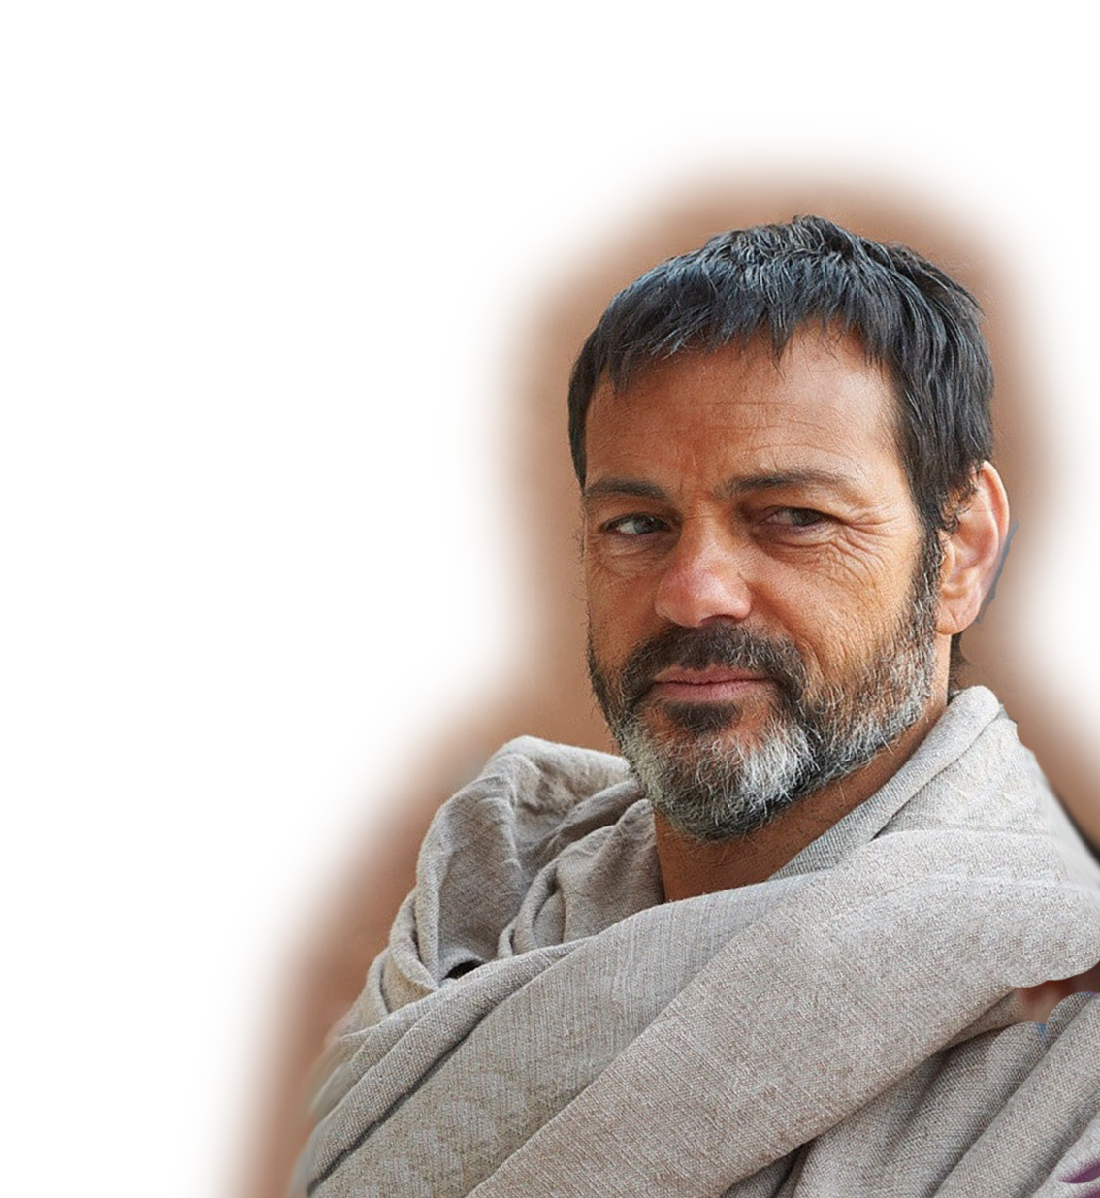
3-The Appearing “Love of God ”
^{Titus 3:3} At one time we … lived in malice and envy, being hated and hating one another. ⁴ But when the kindness and love of God our Savior appeared, ⁵ he saved us, not because of righteous things we had done, but because of his mercy. He saved us through the washing of rebirth and renewal
by the Holy Spirit,
Notes:
God the Father is called our Savior here—because He sent His Son into the world –not to condemn us but to save us.
Notice the “WE” Paul includes himself in this group of haters.

Slide 12

His Love Appeared to “Us” Sinners
^{Titus 3:3} At one time we … lived in malice and envy, being hated and hating one another. ⁴ But when the kindness and love of God our Savior appeared, ⁵ he saved us, not because of righteous things we had done, but because of his mercy. He saved us through the washing of rebirth and renewal by the Holy Spirit,
Notes:
God the Father is called our Savior here—because He sent His Son into the world –not to condemn us but to save us.
Notice the “WE” Paul includes himself in this group of haters.

Slide 13

His Love Appeared to Save Us
^{Titus 3:3} At one time we … lived in malice and envy, being hated and hating one another. ⁴ But when the kindness and love of God our Savior appeared, ⁵ he saved us, not because of righteous things we had done, but because of his mercy. He saved us through the washing of rebirth and renewal
by the Holy Spirit,
Notes:
God the Father is called our Savior here—because He sent His Son into the world –not to condemn us but to save us.
Notice the “WE” Paul includes himself in this group of haters.

Slide 14
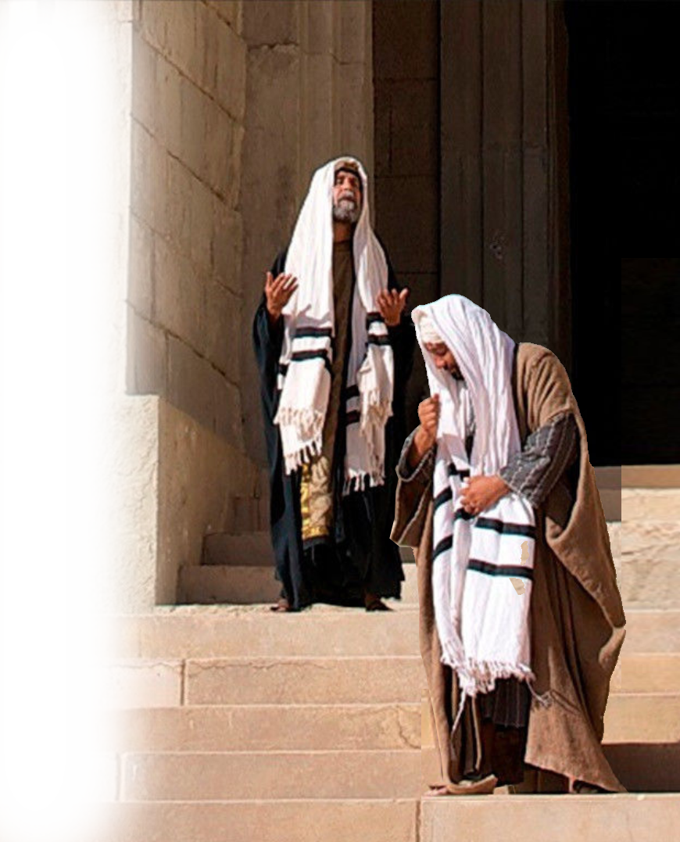
His Love Appeared to Mercy Us
^{Titus 3:3} At one time us… lived in malice and envy, being hated and hating one another. ⁴ But when the kindness and love of God our Savior appeared, ⁵ he saved us, not because of righteous things we had done, but because of his mercy. He saved us through the washing of rebirth and renewal
by the Holy Spirit,
Notes:
https://pixabay.com/illustrations/lifebelt-swimming-ring-save-help-1463427/
God the Father is called our Savior here—because He sent His Son into the world –not to condemn us but to save us.
Notice the “WE” Paul includes himself in this group of haters.

Slide 15
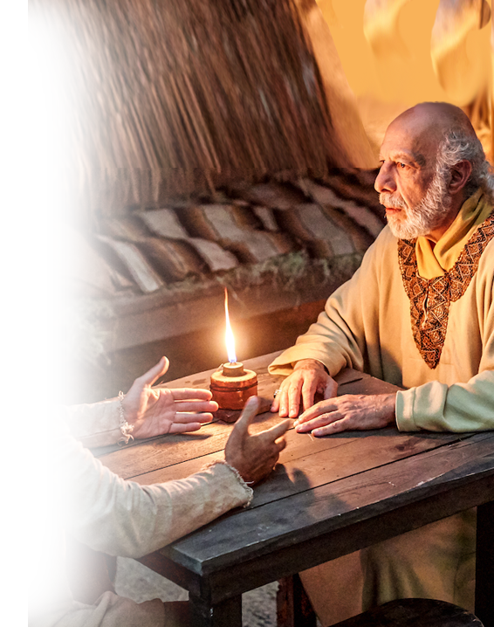
His Love Appeared to Rebirth Us
^{Titus 3:3} At one time us… lived in malice and envy, being hated and hating one another. ⁴ But when the kindness and love of God our Savior appeared, ⁵ he saved us, not because of righteous things we had done, but because of his mercy. He saved us through the washing of rebirth and renewal
by the Holy Spirit,
Notes:
God the Father is called our Savior here—because He sent His Son into the world –not to condemn us but to save us.
Notice the “WE” Paul includes himself in this group of haters.

Slide 16
4-The Invoked “Love of God ”
^{2Cor 13:14}
May the grace of the Lord Jesus Christ, and the love of God, and the fellowship of
the Holy Spirit be with you all.

Slide 17

4-The Invoked “Love of God ”
^{2Cor 13:14}
May the grace of the Lord Jesus Christ, and the love of God, and the fellowship of
the Holy Spirit be with you all.

Slide 18
5-The Inseparable “Love of God ”
^{Romans 8:38} For I am convinced that neither death nor life, neither angels nor demons, neither the present nor the future, nor any powers, ³⁹ neither height nor depth, nor anything else in all creation, will be able to separate us from the love of God that is in Christ Jesus our Lord.
Notes:
Jesus loves me this I know, for the Bible tells me so!
Little ones to him belong—they are weak but He is strong. So strong that nothing can separate us from the Love of God in Christ Jesus.

Slide 19
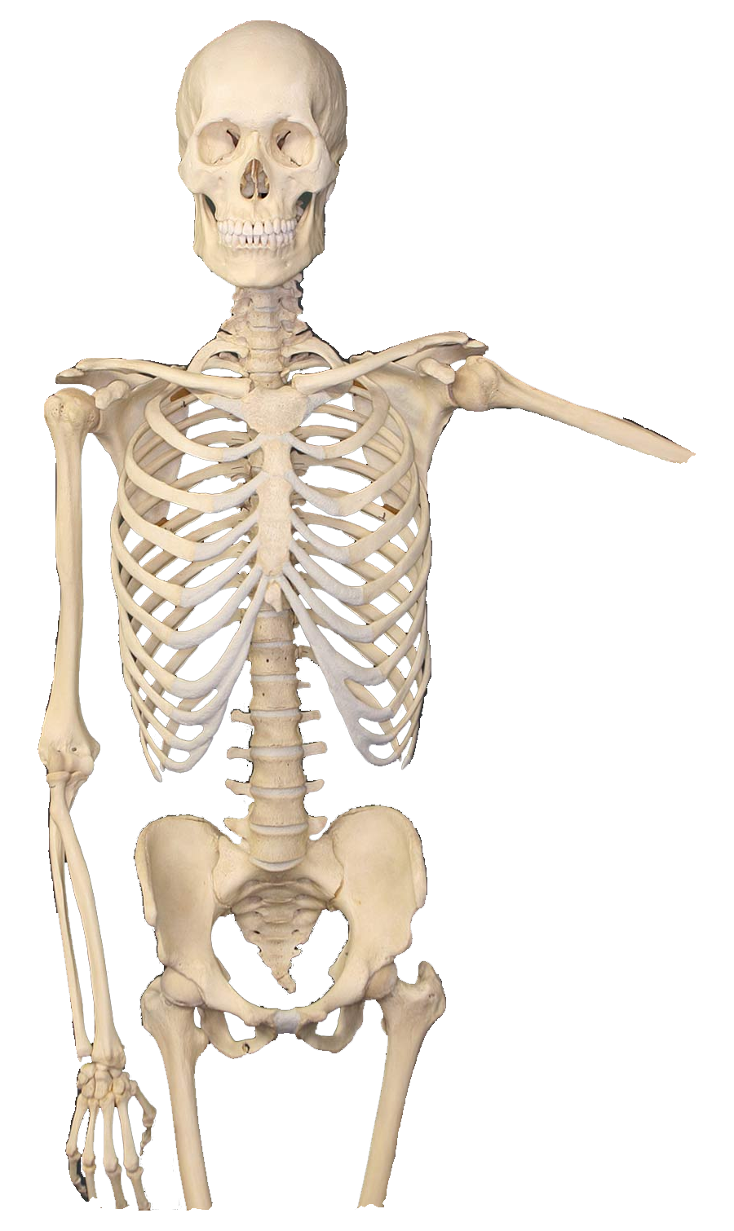

5-The Inseparable “Love of God ”
^{Romans 8:38} For I am convinced that neither death nor life, neither angels nor demons, neither the present nor the future, nor any powers, ³⁹ neither height nor depth, nor anything else in all creation, will be able to separate us from the love of God that is in Christ Jesus our Lord.
⁷ For none of us lives to himself alone and none of us dies to himself alone. ⁸ If we live, we live to the Lord; and if we die, we die to the Lord. So, whether we live or die, we belong to the Lord. (Rom 14:7-8)
Notes:
https://upload.wikimedia.org/wikipedia/commons/1/14/Human-Skeleton.jpg
https://pixabay.com/photos/baby-roses-girl-1262817/
Jesus loves me this I know, for the Bible tells me so!
Little ones to him belong—they are weak but He is strong. So strong that nothing can separate us from the Love of God in Christ Jesus.

Slide 20


5-The Inseparable “Love of God ”
^{Romans 8:38} For I am convinced that neither death nor life, neither angels nor demons, neither the present nor the future, nor any powers, ³⁹ neither height nor depth, nor anything else in all creation, will be able to separate us from the love of God that is in Christ Jesus our Lord.
Notes:
https://pixabay.com/illustrations/devil-fire-hell-mystical-evil-5815356/
Jesus loves me this I know, for the Bible tells me so!
Little ones to him belong—they are weak but He is strong. So strong that nothing can separate us from the Love of God in Christ Jesus.

Slide 21
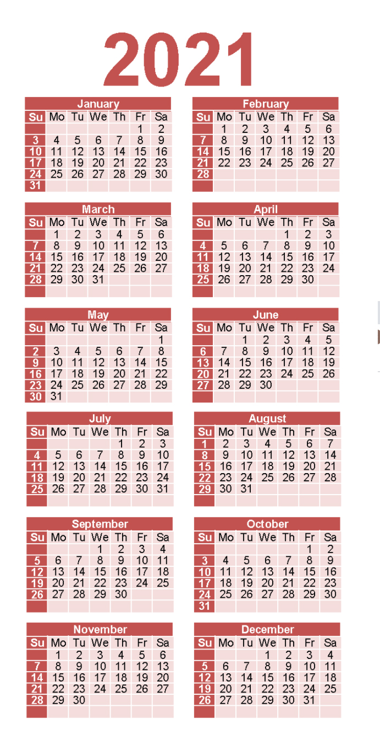
5-The Inseparable “Love of God ”
^{Romans 8:38} For I am convinced that neither death nor life, neither angels nor demons, neither the present nor the future, nor any powers, ³⁹ neither height nor depth, nor anything else in all creation, will be able to separate us from the love of God that is in Christ Jesus our Lord.
Notes:
https://www.wheniscalendars.com/wp-content/uploads/2019/10/three-year-calendar-2019-2020-2021-holidays-tsm-10-5.png
Nothing in the future can separate you from God’s love.

Slide 22

5-The Inseparable “Love of God ”
^{Romans 8:38} For I am convinced that neither death nor life, neither angels nor demons, neither the present nor the future, nor any powers, ³⁹ neither height nor depth, nor anything else in all creation, will be able to separate us from the love of God that is in Christ Jesus our Lord.
Notes:
https://pixabay.com/illustrations/nuclear-nuclear-explosion-apocalypse-4924092/
Jesus loves me this I know, for the Bible tells me so!
Little ones to him belong—they are weak but He is strong. So strong that nothing can separate us from the Love of God in Christ Jesus.

Slide 23

5-The Inseparable “Love of God ”
^{Romans 8:38} For I am convinced that neither death nor life, neither angels nor demons, neither the present nor the future, nor any powers, ³⁹ neither height nor depth, nor anything else in all creation, will be able to separate us from the love of God that is in Christ Jesus our Lord.
Notes:
https://upload.wikimedia.org/wikipedia/commons/thumb/1/1d/View_into_chasm_known_as_Huntsman_Leap_-_geograph.org.uk_-_2154831.jpg/1024px-View_into_chasm_known_as_Huntsman_Leap_-_geograph.org.uk_-_2154831.jpg
Jesus loves me this I know, for the Bible tells me so!
Little ones to him belong—they are weak but He is strong. So strong that nothing can separate us from the Love of God in Christ Jesus.

Slide 24
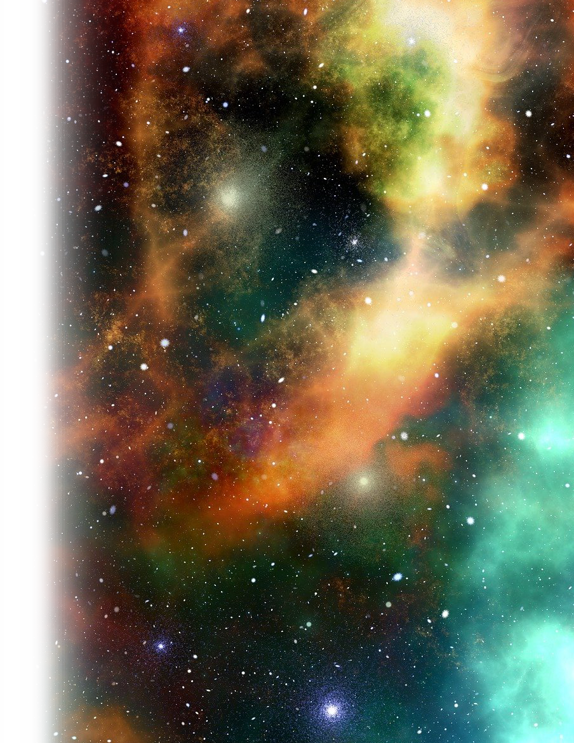
5-The Inseparable “Love of God ”
^{Romans 8:38} For I am convinced that neither death nor life, neither angels nor demons, neither the present nor the future, nor any powers, ³⁹ neither height nor depth, nor anything else in all creation, will be able to separate us from the love of God that is in Christ Jesus our Lord.
Notes:
https://pixabay.com/illustrations/universe-sky-star-space-cosmos-2742113/
Jesus loves me this I know, for the Bible tells me so!
Little ones to him belong—they are weak but He is strong. So strong that nothing can separate us from the Love of God in Christ Jesus.

Slide 25

5-The Inseparable “Love of God ”
^{Romans 8:38} For I am convinced that neither death nor life, neither angels nor demons, neither the present nor the future, nor any powers, ³⁹ neither height nor depth, nor anything else in all creation, will be able to separate us from the love of God that is in Christ Jesus our Lord.
Notes:
https://pixabay.com/photos/god-jesus-christ-easter-death-2012104/
Jesus loves me this I know, for the Bible tells me so!
Little ones to him belong—they are weak but He is strong. So strong that nothing can separate us from the Love of God in Christ Jesus.

Slide 26
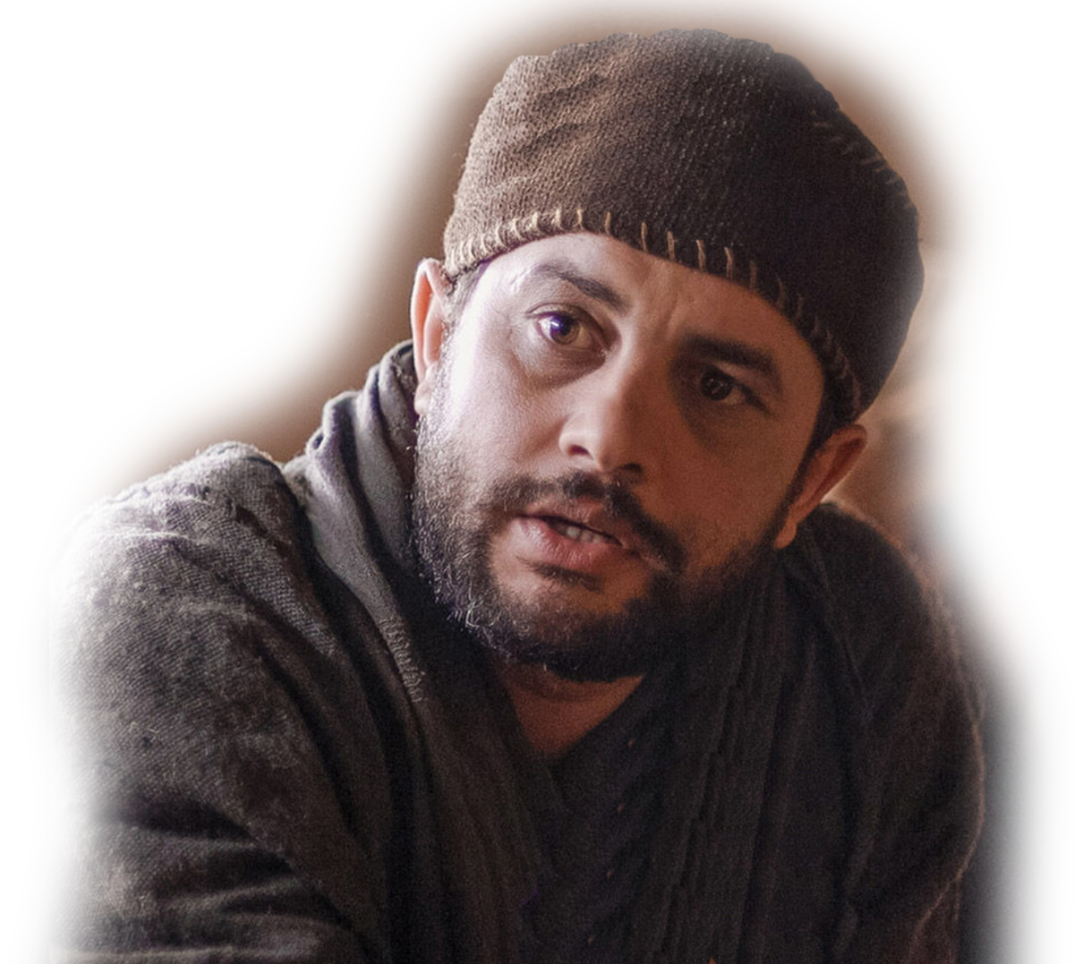
6-The Questionable “Love of God ”
^{1John 3:16} This is how we know what love is: Jesus Christ laid down his life for us. And we ought to lay down our lives for our brothers.
¹⁷ If anyone has material possessions and sees his
brother in need but has no
pity on him, how can the
love of God be in him?

Slide 27
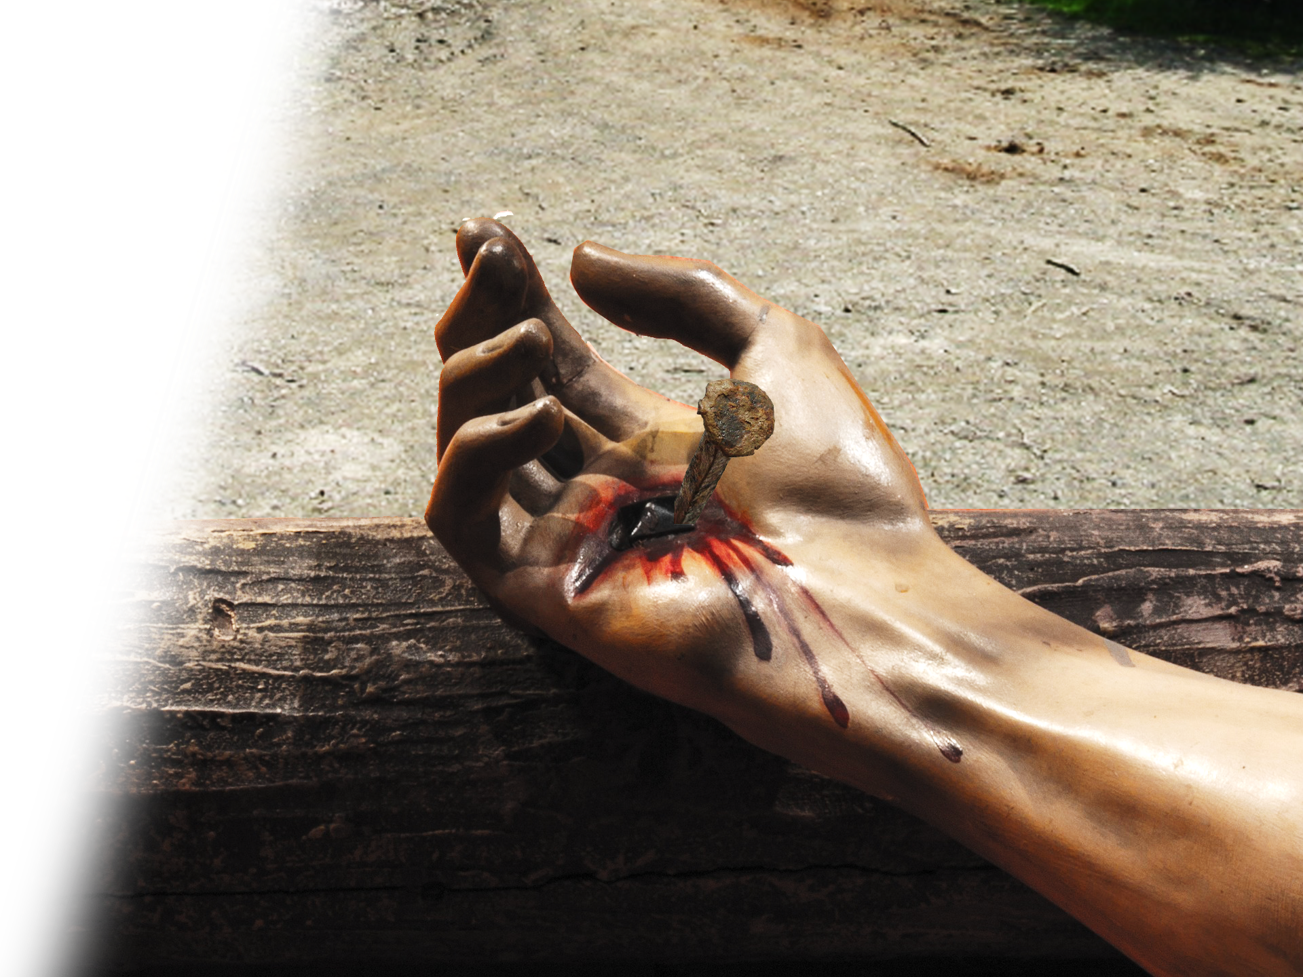
Question 1: What is love?
^{1John 3:16} This is how we know what love is: Jesus Christ laid down his life for us. And we ought to lay down our lives for our brothers.
¹⁷ If anyone has material possessions and sees his
brother in need but has no
pity on him, how can the
love of God be in him?
Notes:
https://pixabay.com/photos/christ-nails-stigmata-religion-2363694/
https://upload.wikimedia.org/wikipedia/commons/1/10/View_of_Pullington_Farm_from_footpath_-_geograph.org.uk_-_787630.jpg

Slide 28
Question 2: What should Love do?
^{1John 3:16} This is how we know what love is: Jesus Christ laid down his life for us. And we ought to lay down our lives for our brothers.
¹⁷ If anyone has material possessions and sees his
brother in need but has no
pity on him, how can the
love of God be in him?

Slide 29
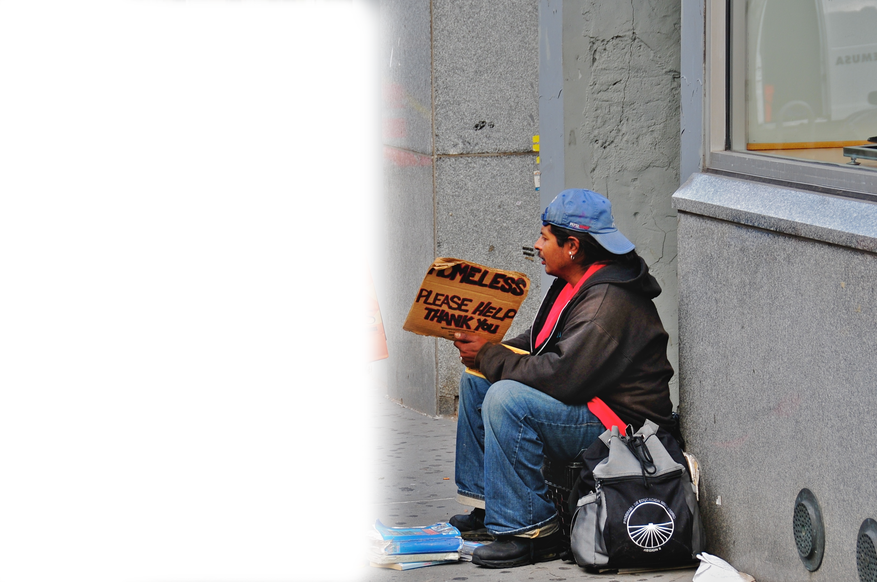
Question 3: How does Love do that?
^{1John 3:16} This is how we know what love is: Jesus Christ laid down his life for us. And we ought to lay down our lives for our brothers.
¹⁷ If anyone has material possessions and sees his
brother in need but has no
pity on him, how can the
love of God be in him?
Notes:
https://upload.wikimedia.org/wikipedia/commons/8/89/Helping_the_homeless.jpg

Slide 30
Question 4: How about you?
^{1John 3:16} This is how we know what love is: Jesus Christ laid down his life for us. And we ought to lay down our lives for our brothers.
¹⁷ If anyone has material possessions and sees his
brother in need but has no
pity on him, how can the
love of God be in him?

Slide 31
Think about “The Love of God ”…

Slide 32
Think about “The Love of God ”…
Some Miss it altogether …

Slide 33
Think about “The Love of God ”…
Some Miss it altogether …
Some Neglect it half-heartedly …

Slide 34
Think about “The Love of God ”…
Some Miss it altogether …
Some Neglect it half-heartedly …
Some accepted its Appearance …

Slide 35
Think about “The Love of God ”…
Some Miss it altogether …
Some Neglect it half-heartedly …
Some accepted its Appearance …
Some have Invoked it …

Slide 36
Think about “The Love of God ”…
Some Miss it altogether …
Some Neglect it half-heartedly …
Some accepted its Appearance …
Some have Invoked it …
Some are Inseparable from it …

Slide 37

Think about “The Love of God ”…
Some Miss it altogether …
Some Neglect it half-heartedly …
Some accepted its Appearance …
Some have Invoked it …
Some know how Inseparable it is …
Some Show what it is!

Slide 38
Finally,
'I tell you the truth, whatever you did not do for one of the least of these, you did not do for me.' (Matthew 25:45)

Slide 39
Let’s Pray!

