Slide 1

The Love of Christ
Notes:
Copyright © 2006−2021. All rights reserved. Bible Point is a registered trademark of Dennis Henderson. All other trademarks acknowledged.
Bible Point contains graphics from Bible Point artists. These illustrations belong to Bible Point and the respective artists. You may use the designs and illustrations for graphical illustration of lessons free and without special permission, provided they are not used in any way that maligns the Christian faith. Furthermore, republication or production of any illustration by any other graphic service whether it be in book, in a machine-readable form, or in any other design resource is strictly prohibited. Furthermore, they cannot be duplicated or resold as any other form of publishing, clip art, or graphic resource.
So What does it mean? (A simple translations of the legal jargon)
So, if you don’t own the presentation(s), graphic(s), and text(s) how can you legally use them? The purchase of the license allows you to use all the images in the product. However, the actual ownership and copyright of the presentation(s), graphic(s), and text(s) remain the property of Bible Point and its licensors. If you had plans on using this product in your “for sale” work—think again!
License Agreement
Article 1: License Grant
All the graphics and text in Bible Point presentations (excluding quotes from the Bible and stated sources) are the intellectual and real property of Bible Point and its licensors, and is protected by law, including United States copyright laws and international treaties. Bible Point grants to you a license:
1. To use the presentation in a single church, single school, or single office of a Christian organization.
2. To make a single archival back-up copy of the program.
3. To modify the presentation(s) and merge with other presentations in a single church, school, or Christian organization.
4. To transfer to another party if that party agrees to accept the terms and conditions of this agreement, and you do not retain any copies of the presentation, whether printed, machine readable, modified, or merged form.
Article 2: Terms
This license is effective until terminated. You may terminate the license at any time by destroying the presentation(s), graphic(s), or text(s) together with all copies, modifications and merged portions in any form. Bible Point may terminate your license if you fail to comply with this Agreement. You agree, upon such termination, for any reason, to destroy the presentation(s), graphics, and text(s) with all copies, modifications, and merged portions in any form.
Article 3: Disclaimers
1. Bible Point presentations, graphics, and texts are licensed to you As Is. You, the consumer, bear the entire risk relating to the quality and performance of the presentation(s), graphic(s), or text(s). In no event will Bible Point be liable for damages resulting from any defect.
2. Thirty-day limited warrantee on disks. Bible Point warrants the disks to be free of defects in material and workmanship under normal use for 30 days after purchase. During the 30-day period you may return a defective presentation, graphic, or text with proof of purchase and it will be replaced without charge, unless the presentation is damaged by misuse.
Article 4: General
1. You may not sub-license, assign, or transfer the license of the presentation(s), graphic(s), or text(s) except as provided by this Agreement.
2. This Agreement will be governed by the laws of the State of Michigan.
So What does it mean? (A simple translations of the legal jargon)
May I let someone borrow or copy my licensed Bible Point presentation (even after I modified it)? As long as it is within your local church, or single school, or the immediate office of a Christian organization you may. Otherwise, please refer the person interested in borrowing to: http://www.biblepoint.com or E-mail: dennis@DrDH.net with any related questions.

Slide 2
The Love of Christ
Notes:
Copyright © 2006−2021. All rights reserved. Bible Point is a registered trademark of Dennis Henderson. All other trademarks acknowledged.
Bible Point contains graphics from Bible Point artists. These illustrations belong to Bible Point and the respective artists. You may use the designs and illustrations for graphical illustration of lessons free and without special permission, provided they are not used in any way that maligns the Christian faith. Furthermore, republication or production of any illustration by any other graphic service whether it be in book, in a machine-readable form, or in any other design resource is strictly prohibited. Furthermore, they cannot be duplicated or resold as any other form of publishing, clip art, or graphic resource.
So What does it mean? (A simple translations of the legal jargon)
So, if you don’t own the presentation(s), graphic(s), and text(s) how can you legally use them? The purchase of the license allows you to use all the images in the product. However, the actual ownership and copyright of the presentation(s), graphic(s), and text(s) remain the property of Bible Point and its licensors. If you had plans on using this product in your “for sale” work—think again!
License Agreement
Article 1: License Grant
All the graphics and text in Bible Point presentations (excluding quotes from the Bible and stated sources) are the intellectual and real property of Bible Point and its licensors, and is protected by law, including United States copyright laws and international treaties. Bible Point grants to you a license:
1. To use the presentation in a single church, single school, or single office of a Christian organization.
2. To make a single archival back-up copy of the program.
3. To modify the presentation(s) and merge with other presentations in a single church, school, or Christian organization.
4. To transfer to another party if that party agrees to accept the terms and conditions of this agreement, and you do not retain any copies of the presentation, whether printed, machine readable, modified, or merged form.
Article 2: Terms
This license is effective until terminated. You may terminate the license at any time by destroying the presentation(s), graphic(s), or text(s) together with all copies, modifications and merged portions in any form. Bible Point may terminate your license if you fail to comply with this Agreement. You agree, upon such termination, for any reason, to destroy the presentation(s), graphics, and text(s) with all copies, modifications, and merged portions in any form.
Article 3: Disclaimers
1. Bible Point presentations, graphics, and texts are licensed to you As Is. You, the consumer, bear the entire risk relating to the quality and performance of the presentation(s), graphic(s), or text(s). In no event will Bible Point be liable for damages resulting from any defect.
2. Thirty-day limited warrantee on disks. Bible Point warrants the disks to be free of defects in material and workmanship under normal use for 30 days after purchase. During the 30-day period you may return a defective presentation, graphic, or text with proof of purchase and it will be replaced without charge, unless the presentation is damaged by misuse.
Article 4: General
1. You may not sub-license, assign, or transfer the license of the presentation(s), graphic(s), or text(s) except as provided by this Agreement.
2. This Agreement will be governed by the laws of the State of Michigan.
So What does it mean? (A simple translations of the legal jargon)
May I let someone borrow or copy my licensed Bible Point presentation (even after I modified it)? As long as it is within your local church, or single school, or the immediate office of a Christian organization you may. Otherwise, please refer the person interested in borrowing to: http://www.biblepoint.com or E-mail: dennis@DrDH.net with any related questions.

Slide 3
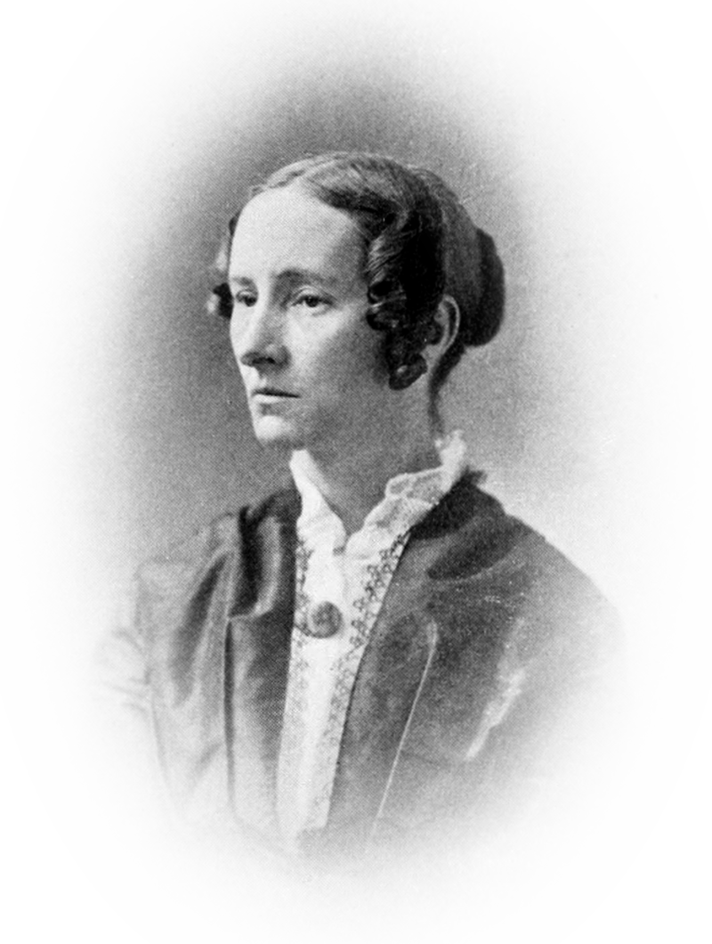
Jesus Loves Me! Poem by Anna Bartlett Warner
Jesus loves me—this I know,
For the Bible tells me so;
Little ones to him belong,—
They are weak, but he is strong.
Jesus loves me—loves me still,
Though I'm very weak and ill;
From his shining throne on high,
Comes to watch me where I lie.
Notes:
"Jesus Loves Me" is a Christian hymn written by Anna Bartlett Warner (1827–1915).^{[1]} The lyrics first appeared as a poem in the context of an 1860 novel called Say and Seal, written by her older sister Susan Warner (1819–1885), in which the words were spoken as a comforting poem to a dying child.^{[2]}

Slide 4
Jesus Loves Me! Poem by Anna Bartlett Warner
Jesus loves me—he will stay,
Close beside me all the way.
Then his little child will take,
Up to heaven for his dear sake.
Notes:
"Jesus Loves Me" is a Christian hymn written by Anna Bartlett Warner (1827–1915).^{[1]} The lyrics first appeared as a poem in the context of an 1860 novel called Say and Seal, written by her older sister Susan Warner (1819–1885), in which the words were spoken as a comforting poem to a dying child.^{[2]} The tune was added in 1862 by William Batchelder Bradbury (1816–1868). Along with his tune, Bradbury added his own chorus "Yes, Jesus loves me, Yes, Jesus Loves me..."^{[3]} After publication as a song it became one of the most popular Christian hymns in churches around the world,^{[4]} especially among children.

Slide 5
Jesus loves me with …

Slide 6

His Inseparable Love Romans 8:35
35 Who shall separate us from the love of Christ? Shall trouble or hardship or persecution or famine or nakedness or danger or sword?
TROUBLE
Notes:
The Love of Christ
The Inseparable Love of Christ Romans 8:35
The Constraining Love of Christ 2 Cor 5:14
The Surpassing Love of Christ Eph 3:19

Slide 7
His Inseparable Love Romans 8:35
35 Who shall separate us from the love of Christ? Shall trouble or hardship or persecution or famine or nakedness or danger or sword?
HARDSHIP
Notes:
The Love of Christ
The Inseparable Love of Christ Romans 8:35
The Constraining Love of Christ 2 Cor 5:14
The Surpassing Love of Christ Eph 3:19

Slide 8
His Inseparable Love Romans 8:35
PERSECUTION
35 Who shall separate us from the love of Christ? Shall trouble or hardship or persecution or famine or nakedness or danger or sword?
Notes:
The Love of Christ
The Inseparable Love of Christ Romans 8:35
The Constraining Love of Christ 2 Cor 5:14
The Surpassing Love of Christ Eph 3:19

Slide 9
His Inseparable Love Romans 8:35
35 Who shall separate us from the love of Christ? Shall trouble or hardship or persecution or famine or nakedness or danger or sword?
FAMINE
Notes:
The Love of Christ
The Inseparable Love of Christ Romans 8:35
The Constraining Love of Christ 2 Cor 5:14
The Surpassing Love of Christ Eph 3:19

Slide 10
His Inseparable Love Romans 8:35
35 Who shall separate us from the love of Christ? Shall trouble or hardship or persecution or famine or nakedness or danger or sword?
NAKEDNESS
Notes:
The Love of Christ
The Inseparable Love of Christ Romans 8:35
The Constraining Love of Christ 2 Cor 5:14
The Surpassing Love of Christ Eph 3:19

Slide 11
His Inseparable Love Romans 8:35
35 Who shall separate us from the love of Christ? Shall trouble or hardship or persecution or famine or nakedness or danger or sword?
DANGER
Notes:
The Love of Christ
The Inseparable Love of Christ Romans 8:35
The Constraining Love of Christ 2 Cor 5:14
The Surpassing Love of Christ Eph 3:19

Slide 12

His Inseparable Love Romans 8:35
35 Who shall separate us from the love of Christ? Shall trouble or hardship or persecution or famine or nakedness or danger or sword?
SWORD
EXPECTED ANSWER = NO!
Notes:
The Love of Christ
The Inseparable Love of Christ Romans 8:35
The Constraining Love of Christ 2 Cor 5:14
The Surpassing Love of Christ Eph 3:19

Slide 13
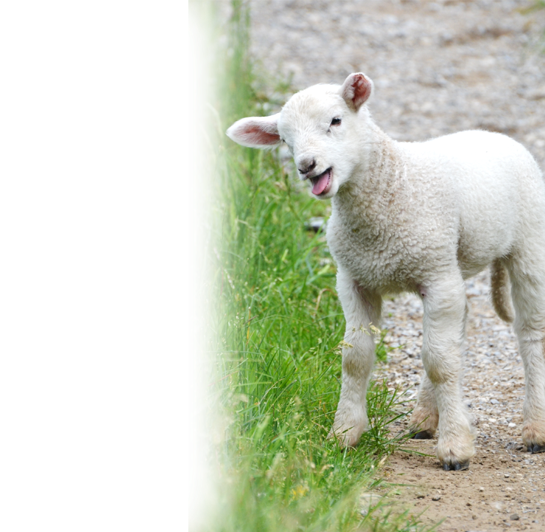
His Inseparable Love Romans 8:35
36 As it is written:
"For your sake we face death all day long; we are considered as sheep to be slaughtered."
Notes:
https://upload.wikimedia.org/wikipedia/commons/3/35/Lamb_%285918001239%29.jpg
Even though it is true that we face death for Christ daily. It cannot separate us from His love.

Slide 14

His Inseparable Love Romans 8:35
37 No, in all these things we are more than conquerors through him who loved us.
Notes:
The Love of Christ
The Inseparable Love of Christ Romans 8:35
The Constraining Love of Christ 2 Cor 5:14
The Surpassing Love of Christ Eph 3:19

Slide 15

His Inseparable Love Romans 8:35
^{Romans 8:38} For I am convinced that neither death nor life, neither angels nor demons, neither the present nor the future, nor any powers, ³⁹ neither height nor depth, nor anything else in all creation, will be able to separate us from the love of God that is in Christ Jesus our Lord.
Notes:
https://upload.wikimedia.org/wikipedia/commons/1/14/Human-Skeleton.jpg
https://pixabay.com/photos/baby-roses-girl-1262817/
Jesus loves me this I know, for the Bible tells me so!
Little ones to him belong—they are weak but He is strong. So strong that nothing can separate us from the Love of God in Christ Jesus.

Slide 16
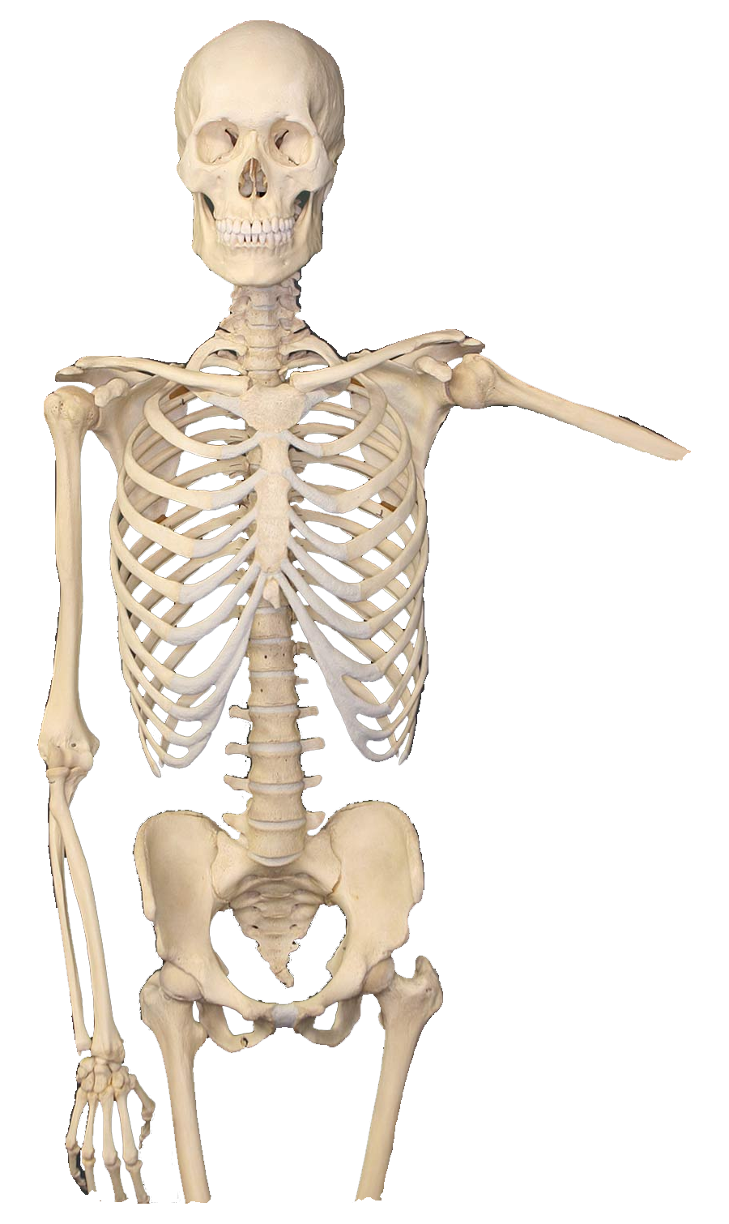

His Inseparable Love Romans 8:35
^{Romans 8:38} For I am convinced that neither death nor life, neither angels nor demons, neither the present nor the future, nor any powers, ³⁹ neither height nor depth, nor anything else in all creation, will be able to separate us from the love of God that is in Christ Jesus our Lord.
Notes:
https://upload.wikimedia.org/wikipedia/commons/1/14/Human-Skeleton.jpg
https://pixabay.com/photos/baby-roses-girl-1262817/
Jesus loves me this I know, for the Bible tells me so!
Little ones to him belong—they are weak but He is strong. So strong that nothing can separate us from the Love of God in Christ Jesus.

Slide 17


His Inseparable Love Romans 8:35
^{Romans 8:38} For I am convinced that neither death nor life, neither angels nor demons, neither the present nor the future, nor any powers, ³⁹ neither height nor depth, nor anything else in all creation, will be able to separate us from the love of God that is in Christ Jesus our Lord.
Notes:
https://pixabay.com/illustrations/devil-fire-hell-mystical-evil-5815356/
Jesus loves me this I know, for the Bible tells me so!
Little ones to him belong—they are weak but He is strong. So strong that nothing can separate us from the Love of God in Christ Jesus.

Slide 18
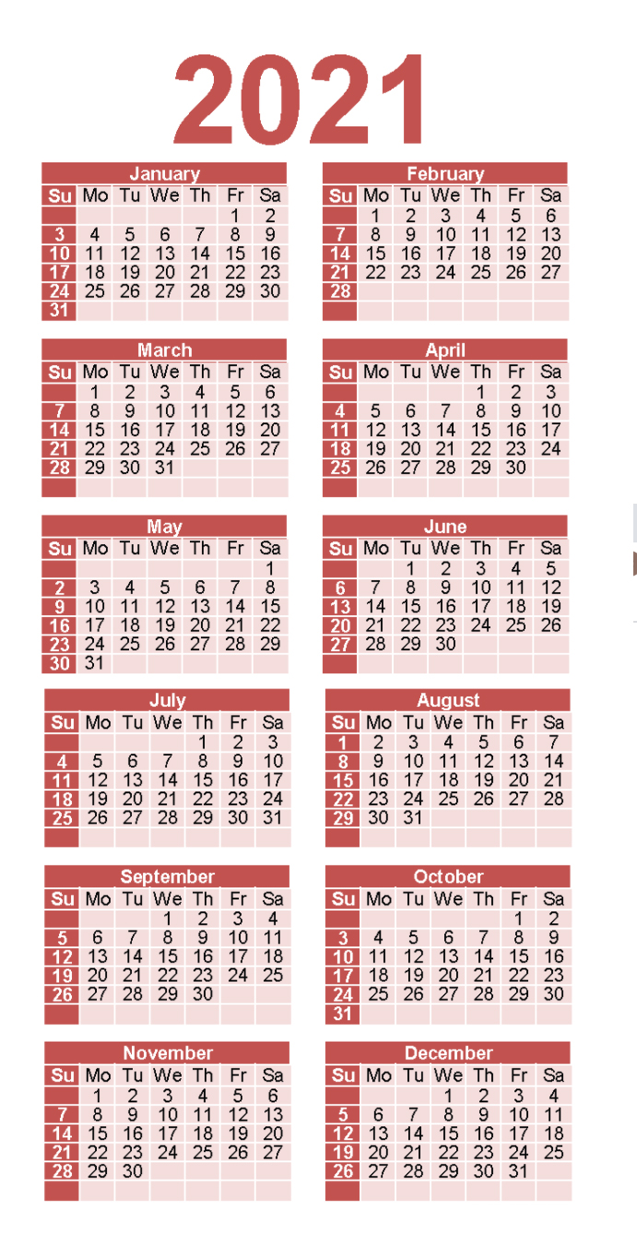
His Inseparable Love Romans 8:35
^{Romans 8:38} For I am convinced that neither death nor life, neither angels nor demons, neither the present nor the future, nor any powers, ³⁹ neither height nor depth, nor anything else in all creation, will be able to separate us from the love of God that is in Christ Jesus our Lord.
Notes:
https://www.wheniscalendars.com/wp-content/uploads/2019/10/three-year-calendar-2019-2020-2021-holidays-tsm-10-5.png
Jesus loves me this I know, for the Bible tells me so!
Little ones to him belong—they are weak but He is strong. So strong that nothing can separate us from the Love of God in Christ Jesus.

Slide 19

His Inseparable Love Romans 8:35
^{Romans 8:38} For I am convinced that neither death nor life, neither angels nor demons, neither the present nor the future, nor any powers, ³⁹ neither height nor depth, nor anything else in all creation, will be able to separate us from the love of God that is in Christ Jesus our Lord.
Notes:
https://pixabay.com/illustrations/nuclear-nuclear-explosion-apocalypse-4924092/
Jesus loves me this I know, for the Bible tells me so!
Little ones to him belong—they are weak but He is strong. So strong that nothing can separate us from the Love of God in Christ Jesus.

Slide 20
His Inseparable Love Romans 8:35
^{Romans 8:38} For I am convinced that neither death nor life, neither angels nor demons, neither the present nor the future, nor any powers, ³⁹ neither height nor depth, nor anything else in all creation, will be able to separate us from the love of God that is in Christ Jesus our Lord.
Notes:
https://upload.wikimedia.org/wikipedia/commons/thumb/1/1d/View_into_chasm_known_as_Huntsman_Leap_-_geograph.org.uk_-_2154831.jpg/1024px-View_into_chasm_known_as_Huntsman_Leap_-_geograph.org.uk_-_2154831.jpg
Jesus loves me this I know, for the Bible tells me so!
Little ones to him belong—they are weak but He is strong. So strong that nothing can separate us from the Love of God in Christ Jesus.

Slide 21
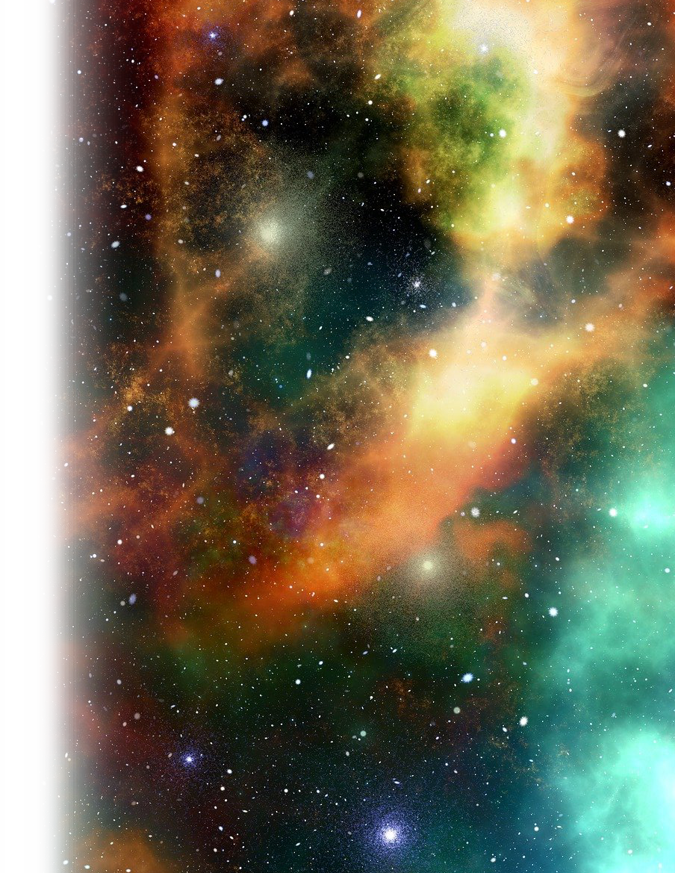
His Inseparable Love Romans 8:35
^{Romans 8:38} For I am convinced that neither death nor life, neither angels nor demons, neither the present nor the future, nor any powers, ³⁹ neither height nor depth, nor anything else in all creation, will be able to separate us from the love of God that is in Christ Jesus our Lord.
Notes:
https://pixabay.com/illustrations/universe-sky-star-space-cosmos-2742113/
Jesus loves me this I know, for the Bible tells me so!
Little ones to him belong—they are weak but He is strong. So strong that nothing can separate us from the Love of God in Christ Jesus.

Slide 22

His Inseparable Love Romans 8:35
^{Romans 8:38} For I am convinced that neither death nor life, neither angels nor demons, neither the present nor the future, nor any powers, ³⁹ neither height nor depth, nor anything else in all creation, will be able to separate us from the love of God that is
in Christ Jesus our Lord.
Notes:
https://pixabay.com/photos/god-jesus-christ-easter-death-2012104/
Jesus loves me this I know, for the Bible tells me so!
Little ones to him belong—they are weak but He is strong. So strong that nothing can separate us from the Love of God in Christ Jesus.

Slide 23

His Compelling Love 2 Cor. 5:14
14 For Christ's love compels us, because we are convinced that one died for all, and therefore all died. 15 And he died for all, that those who live should no longer live for themselves but for him who died for them and was raised again.
Notes:
His compelling love …
Like a strong magnet compels the iron to attract to it, the love of Christ compels/constrains/moves us to Him.

Slide 24
His Compelling Love Convinces us that …
HE DIED FOR US!
14 For Christ's love compels us, because we are convinced that one died for all, and therefore all died. 15 And he died for all, that those who live should no longer live for themselves but for him who died for them and was raised again. (2Co 5:14-15)
Notes:
His compelling love …
1-convinces us that he died for us
2- convinces us that we should live for Him

Slide 25

His Compelling Love Convinces us that …
WE SHOULD LIVE FOR HIM!
14 For Christ's love compels us, because we are convinced that one died for all, and therefore all died. 15 And he died for all, that those who live should no longer live for themselves but for him who died for them and was raised again. (2Co 5:14-15)
Notes:
wzIFz.jpg (400×289) (imgur.com)
His compelling love …
1-convinces us that he died for us
2- convinces us that we should live for Him

Slide 26

His Surpassing Love of Christ Ephesians 3:19
SURPASSING ROOTS
17 …. And I pray that you, being rooted and established in love, 18 may have power, together with all the saints, to grasp how wide and long and high and deep is the love of Christ, 19 and to know this love that surpasses knowledge--
Notes:
market-growth1.jpg (800×550) (asiapathways-adbi.org)
Surpassing roots
Surpassing power
Surpassing grasp
Surpassing size
Surpassing knowledge

Slide 27

His Surpassing Love of Christ Ephesians 3:19
SURPASSING ROOTS
17 …. And I pray that you, being rooted and established in love, 18 may have power, together with all the saints, to grasp how wide and long and high and deep is the love of Christ, 19 and to know this love that surpasses knowledge--
Notes:
Tree Root Forest - Free photo on Pixabay
Surpassing roots
Surpassing power
Surpassing grasp
Surpassing size
Surpassing knowledge

Slide 28

His Surpassing Love of Christ Ephesians 3:19
SURPASSING POWER
17 …. And I pray that you, being rooted and established in love, 18 may have power, together with all the saints, to grasp how wide and long and high and deep is the love of Christ, 19 and to know this love that surpasses knowledge--
Notes:
Nuclear Power Plant Cooling Tower - Free photo on Pixabay
Surpassing roots
Surpassing power
Surpassing grasp
Surpassing size
Surpassing knowledge

Slide 29
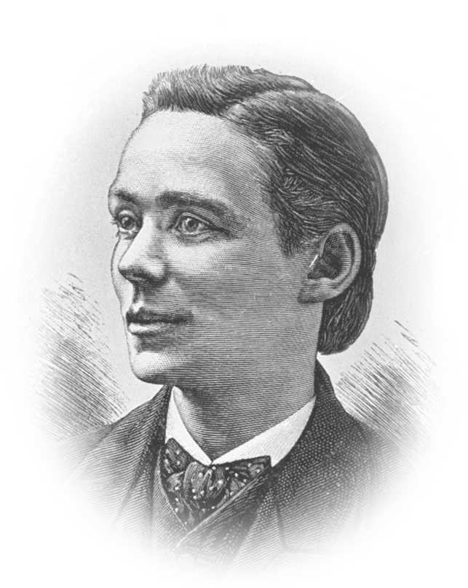
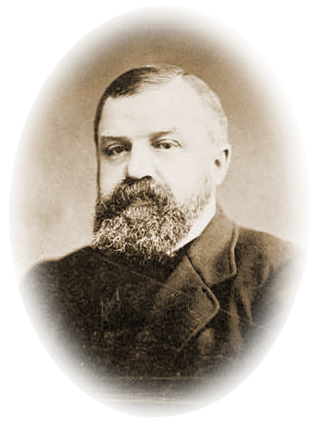
His Surpassing Love of Christ Ephesians 3:19
SURPASSING GRASP
17 …. And I pray that you, being rooted and established in love, 18 may have power, together with all the saints, to grasp how wide and long and high and deep is the love of Christ, 19 and to know this love that surpasses knowledge--
D.L. Moody
Harry Moorhouse
Notes:
Surpassing roots
Surpassing power
Surpassing grasp
Surpassing size
Surpassing knowledge

Slide 30
His Surpassing Love of Christ Ephesians 3:19
SURPASSING KNOWLEDGE
17 …. And I pray that you, being rooted and established in love, 18 may have power, together with all the saints, to grasp how wide and long and high and deep is the love of Christ, 19 and to know this love that surpasses knowledge--
Moorehouse knew it!
Notes:
Surpassing roots
Surpassing power
Surpassing grasp
Surpassing knowledge

Slide 31
His Surpassing Love of Christ Ephesians 3:19
SURPASSING KNOWLEDGE
17 …. And I pray that you, being rooted and established in love, 18 may have power, together with all the saints, to grasp how wide and long and high and deep is the love of Christ, 19 and to know this love that surpasses knowledge--
I want to learn it too!
Moody learned it!
Notes:
Surpassing roots
Surpassing power
Surpassing grasp
Surpassing knowledge

Slide 32

His Surpassing Love of Christ Ephesians 3:19
SURPASSING FULLNESS
that you may be filled to the measure of all the fullness of God.
Notes:
Prays to grasp onto this ….
Surpassing fullness
Surpassing ability
Surpassing imagination
Surpassing power
Surpassing glory

Slide 33
Anna Warner’s Was Full of This Love
Jesus loves me—this I know,
For the Bible tells me so;
Little ones to him belong,—
They are weak, but he is strong.
Notes:
"Jesus Loves Me" is a Christian hymn written by Anna Bartlett Warner (1827–1915).^{[1]} The lyrics first appeared as a poem in the context of an 1860 novel called Say and Seal, written by her older sister Susan Warner (1819–1885), in which the words were spoken as a comforting poem to a dying child.^{[2]}

Slide 34
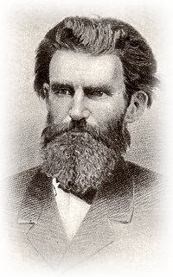
Jesus Loves Me! Tune by William Bradbury
Jesus loves me, this I know,
for the Bible tells me so.
Little ones to him belong;
they are weak, but he is strong.
Refrain
Yes, Jesus loves me!
Yes, Jesus loves me!
Yes, Jesus loves me!
The Bible tells me so.
Notes:
The tune was added in 1862 by William Batchelder Bradbury (1816–1868). Along with his tune, Bradbury added his own chorus "Yes, Jesus loves me, Yes, Jesus Loves me..."^{[3]} After publication as a song it became one of the most popular Christian hymns in churches around the world,^{[4]} especially among children.
Hymn by William Batchelder Bradbury[edit]
William Batchelder Bradbury
Jesus loves me, this I know,
for the Bible tells me so.
Little ones to him belong;
they are weak, but he is strong.
Refrain
Yes, Jesus loves me!
Yes, Jesus loves me!
Yes, Jesus loves me!
The Bible tells me so.
Jesus loves me he who died
heaven's gate to open wide.
He will wash away my sin,
let his little child come in.
Refrain
Jesus loves me, this I know,
as he loved so long ago,
taking children on his knee,
saying, "Let them come to me."

Slide 35
Jesus Loves Me! Hymn by William Bradbury
Jesus loves me he who died
heaven's gate to open wide.
He will wash away my sin,
let his little child come in.
Refrain
Jesus loves me, this I know,
as he loved so long ago,
taking children on his knee,
saying, "Let them come to me."
Notes:
Hymn by William Batchelder Bradbury[edit]
William Batchelder Bradbury
Jesus loves me, this I know,
for the Bible tells me so.
Little ones to him belong;
they are weak, but he is strong.
Refrain
Yes, Jesus loves me!
Yes, Jesus loves me!
Yes, Jesus loves me!
The Bible tells me so.
Jesus loves me he who died
heaven's gate to open wide.
He will wash away my sin,
let his little child come in.
Refrain
Jesus loves me, this I know,
as he loved so long ago,
taking children on his knee,
saying, "Let them come to me."

Slide 36
Let’s Pray

