Slide 1
Seeing
Jesus as
He Saw
Himself
Notes:
Sir, we wish to see Jesus." (Joh 12:21 ESV)

Slide 2
Seeing
Jesus as
He Saw
Himself
Notes:
Sir, we wish to see Jesus." (Joh 12:21 ESV)
Copyright © 2006−2021. All rights reserved. Bible Point is a registered trademark of Dennis Henderson. All other trademarks acknowledged.
Bible Point contains graphics from Bible Point artists. These illustrations belong to Bible Point and the respective artists. You may use the designs and illustrations for graphical illustration of lessons free and without special permission, provided they are not used in any way that maligns the Christian faith. Furthermore, republication or production of any illustration by any other graphic service whether it be in book, in a machine-readable form, or in any other design resource is strictly prohibited. Furthermore, they cannot be duplicated or resold as any other form of publishing, clip art, or graphic resource.
So What does it mean? (A simple translations of the legal jargon)
So, if you don’t own the presentation(s), graphic(s), and text(s) how can you legally use them? The purchase of the license allows you to use all the images in the product. However, the actual ownership and copyright of the presentation(s), graphic(s), and text(s) remain the property of Bible Point and its licensors. If you had plans on using this product in your “for sale” work—think again!
License Agreement
Article 1: License Grant
All the graphics and text in Bible Point presentations (excluding quotes from the Bible and stated sources) are the intellectual and real property of Bible Point and its licensors, and is protected by law, including United States copyright laws and international treaties. Bible Point grants to you a license:
1. To use the presentation in a single church, single school, or single office of a Christian organization.
2. To make a single archival back-up copy of the program.
3. To modify the presentation(s) and merge with other presentations in a single church, school, or Christian organization.
4. To transfer to another party if that party agrees to accept the terms and conditions of this agreement, and you do not retain any copies of the presentation, whether printed, machine readable, modified, or merged form.
Article 2: Terms
This license is effective until terminated. You may terminate the license at any time by destroying the presentation(s), graphic(s), or text(s) together with all copies, modifications and merged portions in any form. Bible Point may terminate your license if you fail to comply with this Agreement. You agree, upon such termination, for any reason, to destroy the presentation(s), graphics, and text(s) with all copies, modifications, and merged portions in any form.
Article 3: Disclaimers
1. Bible Point presentations, graphics, and texts are licensed to you As Is. You, the consumer, bear the entire risk relating to the quality and performance of the presentation(s), graphic(s), or text(s). In no event will Bible Point be liable for damages resulting from any defect.
2. Thirty-day limited warrantee on disks. Bible Point warrants the disks to be free of defects in material and workmanship under normal use for 30 days after purchase. During the 30-day period you may return a defective presentation, graphic, or text with proof of purchase and it will be replaced without charge, unless the presentation is damaged by misuse.
Article 4: General
1. You may not sub-license, assign, or transfer the license of the presentation(s), graphic(s), or text(s) except as provided by this Agreement.
2. This Agreement will be governed by the laws of the State of Michigan.
So What does it mean? (A simple translations of the legal jargon)
May I let someone borrow or copy my licensed Bible Point presentation (even after I modified it)? As long as it is within your local church, or single school, or the immediate office of a Christian organization you may. Otherwise, please refer the person interested in borrowing to: http://www.biblepoint.com or E-mail: dennis@DrDH.net with any related questions.

Slide 3

He Saw Himself as the Light of the World
“I am the light of the world” (John 8:12)
“I am the light of the world” (John 9:5)
"I am the bread of life" (John 6:48)
Notes:
https://www.flickr.com/photos/denharsh/5150191997

Slide 4
He Saw Himself as the Light of the World
Most clearly
seen in the miracle associated with it.
Notes:
https://www.flickr.com/photos/denharsh/5150191997

Slide 5
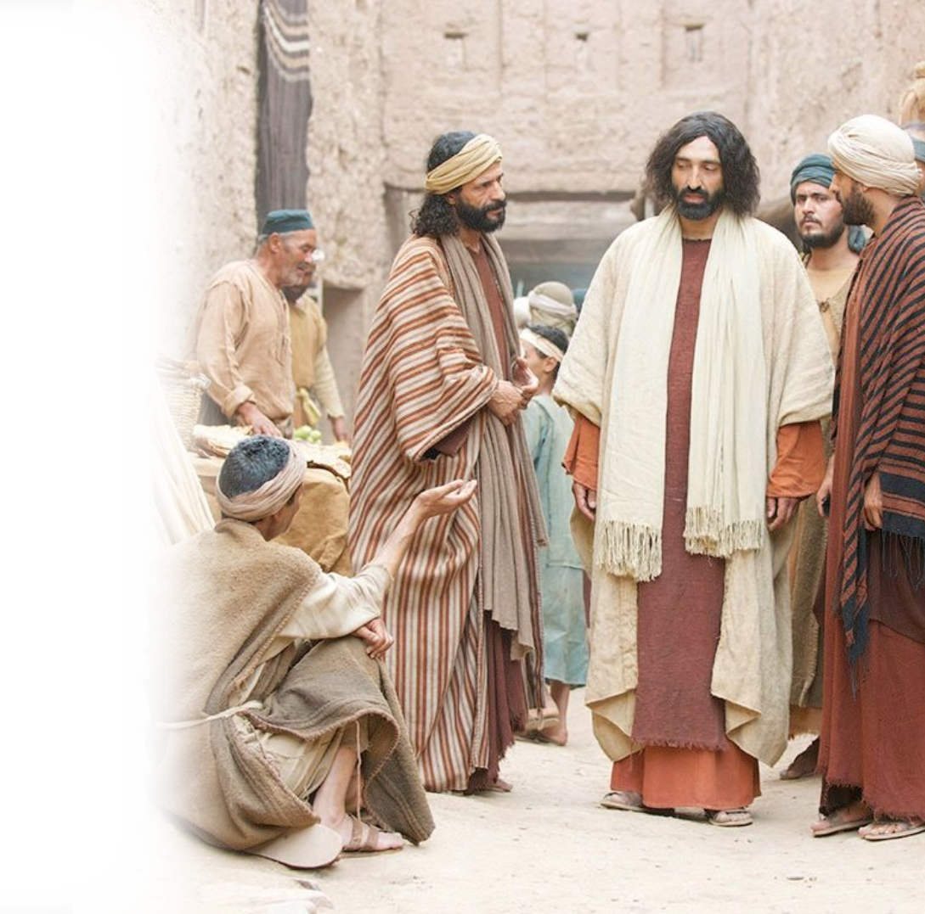
1. The Need for the Light
9:1 As he passed by, he saw a man blind from birth.
² And his disciples asked him, "Rabbi, who sinned, this man or his parents, that he was born blind?"
Notes:
1. The Need
Sin, blindness, glory
2. The Miracle
Spit, Mix, Go wash, See
3. The Controversy
Neighbors, Pharisees, Jews, Parents, Jews again
4. The Testimony
the man Jesus, prophet, know miracle worker, …
5. The Point
to believe
6. The Irony
The blind man sees
The seeing men are blind

Slide 6
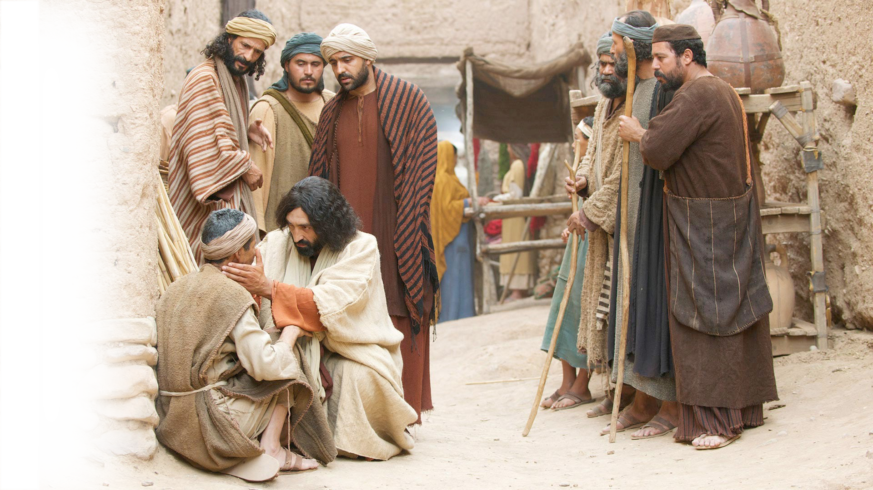
1. The Need for the Light
³ Jesus answered, "It was not that this man sinned, or his parents, but that the works of God might be displayed in him.
Notes:
1. The Need
Sin, blindness, glory
2. The Miracle
Spit, Mix, Go wash, See
3. The Controversy
Neighbors, Pharisees, Jews, Parents, Jews again
4. The Testimony
the man Jesus, prophet, know miracle worker, …
5. The Point
to believe
6. The Irony
The blind man sees
The seeing men are blind

Slide 7
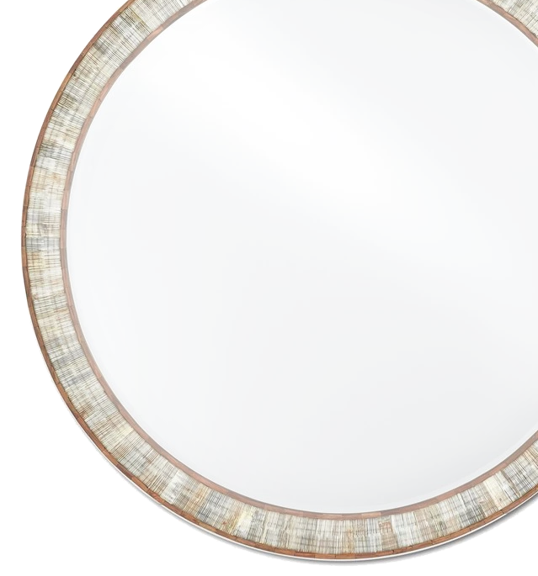
1. The Need for the Light
⁴ We must work the works of him who sent me while it is day; night is coming, when no one can work.
⁵ As long as I am in the world,
I am the light of the world."
Notes:
1. The Need
Sin, blindness, glory
2. The Miracle
Spit, Mix, Go wash, See
3. The Controversy
Neighbors, Pharisees, Jews, Parents, Jews again
4. The Testimony
the man Jesus, prophet, know miracle worker, …
5. The Point
to believe
6. The Irony
The blind man sees
The seeing men are blind

Slide 8
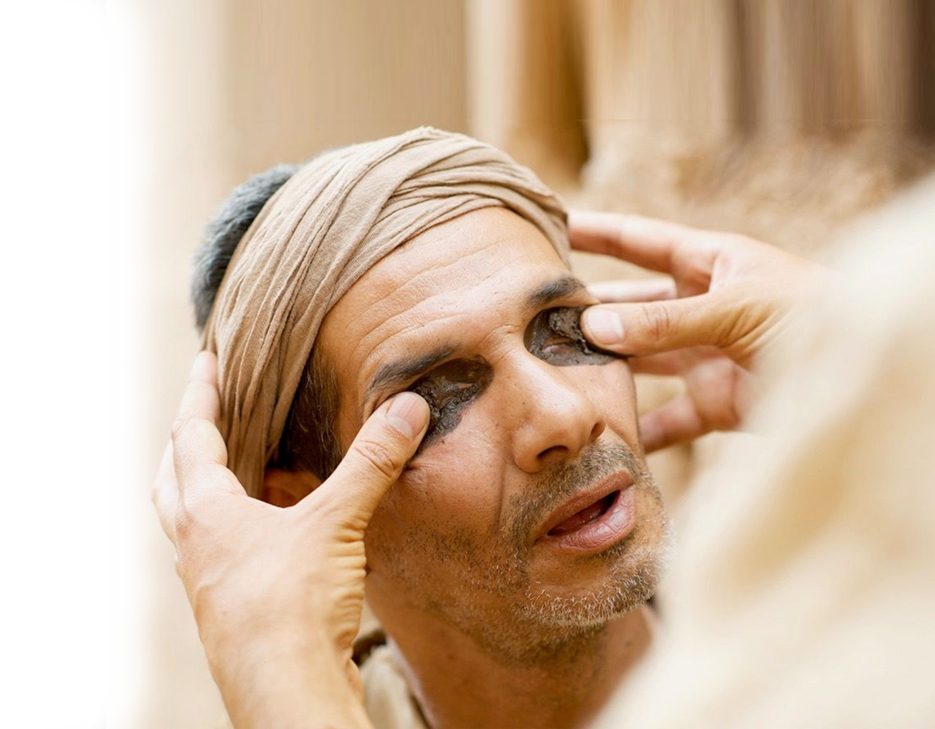
2. The Miracle of the Light
⁶ Having said these things, he spat on the ground and made mud with the saliva. Then he anointed the man's eyes with the mud ⁷ and said to him, "Go, wash in the pool of Siloam" (which means Sent). So he went and washed and came back seeing.
Notes:
1. The Need
Sin, blindness, glory
2. The Miracle
Spit, Mix, Go wash, See
3. The Controversy
Neighbors, Pharisees, Jews, Parents, Jews again
4. The Testimony
the man Jesus, prophet, know miracle worker, …
5. The Point
to believe
6. The Irony
The blind man sees
The seeing men are blind

Slide 9
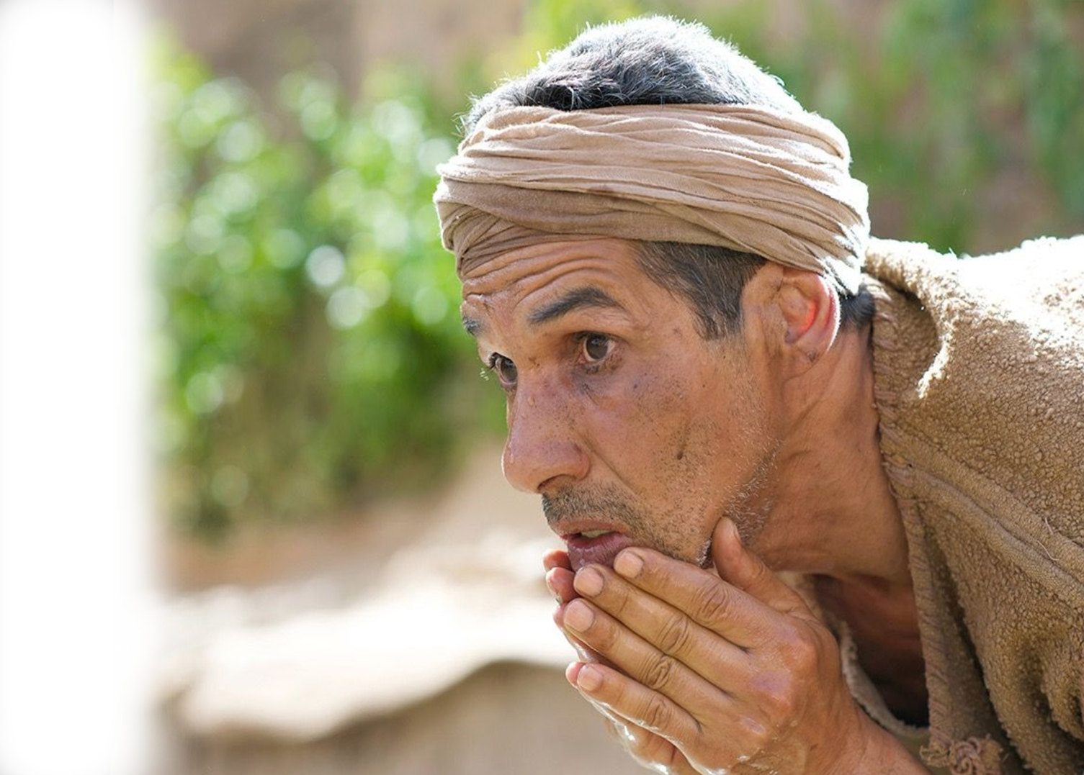
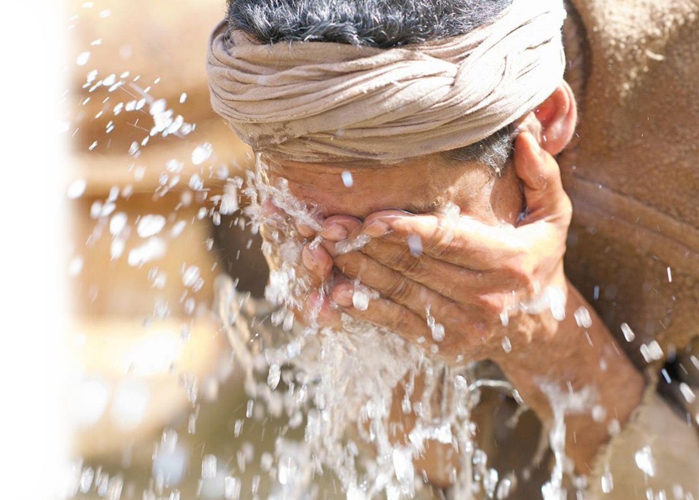
2. The Miracle of the Light
So he went and washed and came back seeing.
Notes:
1. The Need
Sin, blindness, glory
2. The Miracle
Spit, Mix, Go wash, See
3. The Controversy
Neighbors, Pharisees, Jews, Parents, Jews again
4. The Testimony
the man Jesus, prophet, know miracle worker, …
5. The Point
to believe
6. The Irony
The blind man sees
The seeing men are blind

Slide 10
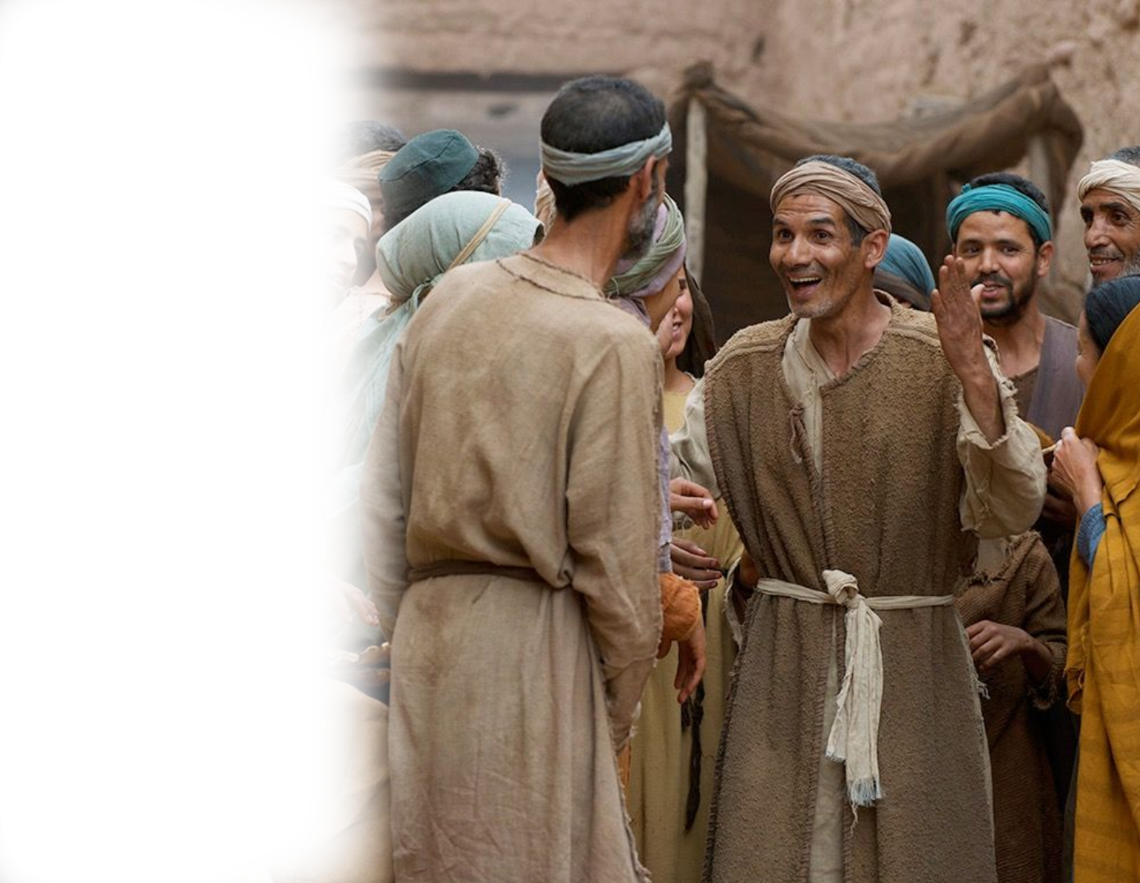
3. The Controversy over the Light
Neighbors
⁸ The neighbors and those who had seen him before as a beggar were saying, "Is this not the man who used to sit and beg?" ⁹ Some said, "It is he." Others said, "No, but he is like him." He kept saying, "I am the man.“
¹⁰ So they said to him, "Then how were your eyes opened?"
¹¹ He answered, "The man called Jesus made mud and anointed my eyes and said to me, 'Go to Siloam and wash.' So I went and washed and received my sight."
¹² They said to him, "Where is he?" He said, "I do not know."
¹³ They brought to the Pharisees the man who had formerly been blind.
(Joh 9:8-13 ESV)

Slide 11
3. The Controversy over the Light
Neighbors
¹⁰ So they said to him, "Then how were your eyes opened?" ¹¹ He answered, "The man called Jesus made mud and anointed my eyes and said to me, 'Go to Siloam and wash.' So I went and washed and received my sight.“ ¹² They said to him, "Where is he?" He said, "I do not know."

Slide 12
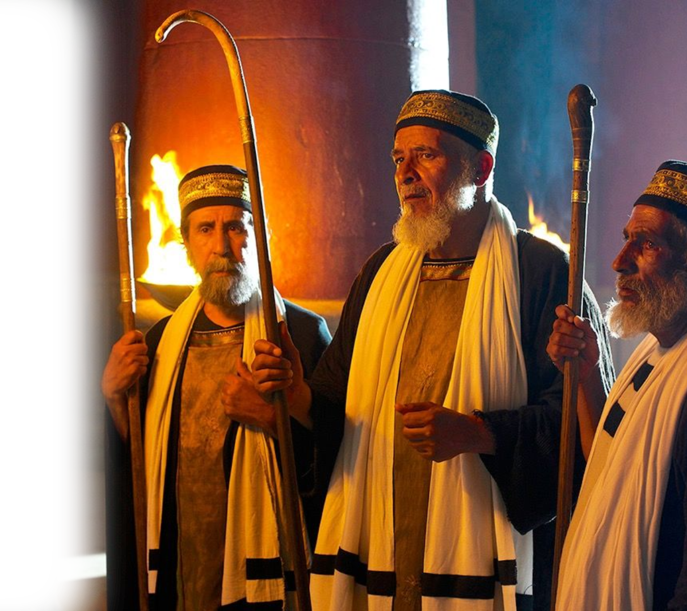
3. The Controversy over the Light
Pharisees
¹³ They brought to the Pharisees the man who had formerly been blind.¹⁴ Now it was a Sabbath day when Jesus made the mud and opened his eyes. ¹⁵ So the Pharisees again asked him how he had received his sight.

Slide 13
3. The Controversy over the Light
Pharisees
And he said to them,
"He put mud on my eyes, and I washed, and I see.“

Slide 14
3. The Controversy over the Light
Pharisees
¹⁶ Some of the Pharisees said, "This man is not from God, for he does not keep the Sabbath." But others said, "How can a man who is a sinner do such signs?" And there was a division among them.
¹⁷ So they said again to the blind man, "What do you say about him, since he has opened your eyes?" He said, "He is a prophet."
(Joh 9:14-17 ESV)

Slide 15
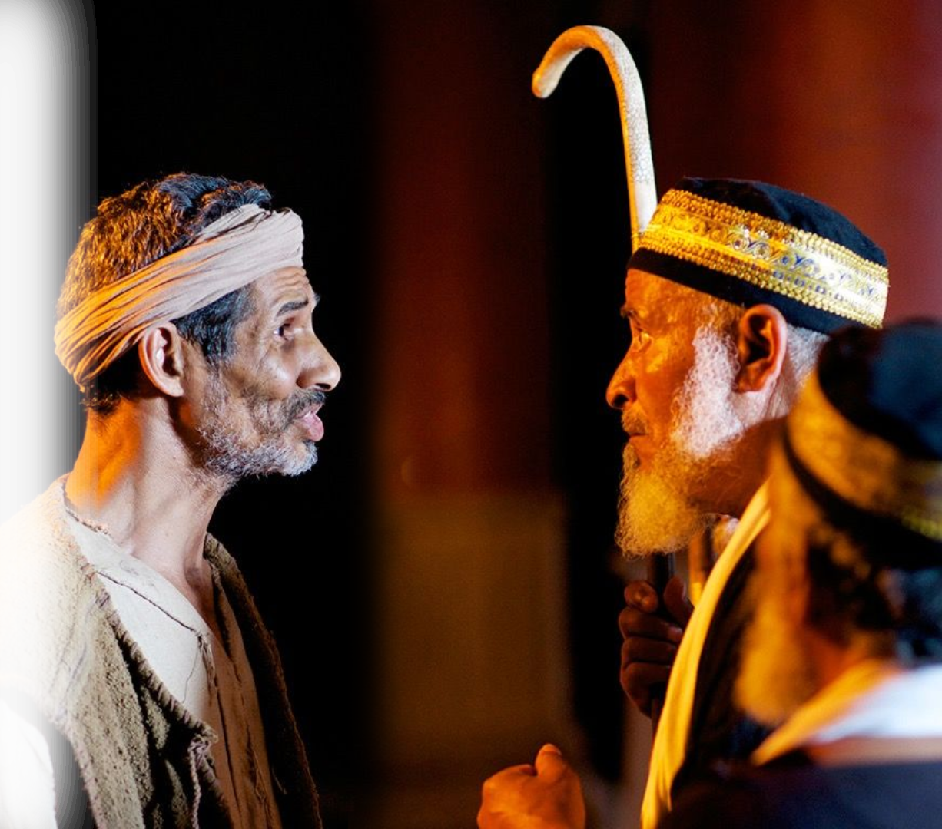
3. The Controversy over the Light
Pharisees
¹⁷ So they said again
to the blind man, "What do you say about him, since he has opened your eyes?"
He said,
"He is a prophet."

Slide 16
3. The Controversy over the Light
Parents
The Jews still did not believe that he had been blind and had received his sight until they sent for the man's parents. ¹⁹ and asked them, "Is this your son, who you say was born blind? How then does he now see?

Slide 17
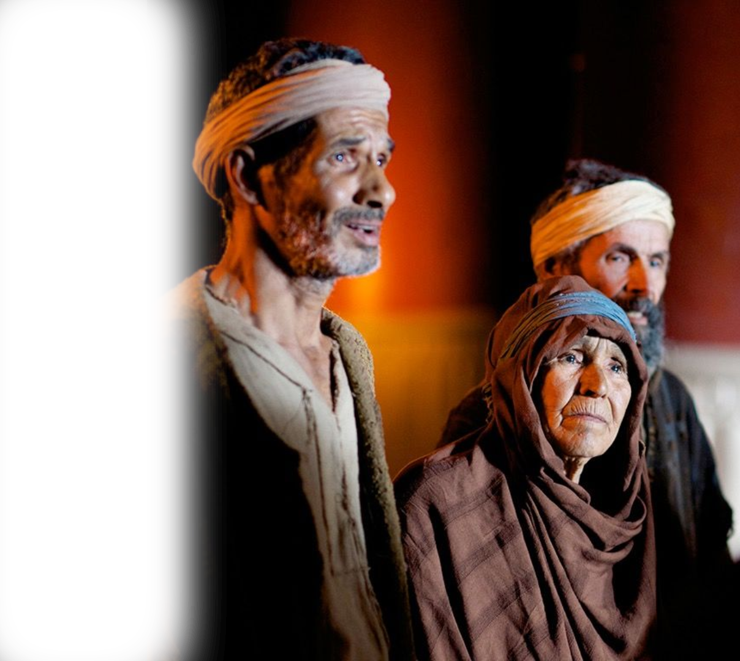
3. The Controversy over the Light
Parents
²⁰ His parents answered, "We know that this is our son and that he was born blind. ²¹ But how he now sees we do not know, nor do we know who opened his eyes. Ask him; he is of age. He will speak for himself."

Slide 18
3. The Controversy over the Light
Parents
²² (His parents said these things because they feared the Jews, for the Jews had already agreed that if anyone should confess Jesus to be Christ, he was to be put out of the synagogue.)
²³ Therefore his parents said, "He is of age; ask him."

Slide 19
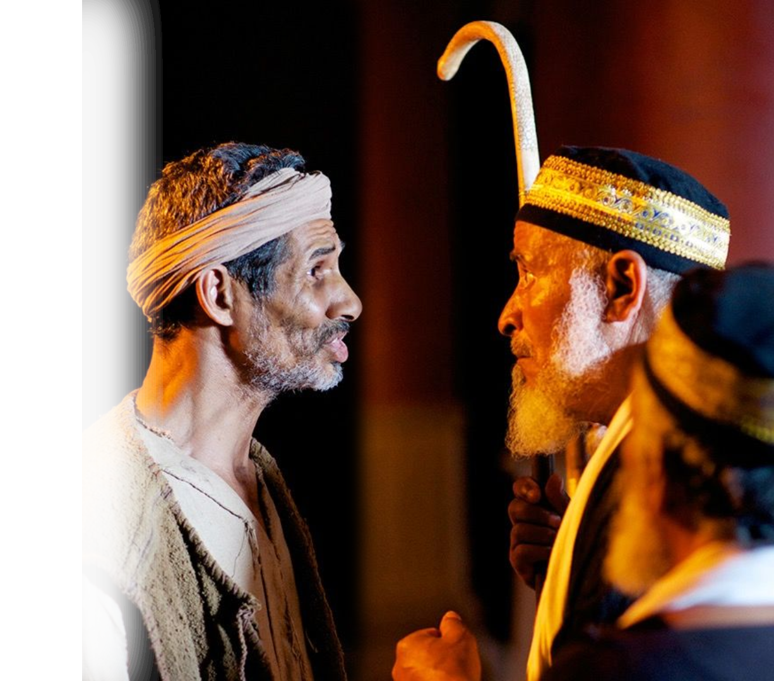
3. The Controversy over the Light
The Pharisees Again
²⁴ So for the second time they called the man who had been blind and said to him, "Give glory to God. We know that this man is a sinner.“

Slide 20
3. The Controversy over the Light
The Pharisees Again
²⁵ He answered, "Whether he is a sinner I do not know. One thing I do know, that though I was blind, now I see.“

Slide 21
3. The Controversy over the Light
The Pharisees Again
²⁶ They said to him, "What did he do to you? How did he open your eyes?"
²⁷ He answered them, "I have told you already, and you would not listen. Why do you want to hear it again? Do you also want to become his disciples?"

Slide 22
3. The Controversy over the Light
The Pharisees Again
²⁸ And they reviled him, saying, "You are his disciple, but we are disciples of Moses. ²⁹ We know that God has spoken to Moses, but as for this man, we do not know where he comes from."

Slide 23
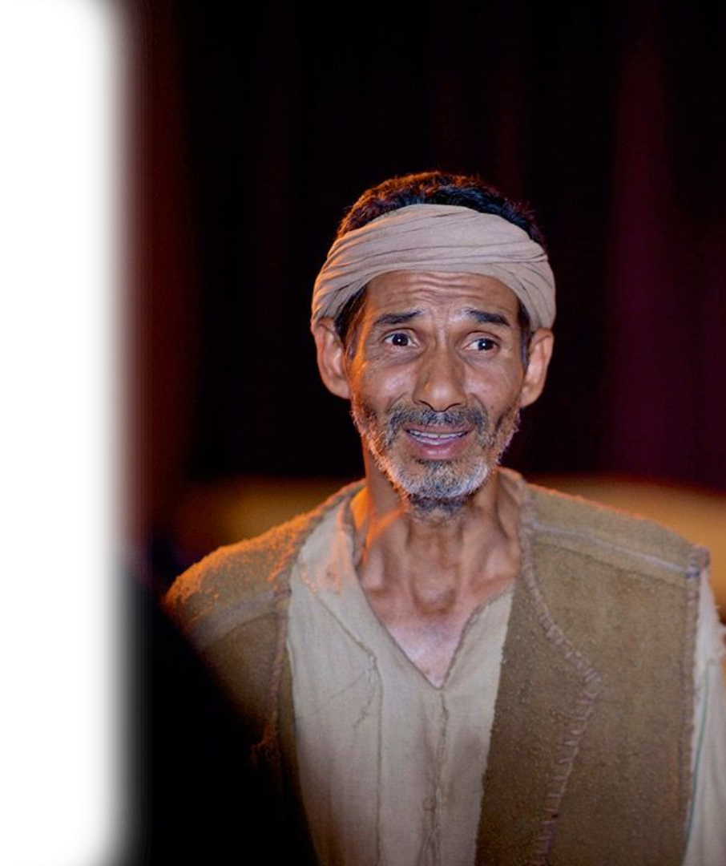
4. The Testimony of the Light
³⁰ The man answered, "Why, this is an amazing thing! You do not know where he comes from, and yet he opened my eyes. ³¹ We know that God does not listen to sinners, but if anyone is a worshiper of God and does his will, God listens to him.
³² Never since the world began has it been heard that anyone opened the eyes of a man born blind.
³³ If this man were not from God, he could do nothing."
³⁴ They answered him, "You were born in utter sin, and would you teach us?" And they cast him out.
(Joh 9:24-34 ESV)
Notes:
This man (here and in verse 11 = the man called Jesus)
Man from God
A Prophet (v. 17)
He will call Him – the Son of God/man

Slide 24
4. The Testimony of the Light
³² Never since the world began has it been heard that anyone opened the eyes of a man born blind. ³³ If this man were not from God, he could do nothing."
³⁴ They answered him, "You were born in utter sin, and would you teach us?" And they cast him out.
(Joh 9:24-34 ESV)
Notes:
This man (here and in verse 11 = the man called Jesus)
Man from God
A Prophet (v. 17)
He will call Him – the Son of God/man

Slide 25
4. The Testimony of the Light
³⁴ They answered him, "You were born in utter sin, and would you teach us?" And they cast him out.
Notes:
This man (here and in verse 11 = the man called Jesus)
Man from God
A Prophet (v. 17)
He will call Him – the Son of God/man

Slide 26
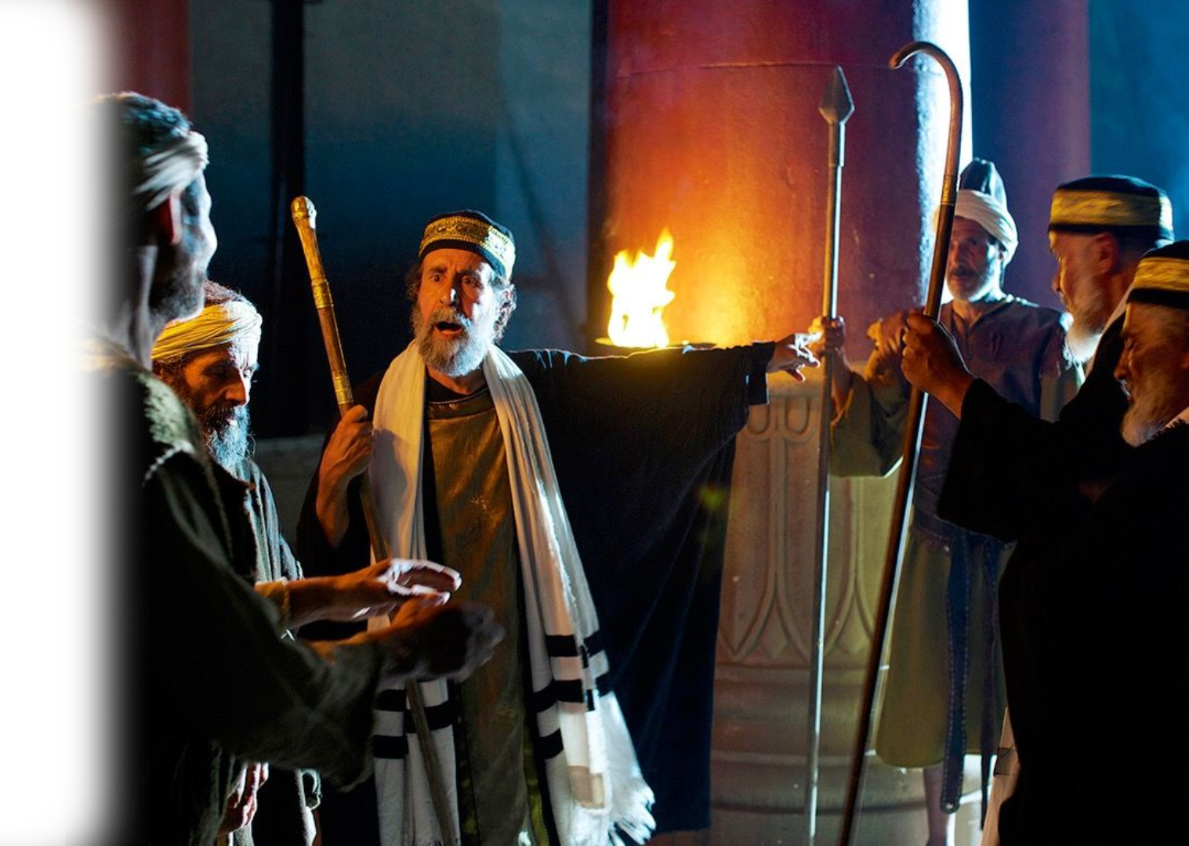
5. The Point of the Light
³⁴ They answered him, "You were born in utter sin, and would you teach us?" And they cast him out.

Slide 27
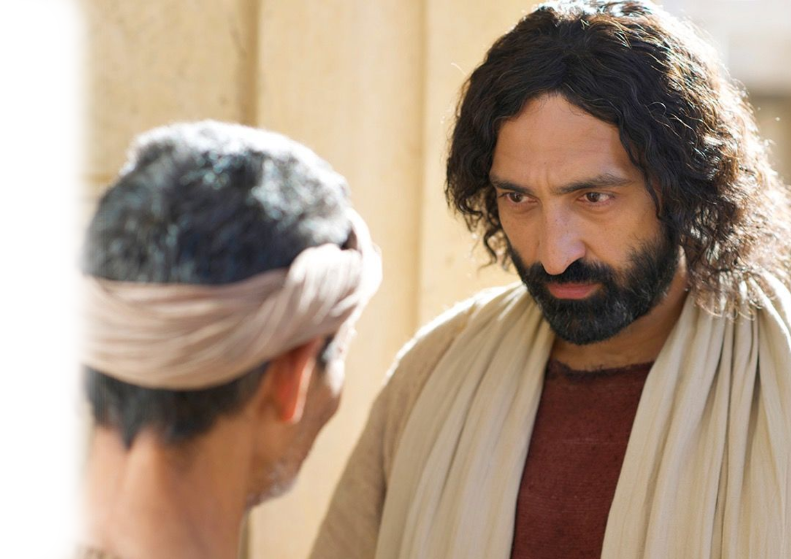
5. The Point of the Light
³⁵ Jesus heard that they had cast him out, and having found him he said, "Do you believe in the Son of Man?“ ³⁶ He answered, "And who is he, sir, that I may believe in him?"

Slide 28
5. The Point of the Light
³⁷ Jesus said to him, "You have seen him, and it is he who is speaking to you."
³⁸ He said, "Lord,
I believe," and he worshiped him.

Slide 29
6. The Irony of the Light
³⁹ Jesus said, "For judgment I came into this world, that those who do not see may see, and those who see may become blind."
The blind man sees

Slide 30
6. The Irony of the Light
The seeing men are blind
⁴⁰ Some of the Pharisees near him heard these things, and said to him, "Are we also blind?“ ⁴¹ Jesus said to them, "If you were blind, you would have no guilt; but now that you say, 'We see,' your guilt remains.

Slide 31
So,
How Did
Jesus See
Himself

Slide 32
He Saw Himself as the Light of the World
“I am the light of the world” (John 8:12)
“I am the light of the world” (John 9:5)
"I am the bread of life" (John 6:48)
Notes:
https://www.flickr.com/photos/denharsh/5150191997

Slide 33
LET’S PRAY!

