Slide 1
Seeing
Jesus as
He Saw
Himself
Notes:
Sir, we wish to see Jesus." (Joh 12:21 ESV)

Slide 2
Seeing
Jesus as
He Saw
Himself
Notes:
Sir, we wish to see Jesus." (Joh 12:21 ESV)
Copyright © 2006−2021. All rights reserved. Bible Point is a registered trademark of Dennis Henderson. All other trademarks acknowledged.
Bible Point contains graphics from Bible Point artists. These illustrations belong to Bible Point and the respective artists. You may use the designs and illustrations for graphical illustration of lessons free and without special permission, provided they are not used in any way that maligns the Christian faith. Furthermore, republication or production of any illustration by any other graphic service whether it be in book, in a machine-readable form, or in any other design resource is strictly prohibited. Furthermore, they cannot be duplicated or resold as any other form of publishing, clip art, or graphic resource.
So What does it mean? (A simple translations of the legal jargon)
So, if you don’t own the presentation(s), graphic(s), and text(s) how can you legally use them? The purchase of the license allows you to use all the images in the product. However, the actual ownership and copyright of the presentation(s), graphic(s), and text(s) remain the property of Bible Point and its licensors. If you had plans on using this product in your “for sale” work—think again!
License Agreement
Article 1: License Grant
All the graphics and text in Bible Point presentations (excluding quotes from the Bible and stated sources) are the intellectual and real property of Bible Point and its licensors, and is protected by law, including United States copyright laws and international treaties. Bible Point grants to you a license:
1. To use the presentation in a single church, single school, or single office of a Christian organization.
2. To make a single archival back-up copy of the program.
3. To modify the presentation(s) and merge with other presentations in a single church, school, or Christian organization.
4. To transfer to another party if that party agrees to accept the terms and conditions of this agreement, and you do not retain any copies of the presentation, whether printed, machine readable, modified, or merged form.
Article 2: Terms
This license is effective until terminated. You may terminate the license at any time by destroying the presentation(s), graphic(s), or text(s) together with all copies, modifications and merged portions in any form. Bible Point may terminate your license if you fail to comply with this Agreement. You agree, upon such termination, for any reason, to destroy the presentation(s), graphics, and text(s) with all copies, modifications, and merged portions in any form.
Article 3: Disclaimers
1. Bible Point presentations, graphics, and texts are licensed to you As Is. You, the consumer, bear the entire risk relating to the quality and performance of the presentation(s), graphic(s), or text(s). In no event will Bible Point be liable for damages resulting from any defect.
2. Thirty-day limited warrantee on disks. Bible Point warrants the disks to be free of defects in material and workmanship under normal use for 30 days after purchase. During the 30-day period you may return a defective presentation, graphic, or text with proof of purchase and it will be replaced without charge, unless the presentation is damaged by misuse.
Article 4: General
1. You may not sub-license, assign, or transfer the license of the presentation(s), graphic(s), or text(s) except as provided by this Agreement.
2. This Agreement will be governed by the laws of the State of Michigan.
So What does it mean? (A simple translations of the legal jargon)
May I let someone borrow or copy my licensed Bible Point presentation (even after I modified it)? As long as it is within your local church, or single school, or the immediate office of a Christian organization you may. Otherwise, please refer the person interested in borrowing to: http://www.biblepoint.com or E-mail: dennis@DrDH.net with any related questions.

Slide 3

He Saw Himself as
The Bread of Life
"I am the bread of life" (John 6:35)
"I am the bread of life" (John 6:48)
Notes:
https://www.needpix.com/photo/913028/bread-baguette-food

Slide 4

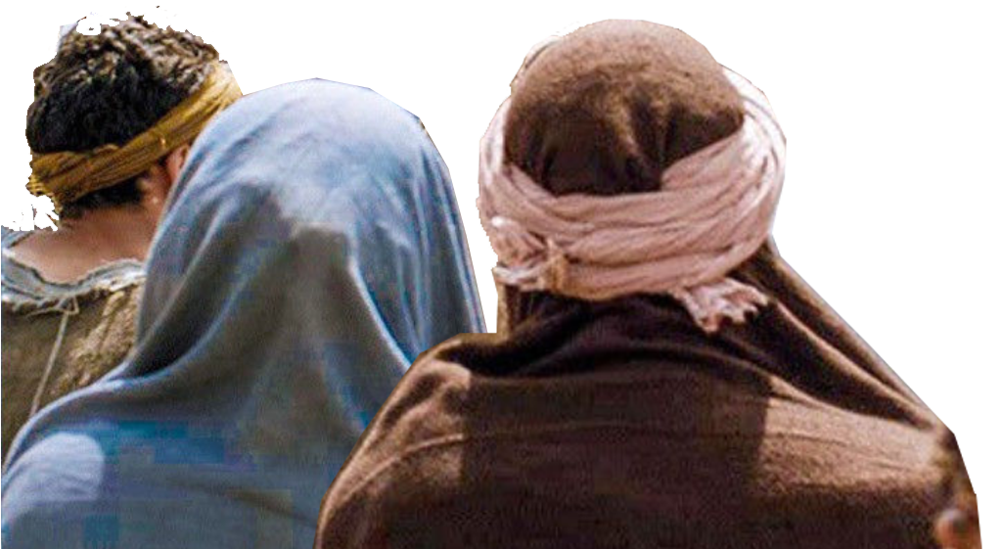
How did the People See Jesus?

Slide 5
The People Saw Jesus As:

Slide 6
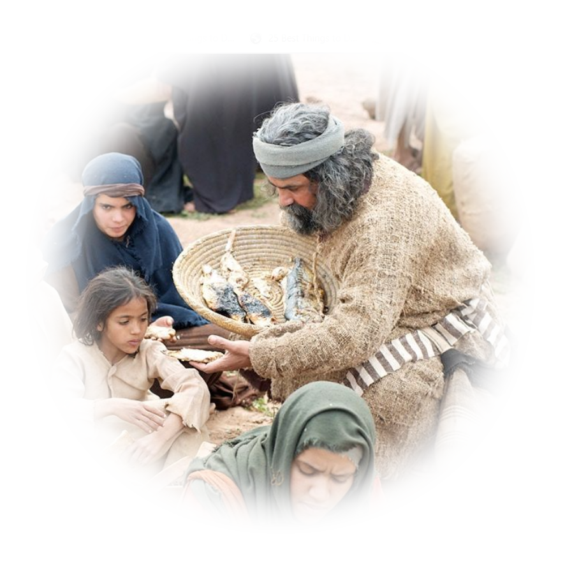
1. A Miracle Worker
Feeding 5,000 (6:1-15)
… five loaves and two fish,
but what are they for so
many?“…. Jesus then took the loaves, and when he had given thanks, he distributed them to those who were seated. So also the fish, as much as they wanted.

Slide 7
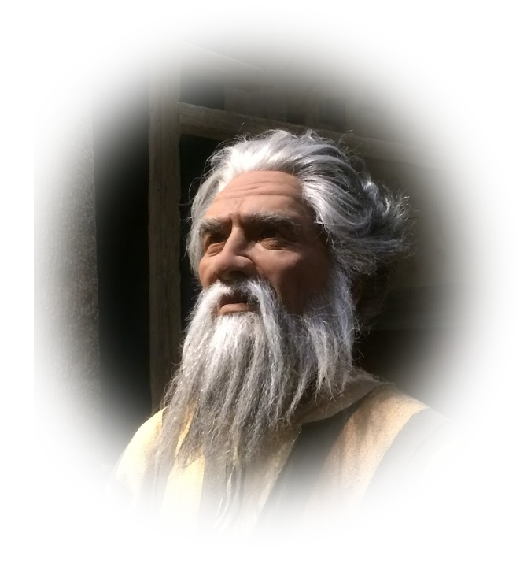
2. A Prophet
¹⁴ When the people saw the
sign that he had done, they
said, "This is indeed the
Prophet who is to come into
the world!"

Slide 8

3. A Potential King
¹⁵ Perceiving then that they
were about to come and take
him by force to make him king, Jesus withdrew again to the mountain by himself.

Slide 9
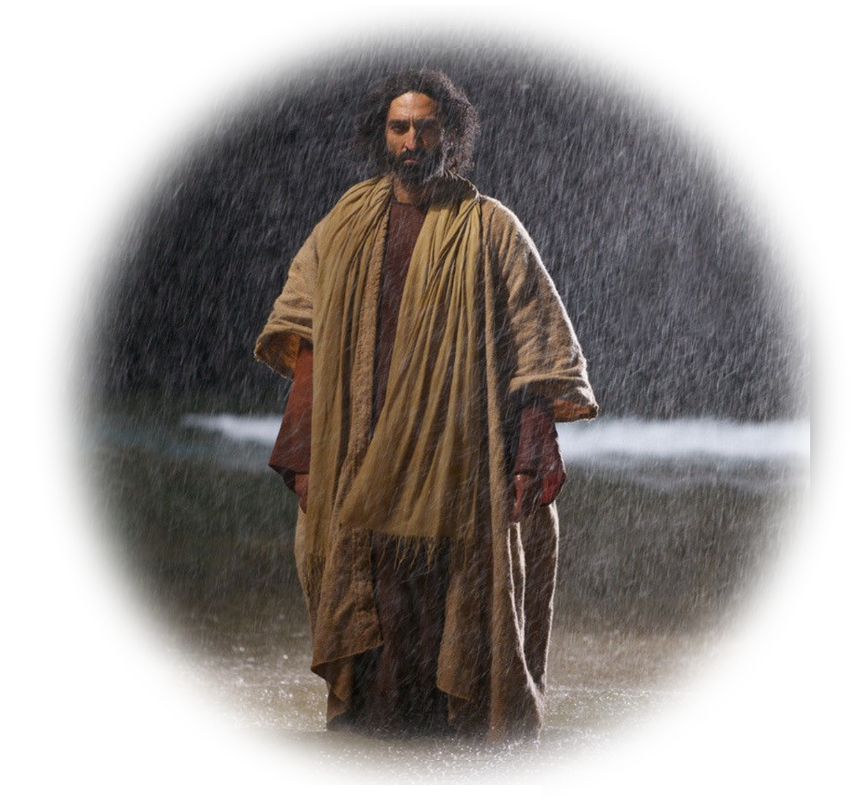
4. Missing in Action
… Jesus walking on the sea and coming near the boat, and they were frightened. ²⁰ But he said
to them, "It is I; do not be afraid.“
²¹ Then they were glad to take
him into the boat, and immediately the boat was at the land to which they were going.

Slide 10
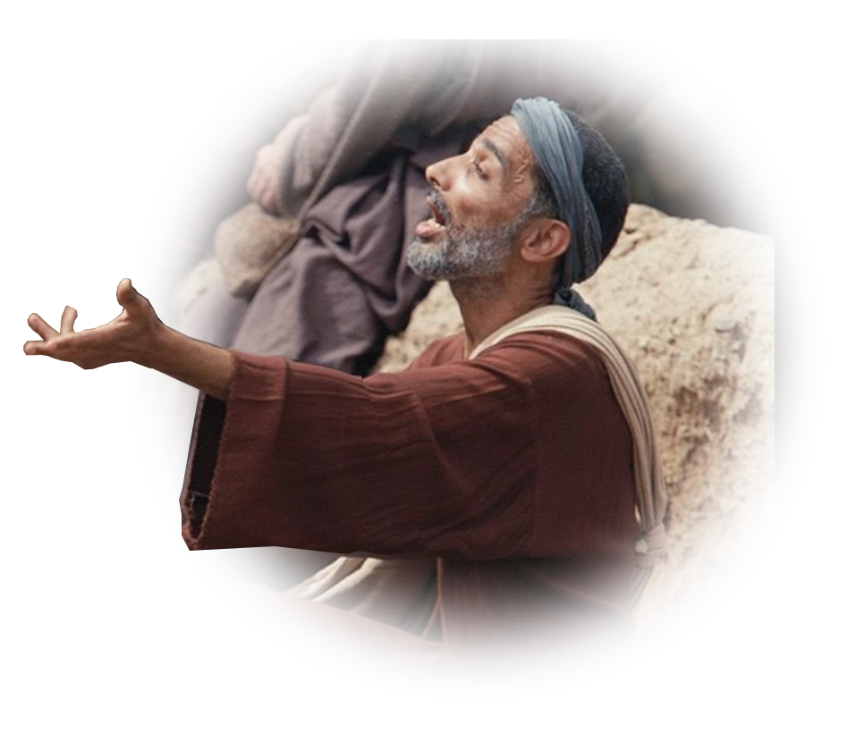
5. Worth Pursuing
²⁴ So when the crowd saw that
Jesus was not there … they …
got into the boats and went … seeking Jesus.²⁵ When they
found him on the other side of
the sea, they said
to him, "Rabbi, when did you
come here?"

Slide 11
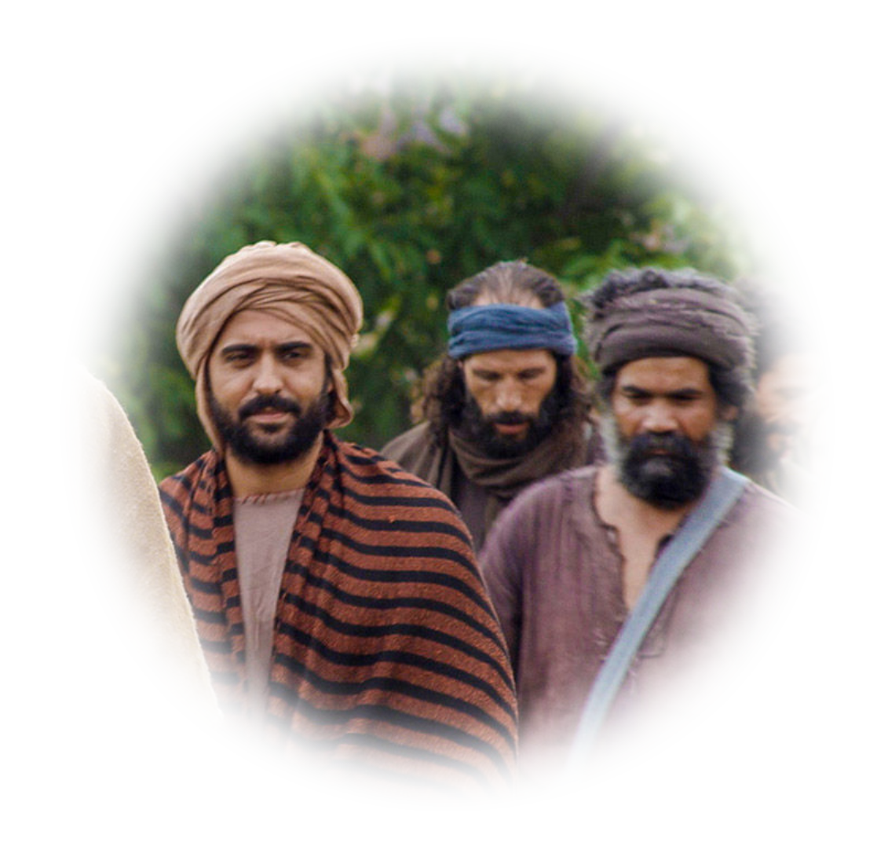

How Jesus Saw Them

Slide 12

Selfie Generation
²⁶ Jesus answered them,
"Truly, truly, I say to you, you
are seeking me, not because
you saw signs, but because you
ate your fill of the loaves.
Notes:
https://pixabay.com/photos/selfie-portrait-phone-mobile-931908/

Slide 13
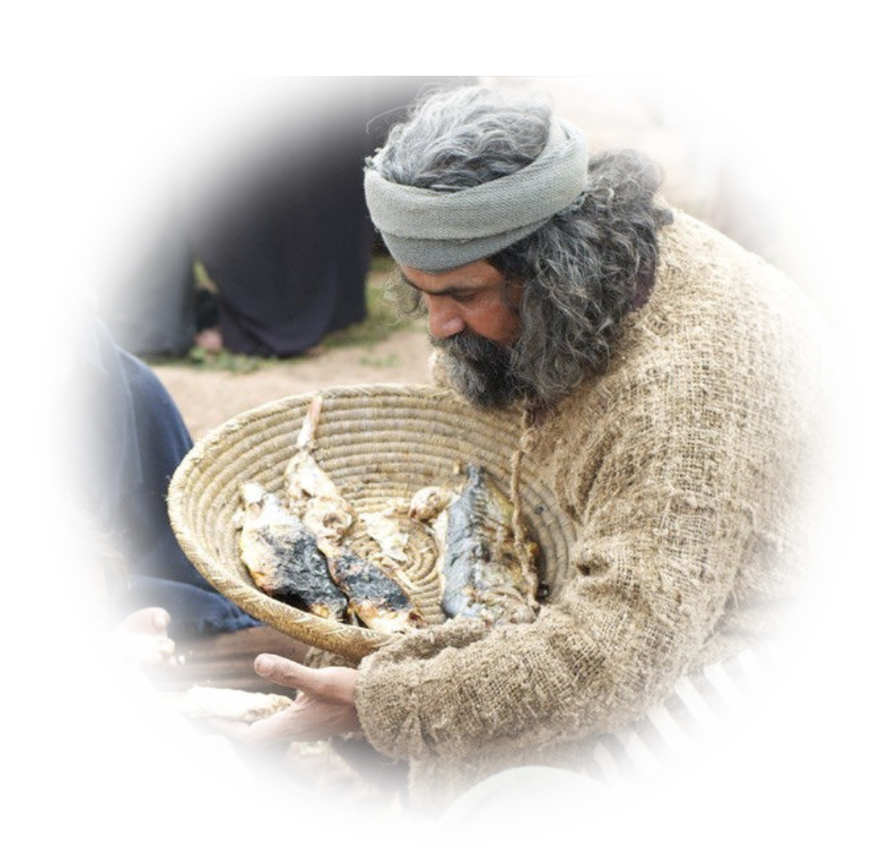
Spiritual Freeloaders
²⁷ Do not labor for the food
that perishes, but for the food
that endures to eternal life,
which the Son of Man will give
to you. For on him God the
Father has set his seal."

Slide 14
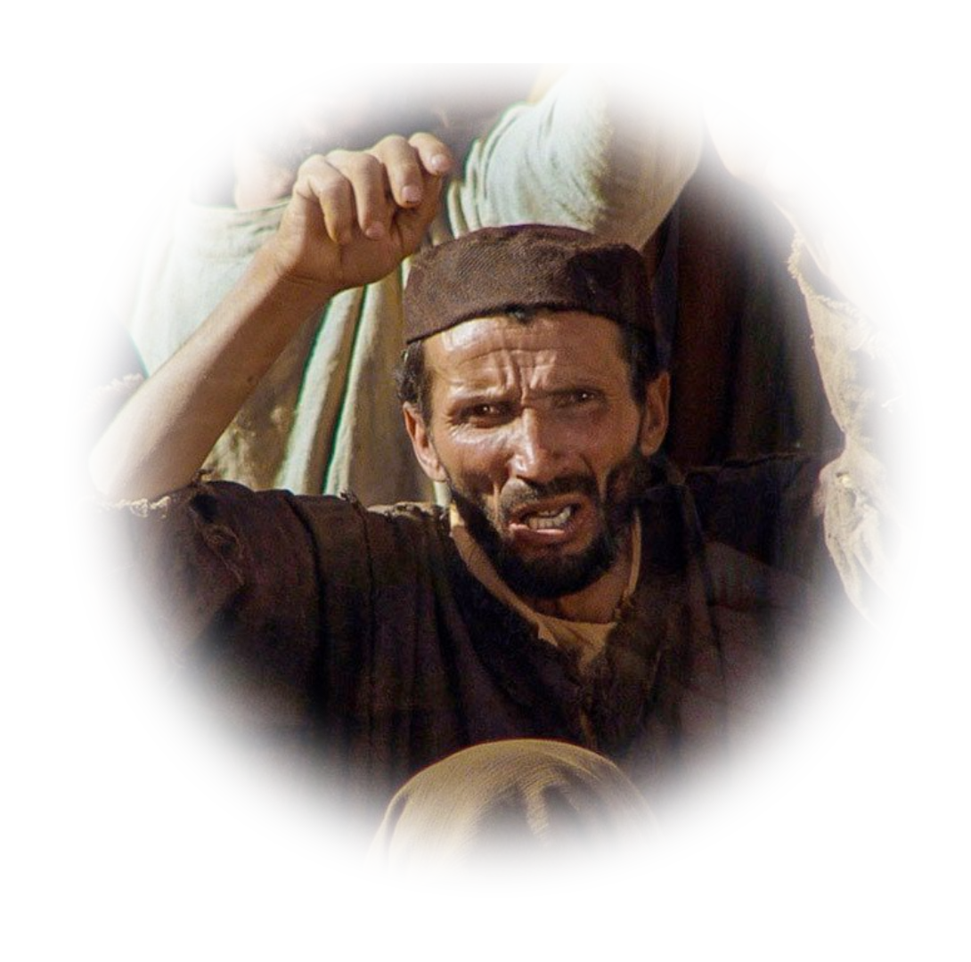
Contentious
²⁸ Then they said to him,
"What must we do, to be
doing the works of God?"
²⁹ Jesus answered them,
"This is the work of God, that
you believe in him whom he has sent."

Slide 15

Arrogant
³⁰ So they said to him, "Then
what sign do you do, that we
may see and believe you?
What work do you perform? ³¹
Our fathers ate the manna in
the wilderness; as it is written, ..."
³² Jesus then said to them, “… it
was not Moses who gave you the bread from heaven, but my Father gives you the true bread from heaven.

Slide 16

Demanding
³³ For the bread of God is he
who comes down from heaven
and gives life to the world.“ ³⁴
They said to him,
"Sir, give us this bread always."
Notes:
https://images.squarespace-cdn.com/content/53dd6676e4b0fedfbc26ea91/1464188407028-NNW94J9YBVJUZR6XII63/one-way-street-signs.jpg?content-type=image%2Fjpeg

Slide 17
How Jesus Saw Himself

Slide 18
As the Bread of Life
³⁵ Jesus said to them, "I am the bread of life;

Slide 19

As the Satisfier of Life
³⁵ Jesus said to them, "I am the bread of life; whoever comes
to me shall not hunger, and whoever believes in me shall
never thirst.

Slide 20
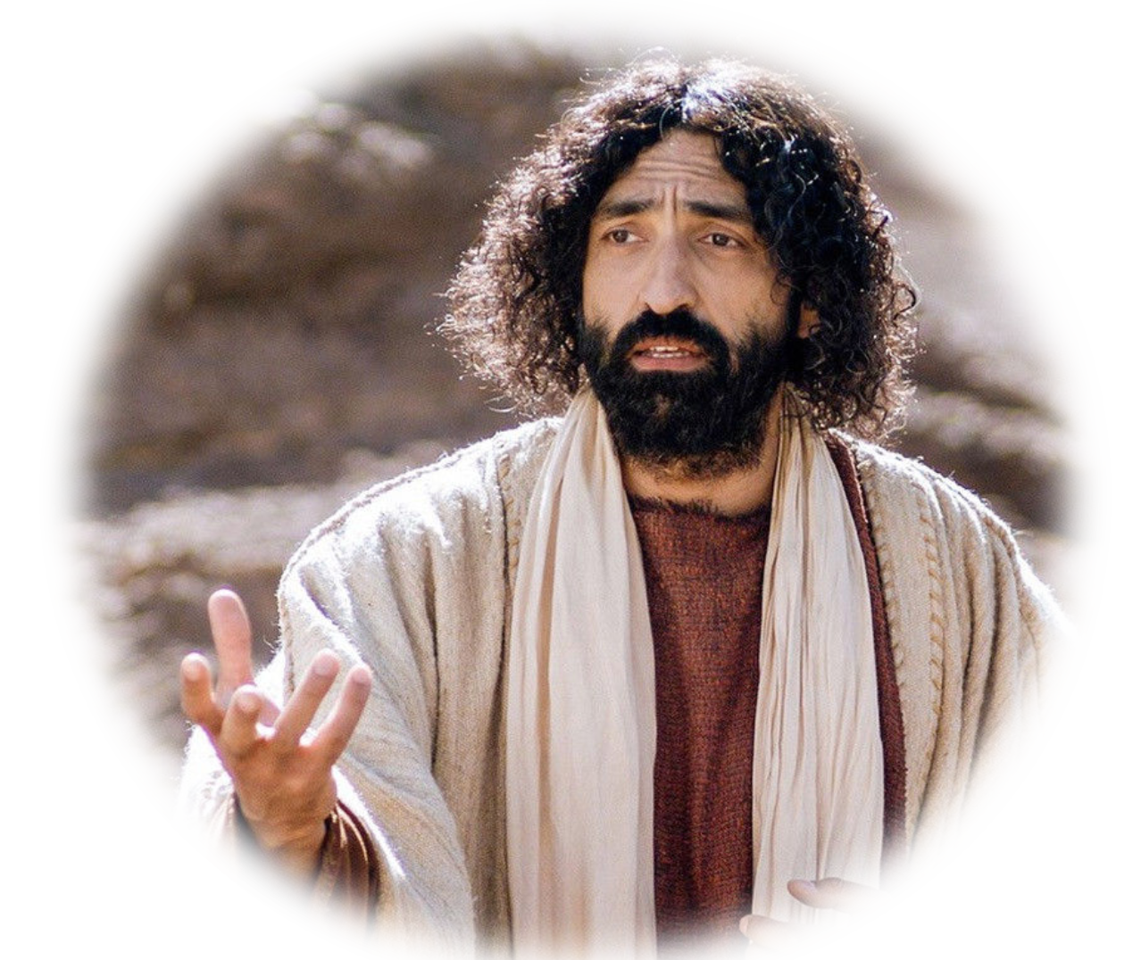
As the Object of Faith
³⁶ But I said to you that you
have seen me and yet do not believe.
³⁷ All that the Father gives me
will come to me, and whoever comes to me I will never cast out.

Slide 21

As the One from Heaven
³⁸ For I have come down from heaven, not to do my own will
but the will of him who sent me.
³⁹ And this is the will of him who sent me, that I should lose nothing of all that he has given me, but raise it up on the last day.

Slide 22

As Eternal Life Giver
⁴⁰ For this is the will of my
Father, that everyone who
looks on the Son and believes
in him should have eternal life,
and I will raise him up on the
last day." ⁴¹ So the Jews grumbled about him, because he said, "I am the bread that came down from heaven."

Slide 23
As Eternal Life Giver
⁴⁰ For this is the will of my
Father, that everyone who
looks on the Son and believes
in him should have eternal life,
and I will raise him up on the
last day." ⁴¹ So the Jews grumbled about him, because he said, "I am the bread that came down from heaven."

Slide 24

So How Do You See Him?

Slide 25
LET’S PRAY!

