Slide 1
Seeing
Jesus as
He Saw
Himself
Notes:
Sir, we wish to see Jesus." (Joh 12:21 ESV)

Slide 2
Seeing
Jesus as
He Saw
Himself
Notes:
Sir, we wish to see Jesus." (Joh 12:21 ESV)
Copyright © 2006−2021. All rights reserved. Bible Point is a registered trademark of Dennis Henderson. All other trademarks acknowledged.
Bible Point contains graphics from Bible Point artists. These illustrations belong to Bible Point and the respective artists. You may use the designs and illustrations for graphical illustration of lessons free and without special permission, provided they are not used in any way that maligns the Christian faith. Furthermore, republication or production of any illustration by any other graphic service whether it be in book, in a machine-readable form, or in any other design resource is strictly prohibited. Furthermore, they cannot be duplicated or resold as any other form of publishing, clip art, or graphic resource.
So What does it mean? (A simple translations of the legal jargon)
So, if you don’t own the presentation(s), graphic(s), and text(s) how can you legally use them? The purchase of the license allows you to use all the images in the product. However, the actual ownership and copyright of the presentation(s), graphic(s), and text(s) remain the property of Bible Point and its licensors. If you had plans on using this product in your “for sale” work—think again!
License Agreement
Article 1: License Grant
All the graphics and text in Bible Point presentations (excluding quotes from the Bible and stated sources) are the intellectual and real property of Bible Point and its licensors, and is protected by law, including United States copyright laws and international treaties. Bible Point grants to you a license:
1. To use the presentation in a single church, single school, or single office of a Christian organization.
2. To make a single archival back-up copy of the program.
3. To modify the presentation(s) and merge with other presentations in a single church, school, or Christian organization.
4. To transfer to another party if that party agrees to accept the terms and conditions of this agreement, and you do not retain any copies of the presentation, whether printed, machine readable, modified, or merged form.
Article 2: Terms
This license is effective until terminated. You may terminate the license at any time by destroying the presentation(s), graphic(s), or text(s) together with all copies, modifications and merged portions in any form. Bible Point may terminate your license if you fail to comply with this Agreement. You agree, upon such termination, for any reason, to destroy the presentation(s), graphics, and text(s) with all copies, modifications, and merged portions in any form.
Article 3: Disclaimers
1. Bible Point presentations, graphics, and texts are licensed to you As Is. You, the consumer, bear the entire risk relating to the quality and performance of the presentation(s), graphic(s), or text(s). In no event will Bible Point be liable for damages resulting from any defect.
2. Thirty-day limited warrantee on disks. Bible Point warrants the disks to be free of defects in material and workmanship under normal use for 30 days after purchase. During the 30-day period you may return a defective presentation, graphic, or text with proof of purchase and it will be replaced without charge, unless the presentation is damaged by misuse.
Article 4: General
1. You may not sub-license, assign, or transfer the license of the presentation(s), graphic(s), or text(s) except as provided by this Agreement.
2. This Agreement will be governed by the laws of the State of Michigan.
So What does it mean? (A simple translations of the legal jargon)
May I let someone borrow or copy my licensed Bible Point presentation (even after I modified it)? As long as it is within your local church, or single school, or the immediate office of a Christian organization you may. Otherwise, please refer the person interested in borrowing to: http://www.biblepoint.com or E-mail: dennis@DrDH.net with any related questions.

Slide 3
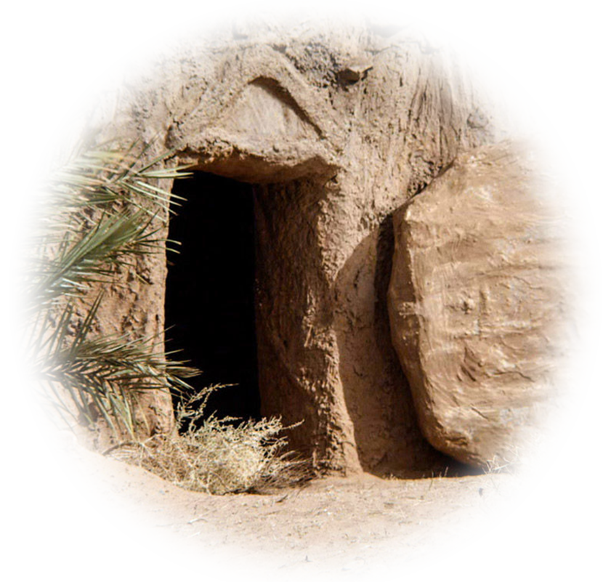
He Saw Himself as the Resurrection
"I am the resurrection and the life." (John 11:25)
Notes:
https://pixabay.com/photos/away-forest-forest-path-mood-trees-2660117/

Slide 4
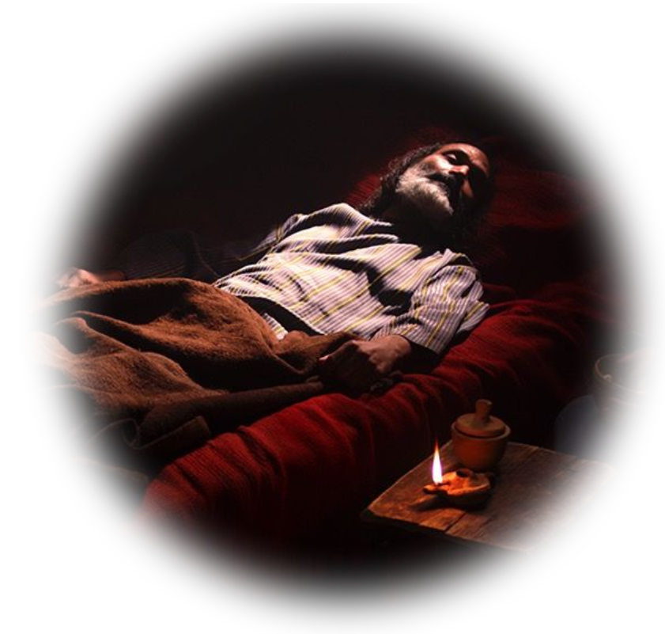
The Setting
Lazarus was sick at Bethany
Notes:
Lazarus sick at Bethany: 20 miles away from Jesus. 1-2
Messenger sent to inform “Lord, the one you love is sick.” 3
Jesus said it will not end in death –did not say he would not die—but instead would end in glory. 4
Jesus delayed – even though he loved Lazarus, Martha and Mary … He delayed two more days 5-6

Slide 5
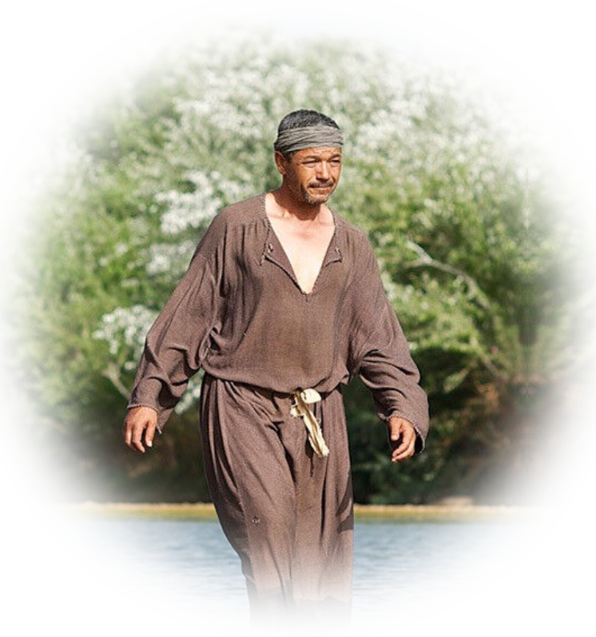
The Setting
Lazarus was sick at Bethany
Messenger was sent to Jesus
Notes:
Lazarus sick at Bethany: 20 miles away from Jesus. 1-2
Messenger sent to inform “Lord, the one you love is sick.” 3
Jesus said it will not end in death –did not say he would not die—but instead would end in glory. 4
Jesus delayed – even though he loved Lazarus, Martha and Mary … He delayed two more days 5-6

Slide 6
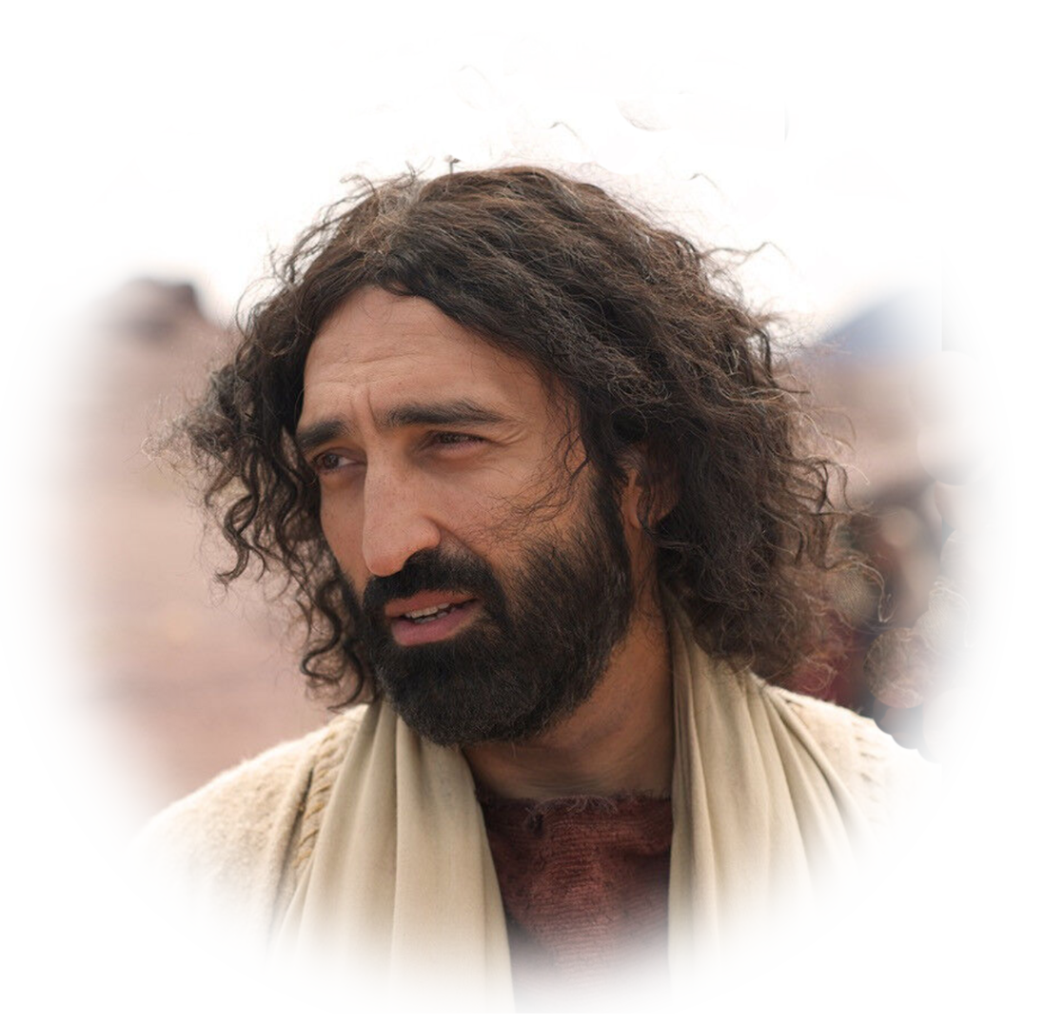
The Setting
Lazarus was sick at Bethany
Messenger was sent to Jesus
Jesus said: “Not end in death”
Notes:
Lazarus sick at Bethany: 20 miles away from Jesus. 1-2
Messenger sent to inform “Lord, the one you love is sick.” 3
Jesus said it will not end in death –did not say he would not die—but instead would end in glory. 4
Jesus delayed – even though he loved Lazarus, Martha and Mary … He delayed two more days 5-6

Slide 7
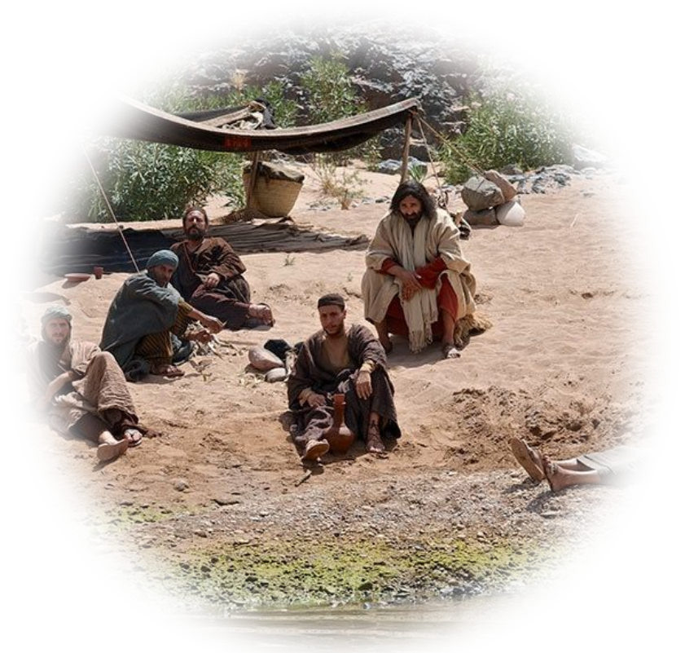
The Setting
Lazarus was sick at Bethany
Messenger was sent to Jesus
Jesus said: “Not end in death”
Jesus delayed going to see him
Notes:
Lazarus sick at Bethany: 20 miles away from Jesus. 1-2
Messenger sent to inform “Lord, the one you love is sick.” 3
Jesus said it will not end in death –did not say he would not die—but instead would end in glory. 4
Jesus delayed – even though he loved Lazarus, Martha and Mary … He delayed two more days 5-6

Slide 8
The Setting
Lazarus was sick at Bethany
Messenger was sent to Jesus
Jesus said: “Not end in death”
Jesus delayed going to see him
“Lazarus has fallen asleep”
Notes:
The Setting: Lazarus sick, Jesus delays, Lazarus dies, Jesus attends funeral, greeted by sisters …
Martha’s Assertion: “If you had been here … he would not have died.” 11:21-22
Jesus’ Consolation: “He will rise again” 11:23 (Jesus know He will raise him … )
Martha’s Assumption: She thinks He’s talking about the resurrection (not about what he is about to do) 11:24
Jesus’ Personalization: He goes along with her line of thinking “I am the resurrection and the life.”
Jesus’ Explanation:
About Death and Resurrection: “He who believes in me will live, even though he dies.” This is the answer to the question, What happens to those who die? “He who believes in me will live, even though he dies.” In fact, to be absent from the body is to be present with the Lord in spirit until reunited with the body at the resurrection. (1 Corinthian 15) Resurrection body
About Life and the Resurrection: “and whoever lives and believes in me will never die.” That is the answer to the question: “What happens if the resurrection takes place while we are still alive? Do we die to be raised? The answer Jesus gives is: “and whoever lives (when the resurrection takes place) and believes in me will never die.” (John 14:1-6 & 1 Thes 4:16-18)
Jesus’ Question: “Do you believe this?”
The Rest of the Story

Slide 9
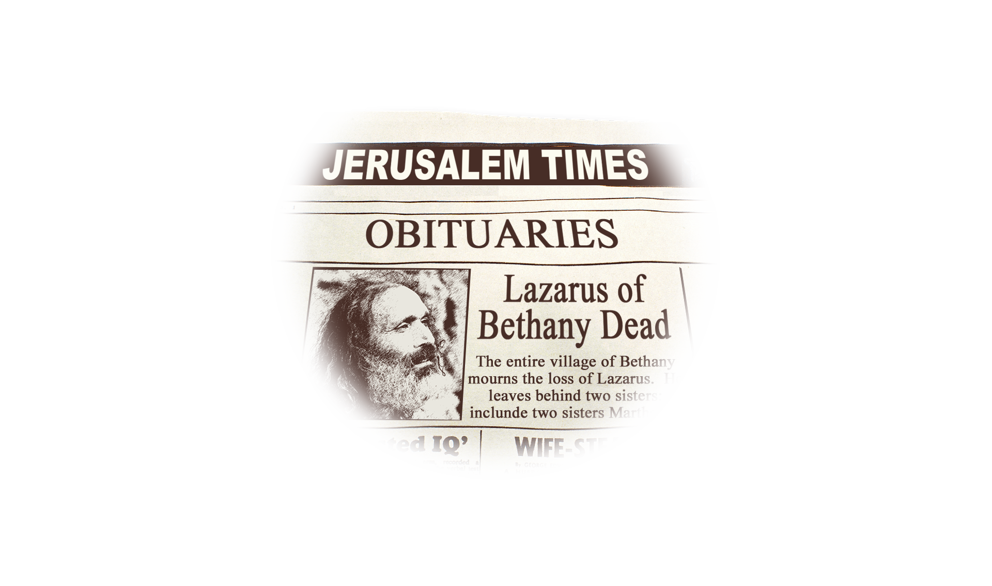
The Setting
Lazarus died
Notes:
The Setting: Lazarus sick, Jesus delays, Lazarus dies, Jesus attends funeral, greeted by sisters …
Martha’s Assertion: “If you had been here … he would not have died.” 11:21-22
Jesus’ Consolation: “He will rise again” 11:23 (Jesus know He will raise him … )
Martha’s Assumption: She thinks He’s talking about the resurrection (not about what he is about to do) 11:24
Jesus’ Personalization: He goes along with her line of thinking “I am the resurrection and the life.”
Jesus’ Explanation:
About Death and Resurrection: “He who believes in me will live, even though he dies.” This is the answer to the question, What happens to those who die? “He who believes in me will live, even though he dies.” In fact, to be absent from the body is to be present with the Lord in spirit until reunited with the body at the resurrection. (1 Corinthian 15) Resurrection body
About Life and the Resurrection: “and whoever lives and believes in me will never die.” That is the answer to the question: “What happens if the resurrection takes place while we are still alive? Do we die to be raised? The answer Jesus gives is: “and whoever lives (when the resurrection takes place) and believes in me will never die.” (John 14:1-6 & 1 Thes 4:16-18)
Jesus’ Question: “Do you believe this?”
The Rest of the Story

Slide 10
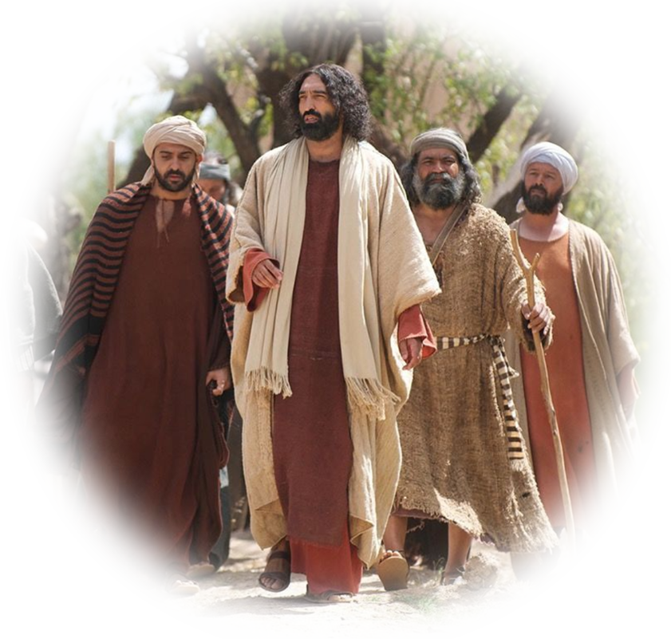
The Setting
Lazarus died
Jesus set out for the funeral
Notes:
The Setting: Lazarus sick, Jesus delays, Lazarus dies, Jesus attends funeral, greeted by sisters …
Martha’s Assertion: “If you had been here … he would not have died.” 11:21-22
Jesus’ Consolation: “He will rise again” 11:23 (Jesus know He will raise him … )
Martha’s Assumption: She thinks He’s talking about the resurrection (not about what he is about to do) 11:24
Jesus’ Personalization: He goes along with her line of thinking “I am the resurrection and the life.”
Jesus’ Explanation:
About Death and Resurrection: “He who believes in me will live, even though he dies.” This is the answer to the question, What happens to those who die? “He who believes in me will live, even though he dies.” In fact, to be absent from the body is to be present with the Lord in spirit until reunited with the body at the resurrection. (1 Corinthian 15) Resurrection body
About Life and the Resurrection: “and whoever lives and believes in me will never die.” That is the answer to the question: “What happens if the resurrection takes place while we are still alive? Do we die to be raised? The answer Jesus gives is: “and whoever lives (when the resurrection takes place) and believes in me will never die.” (John 14:1-6 & 1 Thes 4:16-18)
Jesus’ Question: “Do you believe this?”
The Rest of the Story

Slide 11
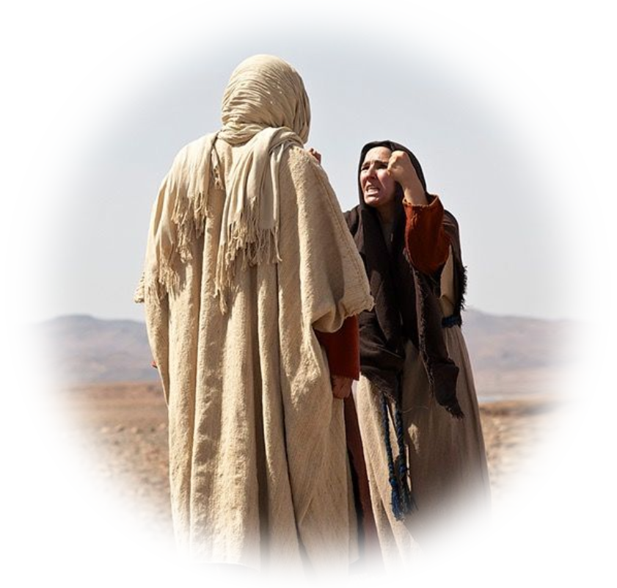
The Setting
Lazarus died
Jesus set out for the funeral
Martha met Him on His arrival
Notes:
The Setting: Lazarus sick, Jesus delays, Lazarus dies, Jesus attends funeral, greeted by sisters …
Martha’s Assertion: “If you had been here … he would not have died.” 11:21-22
Jesus’ Consolation: “He will rise again” 11:23 (Jesus know He will raise him … )
Martha’s Assumption: She thinks He’s talking about the resurrection (not about what he is about to do) 11:24
Jesus’ Personalization: He goes along with her line of thinking “I am the resurrection and the life.”
Jesus’ Explanation:
About Death and Resurrection: “He who believes in me will live, even though he dies.” This is the answer to the question, What happens to those who die? “He who believes in me will live, even though he dies.” In fact, to be absent from the body is to be present with the Lord in spirit until reunited with the body at the resurrection. (1 Corinthian 15) Resurrection body
About Life and the Resurrection: “and whoever lives and believes in me will never die.” That is the answer to the question: “What happens if the resurrection takes place while we are still alive? Do we die to be raised? The answer Jesus gives is: “and whoever lives (when the resurrection takes place) and believes in me will never die.” (John 14:1-6 & 1 Thes 4:16-18)
Jesus’ Question: “Do you believe this?”
The Rest of the Story

Slide 12
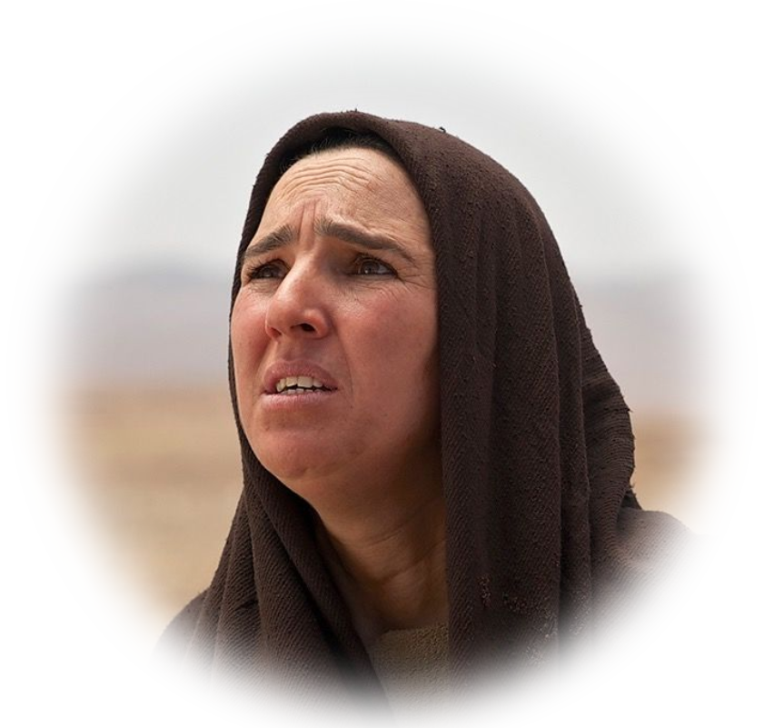
Martha’s Assertion
^{John 11:22} “If you had been
here, my brother would
not have died."
Notes:
This is an assertion of faith—she truly believes the Jesus’ presence would have meant life.
She asserts her faith while we often use questions of doubt:
- If Jesus loved him—WHY did he let him die?
- If Jesus loved him—WHY did he delay?
- If Jesus loved him—Why did he not heal from a distance?
Her faith is so strong that she believes the even after the time of his death—Jesus

Slide 13
Martha’s Assertion
^{John 11:22} “If you had been
here, my brother would
not have died. ²² But I
know that even now God
will give you whatever
you ask."
Notes:
Her faith is so strong that she believes the even after the time of hs death—even now Jesus can make things better.
She does not complain nor tell Jesus what to do only that she believes He can make it better.
There is a lesson to be learned from her faith.
In our most difficult times, Don’t tell God what to do, Believe that God will do something.

Slide 14
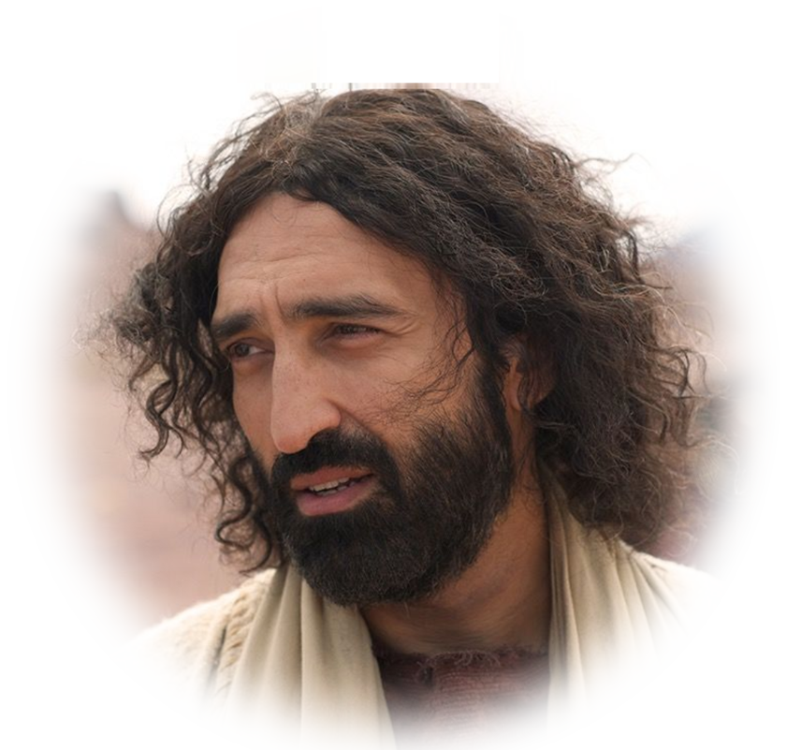
Jesus’ Consolation
²³ Jesus said to her,
"Your brother will rise again."
Notes:
Jesus knows what He is about to do—He is about to perform a miracle of raising the dead.

Slide 15
Martha’s Assumption
²⁴ Martha answered,
"I know he will rise again in the resurrection at the last day."
Notes:
Her assumption is that Jesus is not talking about the immediate, but the future resurrection spoke of in Daniel 12 ² Multitudes who sleep in the dust of the earth will awake: some to everlasting life, others to shame and everlasting contempt. (Dan 12:2 NIV) or a time is coming when all who are in their graves will hear his voice
²⁹ and come out--those who have done good will rise to live, and those who have done evil will rise to be condemned.
(Joh 5:28-29 NIV)

Slide 16
Jesus’ Personalization
1-Of Death and Resurrection
²⁵ Jesus said to her,
"I am the resurrection and
the life."
Notes:
You know what Jesus is saying? Resurrection is not some pie in the sky doctrine found in a book! No! Resurrection is who he is.
Not simply that He has resurrection powers, or that we need to believe in resurrection, but that He is the resurrection—in Him is life-resurrection life.
It is personal—It is who he is.

Slide 17
Jesus’ Explanation
1-Of Death and Resurrection
²⁵ Jesus said to her,
"I am the resurrection and the life. He who believes in me will live, even though he dies;
Notes:
Jesus’ Explanation:
About Death and Resurrection: “He who believes in me will live, even though he dies.” This is the answer to the question, What happens to those who die? “He who believes in me will live, even though he dies.” In fact, to be absent from the body is to be present with the Lord in spirit until reunited with the body at the resurrection. (1 Corinthian 15) Resurrection body
About Life and the Resurrection: “and whoever lives and believes in me will never die.” That is the answer to the question: “What happens if the resurrection takes place while we are still alive? Do we die to be raised? The answer Jesus gives is: “and whoever lives (when the resurrection takes place) and believes in me will never die.” (John 14:1-6 & 1 Thes 4:16-18)
Jesus’ Question: “Do you believe this?”
The Rest of the Story

Slide 18
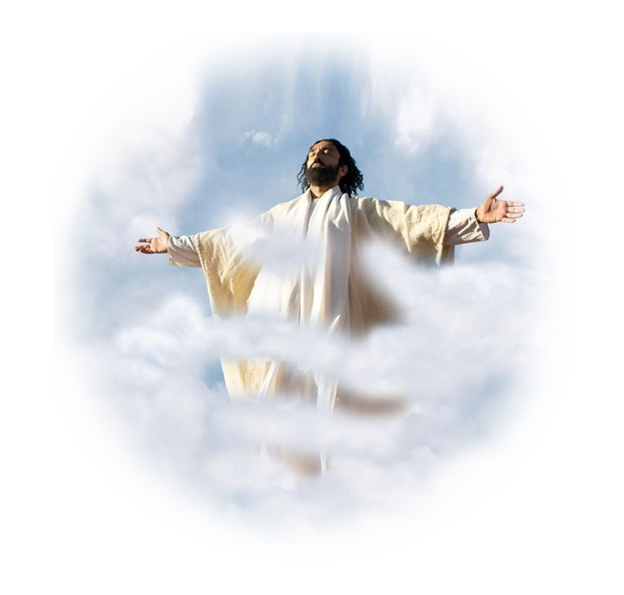
Jesus’ Explanation
2-Of Life and Resurrection
²⁶ and whoever lives and believes in me will never die.
Notes:
The Setting: Lazarus sick, Jesus delays, Lazarus dies, Jesus attends funeral, greeted by sisters …
Martha’s Assertion: “If you had been here … he would not have died.” 11:21-22
Jesus’ Consolation: “He will rise again” 11:23 (Jesus know He will raise him … )
Martha’s Assumption: She thinks He’s talking about the resurrection (not about what he is about to do) 11:24
Jesus’ Personalization: He goes along with her line of thinking “I am the resurrection and the life.”
Jesus’ Explanation:
About Death and Resurrection: “He who believes in me will live, even though he dies.” This is the answer to the question, What happens to those who die? “He who believes in me will live, even though he dies.” In fact, to be absent from the body is to be present with the Lord in spirit until reunited with the body at the resurrection. (1 Corinthian 15) Resurrection body
About Life and the Resurrection: “and whoever lives and believes in me will never die.” That is the answer to the question: “What happens if the resurrection takes place while we are still alive? Do we die to be raised? The answer Jesus gives is: “and whoever lives (when the resurrection takes place) and believes in me will never die.” (John 14:1-6 & 1 Thes 4:16-18)
Jesus’ Question: “Do you believe this?”
The Rest of the Story

Slide 19
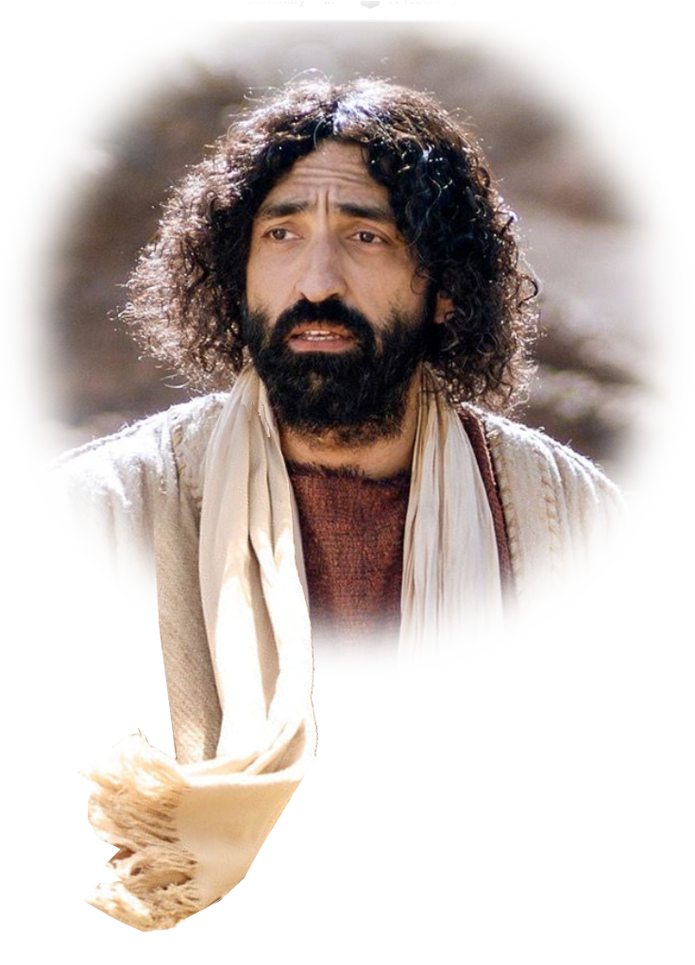

Jesus’ Question
Do you believe this?"
Notes:
The Setting: Lazarus sick, Jesus delays, Lazarus dies, Jesus attends funeral, greeted by sisters …
Martha’s Assertion: “If you had been here … he would not have died.” 11:21-22
Jesus’ Consolation: “He will rise again” 11:23 (Jesus know He will raise him … )
Martha’s Assumption: She thinks He’s talking about the resurrection (not about what he is about to do) 11:24
Jesus’ Personalization: He goes along with her line of thinking “I am the resurrection and the life.”
Jesus’ Explanation:
About Death and Resurrection: “He who believes in me will live, even though he dies.” This is the answer to the question, What happens to those who die? “He who believes in me will live, even though he dies.” In fact, to be absent from the body is to be present with the Lord in spirit until reunited with the body at the resurrection. (1 Corinthian 15) Resurrection body
About Life and the Resurrection: “and whoever lives and believes in me will never die.” That is the answer to the question: “What happens if the resurrection takes place while we are still alive? Do we die to be raised? The answer Jesus gives is: “and whoever lives (when the resurrection takes place) and believes in me will never die.” (John 14:1-6 & 1 Thes 4:16-18)
Jesus’ Question: “Do you believe this?”
The Rest of the Story

Slide 20
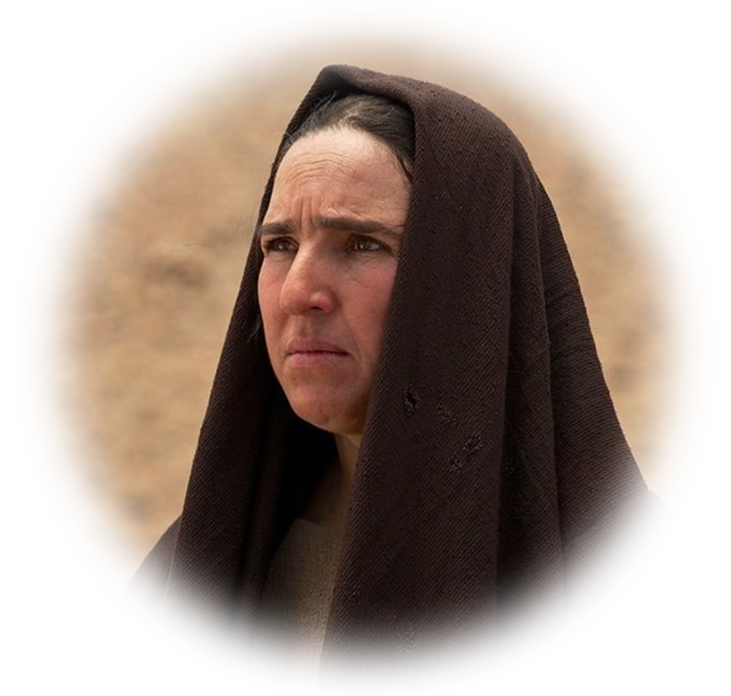
Jesus’ Question
Do you believe this?“
²⁷ "Yes, Lord," she told him,
"I believe that you are the Christ, the Son of God, who
was to come into the world."
Notes:
The Setting: Lazarus sick, Jesus delays, Lazarus dies, Jesus attends funeral, greeted by sisters …
Martha’s Assertion: “If you had been here … he would not have died.” 11:21-22
Jesus’ Consolation: “He will rise again” 11:23 (Jesus know He will raise him … )
Martha’s Assumption: She thinks He’s talking about the resurrection (not about what he is about to do) 11:24
Jesus’ Personalization: He goes along with her line of thinking “I am the resurrection and the life.”
Jesus’ Explanation:
About Death and Resurrection: “He who believes in me will live, even though he dies.” This is the answer to the question, What happens to those who die? “He who believes in me will live, even though he dies.” In fact, to be absent from the body is to be present with the Lord in spirit until reunited with the body at the resurrection. (1 Corinthian 15) Resurrection body
About Life and the Resurrection: “and whoever lives and believes in me will never die.” That is the answer to the question: “What happens if the resurrection takes place while we are still alive? Do we die to be raised? The answer Jesus gives is: “and whoever lives (when the resurrection takes place) and believes in me will never die.” (John 14:1-6 & 1 Thes 4:16-18)
Jesus’ Question: “Do you believe this?”
The Rest of the Story

Slide 21
Jesus’ Question
Do you believe this?“
²⁷ "Yes, Lord," she told him,
"I believe that you are the Christ, the Son of God, who
was to come into the world."
Notes:
The Setting: Lazarus sick, Jesus delays, Lazarus dies, Jesus attends funeral, greeted by sisters …
Martha’s Assertion: “If you had been here … he would not have died.” 11:21-22
Jesus’ Consolation: “He will rise again” 11:23 (Jesus know He will raise him … )
Martha’s Assumption: She thinks He’s talking about the resurrection (not about what he is about to do) 11:24
Jesus’ Personalization: He goes along with her line of thinking “I am the resurrection and the life.”
Jesus’ Explanation:
About Death and Resurrection: “He who believes in me will live, even though he dies.” This is the answer to the question, What happens to those who die? “He who believes in me will live, even though he dies.” In fact, to be absent from the body is to be present with the Lord in spirit until reunited with the body at the resurrection. (1 Corinthian 15) Resurrection body
About Life and the Resurrection: “and whoever lives and believes in me will never die.” That is the answer to the question: “What happens if the resurrection takes place while we are still alive? Do we die to be raised? The answer Jesus gives is: “and whoever lives (when the resurrection takes place) and believes in me will never die.” (John 14:1-6 & 1 Thes 4:16-18)
Jesus’ Question: “Do you believe this?”
The Rest of the Story

Slide 22
The Rest of the Story
“Where have you laid him?"

Slide 23
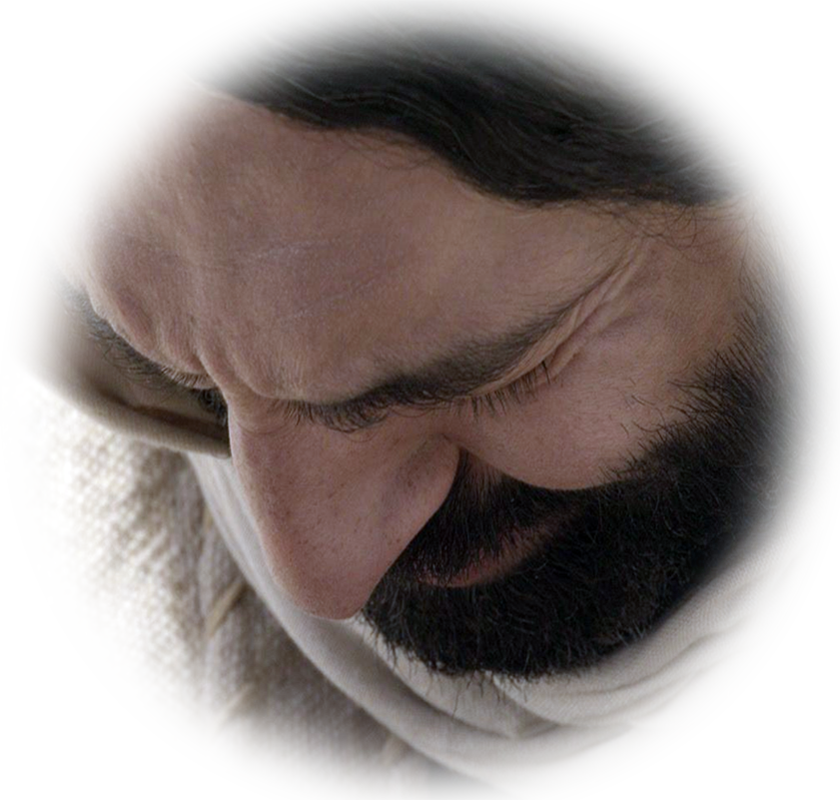
The Rest of the Story
“Where have you laid him?"
“Jesus wept.”
Notes:
³⁷ But some of them said, "Could not he who opened the eyes of the blind man have kept this man from dying?" (Joh 11:37 NIV)
Imagine the audience. He must be crying because he could not rescue Lazarus. He was not even here. He loved him but could not help him. How wrong were they. How wrong are you when you doubt the purpose of Almighty God.
He weeps because He is truly, 100% human. Grief and bereavement are real. He weeps. He is the man of sorrows acquainted with our grief.
Perhaps Jesus weeps because He is calling Lazarus back into this sin cursed world from heaven itself—for Lazarus to die again.

Slide 24
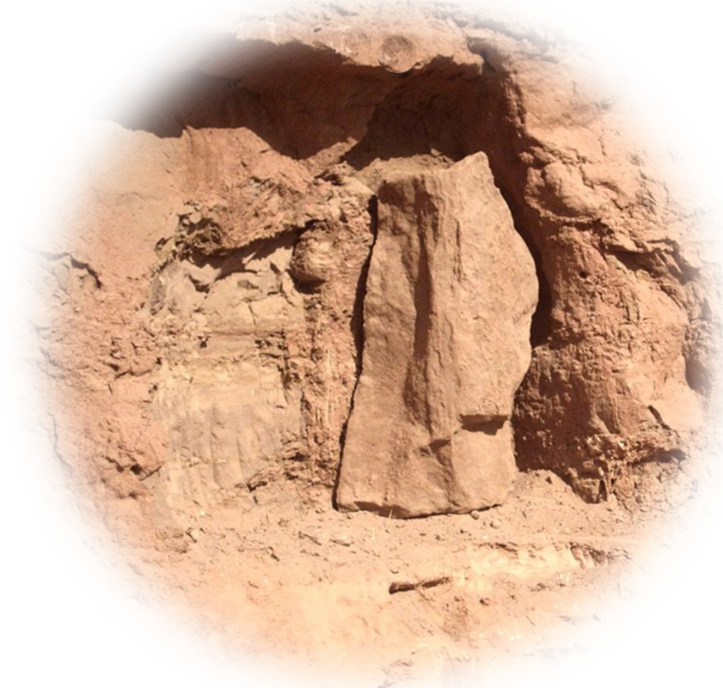
The Rest of the Story
“Where have you laid him?"
“Jesus wept.”
"Take away the stone."
Notes:
³⁹ "Take away the stone," he said. "But, Lord," said Martha, the sister of the dead man, "by this time there is a bad odor, for he has been there four days."
⁴⁰ Then Jesus said, "Did I not tell you that if you believed, you would see the glory of God?"
(Joh 11:39-40 NIV)

Slide 25
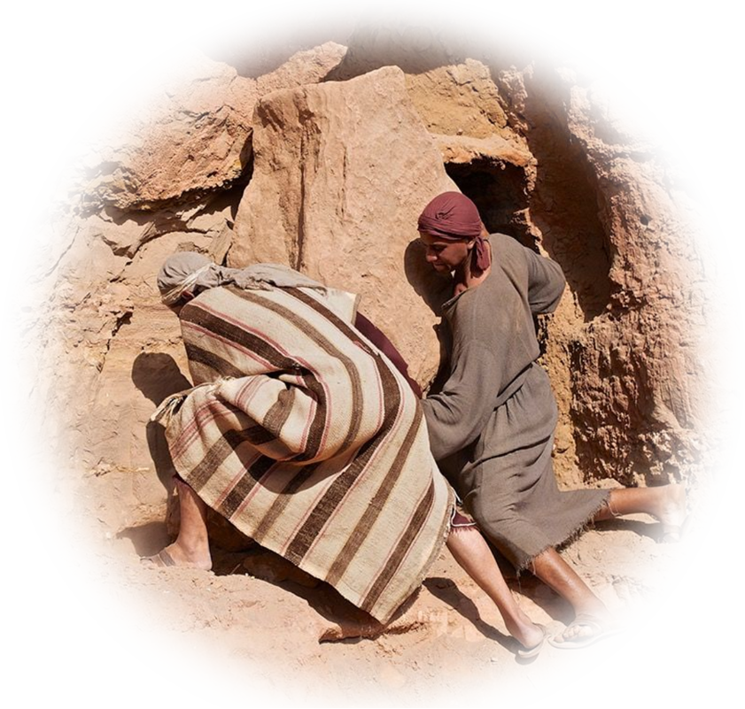
The Rest of the Story
“Where have you laid him?"
“Jesus wept.”
"Take away the stone."
So, they took away the stone.
Notes:
⁴¹ So they took away the stone.

Slide 26
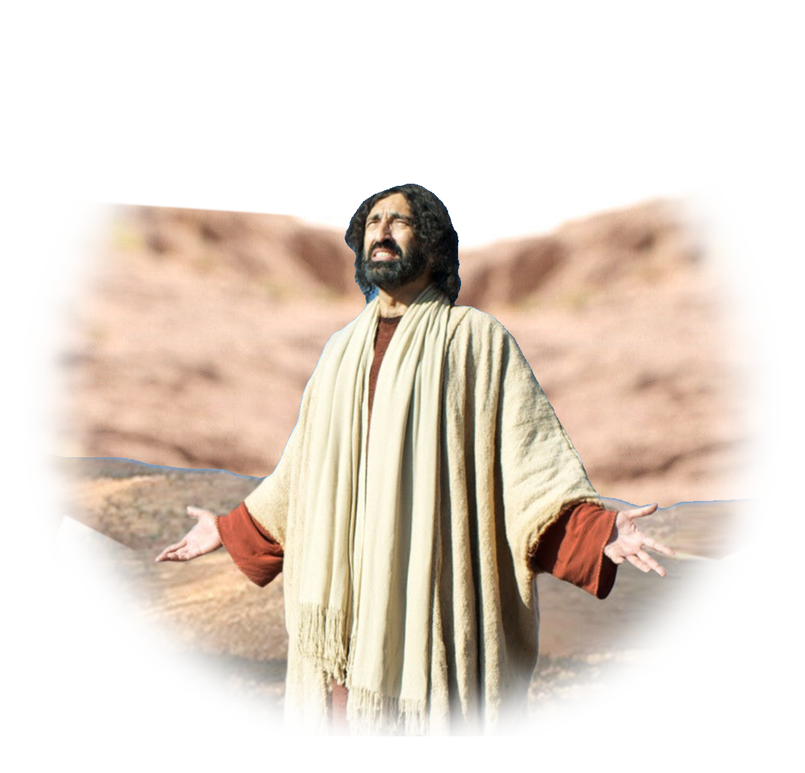
The Rest of the Story
“Where have you laid him?"
“Jesus wept.”
"Take away the stone."
So, they took away the stone.
Jesus prayed.
Notes:
Then Jesus looked up and said, "Father, I thank you that you have heard me.
⁴² I knew that you always hear me, but I said this for the benefit of the people standing here, that they may believe that you sent me."
(Joh 11:41-42 NIV)

Slide 27
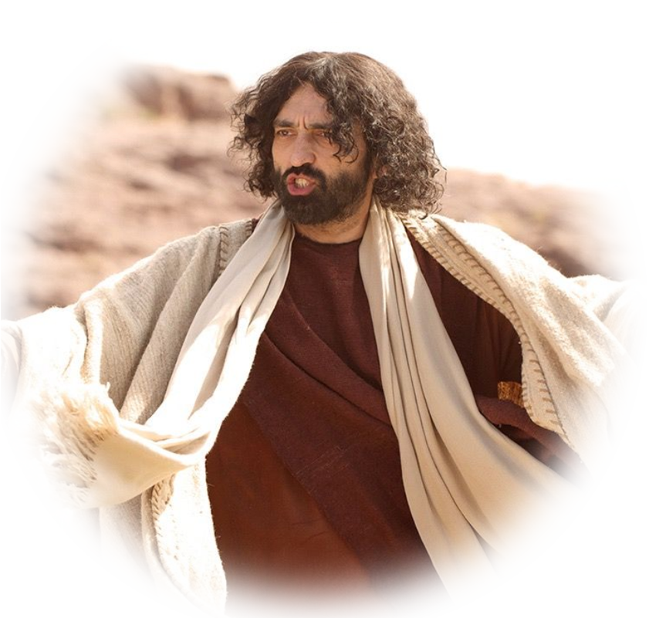
The Rest of the Story
“Where have you laid him?"
“Jesus wept.”
"Take away the stone."
So, they took away the stone.
Jesus prayed.
Jesus called, "Lazarus, come out!“
Notes:
⁴³ When he had said this, Jesus called in a loud voice, "Lazarus, come out!"

Slide 28

The Rest of the Story
“Where have you laid him?"
“Jesus wept.”
"Take away the stone."
So, they took away the stone.
Jesus prayed.
Jesus called, "Lazarus, come out!“
The dead man came out.
Notes:
⁴⁴ The dead man came out, his hands and feet wrapped with strips of linen, and a cloth around his face. Jesus said to them, "Take off the grave clothes and let him go."
(Joh 11:43-44 NIV)

Slide 29
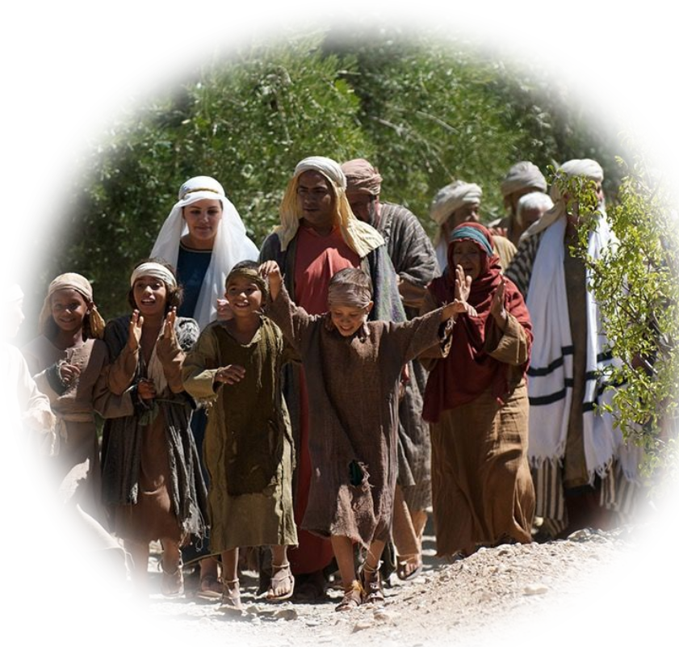
The Rest of the Story
“Where have you laid him?"
“Jesus wept.”
"Take away the stone."
So, they took away the stone.
Jesus prayed.
Jesus called, "Lazarus, come out!“
The dead man came out.
Many put their faith in him.
Notes:
⁴⁵ Therefore many of the Jews who had come to visit Mary, and had seen what Jesus did, put their faith in him.
⁴⁶ But some of them went to the Pharisees and told them what Jesus had done.
(Joh 11:45-46 NIV)

Slide 30
I have only one question:
Do you believe this?"

Slide 31
How did
Jesus See
Himself?

Slide 32
He Saw Himself as the Resurrection
"I am the resurrection and the life." (John 11:25)
Notes:
https://pixabay.com/photos/away-forest-forest-path-mood-trees-2660117/

Slide 33
Let’s
Pray!

