Slide 1


My
is in the Lord
Psalm 39:7
Notes:
Copyright © 2020. All rights reserved. Bible Point is a registered trademark of Dennis Henderson. All other trademarks acknowledged.
Bible Point contains graphics from Bible Point artists. These illustrations belong to Bible Point and the respective artists. You may use the designs and illustrations for graphical illustration of lessons free and without special permission, provided they are not used in any way that maligns the Christian faith. Furthermore, republication or production of any illustration by any other graphic service whether it be in book, in a machine-readable form, or in any other design resource is strictly prohibited. Furthermore, they cannot be duplicated or resold as any other form of publishing, clip art, or graphic resource.
So What does it mean? (A simple translations of the legal jargon)
So, if you don’t own the presentation(s), graphic(s), and text(s) how can you legally use them? The purchase of the license allows you to use all the images in the product. However, the actual ownership and copyright of the presentation(s), graphic(s), and text(s) remain the property of Bible Point and its licensors. If you had plans on using this product in your “for sale” work—think again!
License Agreement
Article 1: License Grant
All the graphics and text in Bible Point presentations (excluding quotes from the Bible and stated sources) are the intellectual and real property of Bible Point and its licensors, and is protected by law, including United States copyright laws and international treaties. Bible Point grants to you a license:
1. To use the presentation in a single church, single school, or single office of a Christian organization.
2. To make a single archival back-up copy of the program.
3. To modify the presentation(s) and merge with other presentations in a single church, school, or Christian organization.
4. To transfer to another party if that party agrees to accept the terms and conditions of this agreement, and you do not retain any copies of the presentation, whether printed, machine readable, modified, or merged form.
Article 2: Terms
This license is effective until terminated. You may terminate the license at any time by destroying the presentation(s), graphic(s), or text(s) together with all copies, modifications and merged portions in any form. Bible Point may terminate your license if you fail to comply with this Agreement. You agree, upon such termination, for any reason, to destroy the presentation(s), graphics, and text(s) with all copies, modifications, and merged portions in any form.
Article 3: Disclaimers
1. Bible Point presentations, graphics, and texts are licensed to you As Is. You, the consumer, bear the entire risk relating to the quality and performance of the presentation(s), graphic(s), or text(s). In no event will Bible Point be liable for damages resulting from any defect.
2. Thirty-day limited warrantee on disks. Bible Point warrants the disks to be free of defects in material and workmanship under normal use for 30 days after purchase. During the 30-day period you may return a defective presentation, graphic, or text with proof of purchase and it will be replaced without charge, unless the presentation is damaged by misuse.
Article 4: General
1. You may not sub-license, assign, or transfer the license of the presentation(s), graphic(s), or text(s) except as provided by this Agreement.
2. This Agreement will be governed by the laws of the State of Michigan.
So What does it mean? (A simple translations of the legal jargon)
May I let someone borrow or copy my licensed Bible Point presentation (even after I modified it)? As long as it is within your local church, or single school, or the immediate office of a Christian organization you may. Otherwise, please refer the person interested in borrowing to: http://www.biblepoint.com or E-mail: dennis@DrDH.net with any related questions.

Slide 2


My
is in the Lord
Psalm 39:7

Slide 3
Because He BLESSES ME

Slide 4

Because He BLESSES ME

Slide 5
Because He BLESSES ME
And God blessed them
(Genesis 1:22)

Slide 6
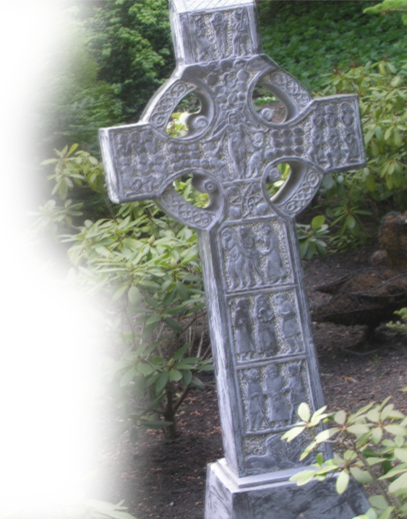
Because He BLESSES ME
Sin came into the world through one man, and death through sin, and so death spread to all men because all sinned-- (Romans 5:12)

Slide 7
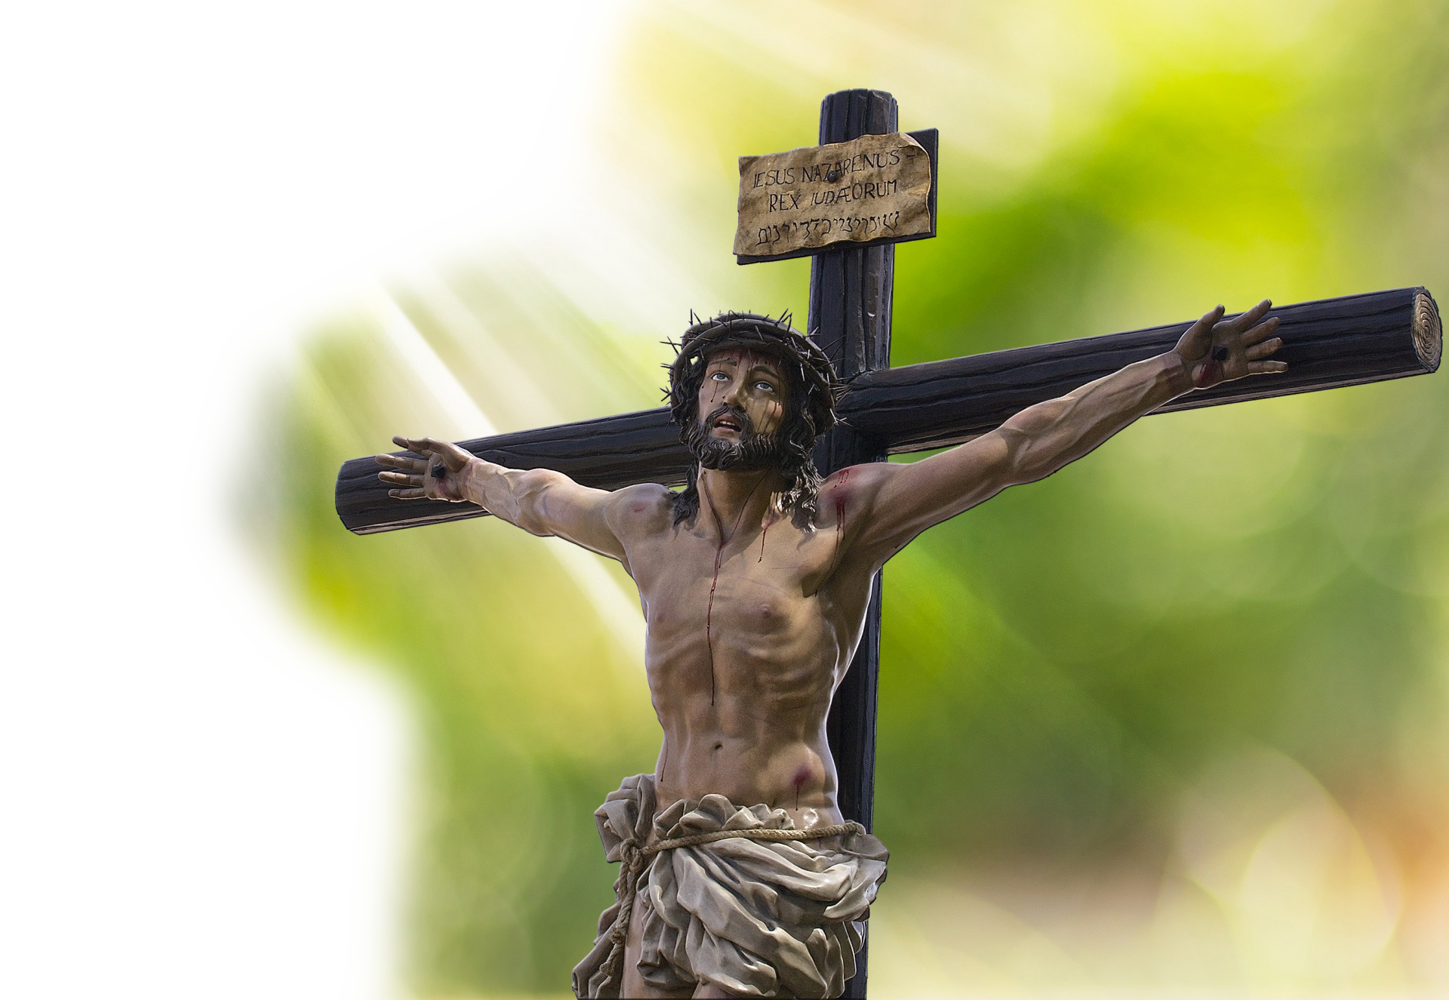
Because He BLESSES ME
I came that they may have life and have it abundantly … and I lay down my life for the sheep. (John 10:10, 15)

Slide 8
Because He BLESSES ME
Psalm 1
¹ Blessed is the man who walks not in the counsel of the wicked, nor stands in the way of sinners, nor sits in the seat of scoffers.

Slide 9
Because He BLESSES ME
Psalm 1
¹ Blessed is the man who walks not in the counsel of the wicked, nor stands in the way of sinners, nor sits in the seat of scoffers.

Slide 10
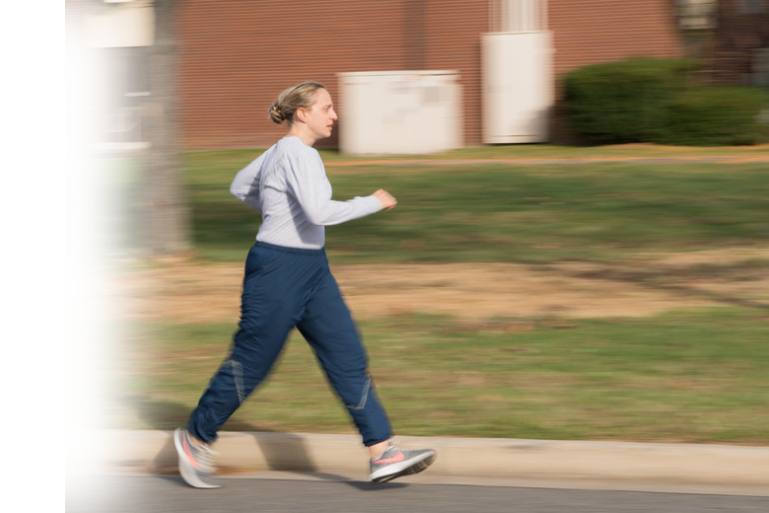
Because He BLESSES ME
Psalm 1
¹ Blessed is the man who walks not in the counsel of the wicked, nor stands in the way of sinners, nor sits in the seat of scoffers.
Notes:
https://media.defense.gov/2019/Nov/03/2002205449/780/780/0/191102-F-CQ856-2001.JPG

Slide 11
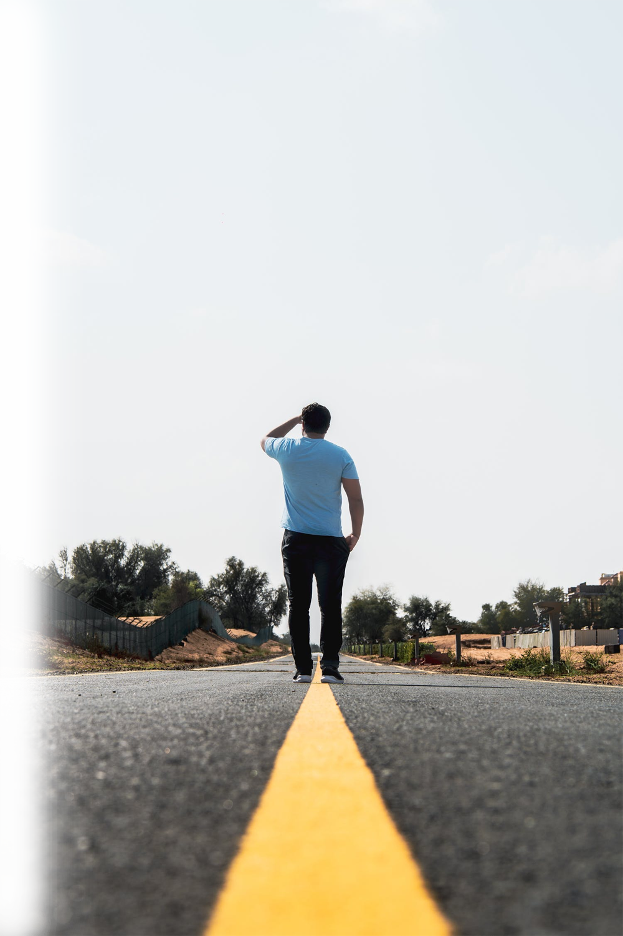
Because He BLESSES ME
Psalm 1
¹ Blessed is the man who walks not in the counsel of the wicked, nor stands in the way of sinners, nor sits in the seat of scoffers.
Notes:
https://www.pexels.com/photo/man-standing-in-the-middle-of-the-road-3399025/

Slide 12
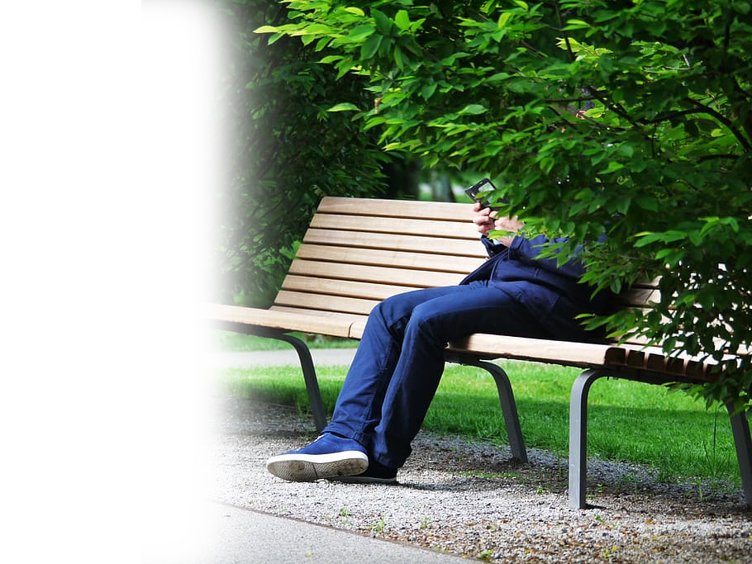
Because He BLESSES ME
Psalm 1
¹ Blessed is the man who walks not in the counsel of the wicked, nor stands in the way of sinners, nor sits in the seat of scoffers.
Notes:
https://www.wallpaperflare.com/person-wearing-blue-jeans-sitting-on-bench-smartphone-park-bench-wallpaper-zycvs

Slide 13
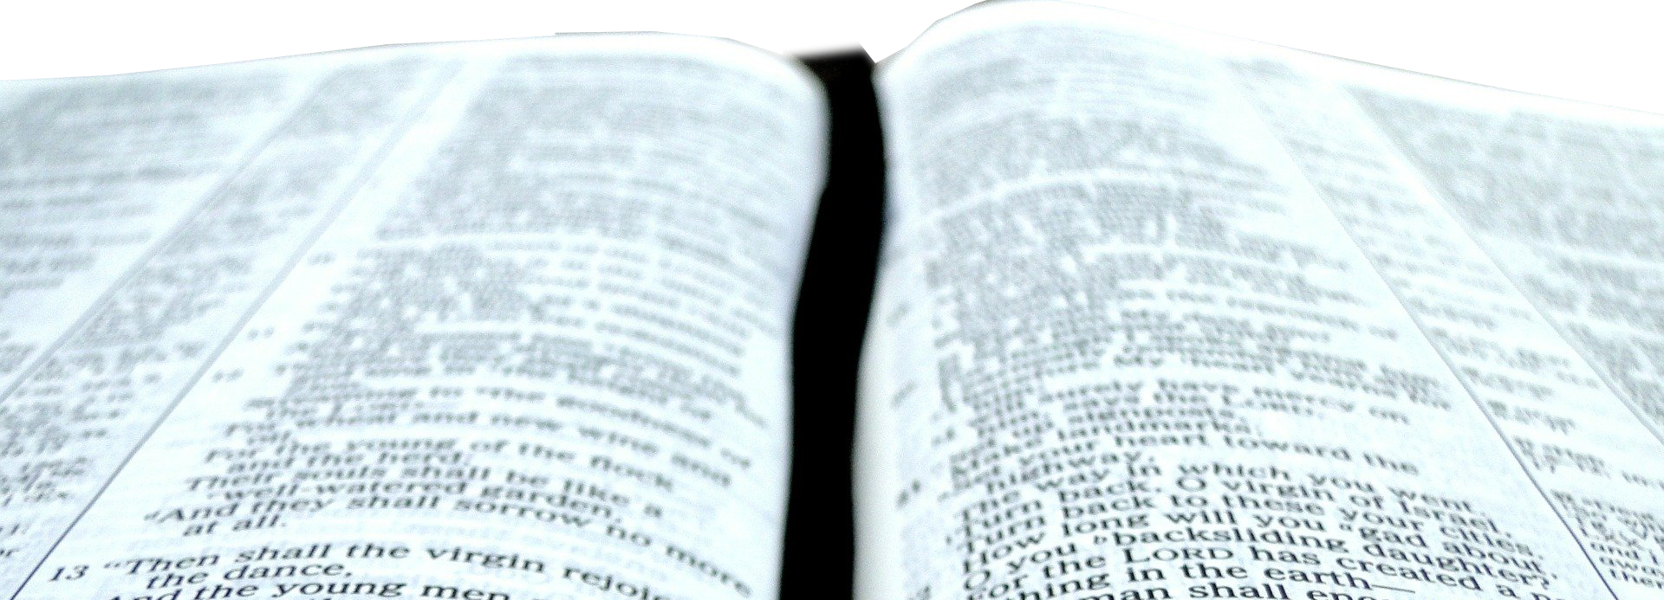
Because He BLESSES ME
² but his delight is in the law of the LORD, and
on his law he meditates day and night.

Slide 14
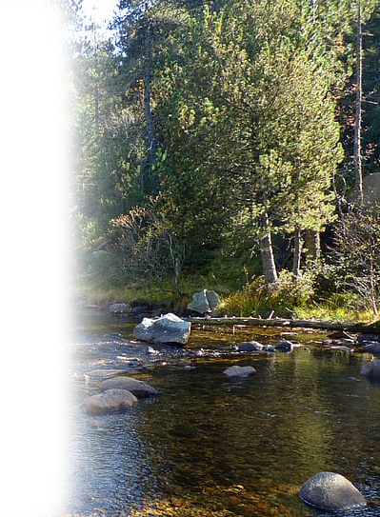
Because He BLESSES ME
³ He is like a tree planted by streams of water that yields its fruit in its season,
Notes:
https://p1.pxfuel.com/preview/365/566/528/river-mountain-water-nature-water-courses-water-s-edge.jpg

Slide 15
Because He BLESSES ME
³ He is like a tree planted by streams of water that yields its fruit in its season,

Slide 16
Because He BLESSES ME
³ He is like a tree planted by streams of water that yields its His fruit in its His season,

Slide 17
Because He BLESSES ME
³ He is like a tree planted by streams of water that yields its His fruit in its His season, and its leaf does not wither. In all that he does, he prospers.

Slide 18
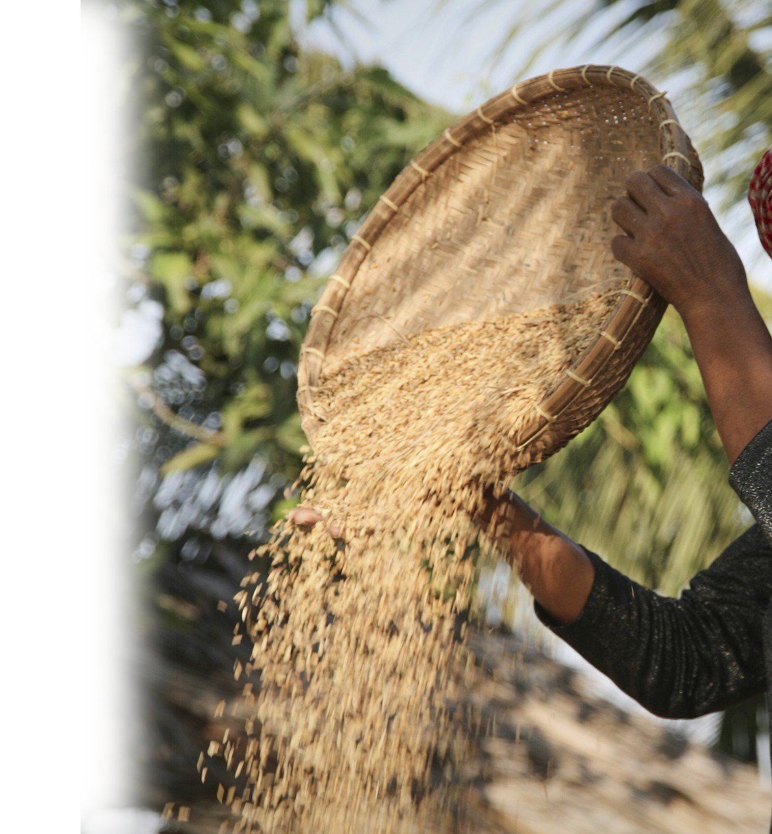
Because He BLESSES ME
⁴ The wicked are not so, but are like chaff that the wind drives away.

Slide 19

Because He BLESSES ME
⁵ Therefore the wicked will not stand in the judgment, nor sinners in the congregation of the righteous;

Slide 20

Because He BLESSES ME
⁶ for the LORD knows the way of the righteous, but the way of the wicked will perish.
RIGHTEOUS

Slide 21
Because He BLESSES ME
⁶ for the LORD knows the way of the righteous, but the way of the wicked will perish.
WICKED
RIGHTEOUS

Slide 22
Because He BLESSES ME
⁶ for the LORD knows the way of the righteous, but the way of the wicked will perish.
WICKED
PERISH
RIGHTEOUS

Slide 23
Because He BLESSES ME
⁶ for the LORD knows the way of the righteous, but the way of the wicked will perish.
WICKED
PERISH
RIGHTEOUS
FLOURISH

Slide 24
Because He BLESSES ME
Blessed is the man
(Psalm 1:1)

Slide 25
My
is in the Lord
Psalm 39:7

Slide 26
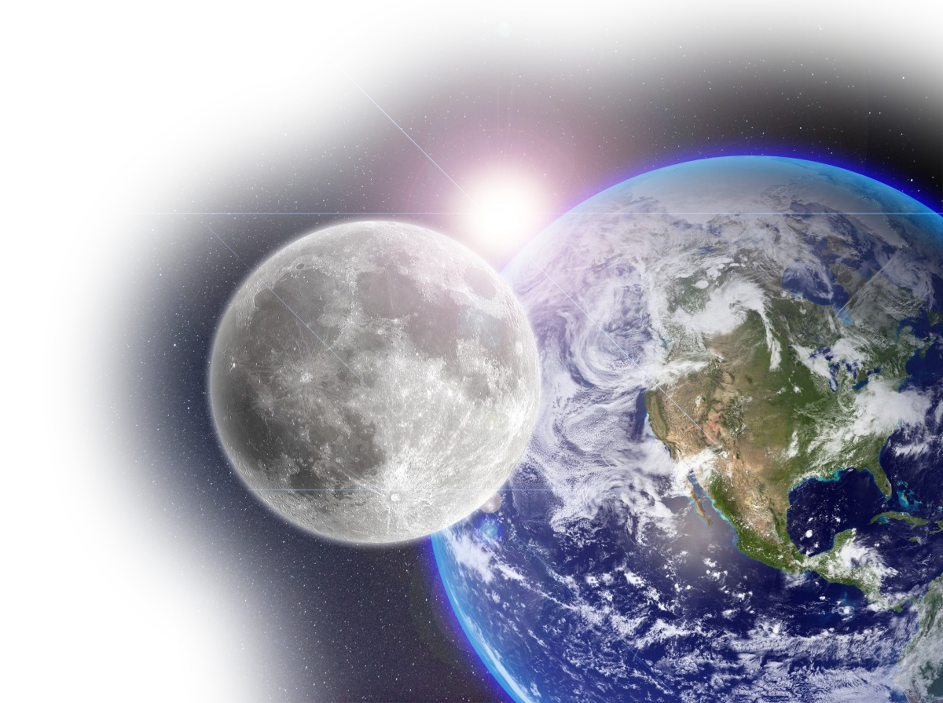
Because He BLESSES ME

Slide 27
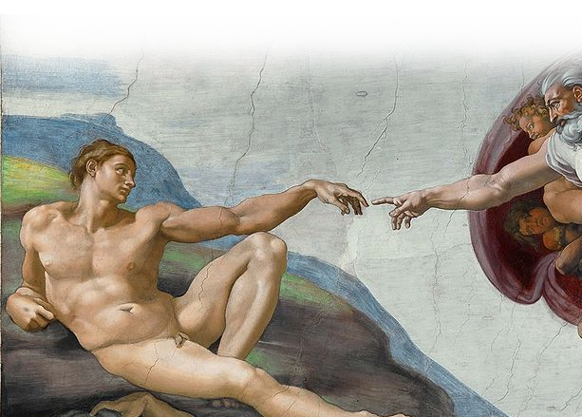
Because He BLESSES ME

Slide 28
Because He BLESSES ME
Blessed is the man
(Psalm 1:1)

