Slide 1


My
is in the Lord
Psalm 39:7
Notes:
Copyright © 2020. All rights reserved. Bible Point is a registered trademark of Dennis Henderson. All other trademarks acknowledged.
Bible Point contains graphics from Bible Point artists. These illustrations belong to Bible Point and the respective artists. You may use the designs and illustrations for graphical illustration of lessons free and without special permission, provided they are not used in any way that maligns the Christian faith. Furthermore, republication or production of any illustration by any other graphic service whether it be in book, in a machine-readable form, or in any other design resource is strictly prohibited. Furthermore, they cannot be duplicated or resold as any other form of publishing, clip art, or graphic resource.
So What does it mean? (A simple translations of the legal jargon)
So, if you don’t own the presentation(s), graphic(s), and text(s) how can you legally use them? The purchase of the license allows you to use all the images in the product. However, the actual ownership and copyright of the presentation(s), graphic(s), and text(s) remain the property of Bible Point and its licensors. If you had plans on using this product in your “for sale” work—think again!
License Agreement
Article 1: License Grant
All the graphics and text in Bible Point presentations (excluding quotes from the Bible and stated sources) are the intellectual and real property of Bible Point and its licensors, and is protected by law, including United States copyright laws and international treaties. Bible Point grants to you a license:
1. To use the presentation in a single church, single school, or single office of a Christian organization.
2. To make a single archival back-up copy of the program.
3. To modify the presentation(s) and merge with other presentations in a single church, school, or Christian organization.
4. To transfer to another party if that party agrees to accept the terms and conditions of this agreement, and you do not retain any copies of the presentation, whether printed, machine readable, modified, or merged form.
Article 2: Terms
This license is effective until terminated. You may terminate the license at any time by destroying the presentation(s), graphic(s), or text(s) together with all copies, modifications and merged portions in any form. Bible Point may terminate your license if you fail to comply with this Agreement. You agree, upon such termination, for any reason, to destroy the presentation(s), graphics, and text(s) with all copies, modifications, and merged portions in any form.
Article 3: Disclaimers
1. Bible Point presentations, graphics, and texts are licensed to you As Is. You, the consumer, bear the entire risk relating to the quality and performance of the presentation(s), graphic(s), or text(s). In no event will Bible Point be liable for damages resulting from any defect.
2. Thirty-day limited warrantee on disks. Bible Point warrants the disks to be free of defects in material and workmanship under normal use for 30 days after purchase. During the 30-day period you may return a defective presentation, graphic, or text with proof of purchase and it will be replaced without charge, unless the presentation is damaged by misuse.
Article 4: General
1. You may not sub-license, assign, or transfer the license of the presentation(s), graphic(s), or text(s) except as provided by this Agreement.
2. This Agreement will be governed by the laws of the State of Michigan.
So What does it mean? (A simple translations of the legal jargon)
May I let someone borrow or copy my licensed Bible Point presentation (even after I modified it)? As long as it is within your local church, or single school, or the immediate office of a Christian organization you may. Otherwise, please refer the person interested in borrowing to: http://www.biblepoint.com or E-mail: dennis@DrDH.net with any related questions.

Slide 2


My
is in the Lord
Psalm 39:7

Slide 3
Because He is JEHOVAH TSIDKENU
“The Lord Is Our Righteousness”
Jeremiah 23:6

Slide 4
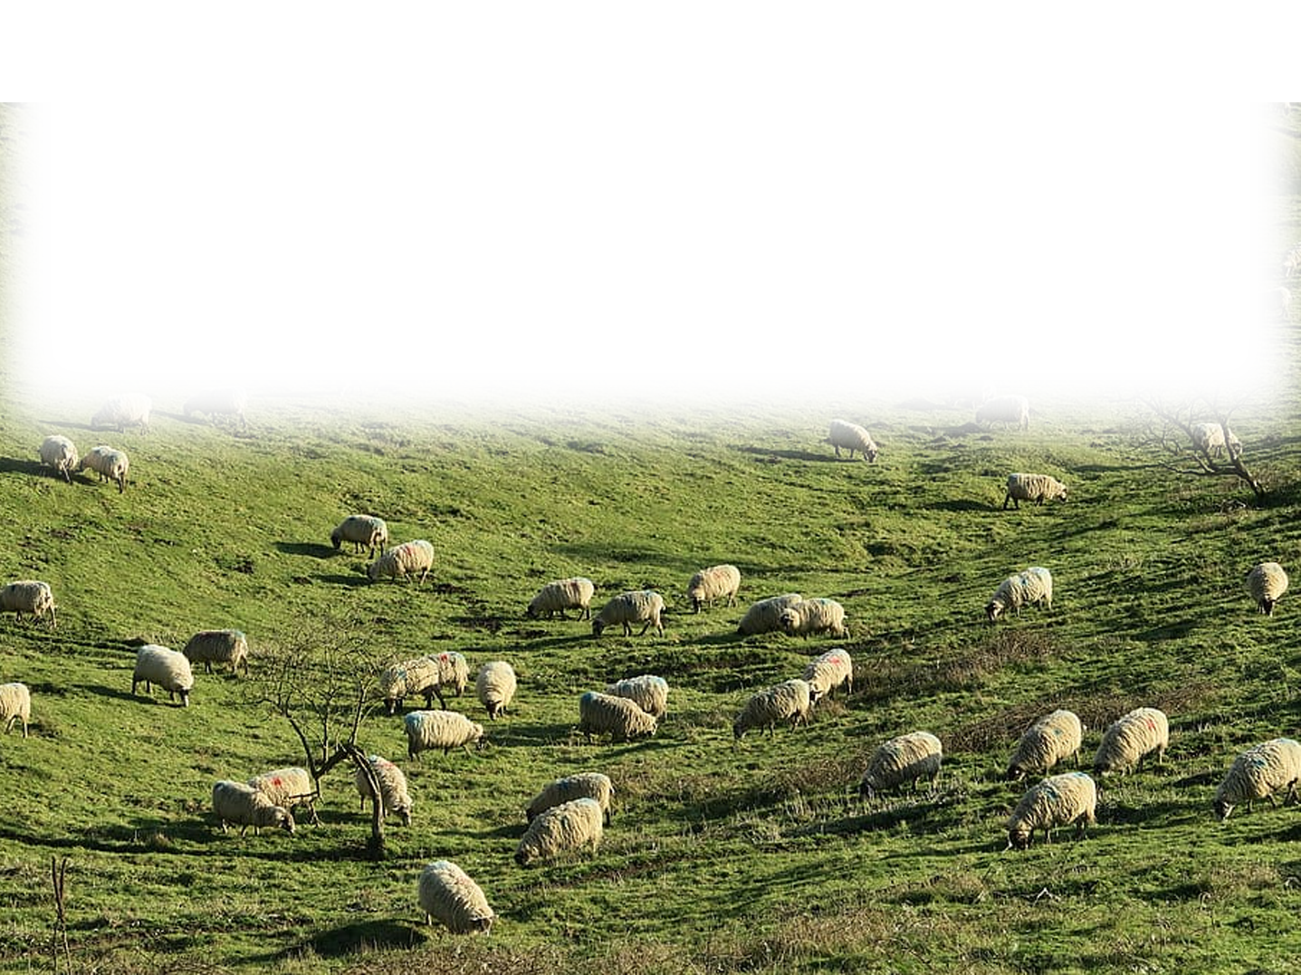
Because He is JEHOVAH TSIDKENU
“destroy or scatter”
Notes:
https://c0.wallpaperflare.com/preview/273/658/494/sheeps-scattered-on-green-grass-field.jpg

Slide 5
Because He is JEHOVAH TSIDKENU
“evil deeds”
Notes:
https://c0.wallpaperflare.com/preview/273/658/494/sheeps-scattered-on-green-grass-field.jpg

Slide 6
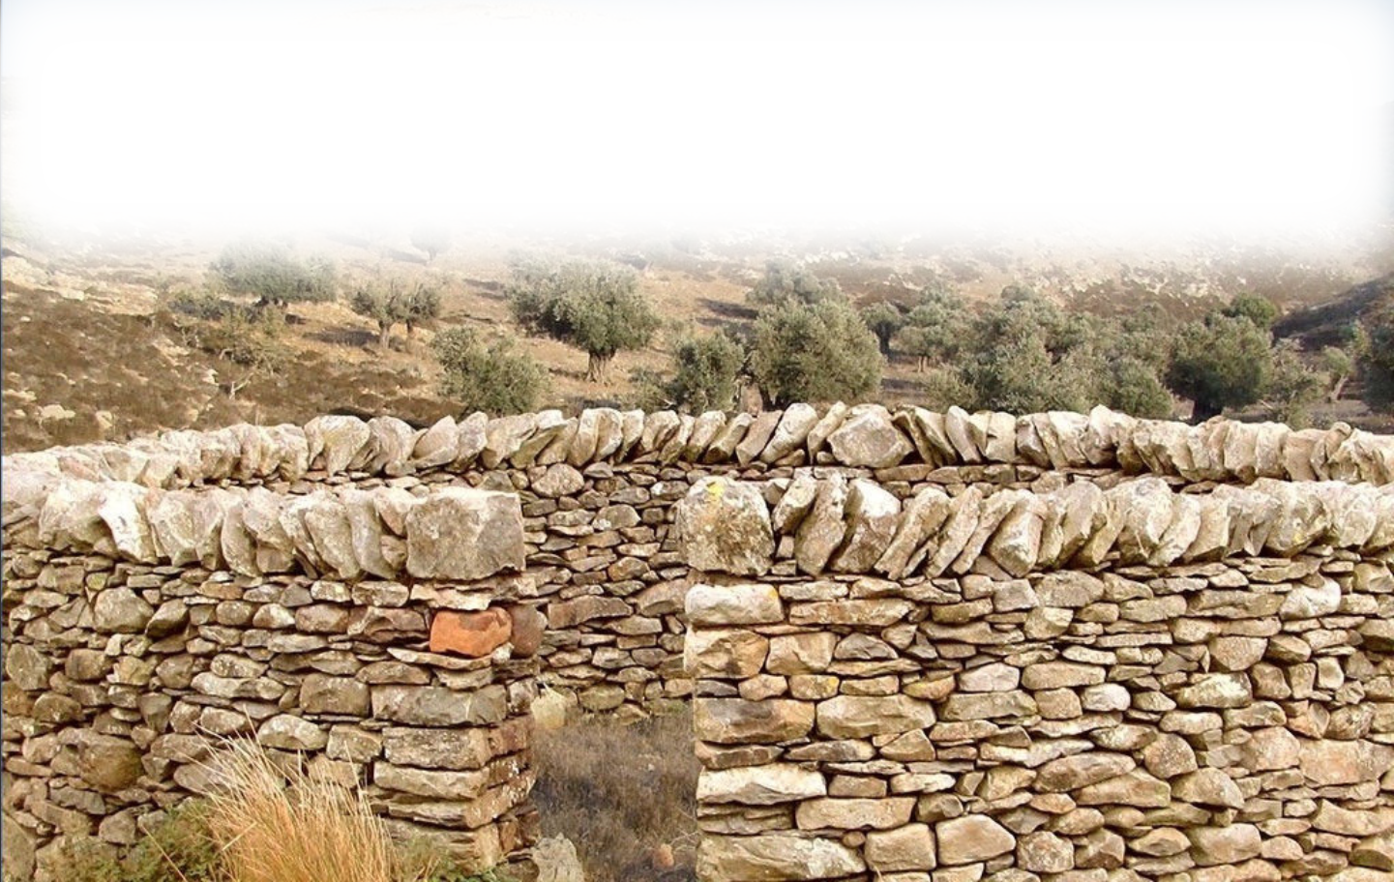
Because He is JEHOVAH TSIDKENU
“gather the remnant of my flock”

Slide 7
Because He is JEHOVAH TSIDKENU
“gather the remnant of my flock”
“bring them back to their fold”

Slide 8
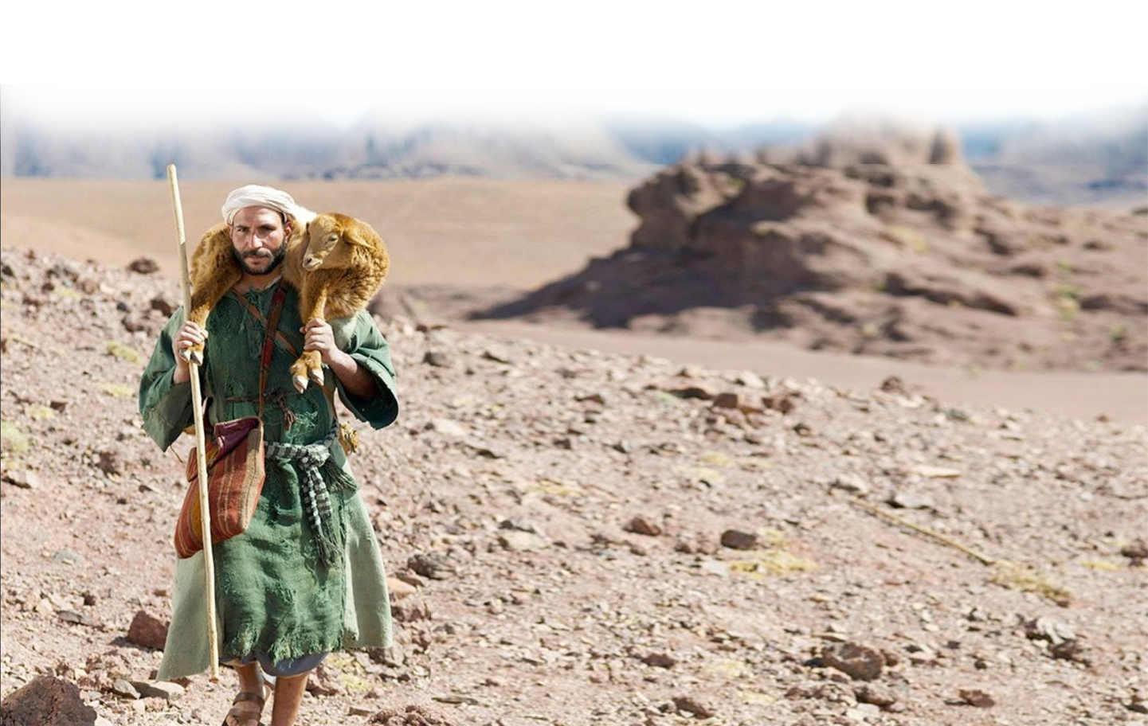
Because He is JEHOVAH TSIDKENU
“ … will set up shepherds over them who will care for them.”

Slide 9
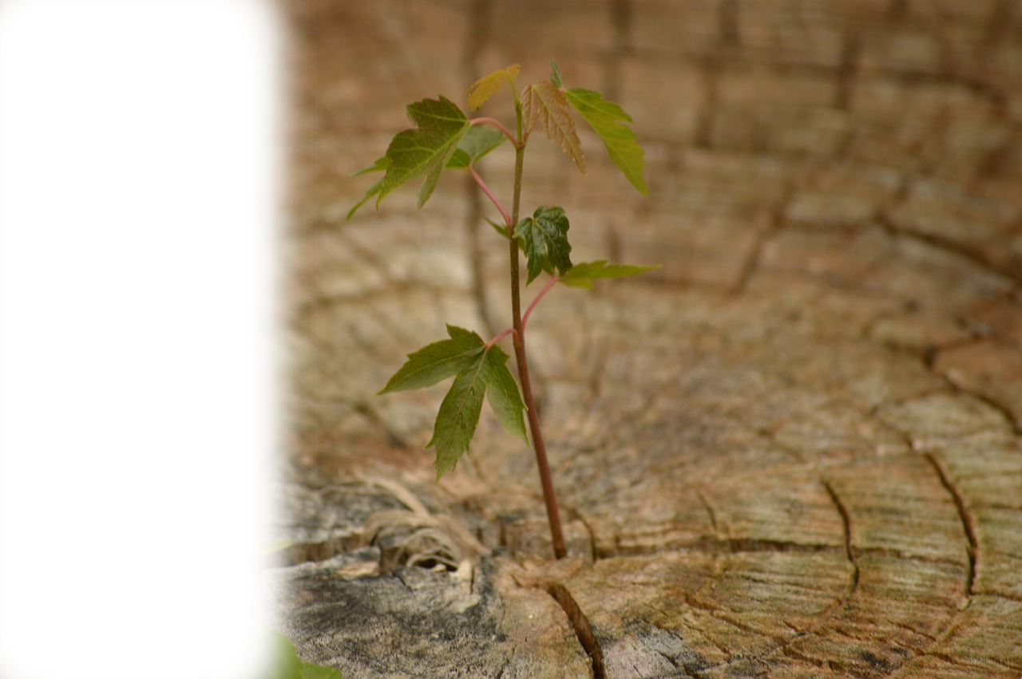
Because He is JEHOVAH TSIDKENU
“Behold, the days are coming … when I will raise up for David a righteous Branch,
Notes:
https://storage.needpix.com/rsynced_images/growth-615750_1280.jpg

Slide 10
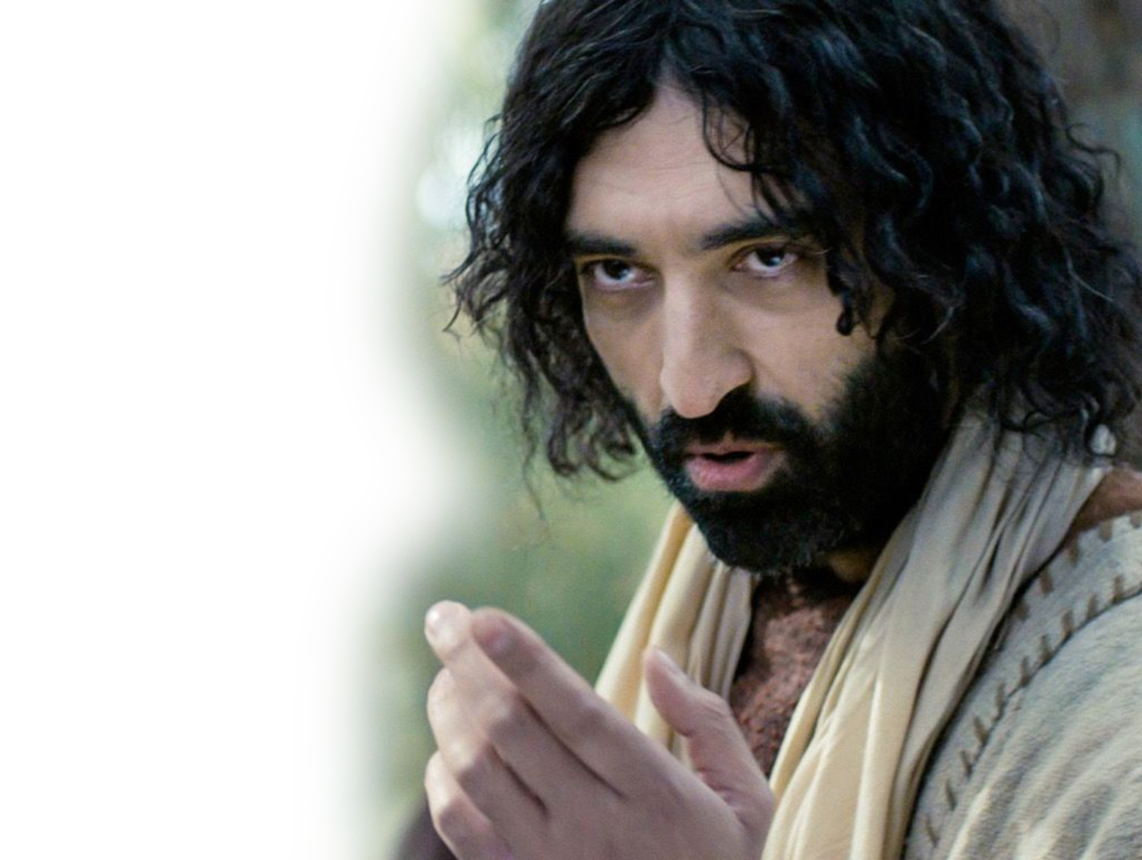
Because He is JEHOVAH TSIDKENU
“Behold, the days are coming … when I will raise up for David a righteous Branch, and he shall reign as king and deal wisely,
Notes:
https://storage.needpix.com/rsynced_images/growth-615750_1280.jpg

Slide 11
Because He is JEHOVAH TSIDKENU
“Behold, the days are coming … when I will raise up for David a righteous Branch, and he shall reign as king and deal wisely, and shall execute justice and righteousness in the land.
Notes:
https://storage.needpix.com/rsynced_images/growth-615750_1280.jpg

Slide 12
Because He is JEHOVAH TSIDKENU
⁶ In his days Judah will be saved
Notes:
https://storage.needpix.com/rsynced_images/growth-615750_1280.jpg

Slide 13
Because He is JEHOVAH TSIDKENU
⁶ In his days Judah will be saved,
and Israel will dwell securely.
Notes:
https://storage.needpix.com/rsynced_images/growth-615750_1280.jpg

Slide 14
Because He is JEHOVAH TSIDKENU
⁶ In his days Judah will be saved,
and Israel will dwell securely.
And this is the name by which he will be called:
Notes:
https://storage.needpix.com/rsynced_images/growth-615750_1280.jpg

Slide 15
Because He is JEHOVAH TSIDKENU
⁶ In his days Judah will be saved,
and Israel will dwell securely.
And this is the name by which he will be called: 'The LORD is our righteousness.'”
Notes:
https://storage.needpix.com/rsynced_images/growth-615750_1280.jpg

Slide 16

Because He is JEHOVAH TSIDKENU
For our sake he (God) made him (Jesus) to be sin who knew no sin, so that in him we might become the righteousness of God. ^{2Corinthians 5:21}

Slide 17
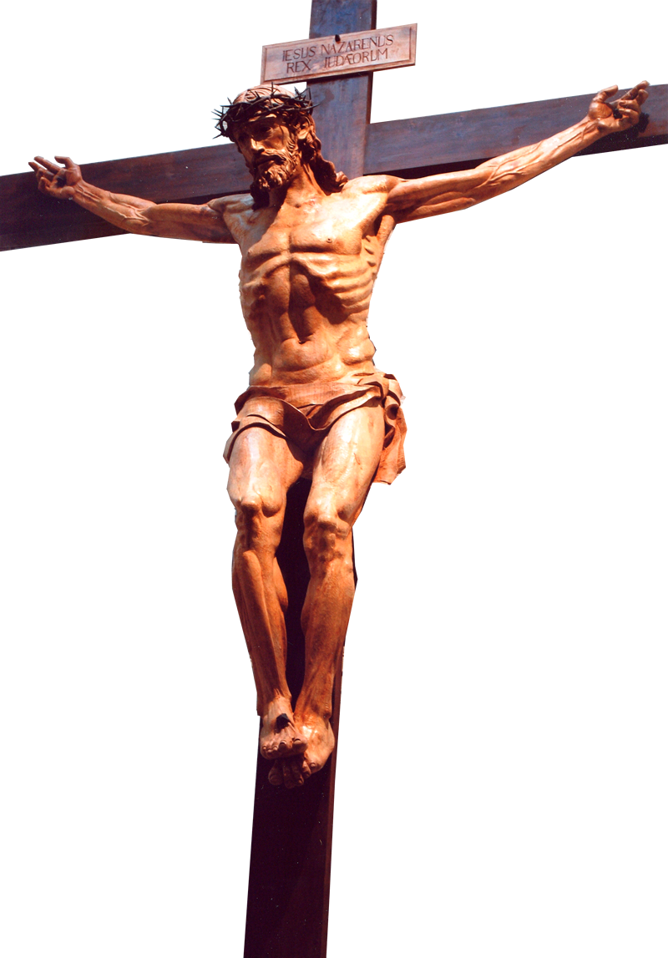
Because He is JEHOVAH TSIDKENU
For our sake he (God) made him (Jesus) to be sin who knew no sin, so that in him we might become the righteousness of God. ^{2Corinthians 5:21}

Slide 18
Because He is JEHOVAH TSIDKENU
For our sake he (God) made him (Jesus) to be sin who knew no sin, so that in him we might become the righteousness of God. ^{2Corinthians 5:21}
SIN

Slide 19
Because He is JEHOVAH TSIDKENU
For our sake he (God) made him (Jesus) to be sin who knew no sin, so that in him we might become the righteousness of God. ^{2Corinthians 5:21}
SIN
RIGHTEOUSNESS

Slide 20
Because He is JEHOVAH TSIDKENU
“The Lord Is Our Righteousness”
Jeremiah 23:6
Notes:
https://storage.needpix.com/rsynced_images/growth-615750_1280.jpg

Slide 21
My
is in the Lord
Psalm 39:7

