Slide 1


My
is in the Lord
Psalm 39:7
Notes:
Copyright © 2020. All rights reserved. Bible Point is a registered trademark of Dennis Henderson. All other trademarks acknowledged.
Bible Point contains graphics from Bible Point artists. These illustrations belong to Bible Point and the respective artists. You may use the designs and illustrations for graphical illustration of lessons free and without special permission, provided they are not used in any way that maligns the Christian faith. Furthermore, republication or production of any illustration by any other graphic service whether it be in book, in a machine-readable form, or in any other design resource is strictly prohibited. Furthermore, they cannot be duplicated or resold as any other form of publishing, clip art, or graphic resource.
So What does it mean? (A simple translations of the legal jargon)
So, if you don’t own the presentation(s), graphic(s), and text(s) how can you legally use them? The purchase of the license allows you to use all the images in the product. However, the actual ownership and copyright of the presentation(s), graphic(s), and text(s) remain the property of Bible Point and its licensors. If you had plans on using this product in your “for sale” work—think again!
License Agreement
Article 1: License Grant
All the graphics and text in Bible Point presentations (excluding quotes from the Bible and stated sources) are the intellectual and real property of Bible Point and its licensors, and is protected by law, including United States copyright laws and international treaties. Bible Point grants to you a license:
1. To use the presentation in a single church, single school, or single office of a Christian organization.
2. To make a single archival back-up copy of the program.
3. To modify the presentation(s) and merge with other presentations in a single church, school, or Christian organization.
4. To transfer to another party if that party agrees to accept the terms and conditions of this agreement, and you do not retain any copies of the presentation, whether printed, machine readable, modified, or merged form.
Article 2: Terms
This license is effective until terminated. You may terminate the license at any time by destroying the presentation(s), graphic(s), or text(s) together with all copies, modifications and merged portions in any form. Bible Point may terminate your license if you fail to comply with this Agreement. You agree, upon such termination, for any reason, to destroy the presentation(s), graphics, and text(s) with all copies, modifications, and merged portions in any form.
Article 3: Disclaimers
1. Bible Point presentations, graphics, and texts are licensed to you As Is. You, the consumer, bear the entire risk relating to the quality and performance of the presentation(s), graphic(s), or text(s). In no event will Bible Point be liable for damages resulting from any defect.
2. Thirty-day limited warrantee on disks. Bible Point warrants the disks to be free of defects in material and workmanship under normal use for 30 days after purchase. During the 30-day period you may return a defective presentation, graphic, or text with proof of purchase and it will be replaced without charge, unless the presentation is damaged by misuse.
Article 4: General
1. You may not sub-license, assign, or transfer the license of the presentation(s), graphic(s), or text(s) except as provided by this Agreement.
2. This Agreement will be governed by the laws of the State of Michigan.
So What does it mean? (A simple translations of the legal jargon)
May I let someone borrow or copy my licensed Bible Point presentation (even after I modified it)? As long as it is within your local church, or single school, or the immediate office of a Christian organization you may. Otherwise, please refer the person interested in borrowing to: http://www.biblepoint.com or E-mail: dennis@DrDH.net with any related questions.

Slide 2
My
is in the Lord
Psalm 39:7

Slide 3
Because He is MERCIFUL
“The LORD is merciful and gracious, slow to anger and abounding in steadfast love.” Psalm 103:8

Slide 4

Because He is MERCIFUL
“The LORD is merciful and gracious, slow to anger and abounding in steadfast love.” Psalm 103:8
Notes:
https://upload.wikimedia.org/wikipedia/commons/e/e2/Push_Hands-close_up.jpg

Slide 5
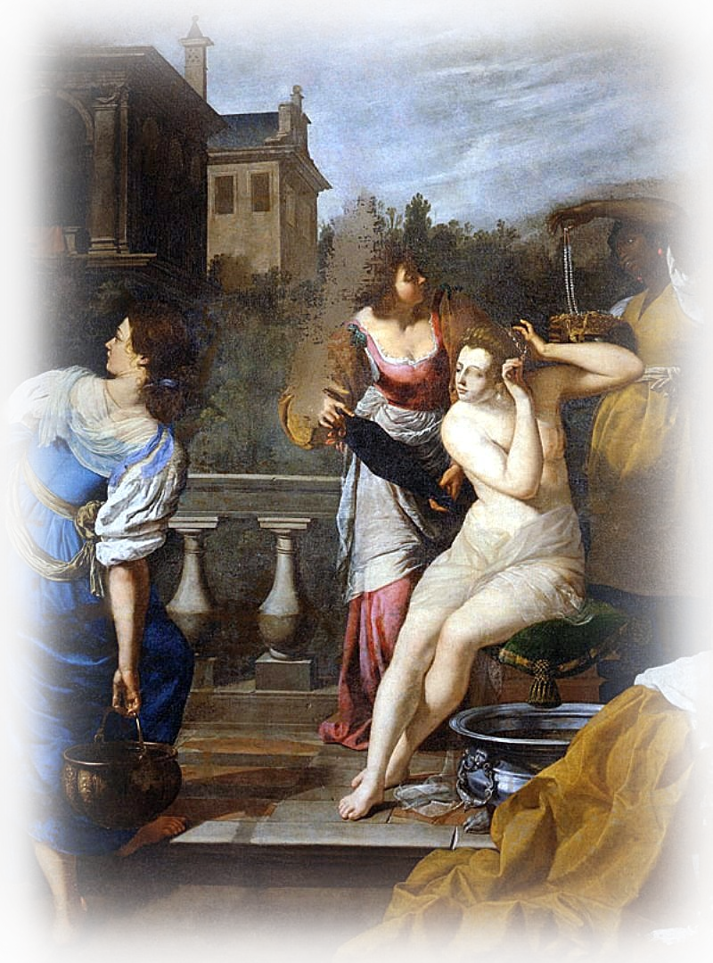
Because He is MERCIFUL
“Have mercy on me, O God,
according to your steadfast love;
according to your abundant mercy
blot out my transgressions.”
Psalm 51:1
Notes:
https://upload.wikimedia.org/wikipedia/commons/b/bb/Gentileschi_palatina_betsabe.jpg

Slide 6
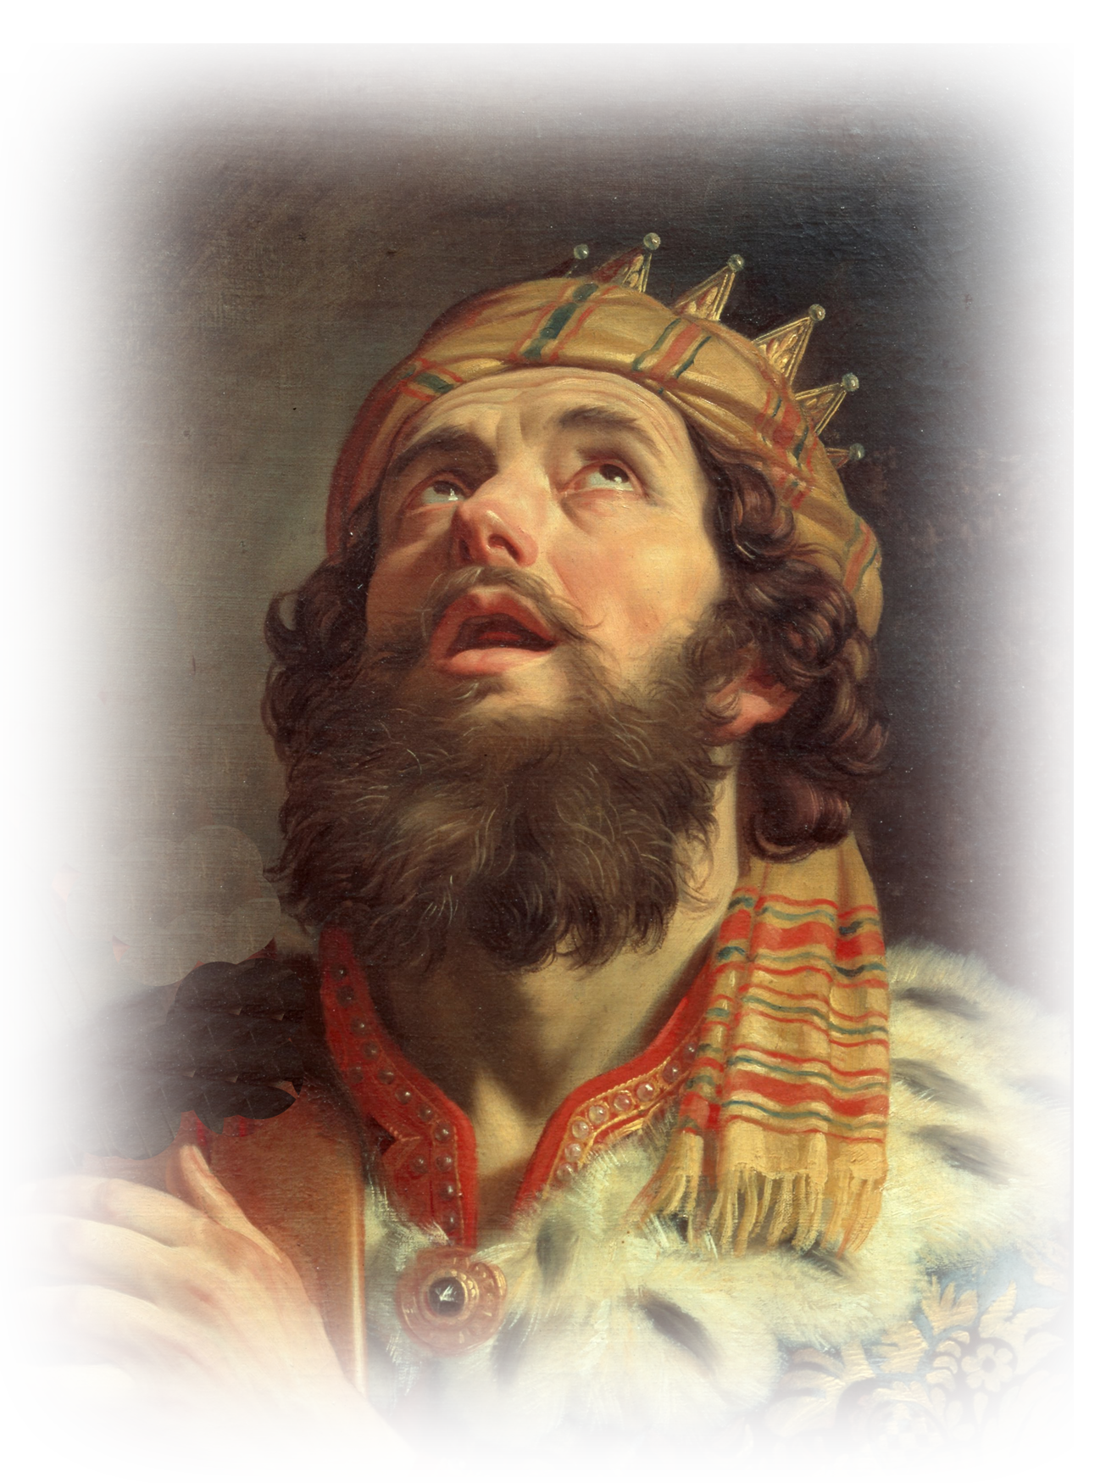
Because He is MERCIFUL
“Have mercy on me, O God,
according to your steadfast love;
according to your abundant mercy
blot out my transgressions.”
Psalm 51:1
Notes:
https://upload.wikimedia.org/wikipedia/commons/b/b6/Gerard_van_Honthorst_-_King_David_Playing_the_Harp_-_Google_Art_Project.jpg

Slide 7
Because He is MERCIFUL
“Have mercy on me, O God,
according to your steadfast love;
according to your abundant mercy
blot out my transgressions.”
Psalm 51:1
“Have mercy.”

Slide 8
Because He is MERCIFUL
“Have mercy on me, O God,
according to your steadfast love;
according to your abundant mercy
blot out my transgressions.”
Psalm 51:1
“Have mercy.”
“All have sinned” Romans 3:23

Slide 9
Because He is MERCIFUL
He saved us, not because of righteous things we had done, but because of his mercy. Titus 3:5
WRATH
Notes:
https://upload.wikimedia.org/wikipedia/commons/e/e2/Push_Hands-close_up.jpg

Slide 10
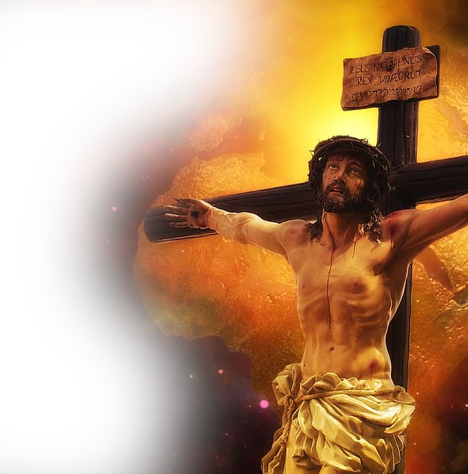
Because He is MERCIFUL
He saved us, not because of righteous things we had done, but because of his mercy. Titus 3:5
WRATH

Slide 11
Because He is MERCIFUL
^{Luke 18:10} "Two men went up into the temple to pray, one a Pharisee and the other a tax collector.

Slide 12
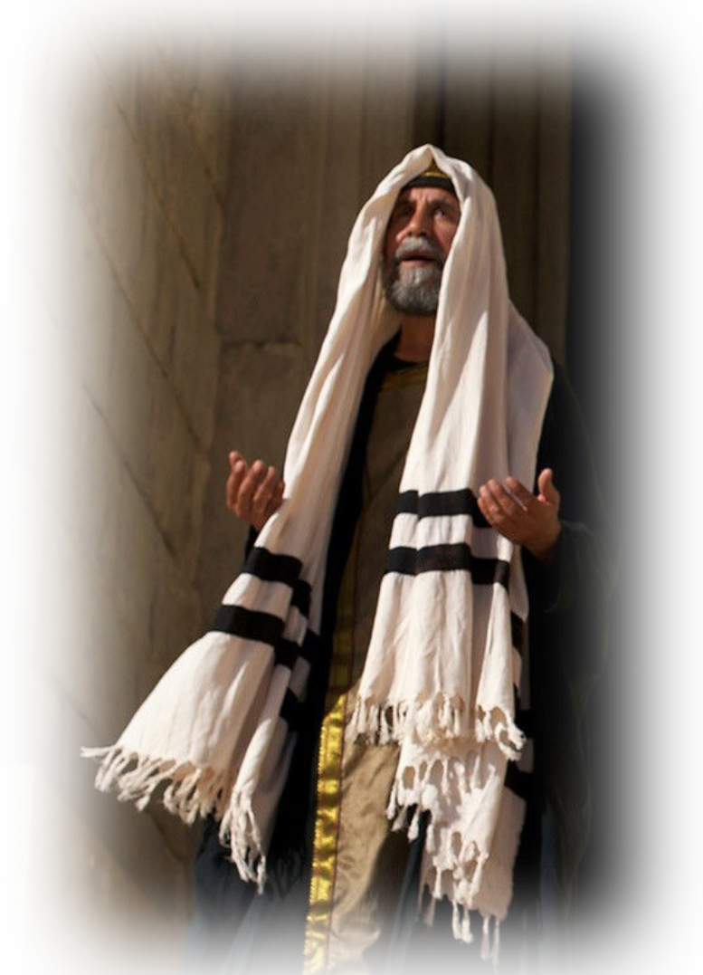
Because He is MERCIFUL
¹¹ The Pharisee, standing by himself, prayed thus: 'God, I thank you that I am not like other men, extortioners, unjust, adulterers, or even like this tax collector. ¹² I fast twice a week; I give tithes of all that I get.’

Slide 13
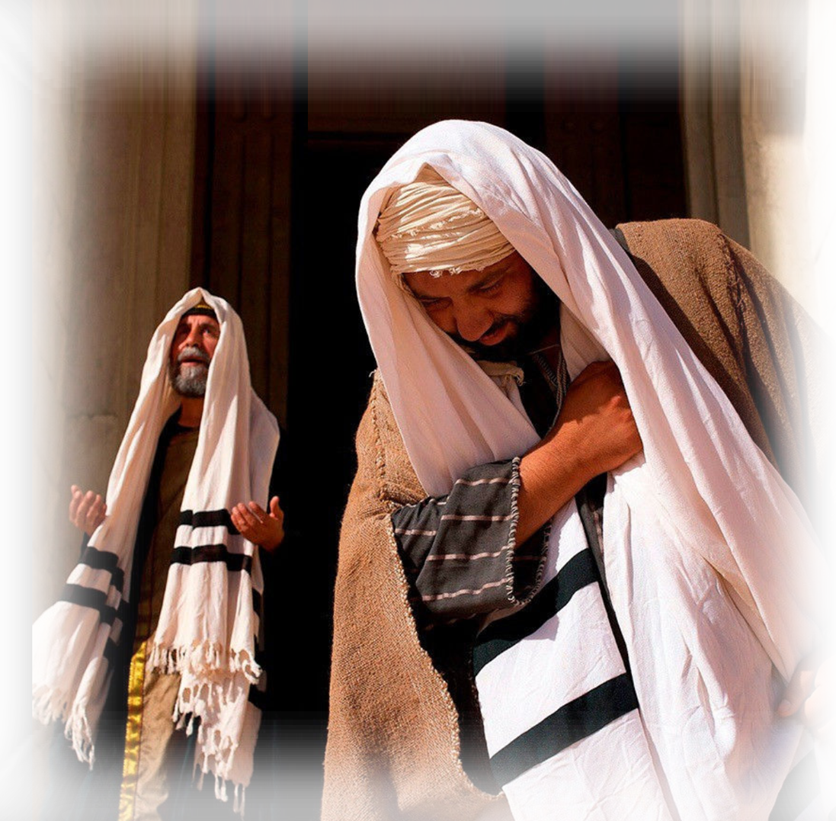
Because He is MERCIFUL
¹³ But the tax collector, standing far off, would not even lift up his eyes to heaven, but beat his breast, saying, 'God, be merciful to me, a sinner!'

Slide 14
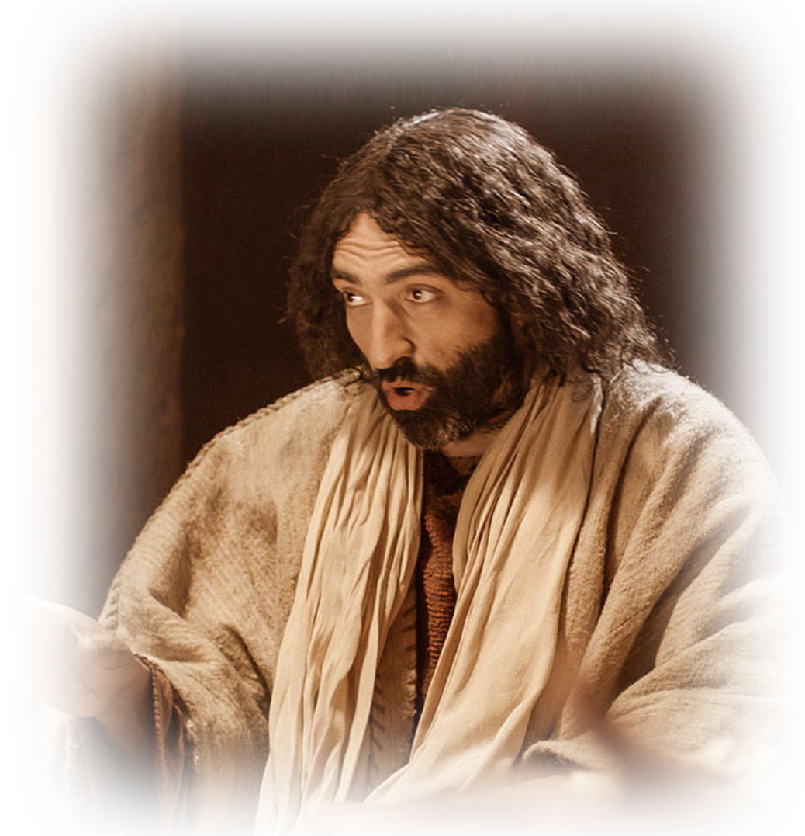
Because He is MERCIFUL
¹⁴ I tell you, this man went down to his house justified, rather than the other. For everyone who exalts himself will be humbled, but the one who humbles himself will be exalted."

Slide 15
Because He is MERCIFUL
Great is your mercy, O LORD
Psalm 119:156

Slide 16
My
is in the Lord
Psalm 39:7

