Slide 1
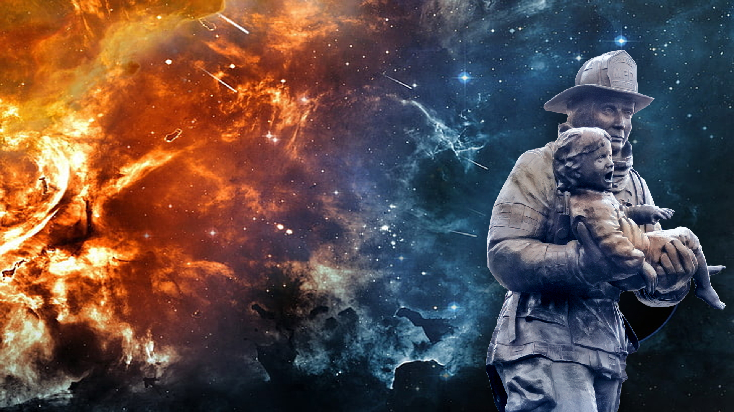

GREAT SALVATION
Watch original presentation at:
https://youtu.be/lrAPYUAyDAk
Notes:
Background https://c4.wallpaperflare.com/wallpaper/618/687/
Statue of rescue http://www.flickr.com/photos/johngonefishing/34715049660 or live.staticflickr.com/4285/34715049660_5edfe2fe9d_b.jpg
Copyright © 2006−2021. All rights reserved. Bible Point is a registered trademark of Dennis Henderson. All other trademarks acknowledged.
Bible Point contains graphics from Bible Point artists. These illustrations belong to Bible Point and the respective artists. You may use the designs and illustrations for graphical illustration of lessons free and without special permission, provided they are not used in any way that maligns the Christian faith. Furthermore, republication or production of any illustration by any other graphic service whether it be in book, in a machine-readable form, or in any other design resource is strictly prohibited. Furthermore, they cannot be duplicated or resold as any other form of publishing, clip art, or graphic resource.
So What does it mean? (A simple translations of the legal jargon)
So, if you don’t own the presentation(s), graphic(s), and text(s) how can you legally use them? The purchase of the license allows you to use all the images in the product. However, the actual ownership and copyright of the presentation(s), graphic(s), and text(s) remain the property of Bible Point and its licensors. If you had plans on using this product in your “for sale” work—think again!
License Agreement
Article 1: License Grant
All the graphics and text in Bible Point presentations (excluding quotes from the Bible and stated sources) are the intellectual and real property of Bible Point and its licensors, and is protected by law, including United States copyright laws and international treaties. Bible Point grants to you a license:
1. To use the presentation in a single church, single school, or single office of a Christian organization.
2. To make a single archival back-up copy of the program.
3. To modify the presentation(s) and merge with other presentations in a single church, school, or Christian organization.
4. To transfer to another party if that party agrees to accept the terms and conditions of this agreement, and you do not retain any copies of the presentation, whether printed, machine readable, modified, or merged form.
Article 2: Terms
This license is effective until terminated. You may terminate the license at any time by destroying the presentation(s), graphic(s), or text(s) together with all copies, modifications and merged portions in any form. Bible Point may terminate your license if you fail to comply with this Agreement. You agree, upon such termination, for any reason, to destroy the presentation(s), graphics, and text(s) with all copies, modifications, and merged portions in any form.
Article 3: Disclaimers
1. Bible Point presentations, graphics, and texts are licensed to you As Is. You, the consumer, bear the entire risk relating to the quality and performance of the presentation(s), graphic(s), or text(s). In no event will Bible Point be liable for damages resulting from any defect.
2. Thirty-day limited warrantee on disks. Bible Point warrants the disks to be free of defects in material and workmanship under normal use for 30 days after purchase. During the 30-day period you may return a defective presentation, graphic, or text with proof of purchase and it will be replaced without charge, unless the presentation is damaged by misuse.
Article 4: General
1. You may not sub-license, assign, or transfer the license of the presentation(s), graphic(s), or text(s) except as provided by this Agreement.
2. This Agreement will be governed by the laws of the State of Michigan.
So What does it mean? (A simple translations of the legal jargon)
May I let someone borrow or copy my licensed Bible Point presentation (even after I modified it)? As long as it is within your local church, or single school, or the immediate office of a Christian organization you may. Otherwise, please refer the person interested in borrowing to: http://www.biblepoint.com or E-mail: dennis@DrDH.net with any related questions.

Slide 2
GREAT SALVATION
Rescue others by snatching them from the flames of judgment. (Jude 1:23 NLT)
Notes:
Background https://c4.wallpaperflare.com/wallpaper/618/687/
Statue of rescue http://www.flickr.com/photos/johngonefishing/34715049660 or live.staticflickr.com/4285/34715049660_5edfe2fe9d_b.jpg

Slide 3
What is this thing called
SALVATION?
It is everything that God does to rescue you from sin and its consequences!
SUCH AS …

Slide 4
SALVATION INCLUDES …
Faith
Calling
Conversion
Regeneration
Reconciliation
Repentance
Redemption
Union
Atonement
Justification
Grace
Imputation
Forgiveness
Mercy
Sanctification
Perseverance
Election
Adoption
Assurance

Slide 5
The Most Important Question in Life!
^{Hebrews 2:3}
How shall we escape if we ignore such a great salvation?
Notes:
Great Salvation
The Most Important Question in Life!

Slide 6
The Great Message of Salvation!

Slide 7
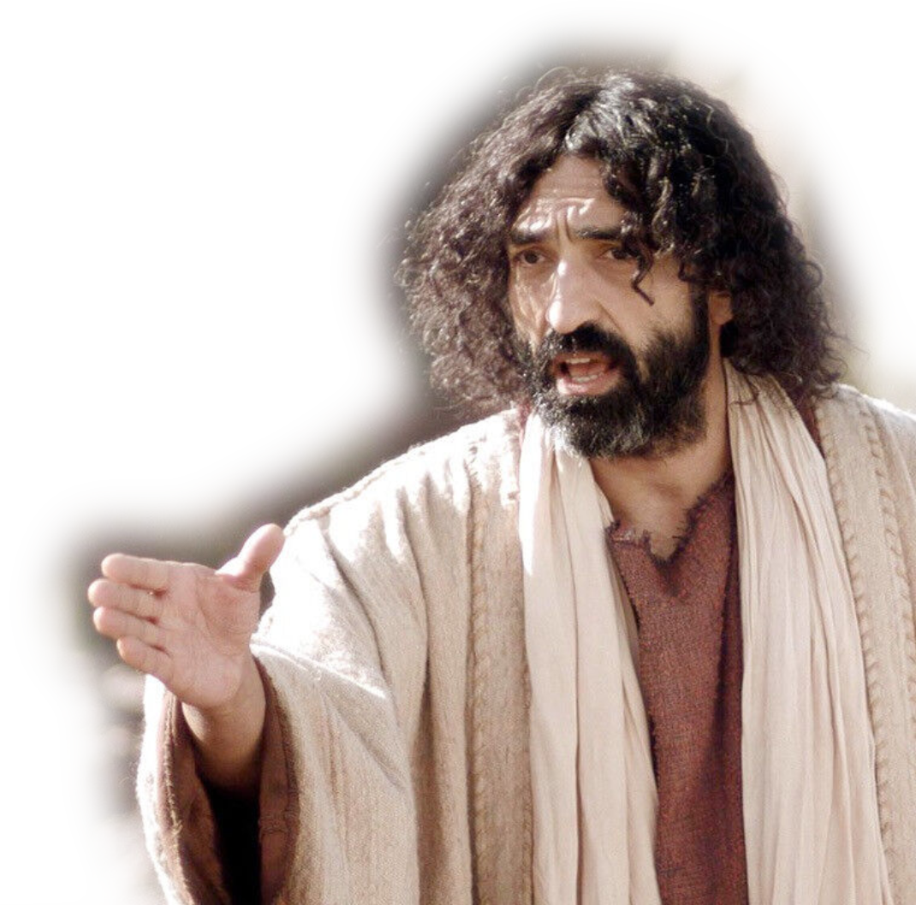
1st Announced:
³ This salvation, which was first announced by the Lord,
Notes:
The Most Important Question in Life!
John 3:1-18 To Nicodemus
John 4: to Woman at the well
Etc.
1st Announced: Testified of His death, burial, and resurrection

Slide 8
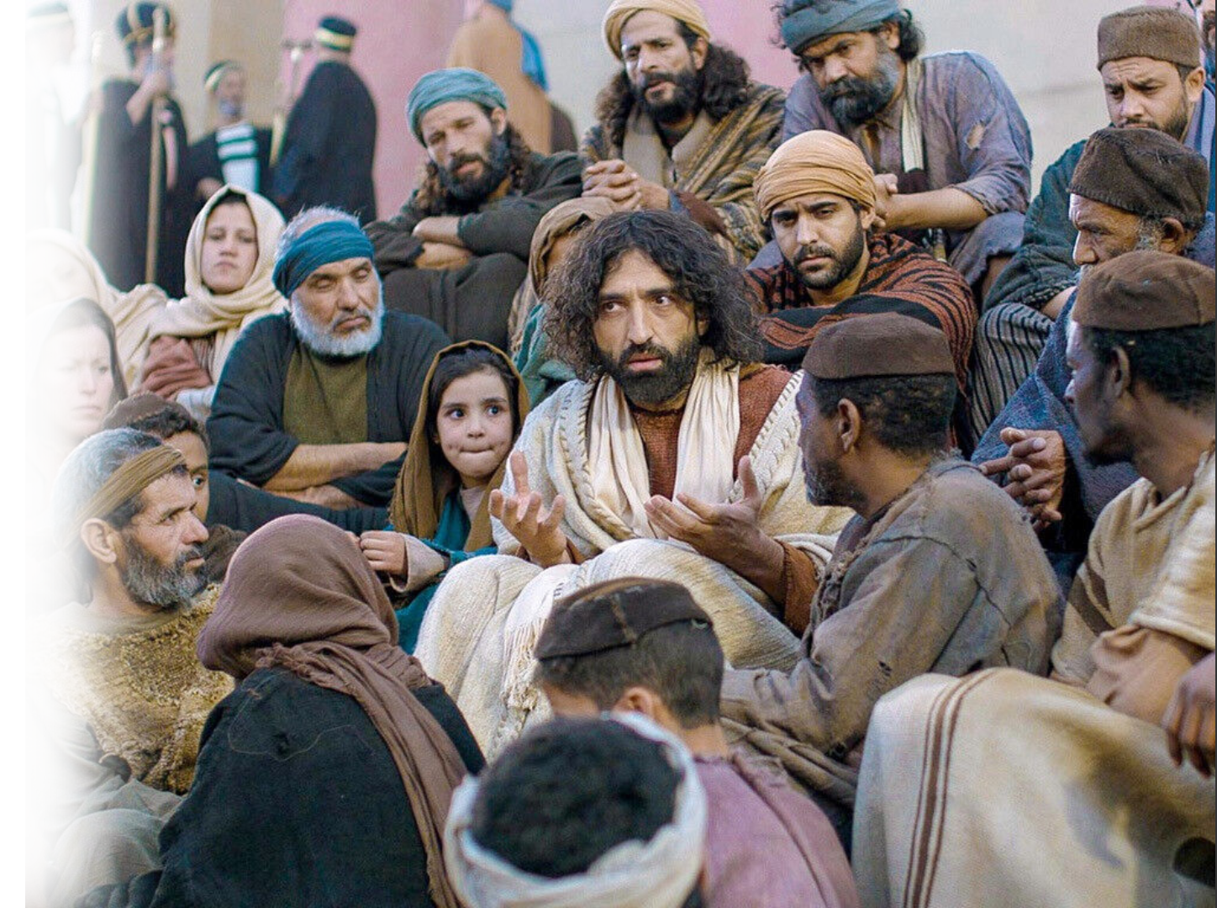
2nd Confirmed:
³ This salvation, which was first announced by the Lord, was confirmed to us by those who heard him.
Notes:
The Most Important Question in Life!
1st Announced: Testified of His death, burial, and resurrection
2nd Confirmed: The Apostles confirmed is as eyewitness
Read carefully the author is a third Generation Christian – Jesus first, Apostles second – the Author third—he heard the second generation.

Slide 9
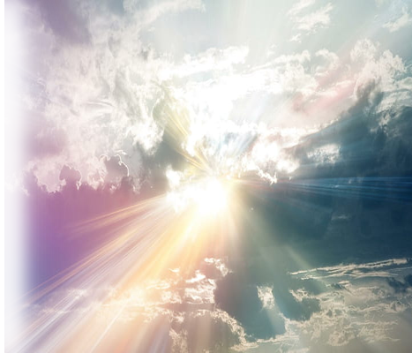
3rd Testified:
4 God also testified to it by signs, wonders and various miracles, and gifts of the Holy Spirit distributed according to his will.
Notes:
c4.wallpaperflare.com/wallpaper/533/388/843/sun-rays-through-the-clouds-wallpaper-preview.jpg
The Most Important Question in Life!
1st Announced: Testified of His death, burial, and resurrection
2nd Confirmed: The Apostles confirmed is as eyewitness
3rd God Himself testified to it by giving the apostles power to perform miracles ,

Slide 10

3rd Testified:
4 God also testified to it by signs, wonders and various miracles, and gifts of the Holy Spirit distributed according to his will.
SIGNS SAY SOMETHING
THIS WAY
Notes:
pixabay.com/illustrations/street-blank-sign-ad-banner-990315/
The Most Important Question in Life!
1st Announced: Testified of His death, burial, and resurrection
2nd Confirmed: The Apostles confirmed is as eyewitness
3rd God Himself testified to it by giving the apostles power to perform miracles ,
And the Spirit gave the revelatory gifts of Apostleship, Prophets, etc.
Signs = special revelation. God is saying something through the miracle.

Slide 11

3rd Testified:
4 God also testified to it by signs, wonders and various miracles, and gifts of the Holy Spirit distributed according to his will.
Notes:
pngall.com/wow-png/download/49467
The Most Important Question in Life!
1st Announced: Testified of His death, burial, and resurrection
2nd Confirmed: The Apostles confirmed is as eyewitness
3rd God Himself testified to it by giving the apostles power to perform miracles ,
And the Spirit gave the revelatory gifts of Apostleship, Prophets, etc.
Signs = special revelation. God is saying something through the miracle.
Wonder = inspires awe of faith to believe

Slide 12

3rd Testified:
4 God also testified to it by signs, wonders and various miracles, and gifts of the Holy Spirit distributed according to his will.
Notes:
freepngimg.com/png/47847-dynamite-free-png-hq
1st Announced: Testified of His death, burial, and resurrection
2nd Confirmed: The Apostles confirmed is as eyewitness
3rd God Himself testified to it by giving the apostles power to perform miracles ,
And the Spirit gave the revelatory gifts of Apostleship, Prophets, etc.
Signs = special revelation. God is saying something through the miracle.
Wonder = inspires awe of faith to believe
Miracles = power dunamis

Slide 13

3rd Testified:
4 God also testified to it by signs, wonders and various miracles, and gifts of the Holy Spirit distributed according to his will.
Notes:
.pexels.com/photo/selective-focus-photography-of-gift-boxes-17796/
1st Announced: Testified of His death, burial, and resurrection
2nd Confirmed: The Apostles confirmed is as eyewitness
3rd God Himself testified to it by giving the apostles power to perform miracles ,
And the Spirit gave the revelatory gifts of Apostleship, Prophets, etc.
Signs = special revelation. God is saying something through the miracle.
Wonder = inspires awe of faith to believe
Miracles = power dunamis
Different views on the gifts—but clearly here the are for the purpose of God Testifying and therefore revelation.
As such I believe they have all ceased. All. All were revelatory in design.
What we have today is the revealed Word of God.

Slide 14
BECAUSE THIS IS SO!

Slide 15
The Great Admonition of Salvation!

Slide 16

PAY ATTENTION!
1 We must pay more
careful attention,
therefore, to what
we have heard,
Notes:
Pay Attention:
More Attention
More Careful Attention … To What you, the reader have heard!!!!

Slide 17

DON’T DRIFT
1 We must pay more
careful attention,
therefore, to what
we have heard,
so that we do
not drift away.
Notes:
pexels.com/photo/white-row-boat-on-body-of-water-127160/
Pay Attention:
To NOT DRIFTING from what you have heard
Stay true to the Faith and to the Word

Slide 18
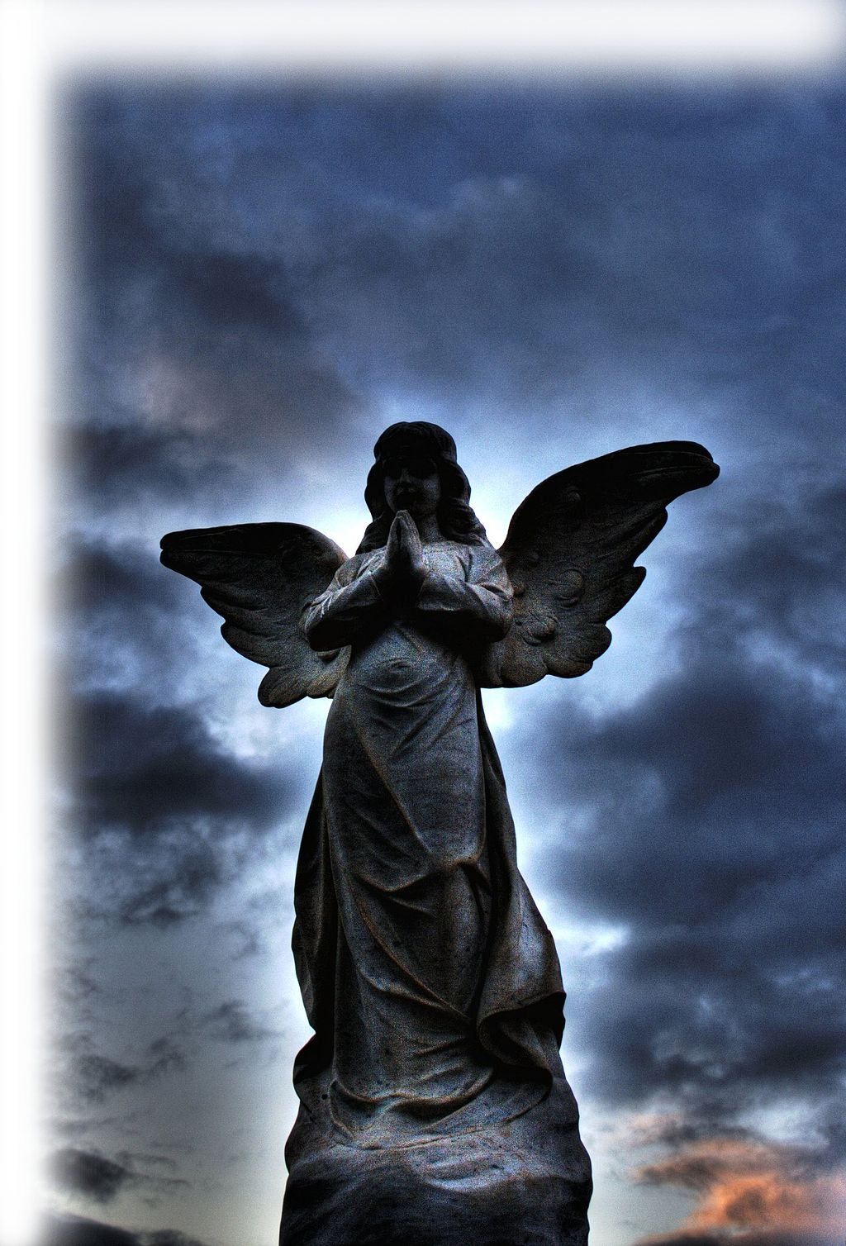
TAKE IT SERIOUSLY
2 For if the message spoken by angels was binding, and every violation and disobedience received its just punishment,
Notes:
upload.wikimedia.org/wikipedia/commons/thumb/1/15/Cemetery_Angel_002_HDR.jpg/1024px-Cemetery_Angel_002_HDR.jpg
Take it seriously …
If the message spoken by angels was binging
So much more the message spoken by Jesus, the Apostles, and the Spirit of Revelatioin.

Slide 19
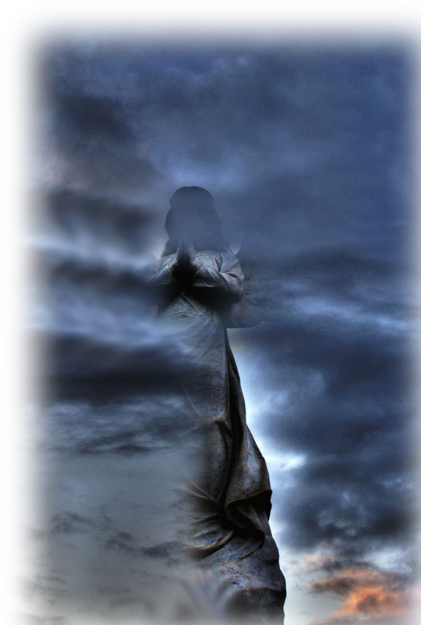
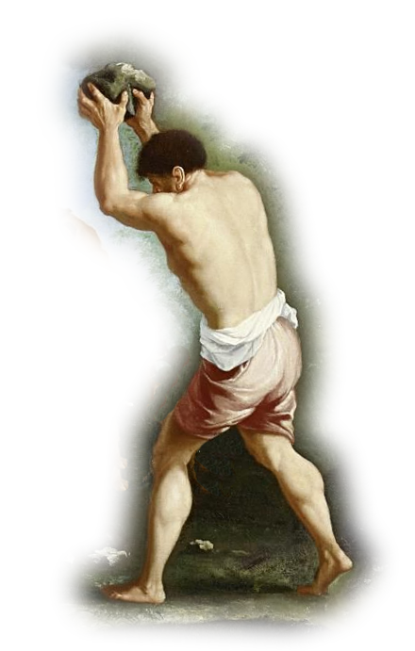
TAKE IT SERIOUSLY
2 For if the message spoken by angels was binding, and every violation and disobedience received its just punishment,
Notes:
upload.wikimedia.org/wikipedia/commons/0/0b/Garzi_%28attr%29_Stoning_of_Saint_Stephen.jpg
Take it seriously …
If the message spoken by angels was binging
So much more the message spoken by Jesus, the Apostles, and the Spirit of Revelatioin.

Slide 20
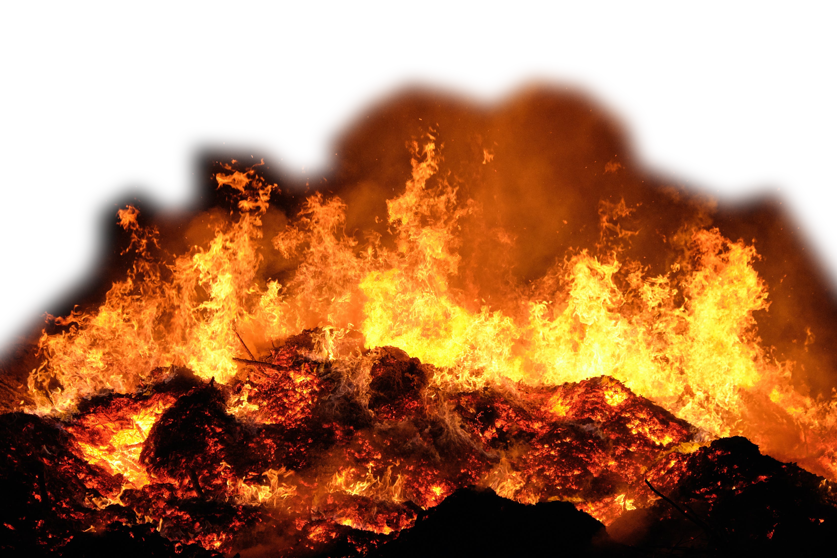
DON’T IGNORE
3 how shall we escape
Notes:
Flames www.pexels.com/photo/flames-during-night-time-4275990/
Don’t Ignore it
Story of son in prison, mother to Governor for pardon, Governor to the prison to see the son.
If I had only known.
Or
United States v. Wilson, 32 U.S. (7 Pet.) 150 (1833), was a case in the United States in which the defendant, George Wilson, was convicted of robbing the US Mail, and putting the life of the carrier in danger, in Pennsylvania and sentenced to death.^{[1]} Due to his friends' influence, Wilson was pardoned by Andrew Jackson.
The pardon included the following condition:^{[2]}
...with this express stipulation, that this pardon shall not extend to any judgment which may be had or obtained against him, in any other case or cases now pending before said court for other offences wherewith he may stand charged.
Wilson, however, refused the pardon. The Supreme Court was thus asked to rule on the case.^{[1]}
The decision was that if the prisoner does not accept the pardon, it is not in effect: "A pardon is a deed, to the validity of which delivery is essential, and delivery is not complete without acceptance. It may then be rejected by the person to whom it is tendered; and if it is rejected, we have discovered no power in this court to force it upon him."^{[3]}
While Wilson refused the pardon, he avoided being hanged unlike his accomplice who was. A report in The National Gazette of Philadelphia dated January 14, 1841 suggests that he was in prison for ten years until released. He received another pardon from President Martin Van Buren, which he accepted.^{[4][5]} The Smithsonian magazine has written that Wilson was hanged as a result of refusing the pardon.^{[6]}

Slide 21

DON’T IGNORE
3 how shall we escape if we ignore such a great salvation?
Notes:
freestock.com/free-photos/woman-portrait-covering-ears-isolated-white-40727455
Don’t Ignore it
Story of son in prison, mother to Governor for pardon, Governor to the prison to see the son.
If I had only known.
Or
United States v. Wilson, 32 U.S. (7 Pet.) 150 (1833), was a case in the United States in which the defendant, George Wilson, was convicted of robbing the US Mail, and putting the life of the carrier in danger, in Pennsylvania and sentenced to death.^{[1]} Due to his friends' influence, Wilson was pardoned by Andrew Jackson.
The pardon included the following condition:^{[2]}
...with this express stipulation, that this pardon shall not extend to any judgment which may be had or obtained against him, in any other case or cases now pending before said court for other offences wherewith he may stand charged.
Wilson, however, refused the pardon. The Supreme Court was thus asked to rule on the case.^{[1]}
The decision was that if the prisoner does not accept the pardon, it is not in effect: "A pardon is a deed, to the validity of which delivery is essential, and delivery is not complete without acceptance. It may then be rejected by the person to whom it is tendered; and if it is rejected, we have discovered no power in this court to force it upon him."^{[3]}
While Wilson refused the pardon, he avoided being hanged unlike his accomplice who was. A report in The National Gazette of Philadelphia dated January 14, 1841 suggests that he was in prison for ten years until released. He received another pardon from President Martin Van Buren, which he accepted.^{[4][5]} The Smithsonian magazine has written that Wilson was hanged as a result of refusing the pardon.^{[6]}

Slide 22
IT’S A GREAT SALVATION
3 how shall we escape if we ignore such a great salvation?
HOW
GREAT?
Notes:
Don’t Ignore it
Story of son in prison, mother to Governor for pardon, Governor to the prison to see the son.
If I had only known.

Slide 23

It’s like this …
ADAM’S HOTEL
Ignore It Nick
Fix It Fred
Feel It Franny
See It Sally
Put It Off Pete
Take It Tommy

Slide 24
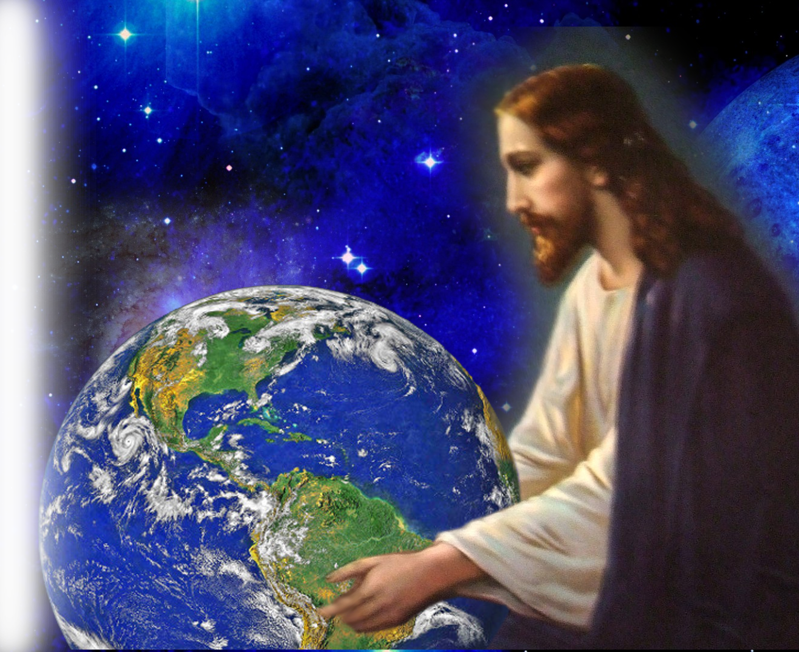
There is no other way …
"Turn to me and be saved,
all you ends of the earth;
for I am God, and
there is no other.
(Isaiah 45:22)

Slide 25
There is no other way …
Salvation is found in no one else, for there is no other name
under heaven given to
men by which we
must be saved."
(Acts 4:12)

Slide 26
There is no other way …
For there is one God and one mediator between God
and men, the man
Christ Jesus,
(1Timothy 2:5)

Slide 27
There is no other way …
Jesus answered, "I am the way and the truth and the life. No one comes to the Father
except through me.
(John 14:6)

Slide 28
The Most Important Question in Life!
^{Hebrews 2:3}
How shall we escape if we ignore such a great salvation?
Notes:
Great Salvation
The Most Important Question in Life!

Slide 29
You can take this Salvation with you today …
A – Acknowledge You Need Rescuing
B – Believe Jesus will Rescue/Save You
C – Call on Him to Save You!

Slide 30
LET’S PRAY!
Notes:
https://c4.wallpaperflare.com/wallpaper/814/1014/370/drown-sea-hands-water-wallpaper-preview.jpg (728×354) (wallpaperflare.com)

