Slide 1
GREAT ASPIRATIONS
“strong desires to achieve something high or great”
Notes:
https://pixabay.com/photos/award-cup-lights-bokeh-trophy-166945/
What is it you want? What is your aspiration?
Perhaps you are thinking, I wish I had great health -- seems admirable … who wants bad health?
Perhaps you are thinking, I wish I had a great marriage – seems admirable – who wants a bad marriage?
Perhaps you are thinking, I wish I had a great family like … – seems admirable – who wants dysfunctional family ?
Perhaps you are thinking, I wish I had great friends like, so in so– seems admirable – who wants to be lonely?
Perhaps you are thinking, I wish I had great job, big house, etc. – seems like the American dream – who wants low pay, tiny house, junker of a car?
What is you want? What is it you aspire?
Setting
Inappropriate Aspirations 20:20-22 (the mom)
Ignorant Aspirations 20:22b-23 (the sons)
Competitive Aspirations 20:24 (the ten)
Carnal Aspirations 20:25 (the world)
Paradoxical Aspiration 20:26-28 (the principle)
Exemplary Aspirations 20:28 (the Savior)

Slide 2
GREAT ASPIRATIONS
“strong desires to achieve something high or great”
Notes:
https://pixabay.com/photos/award-cup-lights-bokeh-trophy-166945/
Setting
Inappropriate Aspirations 20:20-22 (the mom)
Ignorant Aspirations 20:22b-23 (the sons)
Competitive Aspirations 20:24 (the ten)
Carnal Aspirations 20:25 (the world)
Paradoxical Aspiration 20:26-28 (the principle)
Exemplary Aspirations 20:28 (the Savior)

Slide 3
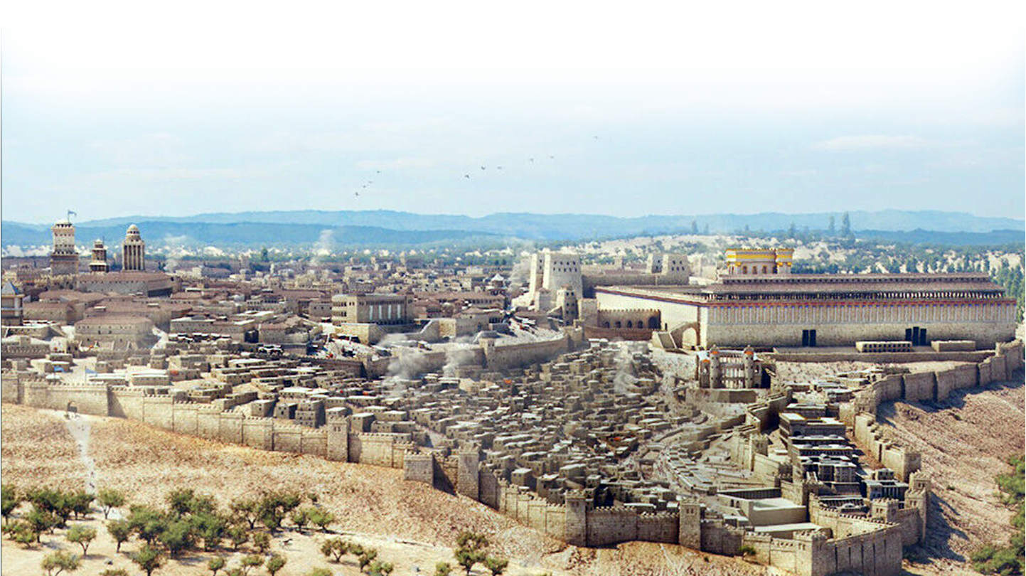
The Setting
^{Mat 20:17} Now as Jesus was going up to Jerusalem, he took the twelve disciples aside and said to them,
Notes:
www.freebibleimages.org
The Aspiring Mom Inappropriate Aspirations Who She Is 20:20 What She Wants 20:21 What She Doesn’t Know 20:22a The Aspiring Sons Their Question: Can you? 20:22b Their Answer: We Can! 20:22c What They Didn’t Know 20:23 The Aspiring Disciples The Ten’s Reaction 20:24 The Aspiring World Lord it over 20:25 Authority over 20:25 The Aspiring Greatness Must be servant 20:26 Must be slave 20:27 The Aspiring Jesus 20:28

Slide 4
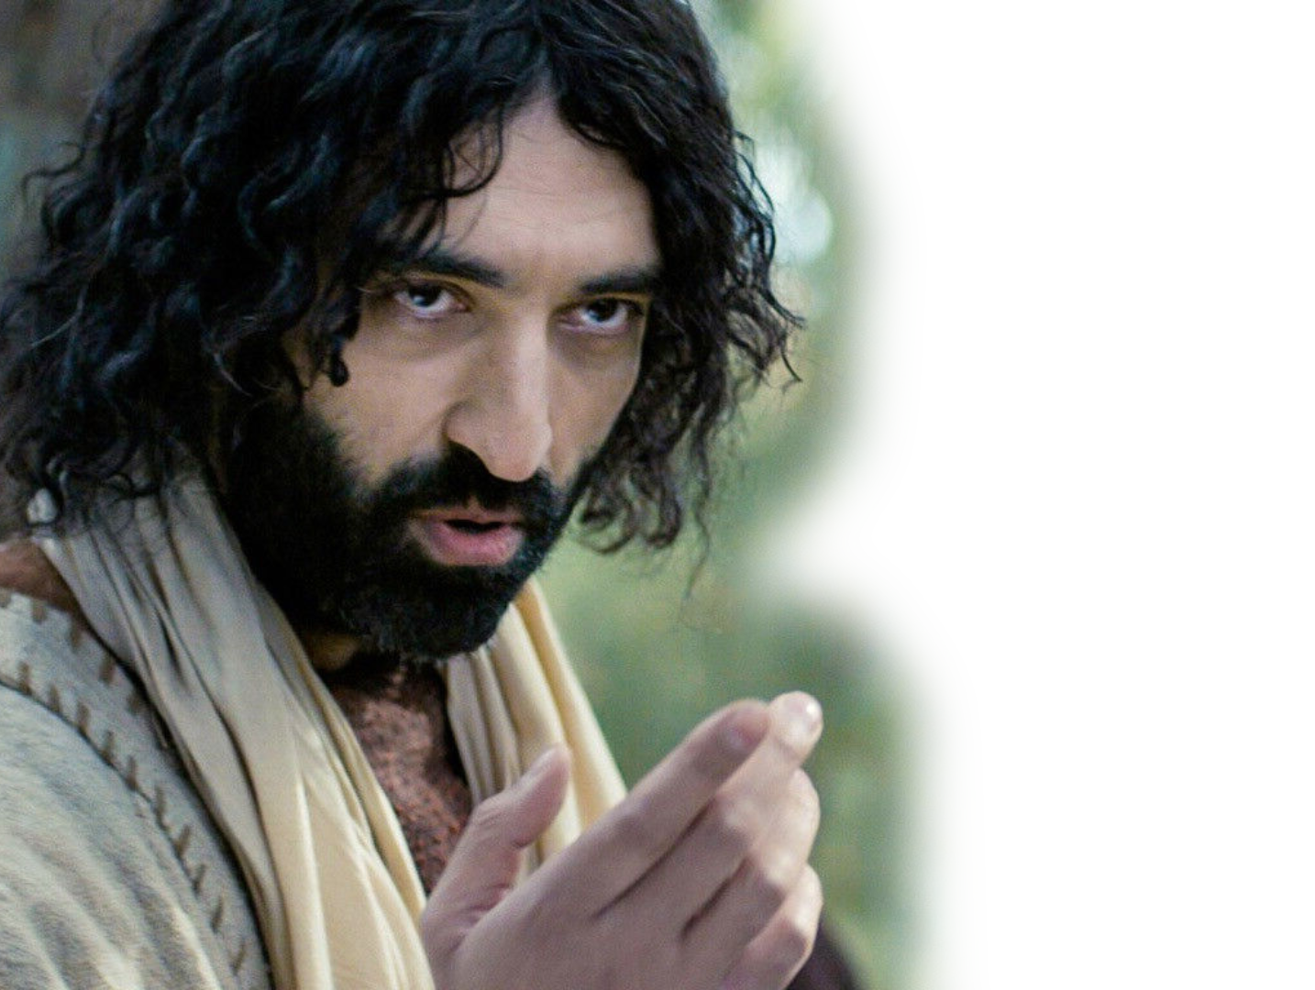
The Setting
^{Mat 20:18} "We are going up to Jerusalem,
Notes:
www.freebibleimages.org
The Aspiring Mom Who She Is 20:20 What She Wants 20:21 What She Doesn’t Know 20:22a The Aspiring Sons Their Question: Can you? 20:22b Their Answer: We Can! 20:22c What They Didn’t Know 20:23 The Aspiring Disciples The Ten’s Reaction 20:24 The Aspiring World Lord it over 20:25 Authority over 20:25 The Aspiring Greatness Must be servant 20:26 Must be slave 20:27 The Aspiring Jesus 20:28

Slide 5
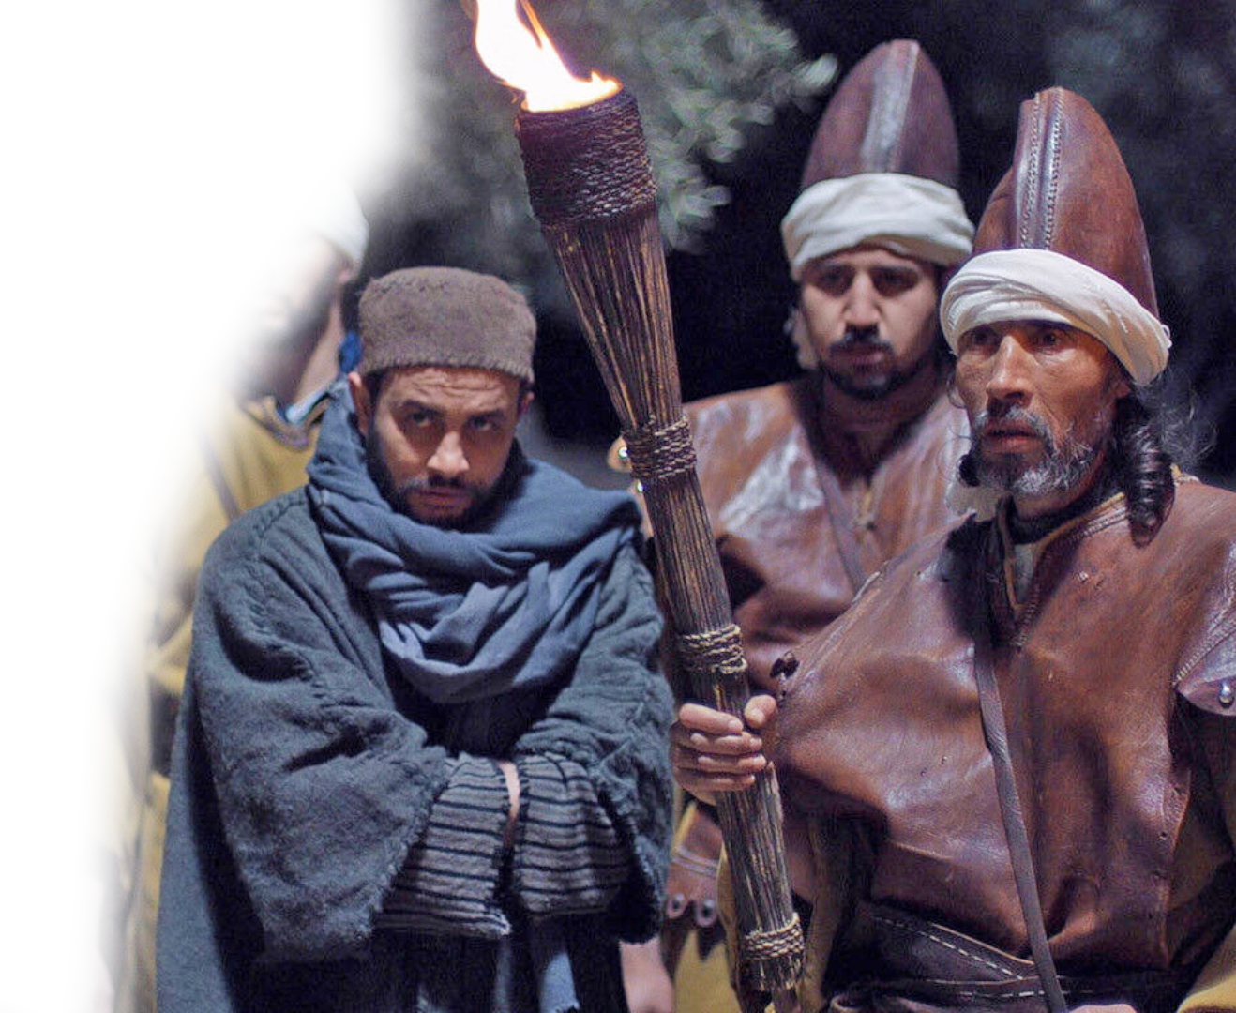
The Setting
^{Mat 20:18} "We are going up to Jerusalem, and the Son of Man will be betrayed to the chief priests and the teachers of the law.
Notes:
www.freebibleimages.org
The Aspiring Mom Who She Is 20:20 What She Wants 20:21 What She Doesn’t Know 20:22a The Aspiring Sons Their Question: Can you? 20:22b Their Answer: We Can! 20:22c What They Didn’t Know 20:23 The Aspiring Disciples The Ten’s Reaction 20:24 The Aspiring World Lord it over 20:25 Authority over 20:25 The Aspiring Greatness Must be servant 20:26 Must be slave 20:27 The Aspiring Jesus 20:28

Slide 6
The Setting
^{Mat 20:18} "We are going up to Jerusalem, and the Son of Man will be betrayed to the chief priests and the teachers of the law. They will condemn him to death ¹⁹ and will turn him over to the Gentiles to be mocked and flogged and crucified.
Notes:
https://pixabay.com/photos/award-cup-lights-bokeh-trophy-166945/
The Aspiring Mom Who She Is 20:20 What She Wants 20:21 What She Doesn’t Know 20:22a The Aspiring Sons Their Question: Can you? 20:22b Their Answer: We Can! 20:22c What They Didn’t Know 20:23 The Aspiring Disciples The Ten’s Reaction 20:24 The Aspiring World Lord it over 20:25 Authority over 20:25 The Aspiring Greatness Must be servant 20:26 Must be slave 20:27 The Aspiring Jesus 20:28

Slide 7
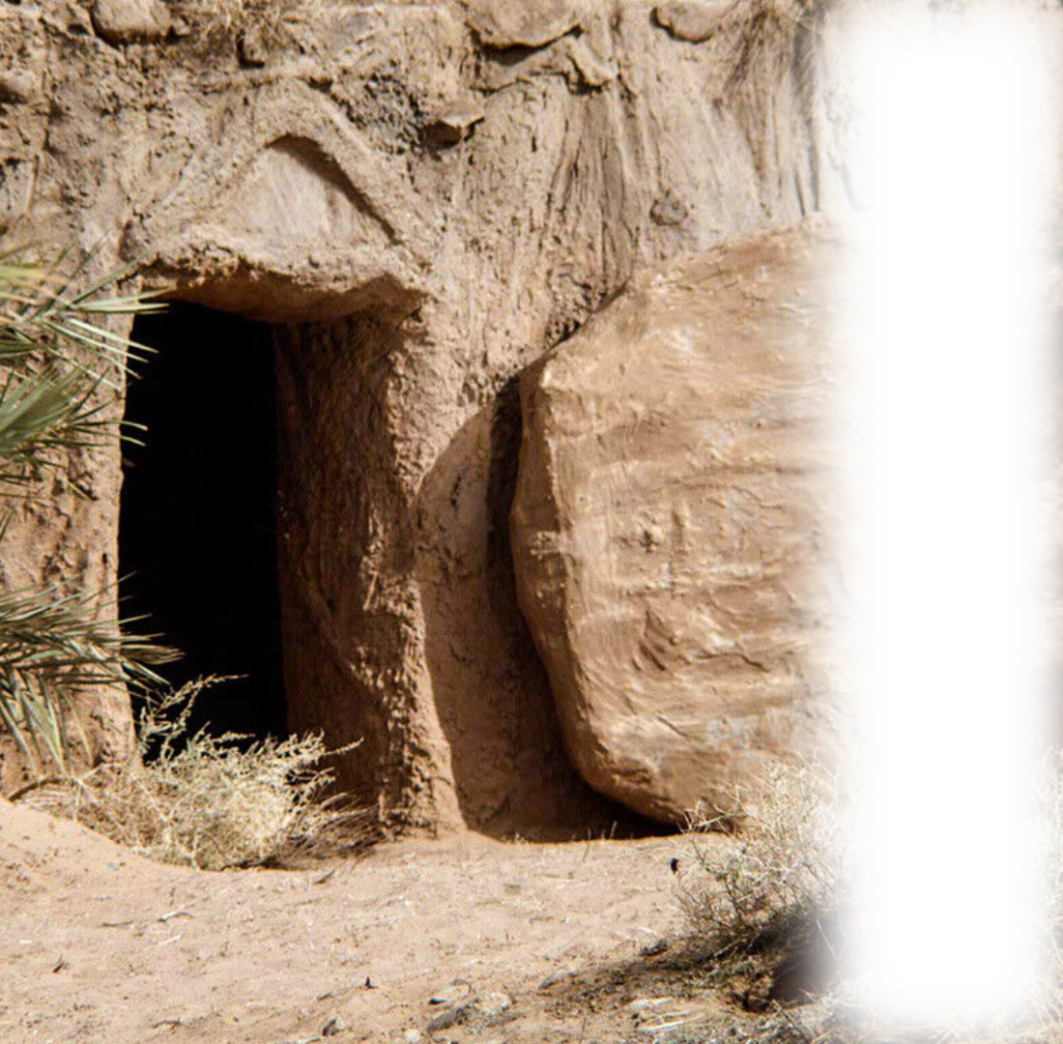
The Setting
^{Mat 20:18} "We are going up to Jerusalem, and the Son of Man will be betrayed to the chief priests and the teachers of the law. They will condemn him to death ¹⁹ and will turn him over to the Gentiles to be mocked and flogged and crucified. On the third day he will be raised to life!"
Notes:
www.freebibleimages.org
The Aspiring Mom Who She Is 20:20 What She Wants 20:21 What She Doesn’t Know 20:22a The Aspiring Sons Their Question: Can you? 20:22b Their Answer: We Can! 20:22c What They Didn’t Know 20:23 The Aspiring Disciples The Ten’s Reaction 20:24 The Aspiring World Lord it over 20:25 Authority over 20:25 The Aspiring Greatness Must be servant 20:26 Must be slave 20:27 The Aspiring Jesus 20:28

Slide 8
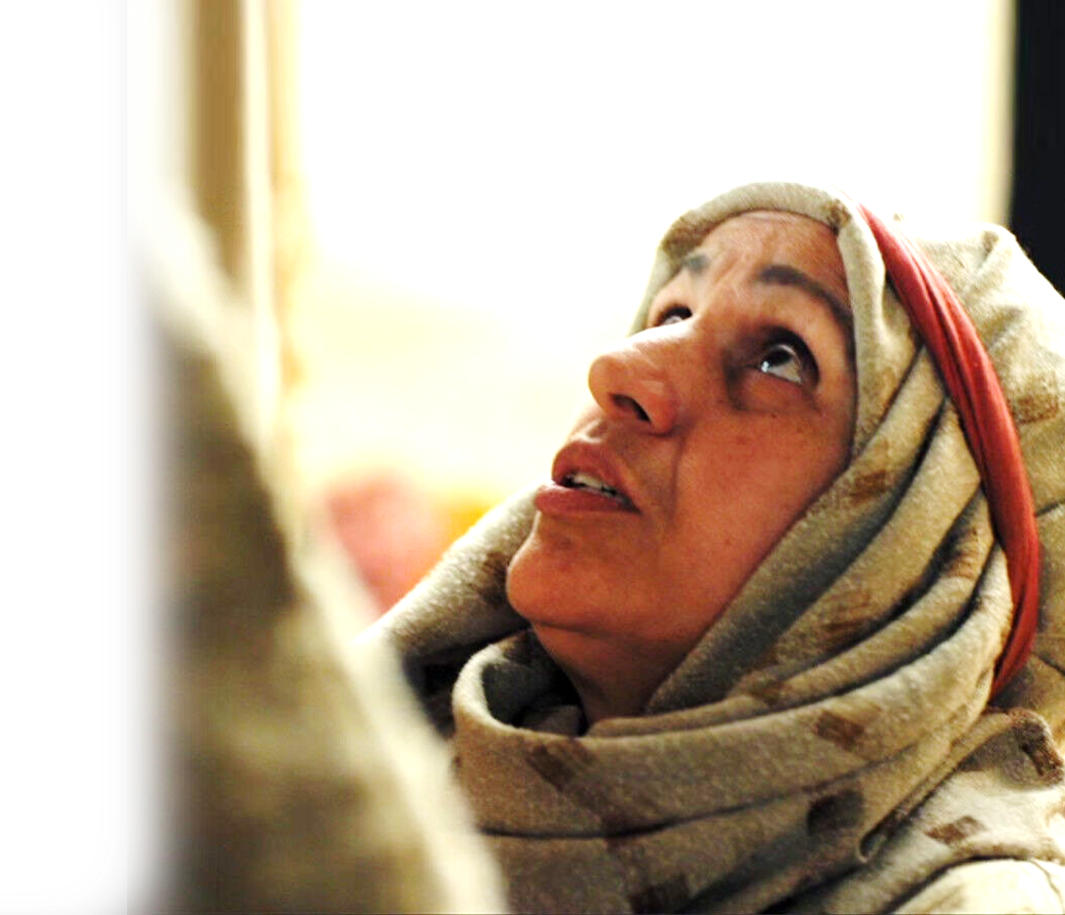
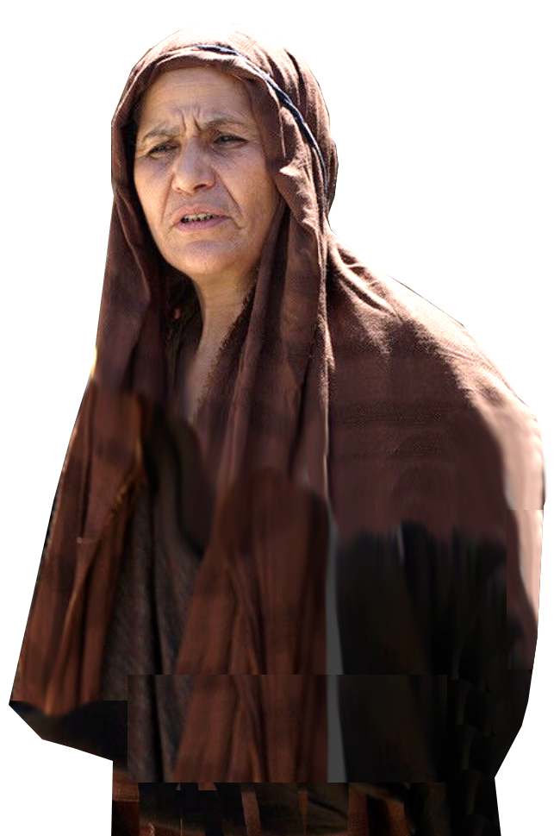
Inappropriate Aspiration (a mom)
²⁰ Then the mother of Zebedee's sons came to Jesus with her sons and, kneeling down, asked a favor of him.
Notes:
www.freebibleimages.org
“Then” = tote = “then, at that time, thereupon, thereafter”
It appears to be sequential. No sooner did Jesus foretell his death, burial, and resurrection, than Salome begs for her own interest.
The Aspiring Mom - Inappropriate Aspirations Who She Is 20:20 What She Wants 20:21 What She Doesn’t Know 20:22a The Aspiring Sons – Ignorant Aspirations Their Question: Can you? 20:22b Their Answer: We Can! 20:22c What They Didn’t Know 20:23 The Aspiring Disciples – Competitive Aspirations The Ten’s Reaction 20:24 The Aspiring World – Carnal Aspirations Lord it over 20:25 Authority over 20:25 The Aspiring Greatness – Paradoxical Aspirations Must be servant 20:26 Must be slave 20:27 The Aspiring Jesus 20:28

Slide 9
Inappropriate Aspiration (a mom)
²¹ "What is it you want?“ he asked.
Notes:
www.freebibleimages.org
The Aspiring Mom -- Inappropriate Aspirations Who She Is 20:20 What She Wants 20:21 What She Doesn’t Know 20:22a The Aspiring Sons Their Question: Can you? 20:22b Their Answer: We Can! 20:22c What They Didn’t Know 20:23 The Aspiring Disciples The Ten’s Reaction 20:24 The Aspiring World Lord it over 20:25 Authority over 20:25 The Aspiring Greatness Must be servant 20:26 Must be slave 20:27 The Aspiring Jesus 20:28

Slide 10
Inappropriate Aspiration (a mom)
²¹ … She said,
"Grant that one of these two sons of mine may sit at your right and the other at your left in your kingdom.“
Notes:
www.freebibleimages.org
Sons = James and John, early followers of Jesus, also called on one occasion by Jesus, the “Sons of Thunder (Mark 3:17),” apparently for their emotional outburst of anger.
The Aspiring Mom-- --- inappropriate timing and request Who She Is 20:20 What She Wants 20:21 What She Doesn’t Know 20:22a The Aspiring Sons Their Question: Can you? 20:22b Their Answer: We Can! 20:22c What They Didn’t Know 20:23 The Aspiring Disciples The Ten’s Reaction 20:24 The Aspiring World Lord it over 20:25 Authority over 20:25 The Aspiring Greatness Must be servant 20:26 Must be slave 20:27 The Aspiring Jesus 20:28

Slide 11
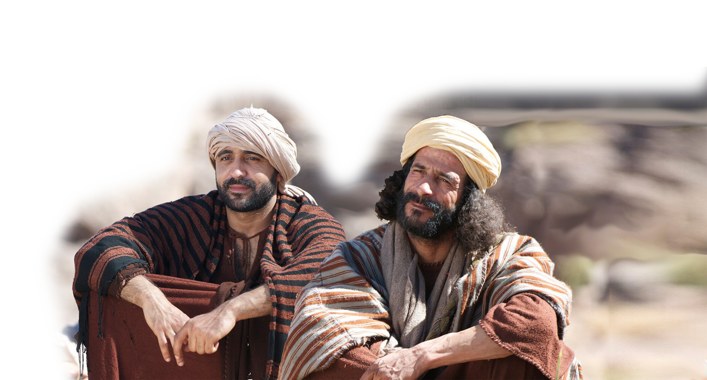
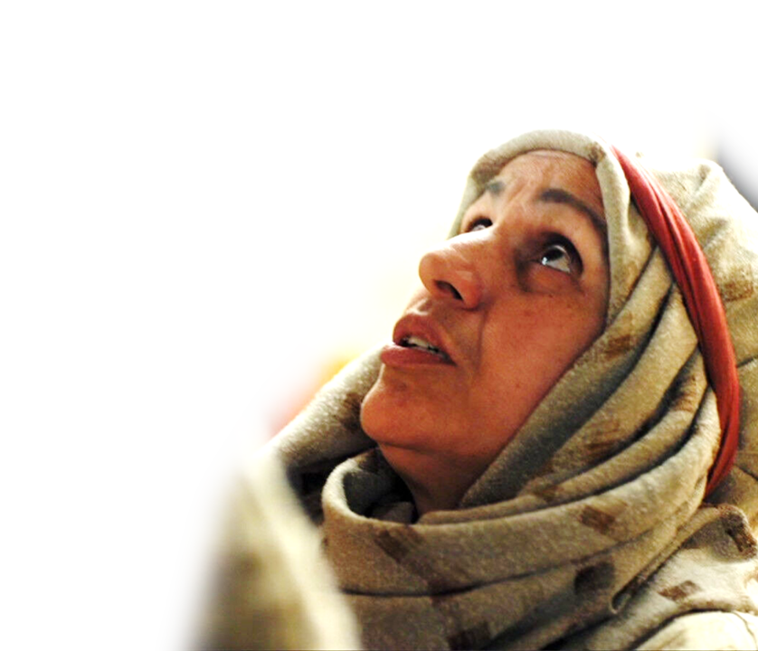
Ignorant Aspirations (two sons)
²² "You don’t know what you are asking," Jesus said to them.
Notes:
www.freebibleimages.org
Not only is this inappropriate – it is ignorant, too. Jesus tells her, she does not know what she is asking!
The Aspiring Mom Who She Is 20:20 What She Wants 20:21 What She Doesn’t Know 20:22a The Aspiring Sons Their Question: Can you? 20:22b Their Answer: We Can! 20:22c What They Didn’t Know 20:23 The Aspiring Disciples The Ten’s Reaction 20:24 The Aspiring World Lord it over 20:25 Authority over 20:25 The Aspiring Greatness Must be servant 20:26 Must be slave 20:27 The Aspiring Jesus 20:28

Slide 12
Ignorant Aspirations (two sons)
"Can you drink the cup I am going to drink?"
Notes:
www.freebibleimages.org
To prove the point to her, he asks the sons, James and John, “Can you drink the cup I am going to drink?”
Now instead of asking “What’s the cup?” The obvious response. I mean. The cup Jesus will drink is so bitter, that even He prays that if it were possible could he avoid it. In Mat 26:39.
On the night in which Jesus inaugurated the Lord’s Supper he took a cup and said, “This cup is the new covenant in my blood, which is poured out for you. (Luk 22:20 NIV)
After that he went out in the garden of Gethsemane to pray. While the disciples slept Jesus prayed, "Father, if you are willing, take this cup from me; yet not my will, but yours be done." (Luk 22:42 NIV)
The cup represents the impending death of Christ.
The Aspiring Mom Who She Is 20:20 What She Wants 20:21 What She Doesn’t Know 20:22a The Aspiring Sons Their Question: Can you? 20:22b Their Answer: We Can! 20:22c What They Didn’t Know 20:23 The Aspiring Disciples The Ten’s Reaction 20:24 The Aspiring World Lord it over 20:25 Authority over 20:25 The Aspiring Greatness Must be servant 20:26 Must be slave 20:27 The Aspiring Jesus 20:28

Slide 13
Ignorant Aspirations (two sons)
"We can," they answered.
Notes:
www.freebibleimages.org
But the two sons of thunder answer, “We can,” to what I’m not sure they even knew what it meant.
The Aspiring Mom Who She Is 20:20 What She Wants 20:21 What She Doesn’t Know 20:22a The Aspiring Sons Their Question: Can you? 20:22b Their Answer: We Can! 20:22c What They Didn’t Know 20:23 The Aspiring Disciples The Ten’s Reaction 20:24 The Aspiring World Lord it over 20:25 Authority over 20:25 The Aspiring Greatness Must be servant 20:26 Must be slave 20:27 The Aspiring Jesus 20:28

Slide 14
Ignorant Aspirations (two sons)
²³ Jesus said to them,
"You will indeed drink from my cup, but to sit at my right or left is not for me to grant. These places belong to those for whom they have been prepared by my Father.“
Notes:
www.freebibleimages.org
Sometimes you have to be careful what you ask for. The first part of this verses says yes you will die a gruesome death.
Later Salome, wife of Zebedee, and mother of John the apostle, will be at the scene of the crucifixion, with the two Mary’s (Mary Magdalene, and Mary the mother of Jesus), and Jose. She will see Jesus Crucified and from the cross look to his mother Mary, and nod his head toward John and say, “Woman, Behold your mother, and to John, behold your mother.”
This is the cup they said they could drink.
Indeed in time, James would die _______________ and John on the isle of Patmos, alone as a Roman prisoner.
The Aspiring Mom Who She Is 20:20 What She Wants 20:21 What She Doesn’t Know 20:22a The Aspiring Sons Their Question: Can you? 20:22b Their Answer: We Can! 20:22c What They Didn’t Know 20:23 – Kinda get what they ask—”Drink the cup” but kinda didn’t get what they asked for –Not necessarily sit at right or left. The Point: Your aspirations and God’s aspirations are not always the same. The Aspiring Disciples The Ten’s Reaction 20:24 The Aspiring World Lord it over 20:25 Authority over 20:25 The Aspiring Greatness Must be servant 20:26 Must be slave 20:27 The Aspiring Jesus 20:28

Slide 15
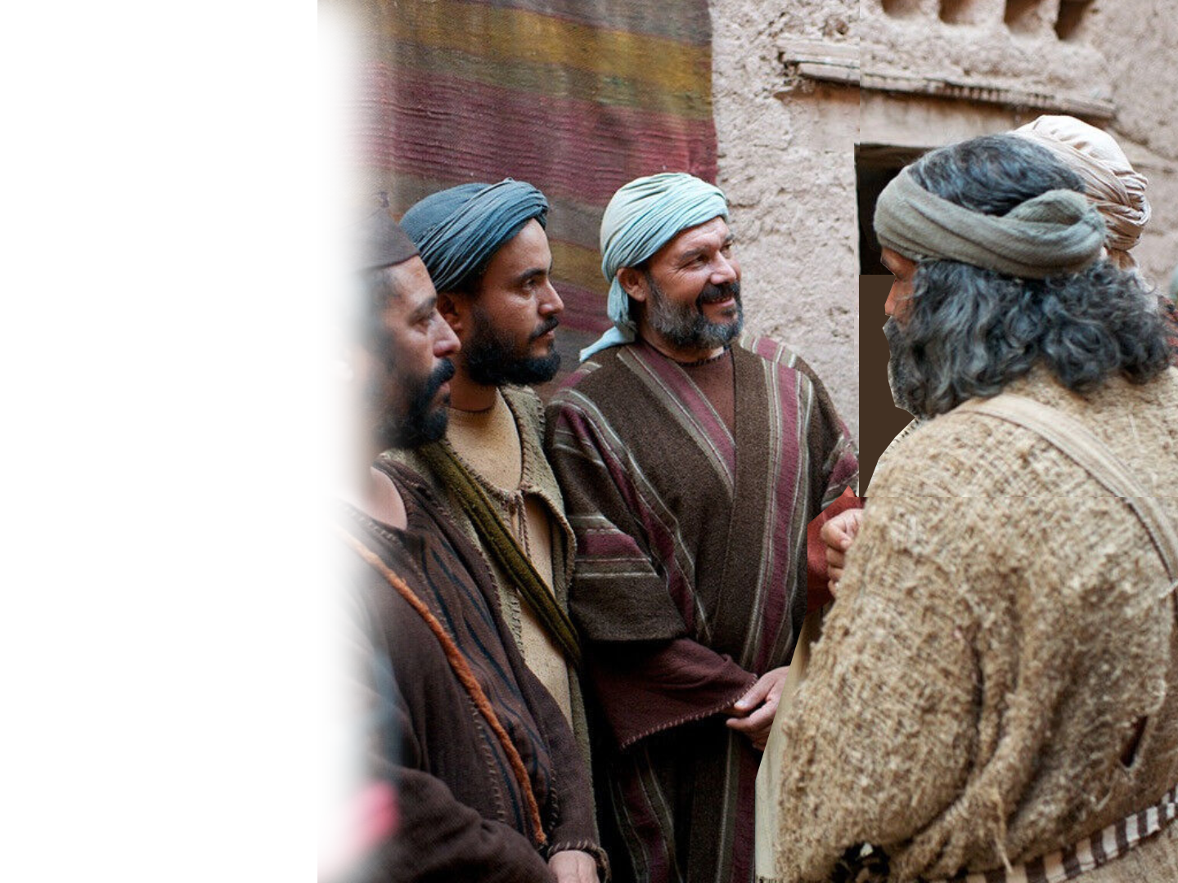
Indignant Aspriations (the ten)
²⁴ When the ten heard about this, they were indignant with the two brothers.
Notes:
www.freebibleimages.org
feeling or showing anger or annoyance at what is perceived as unfair treatment.
Angry over the possibility of the two seated higher in the kingdom than they.
The Aspiring Mom Who She Is 20:20 What She Wants 20:21 What She Doesn’t Know 20:22a The Aspiring Sons Their Question: Can you? 20:22b Their Answer: We Can! 20:22c What They Didn’t Know 20:23 The Aspiring Disciples The Ten’s Reaction 20:24 These aspirations are responsive. Like if someone at work gets a raise and a bonus—jealousy kicks in if you don’t get it too. That’s what’s going down here. The Aspiring World Lord it over 20:25 Authority over 20:25 The Aspiring Greatness Must be servant 20:26 Must be slave 20:27 The Aspiring Jesus 20:28

Slide 16
The Worldly Aspiration (nations)
²⁵ Jesus called them together and said,
"You know that the rulers of the Gentiles lord it over them, and their high officials exercise authority over them.
Notes:
www.freebibleimages.org/
Gentiles here are the Romans. They are powerful and power is everything. Lording it over others is what matters. Having authority to command and control.
That is worldly aspirations is to climb the ladder to the top. The top job, money maker, biggest, most expensive, nicest stuff is our measure of success. If we have more or better we are some how in our American culture better than others. People of upper class look down on those lower. You get th picture. The world aspires to power and wealth to dominate the poor and weak.
www.freepik.com/free-photo/word-rome-carved-old-sculpted-wall_4943321.htm
The Aspiring Mom Who She Is 20:20 What She Wants 20:21 What She Doesn’t Know 20:22a The Aspiring Sons Their Question: Can you? 20:22b Their Answer: We Can! 20:22c What They Didn’t Know 20:23 The Aspiring Disciples The Ten’s Reaction 20:24 The Aspiring World Lord it over 20:25 is all about power. That is politics. All about “lording it over you.” Authority over 20:25 Authority simply means the right to command. It’s all about power and control. Rome had then and US has it now. The Aspiring Greatness Must be servant 20:26 Must be slave 20:27 The Aspiring Jesus 20:28

Slide 17
The Paradoxical Aspirations
²⁶ Not so with you. Instead, whoever wants to become great among you must be your servant, ²⁷ and whoever wants to be first must be your slave--
Notes:
www.freebibleimages.org
Here is a great paradox = a seemingly absurd or self-contradictory statement.
Greatness is not found at the top—but rather at the bottom – not the boss but the servant, not first place but a slave.
The Aspiring Mom Who She Is 20:20 What She Wants 20:21 What She Doesn’t Know 20:22a The Aspiring Sons Their Question: Can you? 20:22b Their Answer: We Can! 20:22c What They Didn’t Know 20:23 The Aspiring Disciples The Ten’s Reaction 20:24 The Aspiring World Lord it over 20:25 Authority over 20:25 The Aspiring Greatness – the key to true greatness is servant leadership. Must be servant 20:26 Must be slave 20:27 The Aspiring Jesus 20:28

Slide 18
The Paradoxical Aspirations
²⁶ Not so with you. Instead, whoever wants to become great among you must be your servant, ²⁷ and whoever wants to be first must be your slave--
Notes:
www.freebibleimages.org
The Aspiring Mom Who She Is 20:20 What She Wants 20:21 What She Doesn’t Know 20:22a The Aspiring Sons Their Question: Can you? 20:22b Their Answer: We Can! 20:22c What They Didn’t Know 20:23 The Aspiring Disciples The Ten’s Reaction 20:24 The Aspiring World Lord it over 20:25 Authority over 20:25 The Aspiring Greatness – the key to true greatness is servant leadership. Must be servant 20:26 Must be slave 20:27 The Aspiring Jesus 20:28

Slide 19
Exemplary Aspirations
²⁸ just as the Son of Man did not come to be served, but to serve, and to give his life as a ransom for many."
Notes:
https://pixabay.com/photos/award-cup-lights-bokeh-trophy-166945/
upload.wikimedia.org/wikipedia/commons/f/f5/Crucifixion.jpg
To explain greatness Jesus uses a simile – a comparison between two things using the word “like of as”
Jesus begins his example with “just as” and refers to himself.
If you want to be great you need to be like Jesus.
How did he achieve greatness? Not by being served, But by serving.
How did he serve? By paying the ransom for our salvation.
So what is a ransom, A ransom is paid to set free. The debt that had to be paid was for sin. The wages of sin is death. So Jesus paid the debt of sin so we could be set free.
The Aspiring Mom Who She Is 20:20 What She Wants 20:21 What She Doesn’t Know 20:22a The Aspiring Sons Their Question: Can you? 20:22b Their Answer: We Can! 20:22c What They Didn’t Know 20:23 The Aspiring Disciples The Ten’s Reaction 20:24 The Aspiring World Lord it over 20:25 Authority over 20:25 The Aspiring Greatness Must be servant 20:26 Must be slave 20:27 The Aspiring Jesus 20:28

Slide 20
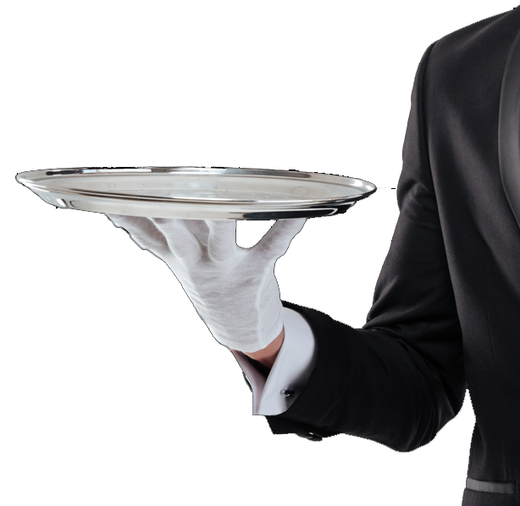
Exemplary Aspirations
²⁸ just as the Son of Man did not come to be served, but to serve, and to give his life as a ransom for many."
BE SERVED
Notes:
www.pngall.com/wp-content/uploads/5/Waiter-Serving-Food-PNG.png
The Aspiring Mom Who She Is 20:20 What She Wants 20:21 What She Doesn’t Know 20:22a The Aspiring Sons Their Question: Can you? 20:22b Their Answer: We Can! 20:22c What They Didn’t Know 20:23 The Aspiring Disciples The Ten’s Reaction 20:24 The Aspiring World Lord it over 20:25 Authority over 20:25 The Aspiring Greatness Must be servant 20:26 Must be slave 20:27 The Aspiring Jesus 20:28

Slide 21
Exemplary Aspirations
²⁸ just as the Son of Man did not come to be served, but to serve, and to give his life as a ransom for many."
TO SERVE
Notes:
freebibleimages.org/photos/jesus-washes-feet/
The Aspiring Mom Who She Is 20:20 What She Wants 20:21 What She Doesn’t Know 20:22a The Aspiring Sons Their Question: Can you? 20:22b Their Answer: We Can! 20:22c What They Didn’t Know 20:23 The Aspiring Disciples The Ten’s Reaction 20:24 The Aspiring World Lord it over 20:25 Authority over 20:25 The Aspiring Greatness Must be servant 20:26 Must be slave 20:27 The Aspiring Jesus 20:28

Slide 22
Exemplary Aspirations
²⁸ just as the Son of Man did not come to be served, but to serve, and to give his life as a ransom for many."
Notes:
https://pixabay.com/photos/award-cup-lights-bokeh-trophy-166945/
upload.wikimedia.org/wikipedia/commons/f/f5/Crucifixion.jpg
The Aspiring Mom Who She Is 20:20 What She Wants 20:21 What She Doesn’t Know 20:22a The Aspiring Sons Their Question: Can you? 20:22b Their Answer: We Can! 20:22c What They Didn’t Know 20:23 The Aspiring Disciples The Ten’s Reaction 20:24 The Aspiring World Lord it over 20:25 Authority over 20:25 The Aspiring Greatness Must be servant 20:26 Must be slave 20:27 The Aspiring Jesus 20:28

Slide 23
Look what’s happening here …
The Mother Put Her Sons above Christ
Notes:
www.freebibleimages.org

Slide 24
Look what’s happening here …
The Mother Put Her Sons above Christ
The Sons Put Themselves Equal with Christ
Notes:
www.freebibleimages.org

Slide 25
Look what’s happening here …
The Mother Put Her Sons above Christ
The Sons Put Themselves Equal with Christ
The Ten Challenged the Two
Notes:
www.freebibleimages.org

Slide 26
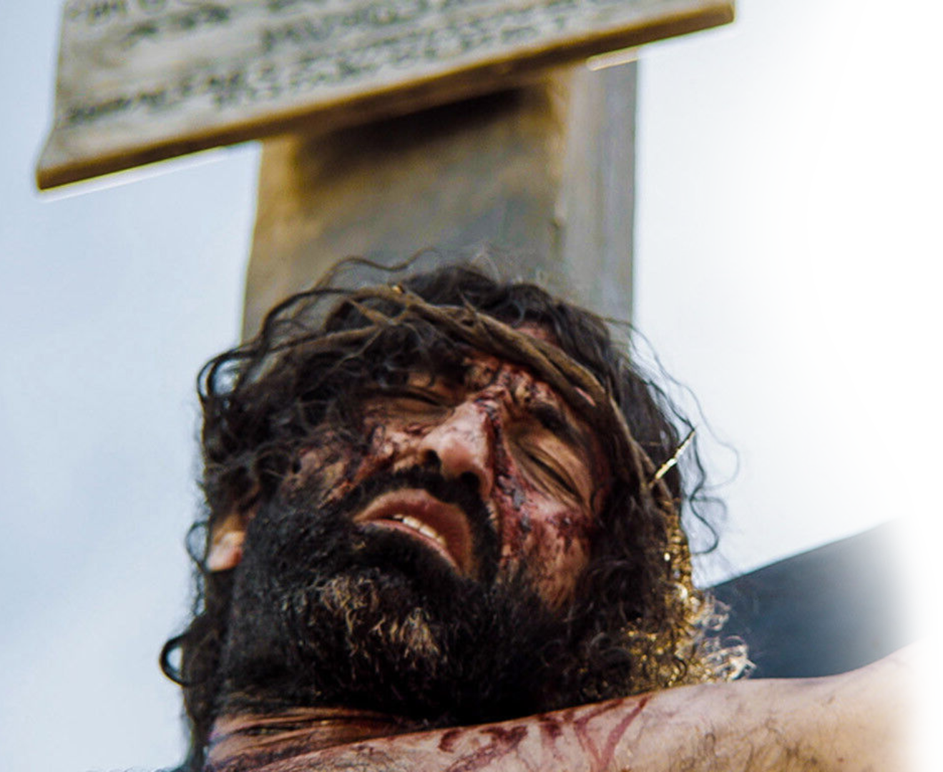
Look what’s happening here …
The Mother Put Her Sons above Christ
The Sons Put Themselves Equal with Christ
The Ten Challenged the Two
But Jesus Put All
above Himself
Notes:
www.freebibleimages.org/photos/jesus-dies/

Slide 27
The Question Now …
Where do you put you?
What are your aspirations?
What is it that you want?
Notes:
What is it that you want? I asked at the beginning, What is it that you want? What did you answer.
Health
Marriage
Family
Friends
Fun
Success
What greatness did you say you wanted?

Slide 28
Here’s the Point:
The Christian’s Aspiration to Greatness is
PARDOXICAL
To be truly GREAT you must become SMALL
To be truly GREAT it will cost you Your ALL
Notes:
That greatness you are aspiring will in all likelihood not happen as you plan it.
Your greatness, happiness, purpose, meaning is not the worldly way.
Your greatness, happiness, purpose and meaning will cost you everything.
But it will be worth it.

Slide 29
Here’s the REWARD!
James 4:10 Humble yourselves before the Lord, and he will lift you up.

Slide 30
Let’s Pray!

