Slide 1

Great
BOLDNESS
Watch original presentation at:
https://youtu.be/z8MIjMwriFo
Notes:
Copyright © 2006−2021. All rights reserved. Bible Point is a registered trademark of Dennis Henderson. All other trademarks acknowledged.
Bible Point contains graphics from Bible Point artists. These illustrations belong to Bible Point and the respective artists. You may use the designs and illustrations for graphical illustration of lessons free and without special permission, provided they are not used in any way that maligns the Christian faith. Furthermore, republication or production of any illustration by any other graphic service whether it be in book, in a machine-readable form, or in any other design resource is strictly prohibited. Furthermore, they cannot be duplicated or resold as any other form of publishing, clip art, or graphic resource.
So What does it mean? (A simple translations of the legal jargon)
So, if you don’t own the presentation(s), graphic(s), and text(s) how can you legally use them? The purchase of the license allows you to use all the images in the product. However, the actual ownership and copyright of the presentation(s), graphic(s), and text(s) remain the property of Bible Point and its licensors. If you had plans on using this product in your “for sale” work—think again!
License Agreement
Article 1: License Grant
All the graphics and text in Bible Point presentations (excluding quotes from the Bible and stated sources) are the intellectual and real property of Bible Point and its licensors, and is protected by law, including United States copyright laws and international treaties. Bible Point grants to you a license:
1. To use the presentation in a single church, single school, or single office of a Christian organization.
2. To make a single archival back-up copy of the program.
3. To modify the presentation(s) and merge with other presentations in a single church, school, or Christian organization.
4. To transfer to another party if that party agrees to accept the terms and conditions of this agreement, and you do not retain any copies of the presentation, whether printed, machine readable, modified, or merged form.
Article 2: Terms
This license is effective until terminated. You may terminate the license at any time by destroying the presentation(s), graphic(s), or text(s) together with all copies, modifications and merged portions in any form. Bible Point may terminate your license if you fail to comply with this Agreement. You agree, upon such termination, for any reason, to destroy the presentation(s), graphics, and text(s) with all copies, modifications, and merged portions in any form.
Article 3: Disclaimers
1. Bible Point presentations, graphics, and texts are licensed to you As Is. You, the consumer, bear the entire risk relating to the quality and performance of the presentation(s), graphic(s), or text(s). In no event will Bible Point be liable for damages resulting from any defect.
2. Thirty-day limited warrantee on disks. Bible Point warrants the disks to be free of defects in material and workmanship under normal use for 30 days after purchase. During the 30-day period you may return a defective presentation, graphic, or text with proof of purchase and it will be replaced without charge, unless the presentation is damaged by misuse.
Article 4: General
1. You may not sub-license, assign, or transfer the license of the presentation(s), graphic(s), or text(s) except as provided by this Agreement.
2. This Agreement will be governed by the laws of the State of Michigan.
So What does it mean? (A simple translations of the legal jargon)
May I let someone borrow or copy my licensed Bible Point presentation (even after I modified it)? As long as it is within your local church, or single school, or the immediate office of a Christian organization you may. Otherwise, please refer the person interested in borrowing to: http://www.biblepoint.com or E-mail: dennis@DrDH.net with any related questions.

Slide 2
Great
BOLDNESS
Notes:
Copyright © 2006−2021. All rights reserved. Bible Point is a registered trademark of Dennis Henderson. All other trademarks acknowledged.
Bible Point contains graphics from Bible Point artists. These illustrations belong to Bible Point and the respective artists. You may use the designs and illustrations for graphical illustration of lessons free and without special permission, provided they are not used in any way that maligns the Christian faith. Furthermore, republication or production of any illustration by any other graphic service whether it be in book, in a machine-readable form, or in any other design resource is strictly prohibited. Furthermore, they cannot be duplicated or resold as any other form of publishing, clip art, or graphic resource.
So What does it mean? (A simple translations of the legal jargon)
So, if you don’t own the presentation(s), graphic(s), and text(s) how can you legally use them? The purchase of the license allows you to use all the images in the product. However, the actual ownership and copyright of the presentation(s), graphic(s), and text(s) remain the property of Bible Point and its licensors. If you had plans on using this product in your “for sale” work—think again!
License Agreement
Article 1: License Grant
All the graphics and text in Bible Point presentations (excluding quotes from the Bible and stated sources) are the intellectual and real property of Bible Point and its licensors, and is protected by law, including United States copyright laws and international treaties. Bible Point grants to you a license:
1. To use the presentation in a single church, single school, or single office of a Christian organization.
2. To make a single archival back-up copy of the program.
3. To modify the presentation(s) and merge with other presentations in a single church, school, or Christian organization.
4. To transfer to another party if that party agrees to accept the terms and conditions of this agreement, and you do not retain any copies of the presentation, whether printed, machine readable, modified, or merged form.
Article 2: Terms
This license is effective until terminated. You may terminate the license at any time by destroying the presentation(s), graphic(s), or text(s) together with all copies, modifications and merged portions in any form. Bible Point may terminate your license if you fail to comply with this Agreement. You agree, upon such termination, for any reason, to destroy the presentation(s), graphics, and text(s) with all copies, modifications, and merged portions in any form.
Article 3: Disclaimers
1. Bible Point presentations, graphics, and texts are licensed to you As Is. You, the consumer, bear the entire risk relating to the quality and performance of the presentation(s), graphic(s), or text(s). In no event will Bible Point be liable for damages resulting from any defect.
2. Thirty-day limited warrantee on disks. Bible Point warrants the disks to be free of defects in material and workmanship under normal use for 30 days after purchase. During the 30-day period you may return a defective presentation, graphic, or text with proof of purchase and it will be replaced without charge, unless the presentation is damaged by misuse.
Article 4: General
1. You may not sub-license, assign, or transfer the license of the presentation(s), graphic(s), or text(s) except as provided by this Agreement.
2. This Agreement will be governed by the laws of the State of Michigan.
So What does it mean? (A simple translations of the legal jargon)
May I let someone borrow or copy my licensed Bible Point presentation (even after I modified it)? As long as it is within your local church, or single school, or the immediate office of a Christian organization you may. Otherwise, please refer the person interested in borrowing to: http://www.biblepoint.com or E-mail: dennis@DrDH.net with any related questions.

Slide 3
Happy INDEPENDENCE Day
Notes:
Copyright © 2006−2021. All rights reserved. Bible Point is a registered trademark of Dennis Henderson. All other trademarks acknowledged.
Bible Point contains graphics from Bible Point artists. These illustrations belong to Bible Point and the respective artists. You may use the designs and illustrations for graphical illustration of lessons free and without special permission, provided they are not used in any way that maligns the Christian faith. Furthermore, republication or production of any illustration by any other graphic service whether it be in book, in a machine-readable form, or in any other design resource is strictly prohibited. Furthermore, they cannot be duplicated or resold as any other form of publishing, clip art, or graphic resource.
So What does it mean? (A simple translations of the legal jargon)
So, if you don’t own the presentation(s), graphic(s), and text(s) how can you legally use them? The purchase of the license allows you to use all the images in the product. However, the actual ownership and copyright of the presentation(s), graphic(s), and text(s) remain the property of Bible Point and its licensors. If you had plans on using this product in your “for sale” work—think again!
License Agreement
Article 1: License Grant
All the graphics and text in Bible Point presentations (excluding quotes from the Bible and stated sources) are the intellectual and real property of Bible Point and its licensors, and is protected by law, including United States copyright laws and international treaties. Bible Point grants to you a license:
1. To use the presentation in a single church, single school, or single office of a Christian organization.
2. To make a single archival back-up copy of the program.
3. To modify the presentation(s) and merge with other presentations in a single church, school, or Christian organization.
4. To transfer to another party if that party agrees to accept the terms and conditions of this agreement, and you do not retain any copies of the presentation, whether printed, machine readable, modified, or merged form.
Article 2: Terms
This license is effective until terminated. You may terminate the license at any time by destroying the presentation(s), graphic(s), or text(s) together with all copies, modifications and merged portions in any form. Bible Point may terminate your license if you fail to comply with this Agreement. You agree, upon such termination, for any reason, to destroy the presentation(s), graphics, and text(s) with all copies, modifications, and merged portions in any form.
Article 3: Disclaimers
1. Bible Point presentations, graphics, and texts are licensed to you As Is. You, the consumer, bear the entire risk relating to the quality and performance of the presentation(s), graphic(s), or text(s). In no event will Bible Point be liable for damages resulting from any defect.
2. Thirty-day limited warrantee on disks. Bible Point warrants the disks to be free of defects in material and workmanship under normal use for 30 days after purchase. During the 30-day period you may return a defective presentation, graphic, or text with proof of purchase and it will be replaced without charge, unless the presentation is damaged by misuse.
Article 4: General
1. You may not sub-license, assign, or transfer the license of the presentation(s), graphic(s), or text(s) except as provided by this Agreement.
2. This Agreement will be governed by the laws of the State of Michigan.
So What does it mean? (A simple translations of the legal jargon)
May I let someone borrow or copy my licensed Bible Point presentation (even after I modified it)? As long as it is within your local church, or single school, or the immediate office of a Christian organization you may. Otherwise, please refer the person interested in borrowing to: http://www.biblepoint.com or E-mail: dennis@DrDH.net with any related questions.

Slide 4

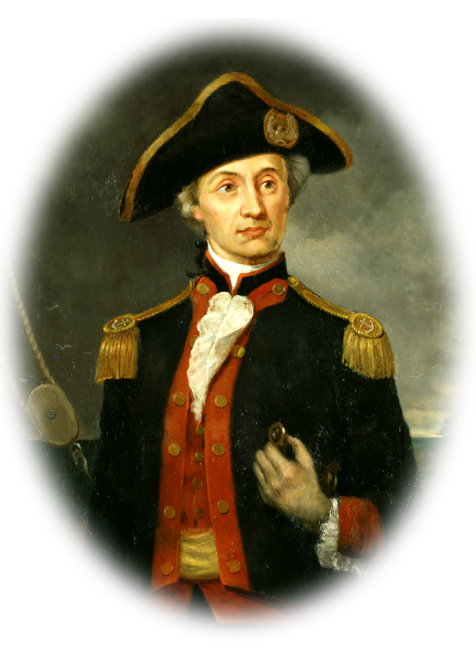
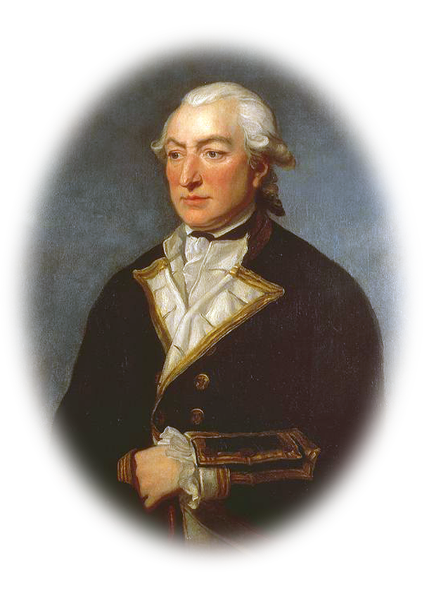
GREAT BOLDNESS
Notes:
www.deviantart.com/ahijah/art/USA-Grunge-Flag-Bright-169611262
en.wikiquote.org/wiki/John_Paul_Jones#/media/File:Cpt_John_Paul_Jones.jpg
en.wikipedia.org/wiki/Richard_Pearson_%28Royal_Navy_officer%29#/media/File:Sir_Richard_Pearson.jpg
I’m not sure there are many who are bolder in battle than John Paul Jones.
Story of JP JONES
In 1779 Jones would go down in history as one of the greatest naval commanders of the Revolutionary War. En route to raid British shipping, Jones’ warship, Bon Homme Richard (named after Benjamin Franklin), came head to head with the more powerful English warship HMS Serapis off the North Sea.
After three hours of relentless gun fire between the two vessels, Jones slammed Bon Homme into Serapis, strategically tying them together. Legend has it that when the British asked if Jones was ready to surrender, he famously responded: “I have not yet begun to fight!”
After one of Jones’ naval officers tossed a grenade onto Serapis, causing severe damage, it was the British who ultimately surrendered. Jones’ surprise victory against the better-equipped British naval ship had turned him into an international hero.
Mast has cross-trees to hold up the sails. .

Slide 5
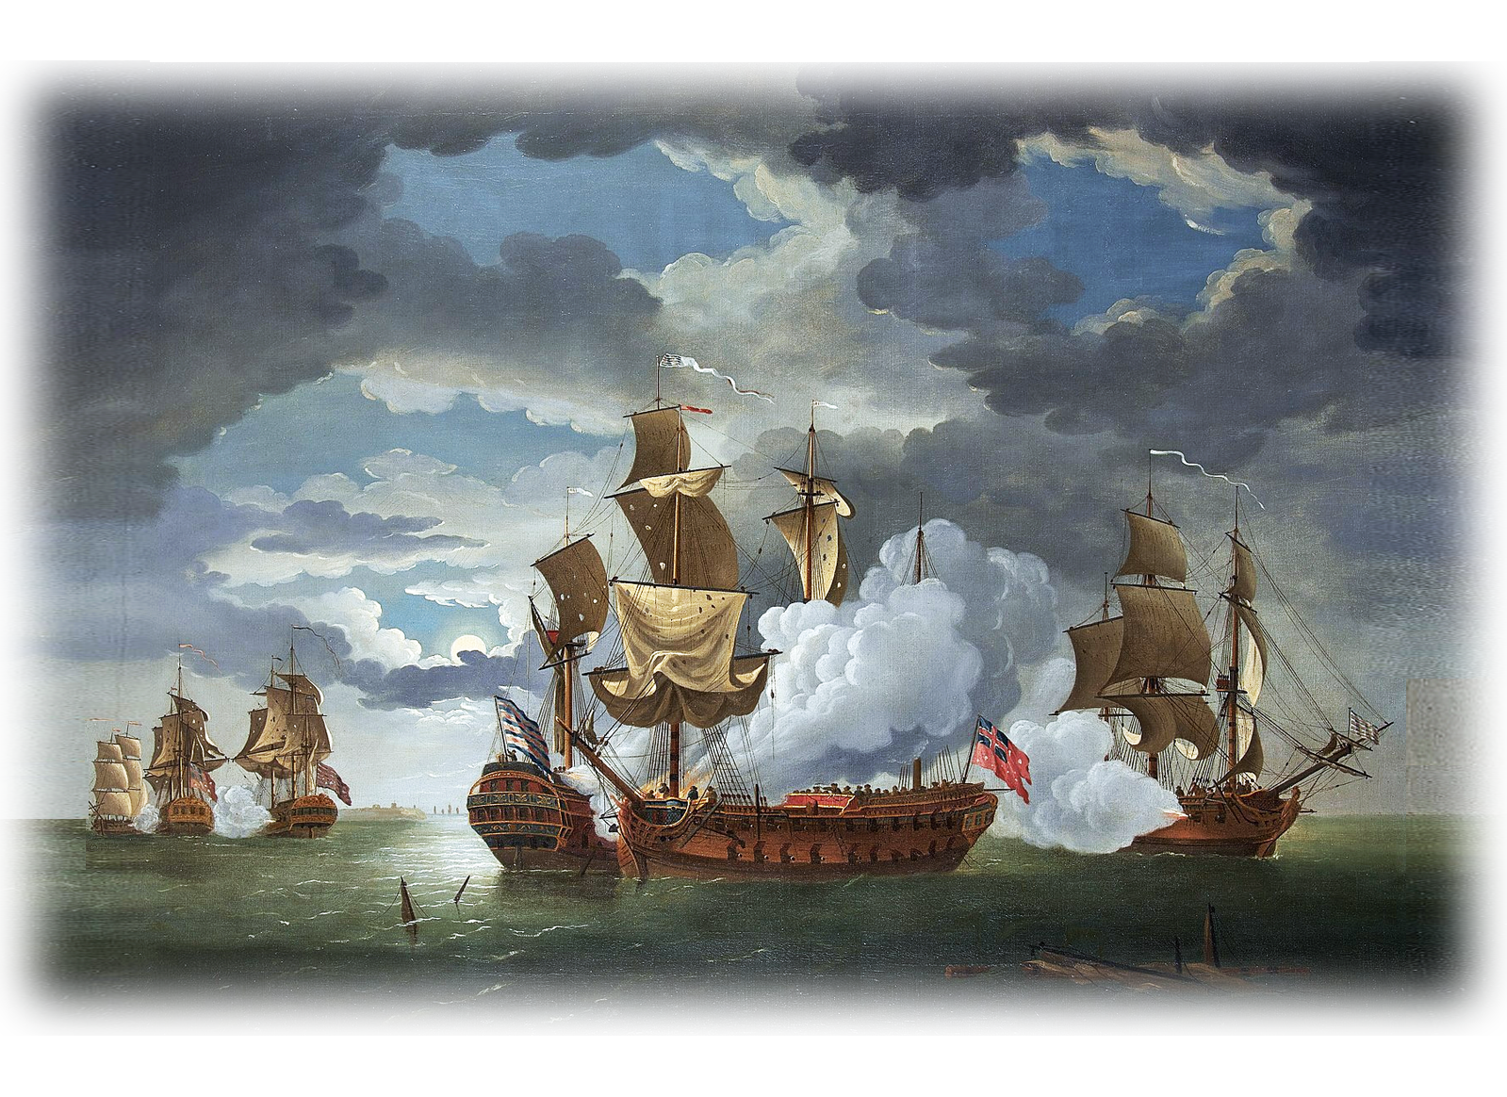
GREAT BOLDNESS
Notes:
www.deviantart.com/ahijah/art/USA-Grunge-Flag-Bright-169611262
I’m not sure there are many who are bolder in battle than John Paul Jones. en.wikiquote.org/wiki/John_Paul_Jones#/media/File:Cpt_John_Paul_Jones.jpg
Story of JP JONES

Slide 6
GREAT BOLDNESS
“I have not yet begun to fight!”
Notes:
www.deviantart.com/ahijah/art/USA-Grunge-Flag-Bright-169611262
en.wikiquote.org/wiki/John_Paul_Jones#/media/File:Cpt_John_Paul_Jones.jpg
en.wikipedia.org/wiki/Richard_Pearson_%28Royal_Navy_officer%29#/media/File:Sir_Richard_Pearson.jpg
I’m not sure there are many who are bolder in battle than John Paul Jones.
Story of JP JONES
In 1779 Jones would go down in history as one of the greatest naval commanders of the Revolutionary War. En route to raid British shipping, Jones’ warship, Bon Homme Richard (named after Benjamin Franklin), came head to head with the more powerful English warship HMS Serapis off the North Sea.
After three hours of relentless gun fire between the two vessels, Jones slammed Bon Homme into Serapis, strategically tying them together. Legend has it that when the British asked if Jones was ready to surrender, he famously responded: “I have not yet begun to fight!”
After one of Jones’ naval officers tossed a grenade onto Serapis, causing severe damage, it was the British who ultimately surrendered. Jones’ surprise victory against the better-equipped British naval ship had turned him into an international hero.

Slide 7
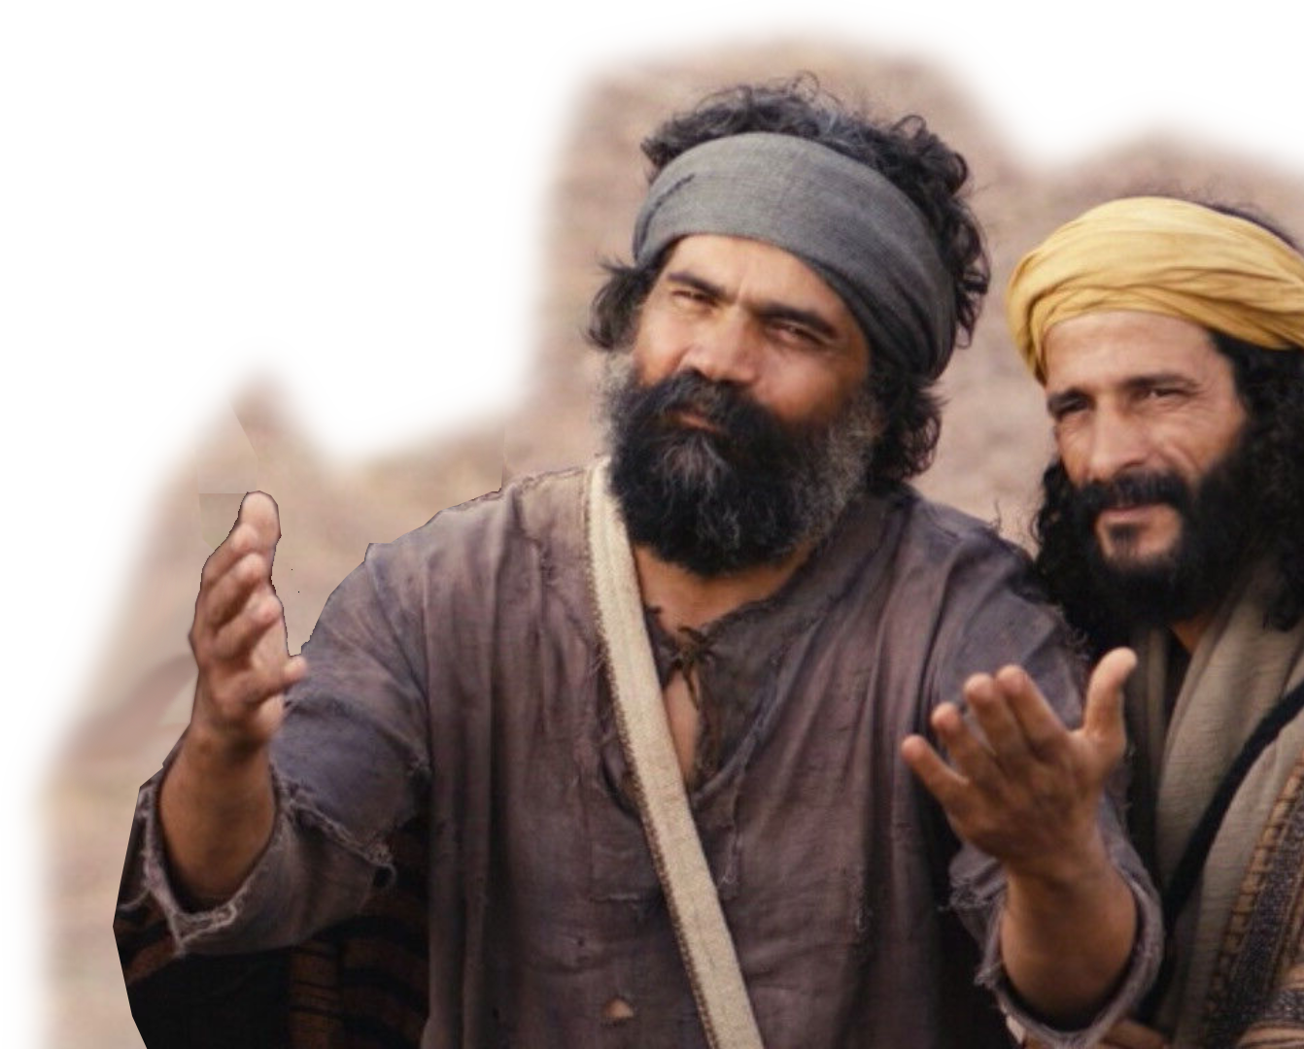

There are Biblical sailors with:
Peter & John
the fishermen
Notes:
https://www.freebibleimages.org/
They sailed the Sea of Galilee—not in battle for America, but battle for fish.\
But they were no longer fishers of fish—but fishers of men. For souls.

Slide 8
GREAT BOLDNESS
^{Acts 4:13} When they saw the courage of Peter and John …
^{Acts 4:29} … great boldness.
BOLDNESS

Slide 9

The Setting – not at sea …

Slide 10
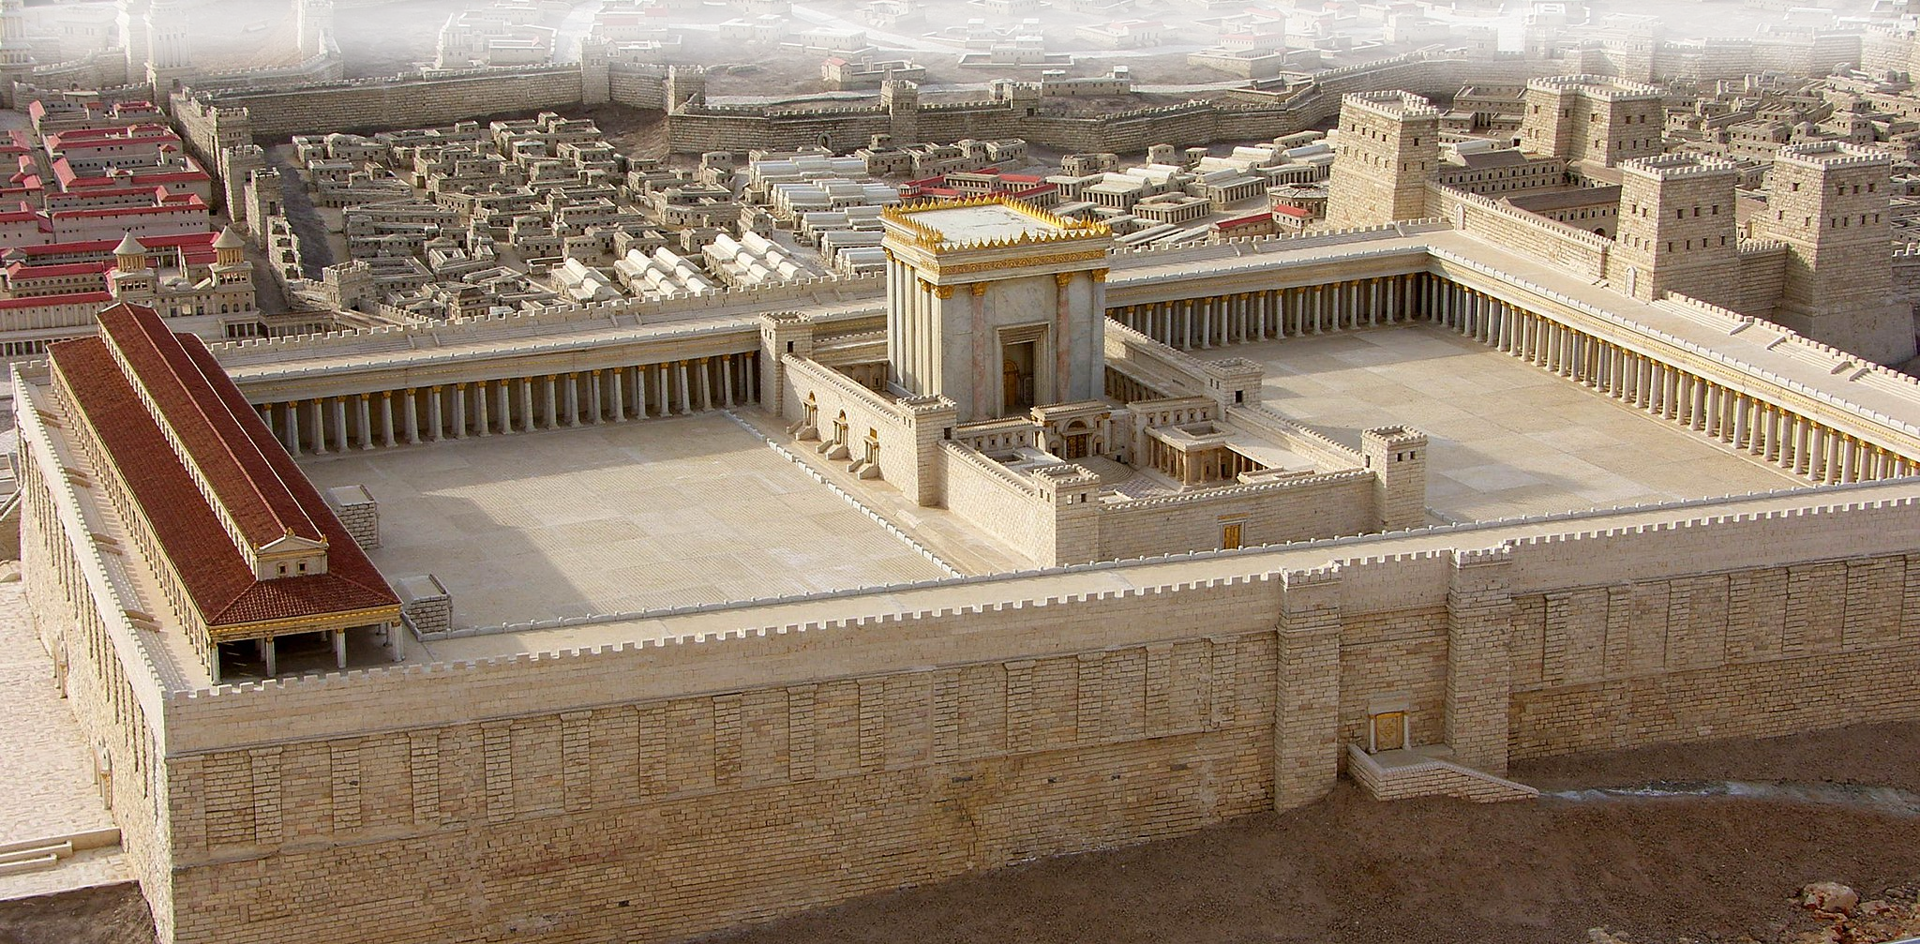
The Setting – in the temple!
Notes:
In the temple a more hostile area for Peter and John than for John Paul Jones.

Slide 11
The Setting – in the temple!
^{Acts 3:6} Then Peter said,
"Silver or gold I do not have,
but what I have I give you.
In the name of Jesus Christ
of Nazareth, walk.“
⁷ Taking him by the right
hand, he helped him up,
… ⁸ He jumped to his feet
and began to walk.
Notes:
https://www.freebibleimages.org/

Slide 12
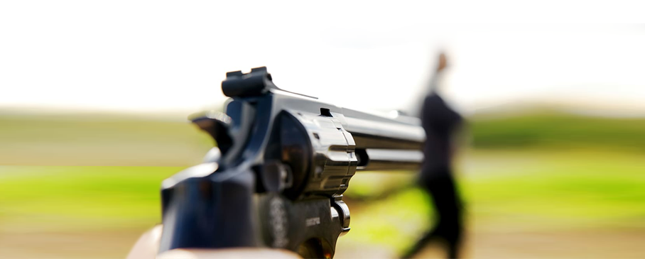
The NEED for Great Boldness
^{Acts 4:29} Now, Lord, consider their threats and enable your servants to speak your word with great boldness.
Who threatened them?
Notes:
c0.wallpaperflare.com/preview/240/204/964/gun-pointed-robber-weapon.jpg
Who threatened
The priests and the captain of the temple guard and the Sadducees came up to Peter and John while they were speaking to the people.
² They were greatly disturbed because the apostles were teaching the people and proclaiming in Jesus the resurrection of the dead.
³ They seized Peter and John, and because it was evening, they put them in jail until the next day.
⁴ But many who heard the message believed, and the number of men grew to about five thousand.
⁵ The next day the rulers, elders and teachers of the law met in Jerusalem.
⁶ Annas the high priest was there, and so were Caiaphas, John, Alexander and the other men of the high priest's family.
(Act 4:1-6 NIV)
What threats

Slide 13
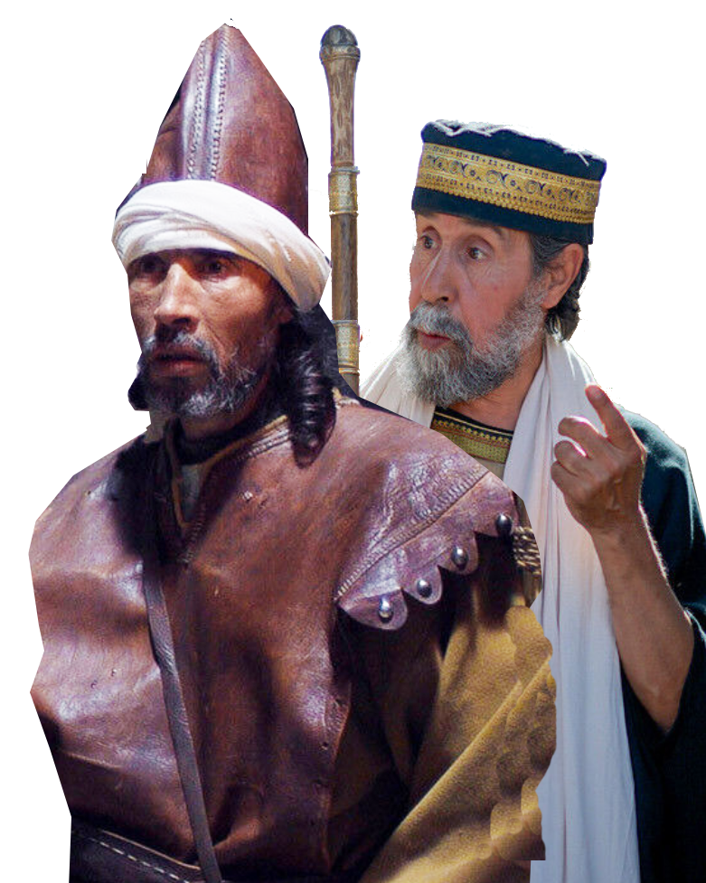
Priests, Guards & Sadducees
^{Acts 4:1} The priests and the captain of the temple guard and the Sadducees came up to Peter and John while they were speaking to the people. ² They were greatly disturbed because the apostles were teaching the people and proclaiming in Jesus the resurrection of the dead.
Notes:
https://www.freebibleimages.org/
Who threatened
The priests and the captain of the temple guard and the Sadducees came up to Peter and John while they were speaking to the people.
² They were greatly disturbed because the apostles were teaching the people and proclaiming in Jesus the resurrection of the dead.
³ They seized Peter and John, and because it was evening, they put them in jail until the next day.
⁴ But many who heard the message believed, and the number of men grew to about five thousand.
⁵ The next day the rulers, elders and teachers of the law met in Jerusalem.
⁶ Annas the high priest was there, and so were Caiaphas, John, Alexander and the other men of the high priest's family.
(Act 4:1-6 NIV)
What threats

Slide 14
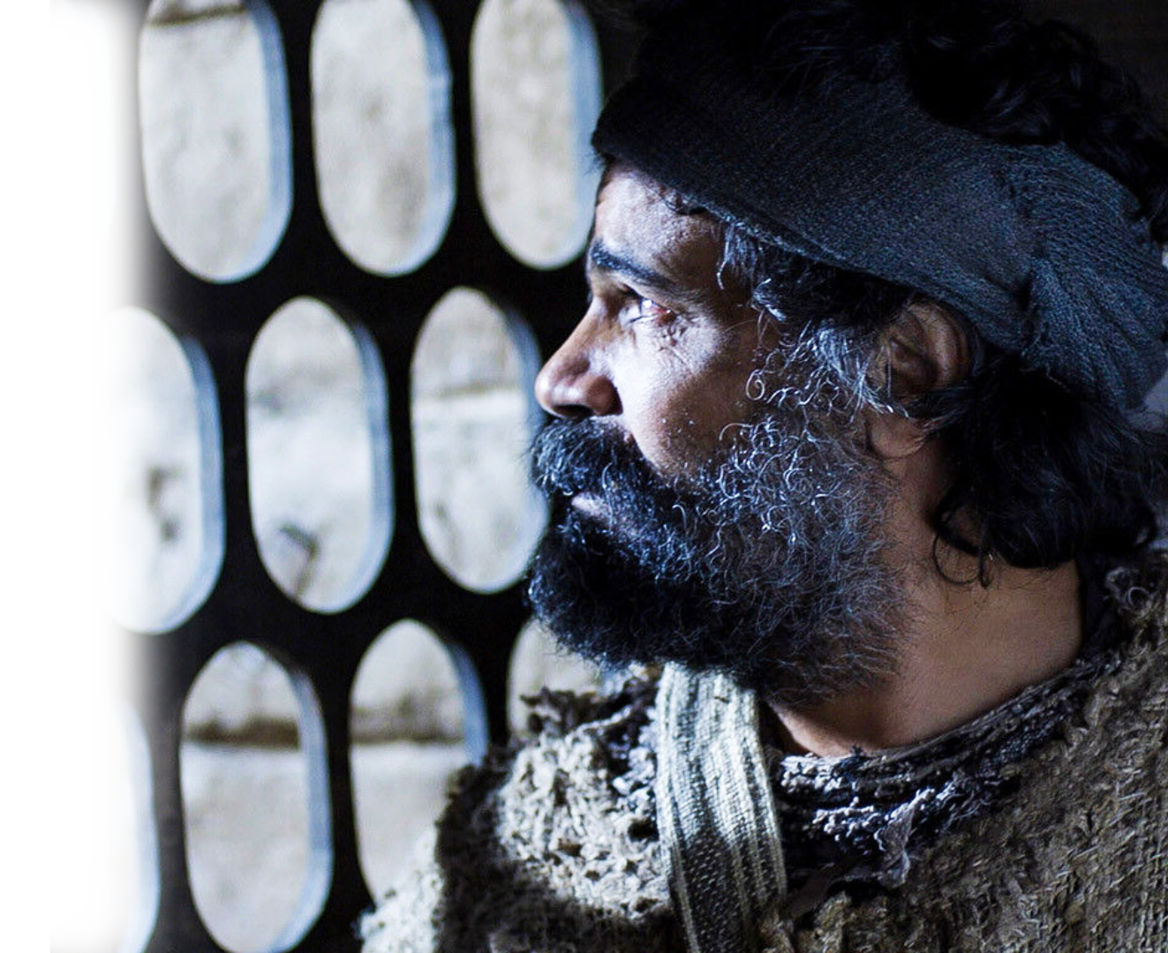
Priests, Guards & Sadducees
³ They seized Peter and John, and because it was evening, they put them in jail until the next day. ⁴ But many who heard the message believed, and the number of men grew to about five thousand.
Notes:
https://www.freebibleimages.org/
Who threatened
The priests and the captain of the temple guard and the Sadducees came up to Peter and John while they were speaking to the people.
² They were greatly disturbed because the apostles were teaching the people and proclaiming in Jesus the resurrection of the dead.
³ They seized Peter and John, and because it was evening, they put them in jail until the next day.
⁴ But many who heard the message believed, and the number of men grew to about five thousand.
⁵ The next day the rulers, elders and teachers of the law met in Jerusalem.
⁶ Annas the high priest was there, and so were Caiaphas, John, Alexander and the other men of the high priest's family.
(Act 4:1-6 NIV)
What threats

Slide 15
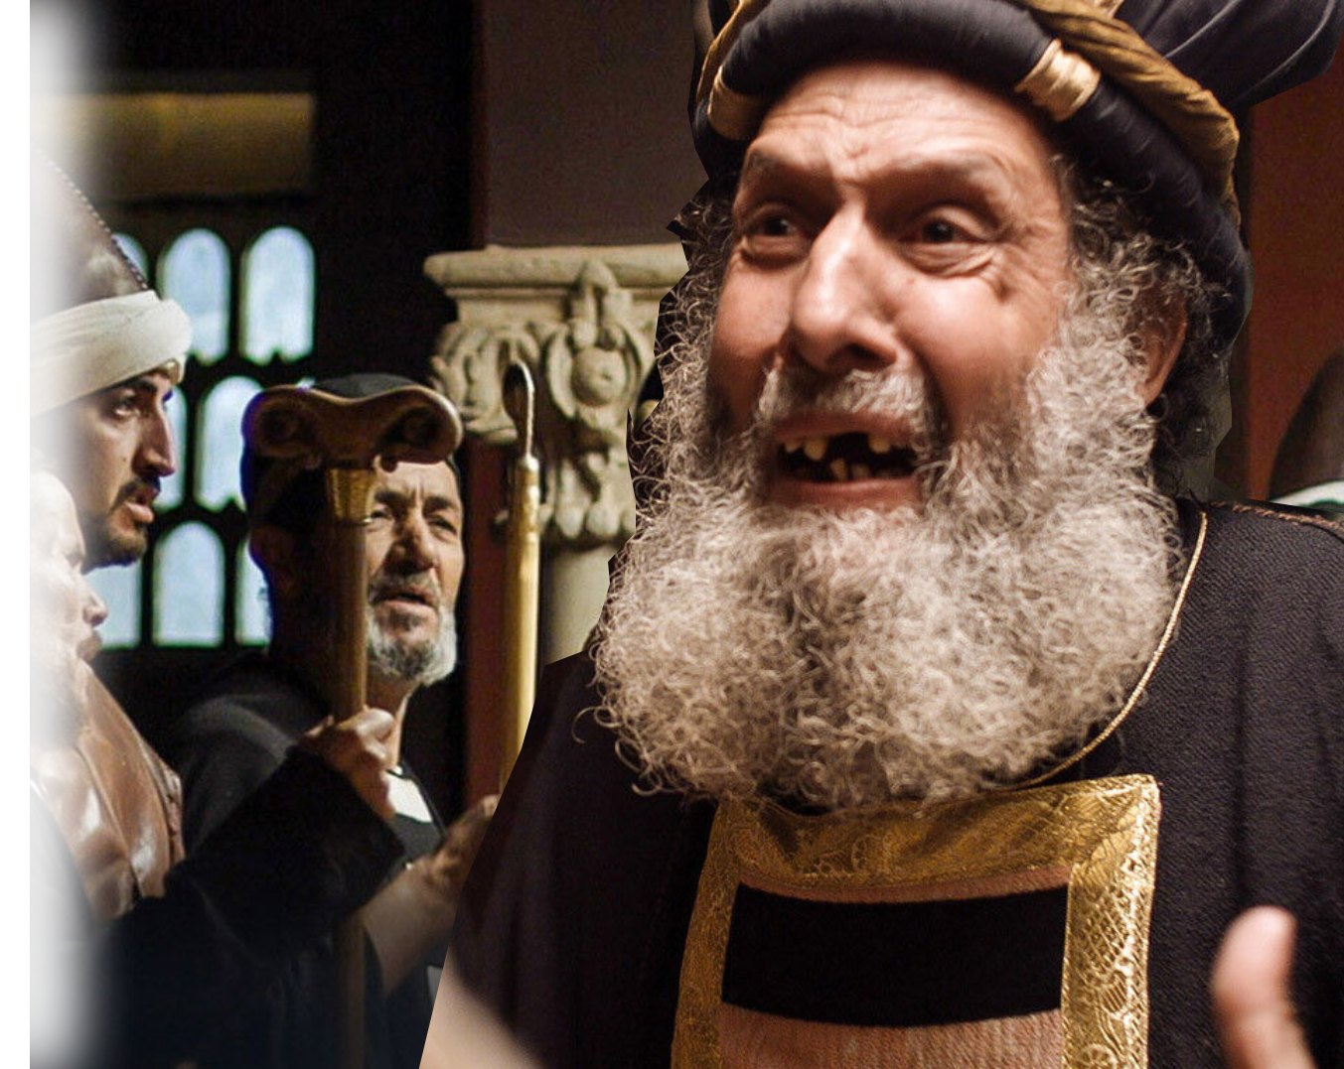
Religious Elite
⁵ The next day the rulers, elders and teachers of the law met in Jerusalem. ⁶ Annas the high priest was there, and so were Caiaphas, John, Alexander and the other men of the high priest's family.
Notes:
https://www.freebibleimages.org/
Who threatened
The priests and the captain of the temple guard and the Sadducees came up to Peter and John while they were speaking to the people.
² They were greatly disturbed because the apostles were teaching the people and proclaiming in Jesus the resurrection of the dead.
³ They seized Peter and John, and because it was evening, they put them in jail until the next day.
⁴ But many who heard the message believed, and the number of men grew to about five thousand.
⁵ The next day the rulers, elders and teachers of the law met in Jerusalem.
⁶ Annas the high priest was there, and so were Caiaphas, John, Alexander and the other men of the high priest's family.
(Act 4:1-6 NIV)
What threats

Slide 16
The Power of Great Boldness
⁷ They had Peter and John brought before them and began to question them:
"By what power
or what name
did you do this?"
Notes:
https://www.freebibleimages.org/
Who threatened
The priests and the captain of the temple guard and the Sadducees came up to Peter and John while they were speaking to the people.
² They were greatly disturbed because the apostles were teaching the people and proclaiming in Jesus the resurrection of the dead.
³ They seized Peter and John, and because it was evening, they put them in jail until the next day.
⁴ But many who heard the message believed, and the number of men grew to about five thousand.
⁵ The next day the rulers, elders and teachers of the law met in Jerusalem.
⁶ Annas the high priest was there, and so were Caiaphas, John, Alexander and the other men of the high priest's family.
(Act 4:1-6 NIV)
What threats

Slide 17
So, why did they threaten them?
Because of …
Notes:
https://www.freebibleimages.org/
Why did they threaten them?
⁸ Then Peter, filled with the Holy Spirit, said to them: "Rulers and elders of the people!
⁹ If we are being called to account today for an act of kindness shown to a cripple and are asked how he was healed,
¹⁰ then know this, you and all the people of Israel: It is by the name of Jesus Christ of Nazareth, whom you crucified but whom God raised from the dead, that this man stands before you healed.
(Act 4:8-10 NIV)

Slide 18
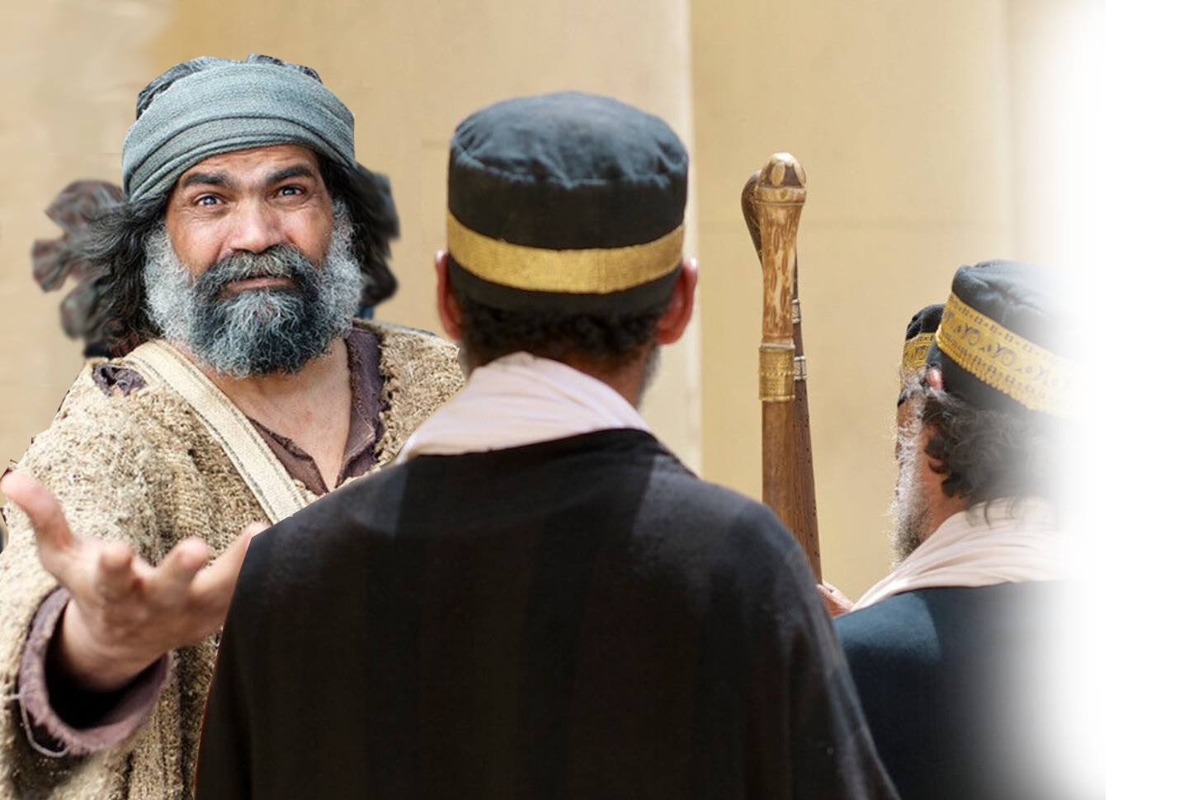
The Miracle of Great Boldness
⁸ Then Peter, filled with the Holy Spirit, said to them:
Notes:
https://www.freebibleimages.org/
Who threatened
The priests and the captain of the temple guard and the Sadducees came up to Peter and John while they were speaking to the people.
² They were greatly disturbed because the apostles were teaching the people and proclaiming in Jesus the resurrection of the dead.
³ They seized Peter and John, and because it was evening, they put them in jail until the next day.
⁴ But many who heard the message believed, and the number of men grew to about five thousand.
⁵ The next day the rulers, elders and teachers of the law met in Jerusalem.
⁶ Annas the high priest was there, and so were Caiaphas, John, Alexander and the other men of the high priest's family.
(Act 4:1-6 NIV)
What threats

Slide 19
The Miracle of Great Boldness
⁸ Then Peter, filled with the Holy Spirit, said to them: "Rulers and elders of the people! ⁹ If we are being called to account today for an act of kindness shown to a cripple and are asked how he was healed, …
Notes:
https://www.freebibleimages.org/
Who threatened
The priests and the captain of the temple guard and the Sadducees came up to Peter and John while they were speaking to the people.
² They were greatly disturbed because the apostles were teaching the people and proclaiming in Jesus the resurrection of the dead.
³ They seized Peter and John, and because it was evening, they put them in jail until the next day.
⁴ But many who heard the message believed, and the number of men grew to about five thousand.
⁵ The next day the rulers, elders and teachers of the law met in Jerusalem.
⁶ Annas the high priest was there, and so were Caiaphas, John, Alexander and the other men of the high priest's family.
(Act 4:1-6 NIV)
What threats

Slide 20
Because of the Healing Name
¹⁰ then know this, you and all the people of Israel: It is by the name of Jesus Christ of Nazareth, whom you crucified but whom God raised from the dead, that this man stands before you healed.
Notes:
https://www.freebibleimages.org/
Who threatened
The priests and the captain of the temple guard and the Sadducees came up to Peter and John while they were speaking to the people.
² They were greatly disturbed because the apostles were teaching the people and proclaiming in Jesus the resurrection of the dead.
³ They seized Peter and John, and because it was evening, they put them in jail until the next day.
⁴ But many who heard the message believed, and the number of men grew to about five thousand.
⁵ The next day the rulers, elders and teachers of the law met in Jerusalem.
⁶ Annas the high priest was there, and so were Caiaphas, John, Alexander and the other men of the high priest's family.
(Act 4:1-6 NIV)
What threats

Slide 21
Because of the Saving Name
¹¹ He is " 'the stone you builders rejected, which has become the capstone. ‘ ¹² Salvation is found in no one else, for there is no other name under heaven given to men by which we must be saved."
Notes:
Who threatened
The priests and the captain of the temple guard and the Sadducees came up to Peter and John while they were speaking to the people.
² They were greatly disturbed because the apostles were teaching the people and proclaiming in Jesus the resurrection of the dead.
³ They seized Peter and John, and because it was evening, they put them in jail until the next day.
⁴ But many who heard the message believed, and the number of men grew to about five thousand.
⁵ The next day the rulers, elders and teachers of the law met in Jerusalem.
⁶ Annas the high priest was there, and so were Caiaphas, John, Alexander and the other men of the high priest's family.
(Act 4:1-6 NIV)
What threats

Slide 22
The Reaction to Great Boldness

Slide 23
The Reaction to Great Boldness
¹³ When they saw the courage of Peter and John and realized that they were unschooled, ordinary men, they were astonished and they took note that these men had been with Jesus.
BOLDNESS
Notes:
https://www.freebibleimages.org/
Courage = Boldness in Greek text

Slide 24
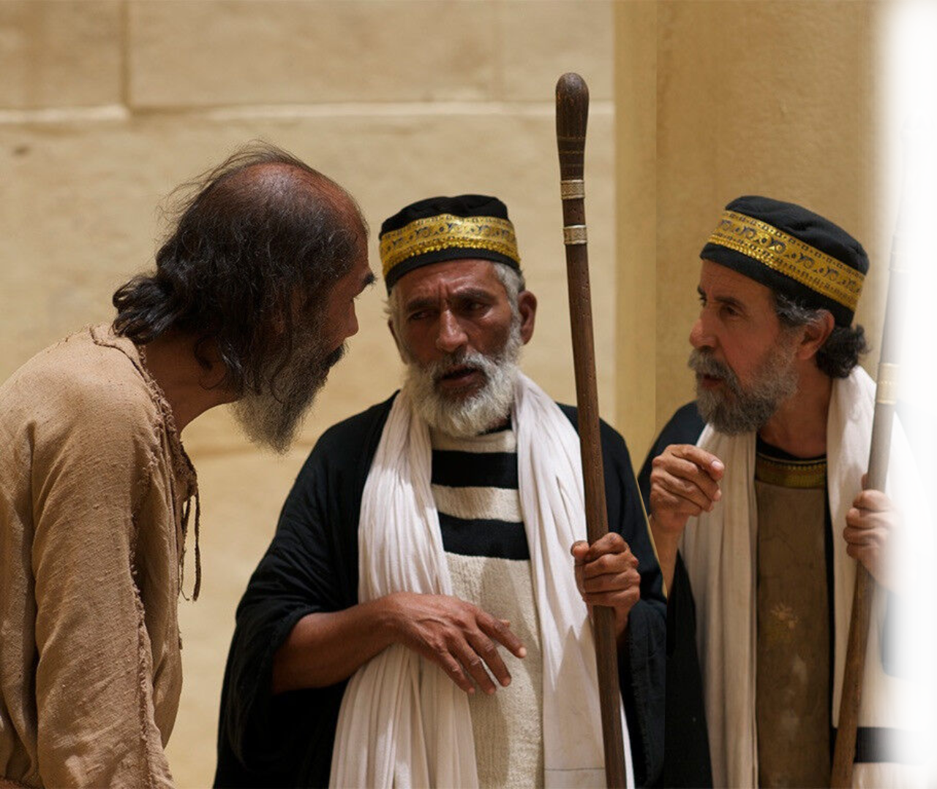
The Reaction to Great Boldness
¹⁴ But since they could see the man who had been healed standing there with them, there was nothing they could say.
Notes:
https://www.freebibleimages.org/

Slide 25
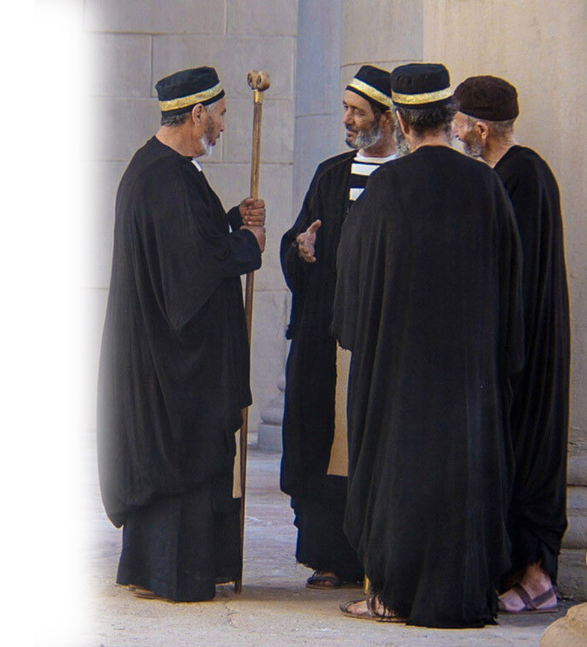
The Reaction to Great Boldness
¹⁵ …the Sanhedrin … then conferred together …¹⁸ Then they … commanded them not to speak or teach at all in the name of Jesus.
CANCEL
Christian Culture
Notes:
https://www.freebibleimages.org/

Slide 26
The Assertion of Great Boldness
¹⁹ But Peter and John replied,
"Judge for yourselves whether it is right in God's sight to obey you rather than God. ²⁰ For we cannot help speak-ing about what we have seen and heard."
Notes:
https://www.freebibleimages.org/
From time to time, we who preach the Word are asked not to. It’s offensive. Of course, it is. It’s the Gospel.

Slide 27
The Report of Great Boldness
²³ On their release, Peter and John went back to their own people and reported all that the chief priests and elders had said to them.
Notes:
https://www.freebibleimages.org/

Slide 28
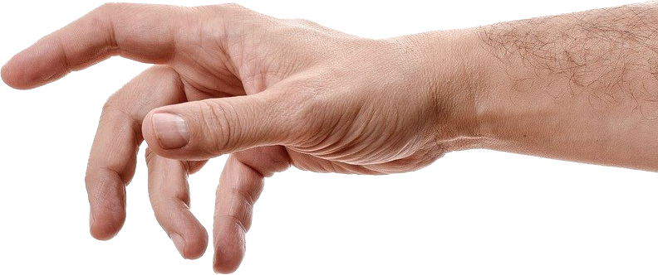

The Prayer for Great Boldness
²⁴ When they heard this, they raised their voices together in prayer to God.
"Sovereign Lord," they said, "you made the heaven and the earth and the sea, and everything in them.
God Created
Notes:
²⁴ When they heard this, they raised their voices together in prayer to God. "Sovereign Lord," they said, "you made the heaven and the earth and the sea, and everything in them.
²⁵ You spoke by the Holy Spirit through the mouth of your servant, our father David: " 'Why do the nations rage and the peoples plot in vain?
²⁶ The kings of the earth take their stand and the rulers gather together against the Lord and against his Anointed One. '
²⁷ Indeed Herod and Pontius Pilate met together with the Gentiles and the people of Israel in this city to conspire against your holy servant Jesus, whom you anointed.
²⁸ They did what your power and will had decided beforehand should happen.
(Act 4:24-28 NIV)

Slide 29
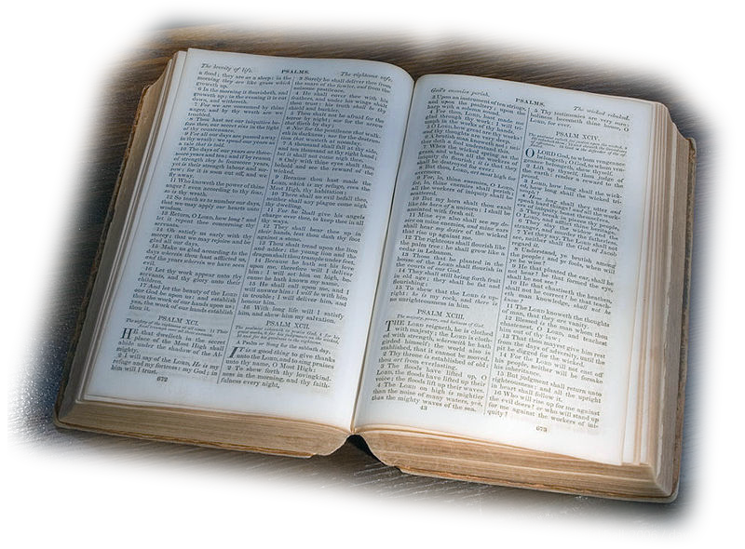
Prayer based on Scripture
²⁵ You spoke by the Holy Spirit through the mouth of your servant, our father David: " 'Why do the nations rage and the peoples plot in vain?
²⁶ The kings of the earth take their stand and the rulers gather together against the Lord and against his Anointed One. '
God Spoke
Notes:
²⁴ When they heard this, they raised their voices together in prayer to God. "Sovereign Lord," they said, "you made the heaven and the earth and the sea, and everything in them.
²⁵ You spoke by the Holy Spirit through the mouth of your servant, our father David: " 'Why do the nations rage and the peoples plot in vain?
²⁶ The kings of the earth take their stand and the rulers gather together against the Lord and against his Anointed One. '
²⁷ Indeed Herod and Pontius Pilate met together with the Gentiles and the people of Israel in this city to conspire against your holy servant Jesus, whom you anointed.
²⁸ They did what your power and will had decided beforehand should happen.
(Act 4:24-28 NIV)

Slide 30
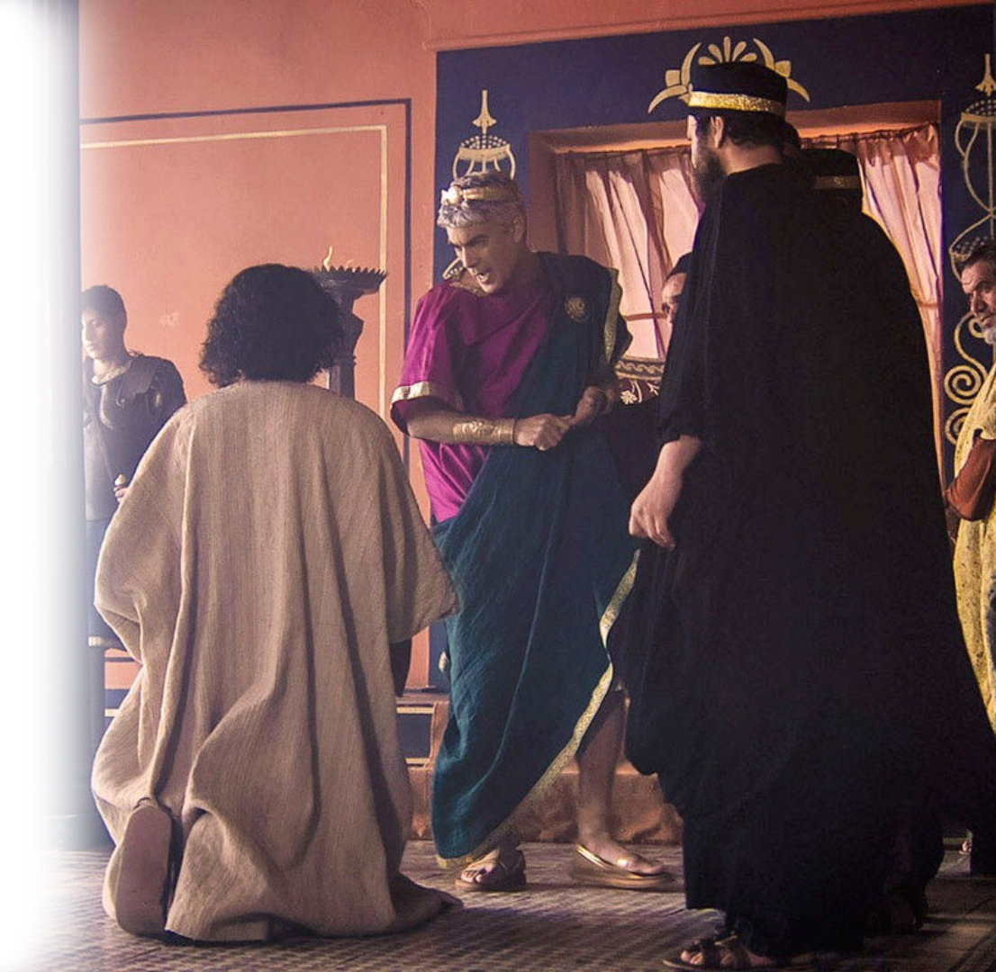
Prayer with Application
²⁷ Indeed Herod and Pontius Pilate met together with the Gentiles and the people of Israel in this city to conspire against your holy servant Jesus, whom you anointed.
It Applies
Notes:
https://www.freebibleimages.org/
²⁴ When they heard this, they raised their voices together in prayer to God. "Sovereign Lord," they said, "you made the heaven and the earth and the sea, and everything in them.
²⁵ You spoke by the Holy Spirit through the mouth of your servant, our father David: " 'Why do the nations rage and the peoples plot in vain?
²⁶ The kings of the earth take their stand and the rulers gather together against the Lord and against his Anointed One. '
²⁷ Indeed Herod and Pontius Pilate met together with the Gentiles and the people of Israel in this city to conspire against your holy servant Jesus, whom you anointed.
²⁸ They did what your power and will had decided beforehand should happen.
(Act 4:24-28 NIV)

Slide 31
Prayer focus on Providence
²⁸ to do whatever Your hand and Your purpose determined before to be done. (NKJ)
²⁸ They did what your power and will had decided beforehand should happen.
God Reigns
Notes:
²⁴ When they heard this, they raised their voices together in prayer to God. "Sovereign Lord," they said, "you made the heaven and the earth and the sea, and everything in them.
²⁵ You spoke by the Holy Spirit through the mouth of your servant, our father David: " 'Why do the nations rage and the peoples plot in vain?
²⁶ The kings of the earth take their stand and the rulers gather together against the Lord and against his Anointed One. '
²⁷ Indeed Herod and Pontius Pilate met together with the Gentiles and the people of Israel in this city to conspire against your holy servant Jesus, whom you anointed.
²⁸ They did what your power and will had decided beforehand should happen.
(Act 4:24-28 NIV)

Slide 32
The Prayer Request
Now, Lord, consider their threats and enable your servants to speak your word with great boldness.
CANCEL
Christian Culture
Notes:
https://www.freebibleimages.org/
Who threatened
The priests and the captain of the temple guard and the Sadducees came up to Peter and John while they were speaking to the people.
² They were greatly disturbed because the apostles were teaching the people and proclaiming in Jesus the resurrection of the dead.
³ They seized Peter and John, and because it was evening, they put them in jail until the next day.
⁴ But many who heard the message believed, and the number of men grew to about five thousand.
⁵ The next day the rulers, elders and teachers of the law met in Jerusalem.
⁶ Annas the high priest was there, and so were Caiaphas, John, Alexander and the other men of the high priest's family.
(Act 4:1-6 NIV)
What threats

Slide 33
The Prayer Request
Now, Lord, consider their threats and enable your servants to speak your word with great boldness.
Notes:
c0.wallpaperflare.com/preview/240/204/964/gun-pointed-robber-weapon.jpg
Who threatened
The priests and the captain of the temple guard and the Sadducees came up to Peter and John while they were speaking to the people.
² They were greatly disturbed because the apostles were teaching the people and proclaiming in Jesus the resurrection of the dead.
³ They seized Peter and John, and because it was evening, they put them in jail until the next day.
⁴ But many who heard the message believed, and the number of men grew to about five thousand.
⁵ The next day the rulers, elders and teachers of the law met in Jerusalem.
⁶ Annas the high priest was there, and so were Caiaphas, John, Alexander and the other men of the high priest's family.
(Act 4:1-6 NIV)
What threats

Slide 34
The Prayer Request
³⁰ Stretch out your hand to heal and perform miraculous signs and wonders through the name of your holy servant Jesus."
Notes:
pixabay.com/photos/hand-woman-female-man-touch-3035665/
The mighty hand of God is the means to Great Boldness

Slide 35
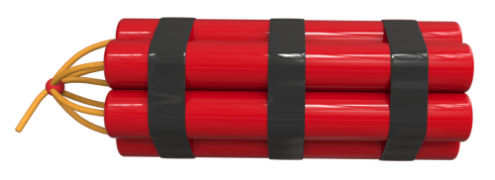
The Prayer Request
³⁰ Stretch out your hand to heal and perform miraculous signs and wonders through the name of your holy servant Jesus."
Dynamite
Healing
Notes:
The word “miraculous” is added. It does not occur in the Greek text. However, the word healing (dunamis = great power) is replaced with the word healing (ἴασιν Act 4:30)—because it was the powerful hand of God that healed. Note also that the word “sign” is used to say, God is speaking and validating this gospel preached by the apostles. Listen to them! It must me noted as well that the “wonders” = marvel and awe as seen in the response of belief on the Jesus followers and outrage and consternation on the part of the adversaries of Jesus. The miracle of healing gets a response of belief or unbelief – you never stand neutral to the work of God.
All three Power, Sign, Wonder make a miracle a Biblical miracle.
My definition of great boldness is when God performs his mighty power through us. That’s great boldness.

Slide 36

The Prayer Request
³⁰ Stretch out your hand to heal and perform miraculous signs and wonders through the name of your holy servant Jesus."
SIGNS SAY SOMETHING
Dynamite
THIS WAY
Healing
Notes:
The word “miraculous” is added. It does not occur in the Greek text. However, the word healing (dunamis = great power) is replaced with the word healing (ἴασιν Act 4:30)—because it was the powerful hand of God that healed. Note also that the word “sign” is used to say, God is speaking and validating this gospel preached by the apostles. Listen to them! It must me noted as well that the “wonders” = marvel and awe as seen in the response of belief on the Jesus followers and outrage and consternation on the part of the adversaries of Jesus. The miracle of healing gets a response of belief or unbelief – you never stand neutral to the work of God.
All three Power, Sign, Wonder make a miracle a Biblical miracle.
My definition of great boldness is when God performs his mighty power through us. That’s great boldness.

Slide 37

The Prayer Request
³⁰ Stretch out your hand to heal and perform miraculous signs and wonders through the name of your holy servant Jesus."
SIGNS SAY SOMETHING
Dynamite
THIS WAY
Healing
Notes:
The word “miraculous” is added. It does not occur in the Greek text. However, the word healing (dunamis = great power) is replaced with the word healing (ἴασιν Act 4:30)—because it was the powerful hand of God that healed. Note also that the word “sign” is used to say, God is speaking and validating this gospel preached by the apostles. Listen to them! It must me noted as well that the “wonders” = marvel and awe as seen in the response of belief on the Jesus followers and outrage and consternation on the part of the adversaries of Jesus. The miracle of healing gets a response of belief or unbelief – you never stand neutral to the work of God.
All three Power, Sign, Wonder make a miracle a Biblical miracle.
My definition of great boldness is when God performs his mighty power through us. That’s great boldness.

Slide 38

The Prayer Worked!
³¹ After they prayed, the place where they were meeting was shaken. And they were all filled with the Holy Spirit and spoke the word of God boldly.
Notes:
pixabay.com/photos/prayer-bible-christian-folded-hands-1308663/
Great boldness works hand in hand with prayer. Don’t expect great boldness without prayer.

Slide 39

The Prayer Worked!
³¹ After they prayed, the place where they were meeting was shaken. And they were all filled with the Holy Spirit and spoke the word of God boldly.
Notes:
www.flickr.com/photos/jeanette4/8079987582/

Slide 40
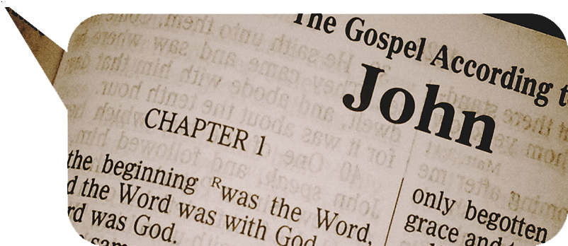
The Prayer Worked!
³¹ After they prayed, the place where they were meeting was shaken. And they were all filled with the Holy Spirit and spoke the word of God boldly.

Slide 41
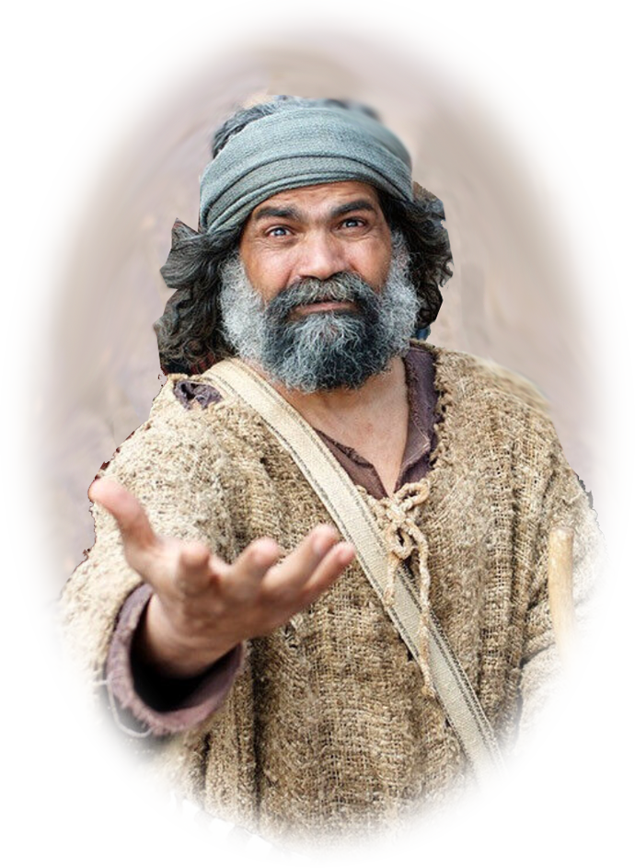

Don’t You Wish You Had Such BOLDNESS?
It is found in …
It is found in …

Slide 42

Don’t You Wish You Had Such BOLDNESS?
It is found in …
The powerful name of Jesus

Slide 43
Don’t You Wish You Had Such BOLDNESS?
It is found in …
The powerful name of Jesus
The healing name of Jesus

Slide 44
Don’t You Wish You Had Such BOLDNESS?
It is found in …
The powerful name of Jesus
The healing name of Jesus
The saving name of Jesus

Slide 45
LET’S PRAY

