Slide 1

Notes:
Copyright © 2006−2021. All rights reserved. Bible Point is a registered trademark of Dennis Henderson. All other trademarks acknowledged.
Bible Point contains graphics from Bible Point artists. These illustrations belong to Bible Point and the respective artists. You may use the designs and illustrations for graphical illustration of lessons free and without special permission, provided they are not used in any way that maligns the Christian faith. Furthermore, republication or production of any illustration by any other graphic service whether it be in book, in a machine-readable form, or in any other design resource is strictly prohibited. Furthermore, they cannot be duplicated or resold as any other form of publishing, clip art, or graphic resource.
So What does it mean? (A simple translations of the legal jargon)
So, if you don’t own the presentation(s), graphic(s), and text(s) how can you legally use them? The purchase of the license allows you to use all the images in the product. However, the actual ownership and copyright of the presentation(s), graphic(s), and text(s) remain the property of Bible Point and its licensors. If you had plans on using this product in your “for sale” work—think again!
License Agreement
Article 1: License Grant
All the graphics and text in Bible Point presentations (excluding quotes from the Bible and stated sources) are the intellectual and real property of Bible Point and its licensors, and is protected by law, including United States copyright laws and international treaties. Bible Point grants to you a license:
1. To use the presentation in a single church, single school, or single office of a Christian organization.
2. To make a single archival back-up copy of the program.
3. To modify the presentation(s) and merge with other presentations in a single church, school, or Christian organization.
4. To transfer to another party if that party agrees to accept the terms and conditions of this agreement, and you do not retain any copies of the presentation, whether printed, machine readable, modified, or merged form.
Article 2: Terms
This license is effective until terminated. You may terminate the license at any time by destroying the presentation(s), graphic(s), or text(s) together with all copies, modifications and merged portions in any form. Bible Point may terminate your license if you fail to comply with this Agreement. You agree, upon such termination, for any reason, to destroy the presentation(s), graphics, and text(s) with all copies, modifications, and merged portions in any form.
Article 3: Disclaimers
1. Bible Point presentations, graphics, and texts are licensed to you As Is. You, the consumer, bear the entire risk relating to the quality and performance of the presentation(s), graphic(s), or text(s). In no event will Bible Point be liable for damages resulting from any defect.
2. Thirty-day limited warrantee on disks. Bible Point warrants the disks to be free of defects in material and workmanship under normal use for 30 days after purchase. During the 30-day period you may return a defective presentation, graphic, or text with proof of purchase and it will be replaced without charge, unless the presentation is damaged by misuse.
Article 4: General
1. You may not sub-license, assign, or transfer the license of the presentation(s), graphic(s), or text(s) except as provided by this Agreement.
2. This Agreement will be governed by the laws of the State of Michigan.
So What does it mean? (A simple translations of the legal jargon)
May I let someone borrow or copy my licensed Bible Point presentation (even after I modified it)? As long as it is within your local church, or single school, or the immediate office of a Christian organization you may. Otherwise, please refer the person interested in borrowing to: http://www.biblepoint.com or E-mail: dennis@DrDH.net with any related questions.

Slide 2
Self-Control
Notes:
Copyright © 2006−2021. All rights reserved. Bible Point is a registered trademark of Dennis Henderson. All other trademarks acknowledged.
Bible Point contains graphics from Bible Point artists. These illustrations belong to Bible Point and the respective artists. You may use the designs and illustrations for graphical illustration of lessons free and without special permission, provided they are not used in any way that maligns the Christian faith. Furthermore, republication or production of any illustration by any other graphic service whether it be in book, in a machine-readable form, or in any other design resource is strictly prohibited. Furthermore, they cannot be duplicated or resold as any other form of publishing, clip art, or graphic resource.
So What does it mean? (A simple translations of the legal jargon)
So, if you don’t own the presentation(s), graphic(s), and text(s) how can you legally use them? The purchase of the license allows you to use all the images in the product. However, the actual ownership and copyright of the presentation(s), graphic(s), and text(s) remain the property of Bible Point and its licensors. If you had plans on using this product in your “for sale” work—think again!
License Agreement
Article 1: License Grant
All the graphics and text in Bible Point presentations (excluding quotes from the Bible and stated sources) are the intellectual and real property of Bible Point and its licensors, and is protected by law, including United States copyright laws and international treaties. Bible Point grants to you a license:
1. To use the presentation in a single church, single school, or single office of a Christian organization.
2. To make a single archival back-up copy of the program.
3. To modify the presentation(s) and merge with other presentations in a single church, school, or Christian organization.
4. To transfer to another party if that party agrees to accept the terms and conditions of this agreement, and you do not retain any copies of the presentation, whether printed, machine readable, modified, or merged form.
Article 2: Terms
This license is effective until terminated. You may terminate the license at any time by destroying the presentation(s), graphic(s), or text(s) together with all copies, modifications and merged portions in any form. Bible Point may terminate your license if you fail to comply with this Agreement. You agree, upon such termination, for any reason, to destroy the presentation(s), graphics, and text(s) with all copies, modifications, and merged portions in any form.
Article 3: Disclaimers
1. Bible Point presentations, graphics, and texts are licensed to you As Is. You, the consumer, bear the entire risk relating to the quality and performance of the presentation(s), graphic(s), or text(s). In no event will Bible Point be liable for damages resulting from any defect.
2. Thirty-day limited warrantee on disks. Bible Point warrants the disks to be free of defects in material and workmanship under normal use for 30 days after purchase. During the 30-day period you may return a defective presentation, graphic, or text with proof of purchase and it will be replaced without charge, unless the presentation is damaged by misuse.
Article 4: General
1. You may not sub-license, assign, or transfer the license of the presentation(s), graphic(s), or text(s) except as provided by this Agreement.
2. This Agreement will be governed by the laws of the State of Michigan.
So What does it mean? (A simple translations of the legal jargon)
May I let someone borrow or copy my licensed Bible Point presentation (even after I modified it)? As long as it is within your local church, or single school, or the immediate office of a Christian organization you may. Otherwise, please refer the person interested in borrowing to: http://www.biblepoint.com or E-mail: dennis@DrDH.net with any related questions.

Slide 3
I. What is Self-Control
Notes:
Bald man = FREE = modified from http://www.rgbstock.com/download/ColinBrough/n9ExeOu.jpg

Slide 4
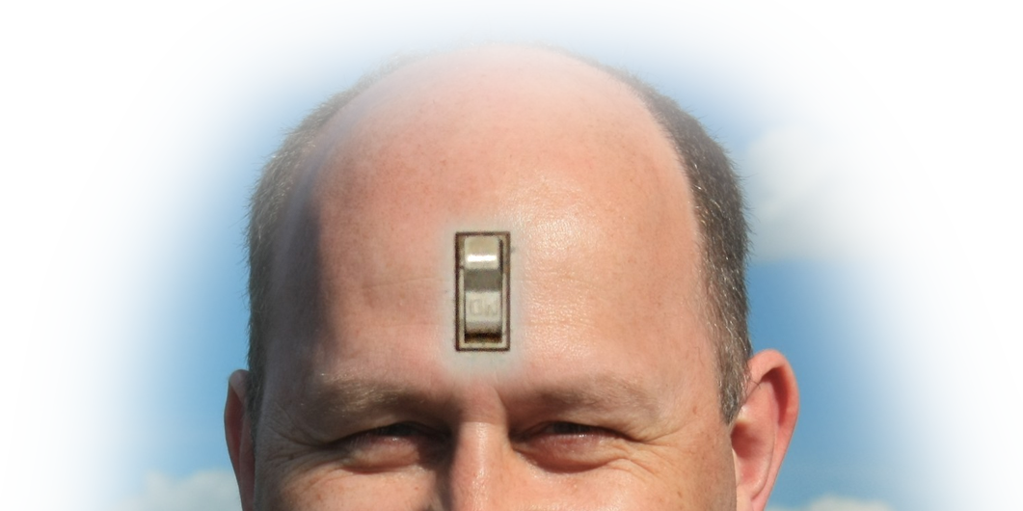
I. What is Self-Control
It is the virtue of mastering your desires and passions, especially sensual appetites.
Notes:
Bald man = FREE = modified from http://www.rgbstock.com/download/ColinBrough/n9ExeOu.jpg

Slide 5
II. Where is it NEEDED?

Slide 6
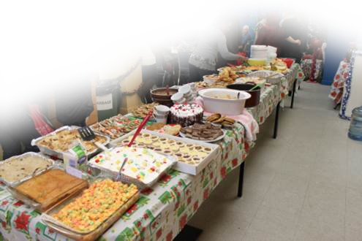
II. Where is it NEEDED?
Food appetite for Dieters

Slide 7
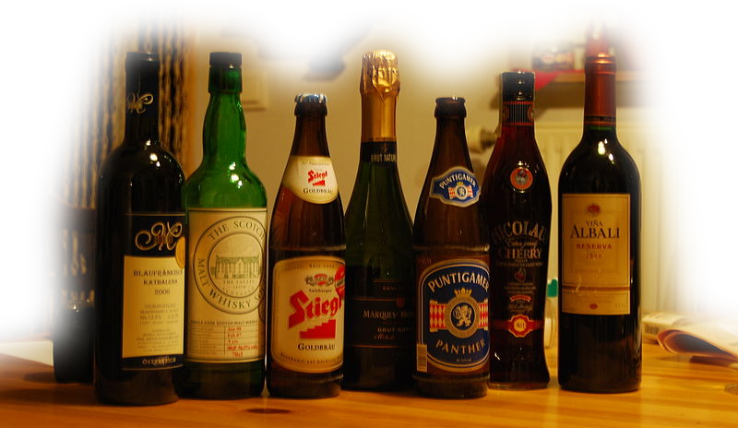
II. Where is it NEEDED?
Food appetite for Dieters
Alcohol appetite for Drunkards
Notes:
Food = FREE = http://commons.wikimedia.org/wiki/File:Interesting_alcoholic_beverages.jpg

Slide 8

II. Where is it NEEDED?
Food appetite for Dieters
Alcohol appetite for Drunkards
High appetite for Addicts
Notes:
Pills = FREE = from http://www.flickr.com/photos/emagineart/4741451457/sizes/l/in/photostream/

Slide 9

II. Where is it NEEDED?
Food appetite for Dieters
Alcohol appetite for Drunkards
High appetite for Addicts
Thrill appetite for Gamblers
Notes:
Casino sign = FREE = http://www.flickr.com/photos/ianloic/95026087/sizes/l/in/photostream/

Slide 10
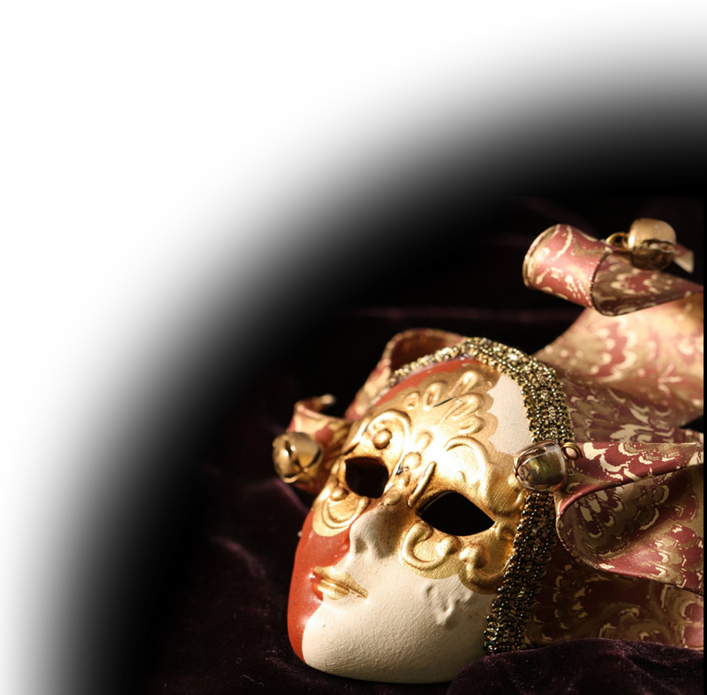
II. Where is it NEEDED?
Food appetite for Dieters
Alcohol appetite for Drunkards
High appetite for Addicts
Thrill appetite for Gamblers
Deceptive appetite for Liars
Notes:
Mask = FREE = from http://www.flickr.com/photos/aidanmorgan/5403823950/sizes/l/in/photostream/

Slide 11

II. Where is it NEEDED?
Food appetite for Dieters
Alcohol appetite for Drunkards
High appetite for Addicts
Thrill appetite for Gamblers
Deceptive appetite for Liars
Material appetite for Covetous
Notes:
Money = FREE = from http://upload.wikimedia.org/wikipedia/commons/f/f9/Money_Cash.jpg

Slide 12
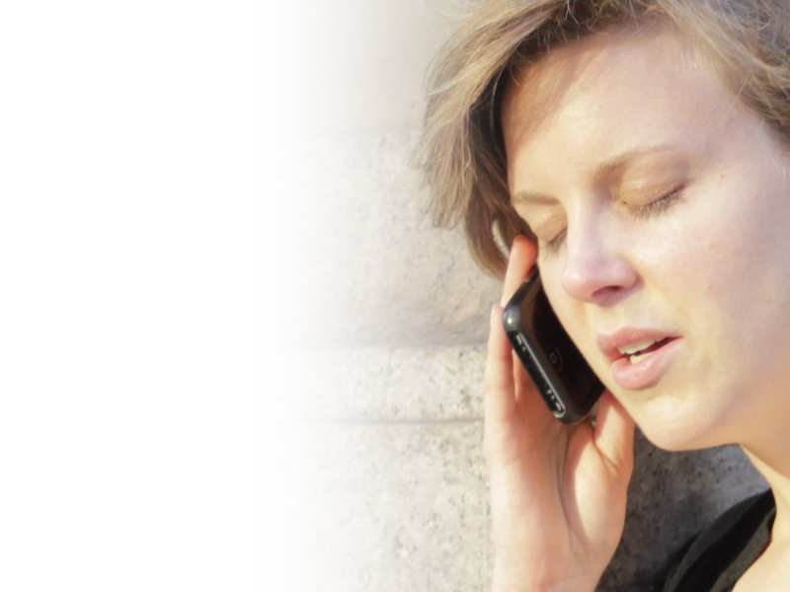
II. Where is it NEEDED?
Food appetite for Dieters
Alcohol appetite for Drunkards
High appetite for Addicts
Thrill appetite for Gamblers
Deceptive appetite for Liars
Material appetite for Covetous
Talk appetite for Gossips
Notes:
Cell phone lady = FREE = from http://www.flickr.com/photos/33498942@N04/5760823608/sizes/o/in/photostream/

Slide 13

II. Where is it NEEDED?
Food appetite for Dieters
Alcohol appetite for Drunkards
High appetite for Addicts
Thrill appetite for Gambler
Deceptive appetite for Liars
Material appetite for Covetous
Talk appetite for Gossips
Sexual appetite for EVERYONE!
Notes:
Porn button = NOT FOR REUSE = This is a licensed image from http://www.bigstockphoto.com/image-35944687/stock-photo-porn-button
Get your own image from them.

Slide 14


1 Corinthians 7: 1-5
¹ Now for the matters you wrote about: It is good for a man not to marry. ² But since there is so much immorality, each man should have his own wife, and each woman her own husband.

Slide 15


1 Corinthians 7: 1-5
¹ Now for the matters you wrote about: It is good for a man not to marry. ² But since there is so much immorality, each man should have his own wife, and each woman her own husband.

Slide 16
1 Corinthians 7: 1-5
¹ Now for the matters you wrote about: It is good for a man not to marry. ² But since there is so much immorality, each man should have his own wife, and each woman her own husband.

Slide 17
1 Corinthians 7: 1-5
¹ Now for the matters you wrote about: It is good for a man not to marry. ² But since there is so much immorality, each man should have his own wife, and each woman her own husband. ³ The husband should fulfill his marital duty to his wife, and likewise the wife to her husband. ⁴ The wife's body does not belong to her alone but also to her husband. In the same way, the husband's body does not belong to him alone but also to his wife.

Slide 18
1 Corinthians 7: 1-5
¹ Now for the matters you wrote about: It is good for a man not to marry. ² But since there is so much immorality, each man should have his own wife, and each woman her own husband. ³ The husband should fulfill his marital duty to his wife, and likewise the wife to her husband. ⁴ The wife's body does not belong to her alone but also to her husband. In the same way, the husband's body does not belong to him alone but also to his wife.

Slide 19
1 Corinthians 7: 1-5
¹ Now for the matters you wrote about: It is good for a man not to marry. ² But since there is so much immorality, each man should have his own wife, and each woman her own husband. ³ The husband should fulfill his marital duty to his wife, and likewise the wife to her husband. ⁴ The wife's body does not belong to her alone but also to her husband. In the same way, the husband's body does not belong to him alone but also to his wife.

Slide 20

1 Corinthians 7: 1-5
<<The COMMAND>>
⁵ Do not deprive each other except by mutual consent and for a time, so that you may devote yourselves to prayer. Then come together again so that
Satan will not tempt you because of
your lack of self-control.

Slide 21
1 Corinthians 7: 1-5
<<The COMMAND>>
⁵ Do not deprive each other except by mutual consent and for a time, so that you may devote yourselves to prayer. Then come together again so that Satan will not tempt you because of your lack of self-control.

Slide 22
1 Corinthians 7: 1-5
<<The COMMAND>>
⁵ Do not deprive each other except by mutual consent and for a time, so that you may devote yourselves to prayer. Then come together again so that Satan will not tempt you because of your lack of self-control.
Don’t become Satan’s accomplice!

Slide 23
1 Corinthians 7: 6-9
⁶ I say this as a concession, not as a command. ⁷ I wish that all men were as I am. But each man has his own gift from God; one has this gift, another has that.

Slide 24
1 Corinthians 7: 6-9
⁶ I say this as a concession, not as a command. ⁷ I wish that all men were as I am. But each man has his own gift from God; one has this gift, another has that.
Point: It is not a command to get married if your are self-controlled—it is if you are not!

Slide 25
1 Corinthians 7: 6-9
⁶ I say this as a concession, not as a command. ⁷ I wish that all men were as I am. But each man has his own gift from God; one has this gift, another has that.
⁸ Now to the unmarried and the widows I say: It is good for them to stay unmarried, as I am. ⁹ But if they cannot control themselves, they should marry, for it is better to marry than to burn with passion.

Slide 26
1 Corinthians 7: 6-9
⁶ I say this as a concession, not as a command. ⁷ I wish that all men were as I am. But each man has his own gift from God; one has this gift, another has that.
⁸ Now to the unmarried and the widows I say: It is good for them to stay unmarried, as I am. ⁹ But if they cannot control themselves, they should marry, for it is better to marry than to burn with passion.

Slide 27
III. It is Needed Now More than Ever
Notes:
Clock = FREE = from http://commons.wikimedia.org/wiki/File:Clock_11-59.svg

Slide 28

III. It is Needed Now More than Ever
¹ But mark this: There will be terrible times in the last days
Notes:
Clock = FREE = from http://commons.wikimedia.org/wiki/File:Clock_11-59.svg

Slide 29
III. It is Needed Now More than Ever
² People will be lovers of themselves, lovers of money, boastful, proud, abusive,
disobedient to their parents, un-
grateful, unholy, ³ without love,
unforgiving, slanderous,
without self-control,
brutal, not lovers of
the good,

Slide 30
III. It is Needed Now More than Ever
⁴ treacherous, rash, conceited, lovers of pleasure rather than lovers of God—
⁵ having a form of godliness
but denying its power.
Have nothing to do
with them. ^{2 Timothy 3:1-5}

Slide 31
III. It is Needed Now More than Ever
⁴ treacherous, rash, conceited, lovers of pleasure rather than lovers of God—
⁵ having a form of godliness
but denying its power.
Have nothing to do
with them. ^{2 Timothy 3:1-5}
Do not be misled: "Bad company corrupts good character." ^{1Cor 15:33}

Slide 32
IV. What’s Associated With It?

Slide 33
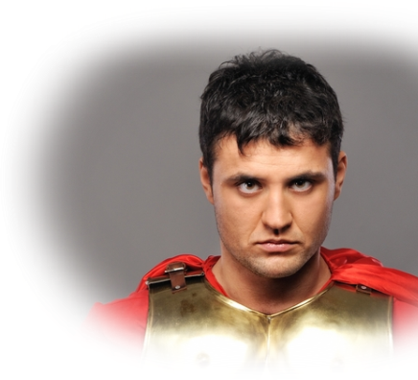
1- Righteousness & Judgment
²⁴ Several days later Felix …. sent for Paul and listened to him as he spoke about faith in Christ Jesus. ²⁵ As Paul discoursed on
righteousness, self-control and
the judgment to come, Felix was
afraid and said, "That's
enough for now! You may
leave. When I find it
convenient, I will send
for you.” ^{Act 24:24-25}
Notes:
Felix =NOT TO BE RESUSED-- licensed from dreamstime http://www.dreamstime.com/royalty-free-stock-photo-roman-legionary-soldier-image13729545
Our faith teaches God is Righteous and expects righteousness from us.
Righteousness = the state of being right before God or an act that is right before God
Self-control = what it takes to do the right thing
Judgment = one day giving account for what you are and have done
Felix’ response was the same in his day as in ours = When (or if) I find it convenient.
Recently a person said, “I don’t need to go to church to be a Christian.” Which is true—but genuine Christians go to church. Faith in action. If you treat church as a convenience—you might want to ask yourself, “Is there enough evidence in my life to convict me of being a Christian?”
You see when you get saved God changes you from the inside out. You desire the Word of God, Prayer and the fellowship of God’s people. Not just a convenience but a necessity.

Slide 34

2. Faith, Love & Hope
⁵ You are all sons of the light and sons of the day. We do not belong to the night or to the darkness. ….
But since we belong to the day, let us be
self-controlled, putting on faith and love as a breastplate, and the hope of salvation as a helmet. ^{1 Thessalonians 5:5,8}
Darkness
Day

Slide 35
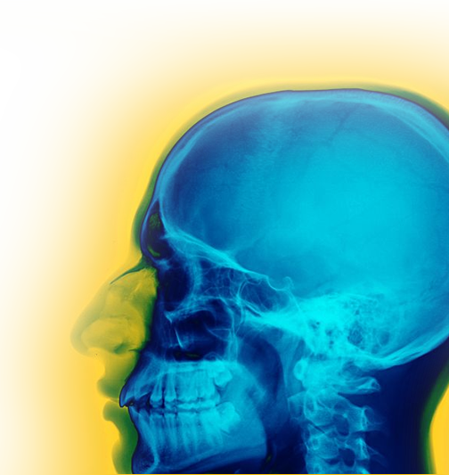
3- Mental Processes
Prepare Your Mind
¹³ Therefore, prepare your minds for action; be self-controlled; set your hope fully on the grace to be given you when Jesus Christ is revealed. ^{1 Peter 1:13}
Notes:
X-ray head = FREE = from http://commons.wikimedia.org/wiki/File:Rad_160601_Skull_X-ray_False_color.nevit.jpg
Prepare your minds for ACTION = Make a plan of what you are going to do when you are tempted with desert that will take you off you diet; Prepare your mind for temptation for a drink when you know it will lead to more and drunkenness; prepare your mind for when someone entices you that you do not compromise your marriage. Job said, “I made a covenant with my eyes that I would not look on a woman with lust.”
This is mental – you make a plan of action:

Slide 36
3- Mental Processes
Clear Your Mind
⁷ The end of all things is near. Therefore be clear minded and self-controlled so
that you can pray.
^{1Peter 4:7}
Notes:
Clear minded – you get rid of every evil, negative thought.
Contol, Alt, delete --

Slide 37
3- Mental Processes
3. Alert Your Mind
⁸ Be self-controlled and alert. Your enemy the devil prowls around like a roaring lion looking for someone to devour. ^{1 Peter 5:8}
Notes:
Be alert – you don’t have to go looking for evil. It is out to get you. Don’t let the TV program suck you into the muck and mire of the evil anti-Christain swamp. You don’t have to go there – turn the channel!

Slide 38
3- Mental Processes
A Knowledgeable Mind
⁵ For this very reason, make every effort to add to your faith goodness; and to goodness, knowledge;
⁶ and to knowledge,
self-control; and to
self-control, perseverance;
and to perseverance,
godliness;
Notes:
Educate yourself on this.
Get into your Bible—learn what God wants.
Persevere in practicing self-control – until you get mastery of it. It takes work. You are porne to fail at first—don’t give up.
Like roller skating– you are going to fall the first time you try. I had a friend who was a Philadelphia cop who tried to skate (tell story) he fell on first try –took off the skates to never try again.
You must persevere until you master self-control.

Slide 39
3- Mental Processes
4. A Knowledgeable Mind
⁷ and to godliness, brotherly kindness; and to brotherly kindness, love. ⁸ For if you possess these qualities in increasing measure, they
will keep you from being ineffective and unproductive in your knowledge of our Lord Jesus Christ. ^{2 Peter 1:5-8}
Notes:
In increasing measure – you are growing in these areas –especially self-control –
You will be effective and productive!
Who doesn’t want that?

Slide 40
3- Mental Processes
4. A Knowledgeable Mind
⁷ and to godliness, brotherly kindness; and to brotherly kindness, love. ⁸ For if you possess these qualities in increasing measure, they
will keep you from being ineffective and unproductive in your knowledge of our Lord Jesus Christ. ^{2 Peter 1:5-8}
For as he thinks in his heart,
so is he.
^{Pro 23:7 NKJ}

Slide 41
V. How do you do it?

Slide 42

V. How do you do it?
1. Walk in the Spirit
I say then: Walk in the Spirit,
and you shall not fulfill the lust of the flesh. (Gal 5:16 NKJ)

Slide 43
V. How do you do it?
2. God does it in you…
for it is God who works in you to will and
to act according to his good purpose. (Phi 2:13 NIV)

Slide 44
V. How do you do it?
3. You can ONLY do it by the Spirit …
⁵ Those who live according to the sinful nature have their minds set on what that nature desires;
Notes:
It’s a mental thing here

Slide 45
V. How do you do it?
3. You can ONLY do it by the Spirit …
⁵ Those who live according to the sinful nature have their minds set on what that nature desires; but those who live in accordance with
the Spirit have their minds
set on what the Spirit
desires.
Notes:
It’s a mental thing here

Slide 46
V. How do you do it?
3. You can ONLY do it by the Spirit …
The mind of sinful man is death,
Notes:
It’s a mental thing here

Slide 47
V. How do you do it?
3. You can ONLY do it by the Spirit …
The mind of sinful man is death, but the mind controlled by the Spirit is life and peace;
Notes:
It’s a mental thing here

Slide 48
V. How do you do it?
3. You can ONLY do it by the Spirit …
⁷ the sinful mind is hostile to God. It does not submit to God's law, nor can it do so.
⁸ Those controlled by the sinful
nature cannot please God.
Notes:
It’s a mental thing here

Slide 49
V. How do you do it?
3. You can do it by the Spirit …
⁹ You, however, are controlled not by the sinful nature but by the Spirit, if the Spirit of God lives in you. And if anyone does not have the
Spirit of Christ, he does not belong
to Christ. ^{Romans 8:5-9}
Notes:
It’s a mental thing here

Slide 50
Bottom Line:
You can have self-control over any area of your life ...

Slide 51
Bottom Line:
You can have self-control over any area of your life ...
If you want to!

Slide 52
Bottom Line:
You can have self-control over any area of your life ...
If you want to!
How?

Slide 53

The Holy Spirit Produces
SELF-CONTROL when
“you walk in the Spirit.” Gal 5:16

Slide 54
Let’s Pray

