Slide 1

Notes:
Copyright © 2006−2021. All rights reserved. Bible Point is a registered trademark of Dennis Henderson. All other trademarks acknowledged.
Bible Point contains graphics from Bible Point artists. These illustrations belong to Bible Point and the respective artists. You may use the designs and illustrations for graphical illustration of lessons free and without special permission, provided they are not used in any way that maligns the Christian faith. Furthermore, republication or production of any illustration by any other graphic service whether it be in book, in a machine-readable form, or in any other design resource is strictly prohibited. Furthermore, they cannot be duplicated or resold as any other form of publishing, clip art, or graphic resource.
So What does it mean? (A simple translations of the legal jargon)
So, if you don’t own the presentation(s), graphic(s), and text(s) how can you legally use them? The purchase of the license allows you to use all the images in the product. However, the actual ownership and copyright of the presentation(s), graphic(s), and text(s) remain the property of Bible Point and its licensors. If you had plans on using this product in your “for sale” work—think again!
License Agreement
Article 1: License Grant
All the graphics and text in Bible Point presentations (excluding quotes from the Bible and stated sources) are the intellectual and real property of Bible Point and its licensors, and is protected by law, including United States copyright laws and international treaties. Bible Point grants to you a license:
1. To use the presentation in a single church, single school, or single office of a Christian organization.
2. To make a single archival back-up copy of the program.
3. To modify the presentation(s) and merge with other presentations in a single church, school, or Christian organization.
4. To transfer to another party if that party agrees to accept the terms and conditions of this agreement, and you do not retain any copies of the presentation, whether printed, machine readable, modified, or merged form.
Article 2: Terms
This license is effective until terminated. You may terminate the license at any time by destroying the presentation(s), graphic(s), or text(s) together with all copies, modifications and merged portions in any form. Bible Point may terminate your license if you fail to comply with this Agreement. You agree, upon such termination, for any reason, to destroy the presentation(s), graphics, and text(s) with all copies, modifications, and merged portions in any form.
Article 3: Disclaimers
1. Bible Point presentations, graphics, and texts are licensed to you As Is. You, the consumer, bear the entire risk relating to the quality and performance of the presentation(s), graphic(s), or text(s). In no event will Bible Point be liable for damages resulting from any defect.
2. Thirty-day limited warrantee on disks. Bible Point warrants the disks to be free of defects in material and workmanship under normal use for 30 days after purchase. During the 30-day period you may return a defective presentation, graphic, or text with proof of purchase and it will be replaced without charge, unless the presentation is damaged by misuse.
Article 4: General
1. You may not sub-license, assign, or transfer the license of the presentation(s), graphic(s), or text(s) except as provided by this Agreement.
2. This Agreement will be governed by the laws of the State of Michigan.
So What does it mean? (A simple translations of the legal jargon)
May I let someone borrow or copy my licensed Bible Point presentation (even after I modified it)? As long as it is within your local church, or single school, or the immediate office of a Christian organization you may. Otherwise, please refer the person interested in borrowing to: http://www.biblepoint.com or E-mail: dennis@DrDH.net with any related questions.

Slide 2
Patience
Notes:
Copyright © 2006−2021. All rights reserved. Bible Point is a registered trademark of Dennis Henderson. All other trademarks acknowledged.
Bible Point contains graphics from Bible Point artists. These illustrations belong to Bible Point and the respective artists. You may use the designs and illustrations for graphical illustration of lessons free and without special permission, provided they are not used in any way that maligns the Christian faith. Furthermore, republication or production of any illustration by any other graphic service whether it be in book, in a machine-readable form, or in any other design resource is strictly prohibited. Furthermore, they cannot be duplicated or resold as any other form of publishing, clip art, or graphic resource.
So What does it mean? (A simple translations of the legal jargon)
So, if you don’t own the presentation(s), graphic(s), and text(s) how can you legally use them? The purchase of the license allows you to use all the images in the product. However, the actual ownership and copyright of the presentation(s), graphic(s), and text(s) remain the property of Bible Point and its licensors. If you had plans on using this product in your “for sale” work—think again!
License Agreement
Article 1: License Grant
All the graphics and text in Bible Point presentations (excluding quotes from the Bible and stated sources) are the intellectual and real property of Bible Point and its licensors, and is protected by law, including United States copyright laws and international treaties. Bible Point grants to you a license:
1. To use the presentation in a single church, single school, or single office of a Christian organization.
2. To make a single archival back-up copy of the program.
3. To modify the presentation(s) and merge with other presentations in a single church, school, or Christian organization.
4. To transfer to another party if that party agrees to accept the terms and conditions of this agreement, and you do not retain any copies of the presentation, whether printed, machine readable, modified, or merged form.
Article 2: Terms
This license is effective until terminated. You may terminate the license at any time by destroying the presentation(s), graphic(s), or text(s) together with all copies, modifications and merged portions in any form. Bible Point may terminate your license if you fail to comply with this Agreement. You agree, upon such termination, for any reason, to destroy the presentation(s), graphics, and text(s) with all copies, modifications, and merged portions in any form.
Article 3: Disclaimers
1. Bible Point presentations, graphics, and texts are licensed to you As Is. You, the consumer, bear the entire risk relating to the quality and performance of the presentation(s), graphic(s), or text(s). In no event will Bible Point be liable for damages resulting from any defect.
2. Thirty-day limited warrantee on disks. Bible Point warrants the disks to be free of defects in material and workmanship under normal use for 30 days after purchase. During the 30-day period you may return a defective presentation, graphic, or text with proof of purchase and it will be replaced without charge, unless the presentation is damaged by misuse.
Article 4: General
1. You may not sub-license, assign, or transfer the license of the presentation(s), graphic(s), or text(s) except as provided by this Agreement.
2. This Agreement will be governed by the laws of the State of Michigan.
So What does it mean? (A simple translations of the legal jargon)
May I let someone borrow or copy my licensed Bible Point presentation (even after I modified it)? As long as it is within your local church, or single school, or the immediate office of a Christian organization you may. Otherwise, please refer the person interested in borrowing to: http://www.biblepoint.com or E-mail: dennis@DrDH.net with any related questions.

Slide 3

I. The SIMPLE DEFINITION:
The Christian Virtue, produced by the Holy Spirit, that enables a believer to:

Slide 4

I. The SIMPLE DEFINITION:
The Christian Virtue, produced by the Holy Spirit, that enables a believer to:
Calmly WAIT without COMPLAINT

Slide 5
I. The SIMPLE DEFINITION:
The Christian Virtue, produced by the Holy Spirit, that enables a believer to:
Calmly WAIT without COMPLAINT
(often in discomfort)

Slide 6
II. The Further ELABORATION

Slide 7

OT Source of this Definition:
But those who wait on the LORD shall renew their strength; they shall mount up with wings like eagles, they shall run and not be weary, they shall walk and not faint. (Isaiah 40:31 NKJ)
Notes:
Sky = FREE = http://www.flickr.com/photos/wandering_angel/1866818846/sizes/l/in/photostream/

Slide 8

OT Source of this Definition:
A patient [“slow to anger”] man has great understanding, but a quick-tempered man displays folly.
Proverbs 14:29
Notes:
Angry woman = FREE = from http://www.sxc.hu/browse.phtml?f=download&id=1192051

Slide 9
NT Source of this Definition:
There are eight Greek NT words in the semantic domain for “patience.”
.
μακροθυμια
υπομενω υποφερω βασταζω
τροππφορεω στεγω
ανεχομαι
καρτερω

Slide 10
NT Source of this Definition:
There are eight Greek NT words in the semantic domain for “patience.”
.
1
τροππφορεω στεγω
ανεχομαι
καρτερω
μακροθυμια
υπομενω υποφερω βασταζω
2
3

Slide 11

1. Focuses on Emotional Calm
In the face of PROVOCATION or
MISFORTUNE
μακροθυμια
Notes:
Dynamite = LICENSED AND NOT FOR REUSE ELSEWHERE = to reuse elsewhere get a licenses from http://www.bigstockphoto.com/image-40542166/stock-photo-red-dynamite

Slide 12

1. Focuses on Emotional Calm
In the face of PROVOCATION or MISFORTUNE
Long Heat
μακρο θυμια
Notes:
Dynamite = LICENSED AND NOT FOR REUSE ELSEWHERE = to reuse elsewhere get a licenses from http://www.bigstockphoto.com/image-40542166/stock-photo-red-dynamite

Slide 13
1. Focuses on Emotional Calm
In the face of PROVOCATION or MISFORTUNE
Long Heat
Waits Patiently Without Complaining!
μακρο θυμια
Notes:
Dynamite = LICENSED AND NOT FOR REUSE ELSEWHERE = to reuse elsewhere get a licenses from http://www.bigstockphoto.com/image-40542166/stock-photo-red-dynamite

Slide 14
2. Focuses on Difficult Situations
THREE OF THE EIGHT WORDS:
Suggest that you just “Bear IT!”
Notes:
Weight Lifter = FREE = http://en.m.wikipedia.org/wiki/File:RIAN_archive_103479_Soviet_weight-lifter_Viktor_Mazin_during_the_XXII_Olympic_Games.jpg

Slide 15
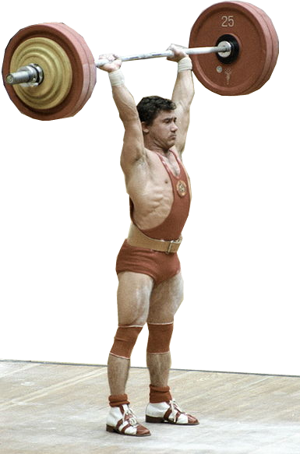
2. Focuses on Difficult Situations
THREE OF THE EIGHT WORDS:
Suggest that you just “Bear IT!”
υπομενω
υποφερω
βασταζω
  “Remain Under,”
  “Bear Under,”
  - more emphatic
Notes:
Weight Lifter = FREE = http://en.m.wikipedia.org/wiki/File:RIAN_archive_103479_Soviet_weight-lifter_Viktor_Mazin_during_the_XXII_Olympic_Games.jpg

Slide 16
2. Focuses on Difficult Situations
TWO OF THE EIGHT WORDS:
Suggest that you just
“put up with IT!”
τροππφορεω
στεγω
Notes:
Tribulation TRIGGERS patience

Slide 17
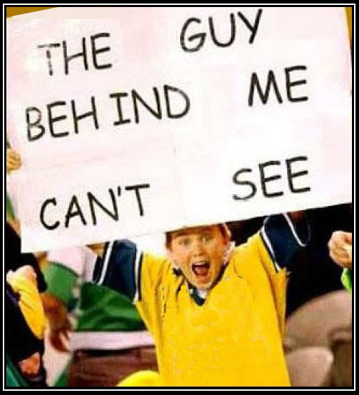
2. Focuses on Difficult Situations
TWO OF THE EIGHT WORDS:
Suggest that you just
“put up with IT!”
τροππφορεω
στεγω
“Put Up With”
someone or
something -
annoyance
Notes:
Tribulation TRIGGERS patience

Slide 18
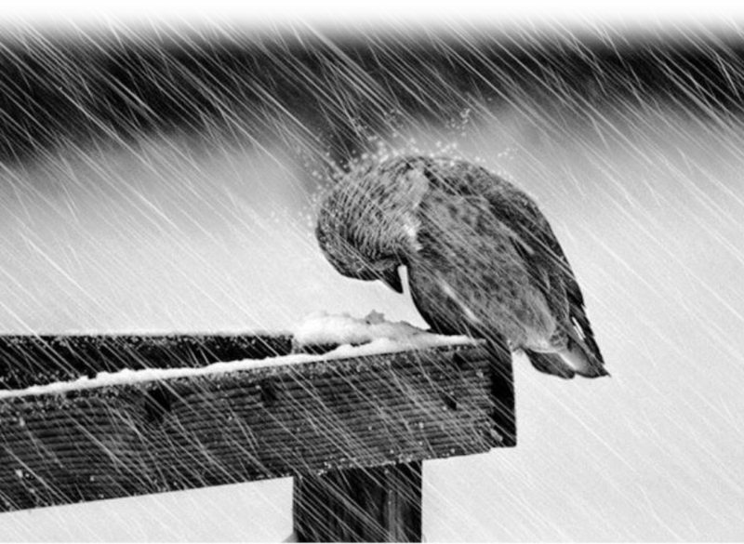
3. Focuses on the Long Duration
ONE OF THE EIGHT WORDS:
Suggests that you just “Endure IT!”
Ανεχομαι
“Endure”

Slide 19
3. Focuses on the Long Duration
THE LAST OF THE 8 WORDS:
Suggests that you
“Persevere in spite of IT!”
καρτερω “Persevere
/ Persist”

Slide 20
Sum this up ...
Patience is the Christian virtue of
Calmly WAITING without COMPLAINING
(often in discomfort)

Slide 21

III. The TRIAL & TRIBULATION
Discomfort, Annoyance, Nuisance
we glory in tribulations also: knowing that tribulation worketh patience; (Rom 5:3 KJV)

Slide 22
III. The TRIAL & TRIBULATION
Discomfort, Annoyance, Nuisance
we glory in tribulations also: knowing that tribulation worketh patience; (Rom 5:3 KJV)
The
TRIGGER

Slide 23
III. The TRIAL & TRIBULATION
Financial Difficulties
Discomfort, Annoyance, Nuisance
we glory in tribulations also: knowing that tribulation worketh patience; (Rom 5:3 KJV)
The
TRIGGER

Slide 24
III. The TRIAL & TRIBULATION
Financial Difficulties
Physical Problems
Discomfort, Annoyance, Nuisance
we glory in tribulations also: knowing that tribulation worketh patience; (Rom 5:3 KJV)
The
TRIGGER

Slide 25
III. The TRIAL & TRIBULATION
Financial Difficulties
Physical Problems
Mental Anguish
Discomfort, Annoyance, Nuisance
we glory in tribulations also: knowing that tribulation worketh patience; (Rom 5:3 KJV)
The
TRIGGER

Slide 26
III. The TRIAL & TRIBULATION
Financial Difficulties
Physical Problems
Mental Anguish
Family Crisis
Discomfort, Annoyance, Nuisance
we glory in tribulations also: knowing that tribulation worketh patience; (Rom 5:3 KJV)
The
TRIGGER

Slide 27
III. The TRIAL & TRIBULATION
Financial Difficulties
Physical Problems
Mental Anguish
Family Crisis
Relational Issues
Discomfort, Annoyance, Nuisance
we glory in tribulations also: knowing that tribulation worketh patience; (Rom 5:3 KJV)
The
TRIGGER

Slide 28
III. The TRIAL & TRIBULATION
Employment Problems
Financial Difficulties
Physical Problems
Mental Anguish
Family Crisis
Relational Issues
Discomfort, Annoyance, Nuisance
we glory in tribulations also: knowing that tribulation worketh patience; (Rom 5:3 KJV)
The
TRIGGER

Slide 29
III. The TRIAL & TRIBULATION
Employment Problems
Annoying People
Financial Difficulties
Physical Problems
Mental Anguish
Family Crisis
Relational Issues
Discomfort, Annoyance, Nuisance
we glory in tribulations also: knowing that tribulation worketh patience; (Rom 5:3 KJV)
The
TRIGGER

Slide 30
III. The TRIAL & TRIBULATION
Employment Problems
Annoying People
Housing Sink Holes
Financial Difficulties
Physical Problems
Mental Anguish
Family Crisis
Relational Issues
Discomfort, Annoyance, Nuisance
we glory in tribulations also: knowing that tribulation worketh patience; (Rom 5:3 KJV)
The
TRIGGER

Slide 31
III. The TRIAL & TRIBULATION
Employment Problems
Annoying People
Housing Sink Holes
Aging Disgracefully
Financial Difficulties
Physical Problems
Mental Anguish
Family Crisis
Relational Issues
Discomfort, Annoyance, Nuisance
we glory in tribulations also: knowing that tribulation worketh patience; (Rom 5:3 KJV)
The
TRIGGER

Slide 32
III. The TRIAL & TRIBULATION
Employment Problems
Annoying People
Housing Sink Holes
Aging Disgracefully
Car Problems
Financial Difficulties
Physical Problems
Mental Anguish
Family Crisis
Relational Issues
Discomfort, Annoyance, Nuisance
we glory in tribulations also: knowing that tribulation worketh patience; (Rom 5:3 KJV)
The
TRIGGER

Slide 33
III. The TRIAL & TRIBULATION
Employment Problems
Annoying People
Housing Sink Holes
Aging Disgracefully
Car Problems
on and on ...
Financial Difficulties
Physical Problems
Mental Anguish
Family Crisis
Relational Issues
Discomfort, Annoyance, Nuisance
we glory in tribulations also: knowing that tribulation worketh patience; (Rom 5:3 KJV)
We all have one!
1 Corinthians 10:13
The
TRIGGER

Slide 34
III. The TRIAL & TRIBULATION
Discomfort, Annoyance, Nuisance
we glory in tribulations also: knowing that tribulation worketh patience;
(Rom 5:3 KJV)

Slide 35
III. The TRIAL & TRIBULATION
Discomfort, Annoyance, Nuisance
we glory in tribulations also: knowing that tribulation worketh patience;
(Rom 5:3 KJV)
we also glory in tribulations,
knowing that tribulation produces perseverance; (NKJ)

Slide 36
IV. The Various MANIFESTATIONS

Slide 37
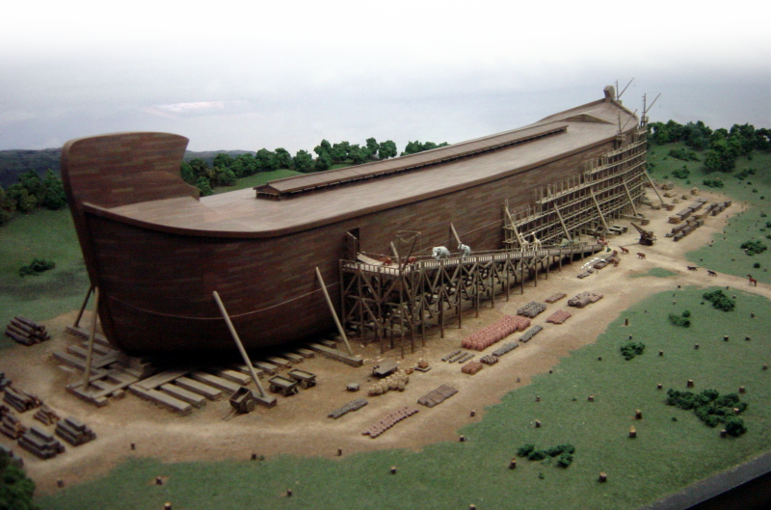
Downward: God is patient with us!
^{1 Peter 3:20} ... God waited patiently in the days of Noah while the ark was being built. In it only a few people, eight in all, were saved through water.
Notes:
Ark = FREE = BiblePoint photo.

Slide 38
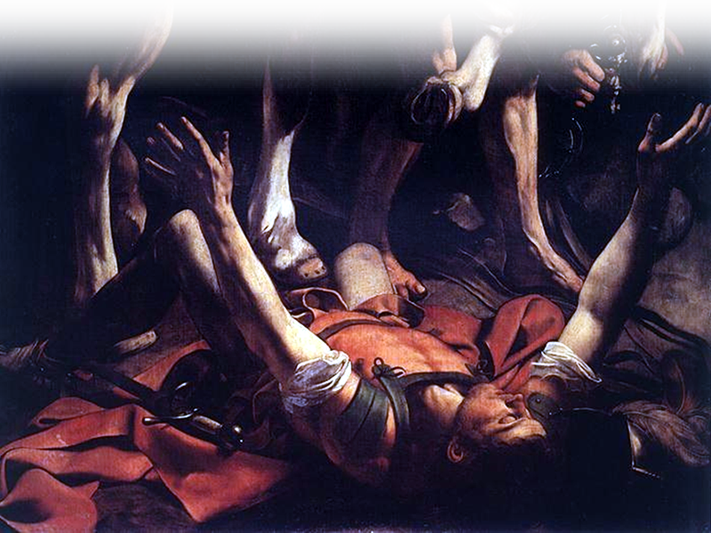
Downward: God is patient with us!
^{1 Timothy 1:16} But for that very reason I was shown mercy so that in me, the worst of sinners, Christ Jesus might display his unlimited patience as an example for those who would believe on him and receive eternal life.

Slide 39

Downward: God is patient with us!
^{2 Peter 3:9} The Lord is not slow in keeping his promise, as some understand slowness.
He is patient with you,
not wanting anyone to
perish, but everyone to
come to repentance.

Slide 40
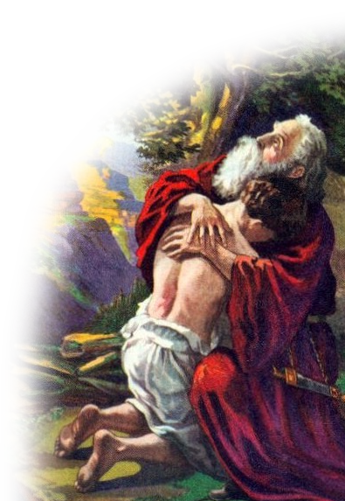
Upward: Be patient with God!
^{Hebrews 6:13-15} ... God made his promise
to Abraham, ... ¹⁴ saying, "I will surely
bless you and give you many
descendants."

Slide 41
Upward: Be patient with God!
^{Hebrews 6:13-15} ... God made his promise
to Abraham, ... ¹⁴ saying, "I will surely
bless you and give you many
descendants."
70 YEARS OLD

Slide 42
Upward: Be patient with God!
^{Hebrews 6:13-15} ... God made his promise
to Abraham, ... ¹⁴ saying, "I will surely
bless you and give you many
descendants."
70 YEARS OLD
30 YEARS LATER

Slide 43
Upward: Be patient with God!
^{Hebrews 6:13-15} ... God made his promise
to Abraham, ... ¹⁴ saying, "I will surely
bless you and give you many
descendants."
70 YEARS OLD
30 YEARS LATER
100 YEARS OLD ...

Slide 44
Upward: Be patient with God!
^{Hebrews 6:13-15} ... God made his promise
to Abraham, ... ¹⁴ saying, "I will surely
bless you and give you many
descendants."
¹⁵ And so after waiting patiently,
Abraham received what was
promised.

Slide 45
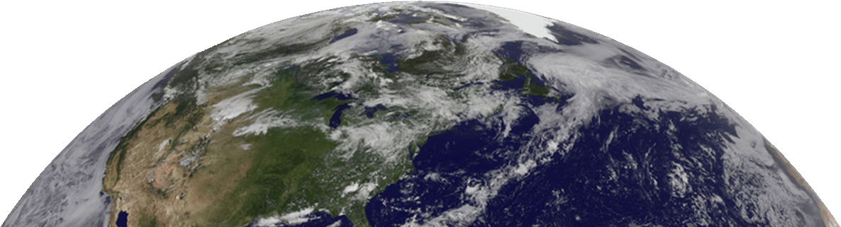
Outward: Be patient with others!
^{1 Thessalonians 5:14} And we urge you, brothers, warn those who are idle, encourage the timid, help the weak, be patient with everyone.

Slide 46

Inward: Be patient with yourself!
^{1 Thessalonians 5:14} And we urge you, brothers, warn those who are idle, encourage the timid, help the weak, be patient with everyone.
That includes
YOURSELF!

Slide 47

V. The OBVIOUS APPLICATION:
HOW DO I DO THIS?

Slide 48
V. The OBVIOUS APPLICATION:
HOW DO I DO THIS?
YOU REALLY DON’T DO THIS!

Slide 49
V. The OBVIOUS APPLICATION:
HOW DO I DO THIS?
YOU REALLY DON’T DO THIS!
God, the Holy Spirit, does this in you!

Slide 50
V. The OBVIOUS APPLICATION:
HOW DO I GET HIM TO DO THIS?

Slide 51
V. The OBVIOUS APPLICATION:
HOW DO I GET HIM TO DO THIS?
Easy ...

Slide 52
V. The OBVIOUS APPLICATION:
1- You must TRUST in Christ as SAVIOR

Slide 53
V. The OBVIOUS APPLICATION:
1- You must TRUST in Christ as SAVIOR
NATURAL

Slide 54
V. The OBVIOUS APPLICATION:
1- You must TRUST in Christ as SAVIOR
NATURAL
INFANTILE

Slide 55
V. The OBVIOUS APPLICATION:
2- Grow to TRUST in God’s SOVEREIGNTY
NATURAL
INFANTILE

Slide 56
V. The OBVIOUS APPLICATION:
2- Grow to TRUST in God’s SOVEREIGNTY
NATURAL
INFANTILE
SPIRITUAL

Slide 57
V. The OBVIOUS APPLICATION:
2- Grow to TRUST in God’s SOVEREIGNTY
NATURAL
INFANTILE
SPIRITUAL

Slide 58
V. The OBVIOUS APPLICATION:
2- Grow to TRUST in God’s SOVEREIGNTY
NATURAL
CARNAL
INFANTILE
SPIRITUAL

Slide 59
V. The OBVIOUS APPLICATION:
3- You must WALK in the SPIRIT
NATURAL
CARNAL
INFANTILE
SPIRITUAL

Slide 60
V. The OBVIOUS APPLICATION:
4-Then God will provide the Fruit of Patience
NATURAL
CARNAL
INFANTILE
SPIRITUAL

Slide 61

The Holy Spirit Produces His Fruit of PATIENCE when ...
you walk in the Spirit. Gal 5:16

Slide 62
²² But the fruit of the Spirit is love, joy, peace, patience,

Slide 63
²² But the fruit of the Spirit is love, joy, peace, patience,
Calmly WAITING without COMPLAINING

Slide 64
Let’s Pray

