Slide 1

Notes:
Copyright © 2006−2021. All rights reserved. Bible Point is a registered trademark of Dennis Henderson. All other trademarks acknowledged.
Bible Point contains graphics from Bible Point artists. These illustrations belong to Bible Point and the respective artists. You may use the designs and illustrations for graphical illustration of lessons free and without special permission, provided they are not used in any way that maligns the Christian faith. Furthermore, republication or production of any illustration by any other graphic service whether it be in book, in a machine-readable form, or in any other design resource is strictly prohibited. Furthermore, they cannot be duplicated or resold as any other form of publishing, clip art, or graphic resource.
So What does it mean? (A simple translations of the legal jargon)
So, if you don’t own the presentation(s), graphic(s), and text(s) how can you legally use them? The purchase of the license allows you to use all the images in the product. However, the actual ownership and copyright of the presentation(s), graphic(s), and text(s) remain the property of Bible Point and its licensors. If you had plans on using this product in your “for sale” work—think again!
License Agreement
Article 1: License Grant
All the graphics and text in Bible Point presentations (excluding quotes from the Bible and stated sources) are the intellectual and real property of Bible Point and its licensors, and is protected by law, including United States copyright laws and international treaties. Bible Point grants to you a license:
1. To use the presentation in a single church, single school, or single office of a Christian organization.
2. To make a single archival back-up copy of the program.
3. To modify the presentation(s) and merge with other presentations in a single church, school, or Christian organization.
4. To transfer to another party if that party agrees to accept the terms and conditions of this agreement, and you do not retain any copies of the presentation, whether printed, machine readable, modified, or merged form.
Article 2: Terms
This license is effective until terminated. You may terminate the license at any time by destroying the presentation(s), graphic(s), or text(s) together with all copies, modifications and merged portions in any form. Bible Point may terminate your license if you fail to comply with this Agreement. You agree, upon such termination, for any reason, to destroy the presentation(s), graphics, and text(s) with all copies, modifications, and merged portions in any form.
Article 3: Disclaimers
1. Bible Point presentations, graphics, and texts are licensed to you As Is. You, the consumer, bear the entire risk relating to the quality and performance of the presentation(s), graphic(s), or text(s). In no event will Bible Point be liable for damages resulting from any defect.
2. Thirty-day limited warrantee on disks. Bible Point warrants the disks to be free of defects in material and workmanship under normal use for 30 days after purchase. During the 30-day period you may return a defective presentation, graphic, or text with proof of purchase and it will be replaced without charge, unless the presentation is damaged by misuse.
Article 4: General
1. You may not sub-license, assign, or transfer the license of the presentation(s), graphic(s), or text(s) except as provided by this Agreement.
2. This Agreement will be governed by the laws of the State of Michigan.
So What does it mean? (A simple translations of the legal jargon)
May I let someone borrow or copy my licensed Bible Point presentation (even after I modified it)? As long as it is within your local church, or single school, or the immediate office of a Christian organization you may. Otherwise, please refer the person interested in borrowing to: http://www.biblepoint.com or E-mail: dennis@DrDH.net with any related questions.

Slide 2
Kindness
Notes:
Copyright © 2006−2021. All rights reserved. Bible Point is a registered trademark of Dennis Henderson. All other trademarks acknowledged.
Bible Point contains graphics from Bible Point artists. These illustrations belong to Bible Point and the respective artists. You may use the designs and illustrations for graphical illustration of lessons free and without special permission, provided they are not used in any way that maligns the Christian faith. Furthermore, republication or production of any illustration by any other graphic service whether it be in book, in a machine-readable form, or in any other design resource is strictly prohibited. Furthermore, they cannot be duplicated or resold as any other form of publishing, clip art, or graphic resource.
So What does it mean? (A simple translations of the legal jargon)
So, if you don’t own the presentation(s), graphic(s), and text(s) how can you legally use them? The purchase of the license allows you to use all the images in the product. However, the actual ownership and copyright of the presentation(s), graphic(s), and text(s) remain the property of Bible Point and its licensors. If you had plans on using this product in your “for sale” work—think again!
License Agreement
Article 1: License Grant
All the graphics and text in Bible Point presentations (excluding quotes from the Bible and stated sources) are the intellectual and real property of Bible Point and its licensors, and is protected by law, including United States copyright laws and international treaties. Bible Point grants to you a license:
1. To use the presentation in a single church, single school, or single office of a Christian organization.
2. To make a single archival back-up copy of the program.
3. To modify the presentation(s) and merge with other presentations in a single church, school, or Christian organization.
4. To transfer to another party if that party agrees to accept the terms and conditions of this agreement, and you do not retain any copies of the presentation, whether printed, machine readable, modified, or merged form.
Article 2: Terms
This license is effective until terminated. You may terminate the license at any time by destroying the presentation(s), graphic(s), or text(s) together with all copies, modifications and merged portions in any form. Bible Point may terminate your license if you fail to comply with this Agreement. You agree, upon such termination, for any reason, to destroy the presentation(s), graphics, and text(s) with all copies, modifications, and merged portions in any form.
Article 3: Disclaimers
1. Bible Point presentations, graphics, and texts are licensed to you As Is. You, the consumer, bear the entire risk relating to the quality and performance of the presentation(s), graphic(s), or text(s). In no event will Bible Point be liable for damages resulting from any defect.
2. Thirty-day limited warrantee on disks. Bible Point warrants the disks to be free of defects in material and workmanship under normal use for 30 days after purchase. During the 30-day period you may return a defective presentation, graphic, or text with proof of purchase and it will be replaced without charge, unless the presentation is damaged by misuse.
Article 4: General
1. You may not sub-license, assign, or transfer the license of the presentation(s), graphic(s), or text(s) except as provided by this Agreement.
2. This Agreement will be governed by the laws of the State of Michigan.
So What does it mean? (A simple translations of the legal jargon)
May I let someone borrow or copy my licensed Bible Point presentation (even after I modified it)? As long as it is within your local church, or single school, or the immediate office of a Christian organization you may. Otherwise, please refer the person interested in borrowing to: http://www.biblepoint.com or E-mail: dennis@DrDH.net with any related questions.

Slide 3
I. Kindness Described

Slide 4
What is it?
There is a fine line between kindness and love. So fine that in the OT one Hebrew word “Hesed”
is often translated
“loving-kindness.”
חֶסֶד

Slide 5
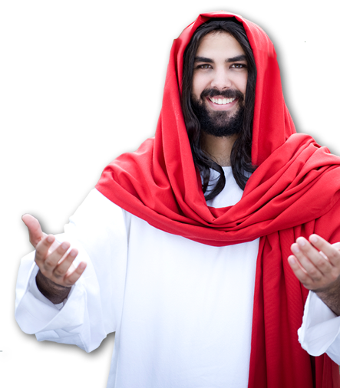
Jesus said …
But love your enemies, do good to them,
and lend to them without expecting to
get anything back. Then your reward
will be great, and you will be sons of
the Most High, because he is kind
to the ungrateful and wicked.
Luke 6:35

Slide 6
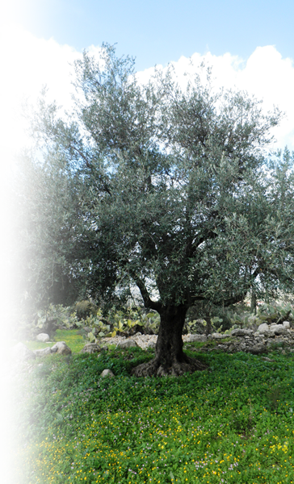
Kindness is the opposite of
STERNESS
Consider therefore the kindness and sternness of God: sternness to those who fell, but kindness to you, provided that you continue in his kindness. Otherwise, you also will be cut off. Rom 11:22
Notes:
Olive Tree = FREE = https://commons.wikimedia.org/wiki/File:Dayr_Aban_Olive_Tree_3.JPG

Slide 7
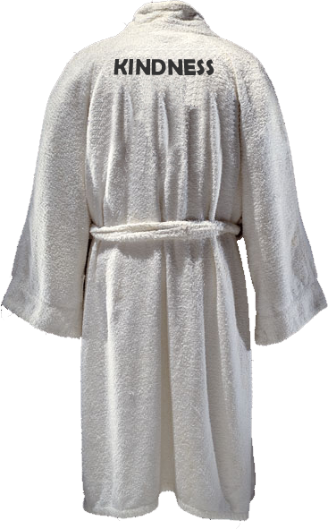
You can WEAR kindness
Therefore, as God's chosen people, holy and dearly loved, clothe yourselves with compassion, kindness, humility, gentleness and patience. Col 3:12
Notes:
Robe = FREE = from http://www.flickr.com/photos/publicresourceorg/493964218/sizes/o/in/photostream/

Slide 8
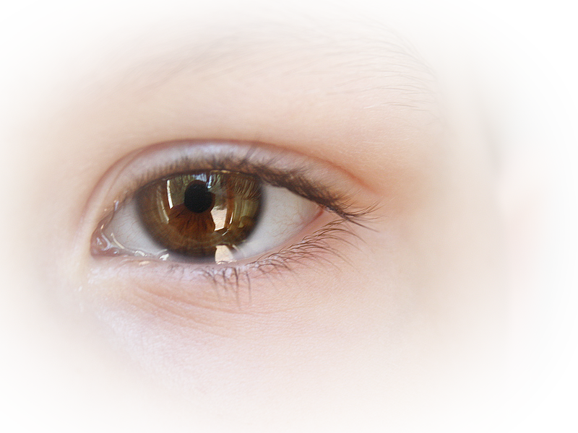
You can SEE kindness
⁴ But when the kindness and love of God our Savior appeared, ⁵ he saved us, not because of righteous things we had done, but because of his mercy. He saved us through the washing of
rebirth and renewal by
the Holy Spirit,
Titus 3:4-5
Notes:
Ill. Of “I saw kindness in his face”

Slide 9
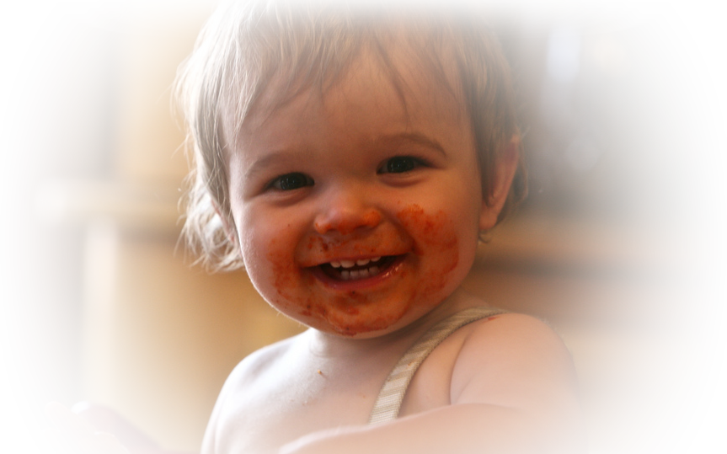
You can TASTE kindness
Now that you have had
a taste of the Lord's kindness.
1 Peter 2:3 (NLT)
Notes:
Baby face = FREE = from http://www.flickr.com/photos/juhansonin/2562591188/sizes/l/in/photostream/

Slide 10

Kindness can be influenced
NEGATIVELY
Do not be misled:
"Bad company corrupts
good character."
1 Cor 15:33
Notes:
Hats = FREE =from http://upload.wikimedia.org/wikipedia/commons/d/d3/Felthat.jpg

Slide 11

Kindness can be influenced
NEGATIVELY
Do not be misled:
"Bad company corrupts
good character."
1 Cor 15:33
Literally “Bad company
corrupts kind habits.”
Notes:
Hats = FREE =from http://upload.wikimedia.org/wikipedia/commons/d/d3/Felthat.jpg

Slide 12
Kindness can be
POSITIVE motivator
⁴ Or do you show contempt for the riches of his [i.e. God’s] kindness, tolerance and patience, not realizing that God's kindness leads you toward repentance? Romans 2:4
Notes:
Story of D.L. Moody & Henry Moorehouse

Slide 13
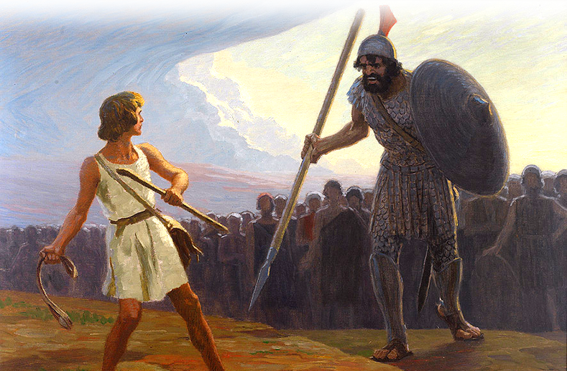
II. Kindness Illustrated
Notes:
David and Goliath = FREE = from https://commons.wikimedia.org/wiki/File:Fugel_David_gegen_Goliath.jpg

Slide 14
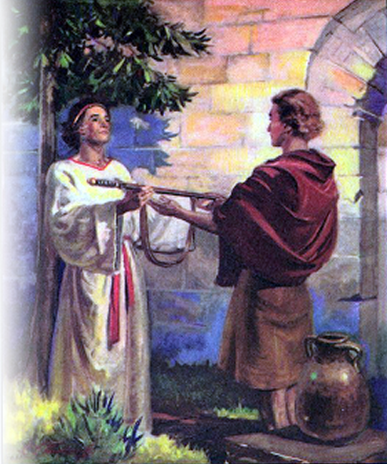
II. Kindness Illustrated
^{1 Sam 18:1} Jonathan became one in spirit
with David, and he loved him as
himself. ² … ³ And Jonathan
made a covenant with David
because he loved him as himself.
Later Jonathan asked …
Later Jonathan requested of David
^{1 Samuel 20:14} “But show me unfailing kindness like that of the LORD as long as I live, so that I may not be killed, ¹⁵ and do not ever cut off your kindness from my family--not even when the LORD has cut off every one of David's enemies from the face of the earth."
Notes:
David and Goliath = FREE = from https://commons.wikimedia.org/wiki/File:Fugel_David_gegen_Goliath.jpg

Slide 15
II. Kindness Illustrated
^{1 Sam} ^{20:14} “But show me unfailing kindness like that of the LORD as long as I live, so that I may not be killed, ¹⁵ and do not ever cut off your kindness from my family--not even when the LORD has cut off every one of David's enemies from the face of the earth."
Notes:
David and Goliath = FREE = from https://commons.wikimedia.org/wiki/File:Fugel_David_gegen_Goliath.jpg

Slide 16
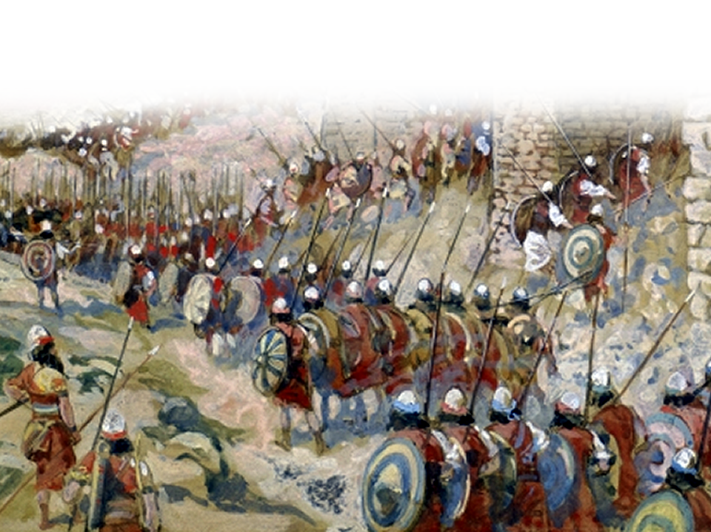
II. Kindness Illustrated
Notes:
Battle = FREE = from http://commons.wikimedia.org/wiki/File:Tissot_The_Taking_of_Jericho.jpg

Slide 17
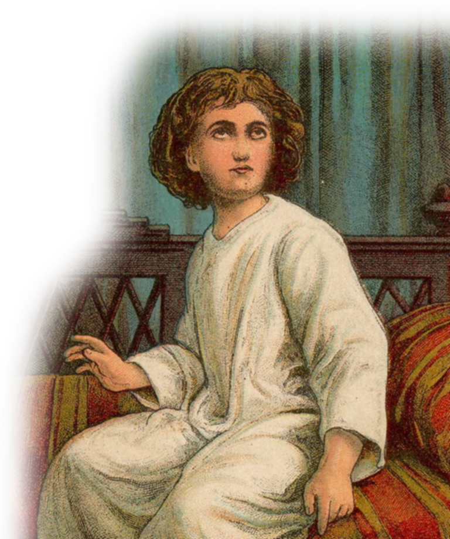
II. Kindness Illustrated
The Story of Mephibosheth
^{2 Sam 4:4} Jonathan … had a son who …
was five years old when the news about
Saul and Jonathan came from Jezreel.
His nurse picked him up and fled,
but as she hurried to leave, he
fell and became crippled. His
name was Mephibosheth.
Notes:
Boy = FREE = from http://commons.wikimedia.org/wiki/File:The_Boy_Samuel.jpg

Slide 18
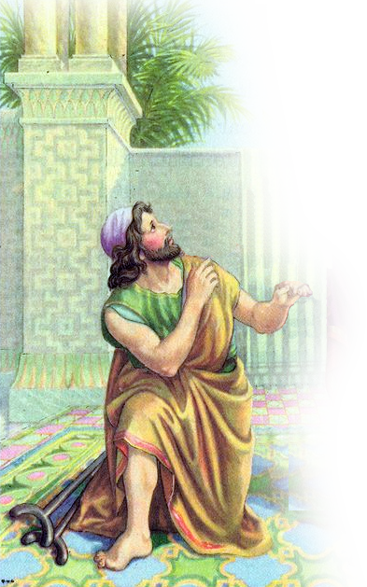

II. Kindness Illustrated
Imagine you are
Mephibosheth.
Notes:
David and Goliath = FREE = from https://commons.wikimedia.org/wiki/File:Fugel_David_gegen_Goliath.jpg

Slide 19
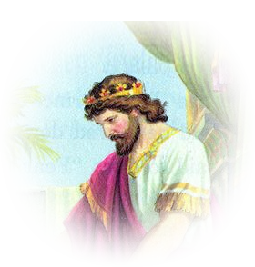
II. Kindness Illustrated
Imagine you are
Mephibosheth.
You have feared King David your whole life.
Notes:
David and Goliath = FREE = from https://commons.wikimedia.org/wiki/File:Fugel_David_gegen_Goliath.jpg

Slide 20
II. Kindness Illustrated
"Is there anyone still left of the house of Saul ..."
Imagine you are
Mephibosheth.
You have feared King David your whole life.
Notes:
David and Goliath = FREE = from https://commons.wikimedia.org/wiki/File:Fugel_David_gegen_Goliath.jpg

Slide 21
II. Kindness Illustrated
"Is there anyone still left of the house of Saul to whom I can show kindness for Jonathan's sake?"
Imagine you are
Mephibosheth.
You have feared King David your whole life.
Notes:
David and Goliath = FREE = from https://commons.wikimedia.org/wiki/File:Fugel_David_gegen_Goliath.jpg

Slide 22
II. Kindness Illustrated
"Is there anyone still left of the house of Saul to whom I can show kindness for Jonathan's sake?"
Imagine you are
Mephibosheth.
"There is still a son of Jonathan; he is crippled in both feet."
You have feared King David your whole life.
Notes:
David and Goliath = FREE = from https://commons.wikimedia.org/wiki/File:Fugel_David_gegen_Goliath.jpg

Slide 23
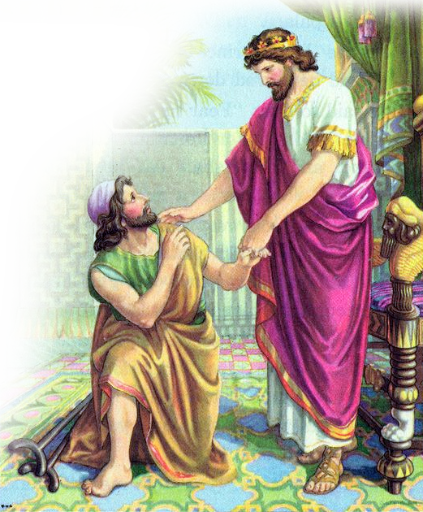
II. Kindness Illustrated
⁵ So King David had him brought …
⁶ When Mephibosheth …came …
he bowed down to pay
him honor.
Notes:
David and Goliath = FREE = from https://commons.wikimedia.org/wiki/File:Fugel_David_gegen_Goliath.jpg

Slide 24
II. Kindness Illustrated
David said,
"Mephibosheth!"
"Your servant,"
he replied.
Notes:
David & Mephibosheth = from http://lavistachurchofchrist.org/Pictures/Standard%20Bible%20Story%20Reader,%20Book%20Three/target35.html

Slide 25
II. Kindness Illustrated
⁷ "Don't be afraid,“
David said to him,
Notes:
David and Goliath = FREE = from https://commons.wikimedia.org/wiki/File:Fugel_David_gegen_Goliath.jpg
Shown KINDNESS for another’s sake – not yours!
You’ve done nothing to deserve this – it is totally unearned, undeserved

Slide 26
II. Kindness Illustrated
⁷ "Don't be afraid,“
David said to him,
"for I will surely show
you kindness for the
sake of your father
Jonathan. “
Notes:
David and Goliath = FREE = from https://commons.wikimedia.org/wiki/File:Fugel_David_gegen_Goliath.jpg
Shown KINDNESS for another’s sake – not yours!
You’ve done nothing to deserve this – it is totally unearned, undeserved

Slide 27
II. Kindness Illustrated
I will restore to you all the land that belonged to your grandfather Saul, ...
Notes:
David and Goliath = FREE = from https://commons.wikimedia.org/wiki/File:Fugel_David_gegen_Goliath.jpg
Restored what your father Adam lost – righteousness, holiness, true knowledge ...
Rev. 3:20 – Behold, I stand at the door and knock,--open, sup with him -- = Fellowship with God – Relationship with God.

Slide 28
II. Kindness Illustrated
I will restore to you all the land that belonged to your grandfather Saul, and you will always eat at my table.
Notes:
David and Goliath = FREE = from https://commons.wikimedia.org/wiki/File:Fugel_David_gegen_Goliath.jpg
Restored what your father Adam lost – righteousness, holiness, true knowledge ...
Rev. 3:20 – Behold, I stand at the door and knock,--open, sup with him -- = Fellowship with God – Relationship with God.

Slide 29
II. Kindness Illustrated
⁸ Mephibosheth bowed down and said,
"What is your servant, that
you should notice a dead
dog like me?"
Notes:
David and Goliath = FREE = from https://commons.wikimedia.org/wiki/File:Fugel_David_gegen_Goliath.jpg
Utter humility – Like singing Amazing Grace! How sweet the sound that saved a WRETCH LIKE ME!
This is hard in our culture of Political Correctness
We’ve even changed the hymns
Alas? And did my Savior Bleed and did my sovereign die?
Would he devote that sacred head for SUCH A WORM as I? (for sinner such as I?)
Hymn “Such a worm as I” this is humble admittance of one’s total unworthiness!

Slide 30
II. Kindness Illustrated
⁹ Then the king summoned Ziba,
Saul's servant, and said to him,
"I have given your master's
grandson everything that
belonged to Saul and his
family....
Notes:
David and Goliath = FREE = from https://commons.wikimedia.org/wiki/File:Fugel_David_gegen_Goliath.jpg
David had given him vast resources of land—but the cripple could not work them himself!
WE are “joint-heirs with Christ;” (Rom 8:17 KJV) All that is Jesus’ is ours!
God has given us vast resources of the spirit—but we cannot work them—the Holy Spirit must produce them in us.

Slide 31
II. Kindness Illustrated
⁹ Then the king summoned Ziba,
Saul's servant, and said to him,
¹⁰ You and your sons and
your servants are to farm
the land for him and …
Notes:
David and Goliath = FREE = from https://commons.wikimedia.org/wiki/File:Fugel_David_gegen_Goliath.jpg
So David gave the worker of the land—just as God has given us the Holy Spirit to produce the fruit in our lives. We only need to sit at His table, in His presence , eat from the Bread of Life , the Word of God.

Slide 32
II. Kindness Illustrated
THAT’S KINDNESS …
Notes:
David and Goliath = FREE = from https://commons.wikimedia.org/wiki/File:Fugel_David_gegen_Goliath.jpg

Slide 33
III. Kindness Applied
^{Eph 4:32} Be kind

Slide 34
III. Kindness Applied
^{Eph 4:32} Be kind [like David]

Slide 35
III. Kindness Applied
^{Eph 4:32} Be kind [like David]
and compassionate to one
another,
Notes:
Good Samaritan = FREE = from http://upload.wikimedia.org/wikipedia/commons/6/6c/Domenico_Fetti_-_Parable_of_the_Good_Samaritan_-_WGA07860.jpg

Slide 36
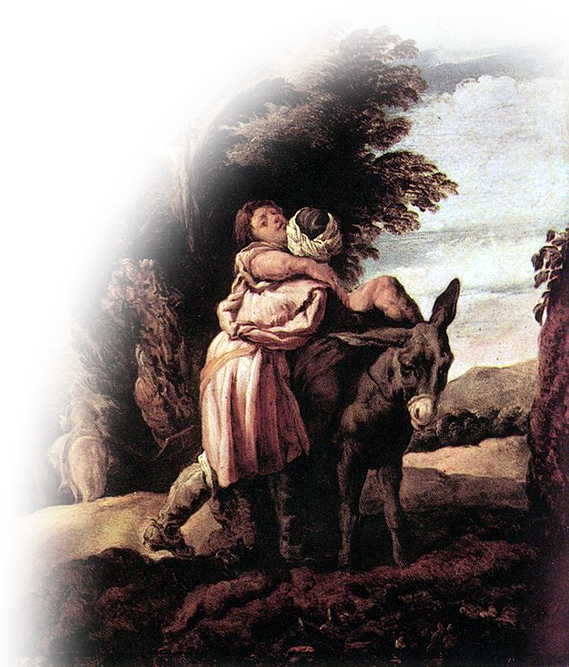
III. Kindness Applied
^{Eph 4:32} Be kind [like David]
and compassionate to one
another [like Good Samaritan],
Notes:
Good Samaritan = FREE = from http://upload.wikimedia.org/wikipedia/commons/6/6c/Domenico_Fetti_-_Parable_of_the_Good_Samaritan_-_WGA07860.jpg

Slide 37
III. Kindness Applied
^{Eph 4:32} Be kind [like David]
and compassionate to one
another [like good Samaritan],
forgiving each other,

Slide 38
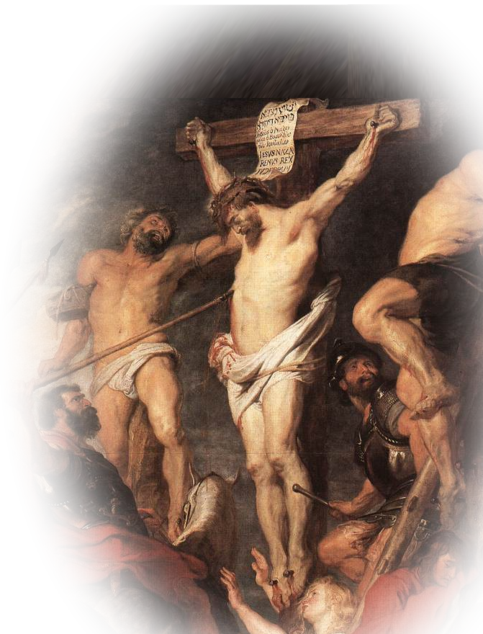
III. Kindness Applied
^{Eph 4:32} Be kind [like David]
and compassionate to one
another [like good Samaritan],
forgiving each other,
just as in Christ God forgave you.

Slide 39
How do you do that?

Slide 40
How do you do that?
You don’t really do it—
God the Holy Spirit does it!

Slide 41
²² But the fruit of the Spirit is love, joy, peace, kindness

Slide 42

The Holy Spirit Produces it when
you walk in the Spirit. Gal 5:16

Slide 43
Let’s Pray

