Slide 1

Notes:
Copyright © 2006−2021. All rights reserved. Bible Point is a registered trademark of Dennis Henderson. All other trademarks acknowledged.
Bible Point contains graphics from Bible Point artists. These illustrations belong to Bible Point and the respective artists. You may use the designs and illustrations for graphical illustration of lessons free and without special permission, provided they are not used in any way that maligns the Christian faith. Furthermore, republication or production of any illustration by any other graphic service whether it be in book, in a machine-readable form, or in any other design resource is strictly prohibited. Furthermore, they cannot be duplicated or resold as any other form of publishing, clip art, or graphic resource.
So What does it mean? (A simple translations of the legal jargon)
So, if you don’t own the presentation(s), graphic(s), and text(s) how can you legally use them? The purchase of the license allows you to use all the images in the product. However, the actual ownership and copyright of the presentation(s), graphic(s), and text(s) remain the property of Bible Point and its licensors. If you had plans on using this product in your “for sale” work—think again!
License Agreement
Article 1: License Grant
All the graphics and text in Bible Point presentations (excluding quotes from the Bible and stated sources) are the intellectual and real property of Bible Point and its licensors, and is protected by law, including United States copyright laws and international treaties. Bible Point grants to you a license:
1. To use the presentation in a single church, single school, or single office of a Christian organization.
2. To make a single archival back-up copy of the program.
3. To modify the presentation(s) and merge with other presentations in a single church, school, or Christian organization.
4. To transfer to another party if that party agrees to accept the terms and conditions of this agreement, and you do not retain any copies of the presentation, whether printed, machine readable, modified, or merged form.
Article 2: Terms
This license is effective until terminated. You may terminate the license at any time by destroying the presentation(s), graphic(s), or text(s) together with all copies, modifications and merged portions in any form. Bible Point may terminate your license if you fail to comply with this Agreement. You agree, upon such termination, for any reason, to destroy the presentation(s), graphics, and text(s) with all copies, modifications, and merged portions in any form.
Article 3: Disclaimers
1. Bible Point presentations, graphics, and texts are licensed to you As Is. You, the consumer, bear the entire risk relating to the quality and performance of the presentation(s), graphic(s), or text(s). In no event will Bible Point be liable for damages resulting from any defect.
2. Thirty-day limited warrantee on disks. Bible Point warrants the disks to be free of defects in material and workmanship under normal use for 30 days after purchase. During the 30-day period you may return a defective presentation, graphic, or text with proof of purchase and it will be replaced without charge, unless the presentation is damaged by misuse.
Article 4: General
1. You may not sub-license, assign, or transfer the license of the presentation(s), graphic(s), or text(s) except as provided by this Agreement.
2. This Agreement will be governed by the laws of the State of Michigan.
So What does it mean? (A simple translations of the legal jargon)
May I let someone borrow or copy my licensed Bible Point presentation (even after I modified it)? As long as it is within your local church, or single school, or the immediate office of a Christian organization you may. Otherwise, please refer the person interested in borrowing to: http://www.biblepoint.com or E-mail: dennis@DrDH.net with any related questions.

Slide 2
Joy
Notes:
Copyright © 2006−2021. All rights reserved. Bible Point is a registered trademark of Dennis Henderson. All other trademarks acknowledged.
Bible Point contains graphics from Bible Point artists. These illustrations belong to Bible Point and the respective artists. You may use the designs and illustrations for graphical illustration of lessons free and without special permission, provided they are not used in any way that maligns the Christian faith. Furthermore, republication or production of any illustration by any other graphic service whether it be in book, in a machine-readable form, or in any other design resource is strictly prohibited. Furthermore, they cannot be duplicated or resold as any other form of publishing, clip art, or graphic resource.
So What does it mean? (A simple translations of the legal jargon)
So, if you don’t own the presentation(s), graphic(s), and text(s) how can you legally use them? The purchase of the license allows you to use all the images in the product. However, the actual ownership and copyright of the presentation(s), graphic(s), and text(s) remain the property of Bible Point and its licensors. If you had plans on using this product in your “for sale” work—think again!
License Agreement
Article 1: License Grant
All the graphics and text in Bible Point presentations (excluding quotes from the Bible and stated sources) are the intellectual and real property of Bible Point and its licensors, and is protected by law, including United States copyright laws and international treaties. Bible Point grants to you a license:
1. To use the presentation in a single church, single school, or single office of a Christian organization.
2. To make a single archival back-up copy of the program.
3. To modify the presentation(s) and merge with other presentations in a single church, school, or Christian organization.
4. To transfer to another party if that party agrees to accept the terms and conditions of this agreement, and you do not retain any copies of the presentation, whether printed, machine readable, modified, or merged form.
Article 2: Terms
This license is effective until terminated. You may terminate the license at any time by destroying the presentation(s), graphic(s), or text(s) together with all copies, modifications and merged portions in any form. Bible Point may terminate your license if you fail to comply with this Agreement. You agree, upon such termination, for any reason, to destroy the presentation(s), graphics, and text(s) with all copies, modifications, and merged portions in any form.
Article 3: Disclaimers
1. Bible Point presentations, graphics, and texts are licensed to you As Is. You, the consumer, bear the entire risk relating to the quality and performance of the presentation(s), graphic(s), or text(s). In no event will Bible Point be liable for damages resulting from any defect.
2. Thirty-day limited warrantee on disks. Bible Point warrants the disks to be free of defects in material and workmanship under normal use for 30 days after purchase. During the 30-day period you may return a defective presentation, graphic, or text with proof of purchase and it will be replaced without charge, unless the presentation is damaged by misuse.
Article 4: General
1. You may not sub-license, assign, or transfer the license of the presentation(s), graphic(s), or text(s) except as provided by this Agreement.
2. This Agreement will be governed by the laws of the State of Michigan.
So What does it mean? (A simple translations of the legal jargon)
May I let someone borrow or copy my licensed Bible Point presentation (even after I modified it)? As long as it is within your local church, or single school, or the immediate office of a Christian organization you may. Otherwise, please refer the person interested in borrowing to: http://www.biblepoint.com or E-mail: dennis@DrDH.net with any related questions.

Slide 3
Review 4 kinds of people:
The man without the Spirit does not accept the things that come from the Spirit of God, 1Cor 2:14
NATURAL

Slide 4
Review 4 kinds of people:
I could not address you as spiritual but as worldly--mere infants in Christ. 1Cor 3:1
NATURAL
INFANTILE

Slide 5
Review 4 kinds of people:
¹⁵ The spiritual man makes judgments about all things, 1Cor 2:15
NATURAL
INFANTILE
SPIRITUAL

Slide 6
Review 4 kinds of people:
... Indeed, you are still not ready. ³ You are still worldly.... Are you not acting like mere men? 1Co 3:2-3
NATURAL
CARNAL
INFANTILE
SPIRITUAL

Slide 7
JOY

Slide 8
Joy: What is it?

Slide 9
Joy: What is it?
More than
happiness:
emotional pleasure from happenstance
IN POSITIVE CIRCUMSTANCES

Slide 10
Joy: What is it?
More than
happiness:
emotional pleasure from happenstance
It is happiness on steroids:
emotional pleasure independent of happenstance
IN
THE
LORD
IN POSITIVE CIRCUMSTANCES

Slide 11

Joy: Where does it come from?

Slide 12
Joy: Where does it come from?
“Joy in the Spirit” Luke 10:21; Rom 14:17

Slide 13
Joy: Where does it come from?
“Joy in the Spirit” Luke 10:21; Rom 14:17
“Joy given by the Spirit” 1 Thess 1:6

Slide 14
Joy: Where does it come from?
“Joy in the Spirit” Luke 10:21; Rom 14:17
“Joy given by the Spirit” 1 Thess 1:6
“Fruit of the Spirit” Gal 5:22

Slide 15
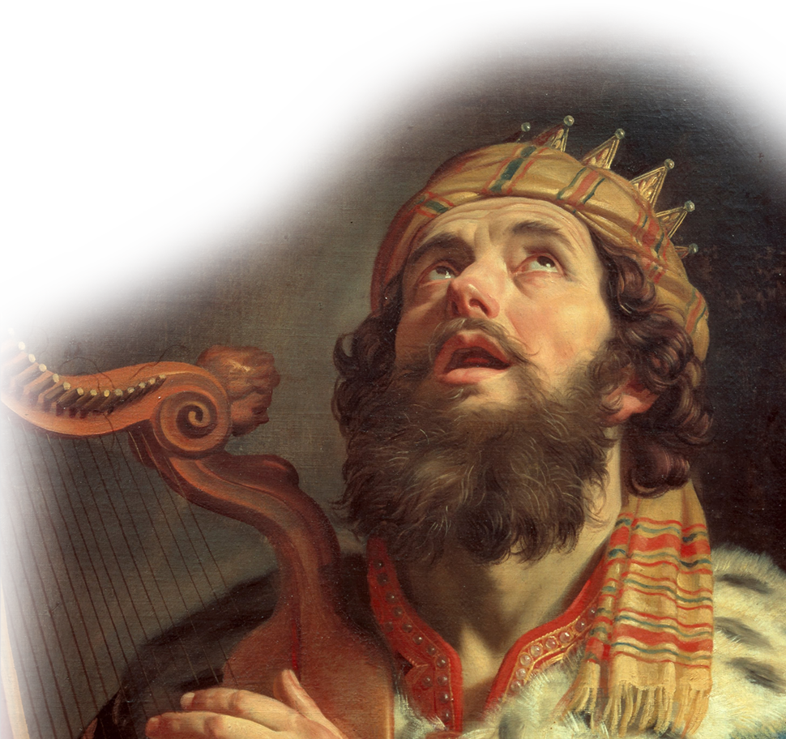
Joy: When do you get it?
King David sings us the answer:
“... the joy of
your salvation”
Psalm 51:12
Notes:
King David = FREE = from http://commons.wikimedia.org/wiki/File:Gerard_van_Honthorst_-_King_David_Playing_the_Harp_-_Google_Art_Project.jpg

Slide 16

Joy: When do you get it?
Paul agrees in a letter:
... if anyone does not have the Spirit of Christ, he does not belong to Christ.
Romans 8:9

Slide 17
Four JOYFUL Principles

Slide 18
1—You can Find Joy: Rom 15:13

Slide 19
1—You can Find Joy: Rom 15:13
How?

Slide 20
1—You can Find Joy: Rom 15:13
How?

Slide 21
1—You can Find Joy: Rom 15:13
How?
¹³ May the God of hope fill you with all joy and peace as you trust in him, so that you may overflow with hope by the power of the Holy Spirit. Romans 15:13

Slide 22
2—You can Lose Joy: Psalm 51:12

Slide 23
2—You can Lose Joy: Psalm 51:12
“Restore the joy” Psalm 51:12

Slide 24
2—You can Lose Joy: Psalm 51:12
“Restore the joy” Psalm 51:12
You only restore what was lost!

Slide 25
2—You can Lose Joy: Psalm 51:12
“Restore the joy” Psalm 51:12
You only restore what was lost!
No lasting joy in the Lord! Only the
“... pleasures of sin for a short time.” ^{Heb 11:25}

Slide 26
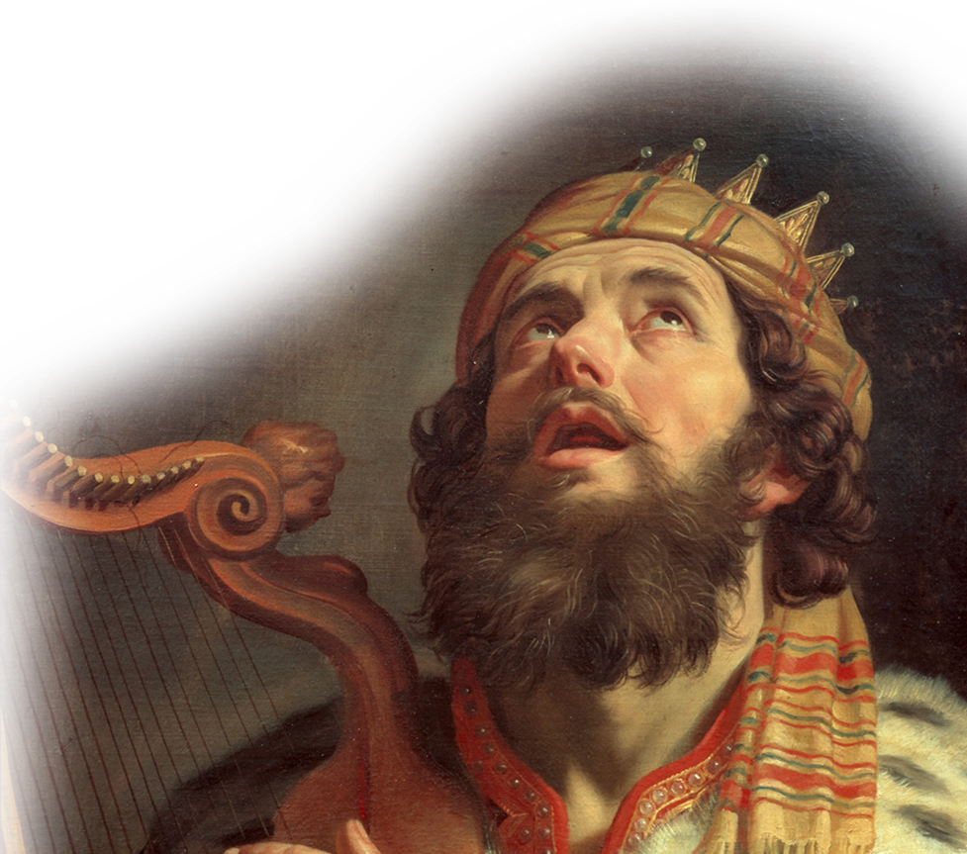
2—You can Lose Joy: Psalm 51:12
Let’s Consider King David whom God called
“man after his own heart”
1 Samuel 13:14

Slide 27

2—You can Lose Joy: Psalm 51:12
JOY
He was enjoying
“... the joy of your salvation”
Psalm 51:12

Slide 28

2—You can Lose Joy: Psalm 51:12
JOY
Innocent Look
^{2 Samuel 11:2}
One evening
David got up from his bed and walked around on the roof of the palace. From the roof he saw a woman bathing. The woman was very beautiful,

Slide 29
2—You can Lose Joy: Psalm 51:12
JOY
Innocent Look
Internal Desire
³ and David
sent someone to
find out about her.
The man said, "Isn't this Bathsheba, the daughter of Eliam and the wife of Uriah the Hittite?"

Slide 30
2—You can Lose Joy: Psalm 51:12
JOY
Innocent Look
Internal Desire
Gave In to It
⁴ Then David
sent messengers
to get her. She came to him, and he slept with her.

Slide 31
2—You can Lose Joy: Psalm 51:12
JOY
Innocent Look
Internal Desire
Gave In to It
Guilt
⁵ The woman conceived and
sent word to David, saying,
"I am pregnant.”

Slide 32
2—You can Lose Joy: Psalm 51:12
JOY
Innocent Look
Internal Desire
Gave In to It
Guilt
Cover Up
"... some of
the king's men
died. Moreover,
your servant Uriah
the Hittite is dead."
2 Samuel 11:24

Slide 33
2—You can Lose Joy: Psalm 51:12
JOY
Innocent Look
Internal Desire
Gave In to It
Guilt
Cover Up
DEPRESSED
³ ... my
bones wasted
away through my
groaning all day
long. ⁴ For day and
night your hand was
heavy upon me; my
strength was sapped as in
the heat of summer. Ps 32:3-4

Slide 34
2—You can Lose Joy: Psalm 51:12
JOY
Innocent Look
Internal Desire
Gave In to It
Guilt
Cover Up
DEPRESSED
This is
a slippery
slope

Slide 35
3—You can Regain Joy: Psa 51:12
“Restore the joy” How?
DEPRESSED

Slide 36
3—You can Regain Joy: Psa 51:12
“Restore the joy” How?
DEPRESSED
Exposed
⁷ Then Nathan
said to David,
"You are the man!” 2 Samuel 12:7

Slide 37
3—You can Regain Joy: Psa 51:12
“Restore the joy” How?
DEPRESSED
Exposed
Confessed
⁵ Then I
acknowledged
my sin to you and did not cover up my iniquity. I said, "I will confess my transgressions to the LORD"-- and you forgave the guilt of my sin. Psalm 32:5
Notes:
My sin = טָּאתִ (Psa 32:5 WTT) = sin =ἁμαρτίαν (Psa 31:5 BGT) = failure to hit the goal
My iniquity = עֲוֹנִ (Psa 32:5 WTT) = ἀνομίαν (Psa 31:5 BGT) = no law = lawlessness
My transgressions = פְשָׁעַי (Psa 32:5 WTT) = rebellion

Slide 38
3—You can Regain Joy: Psa 51:12
“Restore the joy” How?
DEPRESSED
Exposed
Confessed
⁵ Then I
acknowledged
my sin to you and did not cover up my iniquity. I said, "I will confess my transgressions to the LORD"-- and you forgave the guilt of my sin. Psalm 32:5
Notes:
My sin = טָּאתִ (Psa 32:5 WTT) = sin =ἁμαρτίαν (Psa 31:5 BGT) = failure to hit the goal
My iniquity = עֲוֹנִ (Psa 32:5 WTT) = ἀνομίαν (Psa 31:5 BGT) = no law = lawlessness
My transgressions = פְשָׁעַי (Psa 32:5 WTT) = rebellion

Slide 39
3—You can Regain Joy: Psa 51:12
“Restore the joy” How?
DEPRESSED
Exposed
Confessed
¹² Restore to
me the joy of your
salvation and grant me a
willing spirit, to sustain me. (Psa 51:12 )
Repent

Slide 40
3—You can Regain Joy: Psa 51:12
“Restore the joy” How?
DEPRESSED
Exposed
Confessed
⁵ David burned
with anger against
the man ...⁶ He must
pay for that lamb four times over, because he did such a thing and had no pity." 2 Samuel 12:5,6
Repent
(Restitution)

Slide 41
3—You can Regain Joy: Psa 51:12
“Restore the joy” How?
RESTORED JOY
DEPRESSED
Exposed
Confessed
Repent
(Restitution)
Blessed is he whose transgressions are forgiven, whose sins are covered. Psalm 32:1

Slide 42
4. You can Sustain Joy
¹² Restore to me the joy of your salvation and grant me a willing spirit, to sustain me. Psalm 51:12

Slide 43
4. You can Sustain Joy
¹² Restore to me the joy of your salvation and grant me a willing spirit, to sustain me. Psalm 51:12
¹⁶ So I say, live by the Spirit, and
you will not gratify the
desires of the sinful nature.
Galatians 5:16

Slide 44
4. You can Sustain Joy
¹² Restore to me the joy of your salvation and grant me a willing spirit, to sustain me. Psalm 51:12
¹⁶ So I say, live by the Spirit, and
you will not gratify the
desires of the sinful nature.
Galatians 5:16
HOW?

Slide 45
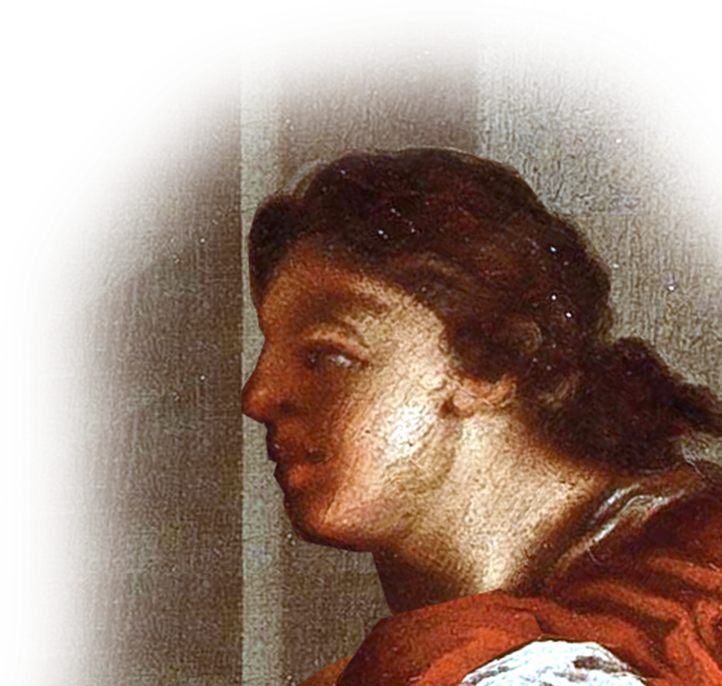
Like JOSEPH ... Genesis
In Genesis Pharaoh asked:
"Can we find anyone like this man, one in whom is the spirit of God?" Genesis 41:38
Notes:
Joseph = FREE = from http://commons.wikimedia.org/wiki/File:Lazzaro_Baldi_%28attr%29_Joseph_and_Potiphar%27s_wife.jpg

Slide 46
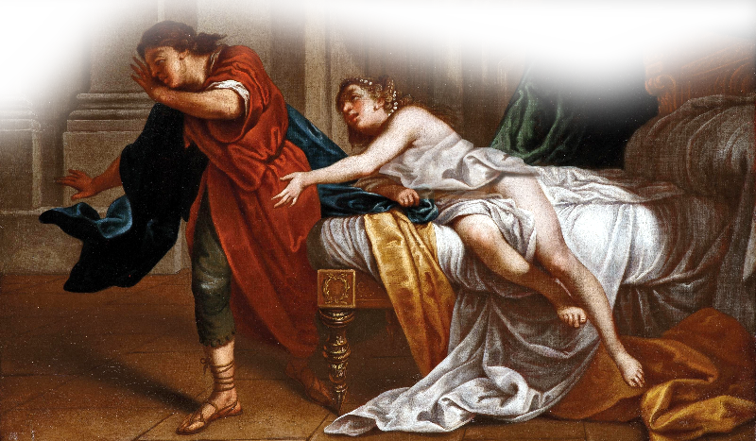
You Need the Right ATTITUDE
⁷ .... his master's wife took notice of Joseph and said, "Come to bed with me!“
Notes:
Joseph and Potipher’s Wife = FREE = Joseph = FREE = from http://commons.wikimedia.org/wiki/File:Lazzaro_Baldi_%28attr%29_Joseph_and_Potiphar%27s_wife.jpg
Gen 39:7

Slide 47
You Need the Right ATTITUDE
⁹ ".... My master has withheld nothing from me except you, .... How then could I do such a
wicked thing and sin
against God?"
(Genesis 39:7,9)

Slide 48
You Need the Right ACTION
¹¹ One day ... ¹² She caught him by his cloak and said, "Come to bed with me!" But he left his cloak in her hand and ran out of the
house. (Genesis 39:11-12)

Slide 49
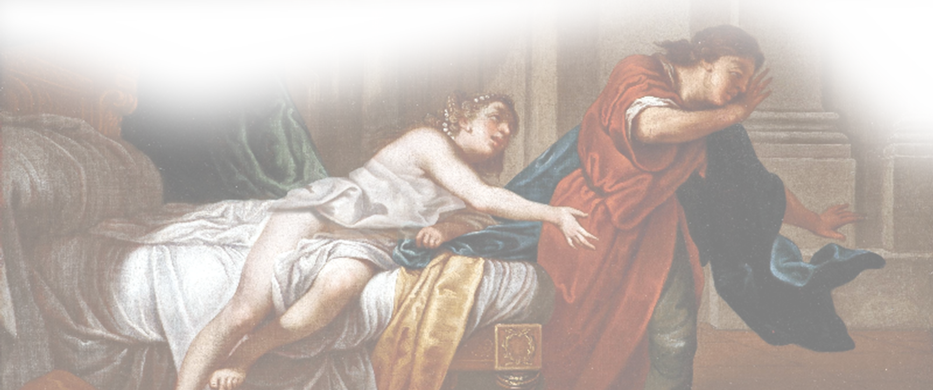
IT’S LIKE THIS ...
Right Action
Right Attitude
JOY
Innocent Look
Internal Desire
Gave In to It
Guilt
Cover Up
DEPRESSED

Slide 50

Can this be said of YOU?
"Can we find anyone like YOU, one in whom is the spirit of God?"

Slide 51
Are you settling for...
Happiness?

Slide 52
Are you settling for...
When you can have...
Happiness?
Joy!

Slide 53
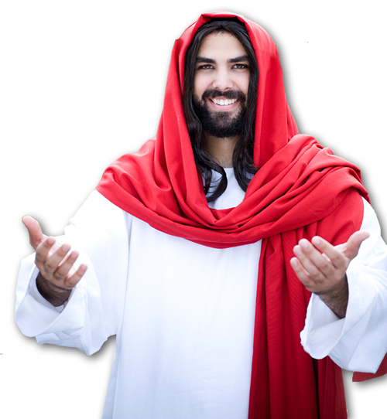
Rewarded now and later ...
"His lord said to him, 'Well done, good and faithful servant; you have been faithful over a few things, I will make you ruler over many things.
Enter into the joy of your lord.' "
(Mat 25:23 NKJ)

Slide 54
²² But the fruit of the Spirit is love, joy

Slide 55
²² But the fruit of the Spirit is love, joy
Emotional pleasure that arises above your circumstances:

Slide 56
²² But the fruit of the Spirit is love, joy
Emotional pleasure that arises above your circumstances:
happiness on steroids!

Slide 57

The Holy Spirit Produces it when
you walk in the Spirit. Gal 5:16

Slide 58
Let’s Pray

