Slide 1

Notes:
Copyright © 2006−2021. All rights reserved. Bible Point is a registered trademark of Dennis Henderson. All other trademarks acknowledged.
Bible Point contains graphics from Bible Point artists. These illustrations belong to Bible Point and the respective artists. You may use the designs and illustrations for graphical illustration of lessons free and without special permission, provided they are not used in any way that maligns the Christian faith. Furthermore, republication or production of any illustration by any other graphic service whether it be in book, in a machine-readable form, or in any other design resource is strictly prohibited. Furthermore, they cannot be duplicated or resold as any other form of publishing, clip art, or graphic resource.
So What does it mean? (A simple translations of the legal jargon)
So, if you don’t own the presentation(s), graphic(s), and text(s) how can you legally use them? The purchase of the license allows you to use all the images in the product. However, the actual ownership and copyright of the presentation(s), graphic(s), and text(s) remain the property of Bible Point and its licensors. If you had plans on using this product in your “for sale” work—think again!
License Agreement
Article 1: License Grant
All the graphics and text in Bible Point presentations (excluding quotes from the Bible and stated sources) are the intellectual and real property of Bible Point and its licensors, and is protected by law, including United States copyright laws and international treaties. Bible Point grants to you a license:
1. To use the presentation in a single church, single school, or single office of a Christian organization.
2. To make a single archival back-up copy of the program.
3. To modify the presentation(s) and merge with other presentations in a single church, school, or Christian organization.
4. To transfer to another party if that party agrees to accept the terms and conditions of this agreement, and you do not retain any copies of the presentation, whether printed, machine readable, modified, or merged form.
Article 2: Terms
This license is effective until terminated. You may terminate the license at any time by destroying the presentation(s), graphic(s), or text(s) together with all copies, modifications and merged portions in any form. Bible Point may terminate your license if you fail to comply with this Agreement. You agree, upon such termination, for any reason, to destroy the presentation(s), graphics, and text(s) with all copies, modifications, and merged portions in any form.
Article 3: Disclaimers
1. Bible Point presentations, graphics, and texts are licensed to you As Is. You, the consumer, bear the entire risk relating to the quality and performance of the presentation(s), graphic(s), or text(s). In no event will Bible Point be liable for damages resulting from any defect.
2. Thirty-day limited warrantee on disks. Bible Point warrants the disks to be free of defects in material and workmanship under normal use for 30 days after purchase. During the 30-day period you may return a defective presentation, graphic, or text with proof of purchase and it will be replaced without charge, unless the presentation is damaged by misuse.
Article 4: General
1. You may not sub-license, assign, or transfer the license of the presentation(s), graphic(s), or text(s) except as provided by this Agreement.
2. This Agreement will be governed by the laws of the State of Michigan.
So What does it mean? (A simple translations of the legal jargon)
May I let someone borrow or copy my licensed Bible Point presentation (even after I modified it)? As long as it is within your local church, or single school, or the immediate office of a Christian organization you may. Otherwise, please refer the person interested in borrowing to: http://www.biblepoint.com or E-mail: dennis@DrDH.net with any related questions.

Slide 2
Goodness
Notes:
Copyright © 2006−2021. All rights reserved. Bible Point is a registered trademark of Dennis Henderson. All other trademarks acknowledged.
Bible Point contains graphics from Bible Point artists. These illustrations belong to Bible Point and the respective artists. You may use the designs and illustrations for graphical illustration of lessons free and without special permission, provided they are not used in any way that maligns the Christian faith. Furthermore, republication or production of any illustration by any other graphic service whether it be in book, in a machine-readable form, or in any other design resource is strictly prohibited. Furthermore, they cannot be duplicated or resold as any other form of publishing, clip art, or graphic resource.
So What does it mean? (A simple translations of the legal jargon)
So, if you don’t own the presentation(s), graphic(s), and text(s) how can you legally use them? The purchase of the license allows you to use all the images in the product. However, the actual ownership and copyright of the presentation(s), graphic(s), and text(s) remain the property of Bible Point and its licensors. If you had plans on using this product in your “for sale” work—think again!
License Agreement
Article 1: License Grant
All the graphics and text in Bible Point presentations (excluding quotes from the Bible and stated sources) are the intellectual and real property of Bible Point and its licensors, and is protected by law, including United States copyright laws and international treaties. Bible Point grants to you a license:
1. To use the presentation in a single church, single school, or single office of a Christian organization.
2. To make a single archival back-up copy of the program.
3. To modify the presentation(s) and merge with other presentations in a single church, school, or Christian organization.
4. To transfer to another party if that party agrees to accept the terms and conditions of this agreement, and you do not retain any copies of the presentation, whether printed, machine readable, modified, or merged form.
Article 2: Terms
This license is effective until terminated. You may terminate the license at any time by destroying the presentation(s), graphic(s), or text(s) together with all copies, modifications and merged portions in any form. Bible Point may terminate your license if you fail to comply with this Agreement. You agree, upon such termination, for any reason, to destroy the presentation(s), graphics, and text(s) with all copies, modifications, and merged portions in any form.
Article 3: Disclaimers
1. Bible Point presentations, graphics, and texts are licensed to you As Is. You, the consumer, bear the entire risk relating to the quality and performance of the presentation(s), graphic(s), or text(s). In no event will Bible Point be liable for damages resulting from any defect.
2. Thirty-day limited warrantee on disks. Bible Point warrants the disks to be free of defects in material and workmanship under normal use for 30 days after purchase. During the 30-day period you may return a defective presentation, graphic, or text with proof of purchase and it will be replaced without charge, unless the presentation is damaged by misuse.
Article 4: General
1. You may not sub-license, assign, or transfer the license of the presentation(s), graphic(s), or text(s) except as provided by this Agreement.
2. This Agreement will be governed by the laws of the State of Michigan.
So What does it mean? (A simple translations of the legal jargon)
May I let someone borrow or copy my licensed Bible Point presentation (even after I modified it)? As long as it is within your local church, or single school, or the immediate office of a Christian organization you may. Otherwise, please refer the person interested in borrowing to: http://www.biblepoint.com or E-mail: dennis@DrDH.net with any related questions.

Slide 3
What is “Goodness?”
Notes:
Sunburst = FREE = from http://www.rgbstock.com/download/ba1969/mw3VDvq.jpg

Slide 4
What is “Goodness?”
First we must ask what is “good?”
Notes:
Sunburst = FREE = from http://www.rgbstock.com/download/ba1969/mw3VDvq.jpg

Slide 5

What is “Goodness?”
First we must ask what is “good?”
Answer:
“God is good”
Notes:
Sunburst = FREE = from http://www.rgbstock.com/download/ba1969/mw3VDvq.jpg

Slide 6
Taste and see that the LORD is good; Ps 34:8

Slide 7
Taste and see that the LORD is good; Ps 34:8
For the LORD is good and his love endures forever Ps 100:5

Slide 8
Taste and see that the LORD is good; Ps 34:8
For the LORD is good and his love endures forever Ps 100:5
Praise the LORD, for the LORD is good; Ps 135:3

Slide 9
Taste and see that the LORD is good; Ps 34:8
For the LORD is good and his love endures forever Ps 100:5
Praise the LORD, for the LORD is good; Ps 135:3
"Give thanks to the LORD Almighty, for the LORD is good; his love endures forever." Jer 33:11

Slide 10
Taste and see that the LORD is good; Ps 34:8
For the LORD is good and his love endures forever Ps 100:5
Praise the LORD, for the LORD is good; Ps 135:3
"Give thanks to the LORD Almighty, for the LORD is good; his love endures forever." Jer 33:11
The LORD is good to those whose hope is in him, to the one who seeks him; Lam 3:25

Slide 11
God is intrinsically GOOD
He is the standard; He is the Good.

Slide 12
God is intrinsically GOOD
He is the standard; He is the Good.
If something is good it is only such by measuring up to Him.

Slide 13
God only DOES good!

Slide 14
God only DOES good!
Surely God is good to Israel, to those who are pure in heart. Psalm 73:1

Slide 15
God only DOES good!
Surely God is good to Israel, to those who are pure in heart. Psalm 73:1
The LORD is good to all; he has compassion on all he has made. Ps 145:9

Slide 16
God only DOES good!
Surely God is good to Israel, to those who are pure in heart. Psalm 73:1
The LORD is good to all; he has compassion on all he has made. Ps 145:9
And we know that in all things God works for the good ... Romans 8:28

Slide 17
God only DOES good!
Surely God is good to Israel, to those who are pure in heart. Psalm 73:1
The LORD is good to all; he has compassion on all he has made. Ps 145:9
You meant evil against me; but God meant it for good, Genesis 50:20 (NKJ)

Slide 18
So then, what is “Goodness?”

Slide 19
So then, what is “Goodness?”
ANSWER: Goodness is
the state or quality of being like God.

Slide 20
So then, what is “Goodness?”
ANSWER: Goodness is
the state or quality of being like God.
Things or creatures are good when
they conform to God or His intended purpose.

Slide 21
“Goodness” IS NOT:

Slide 22
“Goodness” IS NOT:
some external standard that we set up and to which God has to achieve.

Slide 23
“Goodness” IS NOT:
some external standard that we set up and to which God has to achieve.
He is the Good.

Slide 24
“Goodness” IS NOT:
some external standard that we set up and to which God has to achieve.
He is the Good.
If something is good it is only good by measuring up to God and the purpose for which He created it.

Slide 25

Someone might say, “A good god would not send anyone to hell.”
Notes:
Fire = FREE = http://www.rgbstock.com/download/vivekchugh/mf0q6lW.jpg

Slide 26
Someone might say, “A good god would not send anyone to hell.”
What they are actually saying,
“I set the standard for goodness to
which the concept of god must
conform or that god is not good.”
Notes:
Fire = FREE = http://www.rgbstock.com/download/vivekchugh/mf0q6lW.jpg

Slide 27
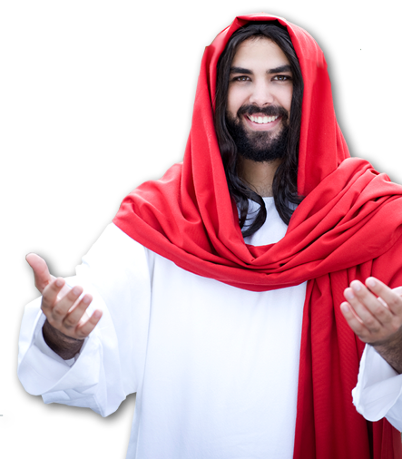
To Jesus that is WRONG:
"No one is good—
except God alone.”
^{Mark 10:18}
Notes:
You are not good enough to set the standard for God or goodness!
Only God can do that!

Slide 28
The truth is--
The God of the Bible is good!

Slide 29
The truth is--
The God of the Bible is good!
He sends people to hell because
He is good and they are evil.

Slide 30
Most Important Point:

Slide 31
Most Important Point:
God is Good.

Slide 32
Most Important Point:
God is Good.
All goodness must conform to
Who He is, what He does, and what He says.

Slide 33
The story of the Rich Young Ruler
Illustrates this…
Notes:
Having established the principle of the preceding slides. We can not examine the story of the Rich Young Ruler.

Slide 34
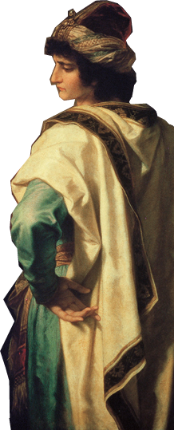
I. The Rich Young Ruler — had a dishonest inquiry:

Slide 35
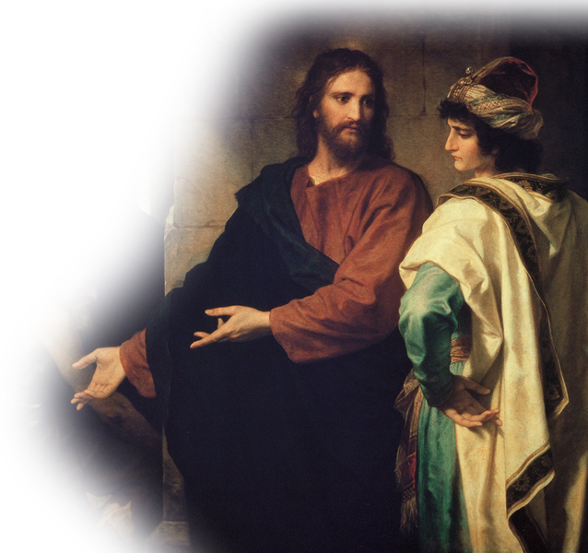
1. He Went to the Right Person
¹⁸ A certain ruler asked him, [i.e., Jesus]
Notes:
http://commons.wikimedia.org/wiki/File:Hoffman-ChristAndTheRichYoungRuler.jpg

Slide 36
2. Asked the Important Question
¹⁸ A certain ruler asked him,
  "Good teacher, what
  must I do to inherit
  eternal life?"

Slide 37
3. Received a Corrective Response
¹⁹ "Why do you call me good?“
Jesus answered.
"No one is good--except God
alone."

Slide 38
3. Received a Corrective Response
¹⁹ "Why do you call me good?“
Jesus answered.
"No one is good--except God
alone."
Do you really mean what you say?

Slide 39
4. Offered an Intriguing Quotation
²⁰ You know the commandments: ‘Do not commit adultery,
do not murder, do not steal, do not give false testimony, honor your father and mother.' "
Notes:
“You know the law” Jesus said. Then he shuffled the deck. He took them out of order. 7, 6, 8, 9, 5.
Why?
So he would say, “Hey you missed one.” That one was the whole point!!!
The 10th commandment, “Do not covet ... [stuff].”

Slide 40
4. Offered an Intriguing Quotation
²⁰ You know the commandments: ‘Do not commit adultery,
do not murder, do not steal, do not give false testimony, honor your father and mother.' "
Tablet II

Slide 41
4. Offered an Intriguing Quotation
²⁰ You know the commandments: ‘Do not commit adultery,
do not murder, do not steal, do not give false testimony, honor your father and mother.' "
7
Tablet II

Slide 42
4. Offered an Intriguing Quotation
²⁰ You know the commandments: ‘Do not commit adultery,
do not murder, do not steal, do not give false testimony, honor your father and mother.' "
7
6
Tablet II

Slide 43
4. Offered an Intriguing Quotation
²⁰ You know the commandments: ‘Do not commit adultery,
do not murder, do not steal, do not give false testimony, honor your father and mother.' "
7
6
8
Tablet II

Slide 44
4. Offered an Intriguing Quotation
²⁰ You know the commandments: ‘Do not commit adultery,
do not murder, do not steal, do not give false testimony, honor your father and mother.' "
7
6
8
9
Tablet II

Slide 45
4. Offered an Intriguing Quotation
²⁰ You know the commandments: ‘Do not commit adultery,
do not murder, do not steal, do not give false testimony, honor your father and mother.' "
7
6
8
9
5
Tablet II

Slide 46
4. Offered an Intriguing Quotation
²⁰ You know the commandments: ‘Do not commit adultery,
do not murder, do not steal, do not give false testimony, honor your father and mother.' "
7
6
8
9
5
10
Tablet II
Minus the 10th

Slide 47
5. Gave a Self-Righteous Response
²¹ "All these I have kept since
I was a boy,"
he said.

Slide 48
6. Offered Clear Instructions
²² When Jesus heard this, he said to him,
  "You still lack one thing.
  Sell everything you have
  and give to the poor, and
  you will have treasure in
  heaven. Then come,
  follow me."
Notes:
JESUS IS NOT CONDEMNING—HE IS EXPOSING!

Slide 49
6. Offered Clear Instructions
²² When Jesus heard this, he said to him,
  "You still lack one thing.
  Sell everything you have
  and give to the poor, and
  you will have treasure in
  heaven. Then come,
  follow me."
Notes:
JESUS IS NOT CONDEMNING—HE IS EXPOSING!

Slide 50
6. Offered Clear Instructions
²² When Jesus heard this, he said to him,
  "You still lack one thing.
  Sell everything you have
  and give to the poor, and
  you will have treasure in
  heaven. Then come,
  follow me."
Notes:
JESUS IS NOT CONDEMNING—HE IS EXPOSING!

Slide 51
6. Offered Clear Instructions
²² When Jesus heard this, he said to him,
  "You still lack one thing.
  Sell everything you have
  and give to the poor, and
  you will have treasure in
  heaven. Then come,
  follow me."
Notes:
JESUS IS NOT CONDEMNING—HE IS EXPOSING!

Slide 52
6. Offered Clear Instructions
²² When Jesus heard this, he said to him,
  "You still lack one thing.
  Sell everything you have
  and give to the poor, and
  you will have treasure in
  heaven. Then come,
  follow me."
Not condemning--
Notes:
JESUS IS NOT CONDEMNING—HE IS EXPOSING!

Slide 53
6. Offered Clear Instructions
²² When Jesus heard this, he said to him,
  "You still lack one thing.
  Sell everything you have
  and give to the poor, and
  you will have treasure in
  heaven. Then come,
  follow me."
Not condemning--He is exposing.
Notes:
JESUS IS NOT CONDEMNING—HE IS EXPOSING!

Slide 54
6. Offered Clear Instructions
²³ When he heard this, he became very sad, because he was a man of great wealth.

Slide 55
7. Given an Hyperbolic Conclusion
²⁴ Jesus looked at him and said,
  "How hard it is for
  the rich to enter the
  kingdom of God!”
Notes:
Camel = FREE = http://www.flickr.com/photos/gregory-moine/7822245662/sizes/c/in/photostream/
Needle = FREE = http://commons.wikimedia.org/wiki/File:Sewing_needle_eye_with_thread.jpg

Slide 56
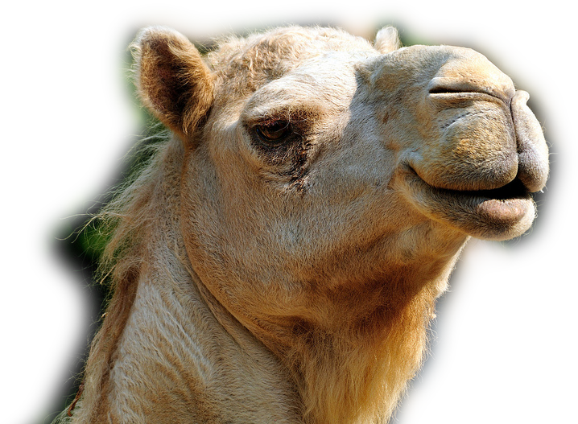
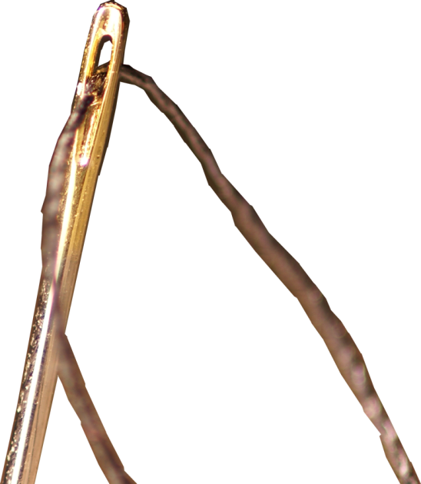
7. Given an Hyperbolic Conclusion
²⁵ Indeed, it is easier for a camel to go through the eye of a needle than for a rich man to enter the kingdom of God."
Notes:
Camel = FREE = http://www.flickr.com/photos/gregory-moine/7822245662/sizes/c/in/photostream/
Needle = FREE = http://commons.wikimedia.org/wiki/File:Sewing_needle_eye_with_thread.jpg

Slide 57
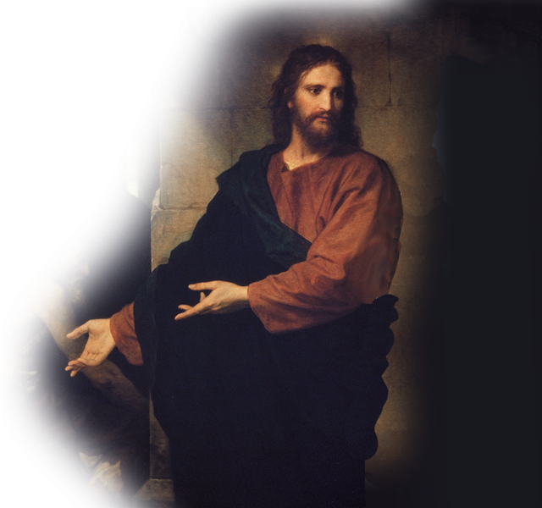
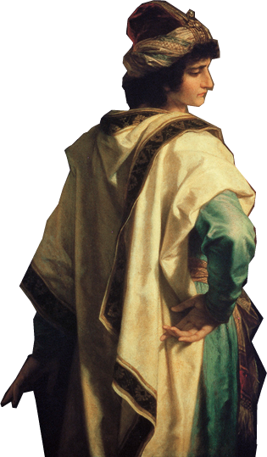
8. Made a Poor Decision
²² When the young man heard this, he went away sad, because he had great wealth. Mat 19:22
Notes:
Camel = FREE = http://www.flickr.com/photos/gregory-moine/7822245662/sizes/c/in/photostream/
Needle = FREE = http://commons.wikimedia.org/wiki/File:Sewing_needle_eye_with_thread.jpg

Slide 58
8. Made a Poor Decision
²² When the young man heard this, he went away sad, because he had great wealth. Mat 19:22
Notes:
Camel = FREE = http://www.flickr.com/photos/gregory-moine/7822245662/sizes/c/in/photostream/
Needle = FREE = http://commons.wikimedia.org/wiki/File:Sewing_needle_eye_with_thread.jpg

Slide 59
8. Made a Poor Decision
²² When the young man heard this, he went away sad, because he had great wealth. Mat 19:22
Notes:
Camel = FREE = http://www.flickr.com/photos/gregory-moine/7822245662/sizes/c/in/photostream/
Needle = FREE = http://commons.wikimedia.org/wiki/File:Sewing_needle_eye_with_thread.jpg

Slide 60
II. The Disciples of Jesus —an honest inquiry that led to:

Slide 61
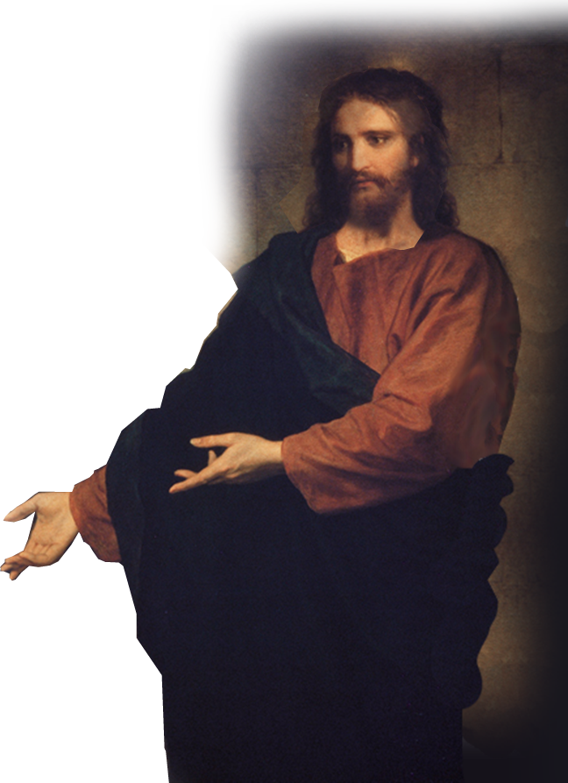
1. Went to the Right Person
²⁶ Those who heard this asked [Jesus],

Slide 62
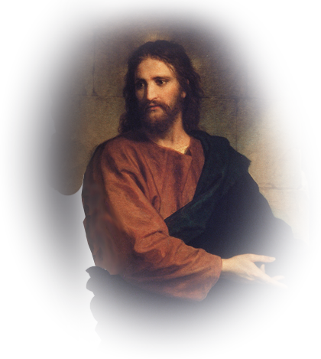
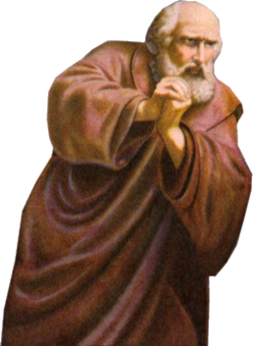
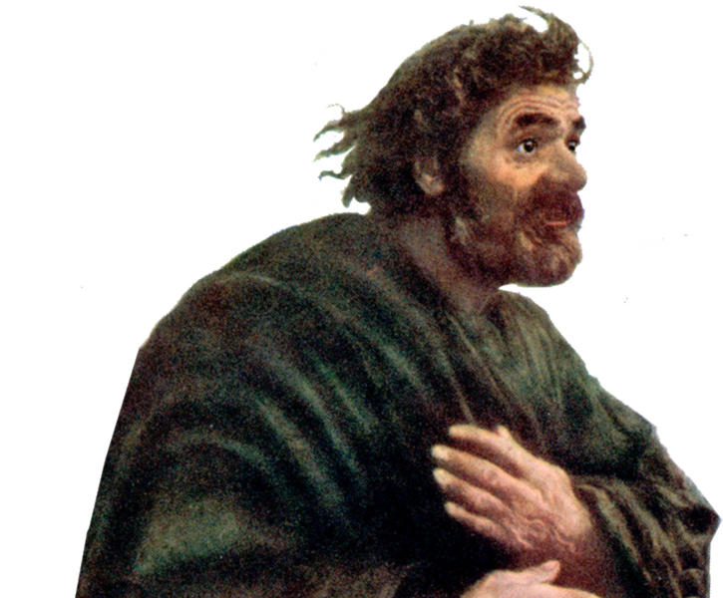
2. Asked the Important Question
²⁶ Those who heard this asked,
  "Who then can
  be saved?”
Notes:
MAN = free = http://www.flickr.com/photos/waitingfortheword/7021783467/sizes/o/in/photostream/
Peter =FREE =

Slide 63
3. Received a Powerful Answer
²⁷ Jesus replied,
  "What is impossible with
  men is possible with God."

Slide 64
4. Made a Good Decision
²⁸ Peter said to him,
  "We have left all we had to follow you!"

Slide 65
5. Given a Great Promise
²⁹ "I tell you the truth,"
Jesus said to them,
"no one who has left home or wife or brothers or parents or children for the sake of the kingdom of God ...

Slide 66
5. Given a Great Promise
.Jesus said to them,
  ³⁰ will fail to receive many times as much in this age and, in the age to come, eternal life."

Slide 67
Let’s Sum This Up
NATURAL

Slide 68
Let’s Sum This Up
NATURAL
INFANTILE

Slide 69
Let’s Sum This Up
NATURAL
INFANTILE
SPIRITUAL

Slide 70
Let’s Sum This Up
NATURAL
CARNAL
INFANTILE
SPIRITUAL

Slide 71
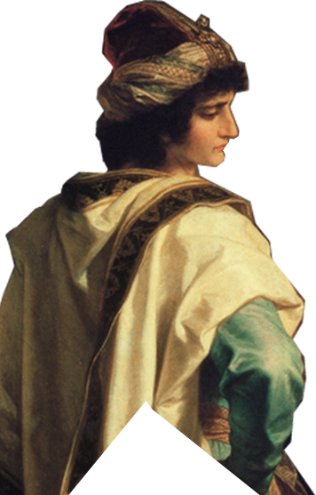
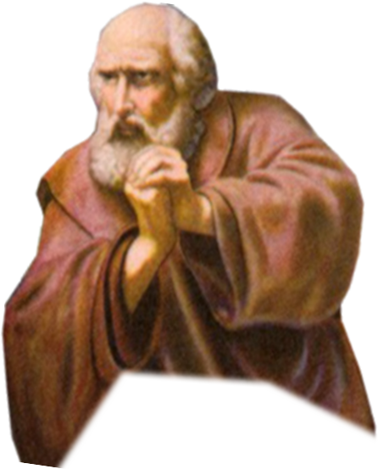
Let’s Sum This Up
NATURAL
SPIRITUAL

Slide 72
How do you do “Goodness”?

Slide 73
How do you do “Goodness”?
You don’t really do it—
God the Holy Spirit does!

Slide 74
²² But the fruit of the Spirit is love, joy, peace, patience, kindness, goodness

Slide 75

The Holy Spirit Produces
GOODNESS when
you walk in the Spirit (Gal 5:16)

Slide 76
The Holy Spirit Produces
GOODNESS when
you walk in the Spirit (Gal 5:16)
and conform to the GOOD!

Slide 77
Let’s Pray

