Slide 1

Notes:
Copyright © 2006−2021. All rights reserved. Bible Point is a registered trademark of Dennis Henderson. All other trademarks acknowledged.
Bible Point contains graphics from Bible Point artists. These illustrations belong to Bible Point and the respective artists. You may use the designs and illustrations for graphical illustration of lessons free and without special permission, provided they are not used in any way that maligns the Christian faith. Furthermore, republication or production of any illustration by any other graphic service whether it be in book, in a machine-readable form, or in any other design resource is strictly prohibited. Furthermore, they cannot be duplicated or resold as any other form of publishing, clip art, or graphic resource.
So What does it mean? (A simple translations of the legal jargon)
So, if you don’t own the presentation(s), graphic(s), and text(s) how can you legally use them? The purchase of the license allows you to use all the images in the product. However, the actual ownership and copyright of the presentation(s), graphic(s), and text(s) remain the property of Bible Point and its licensors. If you had plans on using this product in your “for sale” work—think again!
License Agreement
Article 1: License Grant
All the graphics and text in Bible Point presentations (excluding quotes from the Bible and stated sources) are the intellectual and real property of Bible Point and its licensors, and is protected by law, including United States copyright laws and international treaties. Bible Point grants to you a license:
1. To use the presentation in a single church, single school, or single office of a Christian organization.
2. To make a single archival back-up copy of the program.
3. To modify the presentation(s) and merge with other presentations in a single church, school, or Christian organization.
4. To transfer to another party if that party agrees to accept the terms and conditions of this agreement, and you do not retain any copies of the presentation, whether printed, machine readable, modified, or merged form.
Article 2: Terms
This license is effective until terminated. You may terminate the license at any time by destroying the presentation(s), graphic(s), or text(s) together with all copies, modifications and merged portions in any form. Bible Point may terminate your license if you fail to comply with this Agreement. You agree, upon such termination, for any reason, to destroy the presentation(s), graphics, and text(s) with all copies, modifications, and merged portions in any form.
Article 3: Disclaimers
1. Bible Point presentations, graphics, and texts are licensed to you As Is. You, the consumer, bear the entire risk relating to the quality and performance of the presentation(s), graphic(s), or text(s). In no event will Bible Point be liable for damages resulting from any defect.
2. Thirty-day limited warrantee on disks. Bible Point warrants the disks to be free of defects in material and workmanship under normal use for 30 days after purchase. During the 30-day period you may return a defective presentation, graphic, or text with proof of purchase and it will be replaced without charge, unless the presentation is damaged by misuse.
Article 4: General
1. You may not sub-license, assign, or transfer the license of the presentation(s), graphic(s), or text(s) except as provided by this Agreement.
2. This Agreement will be governed by the laws of the State of Michigan.
So What does it mean? (A simple translations of the legal jargon)
May I let someone borrow or copy my licensed Bible Point presentation (even after I modified it)? As long as it is within your local church, or single school, or the immediate office of a Christian organization you may. Otherwise, please refer the person interested in borrowing to: http://www.biblepoint.com or E-mail: dennis@DrDH.net with any related questions.

Slide 2
Faithfulness
Notes:
Copyright © 2006−2021. All rights reserved. Bible Point is a registered trademark of Dennis Henderson. All other trademarks acknowledged.
Bible Point contains graphics from Bible Point artists. These illustrations belong to Bible Point and the respective artists. You may use the designs and illustrations for graphical illustration of lessons free and without special permission, provided they are not used in any way that maligns the Christian faith. Furthermore, republication or production of any illustration by any other graphic service whether it be in book, in a machine-readable form, or in any other design resource is strictly prohibited. Furthermore, they cannot be duplicated or resold as any other form of publishing, clip art, or graphic resource.
So What does it mean? (A simple translations of the legal jargon)
So, if you don’t own the presentation(s), graphic(s), and text(s) how can you legally use them? The purchase of the license allows you to use all the images in the product. However, the actual ownership and copyright of the presentation(s), graphic(s), and text(s) remain the property of Bible Point and its licensors. If you had plans on using this product in your “for sale” work—think again!
License Agreement
Article 1: License Grant
All the graphics and text in Bible Point presentations (excluding quotes from the Bible and stated sources) are the intellectual and real property of Bible Point and its licensors, and is protected by law, including United States copyright laws and international treaties. Bible Point grants to you a license:
1. To use the presentation in a single church, single school, or single office of a Christian organization.
2. To make a single archival back-up copy of the program.
3. To modify the presentation(s) and merge with other presentations in a single church, school, or Christian organization.
4. To transfer to another party if that party agrees to accept the terms and conditions of this agreement, and you do not retain any copies of the presentation, whether printed, machine readable, modified, or merged form.
Article 2: Terms
This license is effective until terminated. You may terminate the license at any time by destroying the presentation(s), graphic(s), or text(s) together with all copies, modifications and merged portions in any form. Bible Point may terminate your license if you fail to comply with this Agreement. You agree, upon such termination, for any reason, to destroy the presentation(s), graphics, and text(s) with all copies, modifications, and merged portions in any form.
Article 3: Disclaimers
1. Bible Point presentations, graphics, and texts are licensed to you As Is. You, the consumer, bear the entire risk relating to the quality and performance of the presentation(s), graphic(s), or text(s). In no event will Bible Point be liable for damages resulting from any defect.
2. Thirty-day limited warrantee on disks. Bible Point warrants the disks to be free of defects in material and workmanship under normal use for 30 days after purchase. During the 30-day period you may return a defective presentation, graphic, or text with proof of purchase and it will be replaced without charge, unless the presentation is damaged by misuse.
Article 4: General
1. You may not sub-license, assign, or transfer the license of the presentation(s), graphic(s), or text(s) except as provided by this Agreement.
2. This Agreement will be governed by the laws of the State of Michigan.
So What does it mean? (A simple translations of the legal jargon)
May I let someone borrow or copy my licensed Bible Point presentation (even after I modified it)? As long as it is within your local church, or single school, or the immediate office of a Christian organization you may. Otherwise, please refer the person interested in borrowing to: http://www.biblepoint.com or E-mail: dennis@DrDH.net with any related questions.

Slide 3
I. What is Faithfulness?
Notes:
Old Faithful with Rainbow = FREE = from http://commons.wikimedia.org/wiki/File:Old_Faithful_Rainbow.jpg

Slide 4
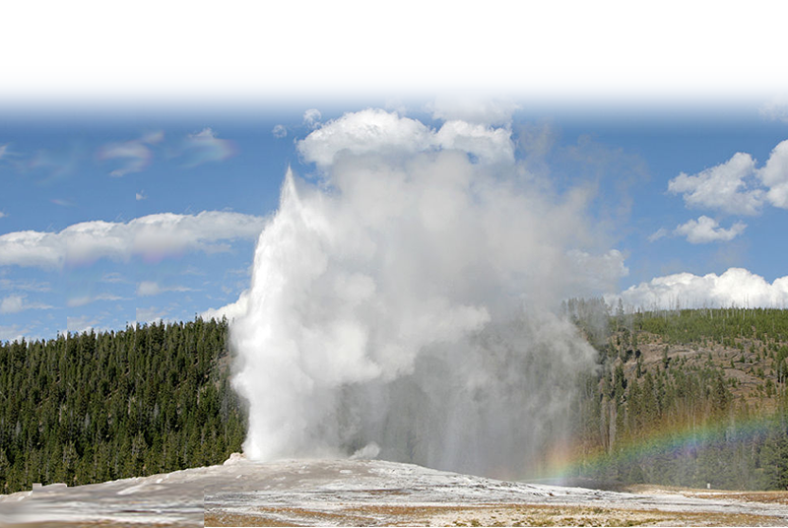
I. What is Faithfulness?
Notes:
Old Faithful with Rainbow = FREE = from http://commons.wikimedia.org/wiki/File:Old_Faithful_Rainbow.jpg

Slide 5
I. What is Faithfulness?
Faithfulness is a quality that the Holy Spirit produces that shows up as reliability and trustworthiness.
Notes:
Old Faithful with Rainbow = FREE = from http://commons.wikimedia.org/wiki/File:Old_Faithful_Rainbow.jpg

Slide 6
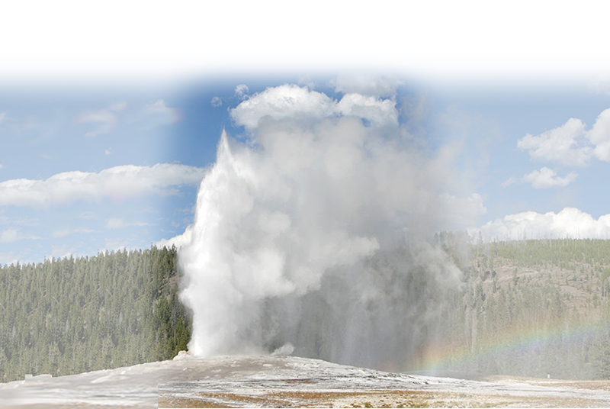
II. Who has Faithfulness?

Slide 7
II. Who has Faithfulness?
God does 1 Cor 10:13; 2 Cor 1:18

Slide 8
II. Who has Faithfulness?
God does 1 Cor 10:13; 2 Cor 1:18
“God is faithful,”

Slide 9
II. Who has Faithfulness?
God does 1 Cor 10:13; 2 Cor 1:18
Others do 1 Cor 4:17

Slide 10
II. Who has Faithfulness?
God does 1 Cor 10:13; 2 Cor 1:18
Others do 1 Cor 4:17
“Timothy, my son whom I love, who is faithful in the Lord”

Slide 11

II. Who has Faithfulness?
God does 1 Cor 10:13; 2 Cor 1:18
Others do 1 Cor 4:17
You can too 1 Cor 4:2

Slide 12
II. Who has Faithfulness?
God does 1 Cor 10:13; 2 Cor 1:18
Others do 1 Cor 4:17
You can too 1 Cor 4:2
those who have been given a trust must prove faithful.

Slide 13
III. How Faithfulness Shows Up
1. In God

Slide 14
[1] Providence 1 Cor 10:13
¹³ … God is faithful; he will not let you be tempted beyond what you can bear….
Notes:
Earth = FREE = wiki
Box = FREE = wiki

Slide 15

[1] Providence 1 Cor 10:13
¹³ … God is faithful; he will not let you be tempted beyond what you can bear….
Notes:
Earth = FREE = wiki
Box = FREE = wiki

Slide 16
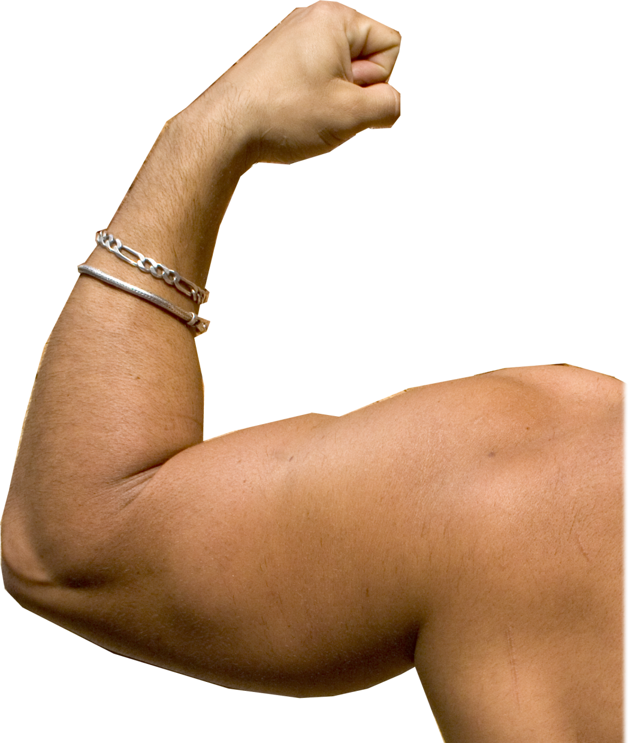
[2] Empowerment 2 Thes 3:3
³ But the Lord is faithful, and he will strengthen and protect you
from the evil one.
Notes:
Muscle = FREE = dreamstime
¹³ I can do everything through him who gives me strength. (Phi 4:13 NIV)
I can do all things through Christ which strengtheneth me. (Phi 4:13 KJV)

Slide 17
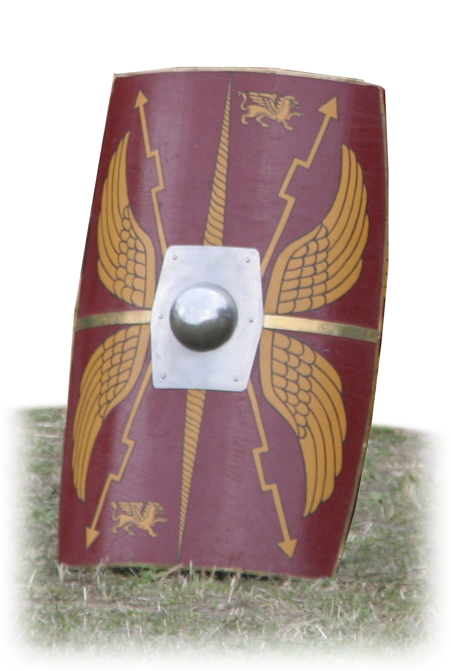
[3] Protection 2 Thes 3:3
³ But the Lord is faithful, and he will strengthen and protect you
from the evil one.
Notes:
Psalm 23:4 Yea, though I walk through the valley of the shadow of death, I will fear no evil: for thou art with me; thy rod and thy staff they comfort me. (Psa 23:4 KJV)

Slide 18


[4] Forgiveness 1 John 1:9
⁹ If we confess our sins, he is faithful and just and will forgive us our sins and purify us from all unrighteousness.

Slide 19
[4] Forgiveness 1 John 1:9
⁹ If we confess our sins, he is faithful and just and will forgive us our sins and purify us from all unrighteousness.
GUILT

Slide 20
[4] Forgiveness 1 John 1:9
⁹ If we confess our sins, he is faithful and just and will forgive us our sins and purify us from all unrighteousness.
GUILT

Slide 21
[4] Forgiveness 1 John 1:9
⁹ If we confess our sins, he is faithful and just and will forgive us our sins and purify us from all unrighteousness.

Slide 22
[4] Forgiveness 1 John 1:9
⁹ If we confess our sins, he is faithful and just and will forgive us our sins and purify us from all unrighteousness.
GUILT

Slide 23
[4] Forgiveness 1 John 1:9
⁹ If we confess our sins, he is faithful and just and will forgive us our sins and purify us from all unrighteousness.

Slide 24
III. How Faithfulness Shows Up
2. In Us

Slide 25
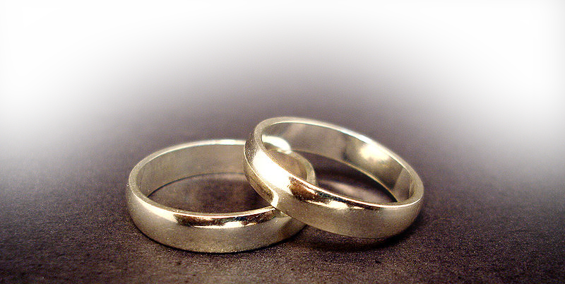
[1] A Faithful Spouse 1 Tim 5:9
⁹ No widow may be put on the list of widows unless she is over sixty, has been faithful to her husband,
Notes:
I think I told you the story of the guy who propose to his sweetheart., “I love you and want to marry you. I will be a great husband and father. I will cherish you and protect you. However, one day of the year I would like to take out my old girl friend.”

Slide 26
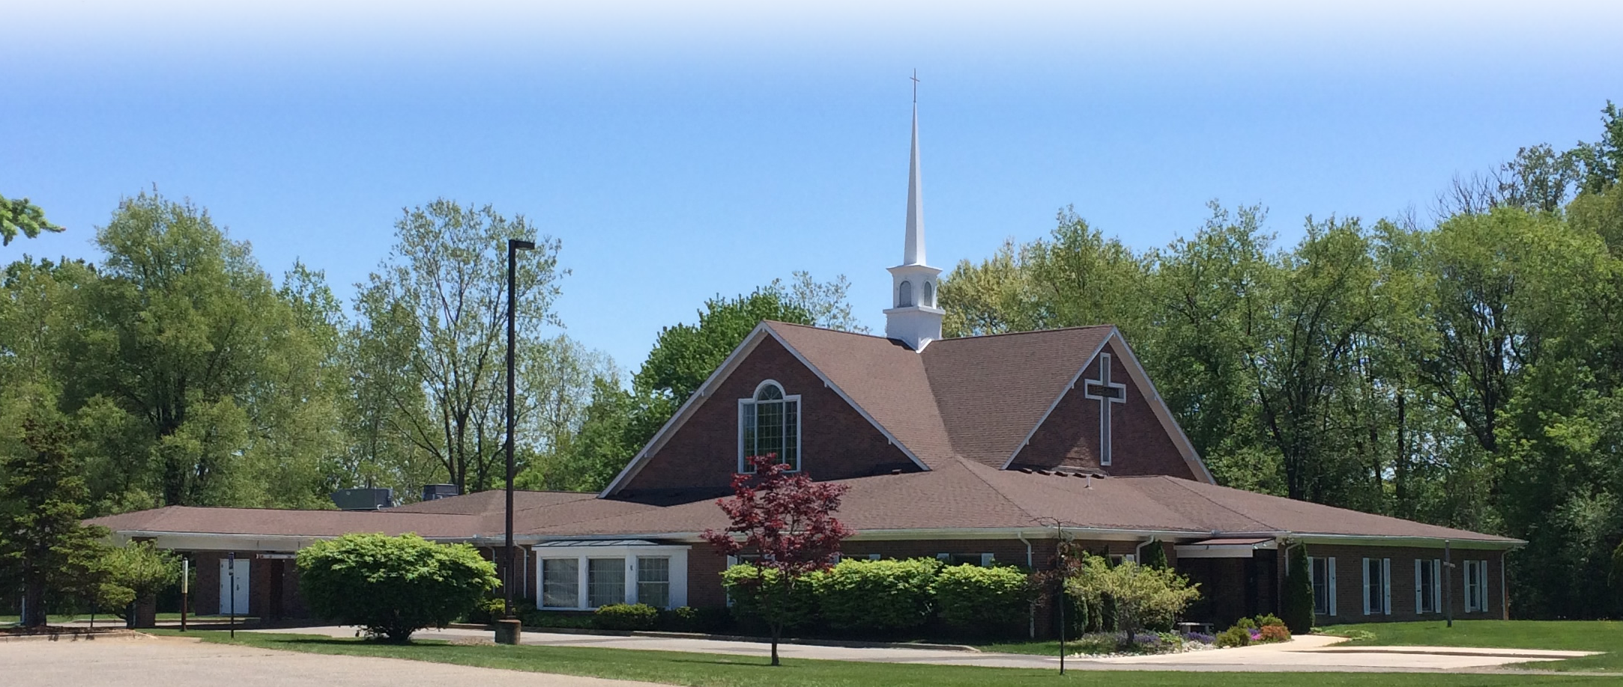
[2] A Faithful Brother 1 Pet 5:12
¹² With the help of Silas, whom I regard as a faithful brother, I have written to you briefly,
Notes:
This is how we know what love is: Jesus Christ laid down his life for us. And we ought to lay down our lives for our brothers. (1Jo 3:16 NIV)

Slide 27

[3] A Faithful Witness Rev 2:13
Yet you remain true to my name. You did not renounce your faith in me, even in the days of Antipas, my faithful witness, who was put to death in your city--where Satan lives.
Notes:
The first part of this verse says, “'I know where you dwell, where Satan's throne is. (Rev 2:13 ESV).
The church was contending with a new political correctness of emperor worship. Rome was worshiped and Satan appears to have been behind it. Appears if you did not cave in to the new political correctness of worshipping the emperor—you were persecuted. There was a call to renounce your faith. At least one who did not was martyred (witness).
Folks we are living in cities in America where Satan too has his way. We too can be faithful to our faith and not cave in to Politically correct culture around us! We too may have to pay with our lives. But that is what faithfulness does.

Slide 28
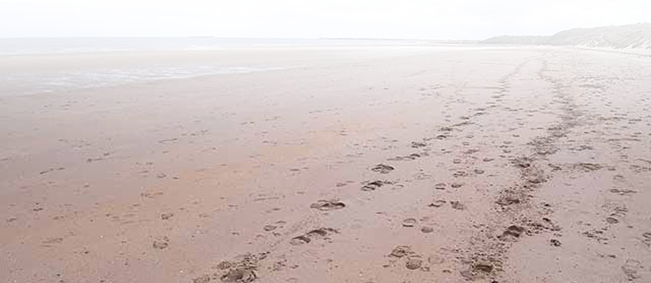
[4] A Faithful Follower Rev 17:14
¹⁴ They will make war against the Lamb, but the Lamb will overcome them because he is Lord of lords and King of kings--and with him will be his called, chosen and faithful followers."
Notes:
Feet prints = FREE = http://www.geograph.org.uk/photo/1859809

Slide 29
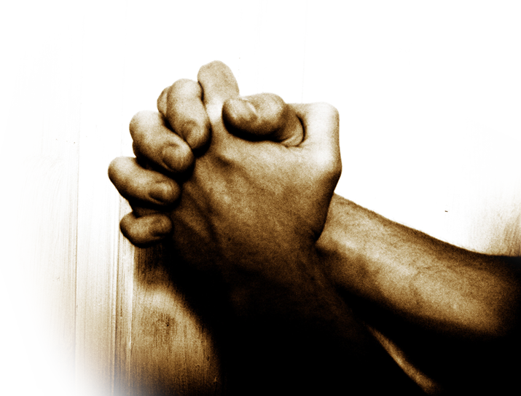
[5] Faithful Prayer Warrior Ro 12:12
¹² Be joyful in hope, patient in affliction, faithful in prayer.
Notes:
Praying hands = FREE =

Slide 30

[6] A Faithful Servant 1 Cor 4:2
So then, men ought to regard us as servants of Christ and as those entrusted with the secret things of God. ² Now it is required that those who have been given a trust must prove faithful.
Notes:
Not fools gold but real gold.

Slide 31
IV. What It look like? Mat 25:14

Slide 32
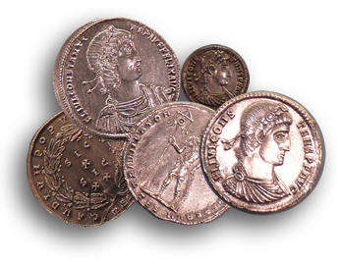
IV. What It look like? Mat 25:14
¹⁵ To one he gave five talents of money,
Notes:
¹³ "Therefore keep watch, because you do not know the day or the hour.
¹⁴ "Again, it will be like a man going on a journey, who called his servants and entrusted his property to them.
(Mat 25:13-15 NIV)

Slide 33
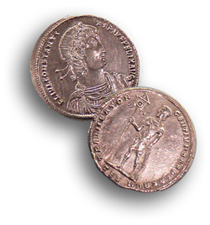
IV. What It look like? Mat 25:14
¹⁵ To one he gave five talents of money, to another two talents,

Slide 34
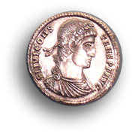
IV. What It look like? Mat 25:14
¹⁵ To one he gave five talents of money, to another two talents, and to another one talent,

Slide 35
IV. What It look like? Mat 25:14
¹⁵ To one he gave five talents of money, to another two talents, and to another one talent, each according to his ability.

Slide 36
IV. What It look like? Mat 25:14
five talents went at once and put his money to work and gained five more.

Slide 37
IV. What It look like? Mat 25:14
five talents went at once and put his money to work and gained five more.

Slide 38
IV. What It look like? Mat 25:14
the one with the two talents gained
two more.

Slide 39
IV. What It look like? Mat 25:14
the one with the two talents gained
two more.

Slide 40
IV. What It look like? Mat 25:14
But the man who had received the one talent went off, dug a hole in the ground and hid his master's money.

Slide 41
IV. What It look like? Mat 25:14
But the man who had received the one talent went off, dug a hole in the ground and hid his master's money.

Slide 42
IV. What It look like? Mat 25:14
But the man who had received the one talent went off, dug a hole in the ground and hid his master's money.

Slide 43
IV. What It look like? Mat 25:14
But the man who had received the one talent went off, dug a hole in the ground and hid his master's money.

Slide 44
Upon the Master’s Return
²¹ … 'Well done, good and faithful servant! You have been faithful with a few things; I will put you in charge of many things. Come and share your master's happiness!‘

Slide 45
Upon the Master’s Return
²³ … 'Well done, good and faithful servant! You have been faithful with a few things; I will put you in charge of many things. Come and share your master's happiness!‘

Slide 46
Upon the Master’s Return
the one talent came.… ²⁵ So I was afraid and went out and hid your talent in the ground. See, here is what belongs to you.'

Slide 47
Upon the Master’s Return
the one talent came.… ²⁵ So I was afraid and went out and hid your talent in the ground. See, here is what belongs to you.'

Slide 48
Upon the Master’s Return
the one talent came.… ²⁵ So I was afraid and went out and hid your talent in the ground. See, here is what belongs to you.'

Slide 49
Upon the Master’s Return
the one talent came.… ²⁵ So I was afraid and went out and hid your talent in the ground. See, here is what belongs to you.'

Slide 50
Upon the Master’s Return
²⁶ "His master replied, 'You wicked, lazy servant! … ²⁸ " 'Take the talent from him and give it to the one who has the ten talents.

Slide 51
Upon the Master’s Return
²⁶ "His master replied, 'You wicked, lazy servant! … ²⁸ " 'Take the talent from him and give it to the one who has the ten talents.

Slide 52
Upon the Master’s Return
²⁶ "His master replied, 'You wicked, lazy servant! … ²⁸ " 'Take the talent from him and give it to the one who has the ten talents.

Slide 53
Upon the Master’s Return
²⁶ "His master replied, 'You wicked, lazy servant! … ²⁸ " 'Take the talent from him and give it to the one who has the ten talents.

Slide 54
Upon the Master’s Return
²⁶ "His master replied, 'You wicked, lazy servant! … ²⁸ " 'Take the talent from him and give it to the one who has the ten talents.

Slide 55
Upon the Master’s Return
²⁶ "His master replied, 'You wicked, lazy servant! … ²⁸ " 'Take the talent from him and give it to the one who has the ten talents.

Slide 56
Upon the Master’s Return
²⁶ "His master replied, 'You wicked, lazy servant! … ²⁸ " 'Take the talent from him and give it to the one who has the ten talents.

Slide 57
Upon the Master’s Return
²⁶ "His master replied, 'You wicked, lazy servant! … ²⁸ " 'Take the talent from him and give it to the one who has the ten talents.

Slide 58
Upon the Master’s Return
²⁹ For everyone who has will be given more, and he will have an abundance. Whoever does not have, even what he has will be taken from him.

Slide 59
Upon the Master’s Return
³⁰ And throw that worthless servant outside, into the darkness, where there will be weeping and gnashing of teeth.'

Slide 60
Obvious Contrast ...
Notes:
Obvious contrast ...
Wicked servant is the natural man – without the Sprit of God with in him. He lives for himself –not the master, God. Loses everything.
Faithful servant is the spiritual man – varying talents – but reliable and dependable to use what they have for God – rewarded with more.

Slide 61
Obvious Contrast ...
Worthless Servant Faithful Servant
Notes:
Obvious contrast ...
Wicked servant is the natural man – without the Sprit of God with in him. He lives for himself –not the master, God. Loses everything.
Faithful servant is the spiritual man – varying talents – but reliable and dependable to use what they have for God – rewarded with more.

Slide 62
Obvious Contrast ...
Worthless Servant Faithful Servant
NATURAL
SPIRITUAL
Notes:
Obvious contrast ...
Wicked servant is the natural man – without the Sprit of God with in him. He lives for himself –not the master, God. Loses everything.
Faithful servant is the spiritual man – varying talents – but reliable and dependable to use what they have for God – rewarded with more.

Slide 63
Obvious Contrast ...
Worthless Servant Faithful Servant
NATURAL
CARNAL
INFANTILE
SPIRITUAL
Notes:
Obvious contrast ...
Wicked servant is the natural man – without the Sprit of God with in him. He lives for himself –not the master, God. Loses everything.
Faithful servant is the spiritual man – varying talents – but reliable and dependable to use what they have for God – rewarded with more.

Slide 64
V. How do you become more Faithful?

Slide 65
V. How do you become more Faithful?
Put your trust in God and then ...

Slide 66
V. How do you become more Faithful?
Put your trust in God and then ...
Walk in the Sprit,

Slide 67
V. How do you become more Faithful?
Put your trust in God and then ...
Walk in the Sprit,
Live in His Word,
Notes:
You need to sign up for the Ladies Bible Study.
Next month we will have 3 Sunday Nights in September –1.5 hours of solid Bible Study for adults.

Slide 68
V. How do you become more Faithful?
Put your trust in God and then ...
Walk in the Sprit,
Live in His Word,
Yield to His will, and

Slide 69
V. How do you become more Faithful?
Put your trust in God and then ...
Walk in the Sprit,
Live in His Word,
Yield to His will, and
Continue in prayer.

Slide 70
²² But the fruit of the Spirit is love, joy, peace, patience, kindness , goodness, faithfulness

Slide 71

The Holy Spirit Produces FAITHFULNESS when
“you walk in the Spirit.” Gal 5:16

Slide 72
Let’s Pray

