Slide 1
Good Friday Had to Happen!
Notes:
Copyright © 2006−2021. All rights reserved. Bible Point is a registered trademark of Dennis Henderson. All other trademarks acknowledged.
Bible Point contains graphics from Bible Point artists. These illustrations belong to Bible Point and the respective artists. You may use the designs and illustrations for graphical illustration of lessons free and without special permission, provided they are not used in any way that maligns the Christian faith. Furthermore, republication or production of any illustration by any other graphic service whether it be in book, in a machine-readable form, or in any other design resource is strictly prohibited. Furthermore, they cannot be duplicated or resold as any other form of publishing, clip art, or graphic resource.
So What does it mean? (A simple translations of the legal jargon)
So, if you don’t own the presentation(s), graphic(s), and text(s) how can you legally use them? The purchase of the license allows you to use all the images in the product. However, the actual ownership and copyright of the presentation(s), graphic(s), and text(s) remain the property of Bible Point and its licensors. If you had plans on using this product in your “for sale” work—think again!
License Agreement
Article 1: License Grant
All the graphics and text in Bible Point presentations (excluding quotes from the Bible and stated sources) are the intellectual and real property of Bible Point and its licensors, and is protected by law, including United States copyright laws and international treaties. Bible Point grants to you a license:
1. To use the presentation in a single church, single school, or single office of a Christian organization.
2. To make a single archival back-up copy of the program.
3. To modify the presentation(s) and merge with other presentations in a single church, school, or Christian organization.
4. To transfer to another party if that party agrees to accept the terms and conditions of this agreement, and you do not retain any copies of the presentation, whether printed, machine readable, modified, or merged form.
Article 2: Terms
This license is effective until terminated. You may terminate the license at any time by destroying the presentation(s), graphic(s), or text(s) together with all copies, modifications and merged portions in any form. Bible Point may terminate your license if you fail to comply with this Agreement. You agree, upon such termination, for any reason, to destroy the presentation(s), graphics, and text(s) with all copies, modifications, and merged portions in any form.
Article 3: Disclaimers
1. Bible Point presentations, graphics, and texts are licensed to you As Is. You, the consumer, bear the entire risk relating to the quality and performance of the presentation(s), graphic(s), or text(s). In no event will Bible Point be liable for damages resulting from any defect.
2. Thirty-day limited warrantee on disks. Bible Point warrants the disks to be free of defects in material and workmanship under normal use for 30 days after purchase. During the 30-day period you may return a defective presentation, graphic, or text with proof of purchase and it will be replaced without charge, unless the presentation is damaged by misuse.
Article 4: General
1. You may not sub-license, assign, or transfer the license of the presentation(s), graphic(s), or text(s) except as provided by this Agreement.
2. This Agreement will be governed by the laws of the State of Michigan.
So What does it mean? (A simple translations of the legal jargon)
May I let someone borrow or copy my licensed Bible Point presentation (even after I modified it)? As long as it is within your local church, or single school, or the immediate office of a Christian organization you may. Otherwise, please refer the person interested in borrowing to: http://www.biblepoint.com or E-mail: dennis@DrDH.net with any related questions.

Slide 2
Good Friday Had to Happen!
Notes:
Copyright © 2006−2021. All rights reserved. Bible Point is a registered trademark of Dennis Henderson. All other trademarks acknowledged.
Bible Point contains graphics from Bible Point artists. These illustrations belong to Bible Point and the respective artists. You may use the designs and illustrations for graphical illustration of lessons free and without special permission, provided they are not used in any way that maligns the Christian faith. Furthermore, republication or production of any illustration by any other graphic service whether it be in book, in a machine-readable form, or in any other design resource is strictly prohibited. Furthermore, they cannot be duplicated or resold as any other form of publishing, clip art, or graphic resource.
So What does it mean? (A simple translations of the legal jargon)
So, if you don’t own the presentation(s), graphic(s), and text(s) how can you legally use them? The purchase of the license allows you to use all the images in the product. However, the actual ownership and copyright of the presentation(s), graphic(s), and text(s) remain the property of Bible Point and its licensors. If you had plans on using this product in your “for sale” work—think again!
License Agreement
Article 1: License Grant
All the graphics and text in Bible Point presentations (excluding quotes from the Bible and stated sources) are the intellectual and real property of Bible Point and its licensors, and is protected by law, including United States copyright laws and international treaties. Bible Point grants to you a license:
1. To use the presentation in a single church, single school, or single office of a Christian organization.
2. To make a single archival back-up copy of the program.
3. To modify the presentation(s) and merge with other presentations in a single church, school, or Christian organization.
4. To transfer to another party if that party agrees to accept the terms and conditions of this agreement, and you do not retain any copies of the presentation, whether printed, machine readable, modified, or merged form.
Article 2: Terms
This license is effective until terminated. You may terminate the license at any time by destroying the presentation(s), graphic(s), or text(s) together with all copies, modifications and merged portions in any form. Bible Point may terminate your license if you fail to comply with this Agreement. You agree, upon such termination, for any reason, to destroy the presentation(s), graphics, and text(s) with all copies, modifications, and merged portions in any form.
Article 3: Disclaimers
1. Bible Point presentations, graphics, and texts are licensed to you As Is. You, the consumer, bear the entire risk relating to the quality and performance of the presentation(s), graphic(s), or text(s). In no event will Bible Point be liable for damages resulting from any defect.
2. Thirty-day limited warrantee on disks. Bible Point warrants the disks to be free of defects in material and workmanship under normal use for 30 days after purchase. During the 30-day period you may return a defective presentation, graphic, or text with proof of purchase and it will be replaced without charge, unless the presentation is damaged by misuse.
Article 4: General
1. You may not sub-license, assign, or transfer the license of the presentation(s), graphic(s), or text(s) except as provided by this Agreement.
2. This Agreement will be governed by the laws of the State of Michigan.
So What does it mean? (A simple translations of the legal jargon)
May I let someone borrow or copy my licensed Bible Point presentation (even after I modified it)? As long as it is within your local church, or single school, or the immediate office of a Christian organization you may. Otherwise, please refer the person interested in borrowing to: http://www.biblepoint.com or E-mail: dennis@DrDH.net with any related questions.

Slide 3
Because ...
700 years before!

Slide 4
Because ...
700 years before!
Isaiah, the seer, foresaw it ...

Slide 5

The GLORIFICATION of Jesus
Notes:
Crown = FREE = https://pxhere.com/en/photo/636367
Compare Phil 2:5ff

Slide 6
The GLORIFICATION of Jesus
He will be EXALTED:
^{Isaiah} ^{52:13} See, my servant will act wisely; he will be raised and lifted up and highly exalted.
Notes:
Crown = FREE = https://pxhere.com/en/photo/636367
Compare Phil 2:5ff

Slide 7
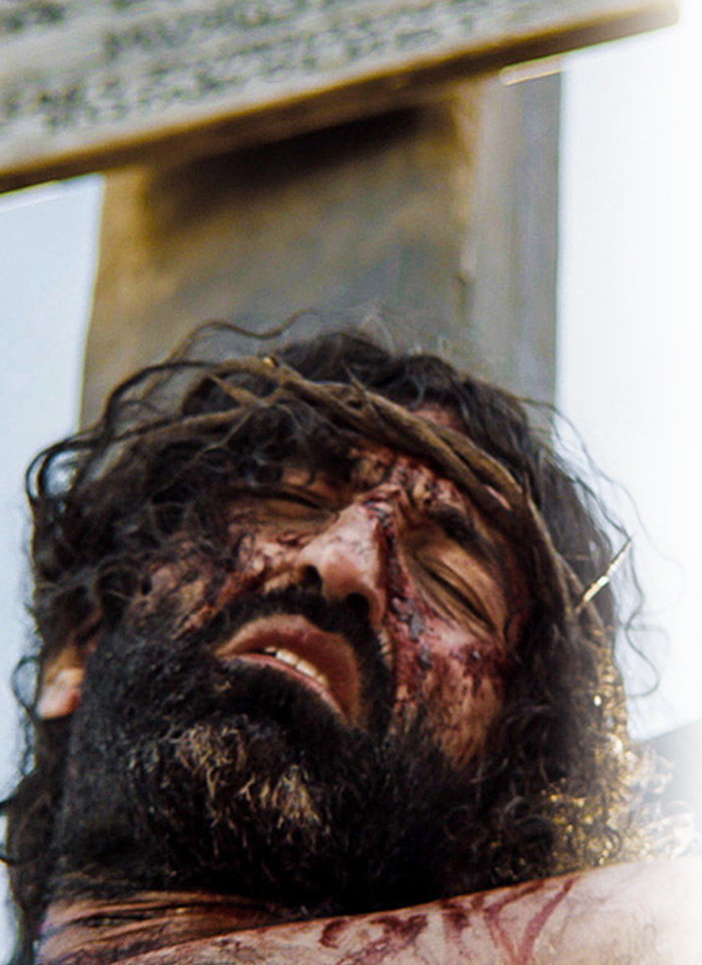
The GLORIFICATION of Jesus
He will be DISFIGURED:
¹⁴ Just as there
were many who
were appalled at
him-- his appearance
was so disfigured
beyond that of any
man and his form
marred beyond
human likeness--
Notes:
http://www.freebibleimages.org/photos/jesus-dies/
Compare Phil 2:5ff

Slide 8
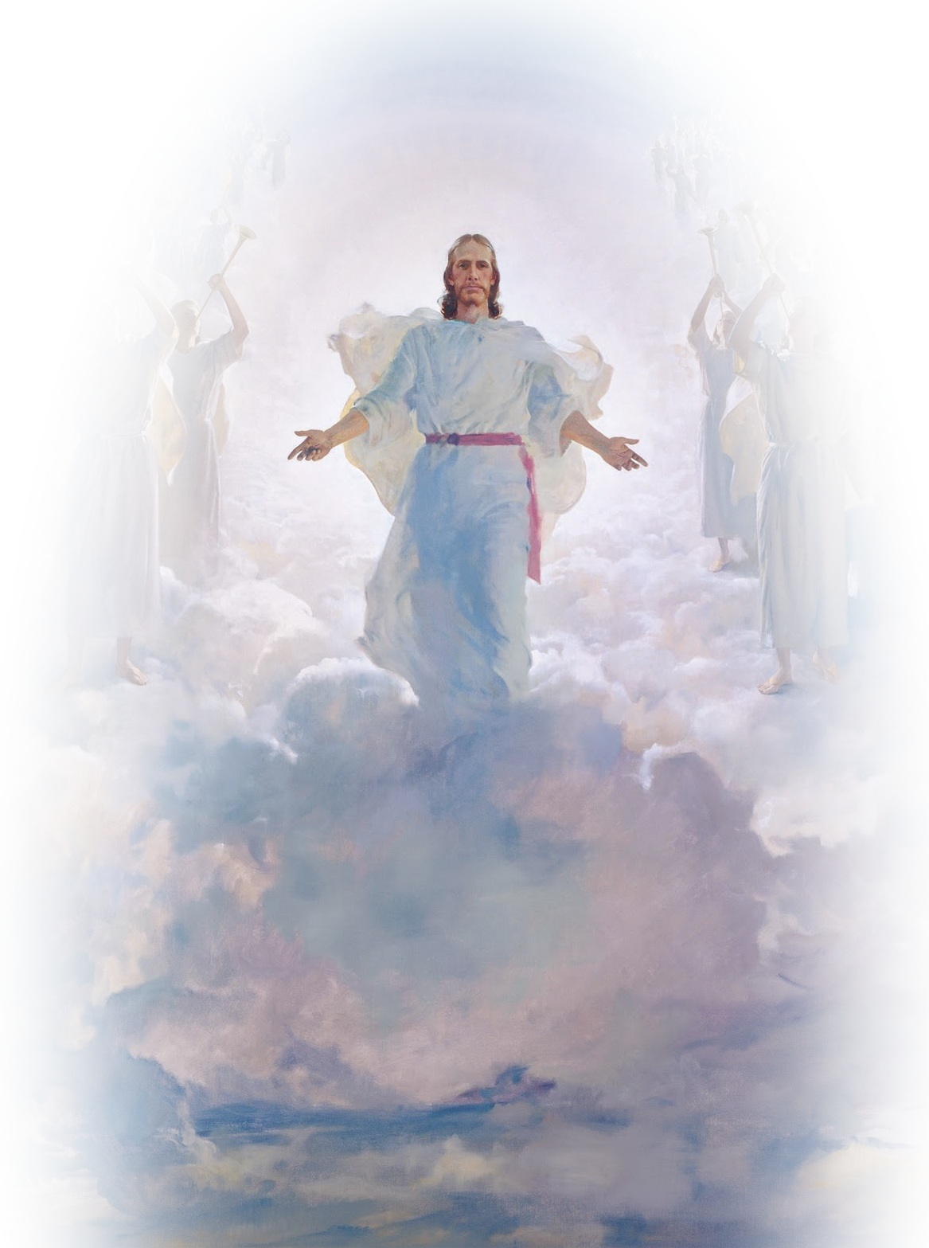
The GLORIFICATION of Jesus
He will be SHOCKING:
¹⁵ so will he sprinkle many nations, and kings will shut their mouths because of him.
Notes:
Jesus in clouds = FREE = https://www.flickr.com/photos/waitingfortheword/5733158786

Slide 9
The GLORIFICATION of Jesus
He will be SHOCKING:
¹⁵ so will he sprinkle many nations, and kings will shut their mouths because of him.
SPATTER
Notes:
Jesus in clouds = FREE = https://www.flickr.com/photos/waitingfortheword/5733158786

Slide 10
The GLORIFICATION of Jesus
He will be SHOCKING:
¹⁵ so will he sprinkle many nations, and kings will shut their mouths because of him.
SPURT
Notes:
Jesus in clouds = FREE = https://www.flickr.com/photos/waitingfortheword/5733158786

Slide 11
The GLORIFICATION of Jesus
He will be SHOCKING:
¹⁵ so will he sprinkle many nations, and kings will shut their mouths because of him.
STARTLE
Notes:
Jesus in clouds = FREE = https://www.flickr.com/photos/waitingfortheword/5733158786

Slide 12
The GLORIFICATION of Jesus
He will be SHOCKING:
¹⁵ so will he sprinkle many nations, and kings will shut their mouths because of him.
SHOCK
Notes:
Jesus in clouds = FREE = https://www.flickr.com/photos/waitingfortheword/5733158786

Slide 13
The GLORIFICATION of Jesus
He will be SHOCKING:
¹⁵ so will he sprinkle many nations, and kings will shut their mouths because of him.
SHOCK
For what they were not told, they will see, and what they have not heard, they will understand.
Notes:
Jesus in clouds = FREE = https://www.flickr.com/photos/waitingfortheword/5733158786

Slide 14
The GLORIFICATION of Jesus
He will be SHOCKING:
¹⁵ so will he sprinkle many nations, and kings will shut their mouths because of him.
SHOCK
For what they were not told, they will see, and what they have not heard, they will understand.
Notes:
Jesus in clouds = FREE = https://www.flickr.com/photos/waitingfortheword/5733158786
Stephen Hawkins was greatly surprised last month when he died and found out that there is a God and Jesus is His Sone. He now knows!

Slide 15
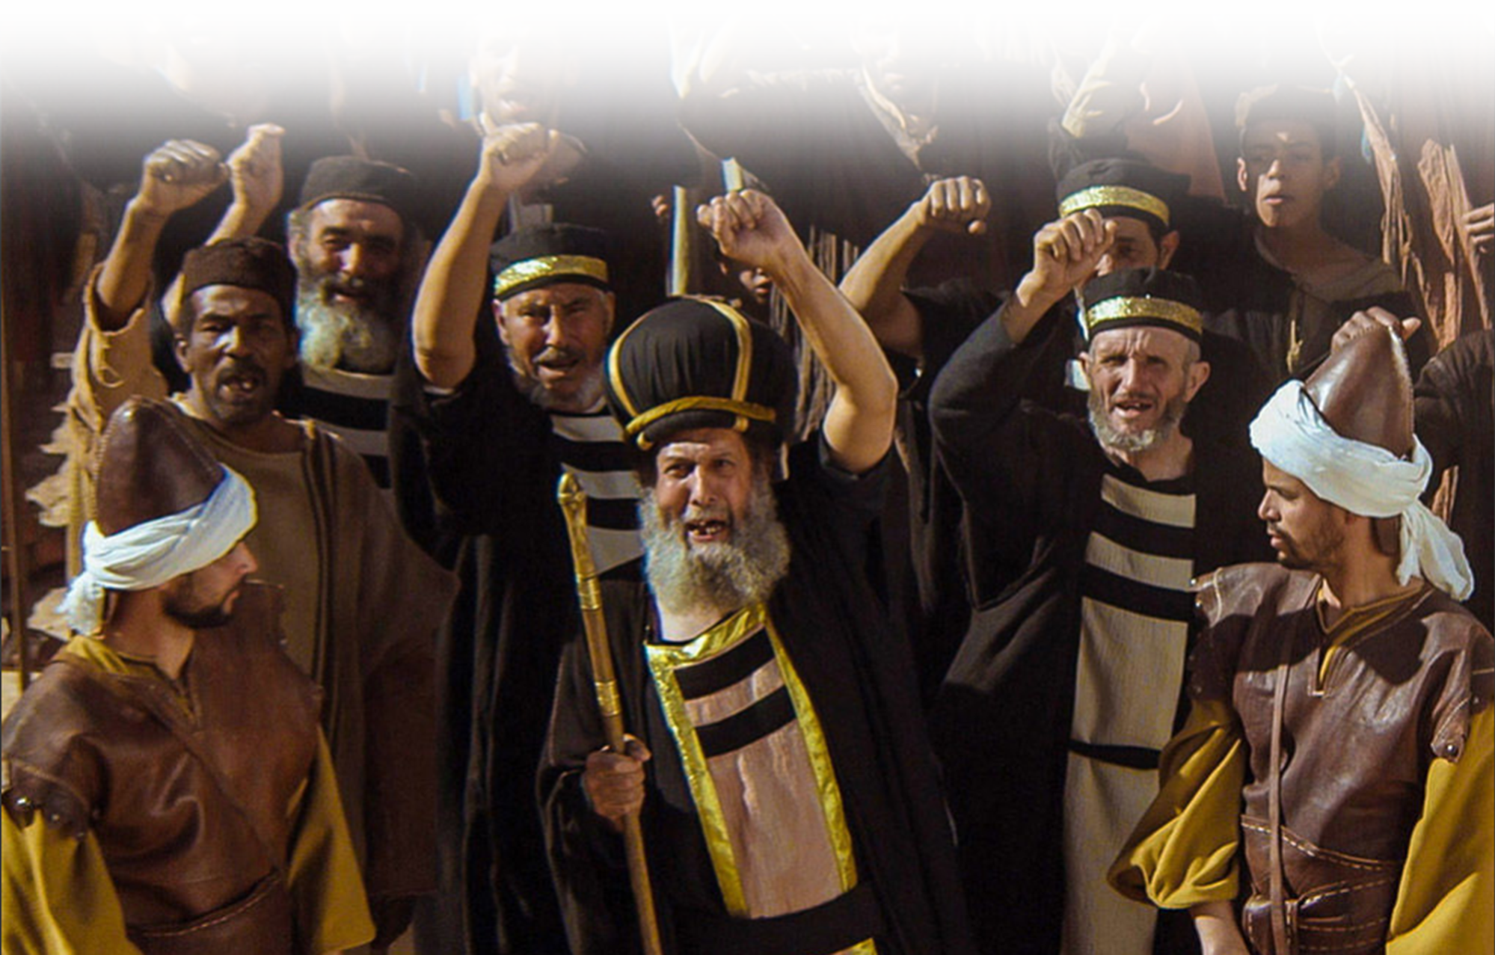
The REJECTION of Jesus

Slide 16
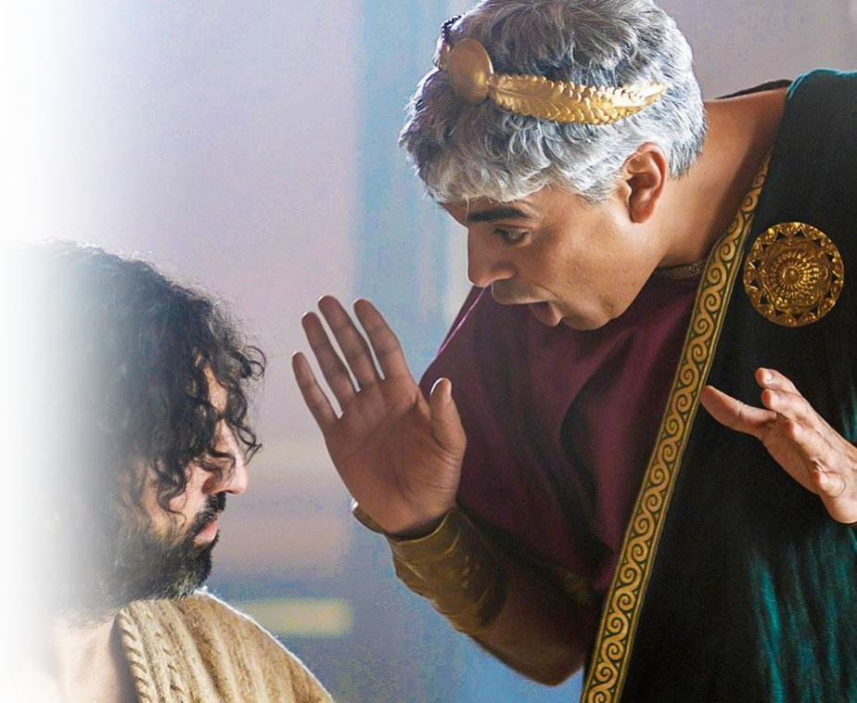
The REJECTION of Jesus
He will be DISBELEIVED:
^{53:1} Who has believed our message and to whom has the arm of the LORD been revealed
Notes:
He came unto his own and his own received him not John 1:11-12

Slide 17
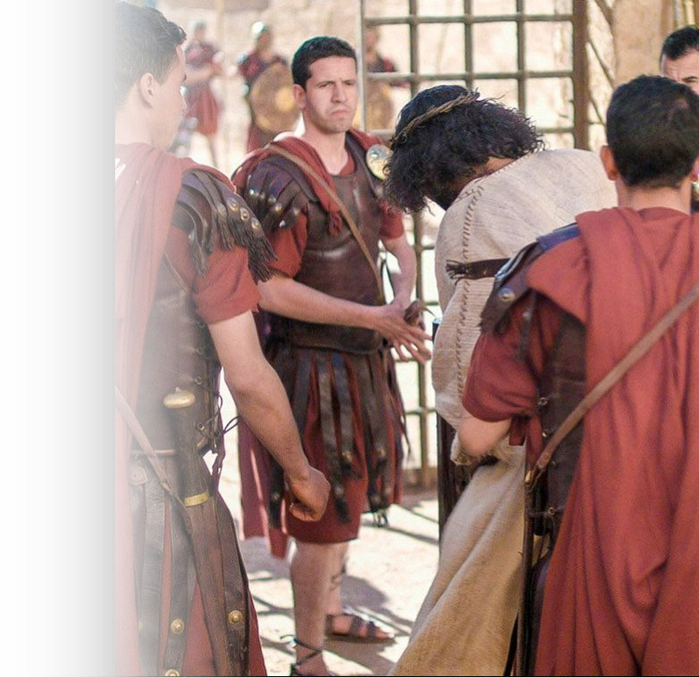
The REJECTION of Jesus
He will be UNDESIRED:
² He grew up before him like a tender shoot, and like a root out of dry ground. He had no beauty or majesty to attract us to him, nothing in his appearance that we
should desire him.
Notes:
No majesty – they mocked Him – crowned him with thorns – hail king.

Slide 18
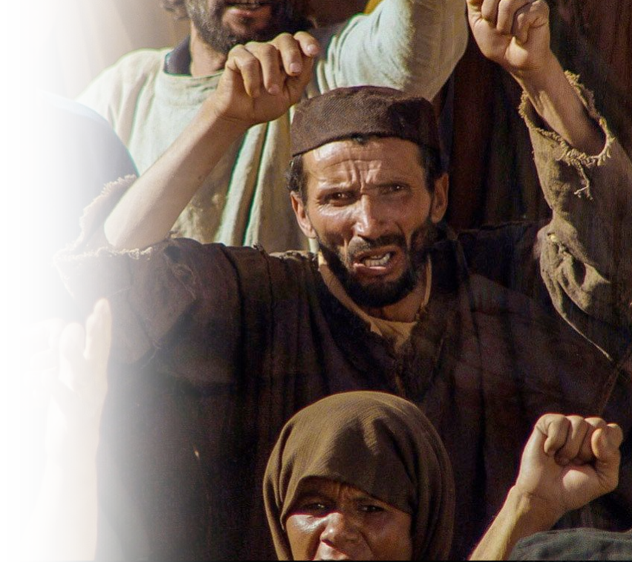
The REJECTION of Jesus
He will be DESPISED:
³ He was despised and rejected by men, a man of sorrows, and familiar with suffering. Like one from whom men hide their faces he was despised, and we esteemed him not.
Notes:
He is pictured here as if he hada disease (leprosy) shunned by the unbelieving Jews. Valueless.
John 1:11-13

Slide 19
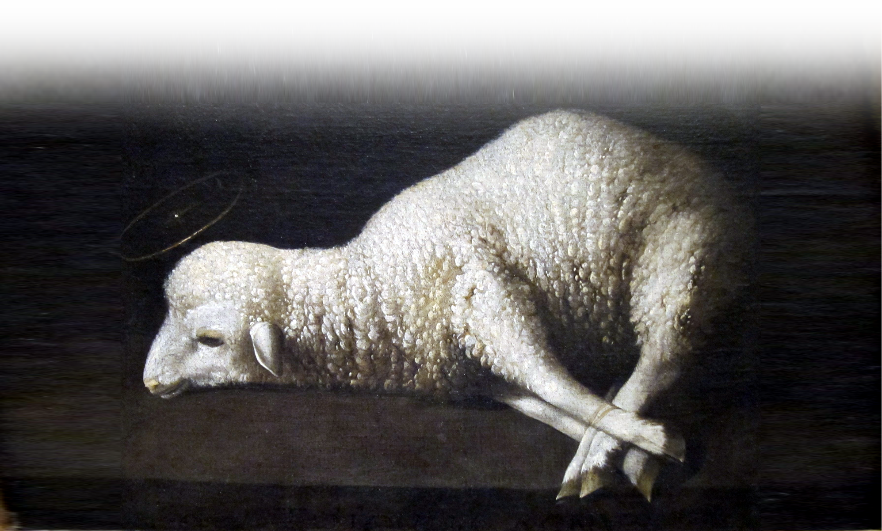
The SUBSTITUTION of Jesus
Notes:
Lamb = FREE = https://upload.wikimedia.org/wikipedia/commons/7/76/Agnus_Dei_%28The_Lamb_of_God%29_by_Zurbar%C3%A1n%2C_San_Diego_Museum_of_Art.JPG
Behold the Lamb of God that takes away the sin of the world.

Slide 20
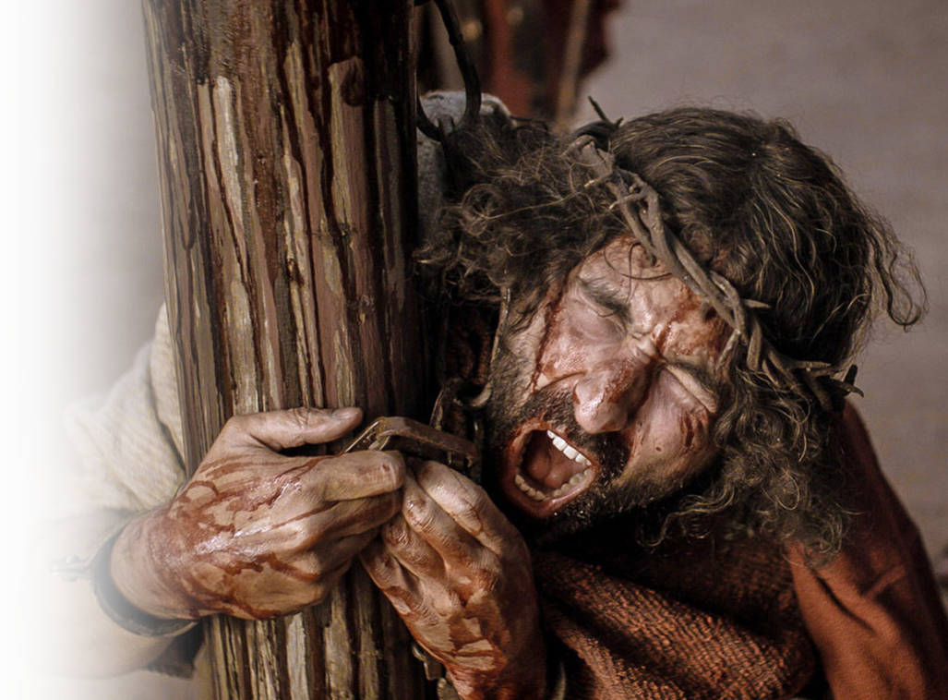
The SUBSTITUTION of Jesus
He will be SMITTEN:
⁴ Surely he took up our infirmities and carried our sorrows, yet we considered him stricken by God, smitten by him, and afflicted.
Notes:
Our infirmity, our sorrows, = spiritual and refer to our sins
2 cor 5:21 ;

Slide 21
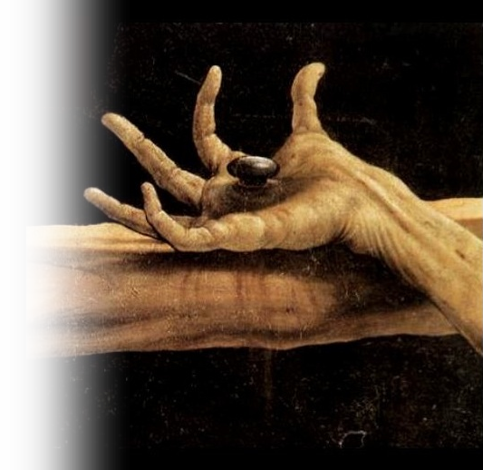
The SUBSTITUTION of Jesus
He will be PIERCED:
⁵ But he was pierced for our transgressions, he was crushed for our iniquities; the punishment that brought us peace was upon him, and by his wounds we are healed.
Notes:
Healing is a metaphor for ‘forgiveness.”

Slide 22
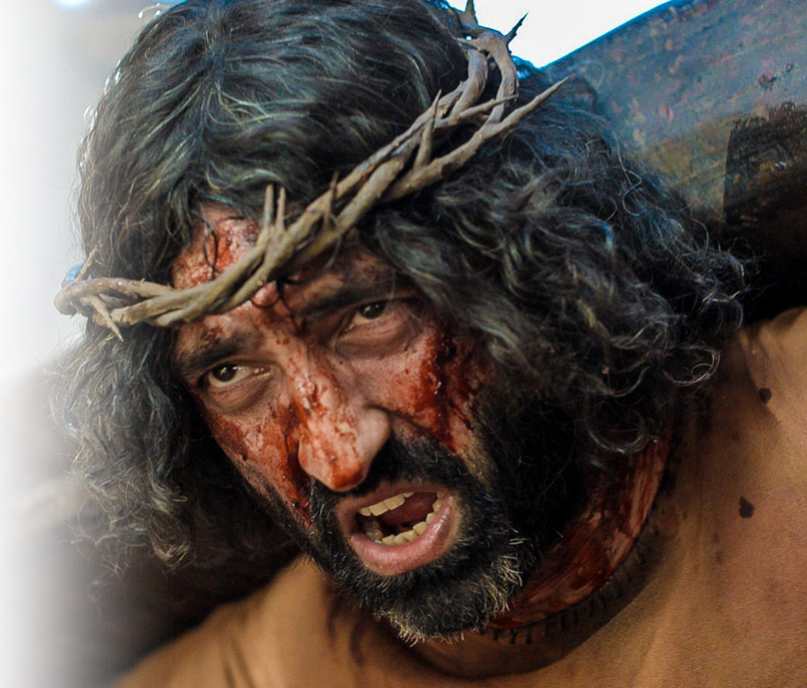
The SUBSTITUTION of Jesus
He will be BURDENED:
⁶ We all, like sheep, have gone astray, each of us has turned to his own way; and the LORD has laid on him the iniquity of us all.
Notes:
It was more than the beam of the cross that He bore to Golgatha – it was our iniquity that would be placed on him.
2 Cor 5:21; 1 Pet 3:17; Roman 4:25

Slide 23
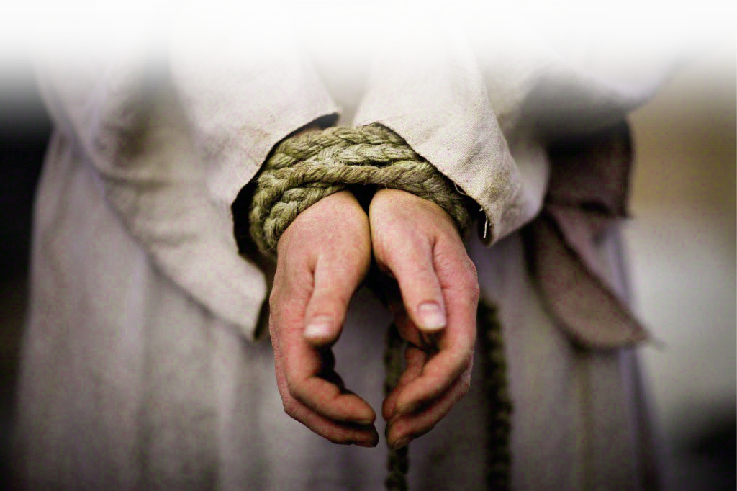
The OPPRESSION of Jesus
Notes:
Oppressed = https://www.lds.org/media-library/images/category/easter?lang=eng
The SUBMISSION of Jesus

Slide 24
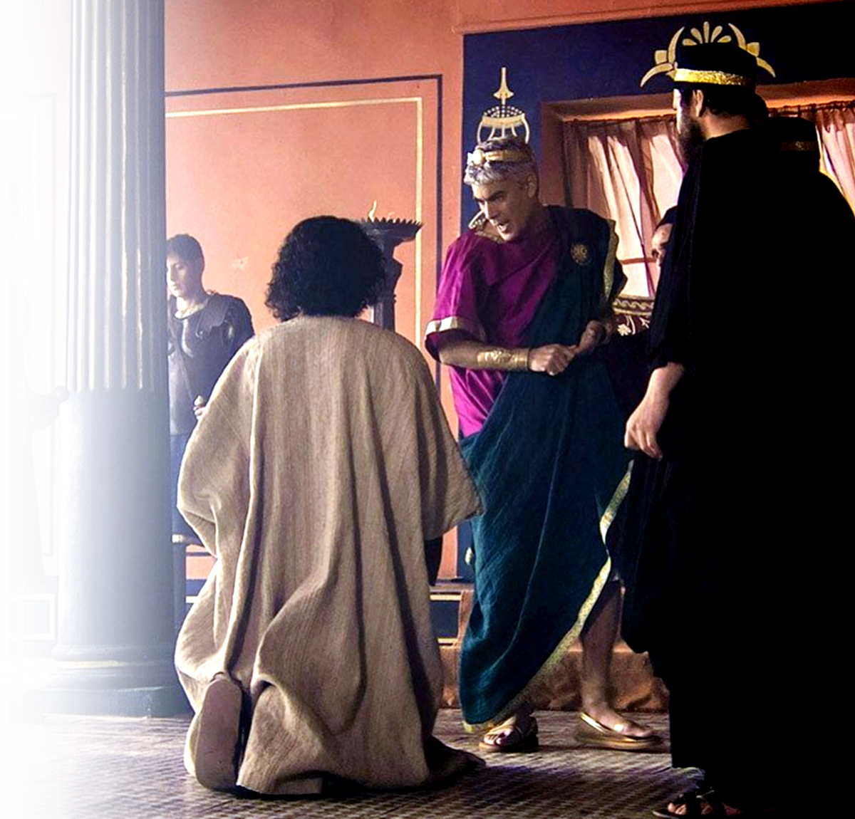
The OPPRESSION of Jesus
Oppressed in TRIALS:
⁷ He was oppressed and afflicted, yet he did not open his mouth; he was led like a lamb to the slaughter, and as a sheep before her shearers is silent, so he did not open his mouth.
Notes:
Oppressed in Silence
Submission in Silence

Slide 25
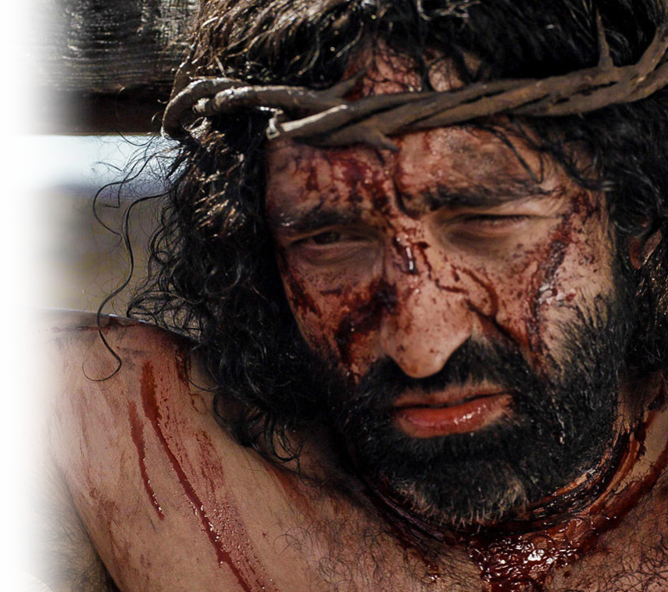
The OPPRESSION of Jesus
Oppressed in DEATH:
⁸ By oppression and judgment he was taken away. And who can speak of his descendants? For he was cut off from the land of the living; for the transgression of my people he was stricken.
Notes:
Oppressed with Death
Submission to death
Oppression and judgment seems to imply that he was treated unfairly, without a defense
Descendant = Heb “Dor” = “generation” = No one in that generation defended Him. Or Who from taht generation spoke up for him? The idiom seems to be “Who cared?”

Slide 26
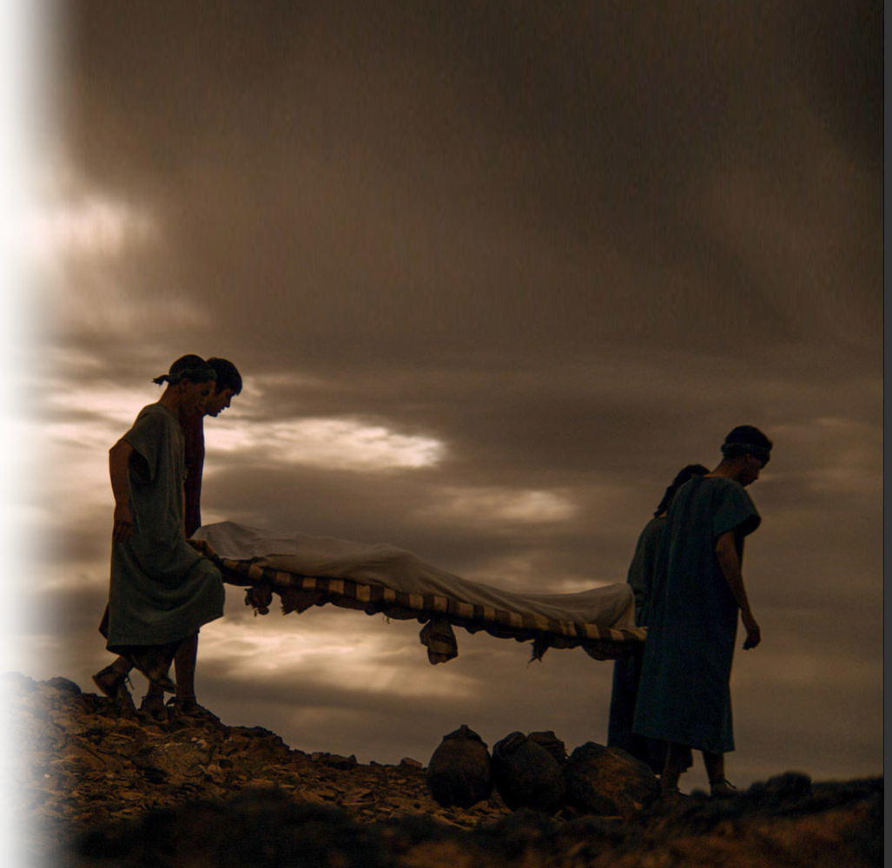
The OPPRESSION of Jesus
Oppressed in the GRAVE:
⁹ He was assigned a grave with the wicked, and with the rich in his death, though he had done no violence, nor was any deceit in his mouth.
Notes:
Oppressed through Violence
Submission to the Grave
They intended to bury him with criminals, but he ended up in a rich man's tomb, because ... (Isa 53:9 NET)

Slide 27
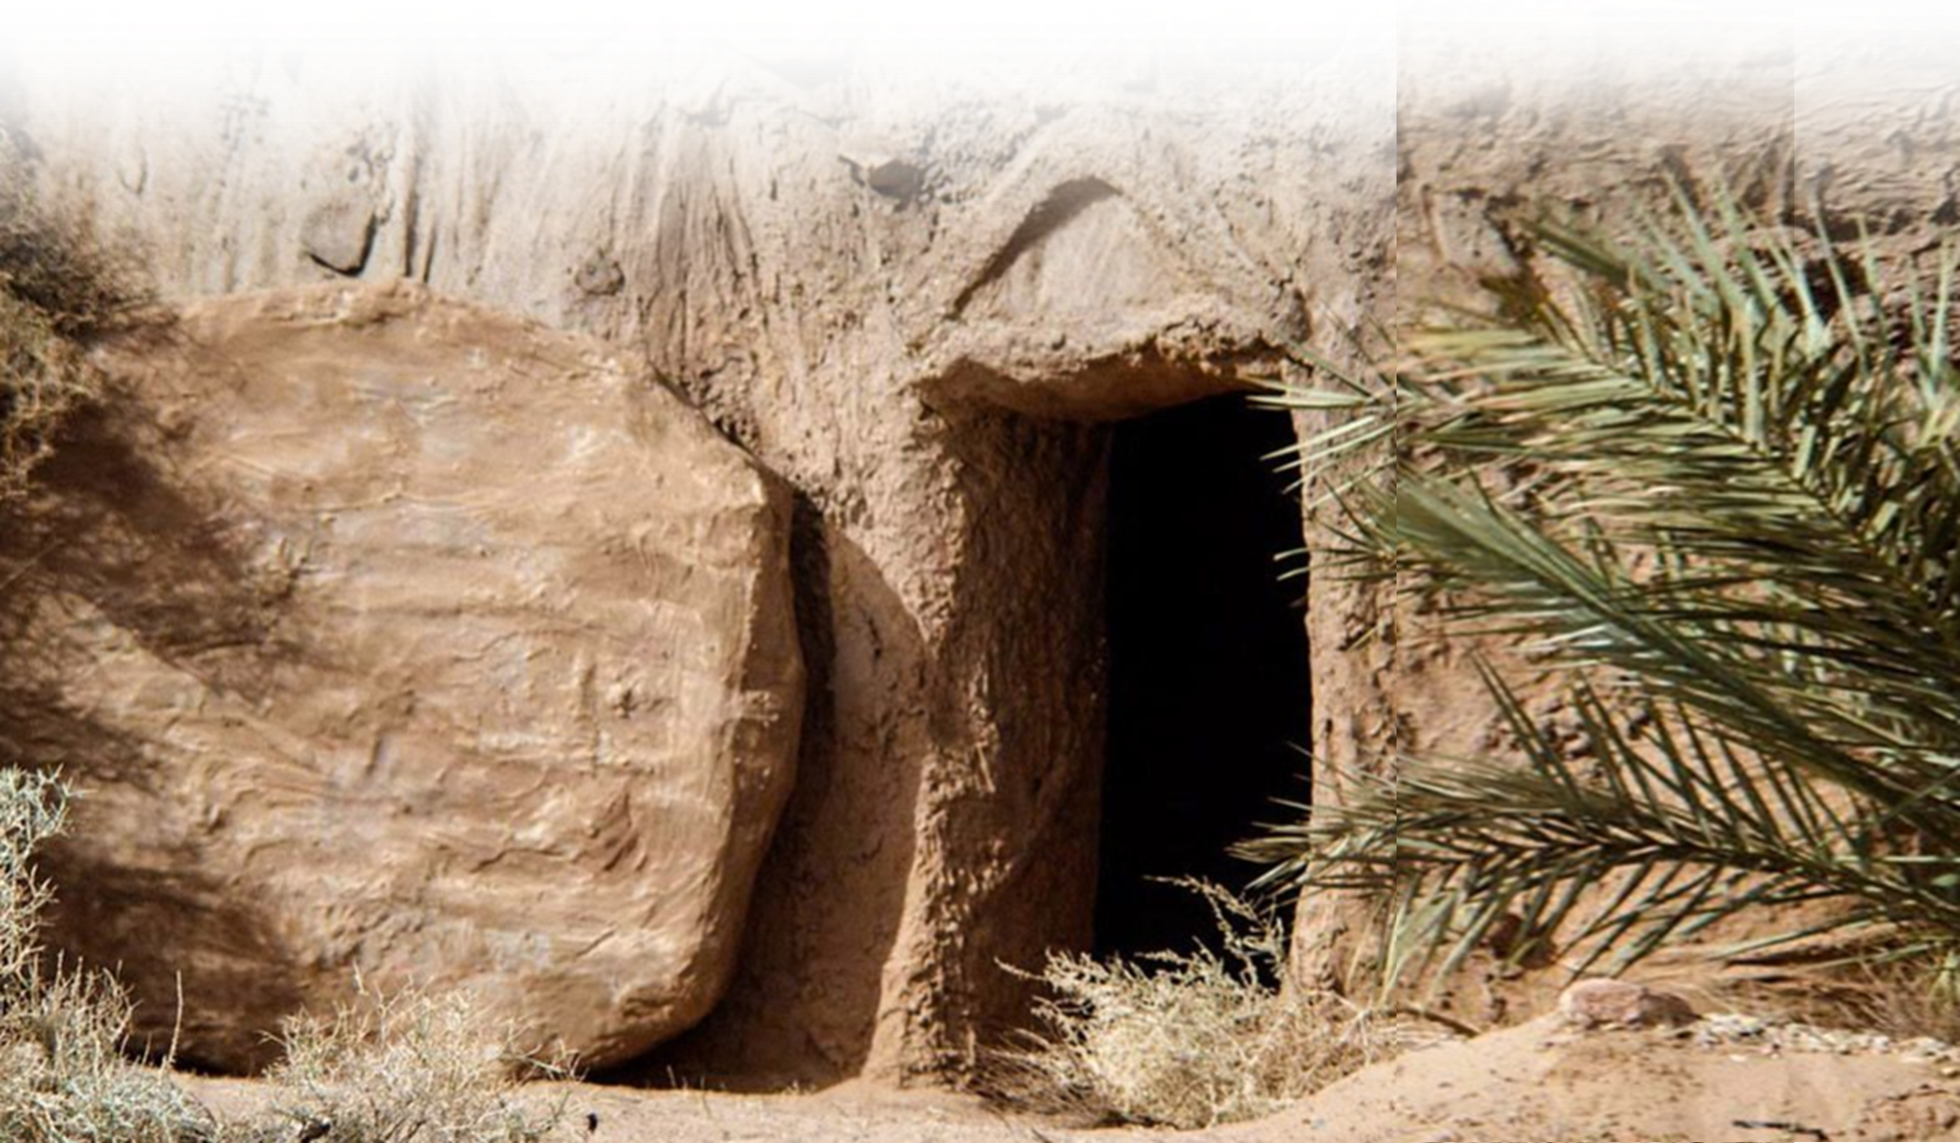
The RESURRECTION of Jesus

Slide 28
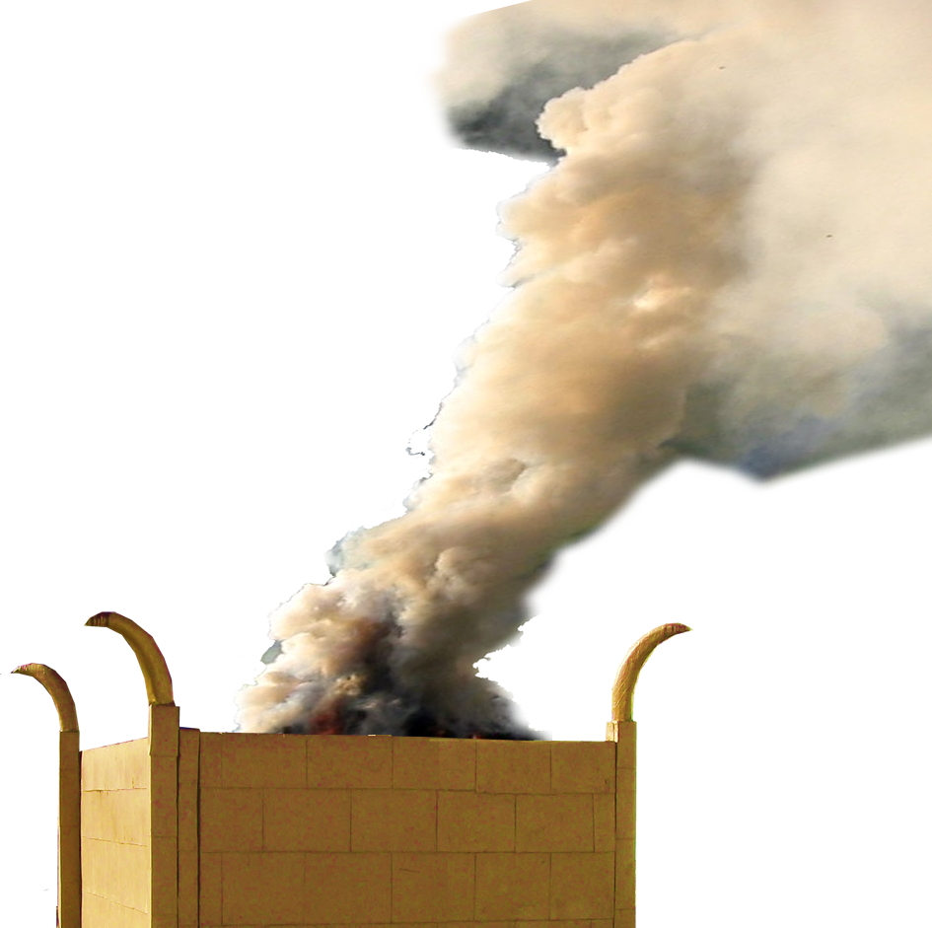
The RESURRECTION of Jesus
After OFFERING:
¹⁰ Yet it was the LORD's will to crush him and cause him to suffer, and though the LORD makes his life a guilt offering, he will see his offspring and prolong his days, and the will of the LORD will prosper in his hand.
Notes:
SMOKE = FREE = https://upload.wikimedia.org/wikipedia/commons/f/f3/Ognisko_ubt_0126.jpeg
ALTER = FREE = https://upload.wikimedia.org/wikipedia/commons/6/60/Timna_Tabernacle_Altar_of_Burnt_Offerings.jpg

Slide 29
The RESURRECTION of Jesus
After OFFERING:
¹⁰ Yet it was the LORD's will to crush him and cause him to suffer, and though the LORD makes his life a guilt offering, he will see his offspring and prolong his days, and the will of the LORD will prosper in his hand.
Notes:
SMOKE = FREE = https://upload.wikimedia.org/wikipedia/commons/f/f3/Ognisko_ubt_0126.jpeg
ALTER = FREE = https://upload.wikimedia.org/wikipedia/commons/6/60/Timna_Tabernacle_Altar_of_Burnt_Offerings.jpg

Slide 30
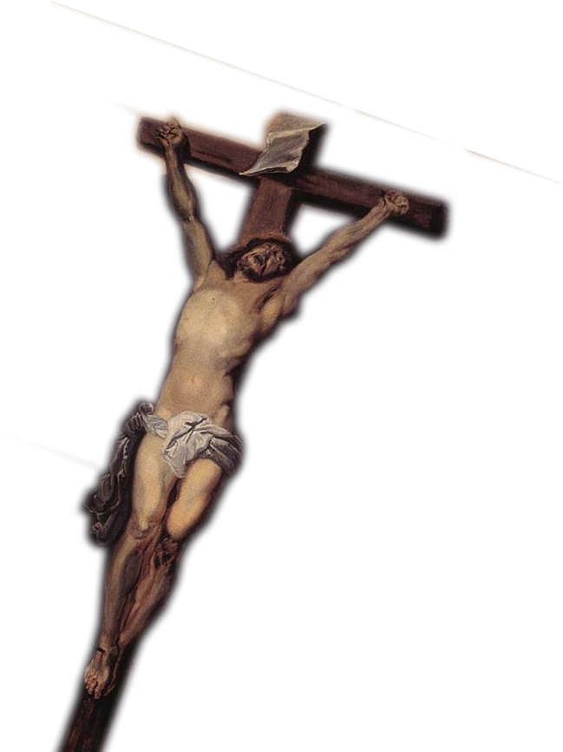
The RESURRECTION of Jesus
After SUFFERING:
¹¹ After the suffering of his soul, he will see the light of life and be satisfied; by his knowledge my righteous servant will justify many, and he will bear their iniquities.
Notes:
Cross = FREE =mhttps://upload.wikimedia.org/wikipedia/commons/0/06/Anthony_van_Dyck_-_Christ_on_the_Cross_-_WGA07431.jpg

Slide 31
The RESURRECTION of Jesus
After SUFFERING:
¹¹ After the suffering of his soul, he will see the light of life and be satisfied; by his knowledge my righteous servant will justify many, and he will bear their iniquities.
Notes:
Cross = FREE =mhttps://upload.wikimedia.org/wikipedia/commons/0/06/Anthony_van_Dyck_-_Christ_on_the_Cross_-_WGA07431.jpg

Slide 32
The RESURRECTION of Jesus
After SUFFERING:
¹¹ After the suffering of his soul, he will see the light of life and be satisfied; by his knowledge my righteous servant will justify many, and he will bear their iniquities.
Notes:
Cross = FREE =mhttps://upload.wikimedia.org/wikipedia/commons/0/06/Anthony_van_Dyck_-_Christ_on_the_Cross_-_WGA07431.jpg

Slide 33
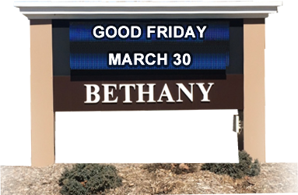
The RESURRECTION of Jesus
Before REWARD:
¹² Therefore I will give him a portion among the great, and he will divide the spoils with the strong, because he poured out his life unto death, and was numbered with the transgressors. For he bore the sin of many, and made intercession for the transgressors.
(Isa 53:12-1 NIV)
Notes:
We, who believe, are the spoils.

Slide 34
The RESURRECTION of Jesus
For REWARD:
¹² Therefore I will give him a portion among the great, and he will divide the spoils with the strong, because he poured out his life unto death, and was numbered with the transgressors. For he bore the sin of many, and made intercession for the transgressors.
(Isa 53:12-1 NIV)
Notes:
Because “He died for us”
Because “He identified with us”
Because “He took our sins”
Because “He ministered to us”

Slide 35
Good Friday Had to Happen

Slide 36
Good Friday Had to Happen
to Fulfill the Prophecy

Slide 37
Good Friday Had to Happen
to Fulfill the Prophecy
and to Bring Us to God!

Slide 38
Let’s Pray!

