Slide 1

GOOD FRIDAY
The Criminality of it all!
Notes:
www.flickr.com/photos/62228949@N02/5661597275
Copyright © 2006−2021. All rights reserved. Bible Point is a registered trademark of Dennis Henderson. All other trademarks acknowledged.
Bible Point contains graphics from Bible Point artists. These illustrations belong to Bible Point and the respective artists. You may use the designs and illustrations for graphical illustration of lessons free and without special permission, provided they are not used in any way that maligns the Christian faith. Furthermore, republication or production of any illustration by any other graphic service whether it be in book, in a machine-readable form, or in any other design resource is strictly prohibited. Furthermore, they cannot be duplicated or resold as any other form of publishing, clip art, or graphic resource.
So What does it mean? (A simple translations of the legal jargon)
So, if you don’t own the presentation(s), graphic(s), and text(s) how can you legally use them? The purchase of the license allows you to use all the images in the product. However, the actual ownership and copyright of the presentation(s), graphic(s), and text(s) remain the property of Bible Point and its licensors. If you had plans on using this product in your “for sale” work—think again!
License Agreement
Article 1: License Grant
All the graphics and text in Bible Point presentations (excluding quotes from the Bible and stated sources) are the intellectual and real property of Bible Point and its licensors, and is protected by law, including United States copyright laws and international treaties. Bible Point grants to you a license:
1. To use the presentation in a single church, single school, or single office of a Christian organization.
2. To make a single archival back-up copy of the program.
3. To modify the presentation(s) and merge with other presentations in a single church, school, or Christian organization.
4. To transfer to another party if that party agrees to accept the terms and conditions of this agreement, and you do not retain any copies of the presentation, whether printed, machine readable, modified, or merged form.
Article 2: Terms
This license is effective until terminated. You may terminate the license at any time by destroying the presentation(s), graphic(s), or text(s) together with all copies, modifications and merged portions in any form. Bible Point may terminate your license if you fail to comply with this Agreement. You agree, upon such termination, for any reason, to destroy the presentation(s), graphics, and text(s) with all copies, modifications, and merged portions in any form.
Article 3: Disclaimers
1. Bible Point presentations, graphics, and texts are licensed to you As Is. You, the consumer, bear the entire risk relating to the quality and performance of the presentation(s), graphic(s), or text(s). In no event will Bible Point be liable for damages resulting from any defect.
2. Thirty-day limited warrantee on disks. Bible Point warrants the disks to be free of defects in material and workmanship under normal use for 30 days after purchase. During the 30-day period you may return a defective presentation, graphic, or text with proof of purchase and it will be replaced without charge, unless the presentation is damaged by misuse.
Article 4: General
1. You may not sub-license, assign, or transfer the license of the presentation(s), graphic(s), or text(s) except as provided by this Agreement.
2. This Agreement will be governed by the laws of the State of Michigan.
So What does it mean? (A simple translations of the legal jargon)
May I let someone borrow or copy my licensed Bible Point presentation (even after I modified it)? As long as it is within your local church, or single school, or the immediate office of a Christian organization you may. Otherwise, please refer the person interested in borrowing to: http://www.biblepoint.com or E-mail: dennis@DrDH.net with any related questions.

Slide 2
GOOD FRIDAY
The Criminality of it all!
Notes:
www.flickr.com/photos/62228949@N02/5661597275
Copyright © 2006−2021. All rights reserved. Bible Point is a registered trademark of Dennis Henderson. All other trademarks acknowledged.
Bible Point contains graphics from Bible Point artists. These illustrations belong to Bible Point and the respective artists. You may use the designs and illustrations for graphical illustration of lessons free and without special permission, provided they are not used in any way that maligns the Christian faith. Furthermore, republication or production of any illustration by any other graphic service whether it be in book, in a machine-readable form, or in any other design resource is strictly prohibited. Furthermore, they cannot be duplicated or resold as any other form of publishing, clip art, or graphic resource.
So What does it mean? (A simple translations of the legal jargon)
So, if you don’t own the presentation(s), graphic(s), and text(s) how can you legally use them? The purchase of the license allows you to use all the images in the product. However, the actual ownership and copyright of the presentation(s), graphic(s), and text(s) remain the property of Bible Point and its licensors. If you had plans on using this product in your “for sale” work—think again!
License Agreement
Article 1: License Grant
All the graphics and text in Bible Point presentations (excluding quotes from the Bible and stated sources) are the intellectual and real property of Bible Point and its licensors, and is protected by law, including United States copyright laws and international treaties. Bible Point grants to you a license:
1. To use the presentation in a single church, single school, or single office of a Christian organization.
2. To make a single archival back-up copy of the program.
3. To modify the presentation(s) and merge with other presentations in a single church, school, or Christian organization.
4. To transfer to another party if that party agrees to accept the terms and conditions of this agreement, and you do not retain any copies of the presentation, whether printed, machine readable, modified, or merged form.
Article 2: Terms
This license is effective until terminated. You may terminate the license at any time by destroying the presentation(s), graphic(s), or text(s) together with all copies, modifications and merged portions in any form. Bible Point may terminate your license if you fail to comply with this Agreement. You agree, upon such termination, for any reason, to destroy the presentation(s), graphics, and text(s) with all copies, modifications, and merged portions in any form.
Article 3: Disclaimers
1. Bible Point presentations, graphics, and texts are licensed to you As Is. You, the consumer, bear the entire risk relating to the quality and performance of the presentation(s), graphic(s), or text(s). In no event will Bible Point be liable for damages resulting from any defect.
2. Thirty-day limited warrantee on disks. Bible Point warrants the disks to be free of defects in material and workmanship under normal use for 30 days after purchase. During the 30-day period you may return a defective presentation, graphic, or text with proof of purchase and it will be replaced without charge, unless the presentation is damaged by misuse.
Article 4: General
1. You may not sub-license, assign, or transfer the license of the presentation(s), graphic(s), or text(s) except as provided by this Agreement.
2. This Agreement will be governed by the laws of the State of Michigan.
So What does it mean? (A simple translations of the legal jargon)
May I let someone borrow or copy my licensed Bible Point presentation (even after I modified it)? As long as it is within your local church, or single school, or the immediate office of a Christian organization you may. Otherwise, please refer the person interested in borrowing to: http://www.biblepoint.com or E-mail: dennis@DrDH.net with any related questions.

Slide 3
4 Accused Criminals

Slide 4
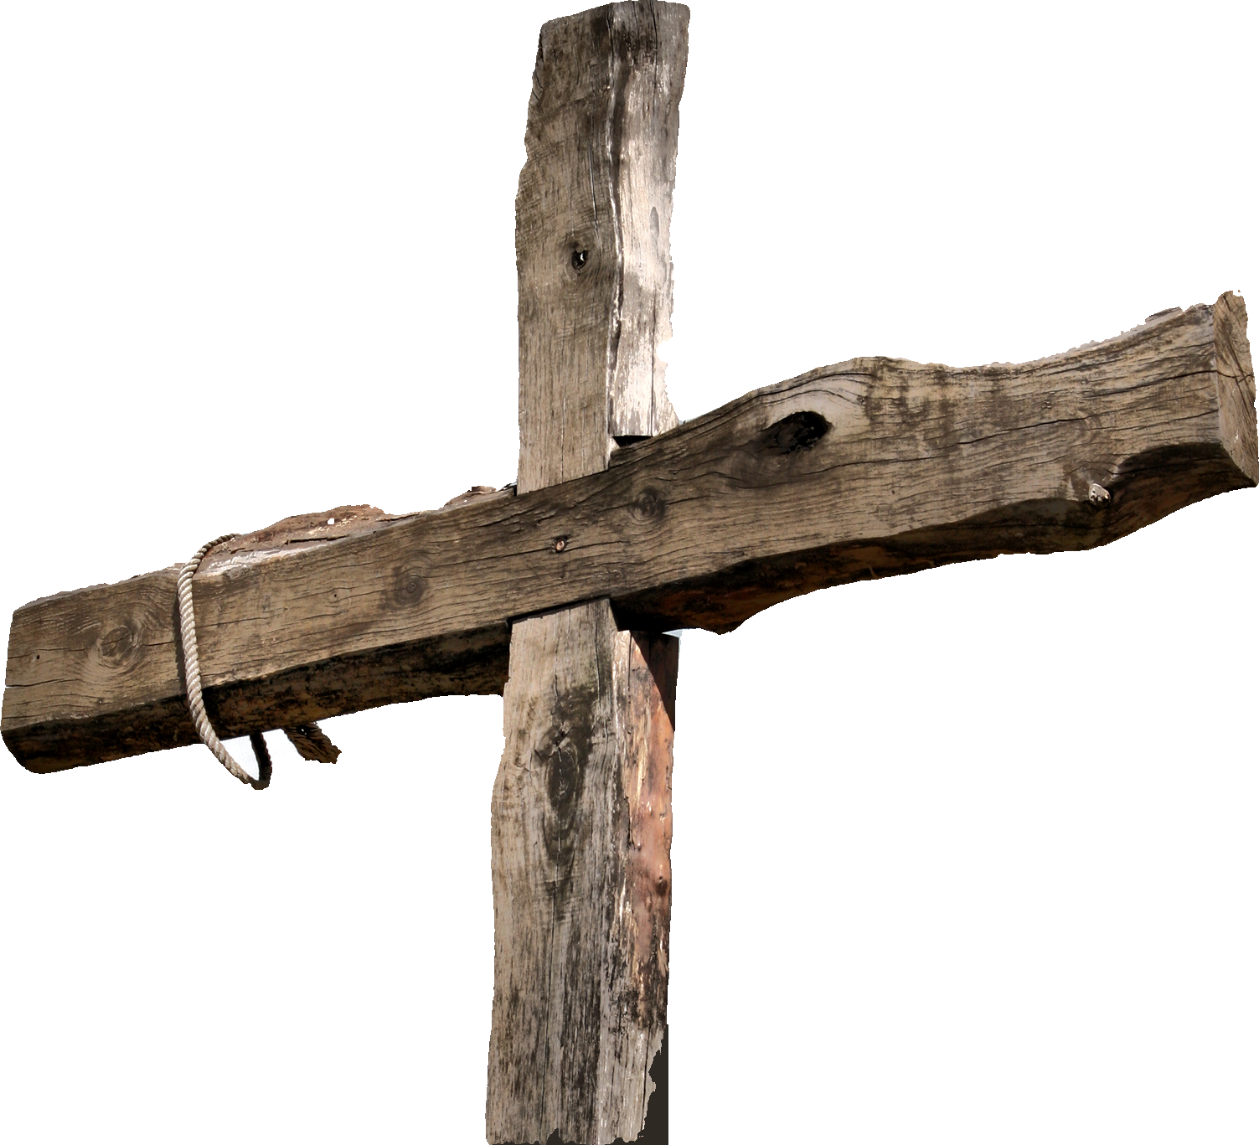
The Criminals: Robbers
^{Mark 15:27} They crucified two robbers with him, one on his right and one on his left.
Notes:
Those crucified with him also heaped insults on him. (Mar 15:32 NIV)

Slide 5
The Criminals
^{John 19:18} … they crucified him, and with him two others--one on each side and Jesus in the middle.
Notes:
he went out to the place of the Skull (which in Aramaic is called Golgotha).
¹⁸ Here they crucified him, and with him two others--one on each side and Jesus in the middle.
(Joh 19:17-18 NIV)

Slide 6
The Criminals: Defiant
^{Mark 15:32} Those crucified with him also heaped insults on him.
Notes:
Those crucified with him also heaped insults on him. (Mar 15:32 NIV)

Slide 7
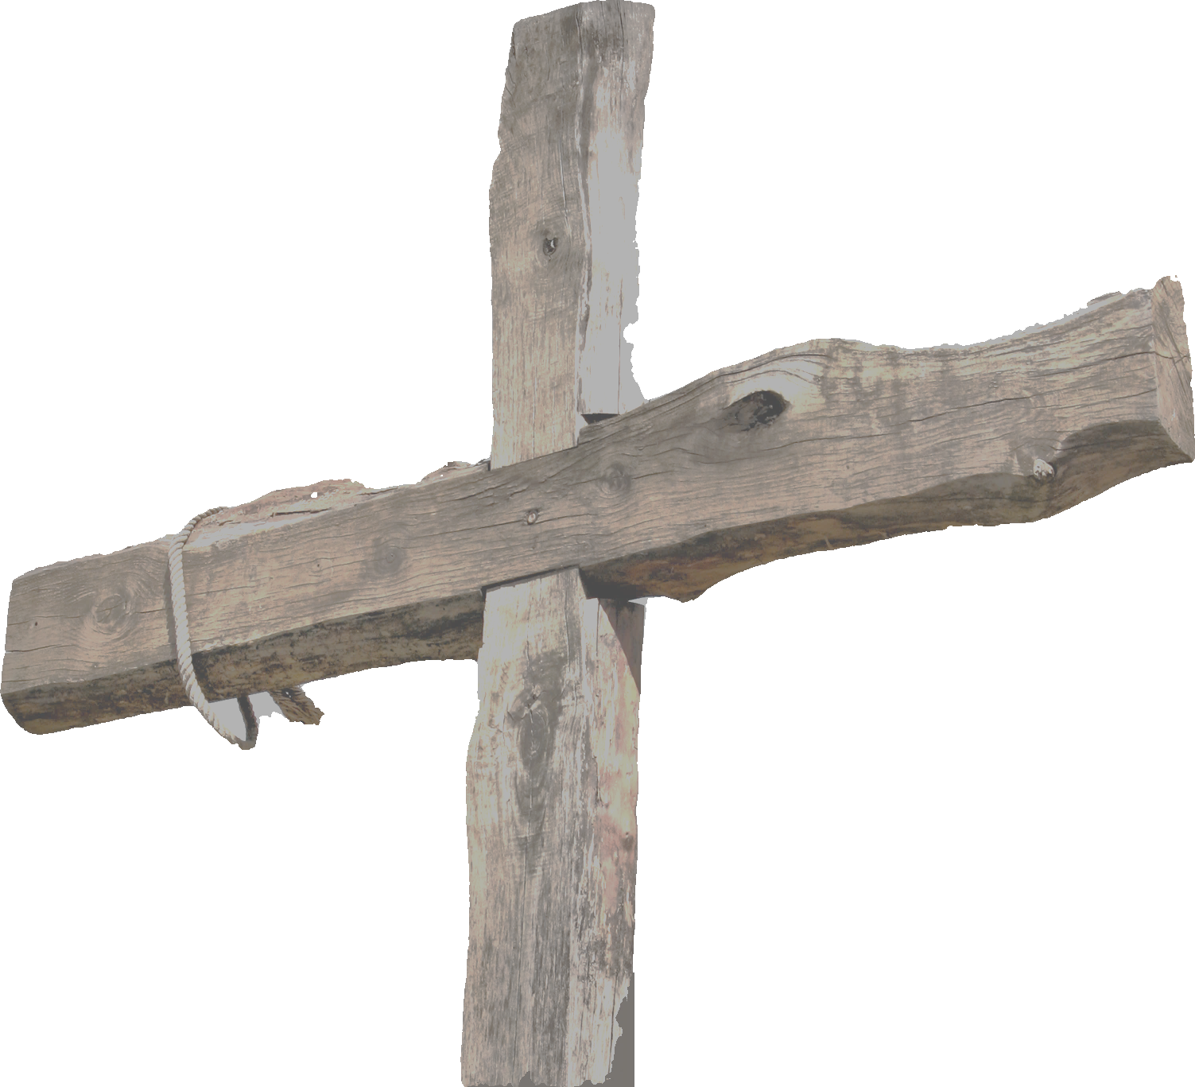
1- The Unrepentant Criminal: Robber
³⁹ One of the criminals who hung there hurled insults at him: "Aren't you the Christ? Save yourself and us!"
Notes:
Those crucified with him also heaped insults on him. (Mar 15:32 NIV)

Slide 8
2- The Repentant Criminal: the Other
^{Luke 23:40} But the other criminal rebuked him.
"Don't you fear God," he said, "since you are under the same sentence?

Slide 9
2- The Repentant Criminal: the Other
⁴¹ We are punished justly, for we are getting what our deeds deserve. But this man has done nothing wrong."

Slide 10
2- The Repentant Criminal: the Other
⁴² Then he said, "Jesus, remember me when you come into your kingdom. "

Slide 11
2- The Repentant Criminal: the Other
⁴³ Jesus answered him, "I tell you the truth, today you will be with me in paradise."

Slide 12
3- The INNOCENT Criminal: Jesus
But this man has done nothing wrong."

Slide 13
3- The INNOCENT Criminal: Jesus
^{1 Peter 2:24} He himself bore our sins in his body on the tree, so that we might die to sins and live for right-eousness; by his wounds you have been healed.

Slide 14
4- The MISSING Criminal: Barabbas
^{Mark 15:15} Pilate released Barabbas to them. He had Jesus flogged, and handed him over to be crucified.

Slide 15
4- The MISSING Criminal: Barabbas
^{1 Peter 3:18} For Christ died for sins once for all, the righteous for the unrighteous, to bring you to God. He was put to death in the body but made alive by the Spirit

Slide 16
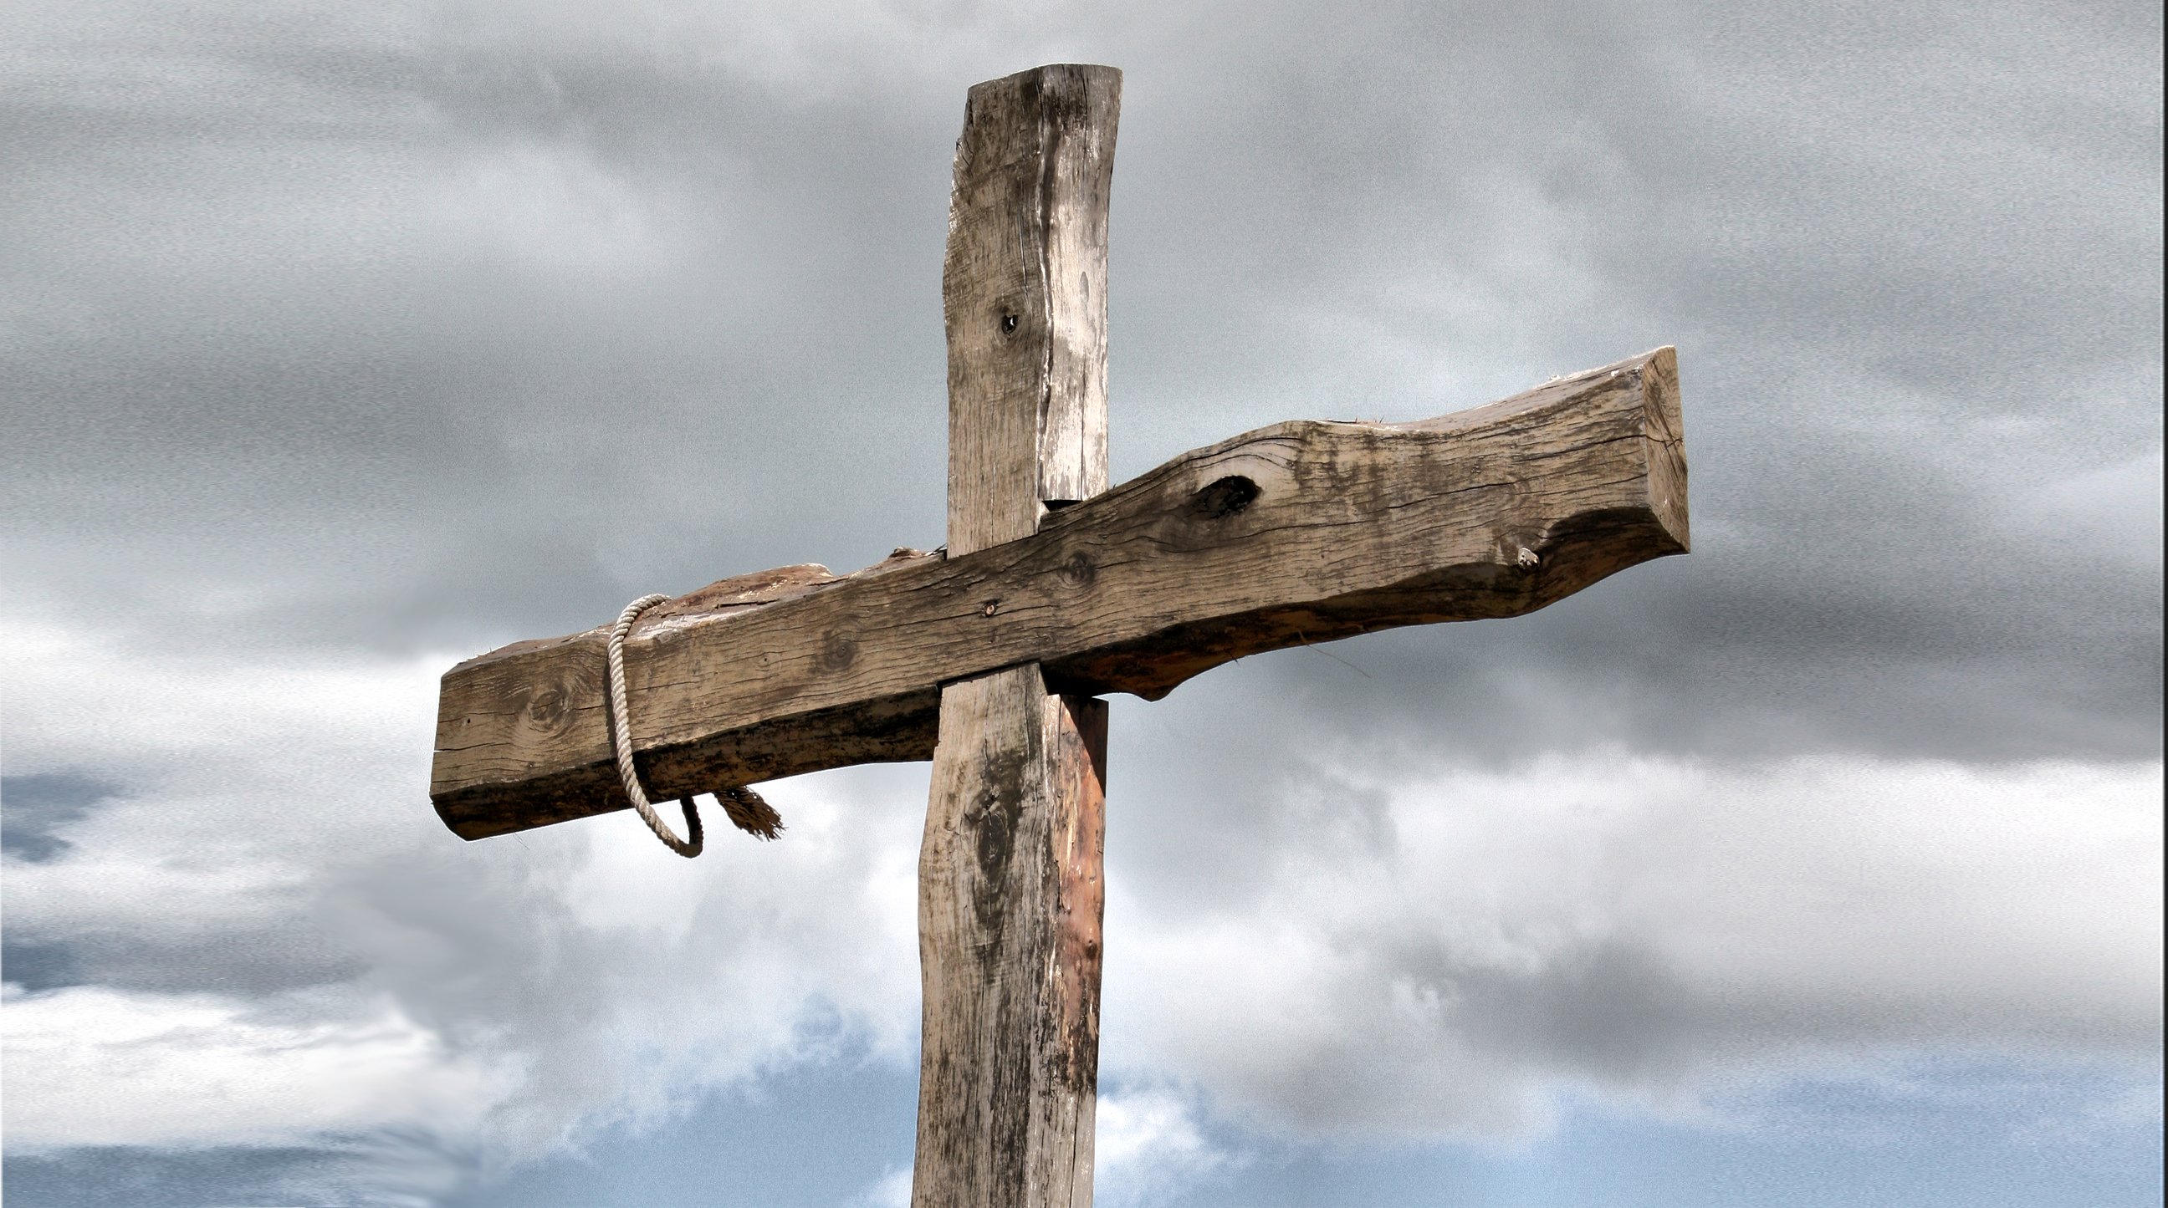
The Criminality of GOOD FRIDAY:
1- Defiant Unrepentant Criminal
2- Guilty Repentant Criminal
3- Innocent “Criminal”
4- Guilty Escaped Criminal

Slide 17
LET’S PRAY

