Slide 1
What Difference Does Good Friday Make?
Notes:
Copyright © 2006−2021. All rights reserved. Bible Point is a registered trademark of Dennis Henderson. All other trademarks acknowledged.
Bible Point contains graphics from Bible Point artists. These illustrations belong to Bible Point and the respective artists. You may use the designs and illustrations for graphical illustration of lessons free and without special permission, provided they are not used in any way that maligns the Christian faith. Furthermore, republication or production of any illustration by any other graphic service whether it be in book, in a machine-readable form, or in any other design resource is strictly prohibited. Furthermore, they cannot be duplicated or resold as any other form of publishing, clip art, or graphic resource.
So What does it mean? (A simple translations of the legal jargon)
So, if you don’t own the presentation(s), graphic(s), and text(s) how can you legally use them? The purchase of the license allows you to use all the images in the product. However, the actual ownership and copyright of the presentation(s), graphic(s), and text(s) remain the property of Bible Point and its licensors. If you had plans on using this product in your “for sale” work—think again!
License Agreement
Article 1: License Grant
All the graphics and text in Bible Point presentations (excluding quotes from the Bible and stated sources) are the intellectual and real property of Bible Point and its licensors, and is protected by law, including United States copyright laws and international treaties. Bible Point grants to you a license:
1. To use the presentation in a single church, single school, or single office of a Christian organization.
2. To make a single archival back-up copy of the program.
3. To modify the presentation(s) and merge with other presentations in a single church, school, or Christian organization.
4. To transfer to another party if that party agrees to accept the terms and conditions of this agreement, and you do not retain any copies of the presentation, whether printed, machine readable, modified, or merged form.
Article 2: Terms
This license is effective until terminated. You may terminate the license at any time by destroying the presentation(s), graphic(s), or text(s) together with all copies, modifications and merged portions in any form. Bible Point may terminate your license if you fail to comply with this Agreement. You agree, upon such termination, for any reason, to destroy the presentation(s), graphics, and text(s) with all copies, modifications, and merged portions in any form.
Article 3: Disclaimers
1. Bible Point presentations, graphics, and texts are licensed to you As Is. You, the consumer, bear the entire risk relating to the quality and performance of the presentation(s), graphic(s), or text(s). In no event will Bible Point be liable for damages resulting from any defect.
2. Thirty-day limited warrantee on disks. Bible Point warrants the disks to be free of defects in material and workmanship under normal use for 30 days after purchase. During the 30-day period you may return a defective presentation, graphic, or text with proof of purchase and it will be replaced without charge, unless the presentation is damaged by misuse.
Article 4: General
1. You may not sub-license, assign, or transfer the license of the presentation(s), graphic(s), or text(s) except as provided by this Agreement.
2. This Agreement will be governed by the laws of the State of Michigan.
So What does it mean? (A simple translations of the legal jargon)
May I let someone borrow or copy my licensed Bible Point presentation (even after I modified it)? As long as it is within your local church, or single school, or the immediate office of a Christian organization you may. Otherwise, please refer the person interested in borrowing to: http://www.biblepoint.com or E-mail: dennis@DrDH.net with any related questions.

Slide 2
What Difference Does Good Friday Make?
Notes:
Copyright © 2006−2021. All rights reserved. Bible Point is a registered trademark of Dennis Henderson. All other trademarks acknowledged.
Bible Point contains graphics from Bible Point artists. These illustrations belong to Bible Point and the respective artists. You may use the designs and illustrations for graphical illustration of lessons free and without special permission, provided they are not used in any way that maligns the Christian faith. Furthermore, republication or production of any illustration by any other graphic service whether it be in book, in a machine-readable form, or in any other design resource is strictly prohibited. Furthermore, they cannot be duplicated or resold as any other form of publishing, clip art, or graphic resource.
So What does it mean? (A simple translations of the legal jargon)
So, if you don’t own the presentation(s), graphic(s), and text(s) how can you legally use them? The purchase of the license allows you to use all the images in the product. However, the actual ownership and copyright of the presentation(s), graphic(s), and text(s) remain the property of Bible Point and its licensors. If you had plans on using this product in your “for sale” work—think again!
License Agreement
Article 1: License Grant
All the graphics and text in Bible Point presentations (excluding quotes from the Bible and stated sources) are the intellectual and real property of Bible Point and its licensors, and is protected by law, including United States copyright laws and international treaties. Bible Point grants to you a license:
1. To use the presentation in a single church, single school, or single office of a Christian organization.
2. To make a single archival back-up copy of the program.
3. To modify the presentation(s) and merge with other presentations in a single church, school, or Christian organization.
4. To transfer to another party if that party agrees to accept the terms and conditions of this agreement, and you do not retain any copies of the presentation, whether printed, machine readable, modified, or merged form.
Article 2: Terms
This license is effective until terminated. You may terminate the license at any time by destroying the presentation(s), graphic(s), or text(s) together with all copies, modifications and merged portions in any form. Bible Point may terminate your license if you fail to comply with this Agreement. You agree, upon such termination, for any reason, to destroy the presentation(s), graphics, and text(s) with all copies, modifications, and merged portions in any form.
Article 3: Disclaimers
1. Bible Point presentations, graphics, and texts are licensed to you As Is. You, the consumer, bear the entire risk relating to the quality and performance of the presentation(s), graphic(s), or text(s). In no event will Bible Point be liable for damages resulting from any defect.
2. Thirty-day limited warrantee on disks. Bible Point warrants the disks to be free of defects in material and workmanship under normal use for 30 days after purchase. During the 30-day period you may return a defective presentation, graphic, or text with proof of purchase and it will be replaced without charge, unless the presentation is damaged by misuse.
Article 4: General
1. You may not sub-license, assign, or transfer the license of the presentation(s), graphic(s), or text(s) except as provided by this Agreement.
2. This Agreement will be governed by the laws of the State of Michigan.
So What does it mean? (A simple translations of the legal jargon)
May I let someone borrow or copy my licensed Bible Point presentation (even after I modified it)? As long as it is within your local church, or single school, or the immediate office of a Christian organization you may. Otherwise, please refer the person interested in borrowing to: http://www.biblepoint.com or E-mail: dennis@DrDH.net with any related questions.

Slide 3
What Difference Does Good Friday Make?
It makes doubters into believers.

Slide 4
The Seven
Sayings
of the Savior
Notes:
Background Three Crosses = FREE = from https://www.flickr.com/photos/abcdz2000/3428819302/

Slide 5
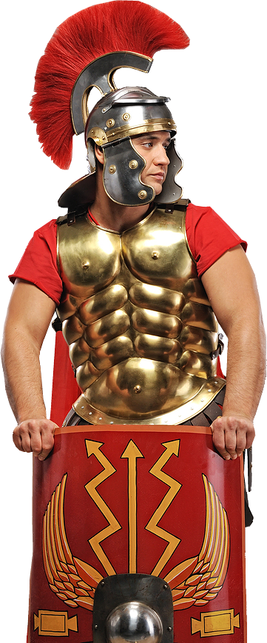
“The Centurion...saw... all that happened.…” (Matthew 27:54)
Notes:
Centurion = Licensed = NOT FOR REUSE ELSEWHERE. To reuse elsewhere get a license from bigstock_Nice_portrait_of_a_legionary_s_10896698

Slide 6
9 am
Notes:
9 am – Jesus’ execution begins ...

Slide 7
First Saying:
“Father, Forgive them for they do not know what they are doing.” (Luke 23:34)
Notes:
Jesus nailed to the cross = Licensed = NOT FOR REUSE ELSEWHERE. To reuse elsewhere get a licenses from http://www.bigstockphoto.com/image-86395184/stock-photo-jesus-on-the-cross-with-nail-and-hand-in-foreground

Slide 8
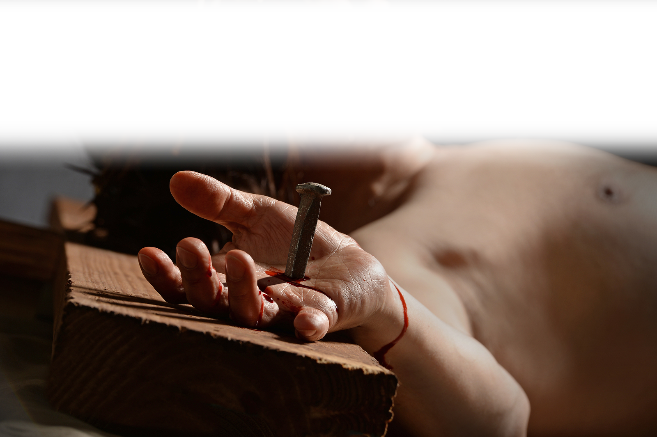
First Saying:
“Father, Forgive them for they do not know what they are doing.” (Luke 23:34)
Notes:
Jesus nailed to the cross = Licensed = NOT FOR REUSE ELSEWHERE. To reuse elsewhere get a licenses from http://www.bigstockphoto.com/image-86395184/stock-photo-jesus-on-the-cross-with-nail-and-hand-in-foreground

Slide 9
Second Saying:

Slide 10
Second Saying:
“Today you will be
with me in paradise.”
(Luke 23:43)

Slide 11
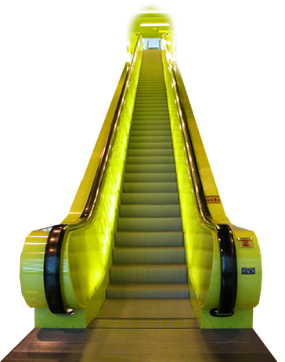
Second Saying:
“Today you will be
with me in paradise.”
(Luke 23:43)

Slide 12
Third Saying:
“Woman, here is your son .... Here is your mother.” (John 19:26-27)

Slide 13
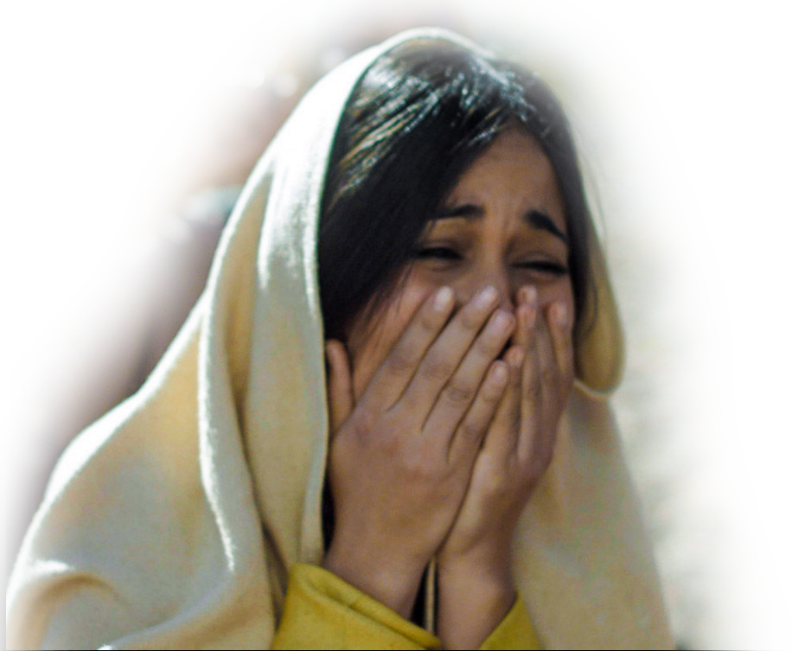
Third Saying:
“Woman, here is your son .... Here is your mother.” (John 19:26-27)
Notes:
Woman = FREE= http://www.freebibleimages.org/photos/jesus-crucified/

Slide 14
Noon ... 3 pm
Notes:
Lightning = FREE = "Lightning NOAA" by C. Clark - NOAA Photo Library (direct), NOAA Central Library; OAR/ERL/National Severe Storms Laboratory (NSSL), Image ID: nssl0010. Licensed under Public Domain via Wikimedia Commons - http://commons.wikimedia.org/wiki/File:Lightning_NOAA.jpg#/media/File:Lightning_NOAA.jpg

Slide 15

Fourth Saying:
“Eloi, Eloi, lama sabachthani?” “My God My God, why have you forsaken me?” (Matthew 27: 46)
Notes:
Lightning = FREE = "Lightning NOAA" by C. Clark - NOAA Photo Library (direct), NOAA Central Library; OAR/ERL/National Severe Storms Laboratory (NSSL), Image ID: nssl0010. Licensed under Public Domain via Wikimedia Commons - http://commons.wikimedia.org/wiki/File:Lightning_NOAA.jpg#/media/File:Lightning_NOAA.jpg

Slide 16

Fifth Saying:
“I am thirsty” (John 19:28)
Notes:
Chalice = FREE = from https://farm8.staticflickr.com/7155/6483106769_87eee11cf2_o.jpg

Slide 17
Sixth Saying:
“It is finished”
(John19:30)
Notes:
Paid = FREE = from http://www.pioneermemorial.org/_files/images/Paid.jpg

Slide 18

Sixth Saying:
“It is finished”
(John19:30)
Notes:
Paid = FREE = from http://www.pioneermemorial.org/_files/images/Paid.jpg

Slide 19
Seventh Saying:
“Father, into your hands I commit
my spirit” (Luke 23:46)
Notes:
Hands = FREE = BiblePoint photo

Slide 20
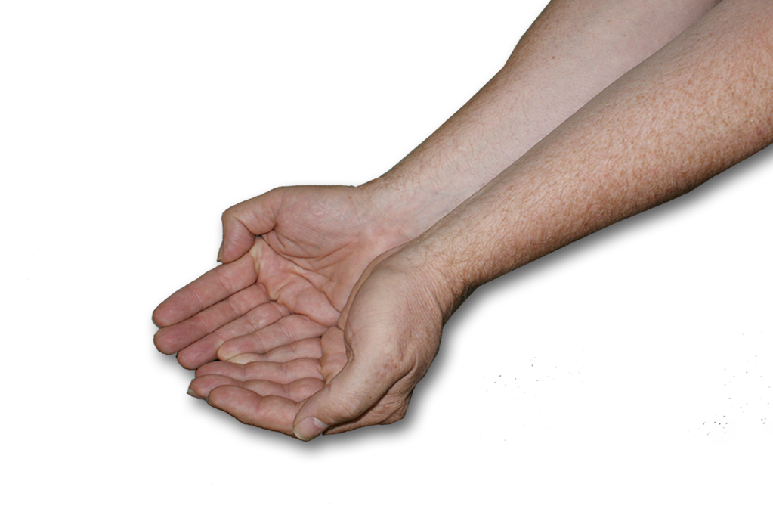
Seventh Saying:
“Father, into your hands I commit
my spirit” (Luke 23:46)
Notes:
Hands = FREE = BiblePoint photo

Slide 21
“When the Centurion saw how he died, he said, “Surely this man was the Son of God.” Mark 15:39
Notes:
Centurion = Licensed = NOT FOR REUSE ELSEWHERE. To reuse elsewhere get a license from bigstock_Nice_portrait_of_a_legionary_s_10896698

Slide 22
“When the Centurion saw how he died, he said, “Surely this man was the Son of God.” Mark 15:39
Good Friday made this doubter into a believer!
Notes:
Centurion = Licensed = NOT FOR REUSE ELSEWHERE. To reuse elsewhere get a license from bigstock_Nice_portrait_of_a_legionary_s_10896698

Slide 23
“When the Centurion saw how he died, he said, “Surely this man was the Son of God.” Mark 15:39
Good Friday can remove your doubts too ...
Notes:
Centurion = Licensed = NOT FOR REUSE ELSEWHERE. To reuse elsewhere get a license from bigstock_Nice_portrait_of_a_legionary_s_10896698

Slide 24
“When the Centurion saw how he died, he said, “Surely this man was the Son of God.” Mark 15:39
Good Friday can remove your doubts too ...
just believe!
Notes:
Centurion = Licensed = NOT FOR REUSE ELSEWHERE. To reuse elsewhere get a license from bigstock_Nice_portrait_of_a_legionary_s_10896698

Slide 25
Title: Seven Sayings of the Savior Lesson by: Dennis Henderson, D.Min. of Bible Point
Text: Romans 4:25
Introduction:
Romans 4:25 leaves me with two thoughts:
1—He was delivered over to death for our sins
2—He was raise to life for our justification
When I think of being delivered over to death—I think of the events of the first Good Friday. There was one man who watched it all close-up. He was the Centurion in charge of the Roman death squad who executed the Lord of Glory. Matthew 27:54 indicates he saw it all and it changed his life profoundly. Today, for a few moments let’s borrow his eyes and view the execution from his perspective.
Look with me through his eyes as the death squad, on the arms and legs of Jesus, hammer spikes into his hands and feet . . . (etc).
1st Saying: “Father forgive them for they do not know what they are doing.” Luke 23:34
      1) The text seems to indicate that Jesus said this while they were nailing Him to the cross.
      2)At the heart of the word “forgive” is the idea of release. Jesus prays for the release of his executioners from the guilt of the greatest crime of all time based on their ignorance.
As we borrow the Centurions eyes we observe the dialog of criminals on the cross . . .
2nd Saying: Today you will be with me in paradise.” Luke 23:43
There are three crosses here:
1) Cross of rejection -- though both thieves initially mocked Jesus
2) Cross of reception -- one of the thieves repents and receives Jesus
3) Cross of redemption -- In the midst of the rejecter and receptor is the redeemer who even in moment of death is extending an offer of salvation.
Again as we borrow the eyes of the Centurion we are touched in our hearts as Mary, the mother of Jesus, dies a thousands deaths just watching her son on the cross . . .
3rd Saying: Woman here is your son . . Here is your mother. John 19:18-27
  1) Jesus fulfills the law by honoring His mother at a moment like this.
  2) Jesus looks to John, the beloved disciple, and says for her to behold her son (John) and to John he says behold your mother. Jesus is placing John in charge with the safe

Slide 26
keeping of his mother.
    Three grueling hours on the cross transpire before the next saying of the Savior. But now He utters an unrecognizable sound . . .
4th Saying: “Eloi, Eloi, lama sabachthani.” This Aramaic expression is rendered “My God, My God, why have you forsaken me?” Matthew 28:46
  1) Darkness covers the entire land. Through the Centurions eyes you see and sense that something profound is happening here. It is eerie and mysterious.
  2) What is happening is that Jesus is being made the sin bearer of the world. (Isaiah 53:6-10; 2 Corinthians 5:21; 1 Peter 3:18)
  3) Jesus is the substitution lamb of God who will take away the sin of the world (John 1:29; Hebrews 7:27; 1 Peter 2:24)
  4) And God is of purer eyes than to behold iniquity (Habakkuk 1:13) so at the moment God made Christ a sin offering (Isaiah 53:10) to pour out his wrath on Christ as the sin bearer he did not look upon him.
5th Saying: “I am thirsty.” (John 19:28)
  1) Both the physical and spiritual anguish was exhausting and dehydrating.
  2) Jesus in perfect humanity craves water—to which they gave him vinegar
  We continue to observe Jesus through the Centurion’s eyes for the final two sayings: dead just as he had said.
6th Saying: “It is finished”
  1) The Greek word, “tetelestai” is equivalent to the expression “paid in full”
  2) When Jesus finished “paying in full” the price of sin (Romans 6:23; 1 Corinthians 6:20) he then cried out . . .
7th Saying: “Father into your hands I commit my spirit.”
  1) These are words of unfailing trust. In the darkest hours Jesus’ faith and trust in His Father never wavered.
  2) “When he had said this, he breathed his last.”

Slide 27
Conclusion: Mark 15:39 tells us that when the Centurion saw Jesus die he said, “Surely this man was the Son of God.”
You know the story from here . . . Jesus was taken down off the cross, buried in a borrowed tomb, guarded by an elite Roman guard. And on the third day . . . he arose from the dead (to speak again!)
On that first Easter morning, an angels at the empty tomb declared he was not in the tomb because he was risen from the dead just as he had said.
A little later Jesus is mistaken for a gardener by Mary and speaks even though he had died—he said: “Woman why are you crying? Who is it you are looking for?”
And I ask this same question—“Who are you looking for?”
Romans 4:25 said he was “delivered over for our sins . . . and was raised from the dead for our justification.” That is to pardon, to acquit, and to forgive of sin. It also means to declare one righteous enough to be accepted by God. Based on our faith in Him as the Son of God!
Will you declare Him to be the Son of God who was raised from the dead?
Will you accept Him as your Savior?

