Slide 1
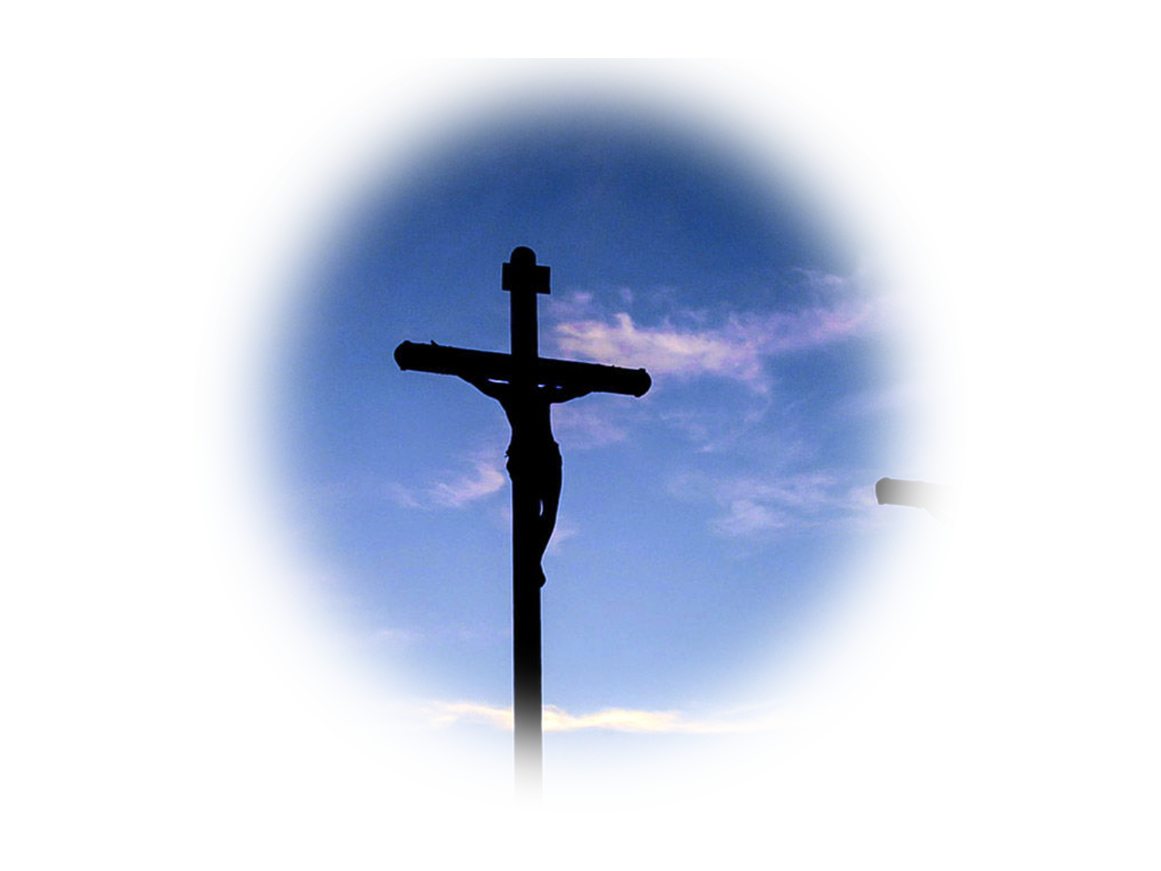
Four
Wonderful
Secrets about
Good Friday
Notes:
https://p0.pxfuel.com/preview/158/655/633/jesus-god-bible-thorn.jpg
Copyright © 2006−2021. All rights reserved. Bible Point is a registered trademark of Dennis Henderson. All other trademarks acknowledged.
Bible Point contains graphics from Bible Point artists. These illustrations belong to Bible Point and the respective artists. You may use the designs and illustrations for graphical illustration of lessons free and without special permission, provided they are not used in any way that maligns the Christian faith. Furthermore, republication or production of any illustration by any other graphic service whether it be in book, in a machine-readable form, or in any other design resource is strictly prohibited. Furthermore, they cannot be duplicated or resold as any other form of publishing, clip art, or graphic resource.
So What does it mean? (A simple translations of the legal jargon)
So, if you don’t own the presentation(s), graphic(s), and text(s) how can you legally use them? The purchase of the license allows you to use all the images in the product. However, the actual ownership and copyright of the presentation(s), graphic(s), and text(s) remain the property of Bible Point and its licensors. If you had plans on using this product in your “for sale” work—think again!
License Agreement
Article 1: License Grant
All the graphics and text in Bible Point presentations (excluding quotes from the Bible and stated sources) are the intellectual and real property of Bible Point and its licensors, and is protected by law, including United States copyright laws and international treaties. Bible Point grants to you a license:
1. To use the presentation in a single church, single school, or single office of a Christian organization.
2. To make a single archival back-up copy of the program.
3. To modify the presentation(s) and merge with other presentations in a single church, school, or Christian organization.
4. To transfer to another party if that party agrees to accept the terms and conditions of this agreement, and you do not retain any copies of the presentation, whether printed, machine readable, modified, or merged form.
Article 2: Terms
This license is effective until terminated. You may terminate the license at any time by destroying the presentation(s), graphic(s), or text(s) together with all copies, modifications and merged portions in any form. Bible Point may terminate your license if you fail to comply with this Agreement. You agree, upon such termination, for any reason, to destroy the presentation(s), graphics, and text(s) with all copies, modifications, and merged portions in any form.
Article 3: Disclaimers
1. Bible Point presentations, graphics, and texts are licensed to you As Is. You, the consumer, bear the entire risk relating to the quality and performance of the presentation(s), graphic(s), or text(s). In no event will Bible Point be liable for damages resulting from any defect.
2. Thirty-day limited warrantee on disks. Bible Point warrants the disks to be free of defects in material and workmanship under normal use for 30 days after purchase. During the 30-day period you may return a defective presentation, graphic, or text with proof of purchase and it will be replaced without charge, unless the presentation is damaged by misuse.
Article 4: General
1. You may not sub-license, assign, or transfer the license of the presentation(s), graphic(s), or text(s) except as provided by this Agreement.
2. This Agreement will be governed by the laws of the State of Michigan.
So What does it mean? (A simple translations of the legal jargon)
May I let someone borrow or copy my licensed Bible Point presentation (even after I modified it)? As long as it is within your local church, or single school, or the immediate office of a Christian organization you may. Otherwise, please refer the person interested in borrowing to: http://www.biblepoint.com or E-mail: dennis@DrDH.net with any related questions.

Slide 2
Four
Wonderful
Secrets about
Good Friday
Notes:
https://p0.pxfuel.com/preview/158/655/633/jesus-god-bible-thorn.jpg
Copyright © 2006−2021. All rights reserved. Bible Point is a registered trademark of Dennis Henderson. All other trademarks acknowledged.
Bible Point contains graphics from Bible Point artists. These illustrations belong to Bible Point and the respective artists. You may use the designs and illustrations for graphical illustration of lessons free and without special permission, provided they are not used in any way that maligns the Christian faith. Furthermore, republication or production of any illustration by any other graphic service whether it be in book, in a machine-readable form, or in any other design resource is strictly prohibited. Furthermore, they cannot be duplicated or resold as any other form of publishing, clip art, or graphic resource.
So What does it mean? (A simple translations of the legal jargon)
So, if you don’t own the presentation(s), graphic(s), and text(s) how can you legally use them? The purchase of the license allows you to use all the images in the product. However, the actual ownership and copyright of the presentation(s), graphic(s), and text(s) remain the property of Bible Point and its licensors. If you had plans on using this product in your “for sale” work—think again!
License Agreement
Article 1: License Grant
All the graphics and text in Bible Point presentations (excluding quotes from the Bible and stated sources) are the intellectual and real property of Bible Point and its licensors, and is protected by law, including United States copyright laws and international treaties. Bible Point grants to you a license:
1. To use the presentation in a single church, single school, or single office of a Christian organization.
2. To make a single archival back-up copy of the program.
3. To modify the presentation(s) and merge with other presentations in a single church, school, or Christian organization.
4. To transfer to another party if that party agrees to accept the terms and conditions of this agreement, and you do not retain any copies of the presentation, whether printed, machine readable, modified, or merged form.
Article 2: Terms
This license is effective until terminated. You may terminate the license at any time by destroying the presentation(s), graphic(s), or text(s) together with all copies, modifications and merged portions in any form. Bible Point may terminate your license if you fail to comply with this Agreement. You agree, upon such termination, for any reason, to destroy the presentation(s), graphics, and text(s) with all copies, modifications, and merged portions in any form.
Article 3: Disclaimers
1. Bible Point presentations, graphics, and texts are licensed to you As Is. You, the consumer, bear the entire risk relating to the quality and performance of the presentation(s), graphic(s), or text(s). In no event will Bible Point be liable for damages resulting from any defect.
2. Thirty-day limited warrantee on disks. Bible Point warrants the disks to be free of defects in material and workmanship under normal use for 30 days after purchase. During the 30-day period you may return a defective presentation, graphic, or text with proof of purchase and it will be replaced without charge, unless the presentation is damaged by misuse.
Article 4: General
1. You may not sub-license, assign, or transfer the license of the presentation(s), graphic(s), or text(s) except as provided by this Agreement.
2. This Agreement will be governed by the laws of the State of Michigan.
So What does it mean? (A simple translations of the legal jargon)
May I let someone borrow or copy my licensed Bible Point presentation (even after I modified it)? As long as it is within your local church, or single school, or the immediate office of a Christian organization you may. Otherwise, please refer the person interested in borrowing to: http://www.biblepoint.com or E-mail: dennis@DrDH.net with any related questions.

Slide 3
1. Good Friday Shows the Wisdom of God
⁷ But we impart a secret
and hidden wisdom of God, which God decreed before
the ages for our glory. ⁸
None of the rulers of this
age understood this, for
if they had, they would not
have crucified the Lord of glory.
WISDOM
Notes:
https://pixabay.com/photos/bible-christian-jesus-religion-2989425/
Good Friday did not take God the Father or Jesus by surprise … it revealed the Wisdom of God in solving the problem of how a Holy, Just, and Righteous God Who abhors sin and must punish it thoroughly to maintain His moral integrity as God, on the one hand; and on the other hand, can maintain His love for us through grace and mercy on the other hand.
God Friday shows God Wisdom of God in resolving the conflict between Divine Justice (giving sinners what they deserve) and Divine Mercy (withholding from sinners what they deserve), He did that through the incarnation, becoming man and becoming our substitute. He took our place to receive the due justice of sin; thereby offering mercy to withhold wrath from us and give us grace , the gift of forgiveness of sins because the debt was justly paid. Now how wise is that!

Slide 4

1. Good Friday Shows the Wisdom of God
Secret/Hidden
Wisdom
⁷ But we impart a secret
and hidden wisdom of God, which God decreed before
the ages for our glory. ⁸
None of the rulers of this
age understood this, for
if they had, they would not
have crucified the Lord of glory.
Notes:
https://pixabay.com/photos/secret-lips-woman-female-girl-2725302/
This plan was a secret that was hidden for ages past.

Slide 5

1. Good Friday Shows the Wisdom of God
Revealed
Wisdom
⁷ But we impart a secret
and hidden wisdom of God, which God decreed before
the ages for our glory. ⁸
None of the rulers of this
age understood this, for
if they had, they would not
have crucified the Lord of glory.
Notes:
But now is imparted to us through the Christ of Scriptures. We’ve been let in on a great secret.

Slide 6
2. Good Friday was in the
Eternal Plan of God
⁷ But we impart a secret
and hidden wisdom of God, which God decreed before
the ages for our glory. ⁸
None of the rulers of this
age understood this, for
if they had, they would not
have crucified the Lord of glory.
PLAN

Slide 7

2. Good Friday was in the
Eternal Plan of God
Decreed
Plan
⁷ But we impart a secret
and hidden wisdom of God, which God decreed before
the ages for our glory. ⁸
None of the rulers of this
age understood this, for
if they had, they would not
have crucified the Lord of glory.
Notes:
Before the world began, before time, God had a plan that He decreed to come to pass. It’s like a divine blueprint of the ages and in that plan was the work of Jesus redeeming a fallen people for Himself.
Peter declares before the Jews that … Jesus “was handed over by the predetermined plan and foreknowledge of God, you executed by nailing him to a cross at the hands of Gentiles. (Act 2:23 NET)
It was in the eternal plan of God.

Slide 8

2. Good Friday was in the
Eternal Plan of God
Glorious
Plan
⁷ But we impart a secret
and hidden wisdom of God, which God decreed before
the ages for our glory. ⁸
None of the rulers of this
age understood this, for
if they had, they would not
have crucified the Lord of glory.
Notes:
https://pixnio.com/free-images/2019/06/08/2019-06-08-09-54-01-1200x800.jpg
In time it became reality “for our glory.” The plan was executed, put into play. Jesus died according to the plan and the Holy Spirit convicted you of your unrighteousness and the need for His righteousness. His Spirit regenerated you with new birth and you believed all according to His eternal plan. So you might be gloried in a resurrection body!

Slide 9
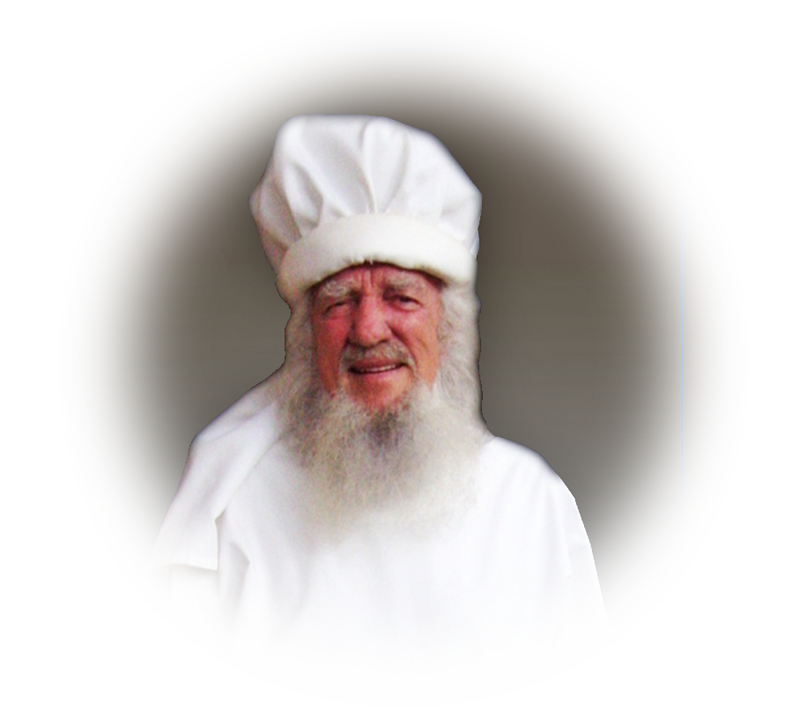
3. It was Misunderstood by the world
Annas
⁷ But we impart a secret
and hidden wisdom of God, which God decreed before
the ages for our glory. ⁸
None of the rulers of this
age understood this, for
if they had, they would not
have crucified the Lord of glory.
MISSED
Notes:
None of the rulers understood ….
Annas, former High Priest, and Father-in-law to the then current High Priest did not understand. He would not have turned Jesus over to Caiaphas.
Caiaphas, the current High Priest, did not understand. Had he, then he would not have turned Jesus over to the Romans …
Herod understood Who Jesus was, he would not have …
Pilate understood Who Jesus was, he would not have …
If people today, really understood who Jesus is, they would not reject him. But, each in the sinfulness of their stubborn hearts refuse to acknowledge that Jesus is the Christ, the Son of God …

Slide 10
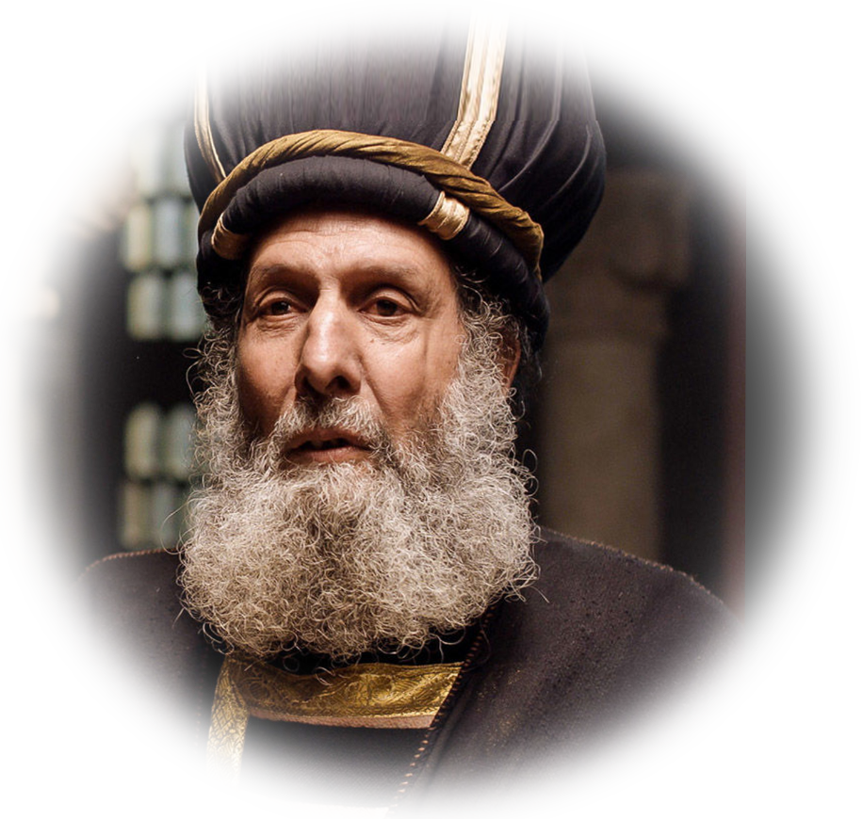
3. It was Misunderstood by the world
Caiaphas
⁷ But we impart a secret
and hidden wisdom of God, which God decreed before
the ages for our glory. ⁸
None of the rulers of this
age understood this, for
if they had, they would not
have crucified the Lord of glory.
Notes:
None of the rulers understood ….
Annas, former High Priest, and Father-in-law to the then current High Priest did not understand. He would not have turned Jesus over to Caiaphas.
Caiaphas, the current High Priest, did not understand. Had he, then he would not have turned Jesus over to the Romans …
Herod understood Who Jesus was, he would not have …
Pilate understood Who Jesus was, he would not have …
If people today, really understood who Jesus is, they would not reject him. But, each in the sinfulness of their stubborn hearts refuse to acknowledge that Jesus is the Christ, the Son of God …

Slide 11
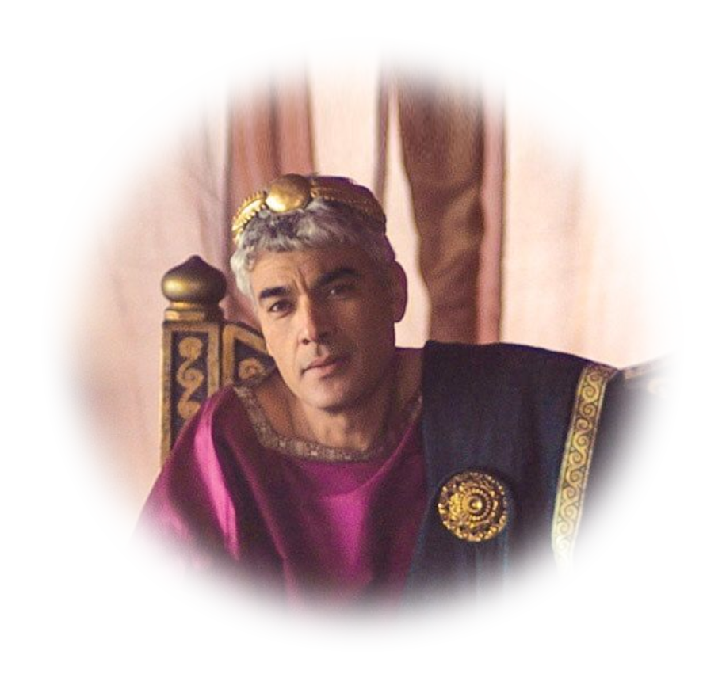
3. It was Misunderstood by the world
Herod
Antipas
⁷ But we impart a secret
and hidden wisdom of God, which God decreed before
the ages for our glory. ⁸
None of the rulers of this
age understood this, for
if they had, they would not
have crucified the Lord of glory.
Notes:
None of the rulers understood ….
Annas, former High Priest, and Father-in-law to the then current High Priest did not understand. He would not have turned Jesus over to Caiaphas.
Caiaphas, the current High Priest, did not understand. Had he, then he would not have turned Jesus over to the Romans …
Herod understood Who Jesus was, he would not have …
Pilate understood Who Jesus was, he would not have …
If people today, really understood who Jesus is, they would not reject him. But, each in the sinfulness of their stubborn hearts refuse to acknowledge that Jesus is the Christ, the Son of God …

Slide 12
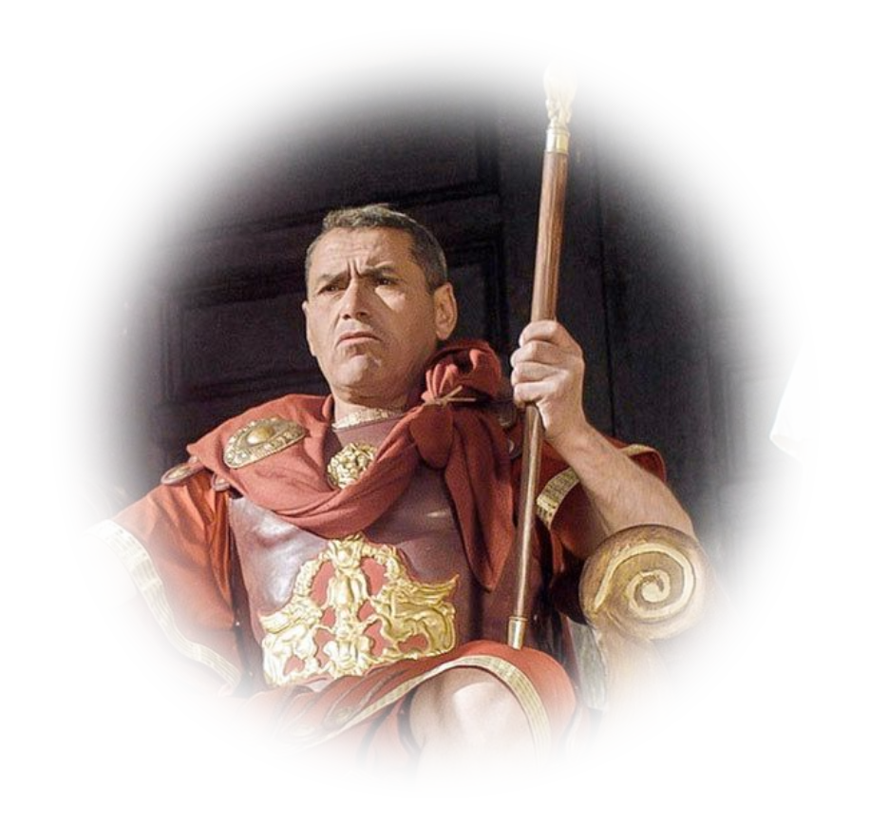
3. It was Misunderstood by the world
Pilate
⁷ But we impart a secret
and hidden wisdom of God, which God decreed before
the ages for our glory. ⁸
None of the rulers of this
age understood this, for
if they had, they would not
have crucified the Lord of glory.
Notes:
None of the rulers understood ….
Annas, former High Priest, and Father-in-law to the then current High Priest did not understand. He would not have turned Jesus over to Caiaphas.
Caiaphas, the current High Priest, did not understand. Had he, then he would not have turned Jesus over to the Romans …
Herod understood Who Jesus was, he would not have …
Pilate understood Who Jesus was, he would not have …
If people today, really understood who Jesus is, they would not reject him. But, each in the sinfulness of their stubborn hearts refuse to acknowledge that Jesus is the Christ, the Son of God …

Slide 13
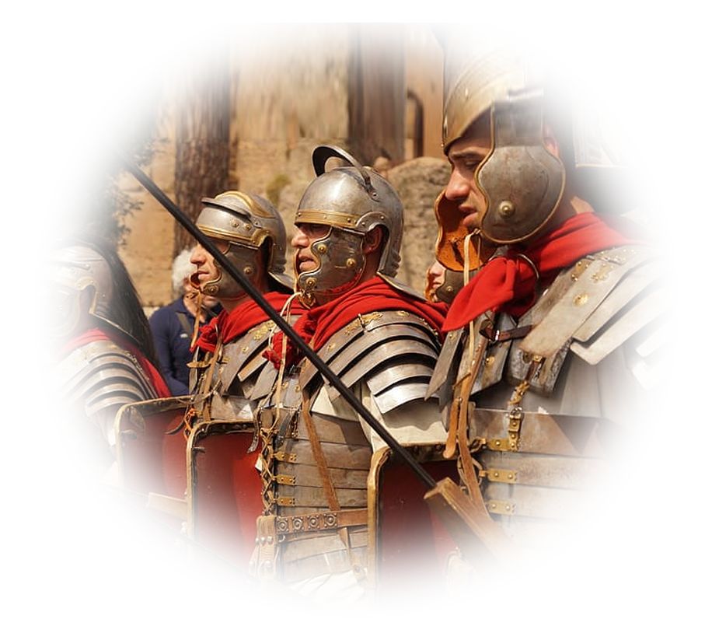
3. It was Misunderstood by the world
Death
Squad
⁷ But we impart a secret
and hidden wisdom of God, which God decreed before
the ages for our glory. ⁸
None of the rulers of this
age understood this, for
if they had, they would not
have crucified the Lord of glory.
Notes:
https://www.pxfuel.com/en/free-photo-jzltk
None of the rulers understood ….
Annas, former High Priest, and Father-in-law to the then current High Priest did not understand. He would not have turned Jesus over to Caiaphas.
Caiaphas, the current High Priest, did not understand. Had he, then he would not have turned Jesus over to the Romans …
Herod understood Who Jesus was, he would not have …
Pilate understood Who Jesus was, he would not have …
If people today, really understood who Jesus is, they would not reject him. But, each in the sinfulness of their stubborn hearts refuse to acknowledge that Jesus is the Christ, the Son of God …

Slide 14
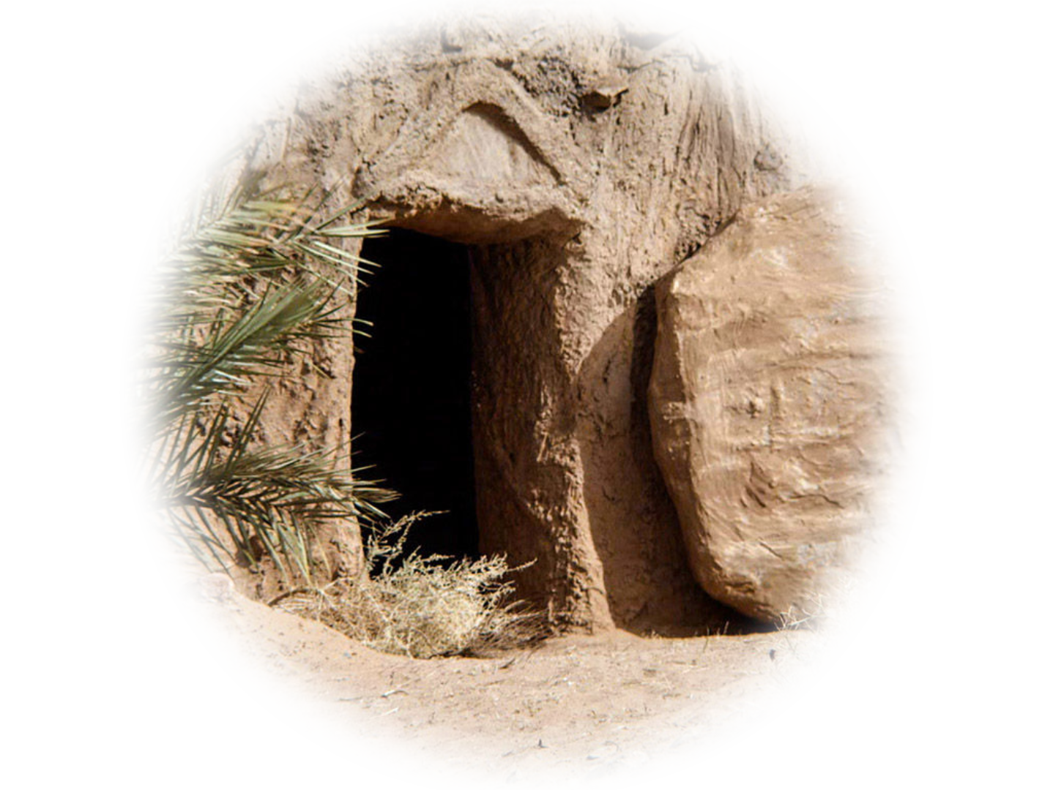
3. It was Misunderstood by the world
IF
THEY
HAD
⁷ But we impart a secret
and hidden wisdom of God, which God decreed before
the ages for our glory. ⁸
None of the rulers of this
age understood this, for
if they had, they would not
have crucified the Lord of glory.
Notes:
While the wisdom of God was a secret being revealed, the death and resurrection of the Messiah was not. Isaiah 53 foretold of it.
They refused to understand it.
You see “if they had … “ things would have been different for them …

Slide 15
3. It was Misunderstood by the world
⁷ But we impart a secret
and hidden wisdom of God, which God decreed before
the ages for our glory. ⁸
None of the rulers of this
age understood this, for
if they had, they would not
have crucified the Lord of glory.
Notes:
“They would not have been guilty of crucifying the ‘Lord of glory’”
“If I had … but I did not” are among the most regrettable words spoken …
People will stan before the judgment bench of God, “If I had just understood …”
But I sent you my Son …

Slide 16

4. Good Friday was Meant for Us
⁹ But, as it is written,
"What no eye has seen,
nor ear heard, nor the
heart of man imagined,
what God has prepared
for those who love him"--
LOVE

Slide 17
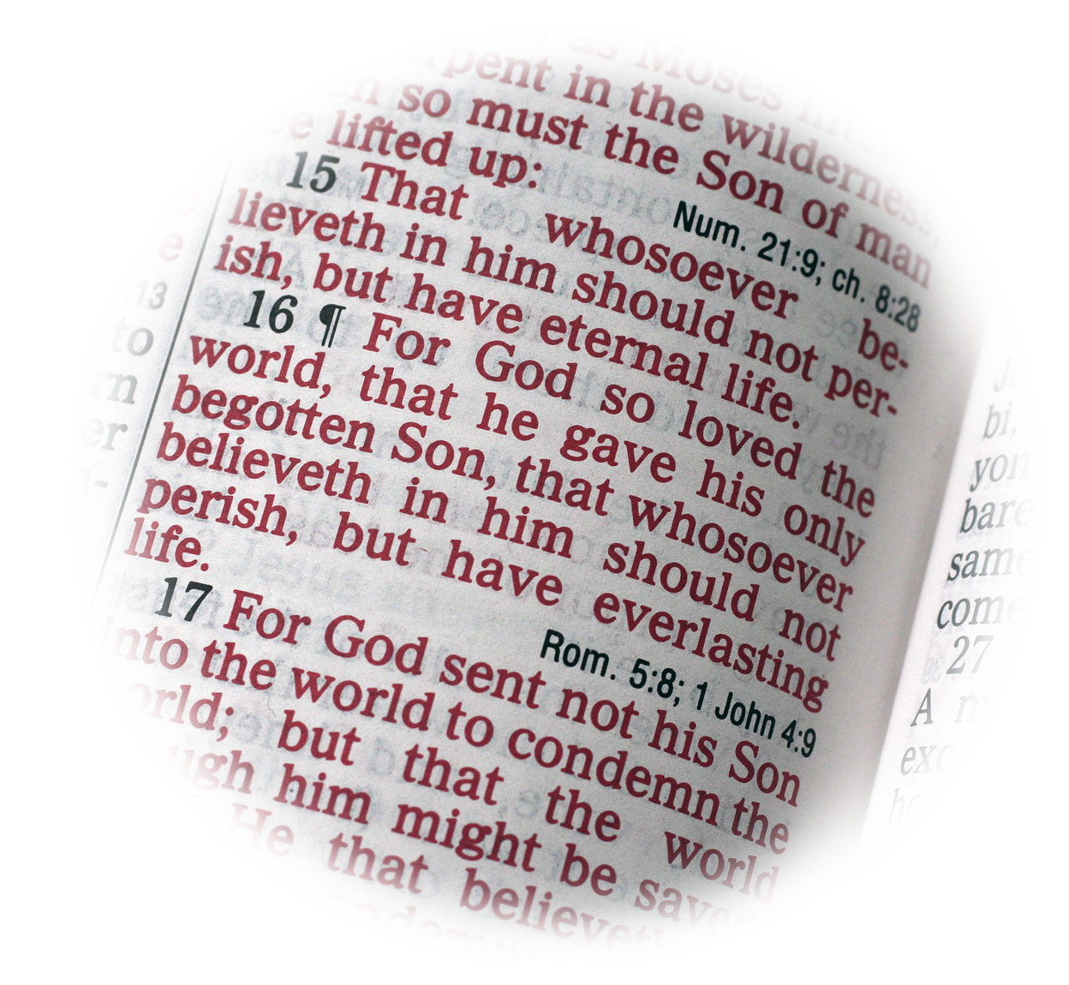
4. Good Friday was Meant for Us
⁹ But, as it is written,
"What no eye has seen,
nor ear heard, nor the
heart of man imagined,
what God has prepared
for those who love him"--
LOVE
Notes:
https://pixabay.com/photos/john-3-16-bible-christian-reading-3700534/

Slide 18

4. Good Friday was Meant for Us
Unimaginable
⁹ But, as it is written,
"What no eye has seen,
nor ear heard, nor the
heart of man imagined,
what God has prepared
for those who love him"--
Notes:
https://pixabay.com/photos/background-bokeh-light-circle-2709638/

Slide 19

4. Good Friday was Meant for Us
Prepared
⁹ But, as it is written,
"What no eye has seen,
nor ear heard, nor the
heart of man imagined,
what God has prepared
for those who love him"--
Notes:
entrance

Slide 20
4. Good Friday was Meant for Us
⁹ But, as it is written,
"What no eye has seen,
nor ear heard, nor the
heart of man imagined,
what God has prepared
for those who love him"--
LOVE
Notes:
https://pixabay.com/illustrations/love-you-red-valentine-love-design-2198772/

Slide 21
4. Good Friday was Meant for Us
⁹ But, as it is written,
"What no eye has seen,
nor ear heard, nor the
heart of man imagined,
what God has prepared
for those who love him"--
So love him with all your heart …
Notes:
https://pixabay.com/illustrations/love-you-red-valentine-love-design-2198772/

Slide 22
Four Secrets about Good Friday…

Slide 23
Four Secrets about Good Friday…
WISDOM
1-It shows God’s Wisdom

Slide 24
Four Secrets about Good Friday…
PLAN
1-It shows God’s Wisdom
2-It was in His Eternal Plan

Slide 25
Four Secrets about Good Friday…
MISSED
1-It shows God’s Wisdom
2-It was in His Eternal Plan
3-It was Misunderstood

Slide 26
Four Secrets about Good Friday…
US!
1-It shows God’s Wisdom
2-It was in His Eternal Plan
3-It was Misunderstood
4-It was meant for US

Slide 27
Let’s Pray!

Slide 28
Four
Wonderful
Secrets
about
Good Friday
March 10 at 7 PM

