Slide 1

When Life
Seems
Unfair
Notes:
Copyright © 2006−2021. All rights reserved. Bible Point is a registered trademark of Dennis Henderson. All other trademarks acknowledged.
Bible Point contains graphics from Bible Point artists. These illustrations belong to Bible Point and the respective artists. You may use the designs and illustrations for graphical illustration of lessons free and without special permission, provided they are not used in any way that maligns the Christian faith. Furthermore, republication or production of any illustration by any other graphic service whether it be in book, in a machine-readable form, or in any other design resource is strictly prohibited. Furthermore, they cannot be duplicated or resold as any other form of publishing, clip art, or graphic resource.
So What does it mean? (A simple translations of the legal jargon)
So, if you don’t own the presentation(s), graphic(s), and text(s) how can you legally use them? The purchase of the license allows you to use all the images in the product. However, the actual ownership and copyright of the presentation(s), graphic(s), and text(s) remain the property of Bible Point and its licensors. If you had plans on using this product in your “for sale” work—think again!
License Agreement
Article 1: License Grant
All the graphics and text in Bible Point presentations (excluding quotes from the Bible and stated sources) are the intellectual and real property of Bible Point and its licensors, and is protected by law, including United States copyright laws and international treaties. Bible Point grants to you a license:
1. To use the presentation in a single church, single school, or single office of a Christian organization.
2. To make a single archival back-up copy of the program.
3. To modify the presentation(s) and merge with other presentations in a single church, school, or Christian organization.
4. To transfer to another party if that party agrees to accept the terms and conditions of this agreement, and you do not retain any copies of the presentation, whether printed, machine readable, modified, or merged form.
Article 2: Terms
This license is effective until terminated. You may terminate the license at any time by destroying the presentation(s), graphic(s), or text(s) together with all copies, modifications and merged portions in any form. Bible Point may terminate your license if you fail to comply with this Agreement. You agree, upon such termination, for any reason, to destroy the presentation(s), graphics, and text(s) with all copies, modifications, and merged portions in any form.
Article 3: Disclaimers
1. Bible Point presentations, graphics, and texts are licensed to you As Is. You, the consumer, bear the entire risk relating to the quality and performance of the presentation(s), graphic(s), or text(s). In no event will Bible Point be liable for damages resulting from any defect.
2. Thirty-day limited warrantee on disks. Bible Point warrants the disks to be free of defects in material and workmanship under normal use for 30 days after purchase. During the 30-day period you may return a defective presentation, graphic, or text with proof of purchase and it will be replaced without charge, unless the presentation is damaged by misuse.
Article 4: General
1. You may not sub-license, assign, or transfer the license of the presentation(s), graphic(s), or text(s) except as provided by this Agreement.
2. This Agreement will be governed by the laws of the State of Michigan.
So What does it mean? (A simple translations of the legal jargon)
May I let someone borrow or copy my licensed Bible Point presentation (even after I modified it)? As long as it is within your local church, or single school, or the immediate office of a Christian organization you may. Otherwise, please refer the person interested in borrowing to: http://www.biblepoint.com or E-mail: dennis@DrDH.net with any related questions.

Slide 2
When Life
Seems
Unfair
Notes:
Background is a combination of FREE https://static.pexels.com/photos/87246/pexels-photo-87246.jpeg and BiblePoint balance drawing.
When it seems as if the scales of justice is tipped against you ...
When work is going wrong,
Relationships are going sour,
Health is bad,
Whatever live just seems unfair ...
Copyright © 2006−2021. All rights reserved. Bible Point is a registered trademark of Dennis Henderson. All other trademarks acknowledged.
Bible Point contains graphics from Bible Point artists. These illustrations belong to Bible Point and the respective artists. You may use the designs and illustrations for graphical illustration of lessons free and without special permission, provided they are not used in any way that maligns the Christian faith. Furthermore, republication or production of any illustration by any other graphic service whether it be in book, in a machine-readable form, or in any other design resource is strictly prohibited. Furthermore, they cannot be duplicated or resold as any other form of publishing, clip art, or graphic resource.
So What does it mean? (A simple translations of the legal jargon)
So, if you don’t own the presentation(s), graphic(s), and text(s) how can you legally use them? The purchase of the license allows you to use all the images in the product. However, the actual ownership and copyright of the presentation(s), graphic(s), and text(s) remain the property of Bible Point and its licensors. If you had plans on using this product in your “for sale” work—think again!
License Agreement
Article 1: License Grant
All the graphics and text in Bible Point presentations (excluding quotes from the Bible and stated sources) are the intellectual and real property of Bible Point and its licensors, and is protected by law, including United States copyright laws and international treaties. Bible Point grants to you a license:
1. To use the presentation in a single church, single school, or single office of a Christian organization.
2. To make a single archival back-up copy of the program.
3. To modify the presentation(s) and merge with other presentations in a single church, school, or Christian organization.
4. To transfer to another party if that party agrees to accept the terms and conditions of this agreement, and you do not retain any copies of the presentation, whether printed, machine readable, modified, or merged form.
Article 2: Terms
This license is effective until terminated. You may terminate the license at any time by destroying the presentation(s), graphic(s), or text(s) together with all copies, modifications and merged portions in any form. Bible Point may terminate your license if you fail to comply with this Agreement. You agree, upon such termination, for any reason, to destroy the presentation(s), graphics, and text(s) with all copies, modifications, and merged portions in any form.
Article 3: Disclaimers
1. Bible Point presentations, graphics, and texts are licensed to you As Is. You, the consumer, bear the entire risk relating to the quality and performance of the presentation(s), graphic(s), or text(s). In no event will Bible Point be liable for damages resulting from any defect.
2. Thirty-day limited warrantee on disks. Bible Point warrants the disks to be free of defects in material and workmanship under normal use for 30 days after purchase. During the 30-day period you may return a defective presentation, graphic, or text with proof of purchase and it will be replaced without charge, unless the presentation is damaged by misuse.
Article 4: General
1. You may not sub-license, assign, or transfer the license of the presentation(s), graphic(s), or text(s) except as provided by this Agreement.
2. This Agreement will be governed by the laws of the State of Michigan.
So What does it mean? (A simple translations of the legal jargon)
May I let someone borrow or copy my licensed Bible Point presentation (even after I modified it)? As long as it is within your local church, or single school, or the immediate office of a Christian organization you may. Otherwise, please refer the person interested in borrowing to: http://www.biblepoint.com or E-mail: dennis@DrDH.net with any related questions.

Slide 3
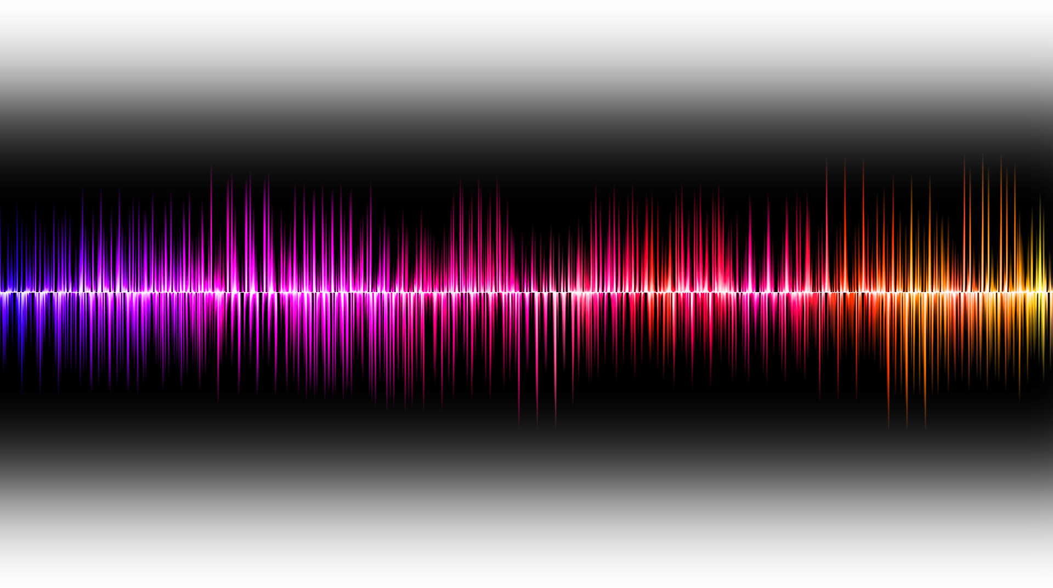
Get the NOISE OUT!
Notes:
Sound wave = FREE = https://pixabay.com/en/sound-wave-voice-listen-856771/

Slide 4
Get the NOISE OUT!
SHUT UP!

Slide 5
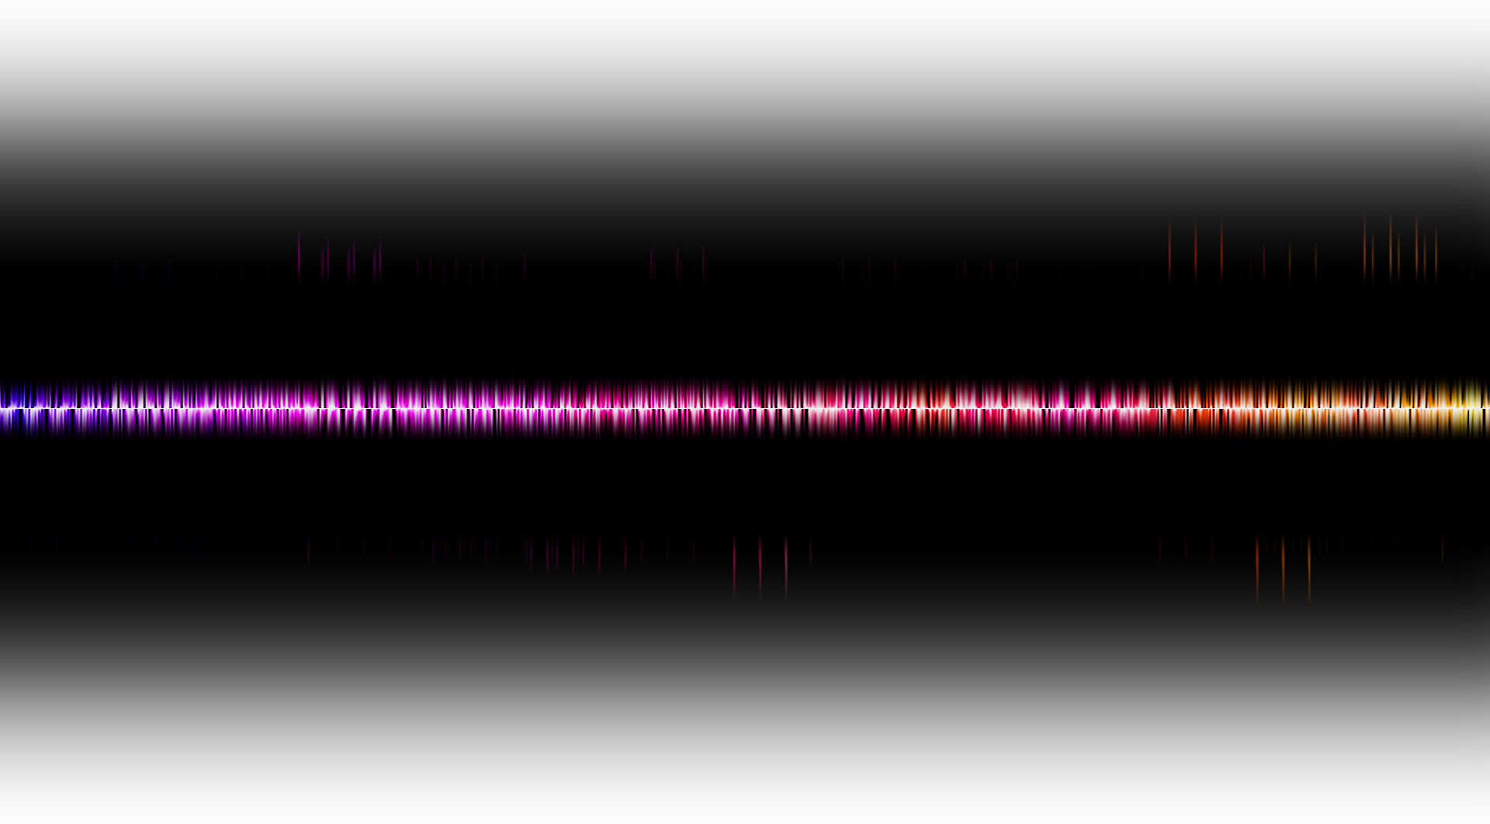
Get the NOISE OUT!
SHUT UP!

Slide 6
Get the NOISE OUT!
SHUT UP!
“Let all the earth be silent before Him!”

Slide 7
Get the NOISE OUT!
“HUSH! before Him all the earth!”
SHUT UP!
“Let all the earth be silent before Him!”

Slide 8
l. Stop the NOISE!

Slide 9
What NOISE?

Slide 10
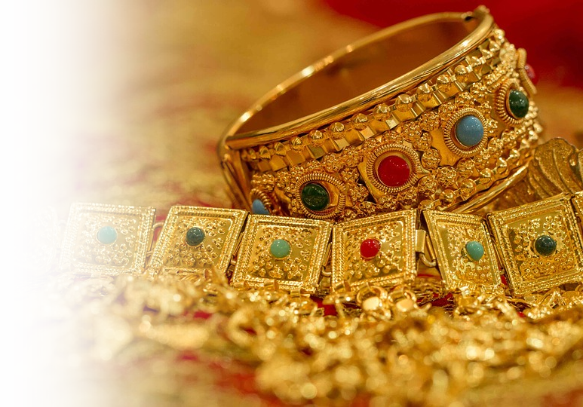
What NOISE?
GREED!
⁶ “ ... Woe to him who piles up stolen goods and makes himself wealthy by extortion!”
Notes:
His greed vs. our greed
When is enough enough? What are we piling up? Never satisfied!
Money in retirement plan? Food in our pantry? Cars? Homes?
Clothes?
Shoes?
Entertainment -- TVs in every room?
It’snot wrong to have stuff—you need stuff to live. But there is a difference in having wht you need and piling up!
What silences this “greed noise?” Answer =opposite = Charity! Being Charitable. Giver not taker

Slide 11
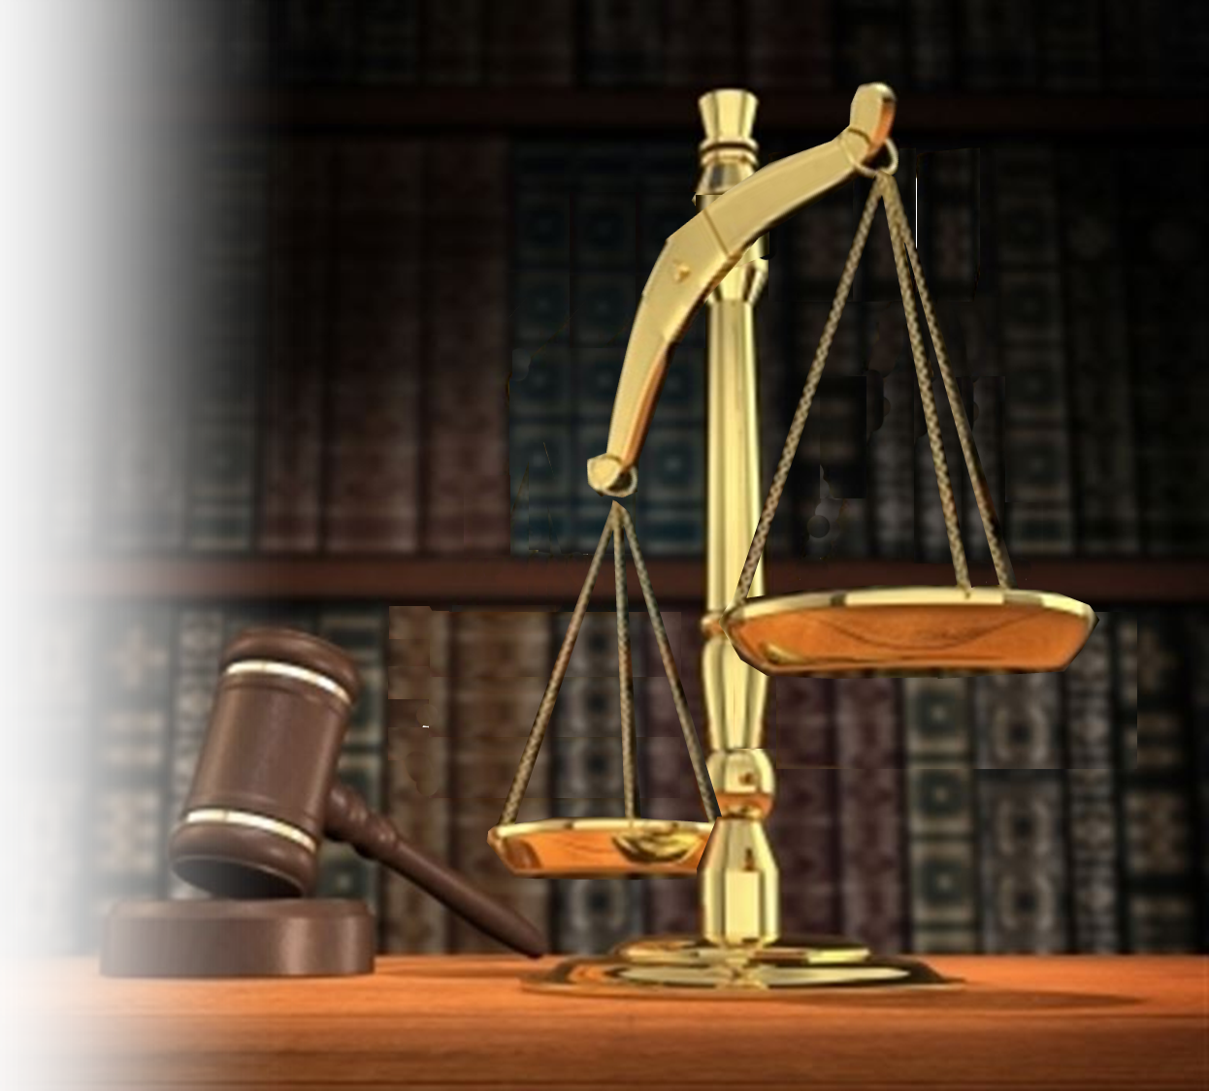

What NOISE?
INJUSTICE!
⁹ "Woe to him who builds his realm by unjust gain to set his nest on high, to escape the clutches of ruin!”
Notes:
His injustices vs. Our injustices
There was great injustice in Habakkuk’s day.
Economic injustice: An in our day too. Amazon paid -2% in taxes last year! Yes you heard that right. Our government took you tax dollars and gave them to the wealthiest corporation ever in human history. That’s not right. That is a travesty of Justice.
Political injustice: Two standards—one for criminal politicians and then for us. Let’s face it—if we had done the corrupt things recent politicians have done—we would be in prison. That’s not right—that’s injustice.
Judges who are activists and do not judge but legislate. That’s not right that’s injustice.
Politicians go to Washington relatively middle class and come out billionaires. That’s not right. That’s injustice.
There are double standards of justice all around us.
Social injustice: There is social injustice. People who take advantage of the poor, or minority as slum lords. Charging exorbitant rents for absolutes dumps.
When you see this daily, on TV, in the news, in the neighborhood.
All this noise eats you up alive. It drowns out the good. You cannot hear anything God is saying because you are so agitated by the noise.
What silences this “injustice noise?” justice = fairness.

Slide 12

What NOISE?
VIOLENCE!
¹² "Woe to him who builds a city with bloodshed and establishes a town by crime!”
Notes:
His Violence vs. Our violence
What silences this “violence noise?”
Watching the nightly local news is just as bad as the national news.
Every day there is a violent act reported locally.

Slide 13
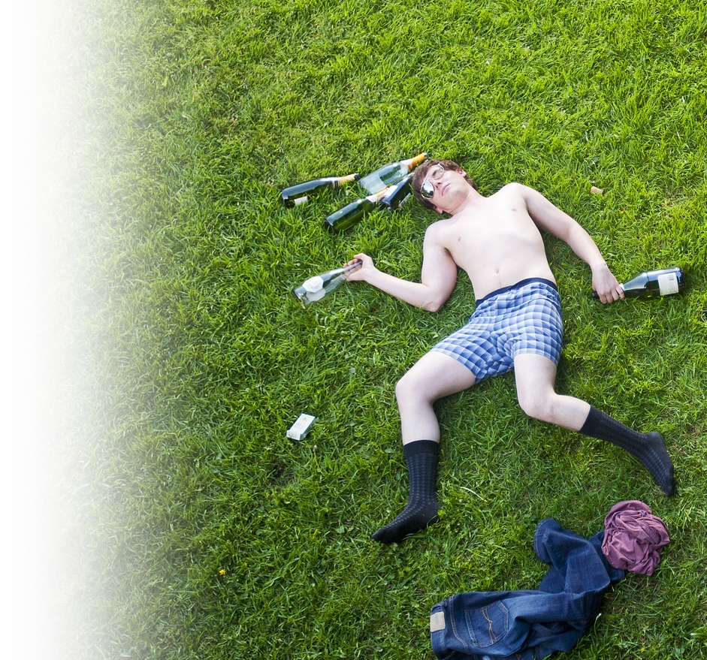
What NOISE?
REVELING!
¹⁵ "Woe to him who gives drink to his neighbors, pouring it from the wineskin till they are drunk, so that he can gaze on their naked bodies.
Notes:
His Reveling vs. Our Reveling
The Babylonian king, Nebuchadnezzar, conqueror the temple and took all the artifacts with him for his treasury.
His son, Belshazzar, to them from the treasury and had a reveling bash with them. He desecrated the temple golden cups, and suddenly a man’s hand and finger appeared writing on the wall across from him. Mene, Mene, Tekel. No one could read it, until they called Daniel.
Mene – God has numbered your days and brought it to an end.
Tekel – You have been weighed on the scales and found wanting.
Parsin – Your kingdom is divided and given to the Medes and Persians.
An it happened that very night.
We have a reveling problem in America – Opioid addiction, drugs, alcohol, sex trafficking, etc.
All this noise—bring one spirit down. The world is out of control.
What silences this “greed noise?” Holiness. Set apart for God. Sanctification. = Being special to God and yourself.

Slide 14

What NOISE?
IDOLATRY!
¹⁹ Woe to him who says to wood, 'Come to life!' Or to lifeless stone, 'Wake up!' Can it give guidance? It is covered with gold and silver; there is no breath in it.
Notes:
The Babylonians worship their war machine and power.
American’s bow at the altar of atheism (nones and dones) , self-centeredness, materialism, entertainment, --so much is put before the worship of the true and living God.
All these are the noise that drowns out the small still voice of God in your heart, soul, conscience.

Slide 15

What NOISE?
Life’s Noise!
Family
Work
School
Sports
Entertainment
Busyness
Notes:
https://commons.wikimedia.org/wiki/File:LIFE_magazine_logo.svg
Life is full of distracting noises that do not let us hear what God is trying to say to us.
Family, work, school, sports, entertainment, and all the busyness of life drown out the small still voice of God the Holy Spirit whispering inoour hearts. “What about me?”

Slide 16
l. Stop the NOISE!

Slide 17
l. Stop the NOISE!
2. Enjoy the SILENCE!
Notes:
Stop! Right now, close your eyes, and for the next minute. Enjoy the silence. I will tell you when the time is up.
Close your eyes. Enjoy silence before the Lord. Go.

Slide 18
l. Stop the NOISE!
HOW?
2. Enjoy the SILENCE!

Slide 19
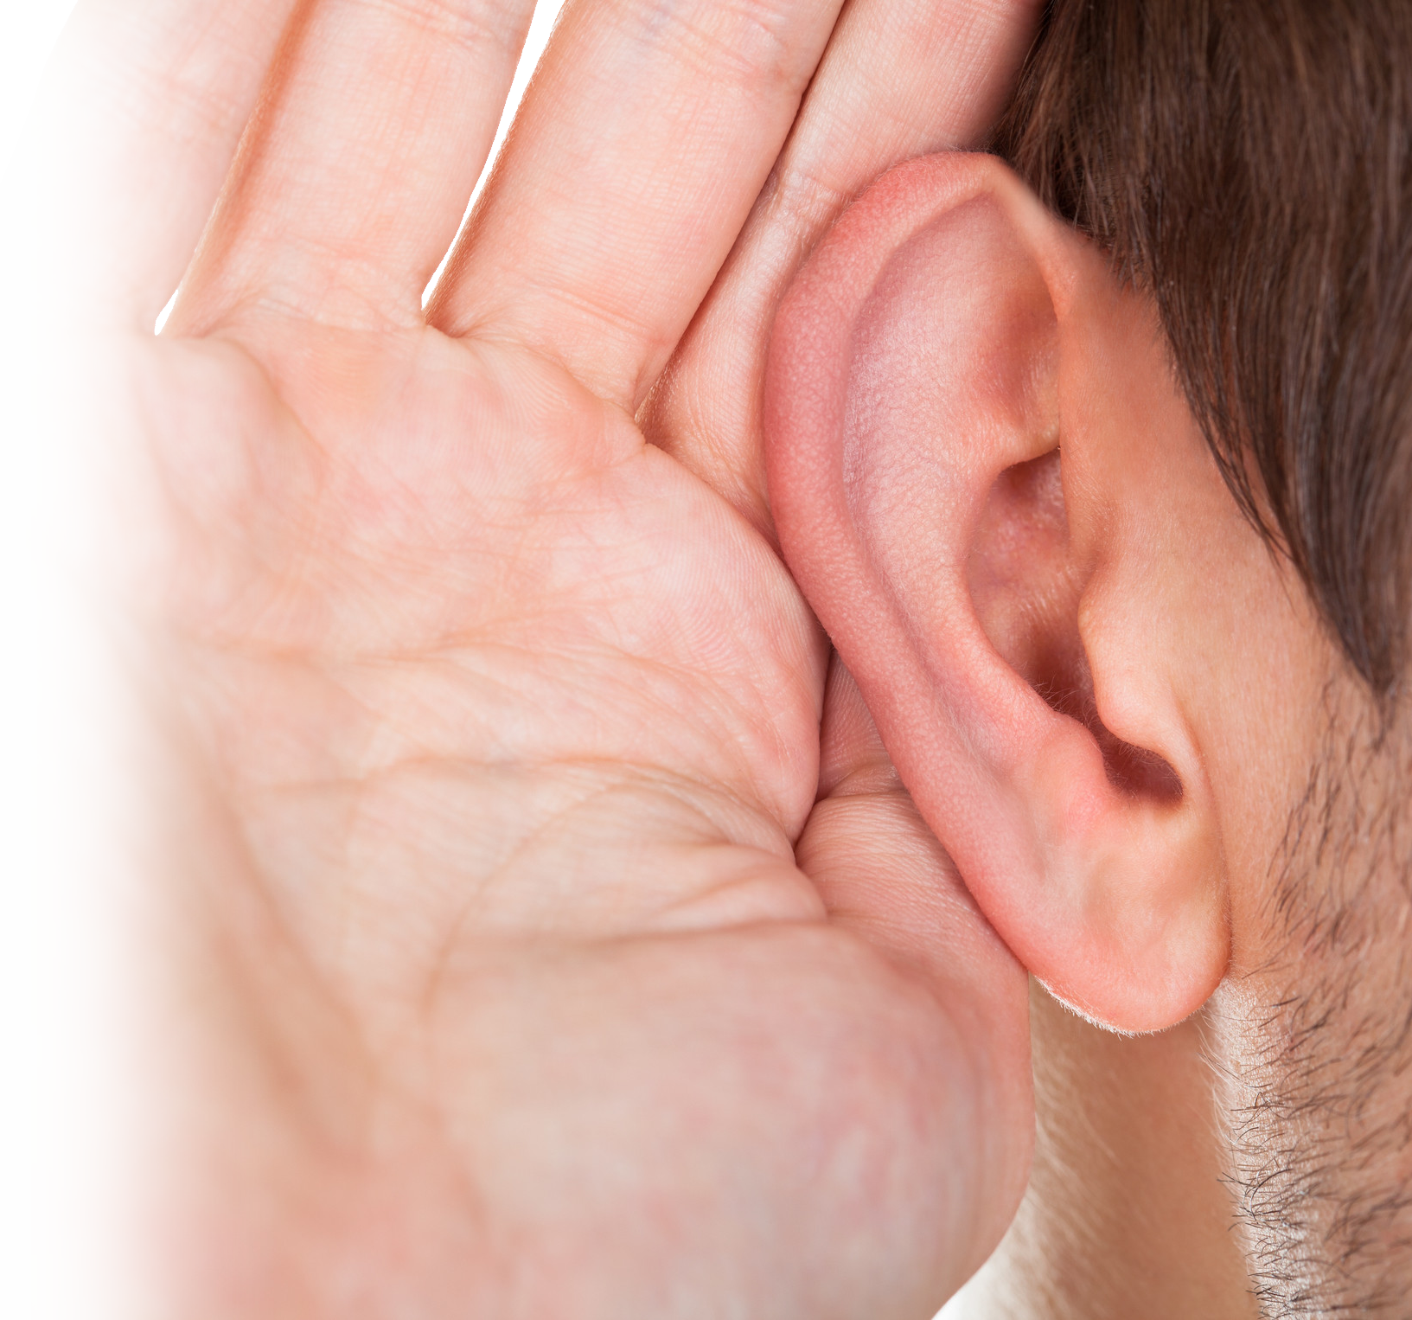
Enjoy ...
LISTENING!
"Be silent, O Israel, and listen! You have now become the people of the LORD your God. (Deu 27:9)
Notes:
Not for reuse - to reuse get a license from https://www.gograph.com/photo/close-up-of-hand-near-ear-gg68179336.html
Did you ever notice that God gave you two ears and only one mouth. Perhaps He want us to listen twice as much as we talk.
Listen to God, in His word, and as you meditate on it, listen to His small still voice in your heart, soul, and mind. He will speak to you, if you will listen. You will only listen, if you get the noise out.

Slide 20

Enjoy ...
SEARCHING!
... search your hearts and be silent. (Psa 4:4)
Notes:
https://pixabay.com/en/magnifying-glass-glass-increase-1324374/
https://pixabay.com/en/heart-love-red-valentine-romantic-157895/
¹³ You will seek me and find me when you seek me with all your heart. (Jer 29:13 NIV)
Search for Him, Search your heart, and then listen—God will speak to you

Slide 21
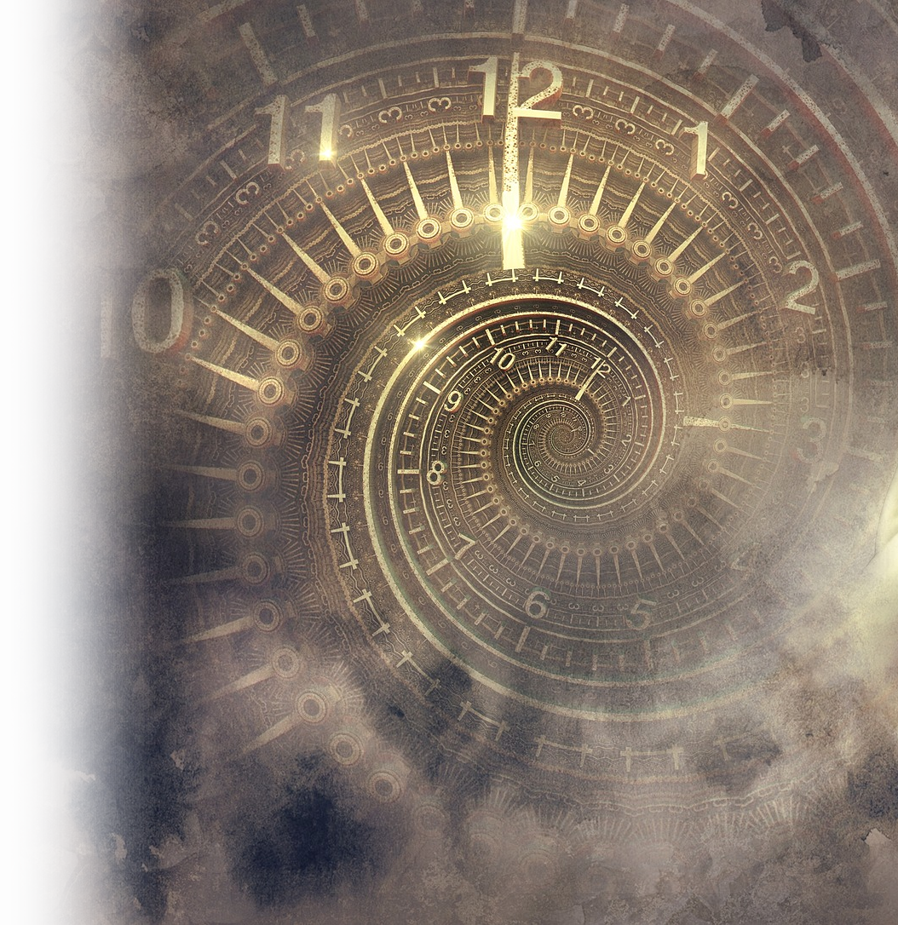
Enjoy ...
LINGERING!
When he opened the seventh seal, there was silence in heaven for about half an hour. (Rev 8:1)
Notes:
CLOCK https://pixabay.com/en/fantasy-clock-statue-light-spiral-2879946/
Can you imagine spending a full half hour in total silence, not sleeping, but silence in the presence of God waiting and anticipating what God will do next?
God is not in the hurry you seem to be in, slow down, get the noise out of your life, spend some quality time in His presence.
Let us therefore come boldly unto the throne of grace, that we may obtain mercy, and find grace to help in time of need. (Heb 4:16 KJV)

Slide 22
l. Stop the NOISE!
WHY?
2. Enjoy the SILENCE!

Slide 23
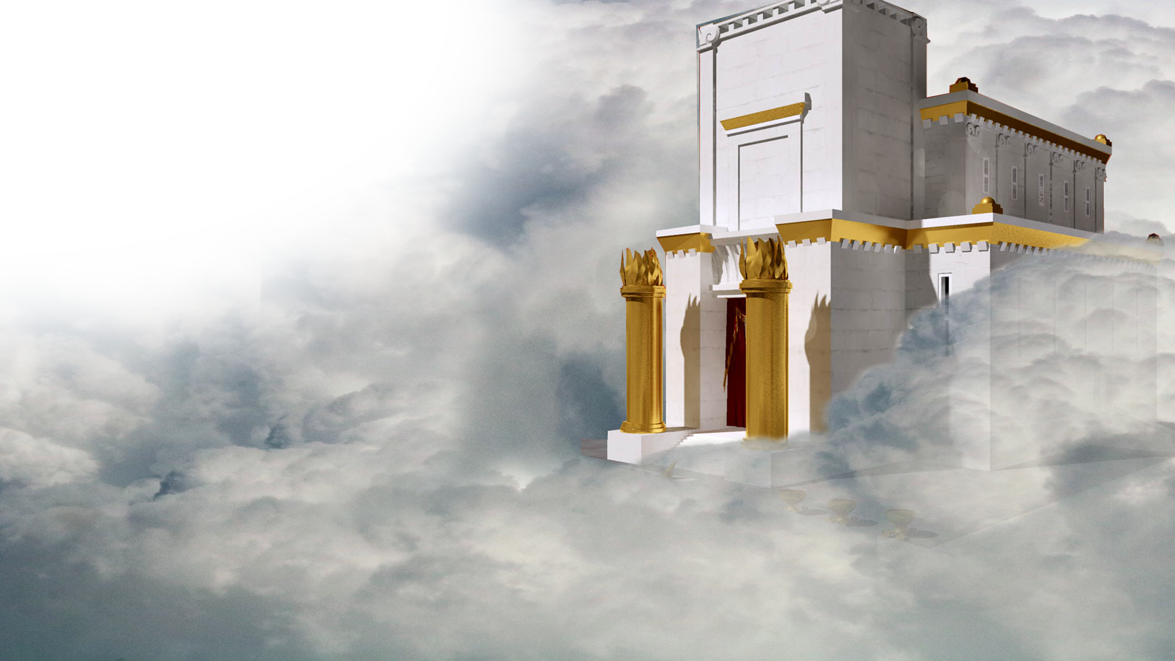
let all the earth be
silent before him."
Notes:
Temple = FREEE = https://upload.wikimedia.org/wikipedia/commons/f/fb/Jerusalem_temple4.jpg
Sky = FREE = https://www.publicdomainpictures.net/pictures/240000/velka/oklahoma-storm-clouds-background.jpg
Because He said so, and ...

Slide 24
BECAUSE ...
^{2O} ... the LORD is in his holy temple...
let all the earth be
silent before him."
Notes:
Temple = FREEE = https://upload.wikimedia.org/wikipedia/commons/f/fb/Jerusalem_temple4.jpg
Sky = FREE = https://www.publicdomainpictures.net/pictures/240000/velka/oklahoma-storm-clouds-background.jpg
The Lord is in his holy temple!
WHAT DOES THAT MEAN?
This is expression only occurs elsewhere in Psalm 11:4, a psalm of David.
At least 500 years before Habakkuk. Before there was a temple. So the temple is not the earthly one. It is the heavenly one where God’s throne is.

Slide 25
BECAUSE ...
“God Rules!”
^{Psalm 11:4} The LORD is in his holy temple;
the LORD is on his heavenly throne.
Notes:
Temple = FREEE = https://upload.wikimedia.org/wikipedia/commons/f/fb/Jerusalem_temple4.jpg
Sky = FREE = https://www.publicdomainpictures.net/pictures/240000/velka/oklahoma-storm-clouds-background.jpg
God Rule’s - This is the throne from which He sovereignly rules. When you sit in silence before the absolute Soveriegn Lord God of the entire universe, all the injustices, unfairness of life flee from your presence. He rules!

Slide 26
BECAUSE ...
“God Sees!”
⁴ He observes the sons of
men; his eyes examine
them. ⁵ The LORD
examines the righteous, but the wicked and those who love violence his soul hates.
Notes:
Temple = FREEE = https://upload.wikimedia.org/wikipedia/commons/f/fb/Jerusalem_temple4.jpg
Sky = FREE = https://www.publicdomainpictures.net/pictures/240000/velka/oklahoma-storm-clouds-background.jpg
He sees you. You matter to Him. He will do what is right. You can count on it.

Slide 27
BECAUSE ...
“God Judges!”
⁶ On the wicked he will
rain fiery coals and
burning sulfur; a scorching wind will be their lot.
⁷ For the LORD is righteous, he loves justice;
upright men will see his face.
Notes:
Temple = FREEE = https://upload.wikimedia.org/wikipedia/commons/f/fb/Jerusalem_temple4.jpg
Sky = FREE = https://www.publicdomainpictures.net/pictures/240000/velka/oklahoma-storm-clouds-background.jpg
Justice will prevail.

Slide 28
Here’s what it saying...

Slide 29
^{2O} ... the LORD is in his holy temple...
Notes:
Temple = FREEE = https://upload.wikimedia.org/wikipedia/commons/f/fb/Jerusalem_temple4.jpg
Sky = FREE = https://www.publicdomainpictures.net/pictures/240000/velka/oklahoma-storm-clouds-background.jpg

Slide 30
^{2O} ... the LORD is in his holy temple...
Hush!
Notes:
Temple = FREEE = https://upload.wikimedia.org/wikipedia/commons/f/fb/Jerusalem_temple4.jpg
Sky = FREE = https://www.publicdomainpictures.net/pictures/240000/velka/oklahoma-storm-clouds-background.jpg

Slide 31
^{2O} ... the LORD is in his holy temple...
Hush!
Get the noise out
of your life!
Notes:
Temple = FREEE = https://upload.wikimedia.org/wikipedia/commons/f/fb/Jerusalem_temple4.jpg
Sky = FREE = https://www.publicdomainpictures.net/pictures/240000/velka/oklahoma-storm-clouds-background.jpg

Slide 32
^{2O} ... the LORD is in his holy temple...
Hush!
Enjoy being in the
presence of God!
Notes:
Temple = FREEE = https://upload.wikimedia.org/wikipedia/commons/f/fb/Jerusalem_temple4.jpg
Sky = FREE = https://www.publicdomainpictures.net/pictures/240000/velka/oklahoma-storm-clouds-background.jpg

Slide 33
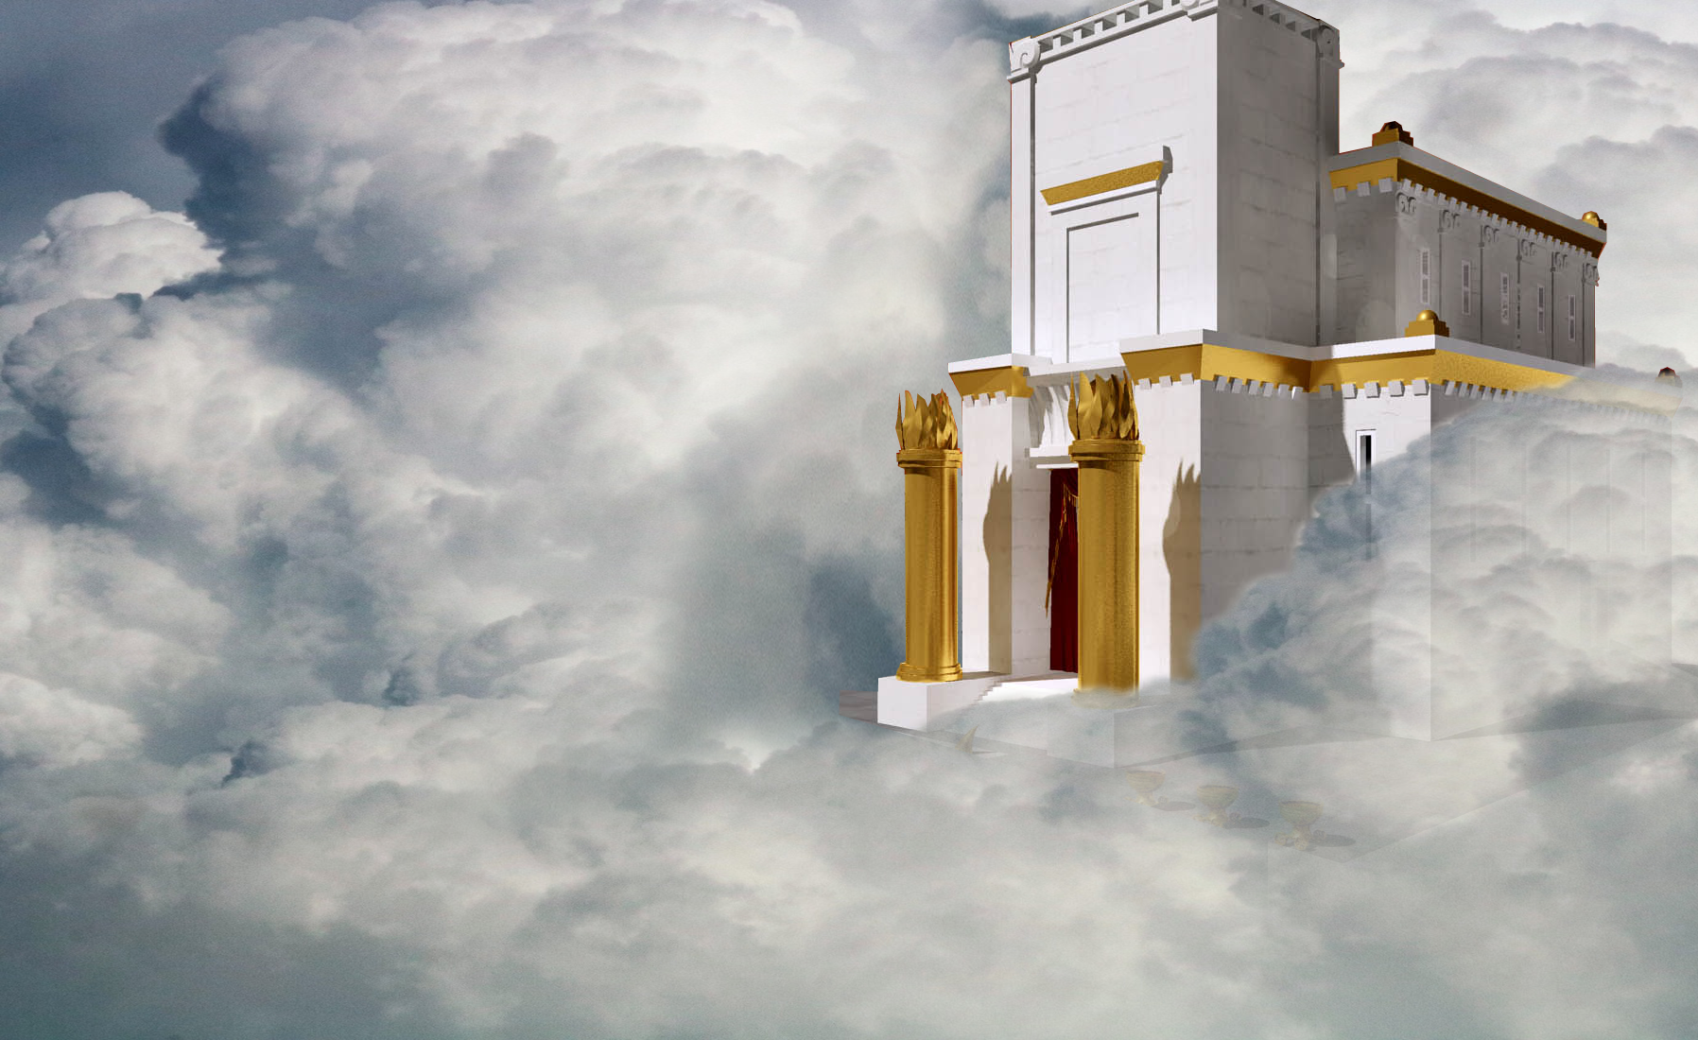
Let’s Pray!
Notes:
Temple = FREEE = https://upload.wikimedia.org/wikipedia/commons/f/fb/Jerusalem_temple4.jpg
Sky = FREE = https://www.publicdomainpictures.net/pictures/240000/velka/oklahoma-storm-clouds-background.jpg
Going to the throne of Grace Heb 4

