Slide 1

When Life
Seems
Unfair
Notes:
Copyright © 2006−2021. All rights reserved. Bible Point is a registered trademark of Dennis Henderson. All other trademarks acknowledged.
Bible Point contains graphics from Bible Point artists. These illustrations belong to Bible Point and the respective artists. You may use the designs and illustrations for graphical illustration of lessons free and without special permission, provided they are not used in any way that maligns the Christian faith. Furthermore, republication or production of any illustration by any other graphic service whether it be in book, in a machine-readable form, or in any other design resource is strictly prohibited. Furthermore, they cannot be duplicated or resold as any other form of publishing, clip art, or graphic resource.
So What does it mean? (A simple translations of the legal jargon)
So, if you don’t own the presentation(s), graphic(s), and text(s) how can you legally use them? The purchase of the license allows you to use all the images in the product. However, the actual ownership and copyright of the presentation(s), graphic(s), and text(s) remain the property of Bible Point and its licensors. If you had plans on using this product in your “for sale” work—think again!
License Agreement
Article 1: License Grant
All the graphics and text in Bible Point presentations (excluding quotes from the Bible and stated sources) are the intellectual and real property of Bible Point and its licensors, and is protected by law, including United States copyright laws and international treaties. Bible Point grants to you a license:
1. To use the presentation in a single church, single school, or single office of a Christian organization.
2. To make a single archival back-up copy of the program.
3. To modify the presentation(s) and merge with other presentations in a single church, school, or Christian organization.
4. To transfer to another party if that party agrees to accept the terms and conditions of this agreement, and you do not retain any copies of the presentation, whether printed, machine readable, modified, or merged form.
Article 2: Terms
This license is effective until terminated. You may terminate the license at any time by destroying the presentation(s), graphic(s), or text(s) together with all copies, modifications and merged portions in any form. Bible Point may terminate your license if you fail to comply with this Agreement. You agree, upon such termination, for any reason, to destroy the presentation(s), graphics, and text(s) with all copies, modifications, and merged portions in any form.
Article 3: Disclaimers
1. Bible Point presentations, graphics, and texts are licensed to you As Is. You, the consumer, bear the entire risk relating to the quality and performance of the presentation(s), graphic(s), or text(s). In no event will Bible Point be liable for damages resulting from any defect.
2. Thirty-day limited warrantee on disks. Bible Point warrants the disks to be free of defects in material and workmanship under normal use for 30 days after purchase. During the 30-day period you may return a defective presentation, graphic, or text with proof of purchase and it will be replaced without charge, unless the presentation is damaged by misuse.
Article 4: General
1. You may not sub-license, assign, or transfer the license of the presentation(s), graphic(s), or text(s) except as provided by this Agreement.
2. This Agreement will be governed by the laws of the State of Michigan.
So What does it mean? (A simple translations of the legal jargon)
May I let someone borrow or copy my licensed Bible Point presentation (even after I modified it)? As long as it is within your local church, or single school, or the immediate office of a Christian organization you may. Otherwise, please refer the person interested in borrowing to: http://www.biblepoint.com or E-mail: dennis@DrDH.net with any related questions.

Slide 2
When Life
Seems
Unfair
Notes:
Background is a combination of FREE https://static.pexels.com/photos/87246/pexels-photo-87246.jpeg and BiblePoint balance drawing.
When it seems as if the scales of justice is tipped against you ...
When work is going wrong,
Relationships are going sour,
Health is bad,
Whatever live just seems unfair ...
Copyright © 2006−2021. All rights reserved. Bible Point is a registered trademark of Dennis Henderson. All other trademarks acknowledged.
Bible Point contains graphics from Bible Point artists. These illustrations belong to Bible Point and the respective artists. You may use the designs and illustrations for graphical illustration of lessons free and without special permission, provided they are not used in any way that maligns the Christian faith. Furthermore, republication or production of any illustration by any other graphic service whether it be in book, in a machine-readable form, or in any other design resource is strictly prohibited. Furthermore, they cannot be duplicated or resold as any other form of publishing, clip art, or graphic resource.
So What does it mean? (A simple translations of the legal jargon)
So, if you don’t own the presentation(s), graphic(s), and text(s) how can you legally use them? The purchase of the license allows you to use all the images in the product. However, the actual ownership and copyright of the presentation(s), graphic(s), and text(s) remain the property of Bible Point and its licensors. If you had plans on using this product in your “for sale” work—think again!
License Agreement
Article 1: License Grant
All the graphics and text in Bible Point presentations (excluding quotes from the Bible and stated sources) are the intellectual and real property of Bible Point and its licensors, and is protected by law, including United States copyright laws and international treaties. Bible Point grants to you a license:
1. To use the presentation in a single church, single school, or single office of a Christian organization.
2. To make a single archival back-up copy of the program.
3. To modify the presentation(s) and merge with other presentations in a single church, school, or Christian organization.
4. To transfer to another party if that party agrees to accept the terms and conditions of this agreement, and you do not retain any copies of the presentation, whether printed, machine readable, modified, or merged form.
Article 2: Terms
This license is effective until terminated. You may terminate the license at any time by destroying the presentation(s), graphic(s), or text(s) together with all copies, modifications and merged portions in any form. Bible Point may terminate your license if you fail to comply with this Agreement. You agree, upon such termination, for any reason, to destroy the presentation(s), graphics, and text(s) with all copies, modifications, and merged portions in any form.
Article 3: Disclaimers
1. Bible Point presentations, graphics, and texts are licensed to you As Is. You, the consumer, bear the entire risk relating to the quality and performance of the presentation(s), graphic(s), or text(s). In no event will Bible Point be liable for damages resulting from any defect.
2. Thirty-day limited warrantee on disks. Bible Point warrants the disks to be free of defects in material and workmanship under normal use for 30 days after purchase. During the 30-day period you may return a defective presentation, graphic, or text with proof of purchase and it will be replaced without charge, unless the presentation is damaged by misuse.
Article 4: General
1. You may not sub-license, assign, or transfer the license of the presentation(s), graphic(s), or text(s) except as provided by this Agreement.
2. This Agreement will be governed by the laws of the State of Michigan.
So What does it mean? (A simple translations of the legal jargon)
May I let someone borrow or copy my licensed Bible Point presentation (even after I modified it)? As long as it is within your local church, or single school, or the immediate office of a Christian organization you may. Otherwise, please refer the person interested in borrowing to: http://www.biblepoint.com or E-mail: dennis@DrDH.net with any related questions.

Slide 3
Live by FAITH!

Slide 4
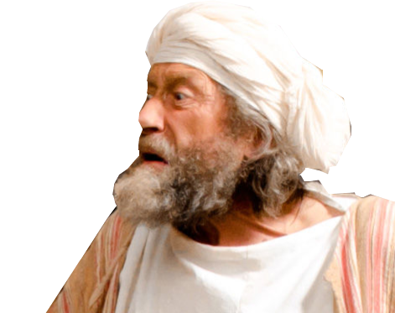
God told Habakkuk ...

Slide 5
God told Habakkuk ...
“But
the righteous
will live
by his faith”

Slide 6
First of four occurrences
Habakkuk 2:4

Slide 7
First of four occurrences
Habakkuk 2:4
Galatians 3:11

Slide 8
First of four occurrences
Habakkuk 2:4
Galatians 3:11
Romans 1:17

Slide 9
First of four occurrences
Habakkuk 2:4
Galatians 3:11
Romans 1:17
Hebrews 10:38

Slide 10
First of four occurrences
Habakkuk 2:4
Galatians 3:11
Romans 1:17
Hebrews 10:38
Today, I have four questions from these four texts:

Slide 11

Is Your Faith Exceptional?
Notes:
https://pixabay.com/en/smilies-emoticons-especially-1607165/

Slide 12
Is Your Faith Exceptional?
“But … the righteous will live by his faith“
Notes:
https://pixabay.com/en/smilies-emoticons-especially-1607165/

Slide 13

Is Your Faith Exceptional?
“But … the righteous will live by his faith“
Everyone Believes Something!
Notes:
https://pixabay.com/en/smilies-emoticons-especially-1607165/

Slide 14
Is Your Faith Exceptional?
“But … the righteous will live by his faith“
Everyone Believes Something!
SELF
Notes:
https://pixabay.com/en/smilies-emoticons-especially-1607165/

Slide 15
Is Your Faith Exceptional?
“But … the righteous will live by his faith“
Everyone Believes Something!
SELF
ALLY
Notes:
https://pixabay.com/en/smilies-emoticons-especially-1607165/

Slide 16
Is Your Faith Exceptional?
“But … the righteous will live by his faith“
Everyone Believes Something!
SELF
ALLY
WAR
Notes:
https://pixabay.com/en/smilies-emoticons-especially-1607165/

Slide 17
Is Your Faith Exceptional?
“But … the righteous will live by his faith“
Everyone Believes Something!
SELF
ALLY
WAR
WIN
Notes:
https://pixabay.com/en/smilies-emoticons-especially-1607165/

Slide 18
Is Your Faith Exceptional?
“But … the righteous will live by his faith“
Everyone Believes Something!
SELF
ALLY
POWER
WAR
WIN
Notes:
https://pixabay.com/en/smilies-emoticons-especially-1607165/

Slide 19
Is Your Faith Exceptional?
“But … the righteous will live by his faith“
Everyone Believes Something!
SELF
ALLY
POWER
STUFF
WAR
WIN
Notes:
https://pixabay.com/en/smilies-emoticons-especially-1607165/

Slide 20
Is Your Faith Exceptional?
“But … the righteous will live by his faith“
Everyone Believes Something!
SELF
ALLY
POWER
STUFF
WAR
WIN
$
Notes:
https://pixabay.com/en/smilies-emoticons-especially-1607165/

Slide 21
Is Your Faith Exceptional?
“But … the righteous will live by his faith“
Everyone Believes Something!
SELF
ALLY
POWER
STUFF
WAR
WIN
KIN
$
Notes:
https://pixabay.com/en/smilies-emoticons-especially-1607165/

Slide 22
Is Your Faith Exceptional?
“But … the righteous will live by his faith“
Everyone Believes Something!
SELF
ALLY
POWER
STUFF
WAR
WIN
KIN
LAW
$
Notes:
https://pixabay.com/en/smilies-emoticons-especially-1607165/

Slide 23
Is Your Faith Exceptional?
“But … the righteous will live by his faith“
^{Gal 3:11} Clearly no one is justified before God by the law, because, "The righteous will live by faith."
LAW
LAW
LAW
LAW
LAW
LAW
LAW
LAW
LAW

Slide 24
Is Your Faith Exceptional?
“But … the righteous will live by his faith“
^{Gal 3:11} Clearly no one is justified before God by the law, because, "The righteous will live by faith."
FAITH
LAW
LAW
LAW
LAW
LAW
LAW
LAW
LAW

Slide 25
Your Faith Can Be Exceptional
“But … the righteous will live by his faith“
^{Gal 3:11} Clearly no one is justified before God by the law, because, "The righteous will live by faith."
FAITH
LAW
LAW
LAW
LAW
LAW
LAW
LAW
LAW

Slide 26
Is Your Faith Righteous?
“But … the righteous ...will live by his faith“

Slide 27
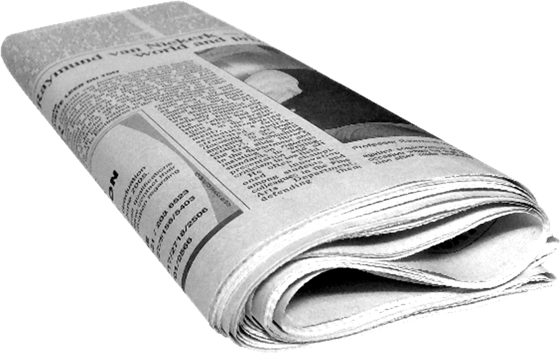
Is Your Faith Righteous?
“But … the righteous ...will live by his faith“
^{Rom 1:17} For in the gospel a
righteousness from God is
revealed, a righteousness
that is by faith from first to
last, just as it is written:
"The righteous will live by faith."
GOOD NEWS
Notes:
The verse beo=fore this say ¹⁶ I am not ashamed of the gospel, because it is the power of God for the salvation of everyone who believes: first for the Jew, then for the Gentile. (Rom 1:16 NIV)

Slide 28
Is Your Faith Righteous?
“But … the righteous ...will live by his faith“
^{Rom 1:17} For in the gospel a
righteousness from God is
revealed, a righteousness
that is by faith from first to
last, just as it is written:
"The righteous will live by faith."
A-Z

Slide 29
Is Your Faith Righteous?
“But … the righteous ...will live by his faith“
^{Rom 1:17} For in the gospel a
righteousness from God is
revealed, a righteousness
that is by faith from first to
last, just as it is written:
"The righteous will live by faith."

Slide 30
Is Your Faith Righteous?
“But … the righteous ...will live by his faith“
^{Rom 4:3} What does the Scripture say?
"Abraham believed God,
and it was credited to him
as righteousness."

Slide 31
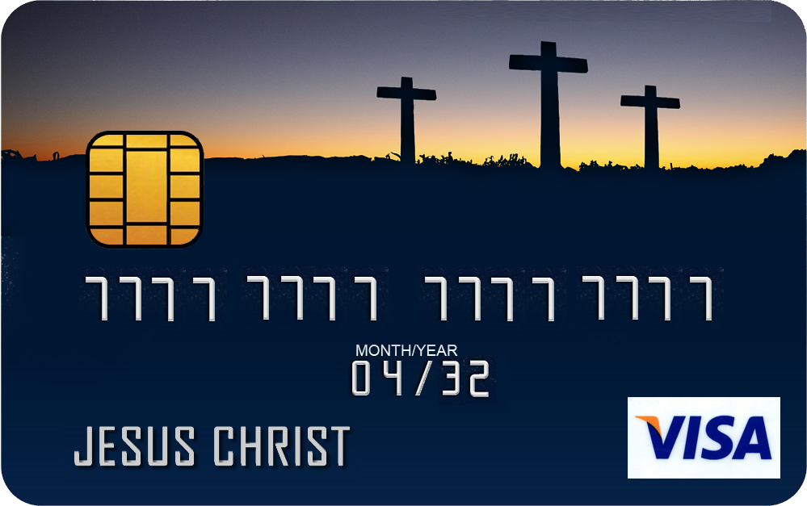
Is Your Faith Righteous?
“But … the righteous ...will live by his faith“
^{Rom 4:3} What does the Scripture say?
"Abraham believed God,
and it was credited to him
as righteousness."

Slide 32
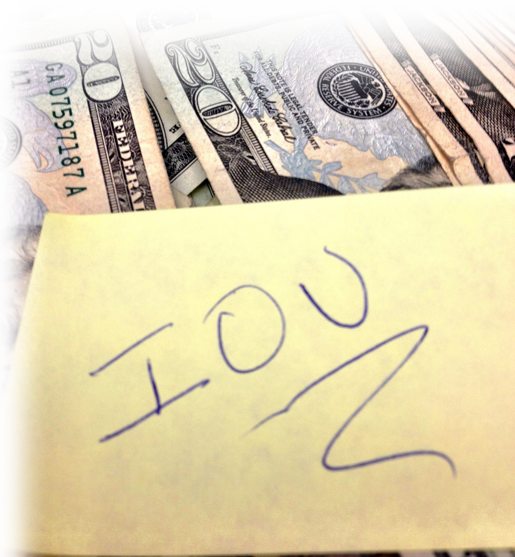
Is Your Faith Righteous?
“But … the righteous ...will live by his faith“
⁴ Now when a man works,
his wages are not credited
to him as a gift, but as an
obligation.
Notes:
IOU = FREE =https://www.flickr.com/photos/23024164@N06/8190373157

Slide 33
Is Your Faith Righteous?
“But … the righteous ...will live by his faith“
⁵ However, to the man who
does not work but trusts
God who justifies the wicked,
his faith is credited as
righteousness. (Rom 4:3-5)

Slide 34
Your Faith Can Be Righteous
“But … the righteous ...will live by his faith“
⁵ However, to the man who
does not work but trusts
God who justifies the wicked,
his faith is credited as
righteousness. (Rom 4:3-5)

Slide 35
Is Your Faith Alive?
“But the righteous ... will live ... by his faith“

Slide 36
Is Your Faith Alive?
“But the righteous ... will live ... by his faith“
^{Heb 11:38} But my righteous one
will live by faith. And if
he shrinks back, I will
not be pleased with him."

Slide 37

Is Your Faith Alive?
“But the righteous ... will live ... by his faith“
^{Heb 11:38} But my righteous one
will live by faith. And if
he shrinks back, I will
not be pleased with him."

Slide 38
Is Your Faith Alive?
“But the righteous ... will live ... by his faith“
³⁹ But we are not of
those who shrink back
and are destroyed,
but of those who believe
and are saved.
Notes:
Wrong Way = FREE = https://www.flickr.com/photos/johnnyjet/3290272880

Slide 39
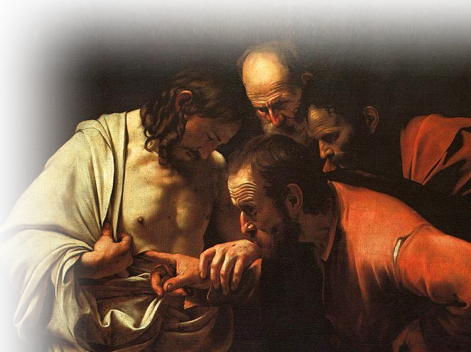
Is Your Faith Alive?
“But the righteous ... will live ... by his faith“
11:1 Now faith is being
sure of what we hope
for and certain of what
we do not see.
Notes:
https://upload.wikimedia.org/wikipedia/commons/e/e0/Caravaggio_-_The_Incredulity_of_Saint_Thomas.jpg

Slide 40
Is Your Faith Alive?
“But the righteous ... will live ... by his faith“
11:1 Now faith is being
sure of what we hope
for and certain of what
we do not see.
² This is what the ancients
were commended for.
Notes:
https://upload.wikimedia.org/wikipedia/commons/e/e0/Caravaggio_-_The_Incredulity_of_Saint_Thomas.jpg

Slide 41
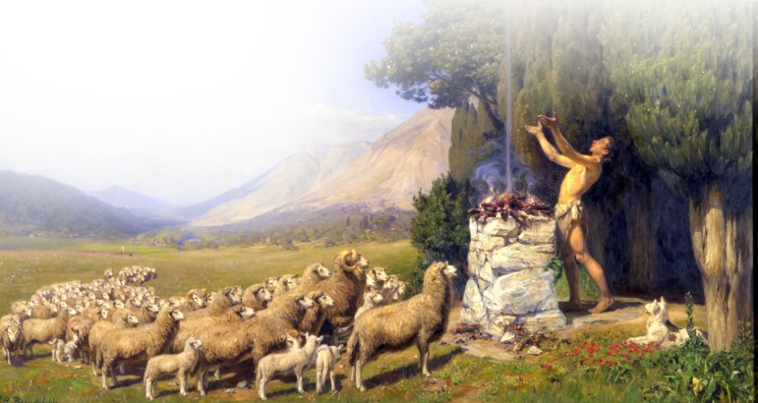
Is Your Faith Alive?
“But the righteous ... will live ... by his faith“
⁴ By faith Abel offered ...
Notes:
https://upload.wikimedia.org/wikipedia/commons/5/52/H._A._Brendekilde_-_Abel%27s_Offer_%281908%29.jpg

Slide 42
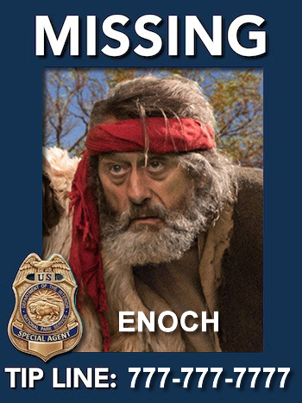
Is Your Faith Alive?
“But the righteous ... will live ... by his faith“
⁵ By faith Enoch was taken ...
Notes:
Bible Point combo from http://www.freebibleimages.org/photos/elijah-horeb/ and https://www.nps.gov/orgs/1563/images/MP_Won_GRCA.jpg?maxwidth=650&autorotate=false

Slide 43
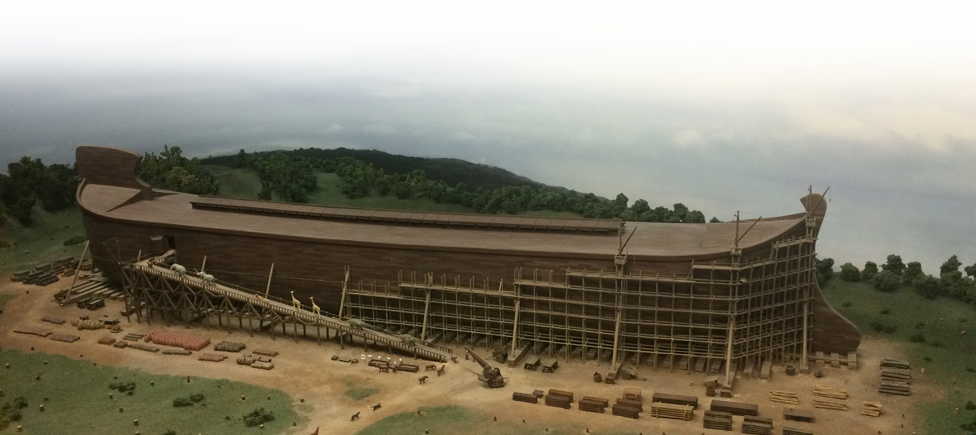
Is Your Faith Alive?
“But the righteous ... will live ... by his faith“
⁷ By faith Noah...built an ark

Slide 44
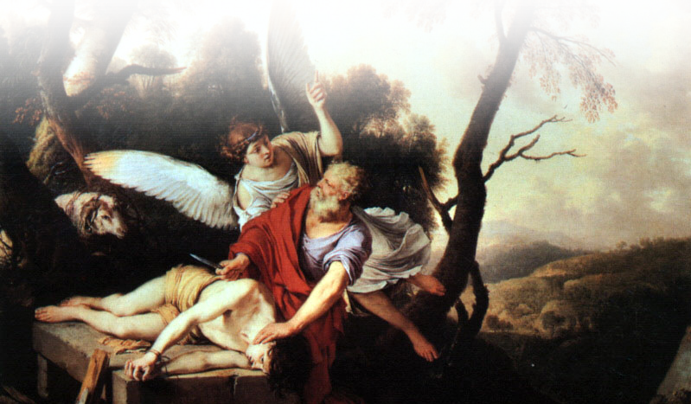
Is Your Faith Alive?
“But the righteous ... will live ... by his faith“
¹⁷ By faith Abraham ...
offered Isaac as a sacrifice.
Notes:
https://upload.wikimedia.org/wikipedia/commons/7/7b/Abraham.jpg

Slide 45
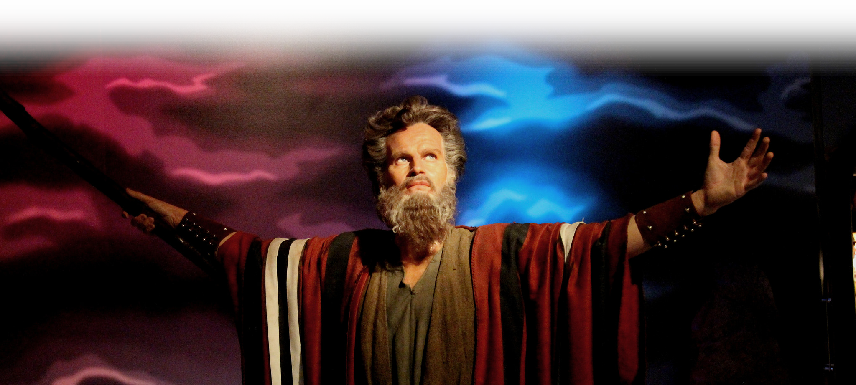
Is Your Faith Alive?
“But the righteous ... will live ... by his faith“
²⁴ By faith Moses ...
²⁵ ...chose to be
mistreated ...
Notes:
https://www.flickr.com/photos/prayitnophotography/21896806849

Slide 46
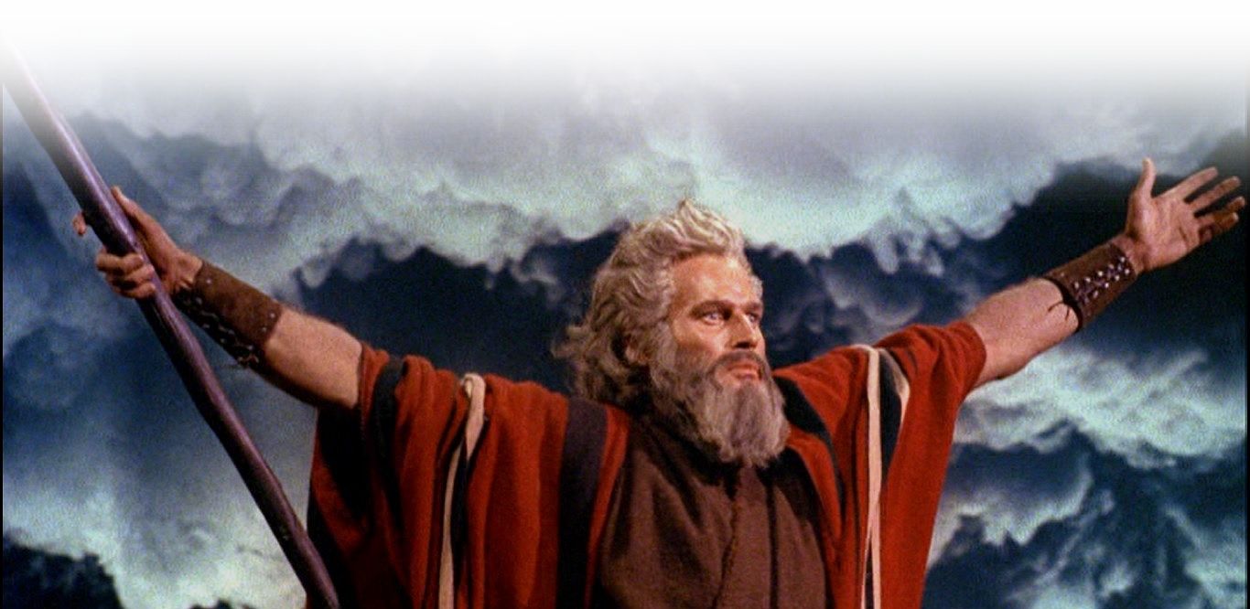
Is Your Faith Alive?
“But the righteous ... will live ... by his faith“
²⁹ By faith the people
passed through the Red Sea

Slide 47
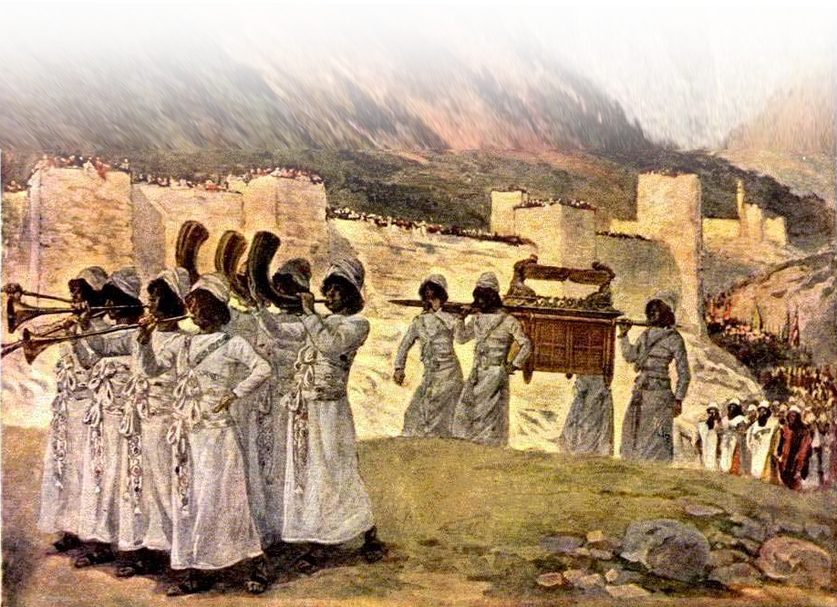
Is Your Faith Alive?
“But the righteous ... will live ... by his faith“
³⁰ By faith the walls
of Jericho fell...
Notes:
https://commons.wikimedia.org/wiki/File:The_seven_trumpets_of_Jericho.jpg

Slide 48
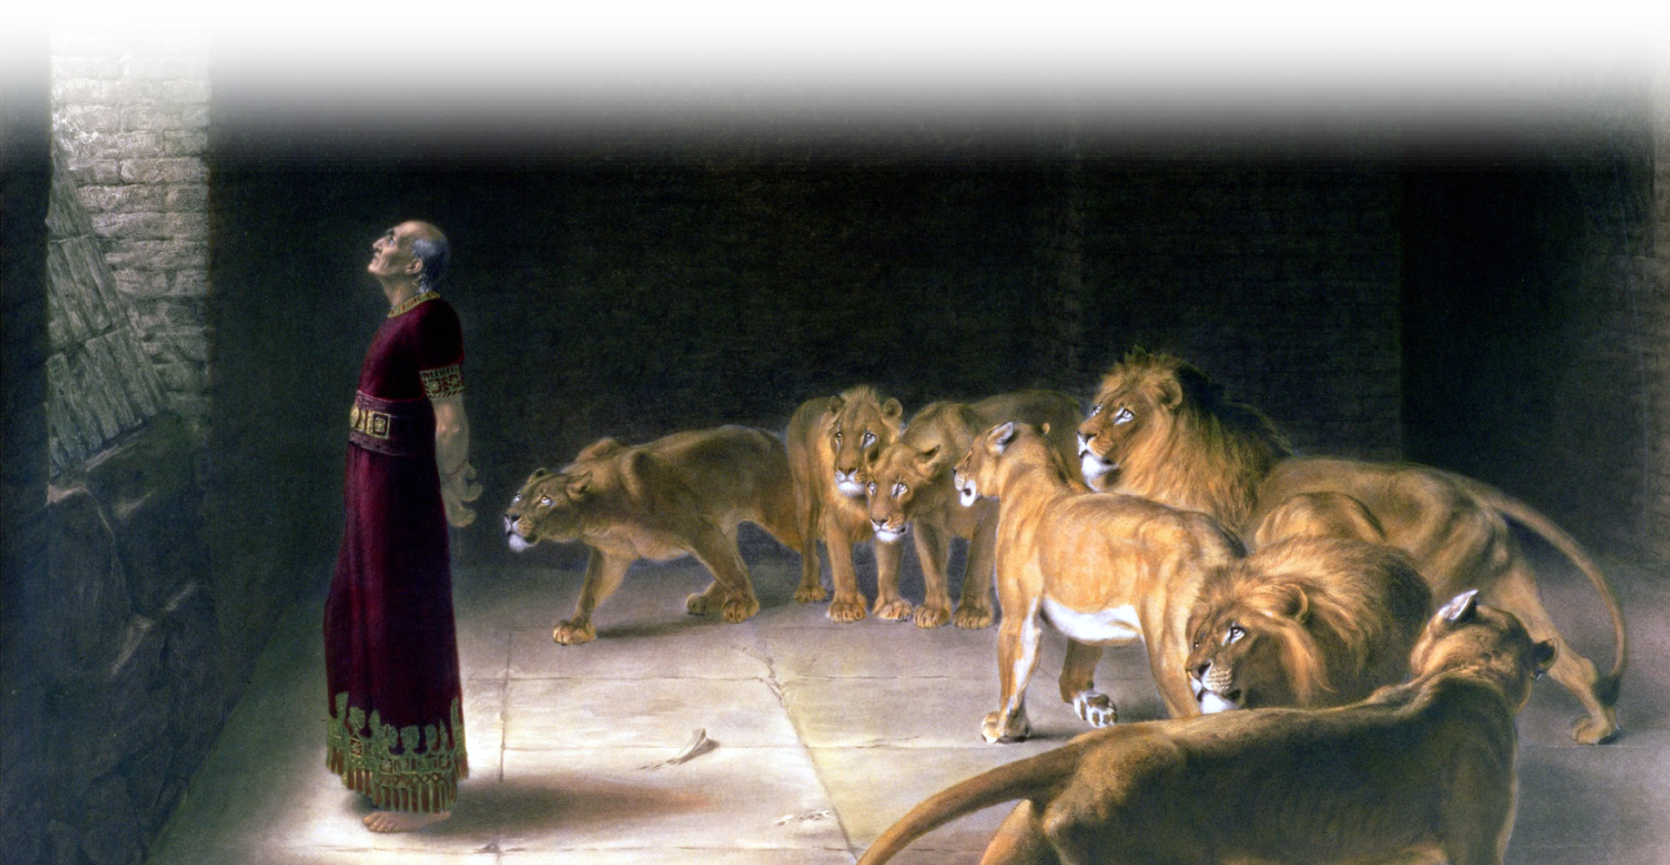
Is Your Faith Alive?
“But the righteous ... will live ... by his faith“
³² And what more shall I say?
³³ [Others] who shut the mouths
of lions,

Slide 49
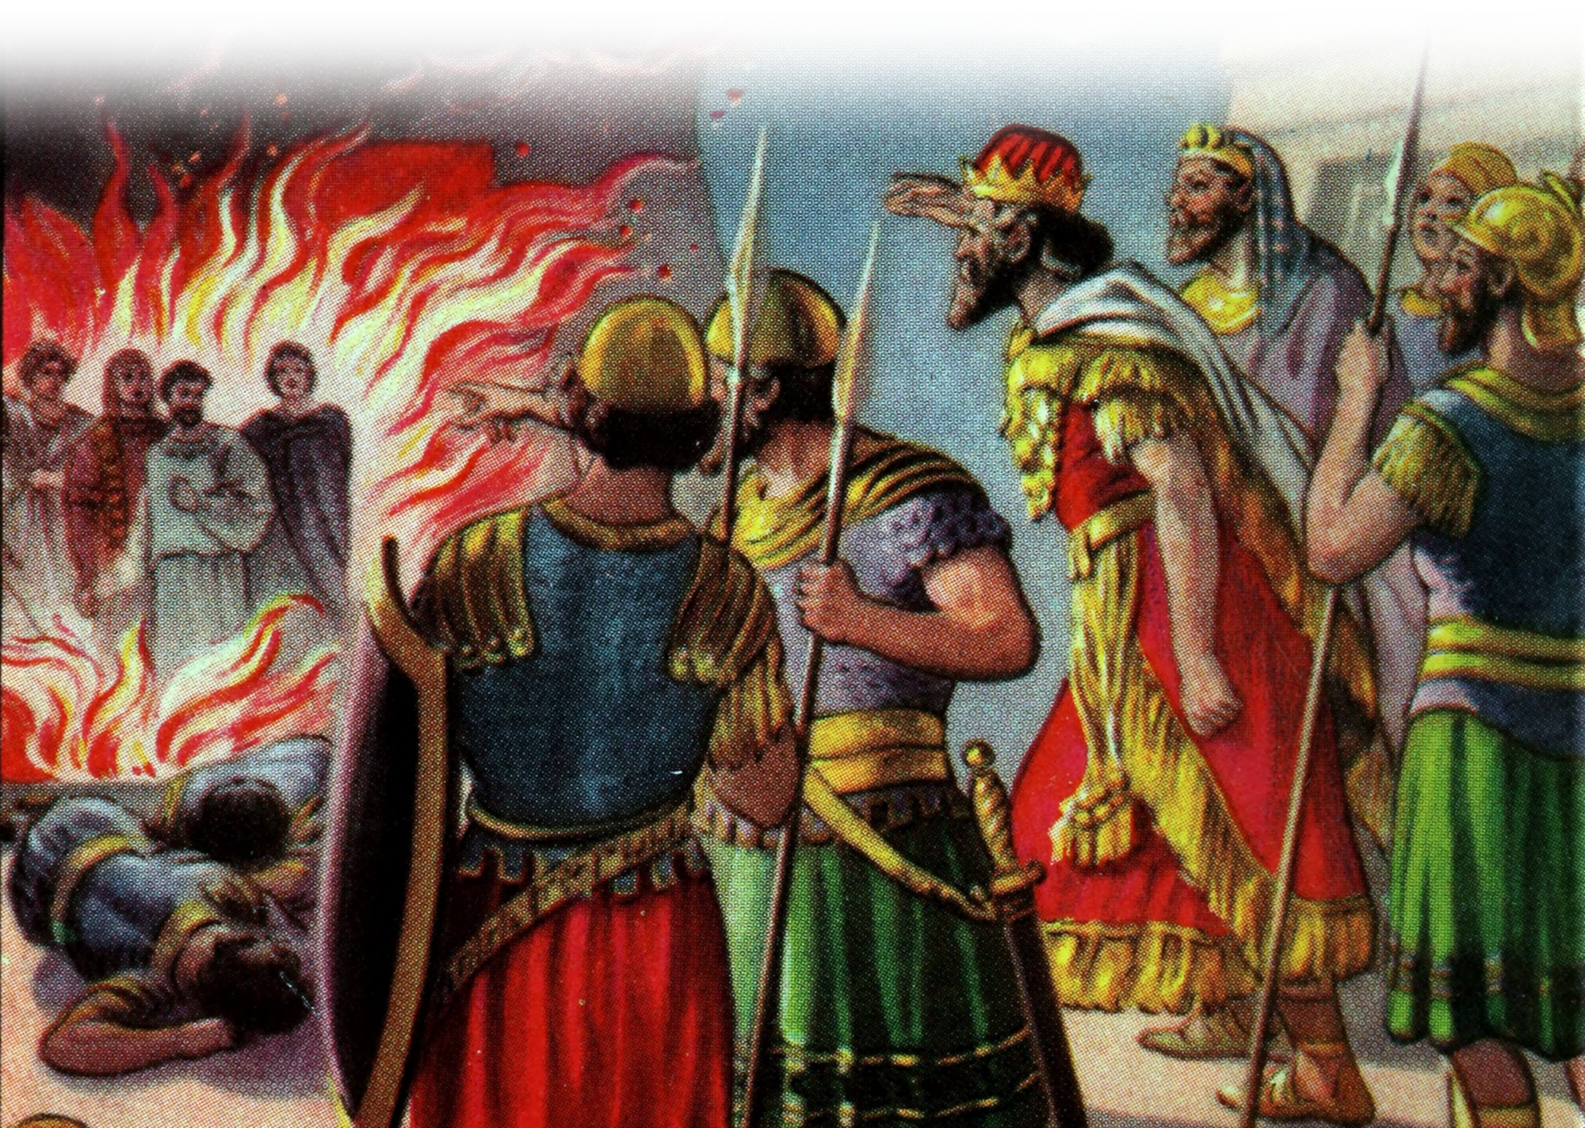
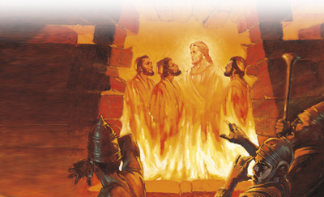
Is Your Faith Alive?
“But the righteous ... will live ... by his faith“
³⁴ quenched the
fury of the
flames,
Notes:
https://www.flickr.com/photos/internetarchivebookimages/14778966371

Slide 50

Is Your Faith Alive?
“But the righteous ... will live ... by his faith“
³⁶ Some faced jeers and flogging,
while still others were chained
and put in prison.
³⁷ They were stoned; they were
sawed in two; they were put to
death by the sword.
Notes:
https://en.wikipedia.org/wiki/Sword_of_Fran%C3%A7ois_I#/media/File:Francois_I_sword-J_316-IMG_1808-gradient.jpg

Slide 51
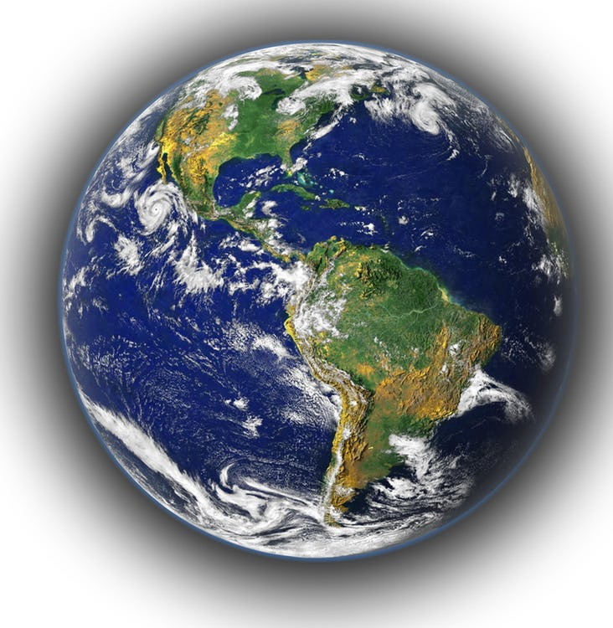
Is Your Faith Alive?
“But the righteous ... will live ... by his faith“
³⁸ the world was not worthy of them.

Slide 52
Is Your Faith Alive?
“But the righteous ... will live ... by his faith“
³⁸ the world was not worthy of them.
    ³⁹ These were
    all commended
    for their faith

Slide 53
Your Faith can be Alive too!
“But the righteous ... will live ... by his faith“
³⁸ the world was not worthy of them.
    ³⁹ These were
    all commended
    for their faith
Notes:
Your faith can be alive—just choose to believe as Moses did!

Slide 54
Is Your Faith Personal?
“But the righteous will live ... by his faith“

Slide 55
Is Your Faith Personal?
“But the righteous will live ... by his faith“
It was for Habakkuk:
^{Hab 3:17} Though the fig tree does not bud
and there are no grapes on the vines,
though the olive crop fails and
the fields produce no food,
though there are no sheep in the pen
and no cattle in the stalls,

Slide 56
Is Your Faith Personal?
“But the righteous will live ... by his faith“
It was for Habakkuk:
¹⁸ yet I will rejoice in the LORD,
I will be joyful in God my Savior.

Slide 57

Let me remind you ...

Slide 58
Let me remind you ...
Your faith can be EXCEPTIONAL!

Slide 59
Let me remind you ...
Your faith can be EXCEPTIONAL!
Your faith makes you RIGHTEOUS!

Slide 60
Let me remind you ...
Your faith can be EXCEPTIONAL!
Your faith makes you RIGHTEOUS!
Your faith needs to be ALIVE!

Slide 61
Let me remind you ...
Your faith can be EXCEPTIONAL!
Your faith makes you RIGHTEOUS!
Your faith needs to be ALIVE!
Your faith must be PERSONAL!

Slide 62
HOW?

Slide 63
HOW?
Develop a Personal Relationship with Jesus!

Slide 64
Let’s Pray!

